Slide 2
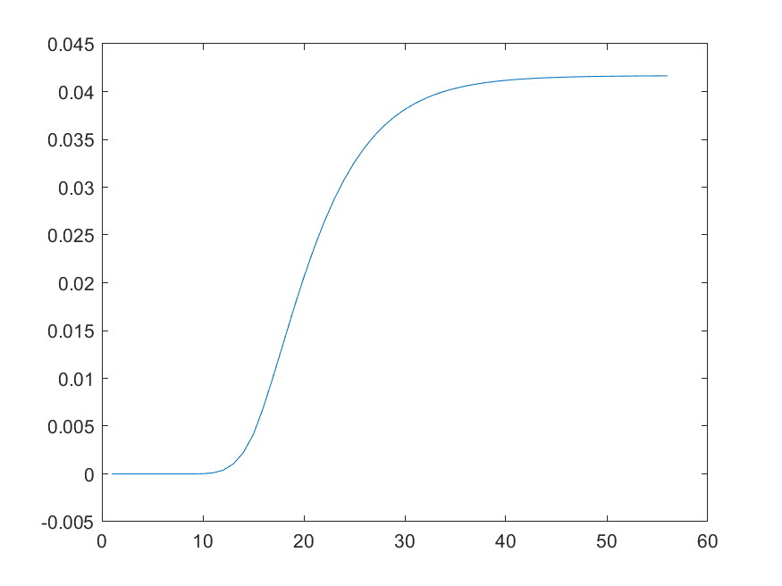
Step change of actuator
(X = 1)
Slope :
0.04/10 = 0.004
D = 9

