Slide 1
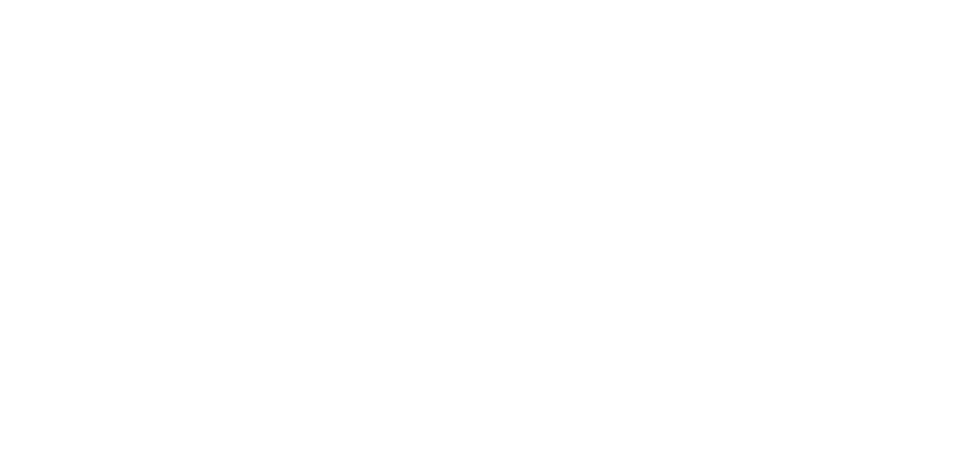
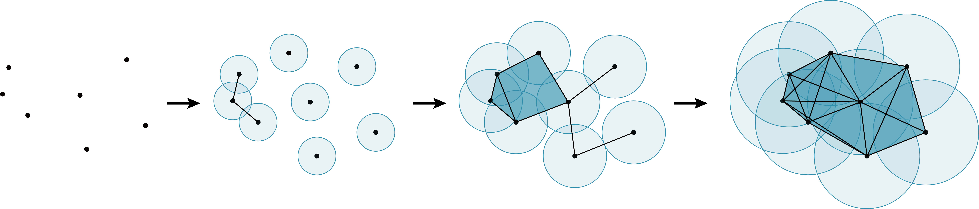
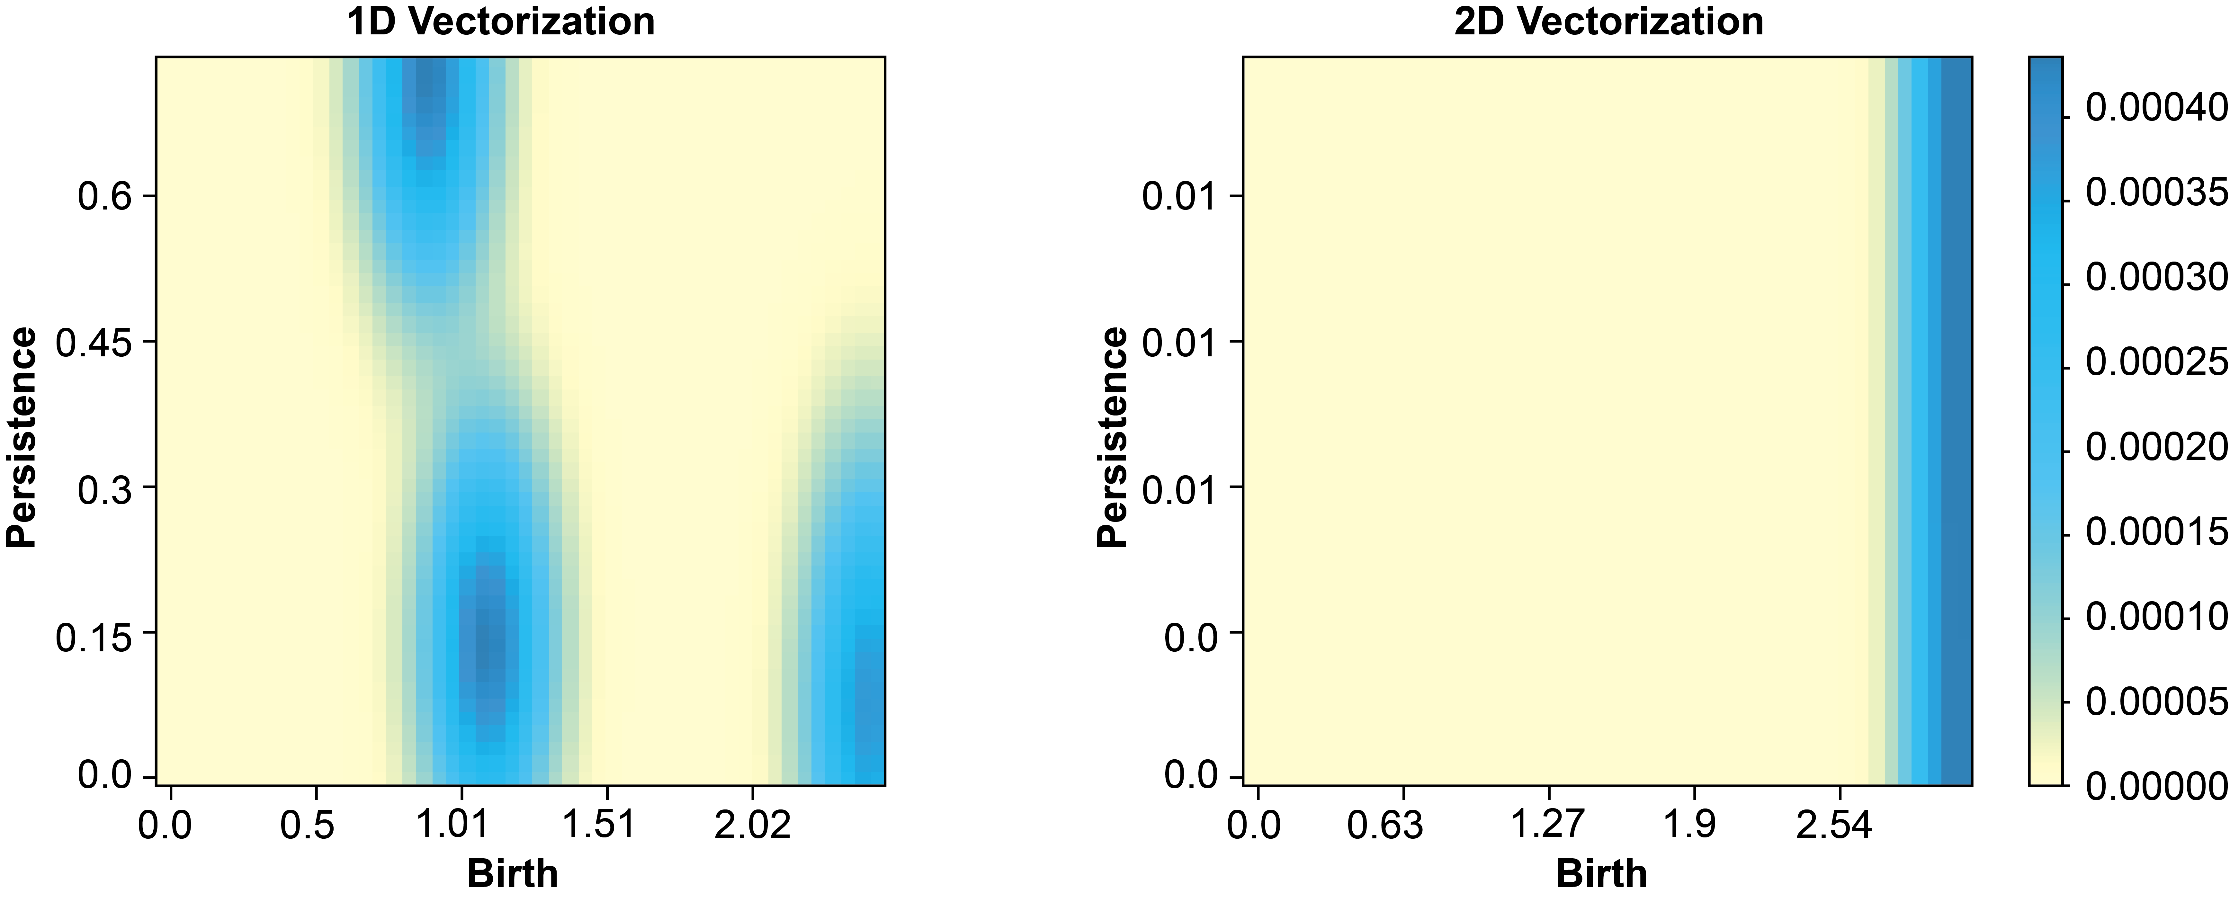
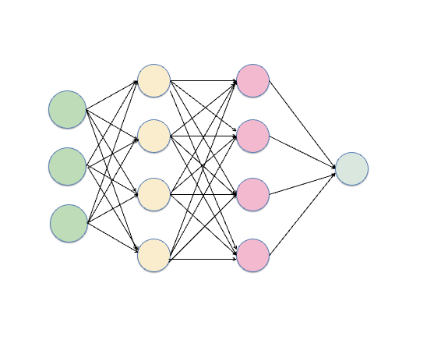
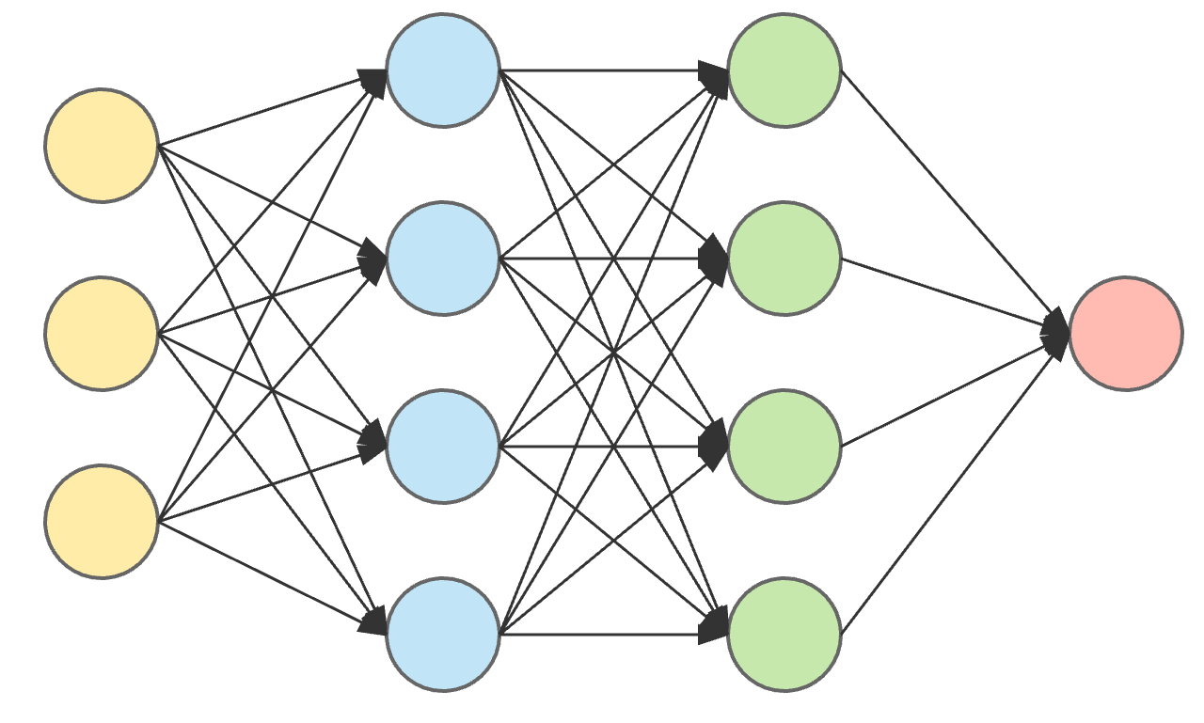
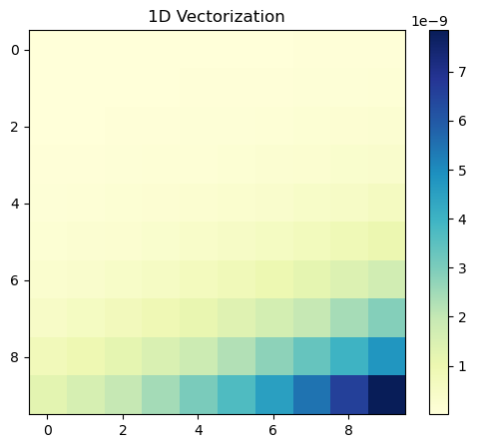
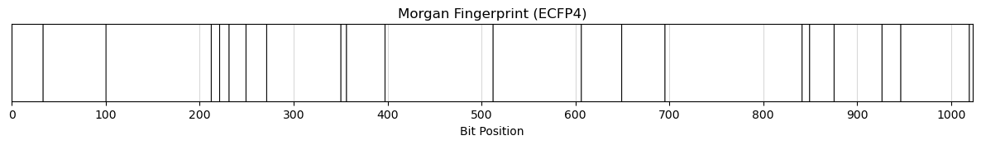
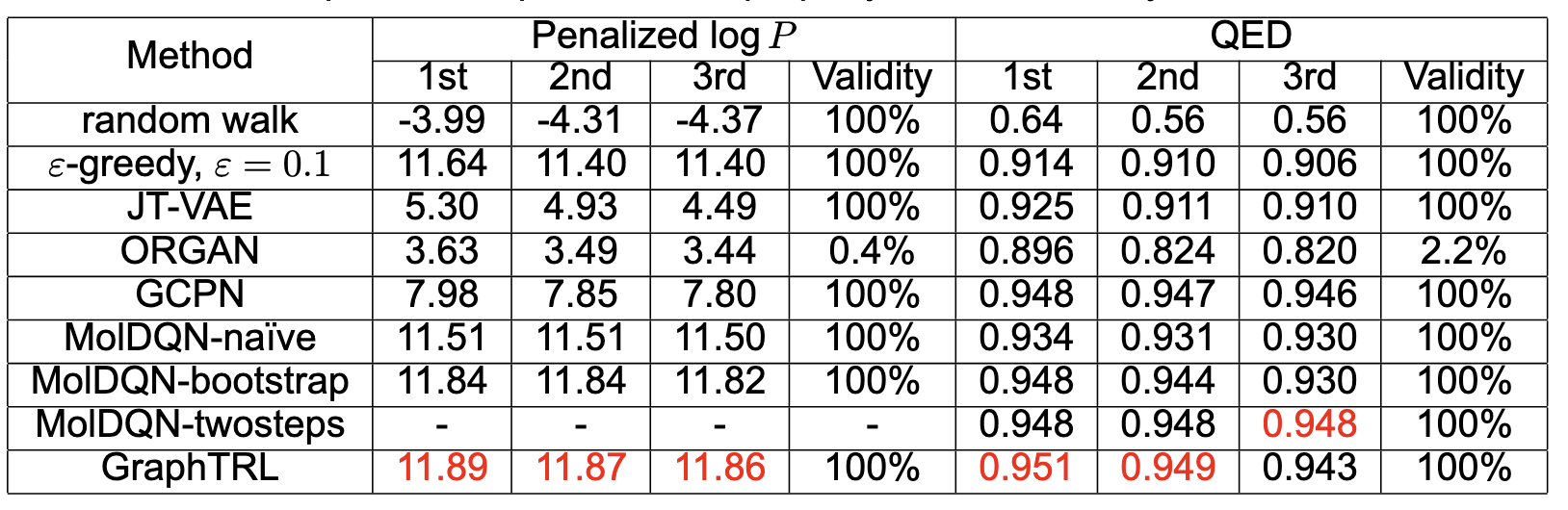
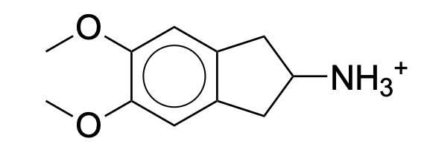
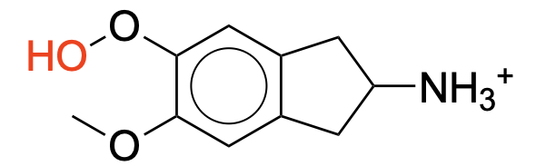
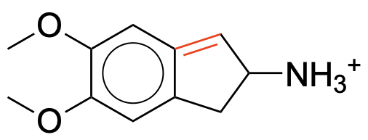
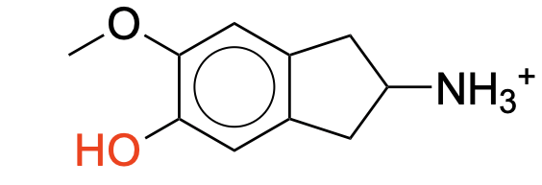
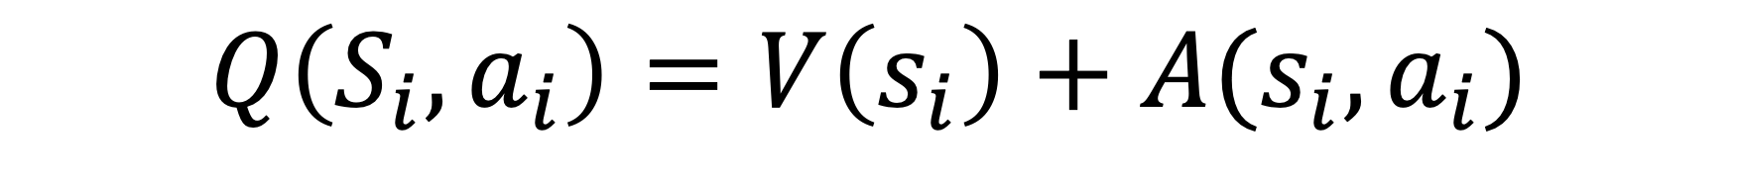
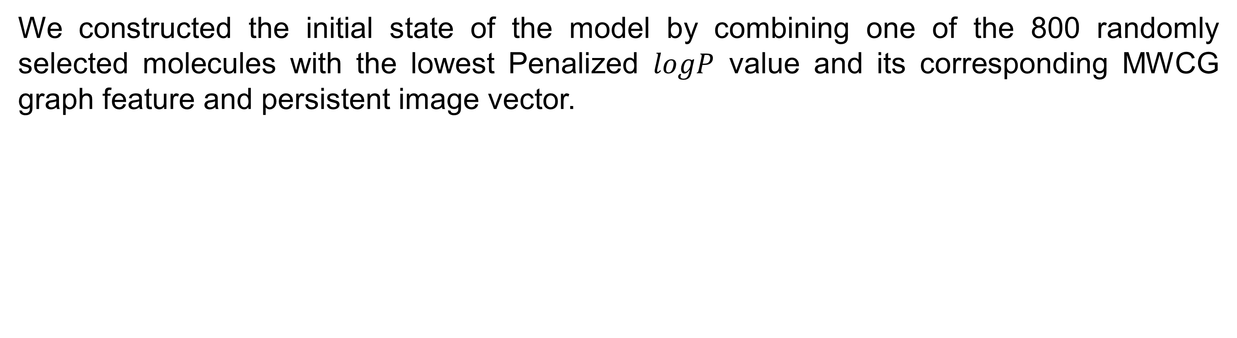
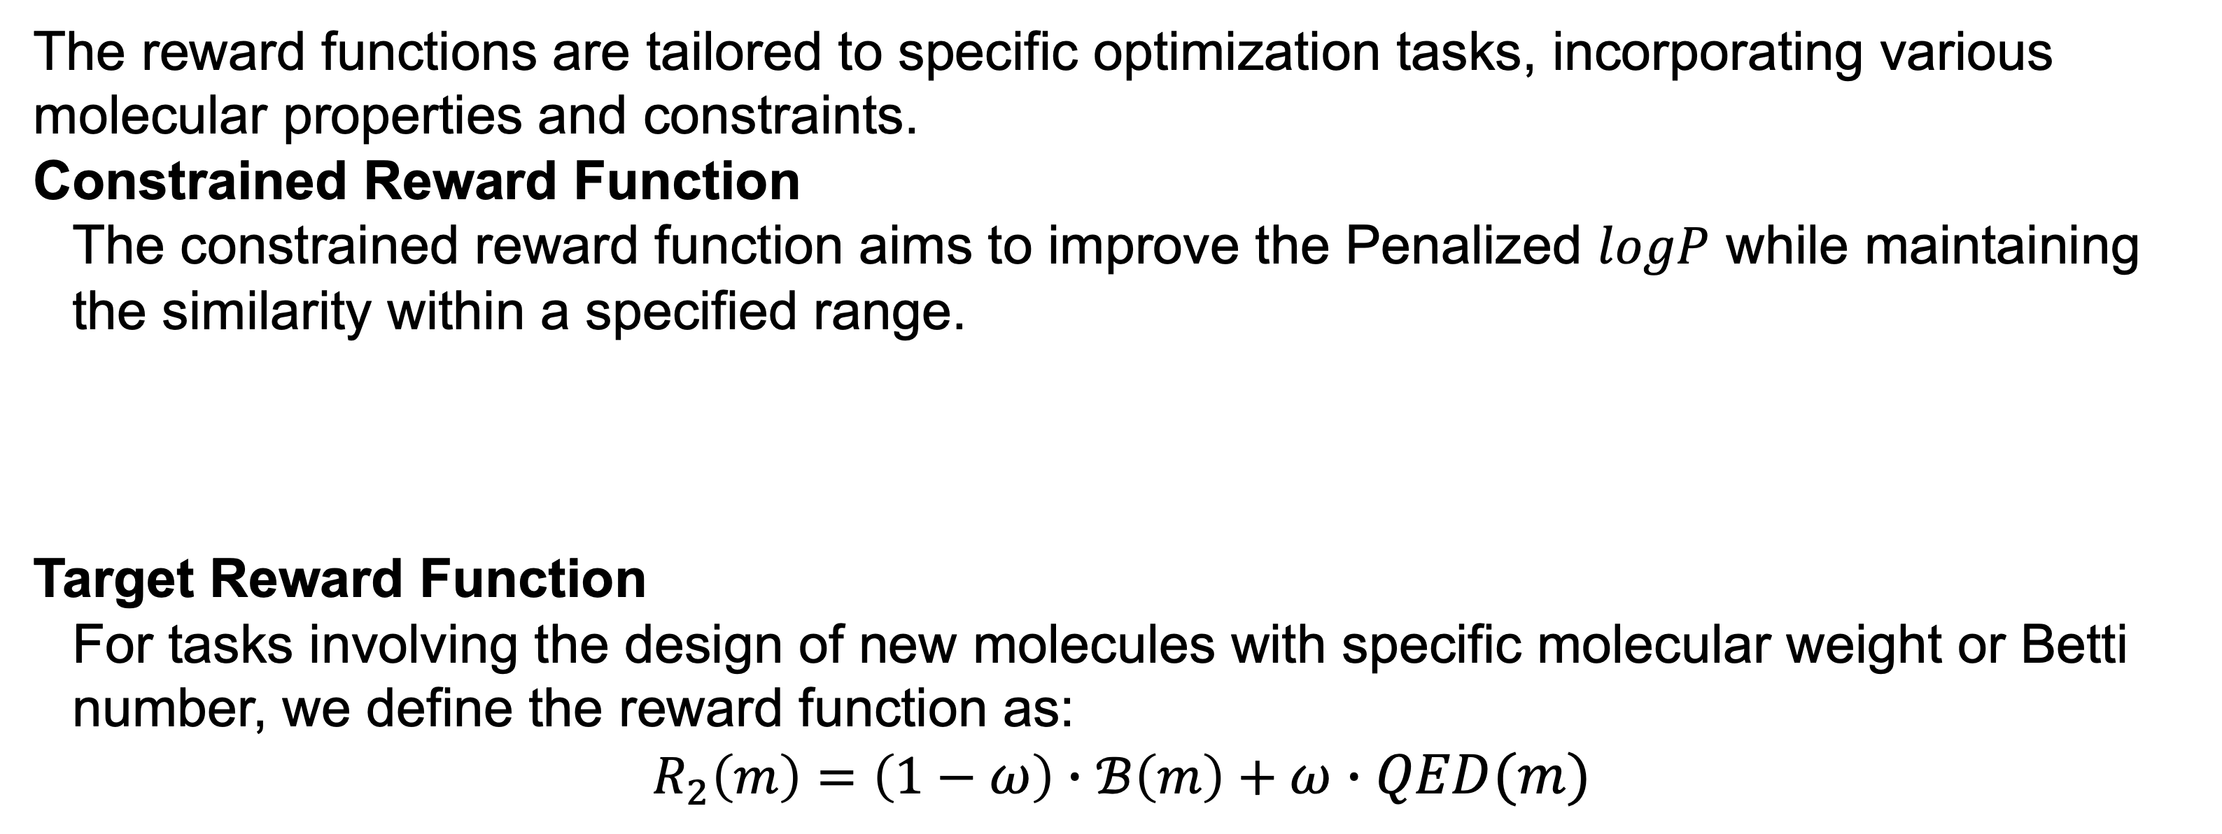
Enhancing Molecular Design through Graph-based Topological
Reinforcement Learning
Xiangyu Zhang
Department of Applied Mathematics and Statistics, Johns Hopkins University
Overview
Materials and Methods
The generation of drug-like molecules is essential for drug design, requiring a balance between exploring novel chemical structures and optimizing known ones to meet specific desirable properties (Olivecrona et al., 2017). This work,
Leverages the sequential decision-making capabilities (Popova et al., 2018) of Reinforcement Learning (RL) by formulating the modification of a molecule as a Markov Decision Process.
Integrates both chemical and structural data of molecules
Multiscale Weighted Colored Graphs (MWCG)
Persistent Homology
Multiscale Weighted Colored Subgraphs (MWGCs)
Graph theory, with its focus on the connectivity between vertices and edges, provides an ideal framework for representing non-covalent interactions between atoms in molecules. The choice of MWCG has two key advantages:
MWCG employs color-labeled atoms to create distinct subgraphs and utilizes colored edges to represent element-specific interactions, which allows for a detailed capture of interactions at the atomic level.
MWCG incorporates a radial basis function to scale Euclidean distances, assigning the strongest weights to edges between nearest neighbors (Rana, M. M. et al., 2023). This weighting scheme enhances the representation of local atomic environments.
Persistent Homology
Persistent homology is a method that utilizes the filtration process to systematically reset the connectivity of a dataset according to a scale parameter, generating a series of topological spaces in various scales. Through filtration process, we can identify the intrinsic structure of the given molecule.
To leverage these topological features within our reinforcement
learning framework, we employ persistent images.
Input SMILE
Optimized SMILES
State Representation
DDQN
Reward Function
$$μ^{G}\left(η_{kk^{′}}\right)=\sum_{i}{μ_{i}^{G}\left(η_{kk^{′}}\right)}=\sum_{i}{\sum_{j}{Φ_{E}\left(∥r_{i}− r_{j}∥;η_{kk^{′}}\right)}}$$
The reward functions are tailored to specific optimization tasks, incorporating various molecular properties and constraints.
Constrained Reward Function
The constrained reward function aims to improve the Penalized $logP$ while maintaining the similarity within a specified range.
Target Reward Function
For tasks involving the design of new molecules with specific molecular weight or Betti number, we define the reward function as:
$$R_{2}\left(m\right)=\left(1−ω\right)∙ℬ\left(m\right)+ω∙QED(m)$$
$$ε_{kk^{′}}=\left\{Φ\left(∥r_{i}− r_{j}∥;η_{kk^{′}}\right) \right| α_{i}=τ_{i},α_{j}=τ_{j}, ∥r_{i}− r_{j}∥ ≤c\}$$
$$R_{1}\left(m\right)=Penalized logP\left(m\right) − λ∙[𝕀\{S\left(m,m_{0}\right)< δ\}(δ−S\left(m,m_{0}\right))+𝕀\{ℬ\left(m,m_{0}\right)<ℇ\}(ℇ−ℬ\left(m,m_{0}\right)]$$
State Construction and Model Structure
SMILE
O.3
Main
Network
Target
Network
COc1cc2c(cc1OC)CC([NH3+])C2
Weighted colored subgraphs
O
N
N3+
Soft Update
O
O.3
Regulated Action
Persistent Images
Q(S, a)
Target
Q(s’)
Experiment and Result
Huber loss
We constructed the initial state of the model by combining one of the 800 randomly selected molecules with the lowest Penalized $logP$ value and its corresponding MWCG graph feature and persistent image vector.
Experiment and Result
COc1cc2c(c(C)c1OC)CC([NH3+])C2
C=COc1cc2c(cc1OC)CC([NH3+])C2
…
CCOc1cc2c(cc1OC)CC([NH3+])C2
Fingerprint
Policy Improvement
Q Value Function
For each SMILE, the Markov decision process (MDP) is denoted as $MDP(𝒮,𝒜,P_{sa},ℛ)$.
The dueling network structure has two streams to separate the contribution of state value V and the advantage A for each action.
Actions:
$$Q\left(S_{i},a_{i}\right)=V\left(s_{i}\right)+A(s_{i},a_{i})$$
Original Structure
Atom Addition
Bond Addition
Bond Removal
Reference:
Popova, M., Isayev, O., & Tropsha, A. (2018). Deep reinforcement learning for de novo drug design. Science advances, 4(7), eaap7885.
Olivecrona, M., Blaschke, T., Engkvist, O., & Chen, H. (2017). Molecular de-novo design through deep reinforcement learning. Journal of cheminformatics, 9, 1-14
Rana, M. M., & Nguyen, D. D. (2023). Geometric graph learning with extended atom-types features for protein-ligand binding affinity prediction. Computers in Biology and Medicine, 164, 107250.

