Slide 1
Datacrowd
Second Milestone Presentation
Tsampras Konstantinos Papoutsas Georgios

Slide 2
Features Overview
Inform Public for better decision making
- Real time data and Predictions [heatmaps and graphs]
- Suggestions and Alerts
Commuting citizens using Public Transport
Monitoring Tools for Authorities & Businesses
- Crowd Overview
- Insights for better resource allocation
- Alerting and notifying
Staff scheduling, Efficient police force management, Bus schedule changes
Tools for Long Term Planning
- Insights about urban planning in popular areas
- Effectiveness evaluation for measures taken
More sidewalks, New business locations

Slide 3

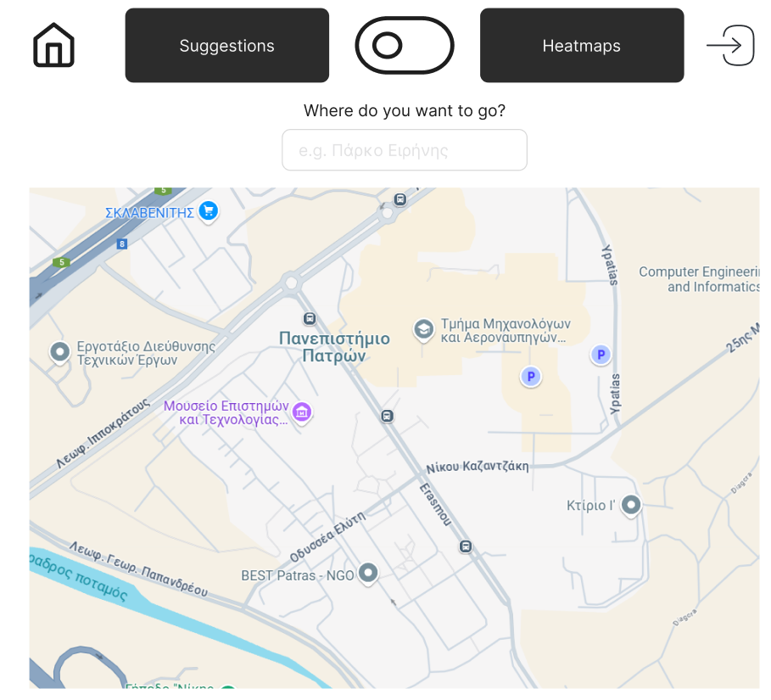
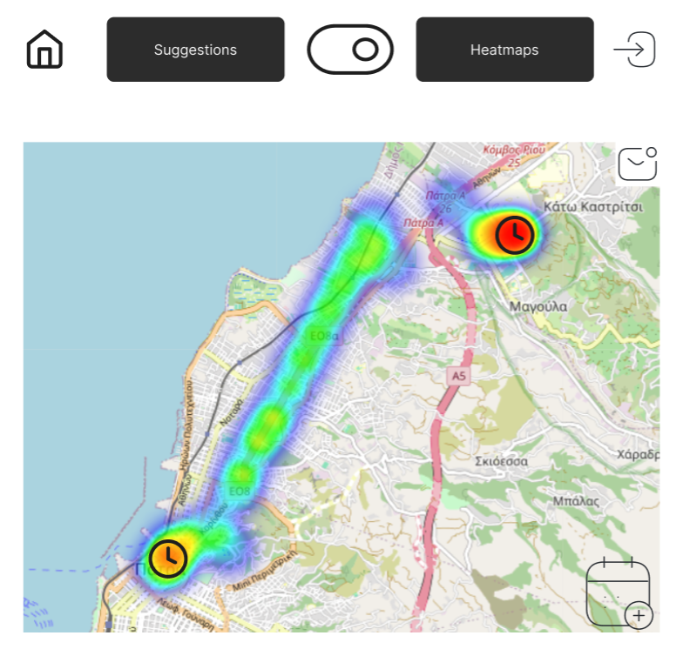
Citizens

Slide 4
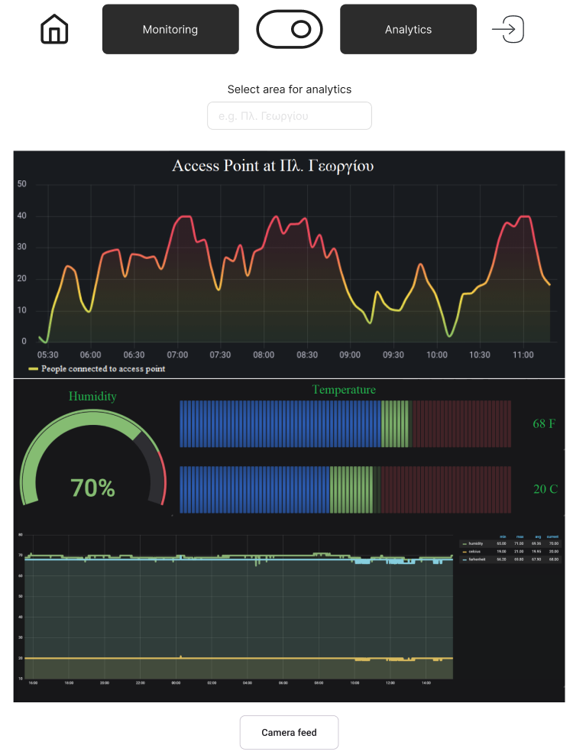
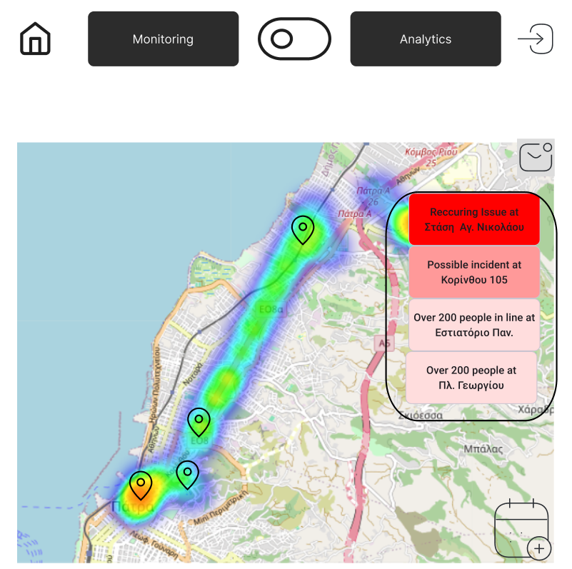
Businesses and Authorities
Monitoring and Notifications
Metrics and sensor data

Slide 5
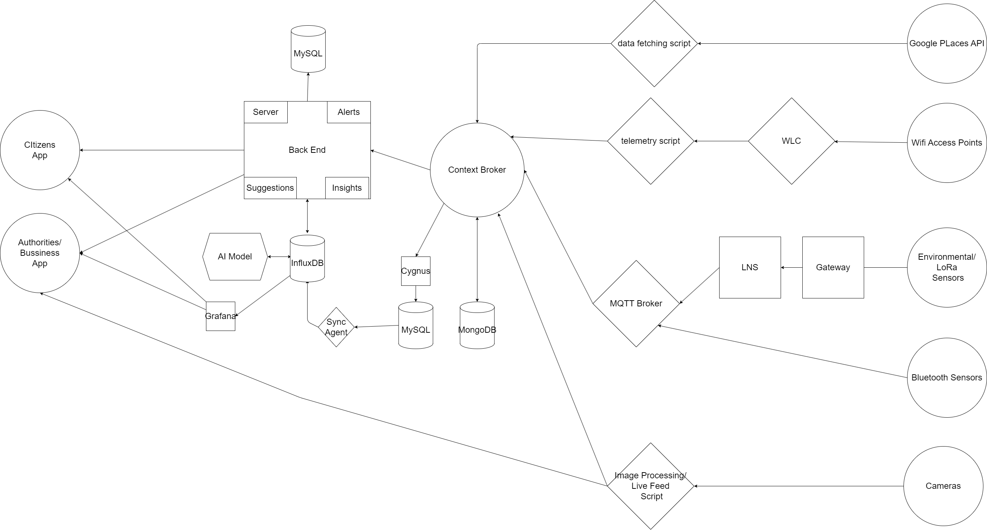
App Architecture

Slide 6
Data processing
The sensor data needs to be organized and processed.
The camera feeds will be used to extract the number of people in view.
The access point traffic data will be used to estimate the number of people connected to the Local Area Network.
The climate data (CO₂, Temperature, Humidity) will be used to determine the rough size of the crowd in a closed space.
Live and historic data from the Google Places API will be used for live and predictive crowd estimations.
AI models will be used to predict the live concentration of people in an area given all the data sources available, as well as the future congestion given live and historic data.

Slide 7
Technologies
Google Places API
Sensor Protocols: LoRa, Bluetooth, SNMP, IP for camera
University Lab Infrastructure:
Context Broker
Back End:
Python Flask
Front End:
Html, CSS
Databases:
MongoDB, Sqlite3, InfluxDB
Analytics, Insights:
Grafana, Facebook Prophet
AI Models:
Pytorch/LSTM
Smart Data Models:
For sensor data and crowd measurements*
Design:
Figma
https://github.com/smart-data-models/dataModel.Environment/tree/master/AirQualityObserved *
https://github.com/smart-data-models/dataModel.Transportation/tree/master/AnonymousCommuterId
https://github.com/smart-data-models/dataModel.Transportation/tree/master/CrowdFlowObserved
https://github.com/smart-data-models/dataModel.OCF/tree/master/Measurement

Slide 8
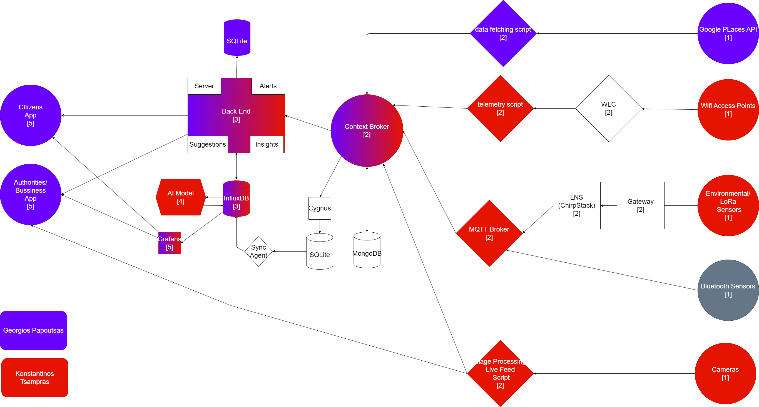
Workload sharing

Slide 9
Time schedule
Data gathering from existing sources and placement of new Sensors (mid-December) [1]
Complete implementation of the Cloud infrastructure (end of December) [2]
Implementation of the Backend of the app (early January) [3]
Design and training of the AI prediction models (mid-January) [4]
Detailed design and implementation of the Frontend of the two websites one for Citizens and one for Municipalities/Businesses (end of January) [5]
Feedback and fine tuning of all the parts of the App (early February)
Final presentation preparation (early February)

Slide 10
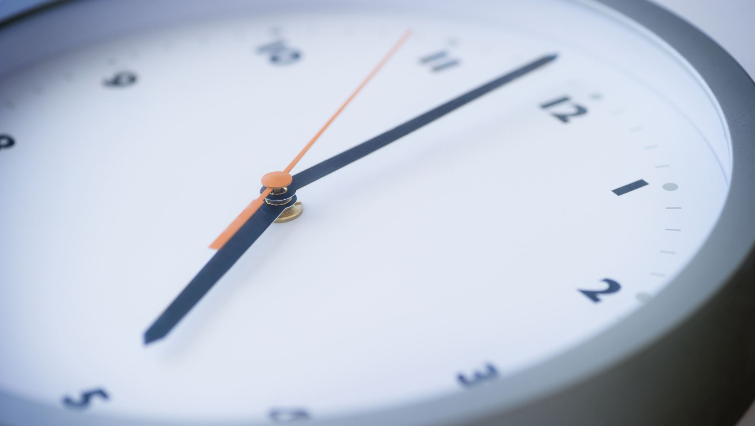
Thank you for your time!

