Slide 1
Project Genesis
A Software Development Fantasy
Robert Hill

Slide 2

The Problem
Software development is complex and easy to do badly. Good practices are poorly understood and often unused.
Agile training is uncommon.
Quality Assurance techniques are not widely known and used.
Good software engineering practices are often regarded as a waste of time.
Software teams often don’t know what ”good” looks like, because they’ve never seen it practiced.

Slide 3
Project Objectives
Learn by experience, through play.
Learn how to balance competing priorities.
Learn about best practices.
Learn how best practices work together.
Learn how to improve teams.
Learn how quality leads to stability and efficiency.

Slide 4
Project Genesis
a software development fantasy
A 10-sprint project deadline.
A small, unskilled team.
Limited hiring budget.
High risk of failure.
http://project-genesis-a-software-development-fantasy.s3-website-eu-west-1.amazonaws.com/
Notes:
In the game, the player takes the role of a new CTO with full responsibility for at new software project.
Importantly, with poor decisions, the project will almost certainly fail.

Slide 5
Winning the Game
Deliver the project on time.
Improve the team.
Notes:
To win the game the player simply needs to deliver the project on time with few bugs. The only way to do this is to improve the team’s knowledge of software development practices in Agile, Quality Assurance and Software Engineering. In the process, learning about these practices themselves.

Slide 6
Obstacles to Success
Speed of delivery
Firefighting
Bugs
Notes:
There are 3 things preventing the player delivering the project on time.
The team start out lacking the skill to build quality software efficiently.
Without improvements in quality, the team will waste time firefighting urgent issues.
Without improvements in quality, the team will also be mired in bugs.

Slide 7
Areas of Improvement
Agile
Quality Assurance
Software engineering
Notes:
While the 3 categories of software development practices impact the game in many ways, they practices learned in the 3 areas broadly have the following effects:
Improving Agile practices improve the team’s ability to estimate and collaborate. Importantly, they also increase the team’s likelihood of learning other practices via Agile Retrospectives.
Improving QA practices improves the quality of the software being built, leading to a reduction in the number of bugs being created by the team, an increase in the number of bugs being found by the team and a decrease in firefighting events that distract the team.
Improving Software Engineering practices increases the skill of the developers, leading to more work done. In some cases, it also improves quality and collaboration.

Slide 8
Player Learning
Agile
Quality Assurance
Software engineering
Notes:
The previous slides cover how the player attempts to win the game by improving their team’s knowledge of software development practices. Now let’s go into a bit of detail about how the game teaches the player.

Slide 9
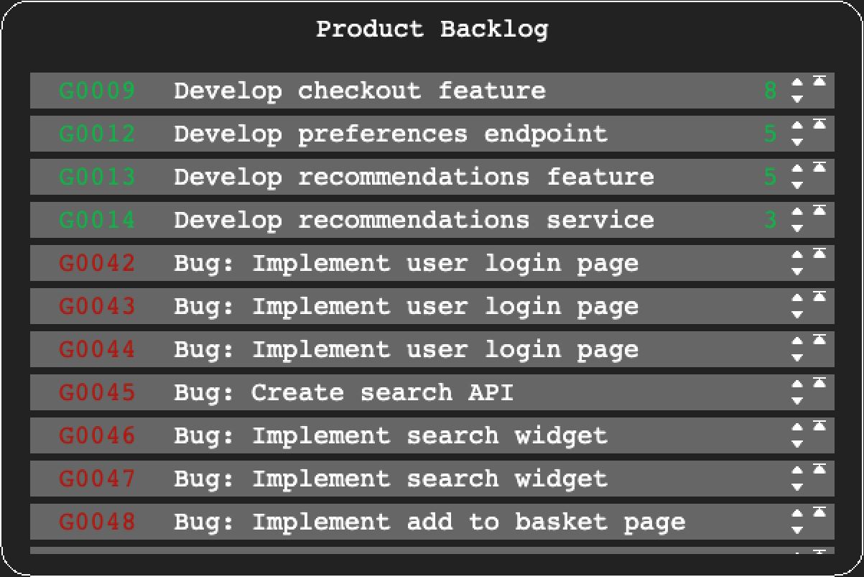
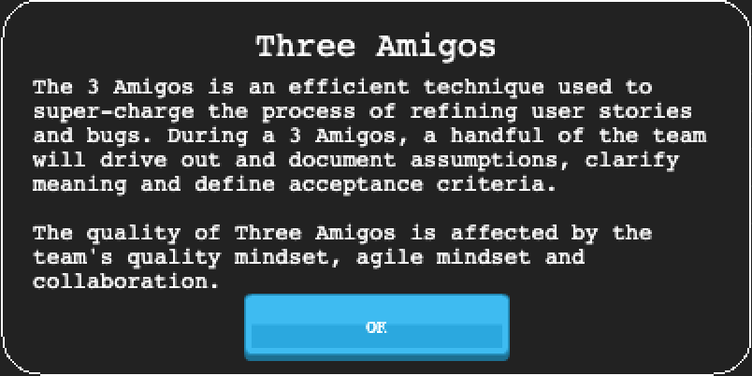
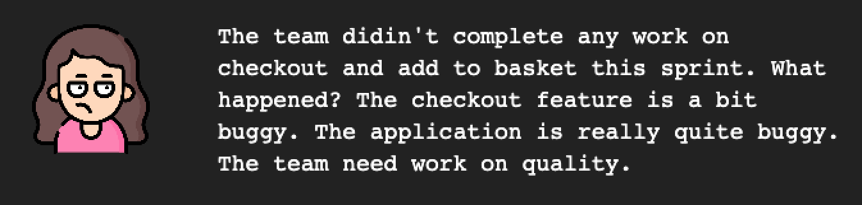
Agile and Agile Project Management
Scrum cadence
Scrum events
Customer interaction
Continuous improvement
Workshops on Agile

Slide 10
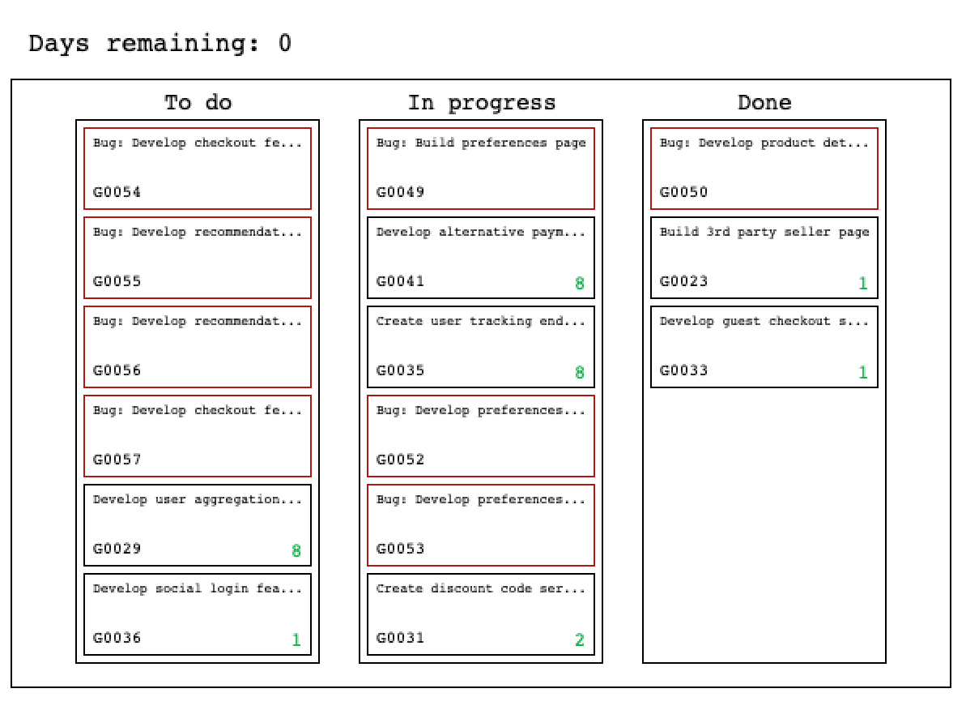
Quality Assurance
Observation
Hiring QAs
Reduction in bugs
Reduction in firefighting
Improved stability
Customer feedback
Workshops on QA
Notes:
The impact of improving Quality Assurance practices was noticed and commented on by many of the survey respondents.

Slide 11
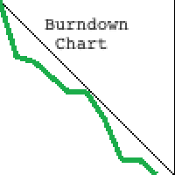
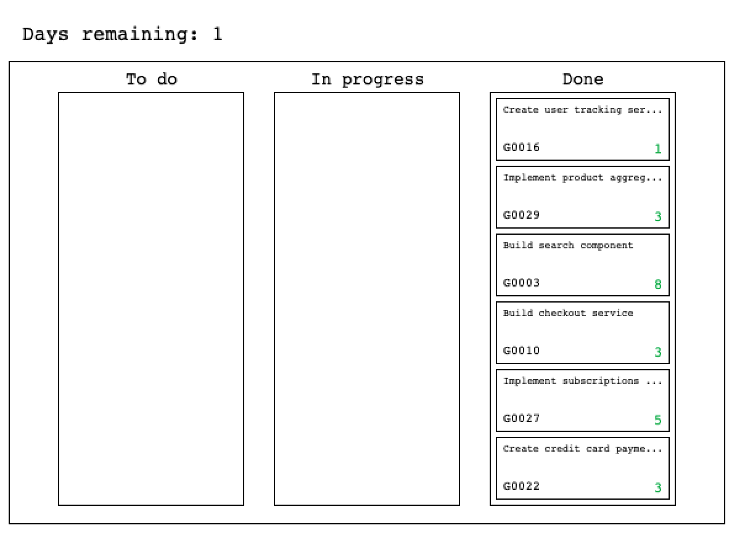
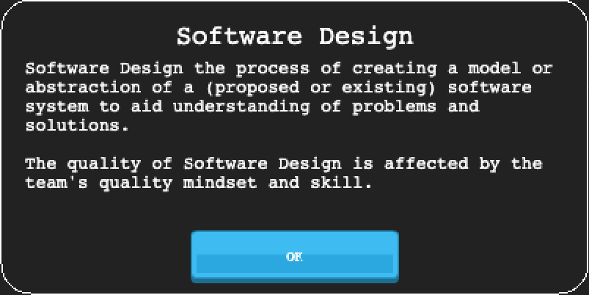
Software Engineering
Observation
Improved efficiency
Customer feedback
Workshops

Slide 12

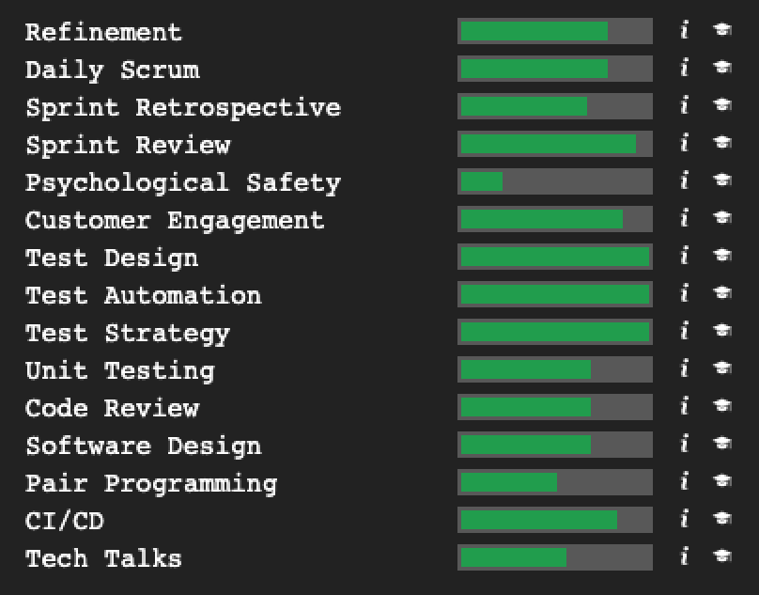
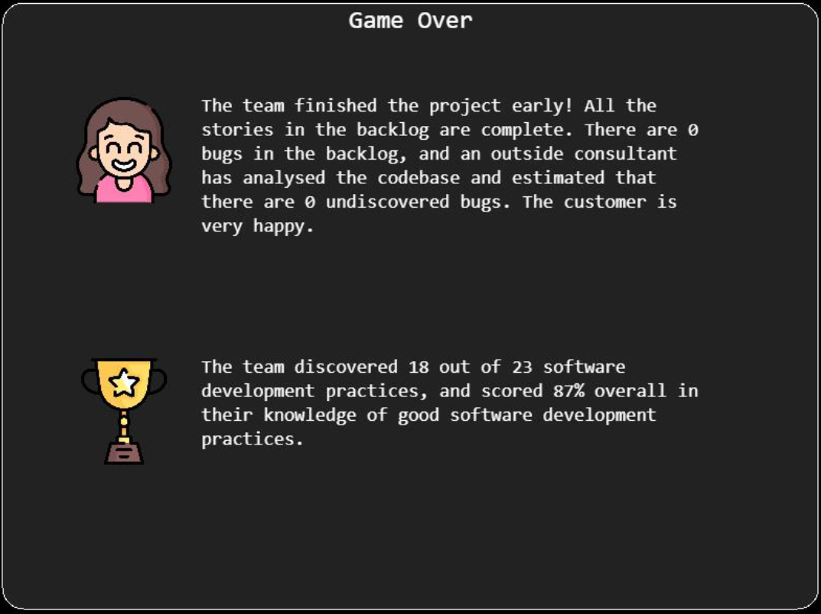
Feedback Mechanisms

Slide 13
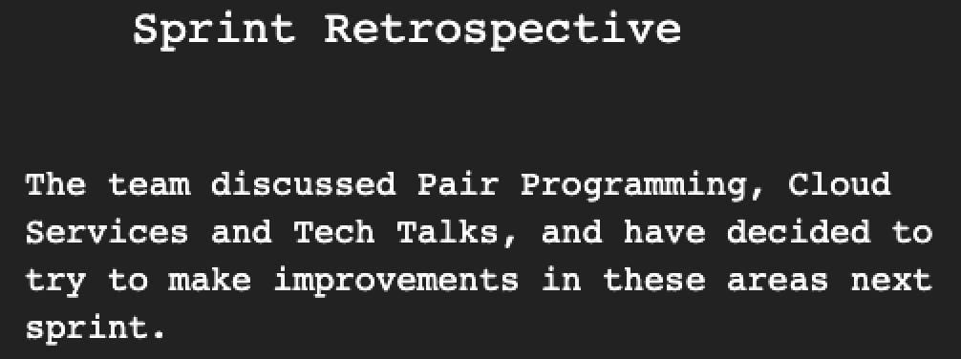
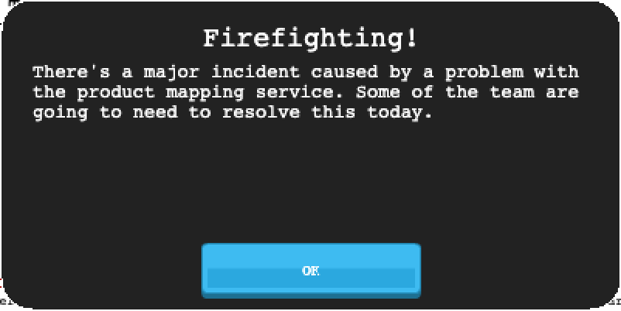
More Feedback Mechanisms

Slide 14
More Feedback Mechanisms

Slide 15
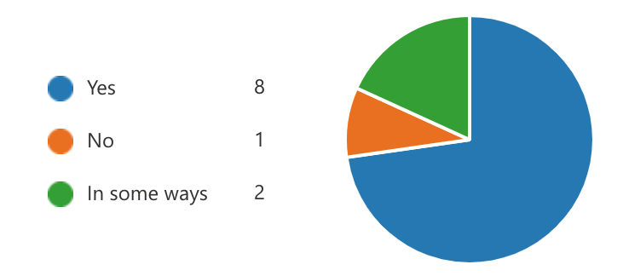
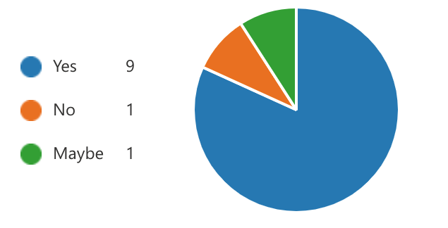
Player Survey
Realism
Learning Opportunities
Notes:
The player survey has been covered in detail in my dissertation, but for me there are two key responses that point to the success of the project.
The players felt that the game realistically represented a software project, meaning that the simulation was good enough.
Secondly the players understood where and when the team learning opportunities occurred in the game, showing the game made it possible to understand the effects of learning for the player.

Slide 16
Presentation Over
Any questions?

