Slide 1
Deep Matching and Retrieval of
Indic Script Documents
Bachelor's Thesis Project (BTP)
Pappu Meghana (S20230030400)
AI & Data Science | IIIT Sricity

Slide 2
Introduction
Roman Scripts
Indic Scripts
The Challenge
Simple left-to-right, one-dimensional structure. Near 1:1 mapping between characters and Unicode. Traditional string matching works well.
Multi-dimensional, hierarchical structure. Aksharas grow in multiple directions. Complex many-to-many mapping between visual glyphs and Unicode.
UTF-8 byte sequences don't reflect linguistic structure. Traditional LED treats code points as atomic units, missing structural relationships.
🔍 Goal: Learn a structurally-aware similarity function for Indic Unicode sequences using deep learning

Slide 3
Representation Levels
Three Levels of Representation — with Increasing Intuitiveness (→)
UTF-8
Unicode
Glyph
Internal Machine Representation
Code Point
Visual Representation
1110xxxx 10xxxxxx 10xxxxxx
0x0C15 (క)
0x0C4d (్)
0x0C37 (ష)
కి (0x0c15, 0x0c3f)
Byte-level encoding. Multiple bytes per character. No linguistic meaning in structure.
→
Code point sequences. Structured but linear. Fails to show multi-dimensional nature.
→
Connected components capturing true visual structure. Most linguistically meaningful.
Least Intuitive
Moderate
Most Intuitive

Slide 4
Problem Statement
Formal Definition
Given two Telugu words x₁ and x₂ represented as Unicode code-point sequences, learn a distance function:
ŷ = f(x₁, x₂) such that ŷ ≈ LED(x₁, x₂)
①
Structural Complexity
②
Many-to-Many Mapping
③
Quadratic Complexity of LED
Aksharas are composite units — base consonant + vowel/consonant modifiers stacked multi-dimensionally. LED treats each code point atomically, missing structural weight.
A single akshara maps to multiple Unicode code points, and the same Unicode sequence can represent different visual forms depending on context.
LED has O(|x₁|·|x₂|) complexity. Our model reduces this to O(|x₁|) + O(|x₂|) at inference by learning embeddings.

Slide 5
Previous Work (Last Presentation)
What was covered:
1
Problem Formulation
2
Literature Review
Defined the task: learn f(x1, x2) -> y where y = LED(x1, x2). Identified Indic script challenges — akshara complexity, many-to-many Unicode mapping, quadratic LED cost.
Navarro (2001): LED limitations. Bromley et al. (1993): Siamese networks. Bellet et al. (2015): Metric learning. Krishnan et al. (2015): Indic script encoding issues.
3
Generic Architecture Proposed
4
Initial Word Collection
Proposed Unicode-level Siamese network with shared encoders. Two encoder pathways: RNN (context) and CNN (for spatial context). MSE regression loss on LED.
Telugu words collected and mapped to Unicode sequences. Concept of word -> Unicode hex -> one-hot encoding pipeline described. Fixed vocab (60 code points) defined.

Slide 6
Present Work — Preprocessing Pipeline
Raw UTF-8
Pairs
Unicode
Sequences
Integer
Mapping
Final
Processed
db1_utf8_pairs.csv
db2_unicode_pairs.csv
db2_unicode_integers.csv
db3_processed.csv
122 word pairs
(Telugu UTF-8)
>
122 pairs
(hex code points
+ LED labels)
>
122 pairs
(decimal Unicode
integers)
>
122 pairs
(vocab-indexed
sequences)
vocab.txt — 60 code points
LED Distribution (122 pairs)
60 unique Telugu Unicode code points selected after filtering rare elements from the 128-point block (0x0C00-0x0C7F). Each mapped to index 0-59 for integer encoding.
Range: 2-19 | Mean: 7.85 | Most common: LED=5 (20), LED=4 & 6 (15 each)
Covers short to long edit distances — good diversity for training.

Slide 7
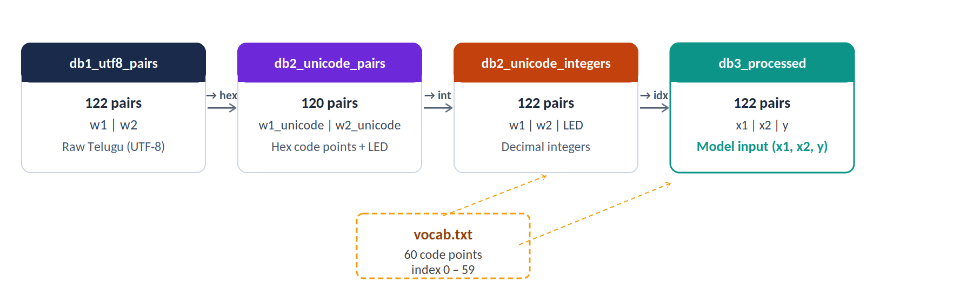
Data Collection & Dataset Creation
122
60
2–19
4 DBs
Telugu Word
Pairs Collected
Vocab
(Unicode code pts)
LED Range
(Mean: 7.85)
Pipeline
Stages
Dataset Creation Pipeline

Slide 8
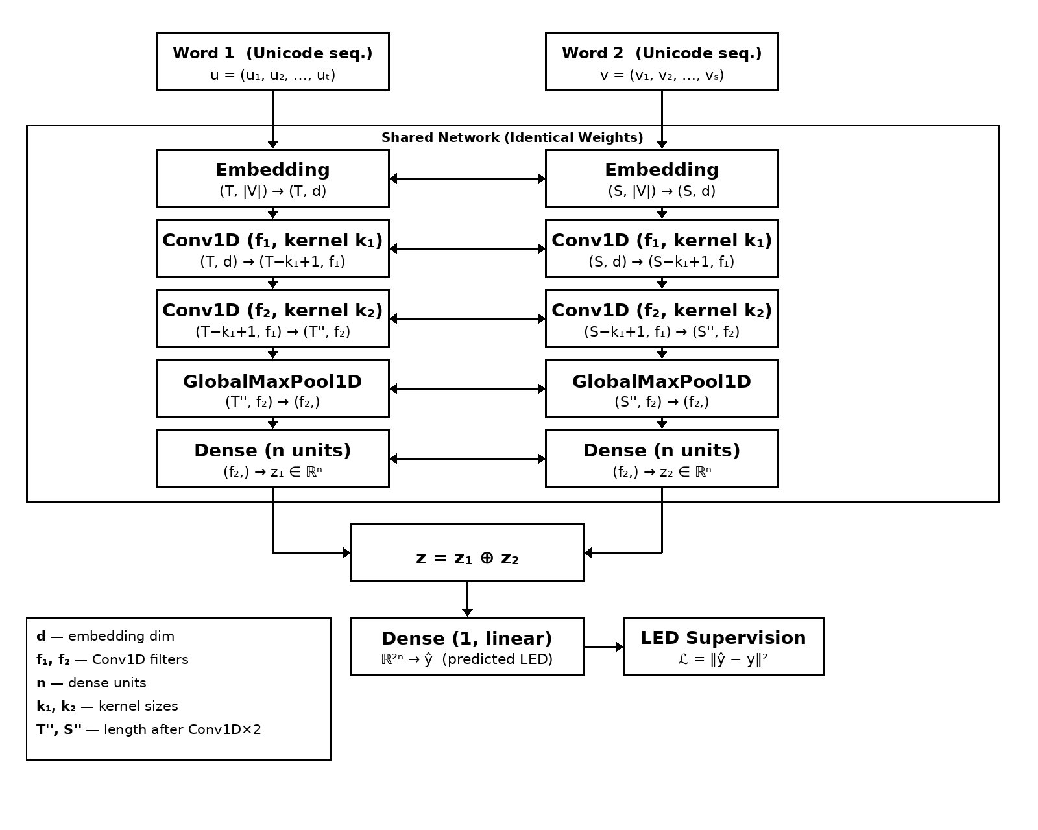
Model Architecture — CNN-Based Siamese Network
Key Design Choices
Input:
Unicode seq. (1×128 one-hot per code point)
Embedding:
Maps to d-dim space (e.g. d=64)
Conv1D ×2:
Learns spatial patterns between code points
GlobalMaxPool:
Resolves variable-length input
Dense:
Projects to n-dim representation (e.g. n=250)
Merge z₁⊕z₂:
Concatenate both word vectors
Loss:
MSE: L = ||ŷ − y||² (LED supervision)

Slide 9
Implementation — Preprocessing Complete
Model Dimensions (Phase 2 Target)
Preprocessing Status
Input
60 x 10 (variable len, one-hot 60)
✓
122 Telugu word pairs collected (db1_utf8_pairs.csv)
Embedding
10 × 64 (d = 64)
✓
UTF-8 → Unicode hex sequence conversion (db2_unicode_pairs.csv)
✓
LED computed for each pair as ground truth label
Conv1D (5 kernels, k=5)
6 × 250 (T−k+1 = 6 dimensions)
✓
Hex → decimal integer mapping (db2_unicode_integers.csv)
Conv1D (5 kernels)
2 × 400 (stacked convolution)
✓
Vocab filtered: 60 code points from 128-pt block (vocab.txt)
GlobalMaxPool1D
400 × 1
✓
Vocab index mapping: code point → index 0-59
Dense
250 (per word vector)
✓
Final (x1, x2, y) triples dataset built (db3_processed.csv)
Concatenate z₁ ⊕ z₂
250(If concat=>diff(-))
○
Model training on db3 dataset (Phase 2)
Dense (1, linear)
1 → predicted LED (ŷ)
○
Evaluation & retrieval benchmarking

Slide 10
Future Work & Roadmap
Phase 1
Phase 2
Phase 3
Phase 4
COMPLETE
NEXT
PLANNED
PLANNED
Vocabulary & preprocessing pipeline
Learn embedding space (dim < 128)
Explore comparison strategies (concat, dot product, cosine)
Expand vocabulary; add modifier characters
Pairwise dataset with LED labels
Replace one-hot with learned embeddings
Cluster analysis of learned representations
Glyph-level matching (visual representation)
Architecture design (CNN Siamese)
Train CNN Siamese network
Performance benchmarking vs baseline LED
Generalize to other Indic scripts (Kannada, Devanagari)
Evaluate MSE alignment with LED
Progress: Phase 1/4 Complete

Slide 11
References
[1] A. Bellet, A. Habrard, M. Sebban. "A Survey on Metric Learning for Feature Vectors and Structured Data." IEEE TPAMI, vol. 37, no. 11, pp. 2172--2189, 2015.
[2] P. K. Perepu, "A semantic-based deep learning framework for mathematical expression retrieval," Knowledge and Information Systems, vol. 68, p. 115, 2026.
[3] A. Graves. "Supervised Sequence Labelling with Recurrent Neural Networks." Springer, 2009.
[4] P. K. Perepu, "OpenMP Implementation of Parallel Longest Common Subsequence Algorithm for Mathematical Expression Retrieval," Parallel Processing Letters, vol. 31, no. 2, p. 2150007, 2021.
[5] G. Navarro. "A Guided Tour to Approximate String Matching." ACM Computing Surveys, vol. 33, no. 1, pp. 31--88, 2001.

Slide 12
Thank You
Questions & Discussion
Pappu Meghana | S20230030400 | AI & Data Science | IIIT Sricity

