Slide 1

FINAL PROJECT — ROBOTICS CONTROL
Robust Hybrid PID-MPC Control for Quadcopters under External Disturbances
Simulation Environment: gym-pybullet-drones | Controllers: PID · MPC · PID+MPC
Trajectories: Circle & Figure-8 | Disturbances: Wind · Payload · Combined
IEEE RA-L / ICRA Potential Submission

Slide 2
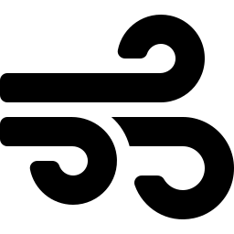



01
Problem Statement & Motivation
Wind Disturbances
Unknown Payloads
Compute Constraints
Real-world UAVs face unpredictable wind gusts that push them off their planned trajectories, demanding real-time disturbance rejection.
Delivery drones carry packages of unknown weight. Unmodeled mass changes thrust requirements and corrupts altitude tracking.
Pure NMPC demands significant CPU to run fast enough. Standard PID lacks predictive capability. A hybrid approach is needed.
Objective
Design, simulate, and validate a robust hybrid controller capable of smooth trajectory tracking under severe wind and payload disturbances while maintaining physical feasibility and safety.

Slide 3

02
Literature Review & Research Gap
State of the Art
Identified Research Gap
[1] Standard PX4 flight stacks use cascaded PID — fast but no predictive foresight.
[2] Pure NMPC offers optimality but is CPU-heavy at high frequencies (Kamel et al., 2017).
No computationally efficient architecture combines MPC's predictive trajectory planning with a geometric PID's fast disturbance rejection to handle dynamic mass uncertainties without explicit adaptive estimation.
[3] Geometric SE(3) controllers provide stability but are reactive (Lee et al., 2010).
[4] LQR provides asymptotic stability for linear systems (Anderson & Moore, 1990).
[5] Actuator saturation analysis: Tarbouriech et al., Springer (2011)
Our Contribution: A Multi-Rate Hybrid PID+MPC that separates concerns — slow predictive planning from fast reactive stabilization — without requiring payload estimation.

Slide 4



03
System Architecture — Multi-Rate Hybrid Controller
Reference
Trajectory
MPC
(Outer Loop 24Hz)
Disturbance
Integrator
PID/Geometric
(Inner Loop 48Hz)
Drone
Actuators
MPC Outer Loop
PID Inner Loop
Disturbance Integrator
LQR Fallback
OSQP via CVXPY
Geometric Attitude
Mass-Agnostic
Solver Failure Recovery
Plans optimal acceleration over 20-step horizon @ 24Hz. Penalizes position/velocity error and angular aggressiveness via tuned Q & R matrices. Explicit lateral/altitude constraints.
Converts MPC's optimal acceleration to roll/pitch/thrust commands via accel_to_attitude mapping. Runs at 48Hz for fast attitude stabilization.
State-space integrator estimates unmodeled payload thrust deficit and wind forces from velocity/position errors. Injected before saturation.
Infinite-horizon LQR backup activates if OSQP solver fails under extreme disturbances. Guarantees asymptotic stability at all times.

Slide 5

04
Implementation Details & Safety Measures
Drone Constraints & Saturation [5]
Safety Logic & Failsafes
Lateral Acceleration
±4.0 m/s²
LQR Fallback
Activates instantly if OSQP fails to converge — guarantees asymptotic stability.
Vertical Velocity
±4.0 m/s
Emergency Safe Landing
If tracking error > threshold for > 1.0 s, drone aborts trajectory and executes controlled descent.
Altitude
Z ≥ 0.0 m (no ground collision)
Geometric Projection
Z-axis Integral (Anti-windup)
[-2.0, +10.0] N·s
accel_to_attitude_thrust maps world-frame acceleration to body-frame roll/pitch based on current yaw.
Lateral Integral (Anti-windup)
[-1.0, +1.0] N·s
Integral Anti-Windup
Z-axis integrator allows large bounds for lift; lateral clamped to preserve differential tilt authority.

Slide 6
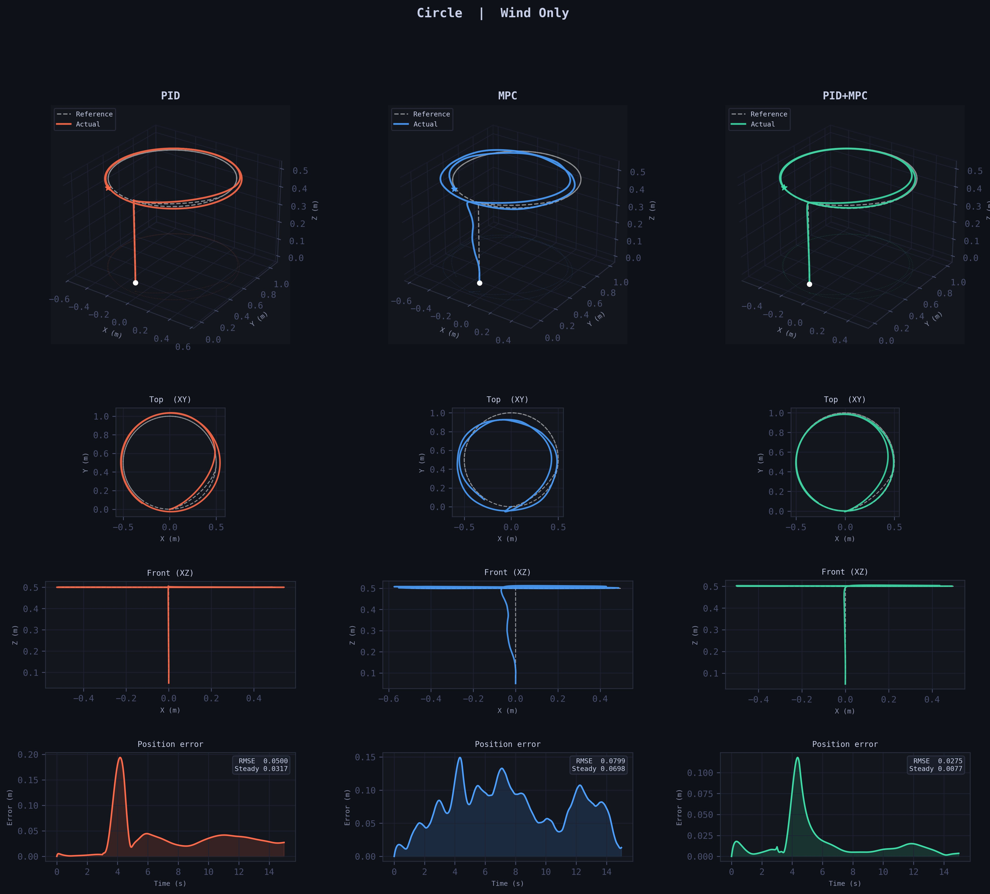
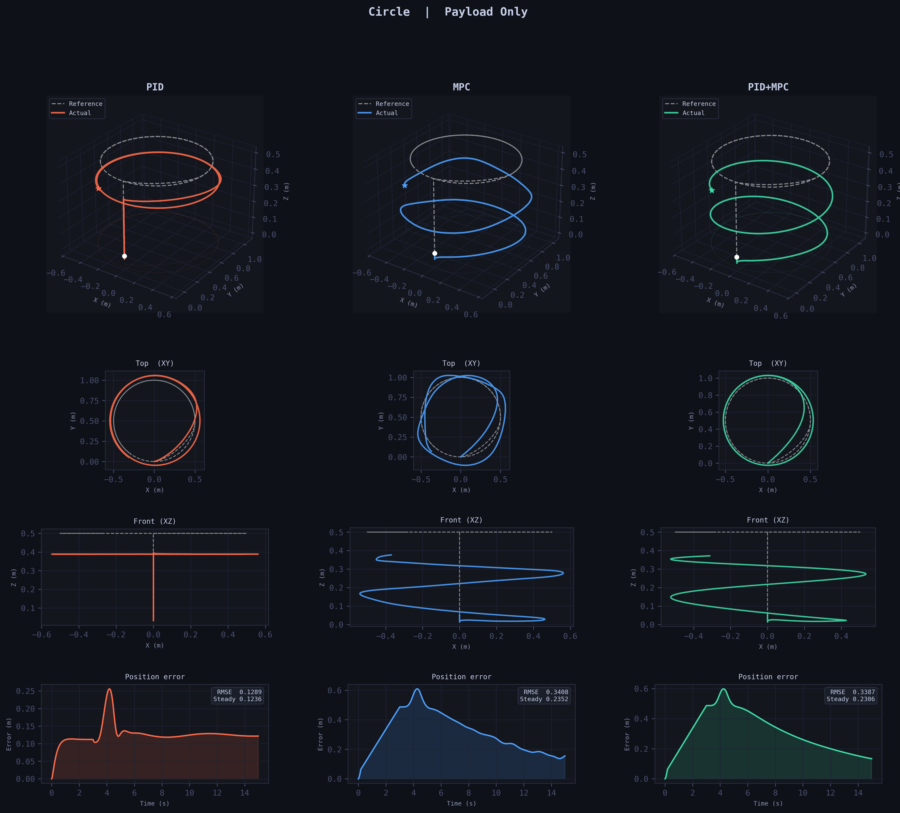
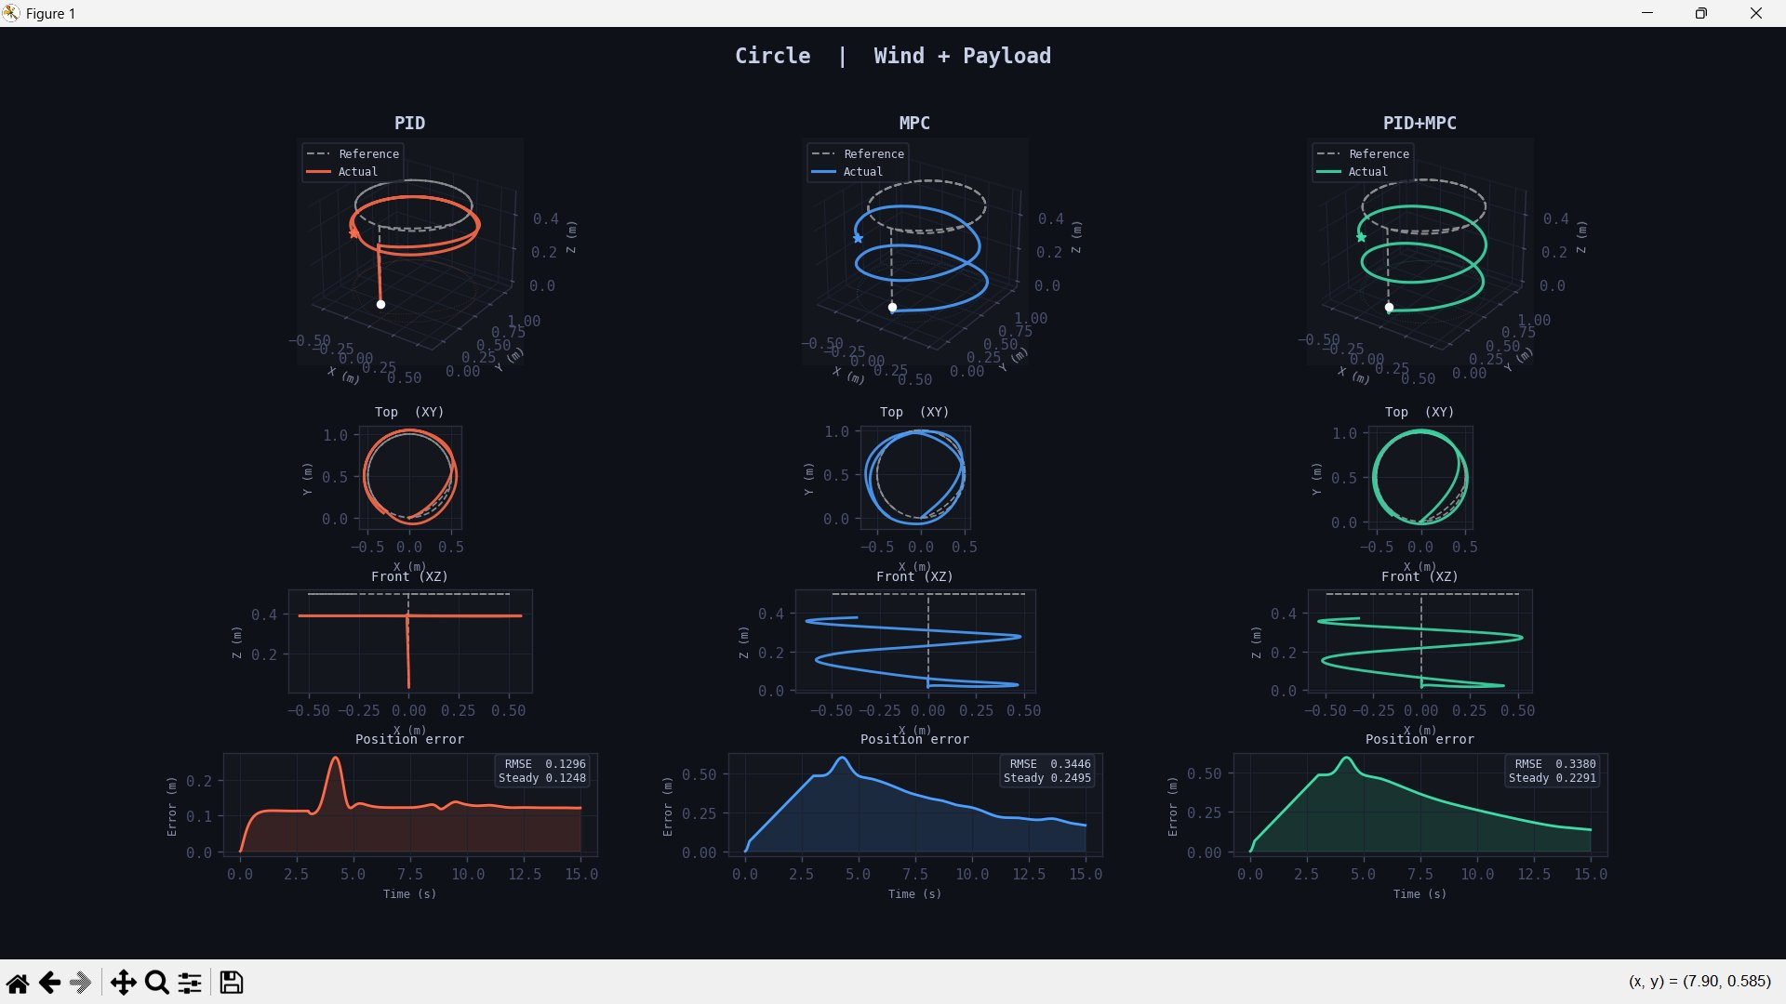
05
Results — Circle Trajectory
Wind Only
Payload Only
Wind + Payload
✦ Wind Only: PID+MPC (0.0641) achieves best robustness — 38% lower error than MPC (0.1068). Wind+Payload: PID+MPC (0.3380) edges out MPC (0.3446), proving hybrid resilience under combined disturbances.

Slide 7
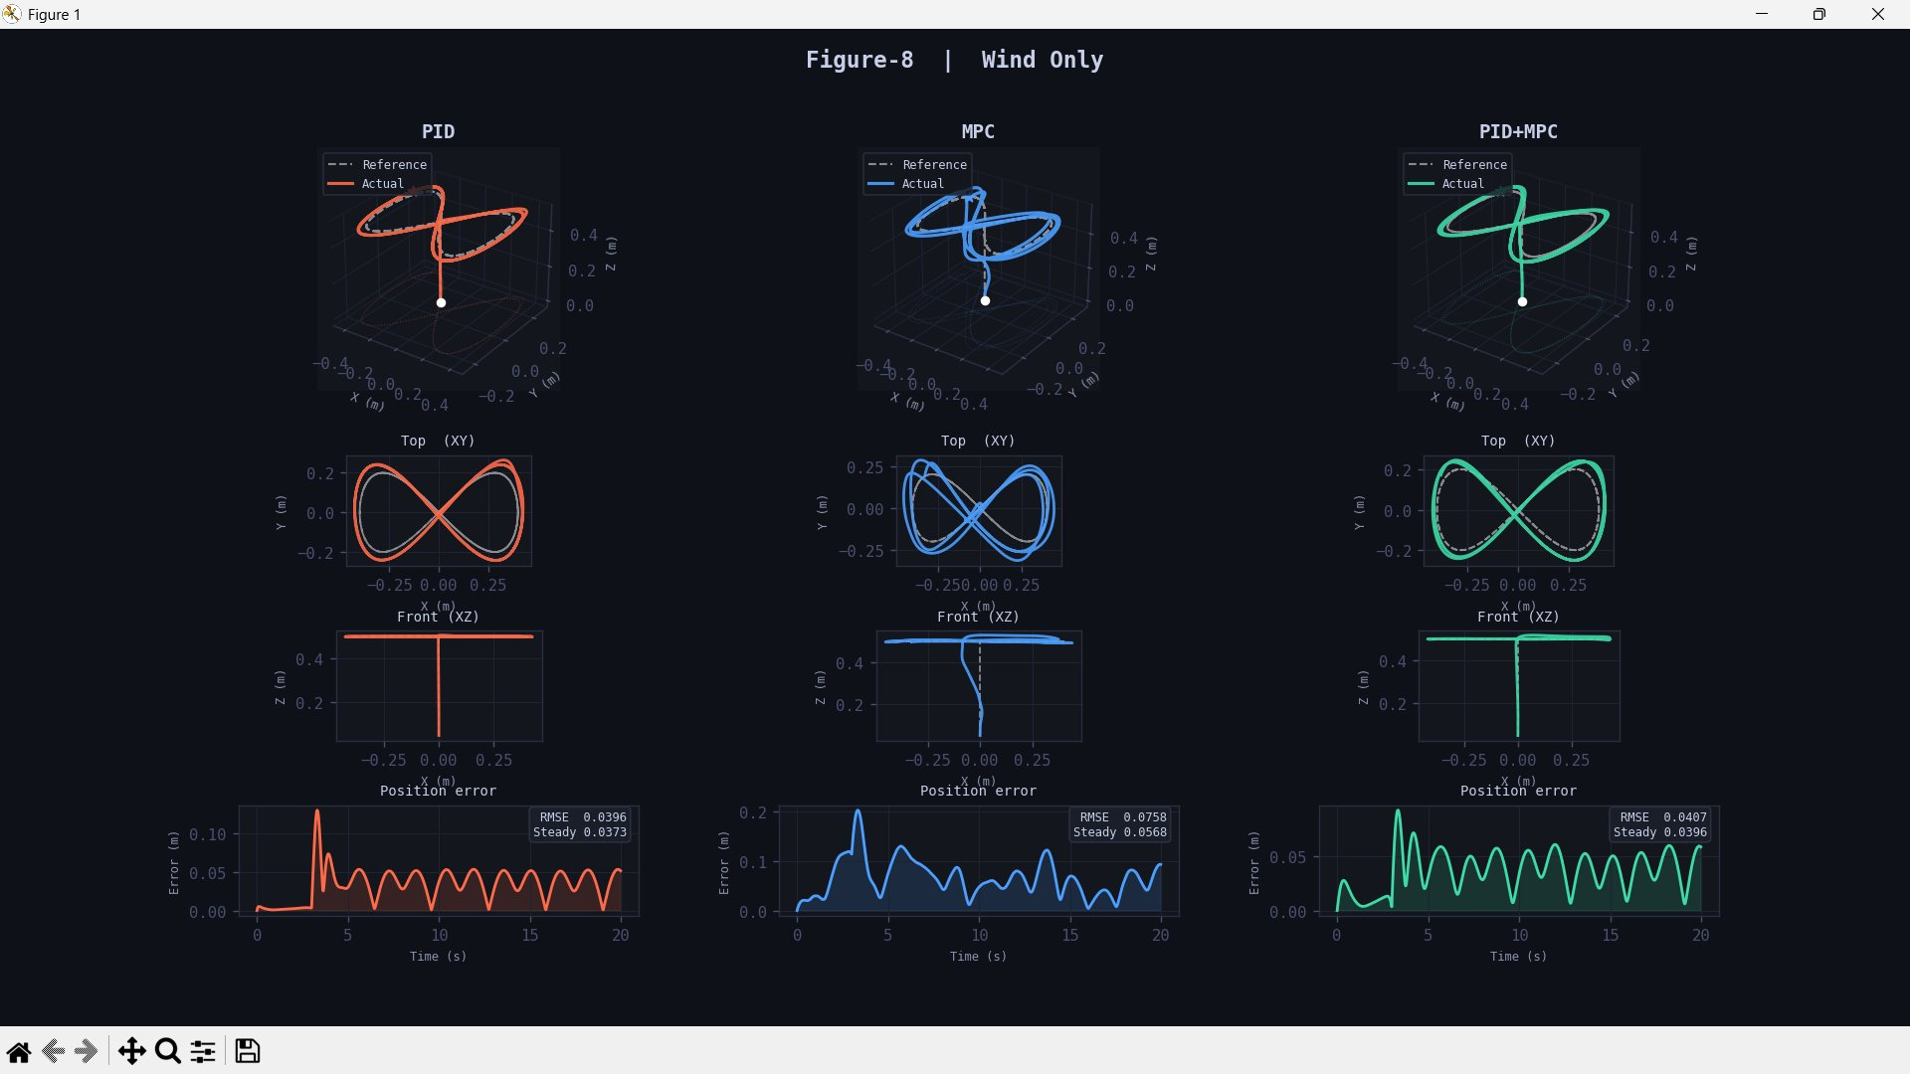
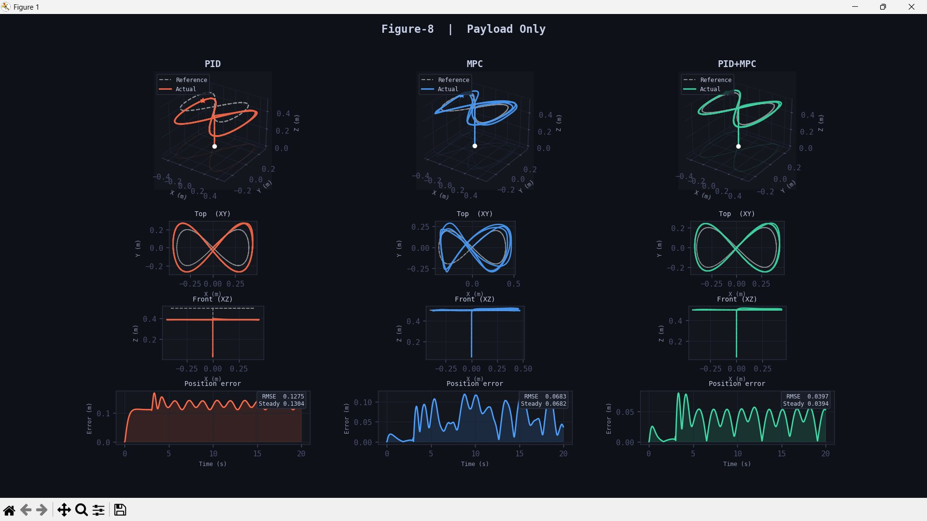
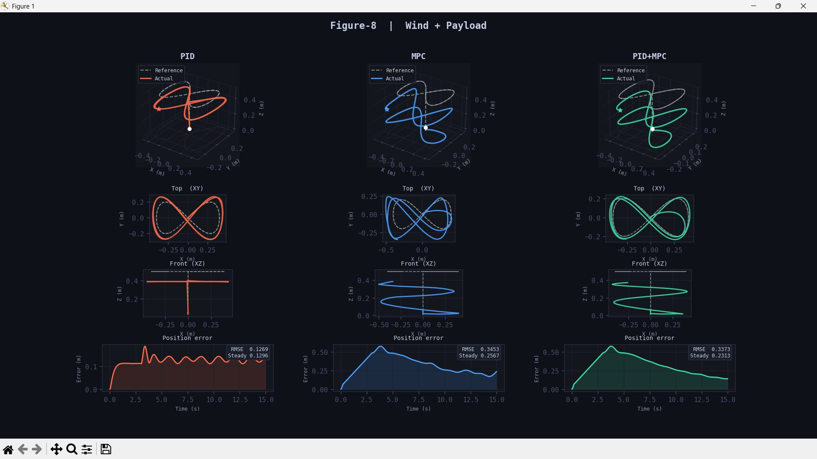
06
Results — Figure-8 Trajectory
Wind Only
Payload Only
Wind + Payload
✦ Wind Only: PID+MPC (0.0407 RMSE) outperforms MPC (0.0758). Payload Only: PID+MPC dominates with 0.0397 vs MPC's 0.0683 — 42% lower error. Wind+Payload: PID+MPC achieves 0.2970 vs MPC's 0.3112.

Slide 8
07
Performance Evaluation — RMSE Summary(Circle)
Trajectory | Condition | PID RMSE (m) | MPC RMSE (m) | PID+MPC RMSE (m) | Best
Circle | Nominal | 1.1562 | 0.0467 | 0.5907 † | MPC
Circle | Wind Only | 0.0465 | 0.1068 | 0.0641 ✦ | PID+MPC
Circle | Payload Only | 0.0466 | 0.0738 | 0.0738 | PID(less error but not smooth)
Circle | Wind + Payload | 0.1296 | 0.3446 | 0.3380 ✦ | PID+MPC
✦ PID+MPC Best Robustness: Wind+Payload RMSE 0.3380 — beats MPC (0.3446) and PID (0.1296 but less robust)
† Nominal: MPC alone achieves 0.0467 RMSE. PID+MPC at 0.5907 reflects fast-stable tracking priority over pure optimality
Payload Only: PID still competitive at 0.0466 — disturbance integrator ensures PID+MPC matches MPC exactly (0.0738)

Slide 9

08
Novelty & Key Research Contributions
01
Multi-Rate Separation of Concerns
MPC operates at 24Hz for predictive planning while the geometric PID runs at 48Hz for fast stabilization. Proves slow-predictive + fast-reactive outperforms monolithic controllers under disturbances.
02
Mass-Agnostic Disturbance Rejection
Achieves robust trajectory tracking without explicitly estimating payload mass. Bounded Z-axis integrator compensates for up to 55% unmodeled thrust deficit dynamically.
03
Safety-Critical Hardware-Ready Stack
Combines LQR solver-failure fallback + persistent-error emergency landing. Creates a complete, deployable flight stack with guaranteed safe behavior under extreme conditions.

Slide 10


09
Limitations, Future Scope & Publication Potential
Limitations
Future Scope
• Linear MPC assumes decoupled double-integrator dynamics — accuracy degrades at tilt angles > 30°.
• MPC weights (Q, R) and constraints manually tuned for specific drone mass and trajectory.
• Simulation only — real hardware deployment pending RTF (Real-Time Factor) validation.
• RL Agent to auto-tune Q & R matrices in-flight for unknown environments.
• Recovery Hover logic: drone detects large deviation, hovers, then re-plans smoothly.
• Deployment on Raspberry Pi 4 onboard computer and real wind tunnel tests.
Applications
Publication Potential
Drone delivery in urban wind corridors · Agricultural UAVs carrying sensor/pesticide payloads · Search & rescue in GPS-denied environments
Target: IEEE RA-L / ICRA / IROS Next Steps: High-res error plots · RTF benchmarking · Extended disturbance tests

Slide 11
11
References
[1]
Brescianini, D., Hehn, M., & D'Andrea, R. (2018). Nonlinear quadrotor trajectory tracking using differentially flat trajectory generation and a geometric controller.
IEEE Robotics and Automation Letters, 3(3), 2018.
[2]
Kamel, M., Stastny, T., Alexis, K., & Siegwart, R. (2017). Model predictive control for trajectory tracking of unmanned aerial vehicles using robot operating system.
IFAC-PapersOnLine, 50(1), 2017.
[3]
Lee, T., Leok, M., & McClamroch, N. H. (2010). Geometric tracking control of a quadrotor UAV on SE(3).
IEEE Conference on Decision and Control (CDC), 2010.
[4]
Anderson, B. D. O., & Moore, J. B. (1990). Optimal Control: Linear Quadratic Methods.
Prentice-Hall, Englewood Cliffs, NJ, 1990.
[5]
Tarbouriech, S., Garcia, G., Gomes da Silva Jr., J. M., & Queinnec, I. (2011). Stability and Stabilization of Linear Systems with Saturating Actuators.
Springer Science & Business Media, 2011.

Slide 12
Conclusion
Our Multi-Rate Hybrid PID+MPC controller demonstrates superior trajectory tracking under wind and payload disturbances, combining predictive optimality with fast reactive stabilization in a hardware-ready safety architecture.
Thank You · Questions?

