Slide 1
Final Project
USML – DS5230
Targeted deals recommendation system based on credit card usage
By
Dinesh Sai Pappuru
Nikitha Kanaparthi

Slide 2

Introduction:
Credit cards are extensively utilized in the USA for a wide range of purchases, with credit card companies frequently providing recommendations on various deals.
However, these suggested deals often fail to resonate with users' preferences. As credit card users ourselves, from the inception of our credit card usage, we have observed a consistent lack of relevance in the recommended deals.
Our primary project objective is to collaborate with credit card companies to devise an improved recommendation system. This system aims to better align offers with individual customer preferences, fostering increased satisfaction. The goal is to encourage customers to use their credit cards in more diverse ways, benefiting both the company and customers.

Slide 3
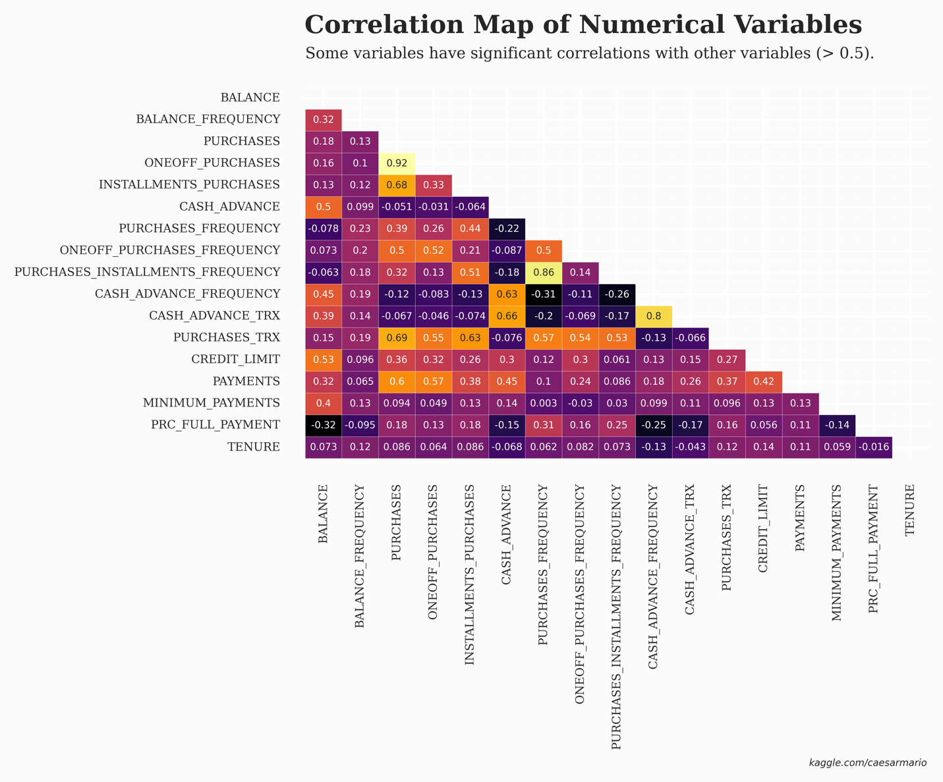
Dataset:
With a dataset encompassing the usage behavior of approximately 9,000 credit card users over the past six months, our primary objective is to employ clustering techniques for grouping customers based on their behavior. This segmentation process is crucial for developing a targeted and impactful credit card marketing strategy.
Correlation analysis reveals interesting relationships between variables. Notably, there is a high correlation (0.92) between PURCHASES and ONEOFF_PURCHASES. Similarly, CASH_ADVANCE_TRX and CASH_ADVANCE_FREQUENCY exhibit a significant correlation value of 0.8.

Slide 4
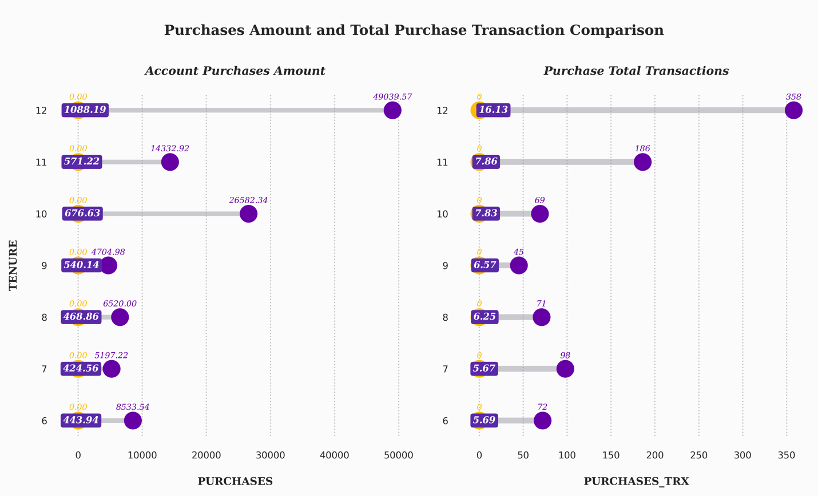
EDA (exploratory data analysis):
The insights drawn from the dumbbell chart highlight a distinct pattern among credit card customers based on their tenure periods. Specifically, customers with a 12-month tenure exhibit a higher willingness to engage in purchase transactions and tend to have larger total purchase amounts compared to customers with other tenure periods.

Slide 5
Preprocessing:
1. Imputation:
Since the dataset is about clustering, imputation will use KNNImputer() to avoid biased clustering results. The mean value from the nearest n_neighbors found in the dataset is used to impute the missing values for each sample.
2. Scaling:
The next step is scaling the dataset. Scaling is essential since it manages the dataset's variability, transforms data into a defined range using a linear transformation to produce high-quality clusters, and boosts the precision of clustering algorithms. In this case, a standard scaler used to standardize the feature by removing the mean and scaling to unit variance.
3. Hopkins test:
The Hopkins statistic (introduced by Brian Hopkins and John Gordon Skellam) is a way of measuring the cluster tendency of a data set.
Hopkins Test:
Result: 0.9664
From the result above, it has a high tendency to cluster (contains meaningful clusters)
4. PCA:
Principal component analysis (PCA) is a method used in unsupervised machine learning (such as clustering) that reduces high-dimension data to smaller dimensions while preserving as much information as possible.

Slide 6
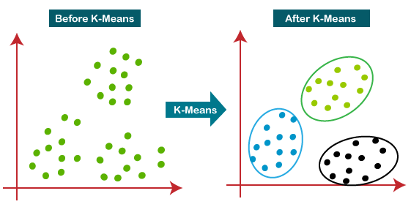
K-Means Clustering:
K-Means Clustering is a popular unsupervised machine learning algorithm designed for the partitioning of data into distinct, non-overlapping groups or clusters. The algorithm's objective is to minimize the variance within each cluster while maximizing the separation between clusters.

Slide 7
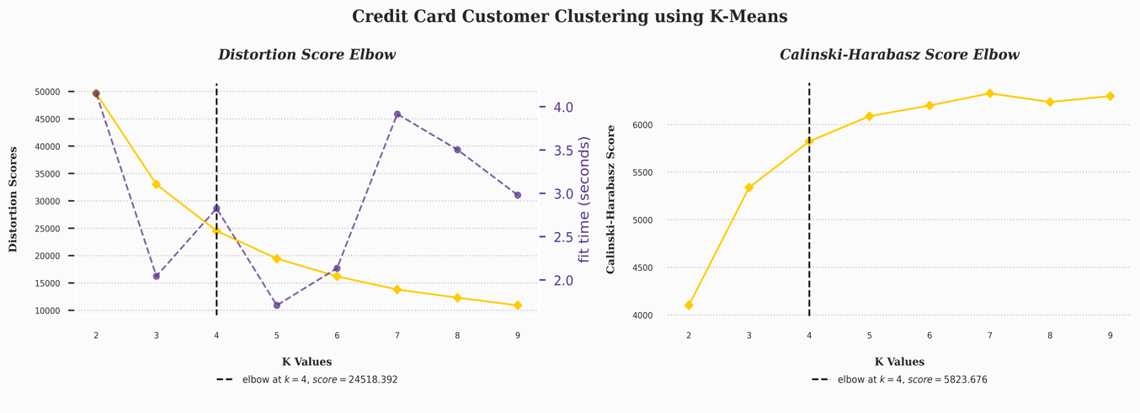
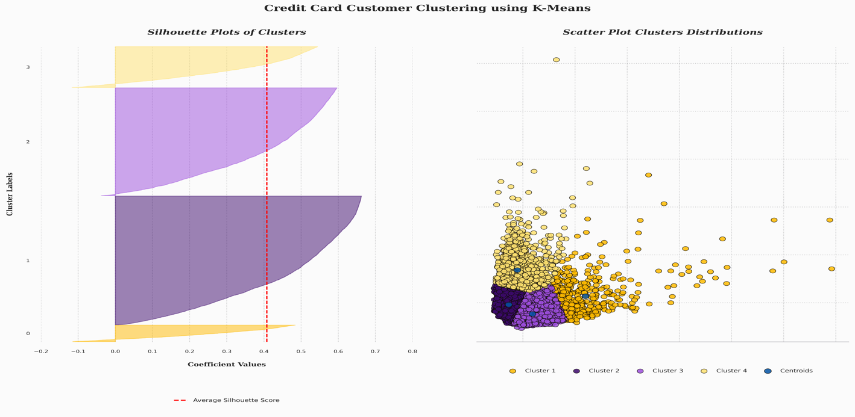
Distortion Score Elbow:
In this case, the breadth of data is called distortion or sum of square errors (SSE). Distortion could decrease rapidly at first then slowly flatten forming an “elbow” in a line graph.
Calinski-Harabasz Score Elbow:
The Calinski-Harabasz (CH) scores are then plotted against the number of clusters, forming a curve. The "elbow" of the curve represents a point where adding more clusters does not significantly increase the CH score.
Results from Evaluation:
Davies-Bouldin Index: 0.801
Silhouette Score: 0.408
Calinski Harabasz Index: 5823.676

Slide 8
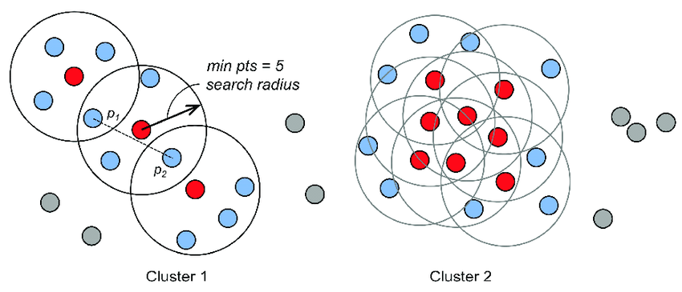
DBSCAN:
DBSCAN (Density-Based Spatial Clustering of Applications with Noise) groups points based on the lowest number of points and the Euclidean distance. It also marks as outliers the points that are in low-density regions. The two DBSCAN parameters are MinPoints and Epsilon.

Slide 9
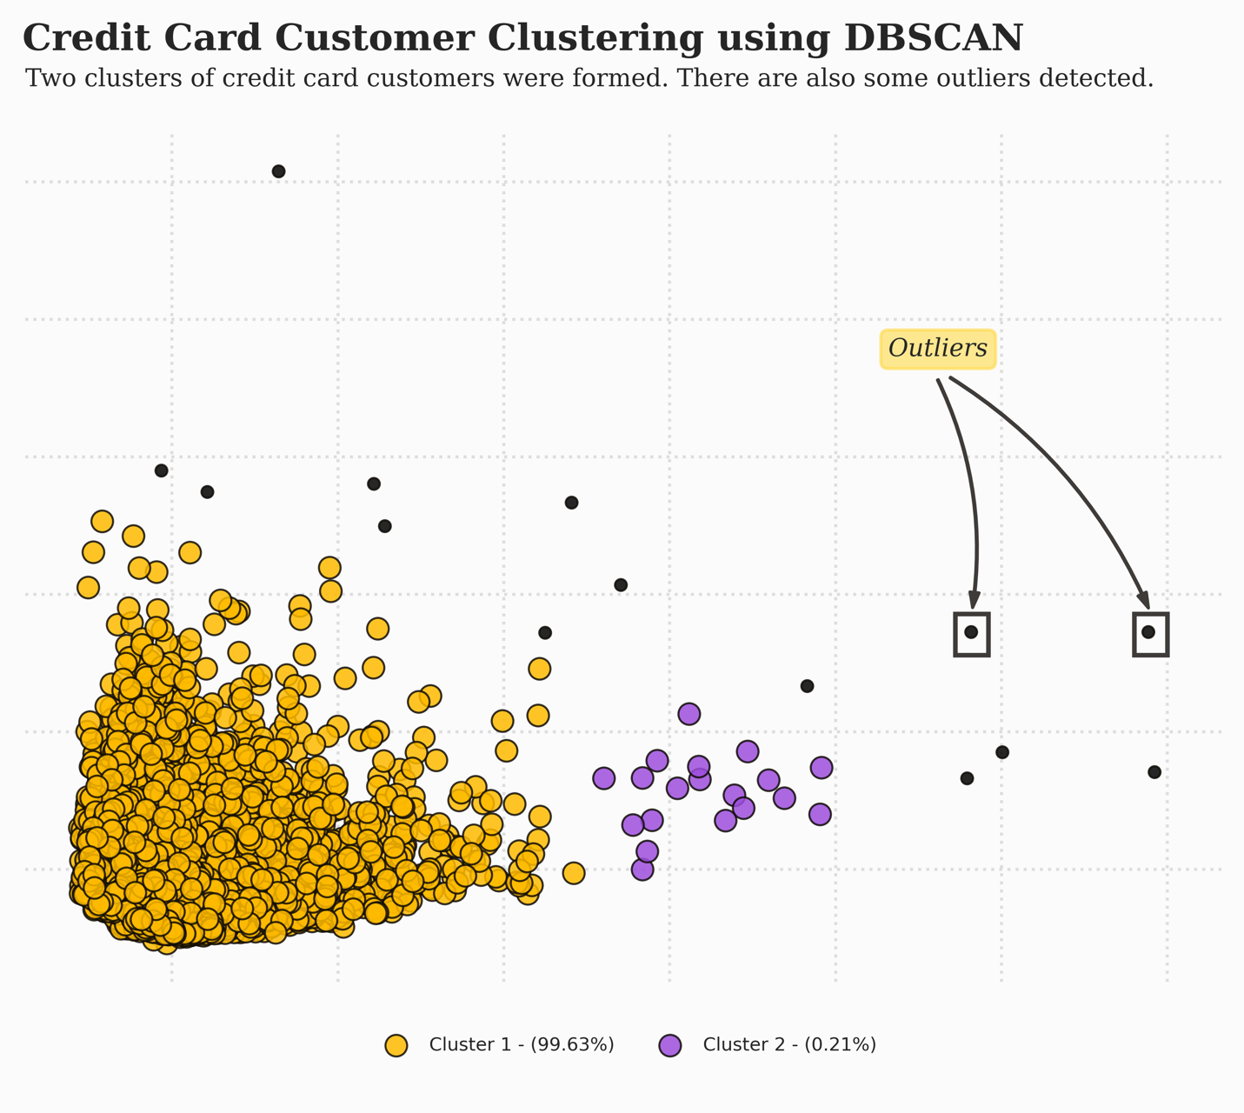
Implementation:
The clustering quality using DBSCAN with two clusters and outliers is fair according to the evaluation score above. The silhouette score is better than K-Means since there are one large cluster and one small cluster formed, although the Davies-Bouldin index is higher than K-Means, which indicates fair clustering.
Results from Evaluation:
Davies-Bouldin Index: 1.287
Silhouette Score: 0.803
Calinski Harabasz Index: 685.303

Slide 10
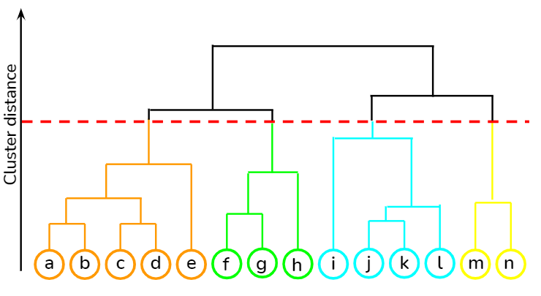
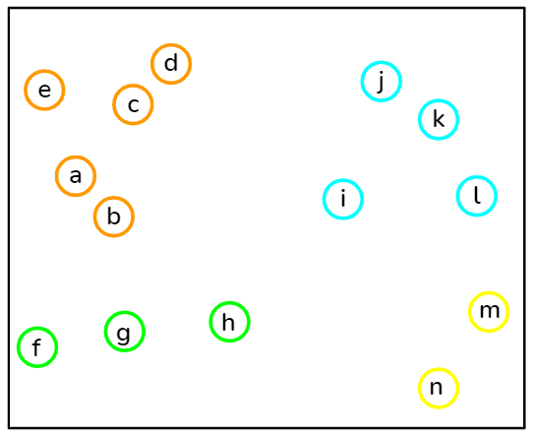
Hierarchical Clustering (Agglomerative):
Hierarchical clustering works via grouping data into a tree of clusters. Hierarchical clustering begins by treating every data point as a separate cluster.
Then, it repeatedly identify the 2 clusters which can be closest together and merge the 2 maximum comparable clusters until all the clusters are merged together. In hierarchical clustering, the objective is to produce a hierarchical series of nested clusters. Dendrograms will be used to visualize the history of groupings and figure out the optimal number of clusters.

Slide 11
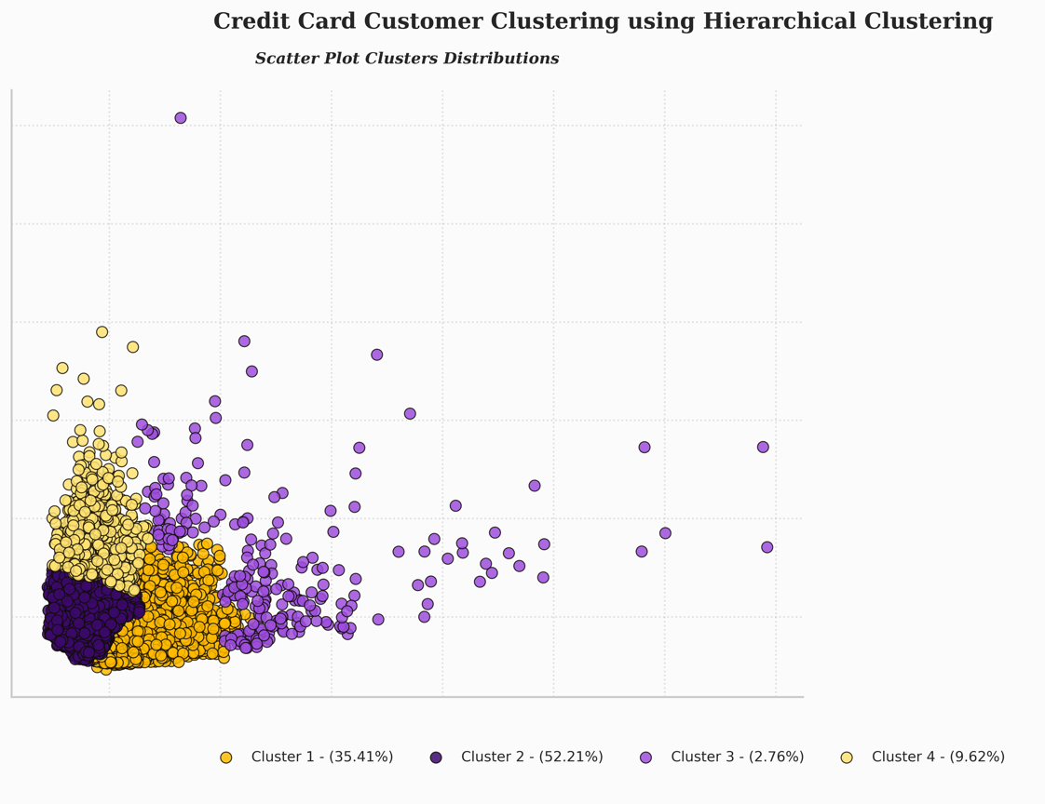
Implementation:
Based on the results of evaluating the quality of clustering using hierarchical clustering, it can be seen that the results obtained are slightly different from K-Means. By using hierarchical clustering, the silhouette score obtained is close to 0, indicating overlapping clusters. In addition, a high Davies-Bouldin index indicates decent clustering quality. Compared to K-Means, the silhouette score for hierarchical clustering is 0.06 higher. And for the Davies-Bouldin index, the results obtained are 0.02 lower. The Calinski-Harabasz index obtained is slightly lower compared to K-Means, but higher compared to DBSCAN.
Results from Evaluation:
Davies-Bouldin Index: 0.863
Silhouette Score: 0.388
Calinski Harabasz Index: 4797.51

Slide 12
Model | Davies-Bouldin Index | Silhouette Score | Calinski-Harabasz Index
K-Means | 0.801000 | 0.408000 | 5823.676000
Hierarchical Clustering | 0.863000 | 0.388000 | 4797.510000
DBSCAN | 1.287000 | 0.803000 | 685.303000
Model Accuracy Comparison:

Slide 13
Summary:
Cluster 1 (Full Payers Users):
Customers in this cluster are active users of the bank's credit card. This can be seen from the frequency of the balance which frequently changes and the balances amount is high enough compared to other clusters.
Cluster 2 (Starter/Student users):
In contrast to cluster 1, customers rarely/almost never use credit cards for transactions and installments in this cluster. This is because the customer has a relatively small balance, the frequency of the balance rarely changes, and the installments are very low.
Cluster 3 (Installment Users):
In this cluster, customers use credit cards specifically for installment purposes. This is due to the relatively high level of transactions using installments in this cluster.
Cluster 4 (Cash Advance/Withdraw Users):
Customers in this cluster have high balances, the balances frequency are always changing, and the frequency of cash in advance and cash in advance is high.

Slide 14
Conclusion and Future Scope:
In conclusion, the clustering analysis has successfully segmented the credit card dataset into four distinct clusters, each representing a unique category of credit card users. This segmentation allows for a more nuanced understanding of customer behavior and preferences.
With this knowledge, targeted deals or recommendations can be tailored to each specific cluster, ensuring a more personalized approach in marketing strategies. By aligning promotions with the distinct needs and habits of each cluster, credit card companies can enhance customer satisfaction, engagement, and overall experience. This targeted approach is poised to be more effective in meeting the diverse expectations of different customer segments, ultimately contributing to a more successful and customer-centric marketing strategy.
As we look to the future, our vision is to enhance the recommendation system by incorporating users' day-to-day expenditure. This extension aims to provide even more personalized and timely deals, aligning closely with individual spending habits.

Slide 15

Thank You

