Slide 1

An e-learning info-graphic template for class 10 chemistry laboratory experiments
Rimi Akter - 303
Umme Kulsum Papri - 305
Mallika Dey - 307
MD. Forhad Hossain - 329
Mahbub Islam Mahim - 323
Azizul Islam - 334
Rama Kundu Prova - 1837
Presented By
Cool Teachers
Notes:
Create an outline to get ready:
Introduce the era (Use a mix of media and text)
Organize your artifacts to outline what life was like during the era you are presenting
Think about using a storyboard to outline your images and ideas
Make sure you prepare a clear and well rounded presentation of all aspects of the era (People, jobs, food, transportation, etc. What else should you include so the audience feels like they have visited your era?)

Slide 2
Project Goal
Make chemistry laboratory interesting
Provide a visual representation of chemical reaction
Learn through fun
Notes:
Create an outline to get ready:
Introduce the era (Use a mix of media and text)
Organize your artifacts to outline what life was like during the era you are presenting
Think about using a storyboard to outline your images and ideas
Make sure you prepare a clear and well rounded presentation of all aspects of the era (People, jobs, food, transportation, etc. What else should you include so the audience feels like they have visited your era?)

Slide 3





Tools
Gantt Project: Project management tool
Blender: 3D computer graphics software tool
Kdenlive : Video editing tool
Ardour : Digital audio workstation application
Inkscape : Vector graphics editor

Slide 4
Progress so far
Project Planning
Tool Selection
Work distribution
Script writing
Introductory part of animation

Slide 5
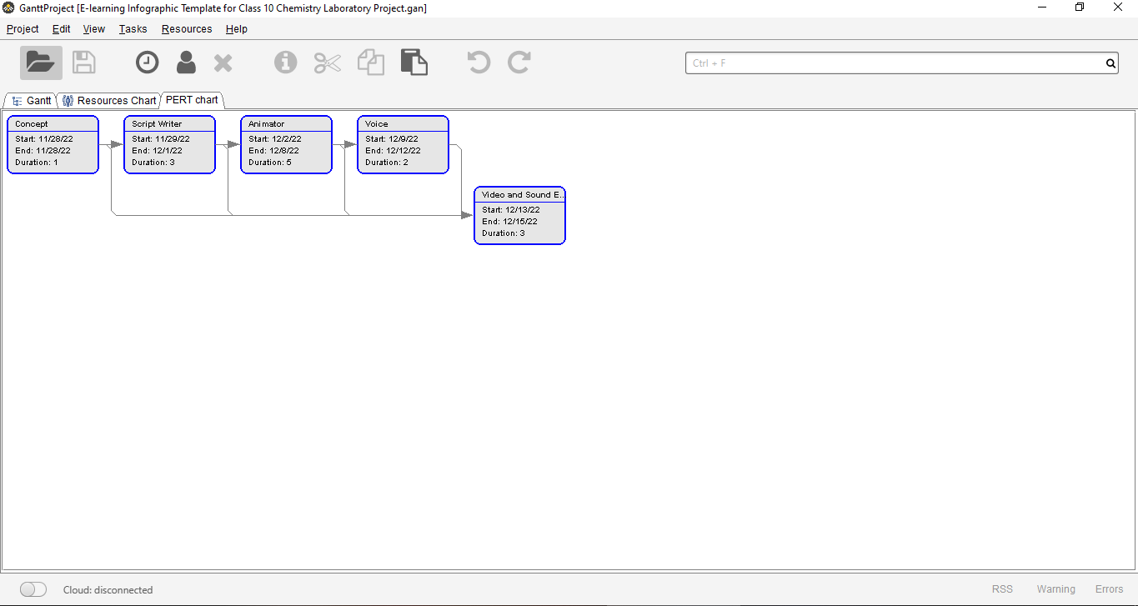
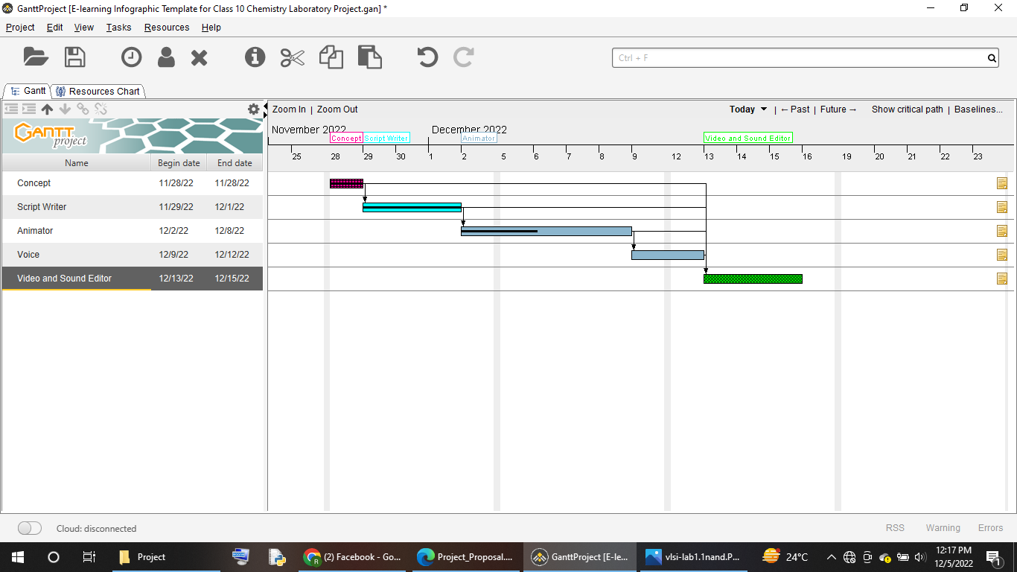
Gantt Chart
Our Gantt Project chart is a horizontal bar chart that shows a project's planned schedule and tasks or events between start and finish dates. Each bar of the Gantt chart represents a specific task, while dates are placed horizontally.

Slide 6
Script-1(Baeyers Test)
Potassium permanganate (KMnO4) solution is a purple color. When potassium permanganate reacts with an alkene the solution changes from a purple color to a brown color, and a glycol is formed. For example, potassium permanganate reacts with ethene to form ethylene glycol:
Materials we are going to use :
• Test tubes • Test tube rack • Potassium permanganate solution • Sodium carbonate solution • Acetone • Compound to be tested.
Procedure 1. Dissolve 25-30 mg of organic compound in 2 mL of water or acetone (free of alcohol). 2. Add 1% potassium permanganate solution containing an equal volume of 1% sodium carbonate solution. 3. The potassium permanganate solution is purple. If the solution turns to a brown color when potassium permanganate is added an unsaturated carbon carbon bond is present. If the solution stays purple then no unsaturated carbon carbon bond is present. Carrying out the reaction under alkaline conditions removes the possibility of confusion due to substitution in aromatic compounds. 4. This test should be confirmed with the bromine test.
Hello students, hope you guys are doing well. As you all know that chemistry is a practical based subject, so we need to understand those lab cleanly. Our visual system will help you guys in learning chemistry lab appropriately. So no more cheating in laboratory. Every student will understand the topic & can be able to apply the lab by themselves. Today we are going to learn about “ Baeyers Test ”. The baeyers test is used to test for an unsaturated carbon carbon bond, such as an alkene or alkyne, but not an aromatic carbon carbon bond.
Cool Teachers

Slide 7
Script-2(Bromine Test)
For example, we can take ethene (image showing) in a test tube as an unsaturated compound and bromine solution (image showing) in a dropper.
Now if we add this bromine solution with the ethane, we can see a colorless solution. The brown color disappears because Bromine forms an addition product with the unsaturated hydrocarbon and produce di-bromo-ethane.
H₂-C=C-H₂ + Br₂ (brown) → H₂-C (Br)-C (Br)-H₂ (colorless)
So, students hope you all can understand and enjoy the unsaturation test of hydrocarbon. See you in the next lab experiment.
Start:
A teacher speaking:
Students your favorite teacher Forhad Sir presented the “baeyers test” of unsaturation compound. Now we can confirm the unsaturation test with bromine test.
Let’s go…
We know, Bromine solution is brown. In this test when bromine solution is added to the unsaturated hydrocarbon the brown color will disappear. Bromine forms an addition product with the unsaturated hydrocarbon.
Cool Teachers

Slide 8

Animated Intro Part
This part was done by our team member “ Umme Kulsum Papri ” which will be the starting part of our visionary video.
Cool Teachers

Slide 9

Some Audio Part
This is just a demo of our recording. We will use it in further progress of our project.
Cool Teachers

Slide 10

Hindrance
Tried to add an image as background.
That didn’t work. Video was rendering without background image.

Slide 11


How this was fixed

Slide 12
Next Week Progress Proposal
To complete rest of the animation
Audio recording and merge with video
Video and audio editing

Slide 13


