Slide 1

MBTI Kaleidoscope
Collect crowdsourced MBTI perceptions for self-Insight, interpersonal reflection and fewer stereotypes
Presenter: Yuanxin Pang
Advised by John Kim

Slide 2
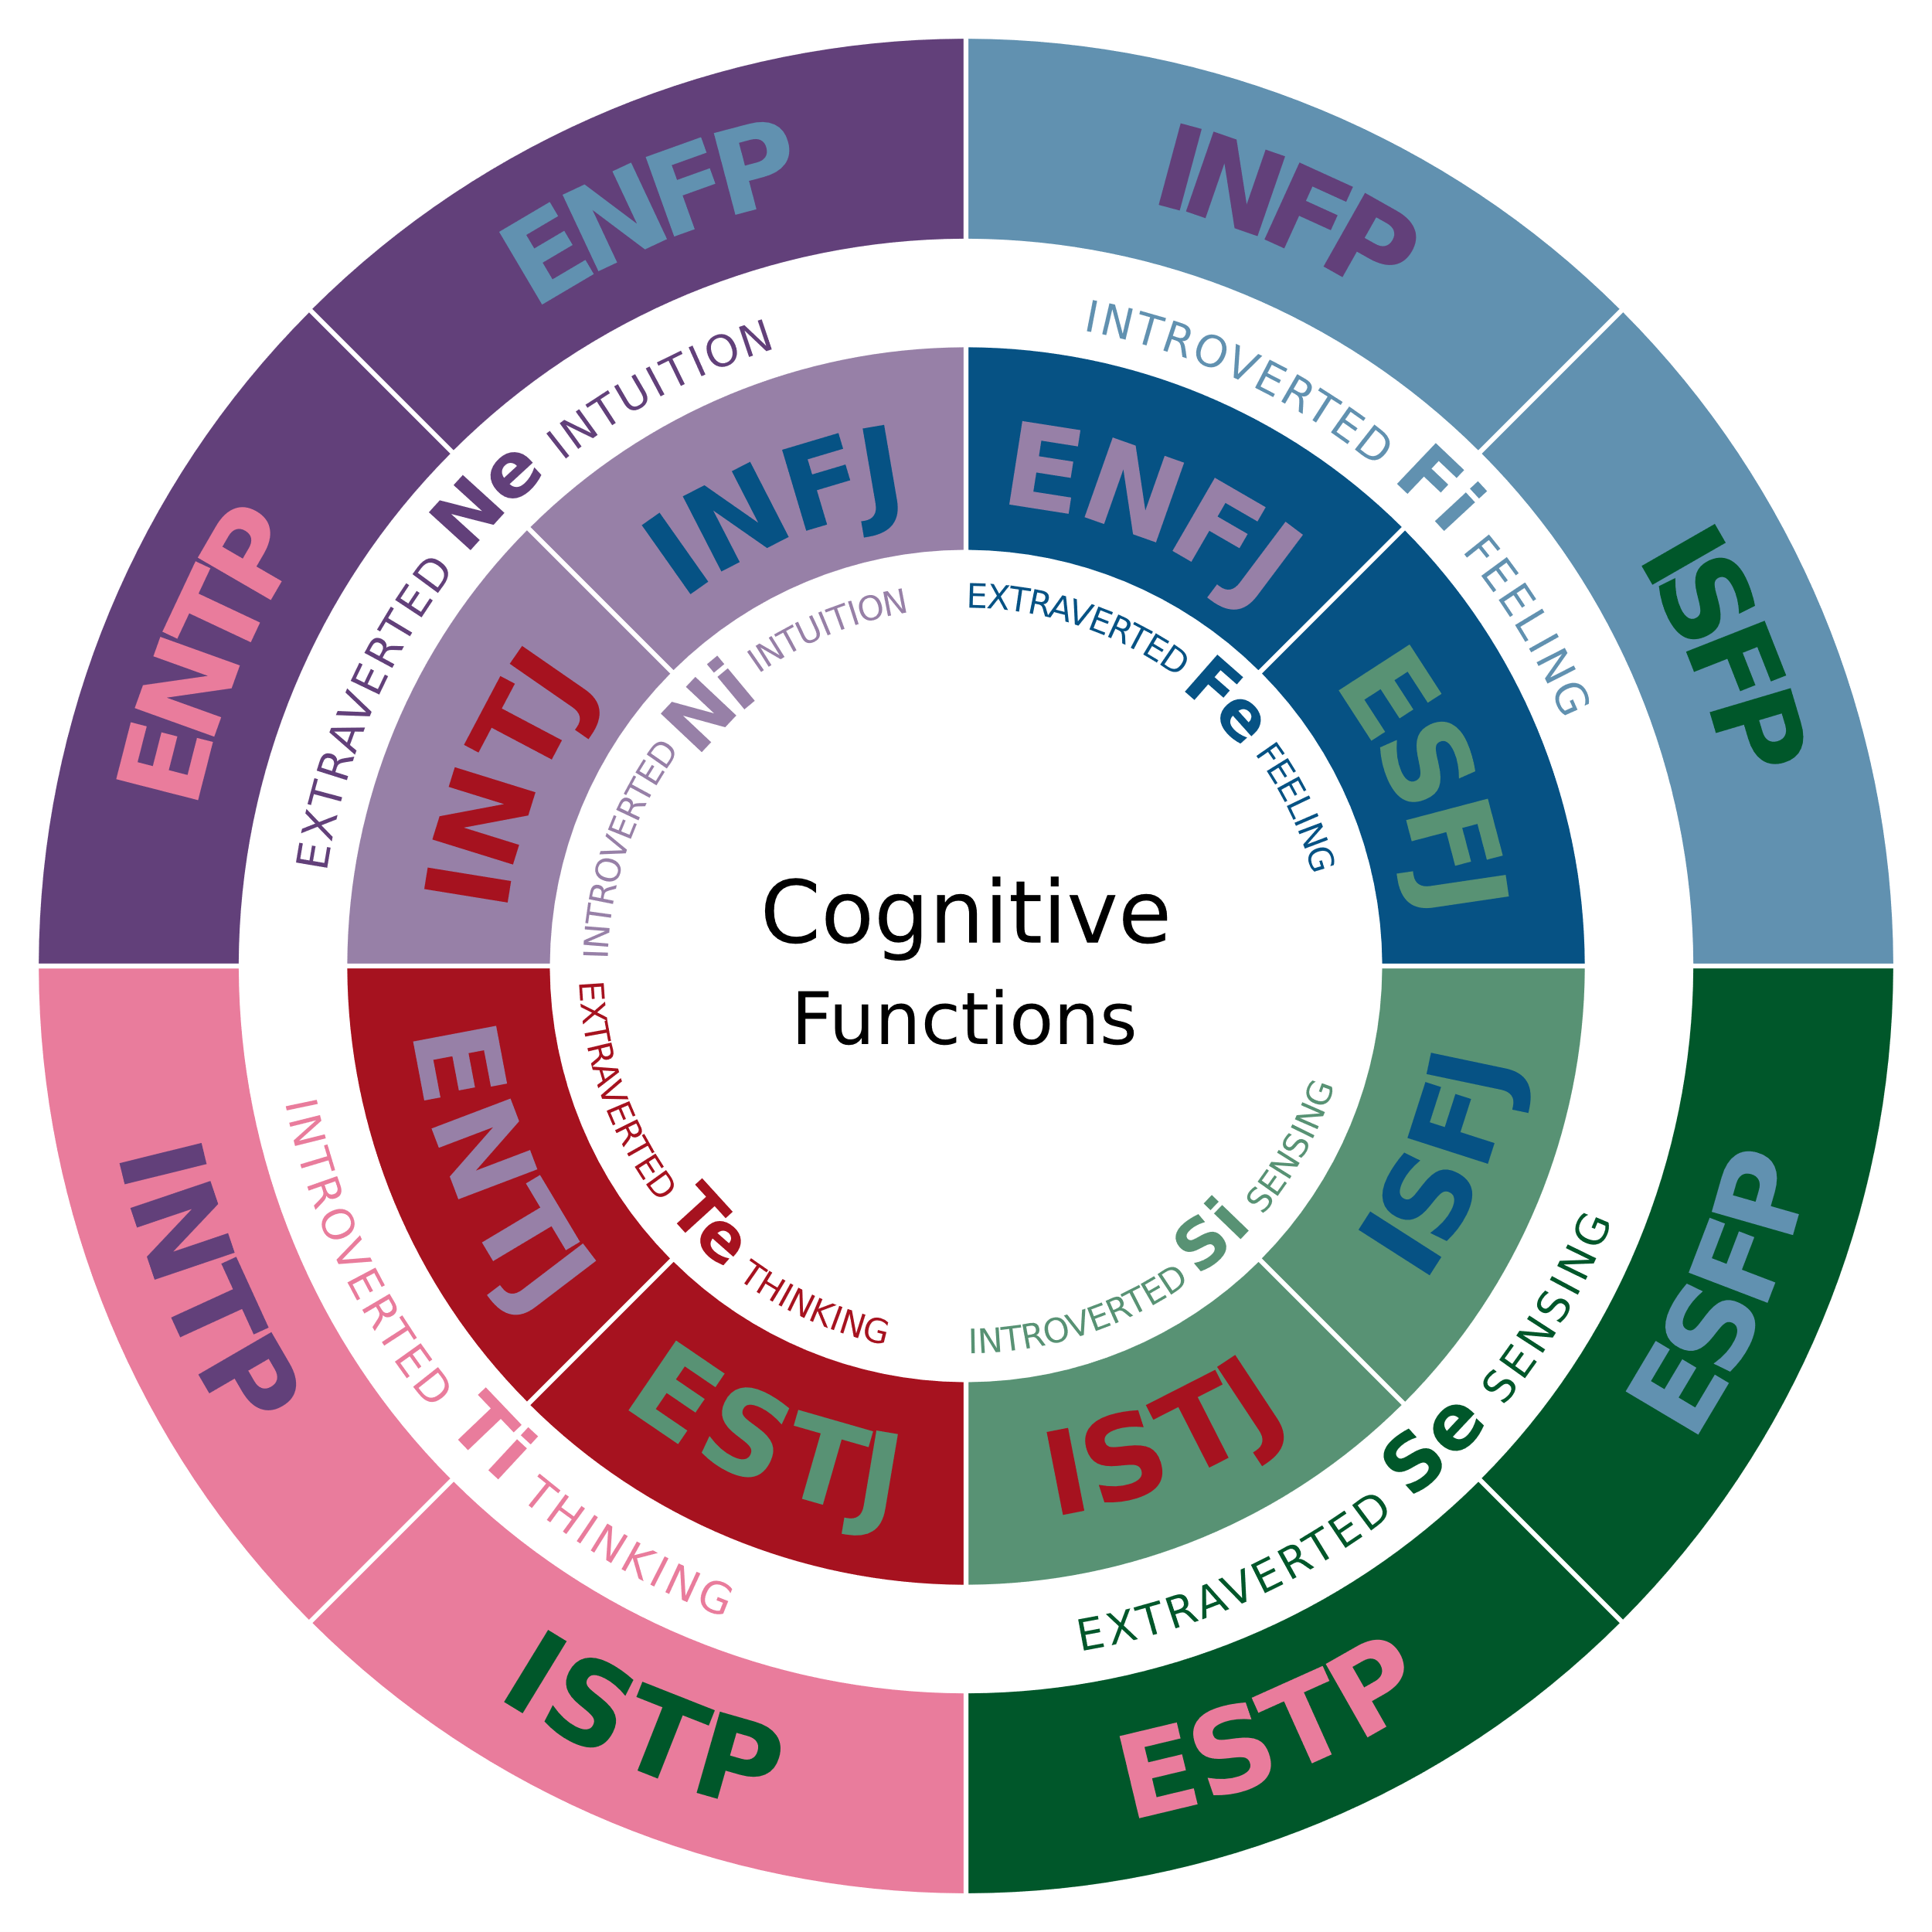


Background
MBTI (Myers–Briggs Type Indicator)
Country | Usage | Stats
USA | Common in companies & education | 80% Fortune 500 companies
South Korea | Popular among youth & dating | ~50% population tested
China | Trending on social media (Weibo) | 3.15B reads, 737K posts
Global | Widely used worldwide | More than 40102 423 responses
Statistics of MBTI usage
Type A
Type A
Self-representation
Type B
Type C
Self-assessment

Slide 3
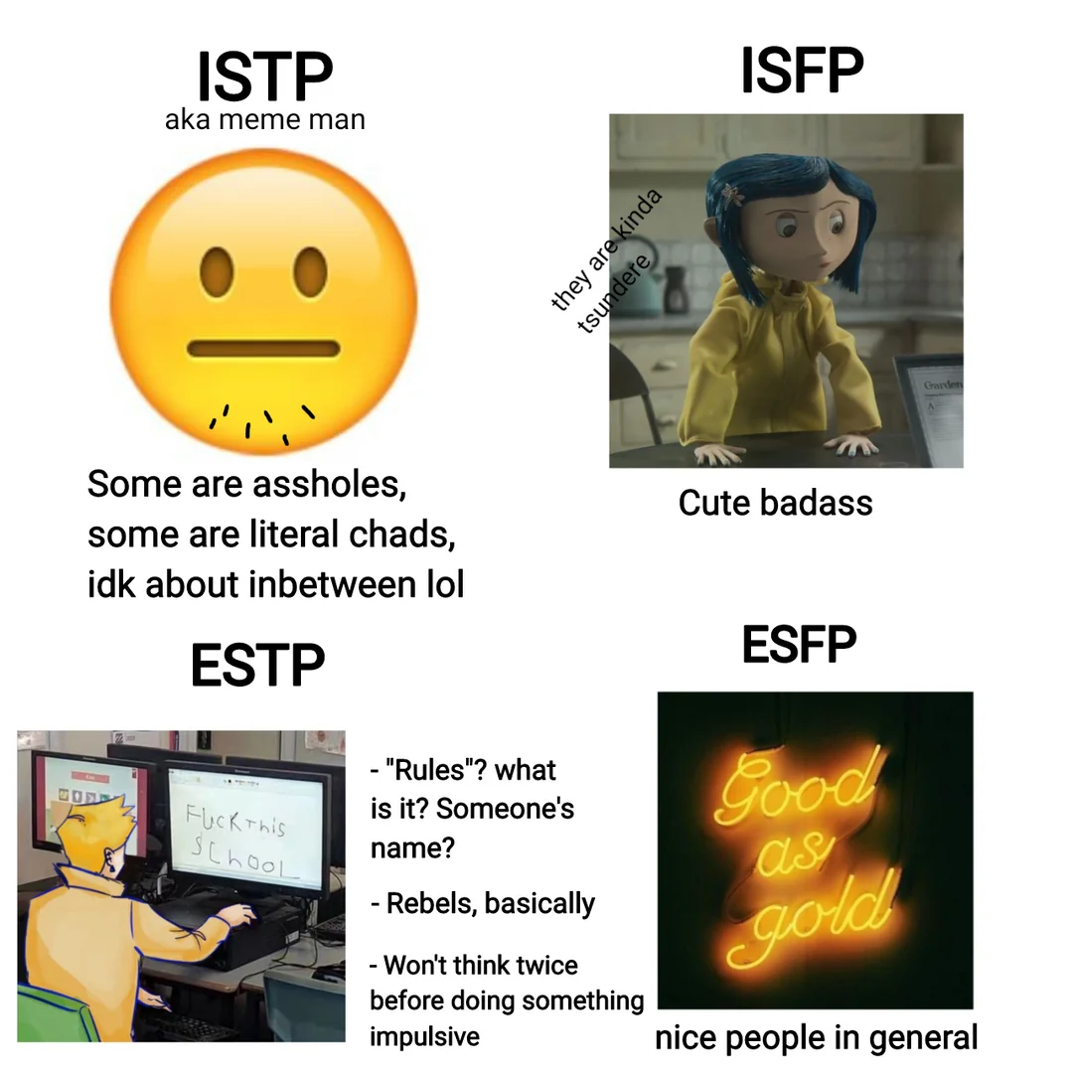
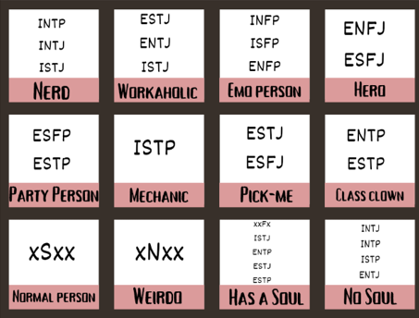
Current Problems in MBTI usage
Stereotype
Self-stereotyping
individual integrates and internalizes commonly held characterizations (i.e. stereotypes or prototypes) of an in-group into their self-concept.
Other-stereotyping
individual judges others with predefined traits of the type
Common impressions of MBTI types
Notes:
Figure: https://oiblackestsheep.tumblr.com/post/752476600558288896
[1] https://www.researchgate.net/publication/375114980_A_Study_on_the_Popularity_of_MBTI_in_Social_Media_Platform_Brings_Self-labeling_and_Group_Stereotype_to_College_Students

Slide 4
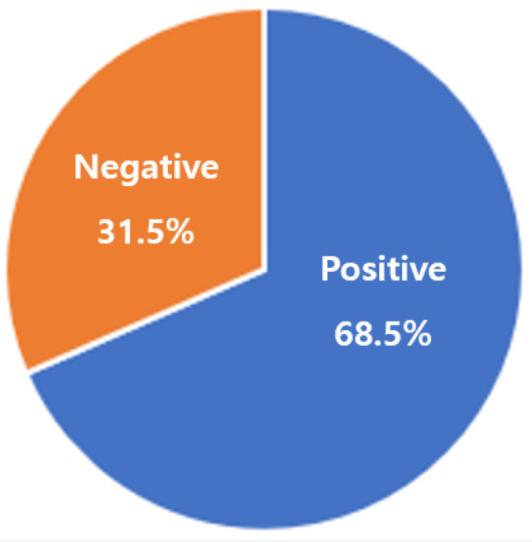
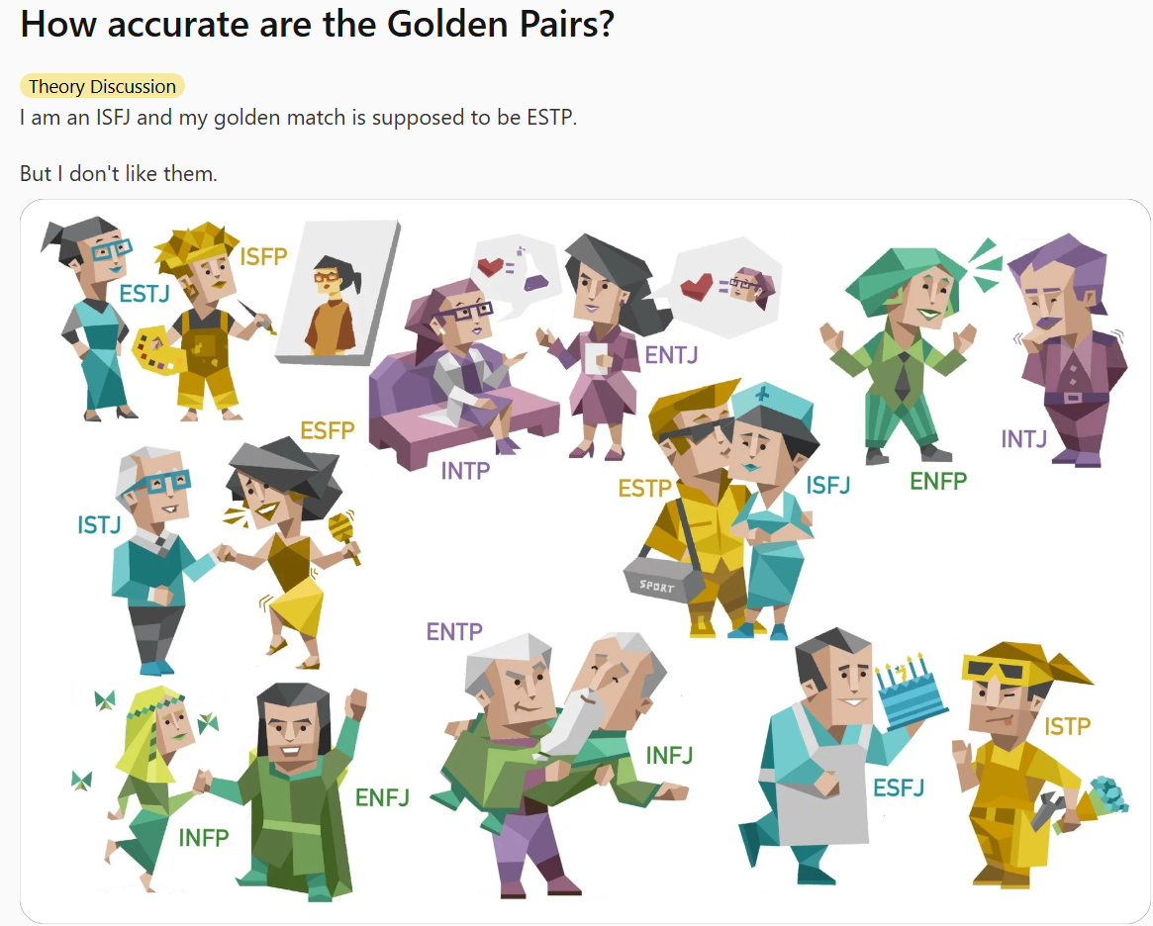
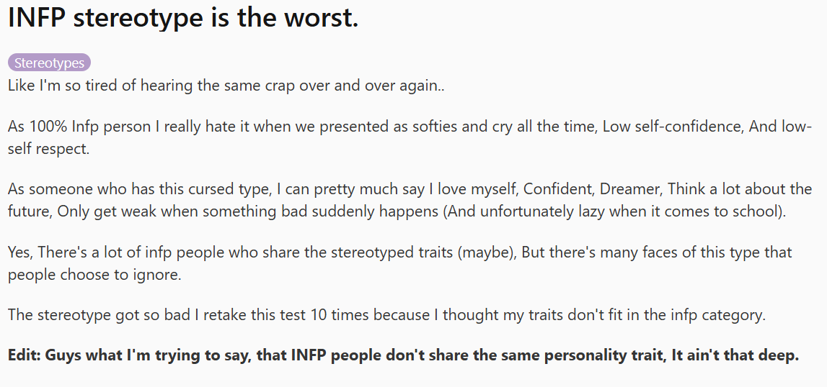
Current Problems in MBTI usage
Sentimental analysis of MBTI usage
Internal impacts
Fixed mindset; Social anxiety; Identity confusion..
External impacts
Stigmatizing others; Limiting human relationships..
Examples of stereotypes
Notes:
Figure: https://oiblackestsheep.tumblr.com/post/752476600558288896
[1] sentimental paper: https://www.mdpi.com/2071-1050/16/10/4152

Slide 5
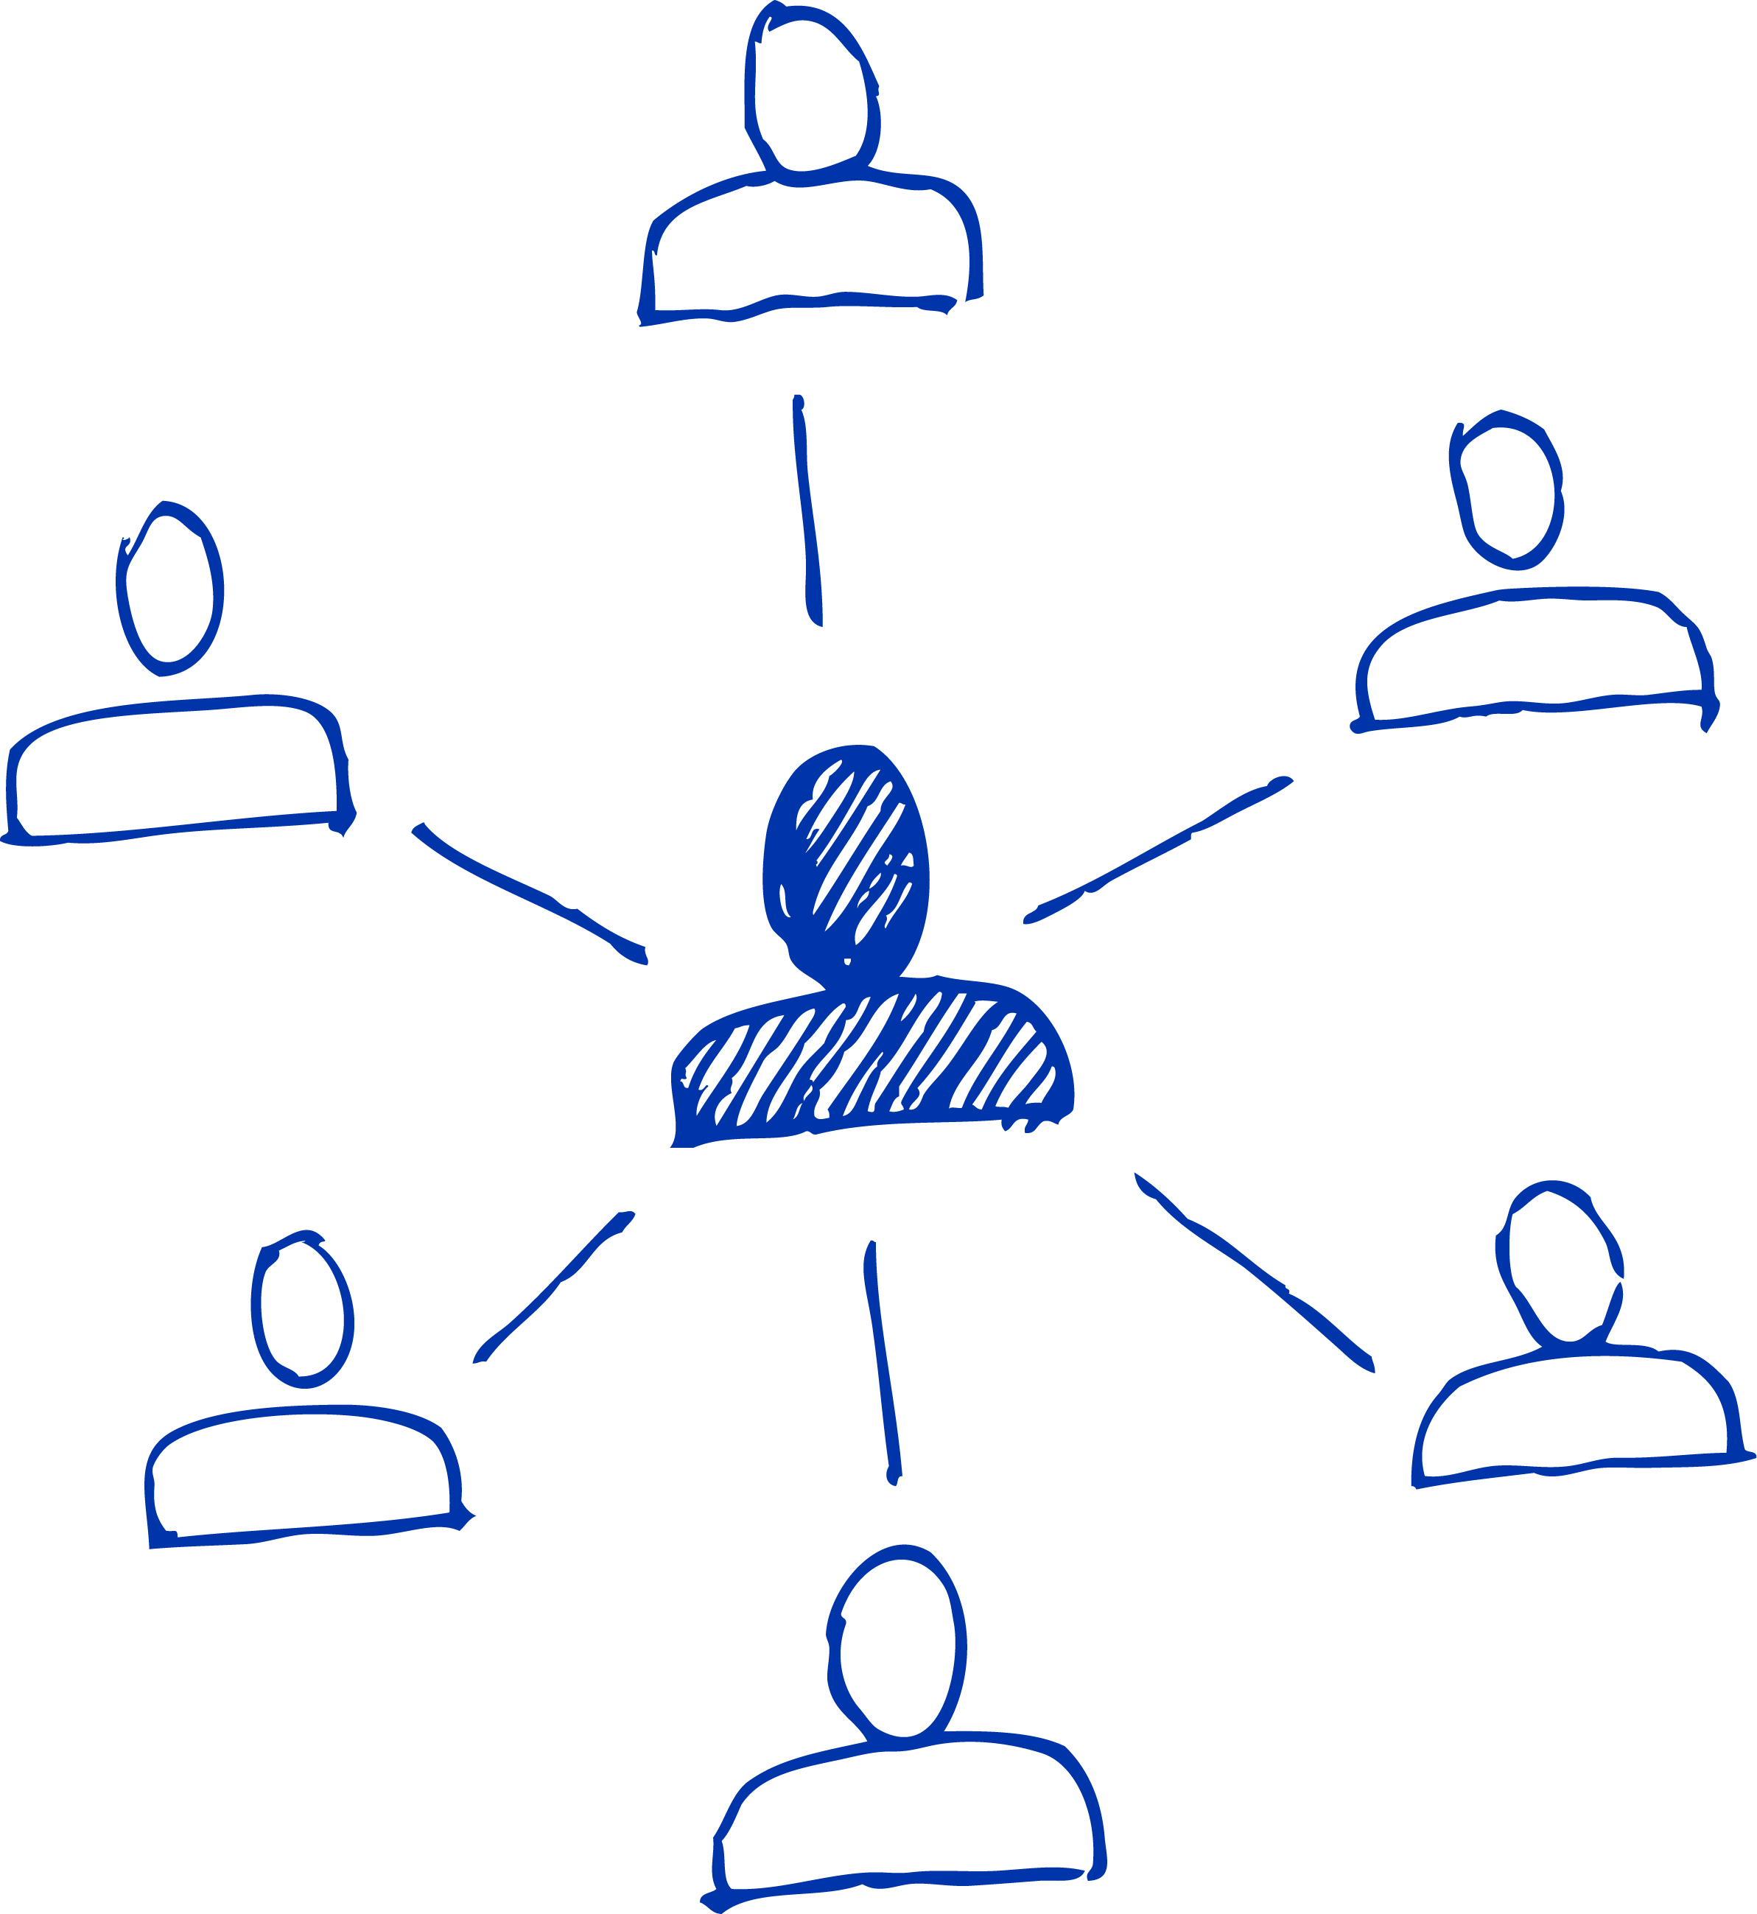
Motivation
“Avoiding stereotypes requires looking at everything in detail with a fresh perspective, not generalizing or stereotyping all problems.” -- Walter Lippmann
Proposed solution
Parents
Provide users with multiple MBTI perspectives to:
Relatives
Friends
improve meta-cognitive self-reflection
reduces self-stereotyping and other-stereotyping
improve awareness and self-perception on relationship
Boyfriend
…
Colleagues
Notes:
（1）https://monoskop.org/images/b/bf/Lippman_Walter_Public_Opinion.pdf

Slide 6
Metrics
You
Other
You
Other
You
Other
You
Other
You
Other
You
Other
You
Other

