Slide 1
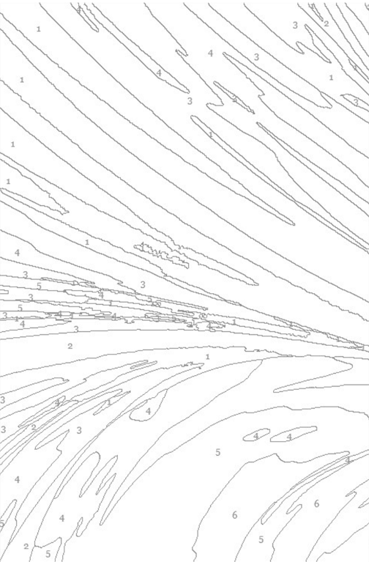

Abstract art Number-guided painting

Slide 2

Abstract swirls

Slide 3

Print then paint or color

Slide 4
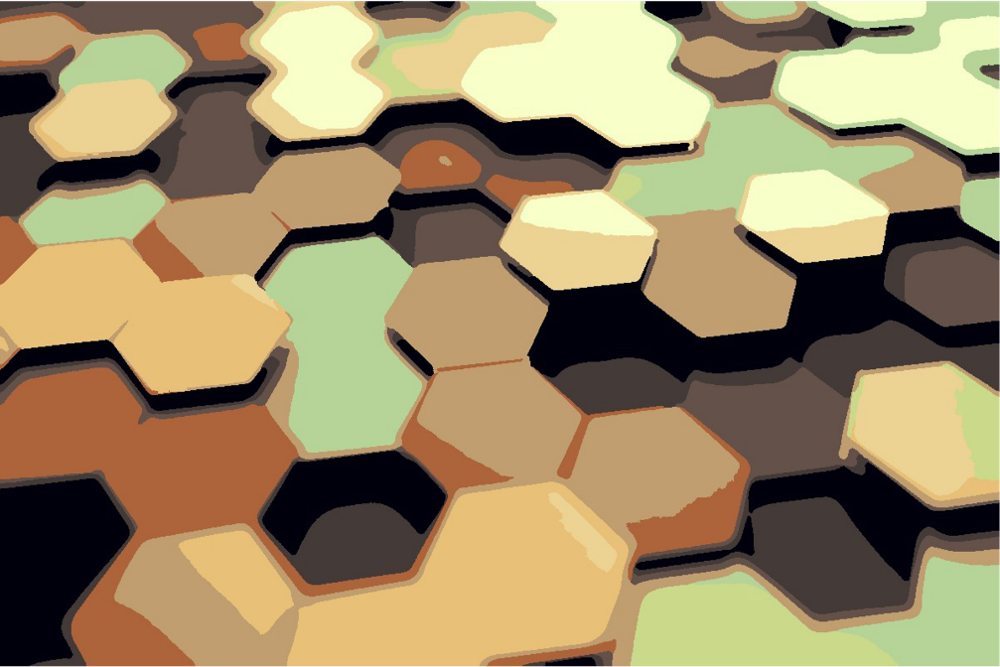
Abstract hexagons

Slide 5
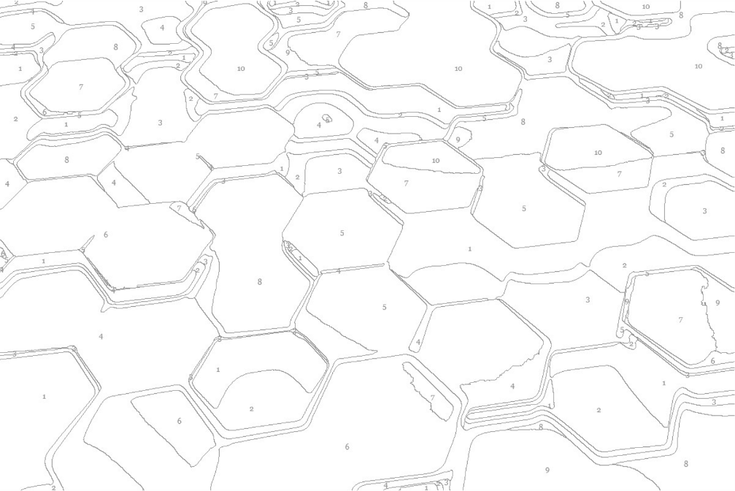
Print then paint or color

Slide 6

Abstract teardrops

Slide 7
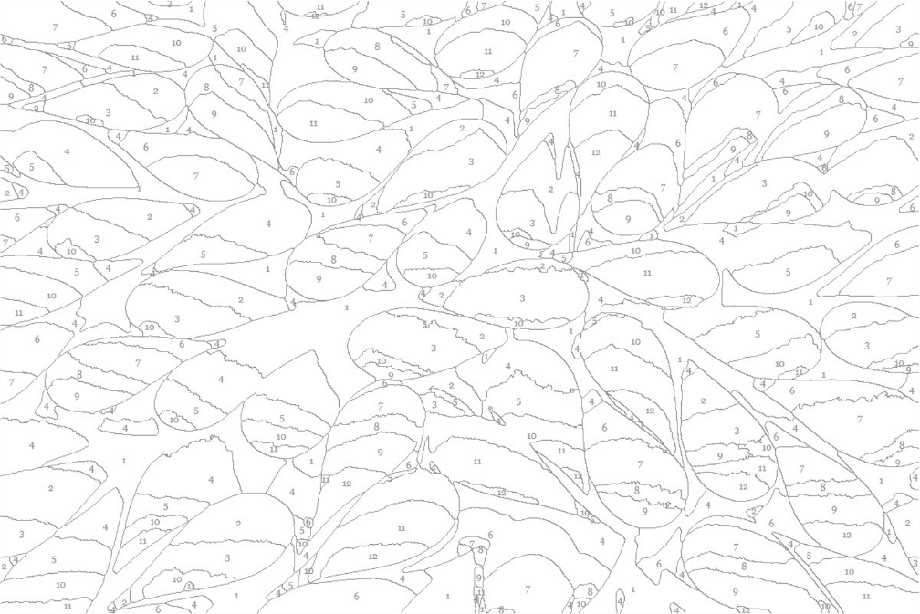
Print then paint or color

Slide 8

Abstract bokeh

Slide 9

Print then paint or color

