Slide 1

PRESENTATION TITLE
a presentation by mirjam nilsson

Slide 2

Agenda
3 | Introduction
4 | Primary goals
5 | areas of growth
10 | timeline
13 | summary

Slide 3

INTRODUCTION
At Contoso, we empower organizations to foster collaborative thinking to further drive workplace innovation. By closing the loop and leveraging agile frameworks, we help business grow organically and foster a consumer-first mindset.

Slide 4

Primary Goals
annual revenue growth

Slide 5
AREAS OF GROWTH
 | B2B | Supply chain | ROI | E-commerce
Q1 | 4.5 | 2.3 | 1.7 | 5.0
Q2 | 3.2 | 5.1 | 4.4 | 3.0
Q3 | 2.1 | 1.7 | 2.5 | 2.8
Q4 | 4.5 | 2.2 | 1.7 | 7.0

Slide 6

Business opportunities are like buses. There's always another one coming.
quote by richard branson

Slide 7



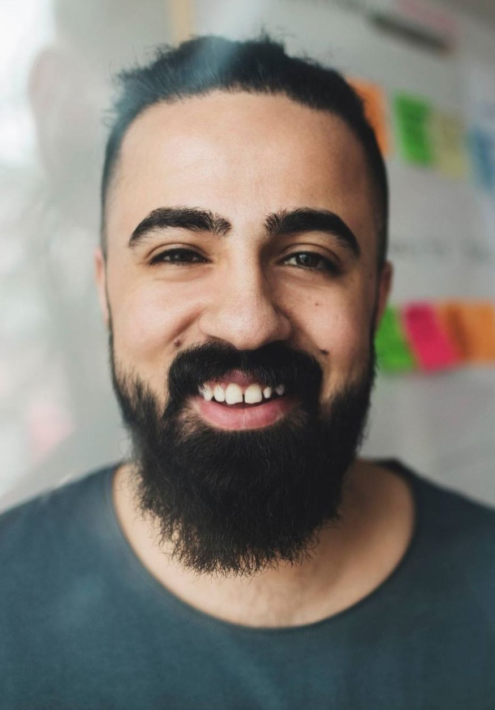
OUR TEAM
Takuma Hayashi​​
Mirjam Nilsson
Flora
Berggren
Rajesh Santoshi
president
chief operations officer
chief executive officer
vp marketing

Slide 8




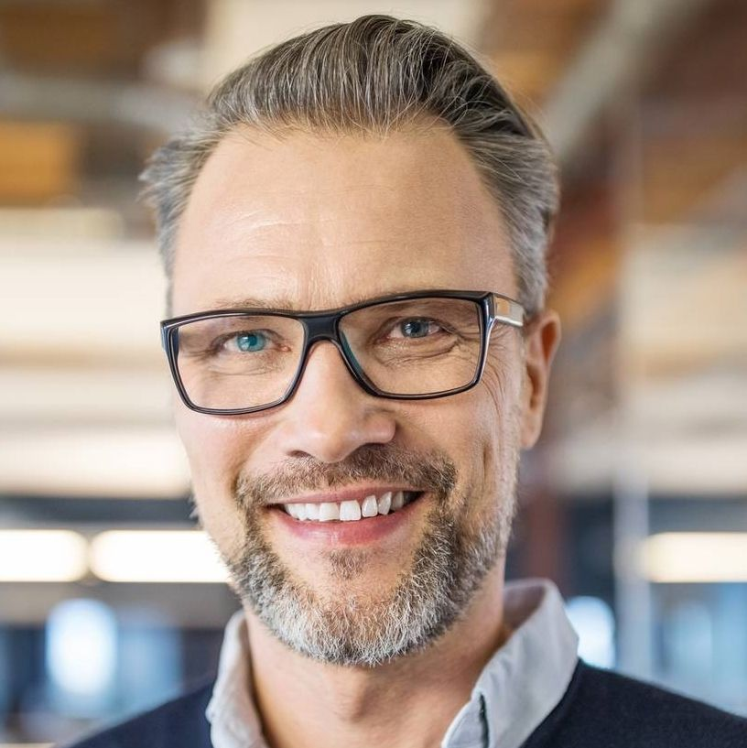



OUR Extended TEAM
Takuma Hayashi​​
Mirjam Nilsson
Flora Berggren
Rajesh Santoshi
president
chief operations officer
chief executive officer
vp marketing
Graham barnes
rowan murphy
ELIZAbeth moore
robin kline
vp product
seo strategist
product designer
content developer

Slide 9

PLANS FOR PRODUCT LAUNCH
MARKETING
STRATEGY
Disseminate standardized metrics
Foster holistically superior methodologies
2
4
DESIGN
LAUNCH
Coordinate e-business applications
Deploy strategic networks with compelling e-business needs
1
PLANNING
Synergize scalable e-commerce
3
5

Slide 10
TIMELINE
SEPT
NOV
JAN
Mar
MAY
Synergize scalable e-commerce
Disseminate standardized metrics
Coordinate e-business applications
Foster holistically superior methodologies
Deploy strategic networks with compelling e-business needs
YEAR 20XX

Slide 11

AREAS OF FOCUS
b2b market scenarios
Develop winning strategies to keep ahead of the competition
Capitalize on low-hanging fruit to identify a ballpark value
Visualize customer directed convergence
cloud-based opportunities
Iterative approaches to corporate strategy
Establish a management framework from the inside

Slide 12
HOW WE GET THERE
Envision multimedia-based expertise and cross-media growth strategies
Visualize quality intellectual capital
Engage worldwide methodologies with web-enabled technologies
ROI
Pursue scalable customer service through sustainable strategies
Engage top-line web services with cutting-edge deliverables
NICHE MARKETS
Cultivate one-to-one customer service with robust ideas
Maximize timely deliverables for real-time schemas
SUPPLY CHAINS

Slide 13
SUMMARY
At Contoso, we believe in giving 110%. By using our next-generation data architecture, we help organizations virtually manage agile workflows. We thrive because of our market knowledge and great team behind our product. As our CEO says, "Efficiencies will come from proactively transforming how we do business."

Slide 14

THANK YOU
MIRJAM NILSSON
mirjam@contoso.com
www.contoso.com

