Slide 1


PRESENTATION
Title
By Mirjam Nilsson

Slide 2

Agenda
INTRODUCTION
PRIMARY GOALS
AREAS OF GROWTH
TIMELINE
SUMMARY

Slide 3
INTRODUCTION
At Contoso, we empower organizations to foster collaborative thinking to further drive workplace innovation. By closing the loop and leveraging agile frameworks, we help business grow organically and foster a consumer-first mindset.
INTRODUCTION

Slide 4


PRIMARY
GOALS
Annual Revenue Growth

Slide 5
Areas of growth
 | B2B | SUPPLY CHAIN | ROI | E-COMMERCE
Q1 | 4.5 | 2.3 | 1.7 | 5.0
Q2 | 3.2 | 5.1 | 4.4 | 3.0
Q3 | 2.1 | 1.7 | 2.5 | 2.8
Q4 | 4.5 | 2.2 | 1.7 | 7.0

Slide 6
Success is the sum of small efforts - repeated day in and day out.
“
”
Robert Collier

Slide 7




Meet our team
Takuma HAYASHI​
MIRJAM NILSSON​
President
Chief Executive Officer
FLORA BERGGREN​
RAJESH SANTOSHI​
Chief Operations Officer
VP Marketing

Slide 8



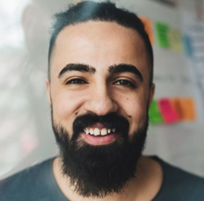
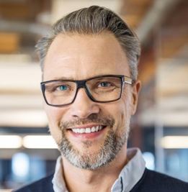
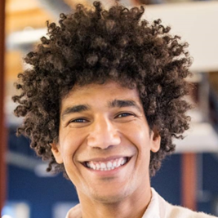


Meet our extended team
Takuma HAYASHI​
MIRJAM NILSSON​
FLORA BERGGREN​
RAJESH SANTOSHI​
President
Chief Executive Officer
Chief Operations Officer
VP Marketing
GRAHAM BARNES
ROWAN MURPHY
ELIZABETH MOORE
ROBIN KLINE
VP Product
CEO Strategist
Product Designer
Content Developer

Slide 9
Plan for product launch
Deploy strategic networks with compelling e-business needs
PLANNING
Synergize scalable e-commerce
MARKETING
Disseminate standardized metrics
DESIGN
Coordinate e-business applications
Foster holistically superior methodologies
LAUNCH
STRATEGY

Slide 10
Timeline
Synergize scalable e-commerce
Disseminate standardized metrics
Coordinate e-business applications
Foster holistically superior methodologies
Deploy strategic networks with compelling e-business needs
SEPTEMBER 20XX
NOVEMBER 20XX
JANUARY 20XX
MARCH 20XX
MAY 20XX

Slide 11
Areas of focus
B2B MARKET SCENARIOS
Develop winning strategies to keep ahead of the competition
Capitalize on low-hanging fruit to identify a ballpark value
Visualize customer directed convergence
CLOUD-BASED OPPORTUNITIES
Iterative approaches to corporate strategy
Establish a management framework from the inside

Slide 12
How we get there
ROI
NICHE MARKETS
SUPPLY CHAINS
Envision multimedia-based expertise and cross-media growth strategies
Visualize quality intellectual capital
Engage worldwide methodologies with web-enabled technologies
Pursue scalable customer service through sustainable strategies​
Engage top-line web services with cutting-edge deliverables
Cultivate one-to-one customer service with robust ideas​
Maximize timely deliverables for real-time schemas

Slide 13
SUMMARY
At Contoso, we believe in giving 110%. By using our next-generation data architecture, we help organizations virtually manage agile workflows. We thrive because of our market knowledge and great team behind our product. As our CEO says, "Efficiencies will come from proactively transforming how we do business."​
SUMMARY

Slide 14


THANK
YOU
Mirjam Nilsson
mirjam@contoso.com
www.contoso.com

