Slide 1
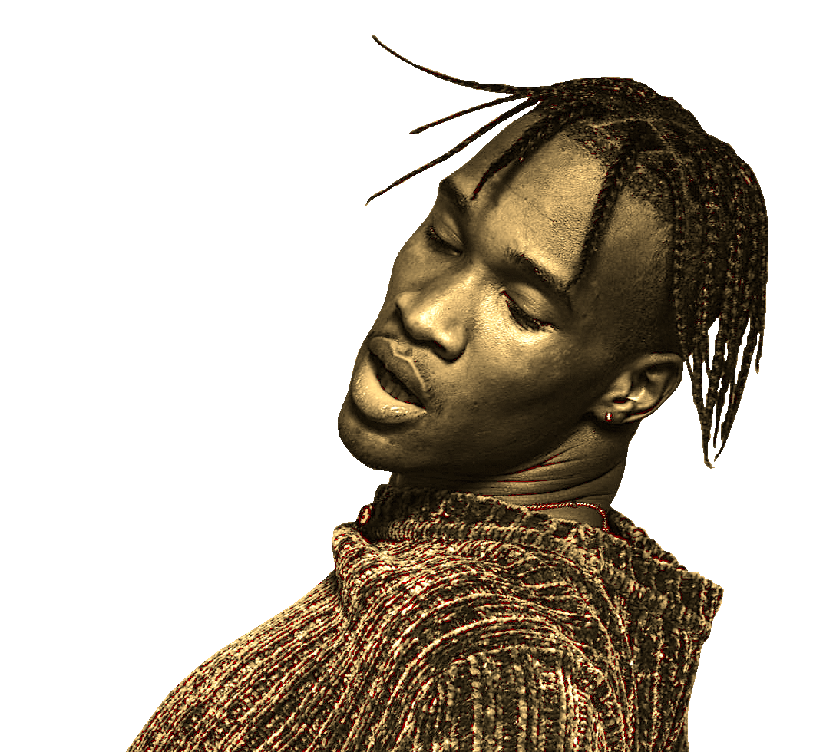

artist
ELECTRONIC DANCE MUSIC BY DANIEL MELAMEd
Portfolio

Slide 2
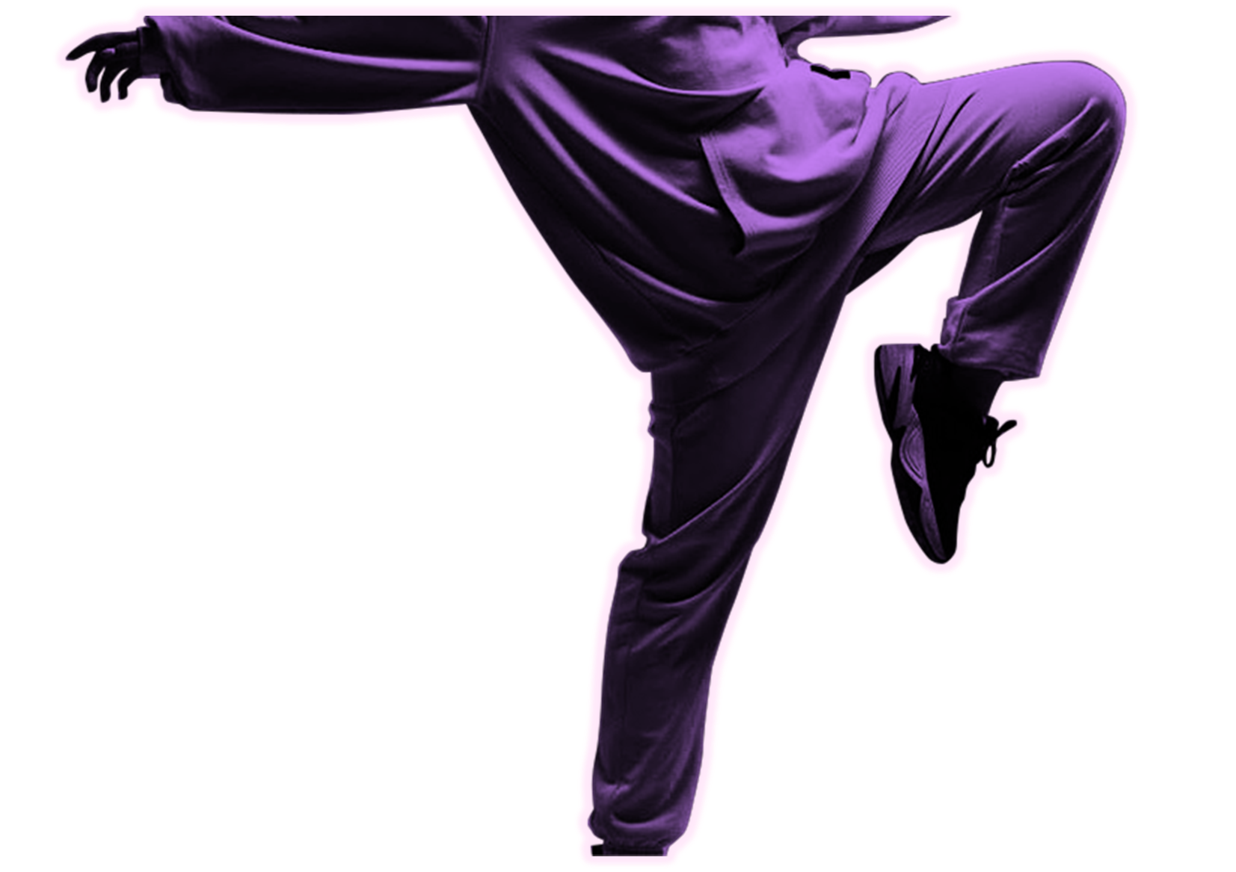
CONTENTS
About Me
Streaming Stats
Meet our team
Products & Services
Tour Dates

Slide 3
ABOUT ME
As an EDM artist, I'm inspired by my fans to think constantly about the future landscape of electronic music and where I fit in. By staying involved with the festival circuit and maintaining an active presence on social media, I'm able to create organically for me and my fans which helps me foster a genuine creator-listener relationship.

Slide 4

stats
1.3 million streams globally
Streaming

Slide 5
INTERNATIONAL STREAMING
 | Platform Red | Platform Green | Platform Blue | Platform Purple
N. & S. AMERICAS | 4.5 | 2.3 | 1.7 | 5.0
EUROPE | 3.2 | 5.1 | 4.4 | 3.0
ASIA | 2.1 | 1.7 | 2.5 | 2.8
AFRICA | 4.5 | 2.2 | 1.7 | 7.0

Slide 6
Where words fail, Music speaks.
Hans Christian Andersen

Slide 7
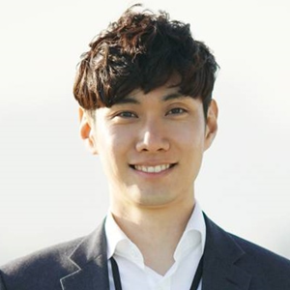
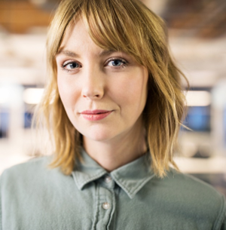
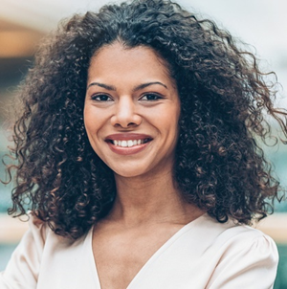
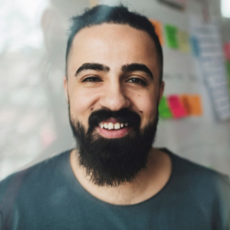
team
Meet our
Takuma Hayashi​
Mirjam Nilsson​
Manager
Public Relations
Flora Berggren​
Rajesh Santoshi​
Producer
Assistant Producer

Slide 8
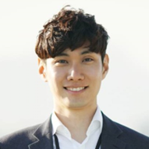
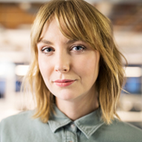

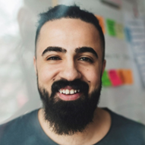
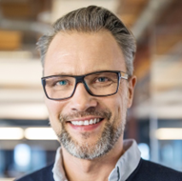
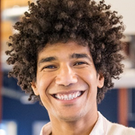

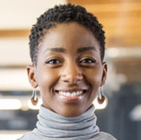
MEET OUR EXTENDED TEAM
Takuma Hayashi
Mirjam Nilsson​
Flora Berggren​
Rajesh Santoshi​
Manager
Public Relations
Producer
Assistant Producer
Graham Barnes
Rowan Murphy
Elizabeth Moore
Robin Kline
Sound Engineer
Lighting Engineer
Photographer
Videographer

Slide 9
Products
T-shirts
Albums
Digital download
Recording Services
Studio rental
Private Events
Full set-up & breakdown
30-60 min set
Merchandise
Public Events
Vinyl records
CDs
Sound engineering
Pro production
60-120 min set
Meet the artist
Meet the artist
Swag bags
Hats
Posters
And services

Slide 10
TOUR DATES
Sep. 2023
San Francisco, CA
Nov. 2023
Chicago, IL
Jan. 2024
New Orleans, LA
Mar. 2024
Atlanta, GA
May 2024
New York City, NY

Slide 11
Tour
Opening bands
Trash Panda and the Garbage Bags
Hearts and a Bottle
My Gazer Romance
Featured artists
Details
Hailey Clark
Juan Morgan
Nikola Janu

Slide 12



How to
Online
Visit www.greatsiteaddress.com to buy your tickets​
Create a username and password​
Select from general, floor, or box seats
Box Office
get your tix
Visit your local box office to purchase your tickets
Use code DANMEL at the window for 10% off
Sweepstakes
Follow all our social media accounts
Post a video of you singing one of our songs
Tag our accounts for a chance to win free tickets

Slide 13
YOUR CITY
COMING TO
Make sure to follow Daniel Melamed on social media to catch all the newest updates on tours, new music, and more.
Thanks for checking out my site and can't wait to see you at the next show!

Slide 14
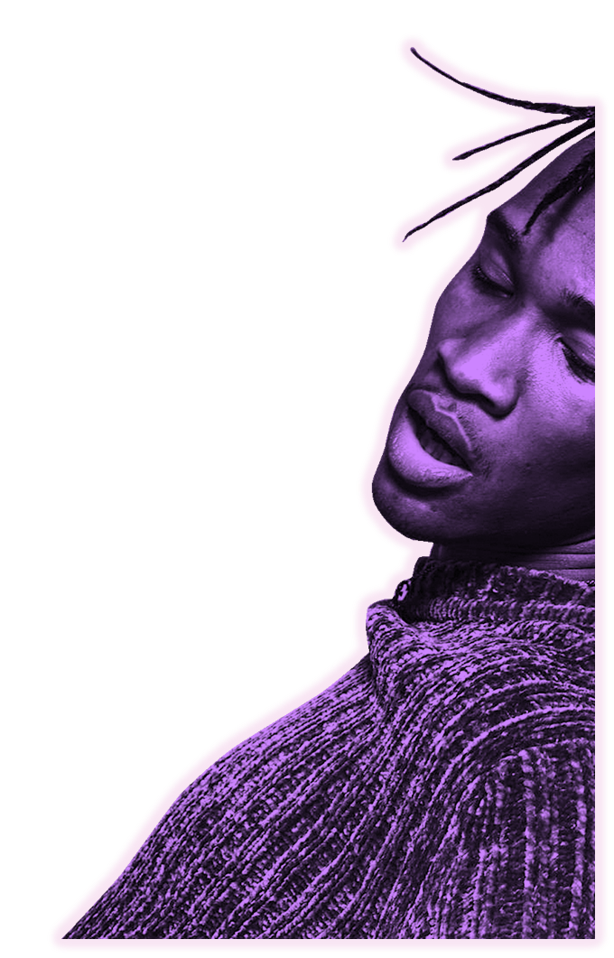
Contact
Daniel Melamed daniel@greatsiteaddress.comwww.greatsiteaddress.com

