Slide 1

Family means forever.

Slide 2



Slide 2

Slide 3
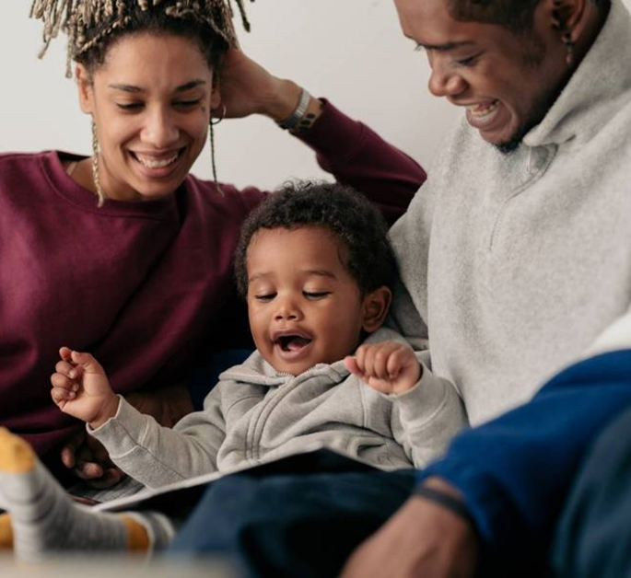

Slide 3

Slide 4
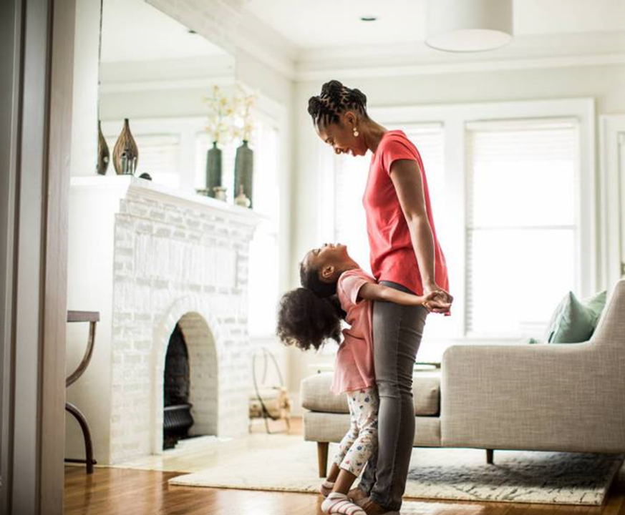
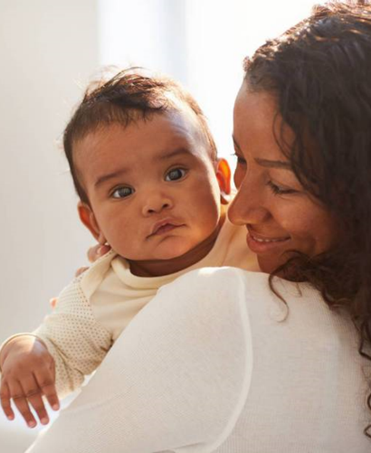
Slide 4

Slide 5



Slide 5

Slide 6
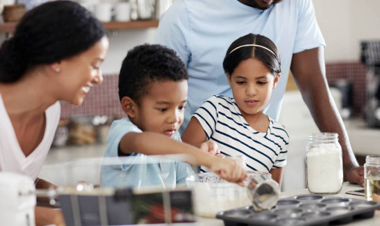

Slide 6

Slide 7
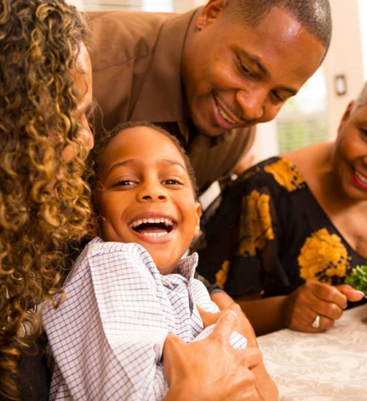

Slide 7

Slide 8


Slide 8

Slide 9



Slide 9

Slide 10


Slide 10

Slide 11

The end.

