Slide 1

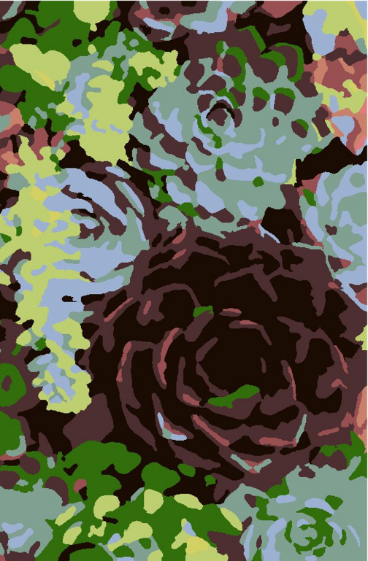
Succulents number-guided painting

Slide 2
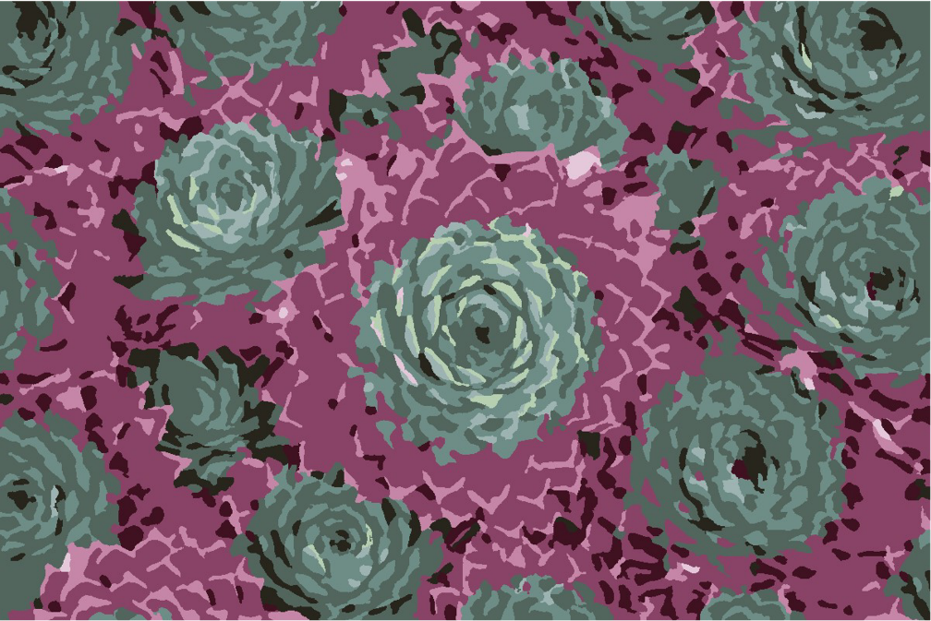
Echevaria plant

Slide 3

Print then paint or color

Slide 4
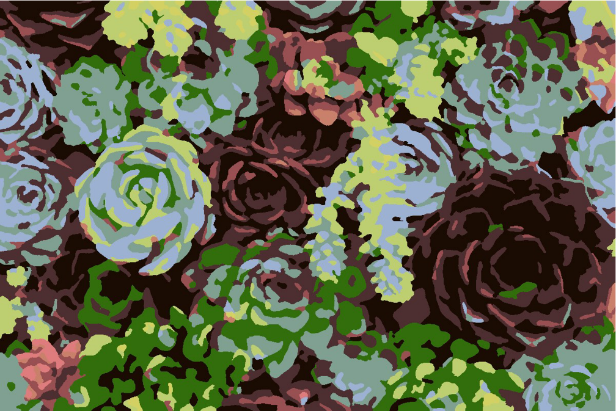
Succulent mix

Slide 5

Print then paint or color

Slide 6

Agave plant

Slide 7

Print then paint or color

Slide 8

Agave leaves

Slide 9
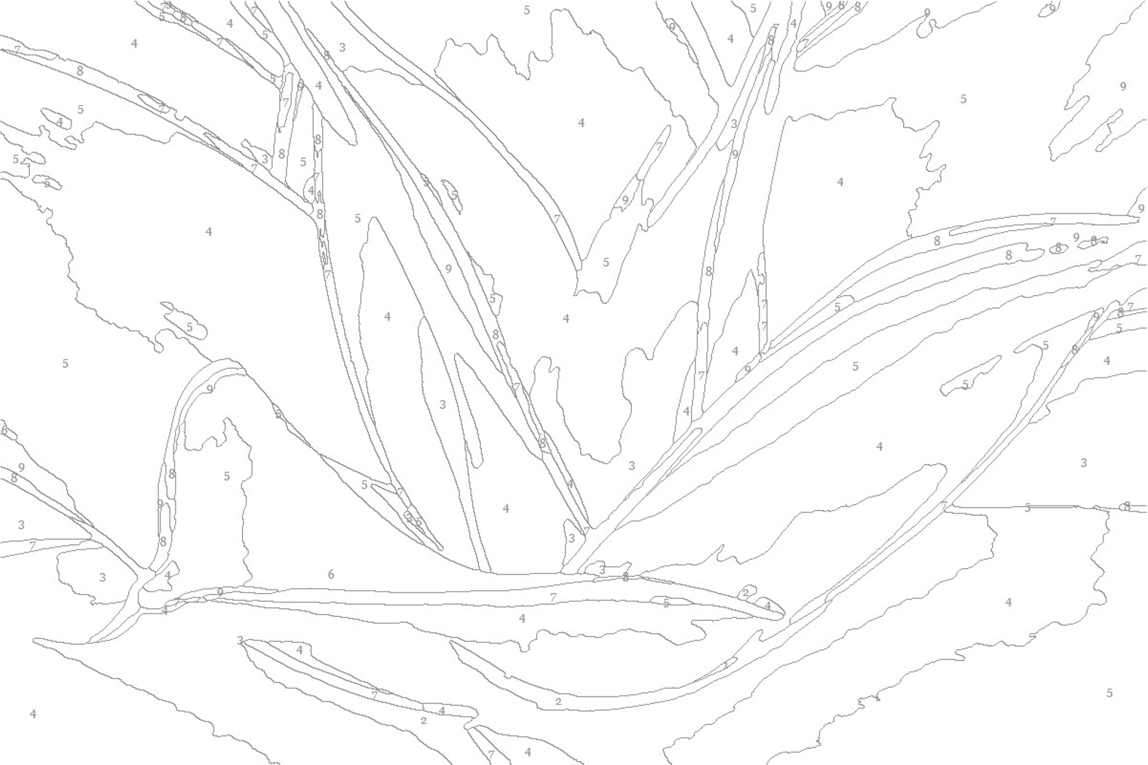
Print then paint or color

