Slide 1

Contoso & Contoso
We are committed to protecting your rights and fighting for justice.
Contact
4567 Main St
Buffalo, NY 98052
555-0100
info@contoso.com
www.contoso.com
PARTNERS AT LAW

Slide 2


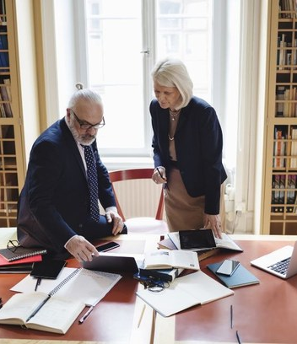
Our team
Our services
Contoso and Contoso offers a comprehensive range of legal services tailored to meet the unique needs of individuals and businesses. From corporate law to family law, real estate to intellectual property, our firm has the knowledge and resources to handle complex legal issues.
We can help
At Contoso and Contoso, we take pride in our exceptional team of legal professionals who provide top-notch representation and personalized solutions to our clients.
Navigating the legal landscape can be overwhelming, but you don't have to face it alone. We are here to help you through every step of your legal journey. Our team of attorneys will listen to your concerns, provide clear explanations of your options, and guide you towards the most favorable resolution.

Slide 3
Contoso & Contoso
We can help
Whether you require expert legal advice, contract drafting and negotiation, dispute resolution, or representation in court, our skilled attorneys will provide strategic guidance and dedicated advocacy to protect your interests and achieve the best possible outcomes.
With our unwavering commitment to excellence and client satisfaction, you can trust us to handle your legal matters with the utmost professionalism and care.
Contact
4567 Main St
Buffalo, NY 98052
555-0100
info@contoso.com
www.contoso.com
PARTNERS AT LAW

Slide 4
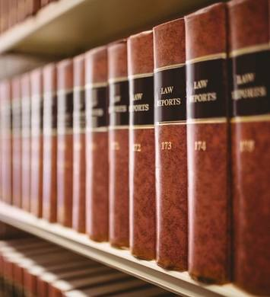
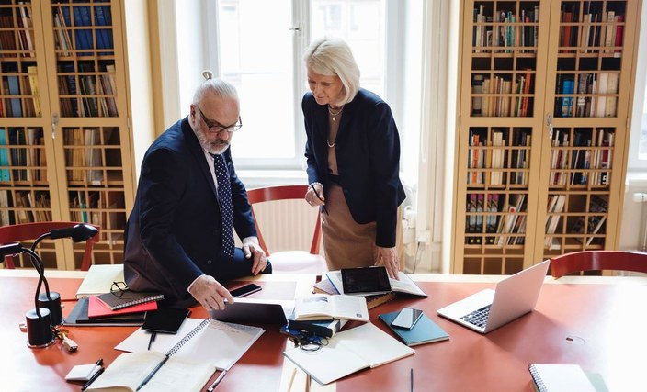
Our team
Our areas of practice​
Our experienced attorneys provide expert guidance and representation, ensuring that your business, family, and intellectual property interests are protected with utmost care and professionalism.
We offer comprehensive legal services in corporate law, family law, and intellectual property.
Comprehensive legal counsel to businesses of all sizes
Family-related legal issues, including divorce, child custody, adoption, prenuptial agreements, and domestic violence matters
Trademarks, copyrights, patents, licensing agreements, and trade secrets
Our attorneys leverage their extensive knowledge and expertise to deliver innovative legal strategies while maintaining a strong focus on client satisfaction. With Contoso and Contoso, you can trust that your legal matters are in capable hands.

