Slide 1
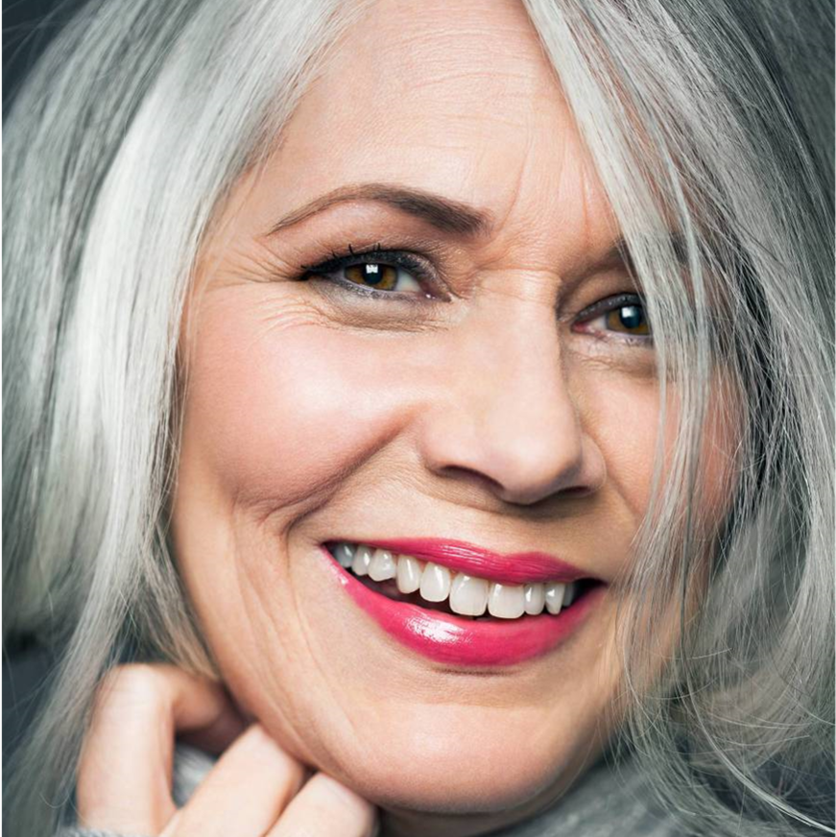
Celebrating
The life of
IRIS
LEPEK

Slide 2
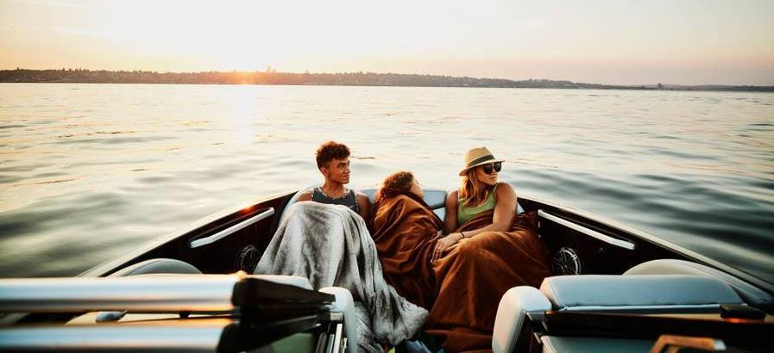
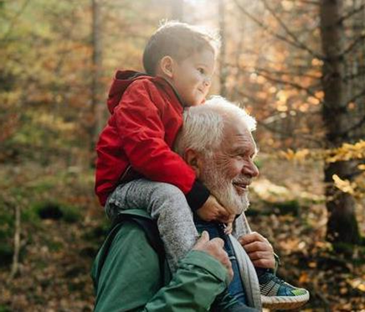
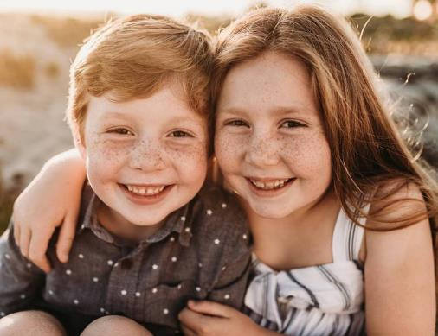
Iris’s
Childhood
Growing up on Lake Michigan, Iris developed an early love of the outdoors. She spent many days out on the water with friends and family.

Slide 3
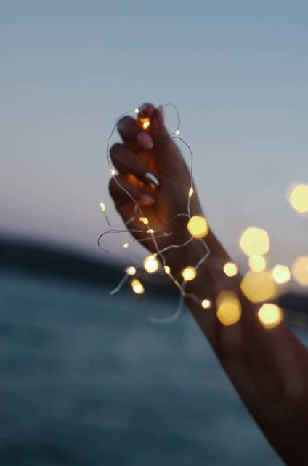
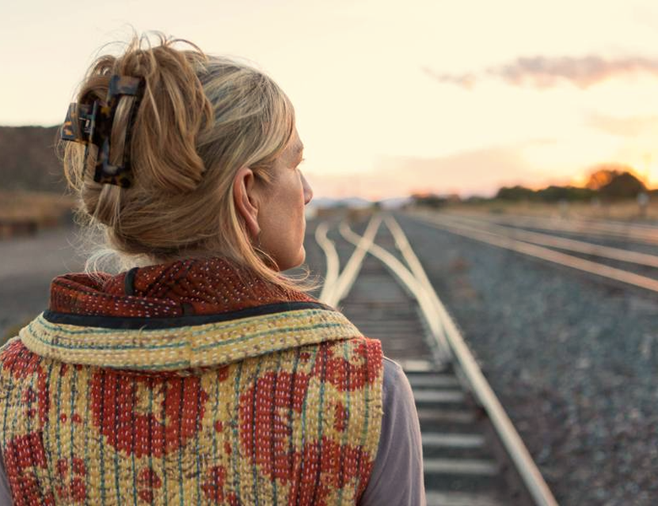
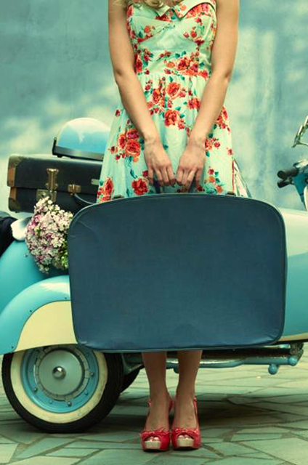
Slide 3
Building on her love of adventure, Iris was also an avid traveler. She loved to visit new and exciting places and meet all kinds of people.
Over her lifetime she visited 56 countries and 6 out of 7 continents, making her the most well-traveled member of our family.

Slide 4
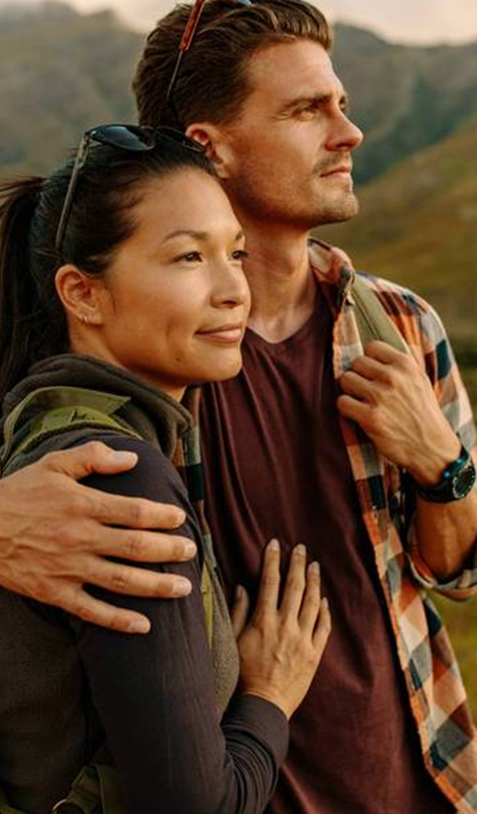
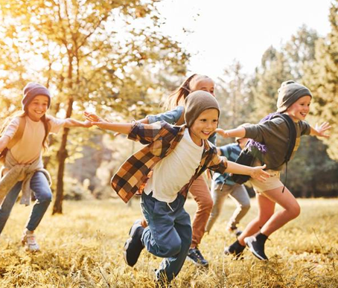
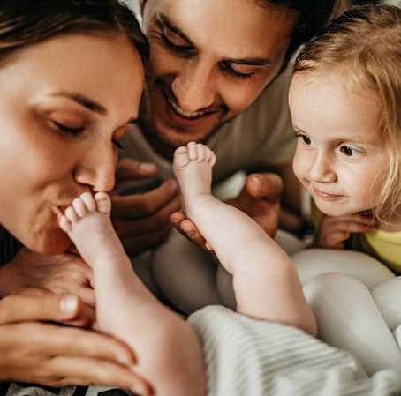
Iris’s
Family
Iris was born on May 6th, 1936, to her father Donald and mother Iris, her namesake. She is survived by her two younger sisters, Elizabeth and Sarah, and their children.

Slide 5
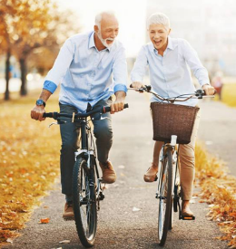
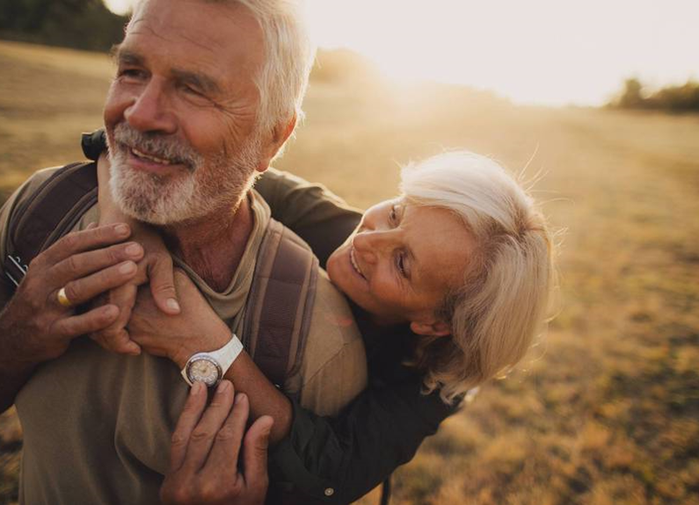
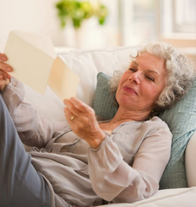
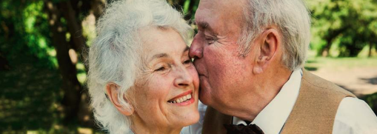
Slide 5
Iris met Henry in the fall of 1955 at Jasper University, where they both attended school. Henry asked Iris to marry him the following year and they were married in the spring of 1957.
The two were married for 61 years before Henry's passing. Her love for him never faded, and she kept him alive through her memories.

Slide 6
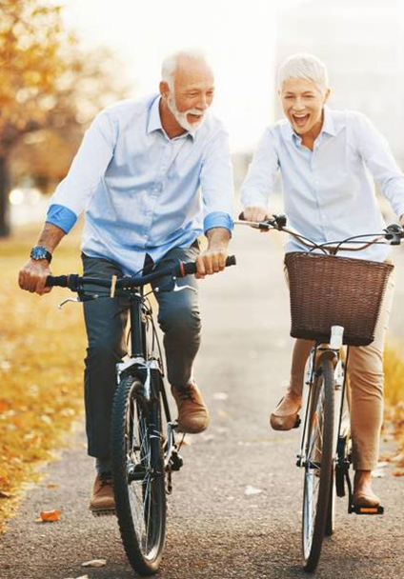
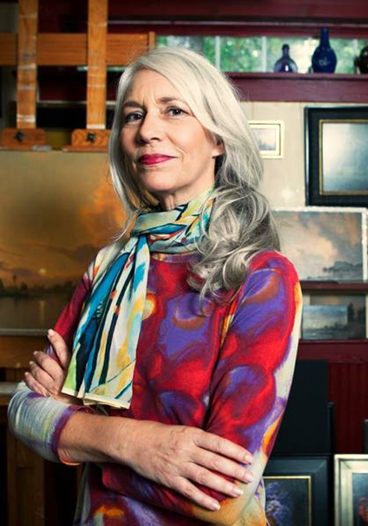
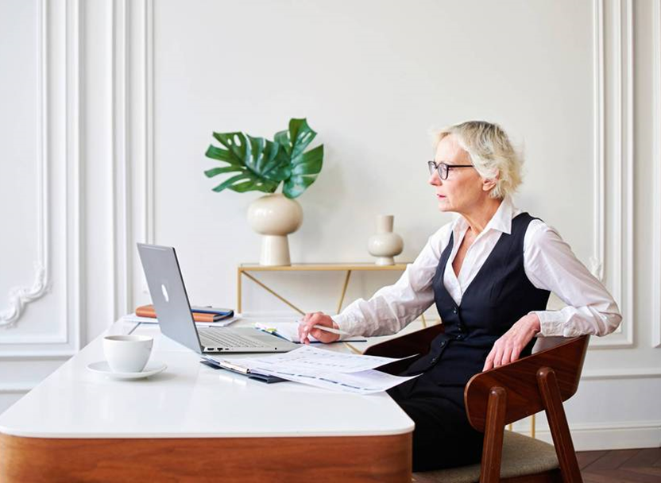
Iris’s
Along with traveling and adventuring outdoors, Iris loved to challenge herself. At 55 years old she taught herself how to surf, took up oil painting, and traded her car for a bicycle to ride to work every day.
HOBBIES

Slide 7
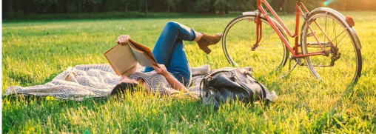
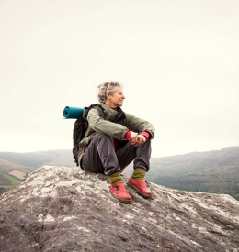
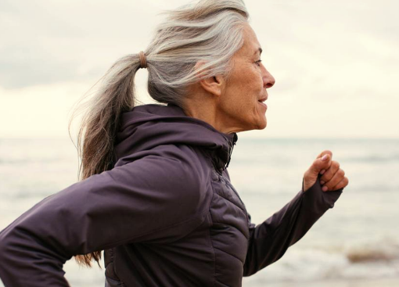
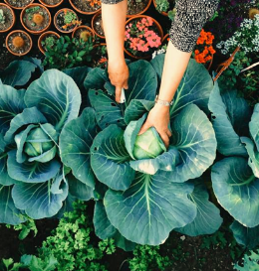
Slide 7
Iris never took her life for granted and there is something each of us can learn from her incredible journey.
She used to say, "Life is for the living!" Which is wonderful advice from a woman who was always present in each moment.

Slide 8
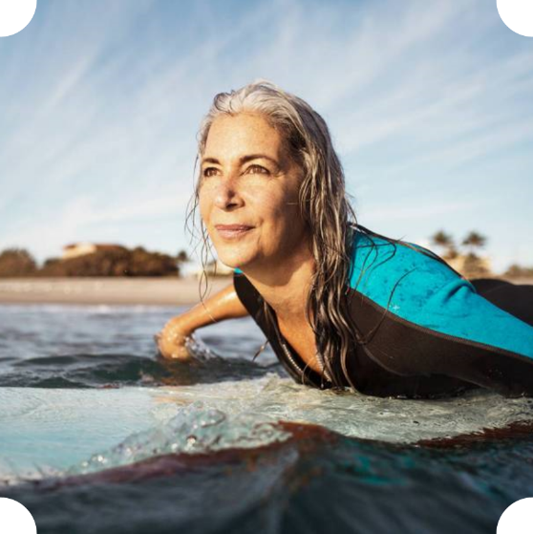
Forever
With love
IRIS
LEPEK

