Slide 1

Text Classification
Data Science Applications
Prof. Arya Rahgozar
Group 22

Slide 2
Outline
Data Preparation
Feature Engineering
Modelling
Evaluation
Error Analysis
Visualization
Conclusion

Slide 3
Preliminary Data From Gutenberg Library
Genre | Book | Author
Physics | Ancient and Modern Physics | Thomas Edgar Willson
Education | The Infant System | Samuel Wilderspin
Photography | The art and Practice of Silver Printing | Abney and Robinson
Horror | The Great God Pan | Arthur Machen
Science Fiction | People Soup | Alan Arkin
Love | The evolution of Love | Emil Lucka
Technology | American Rural Highways | T. R. Agg

Slide 4
Data Preparation
Removing numbers, white spaces, and punctuations
Tokenizing the data for each textbook
Removing stop words
Lower casing all the words so that we wouldn't differentiate between two same words with lower and uppercase difference
Creating random samples of 200 documents each containing 150 words and creating a data frame for each book containing a label from a to g corresponding to each author
Creating a data frame called corpus that contains all the documents for the purpose of further analysis of the data all in one place

Slide 5
Feature Engineering
In order to analyze text data, we should transform it into numerical values
Bag of Words: Results in 13087 words that exist in all the documents
Term Frequency-Inverse Document Frequency: Because BOW method puts equal emphasis on all words, we use TF-IDF that shows how rare a word is instead of only showing its occurrence

Slide 6
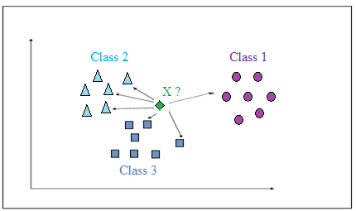
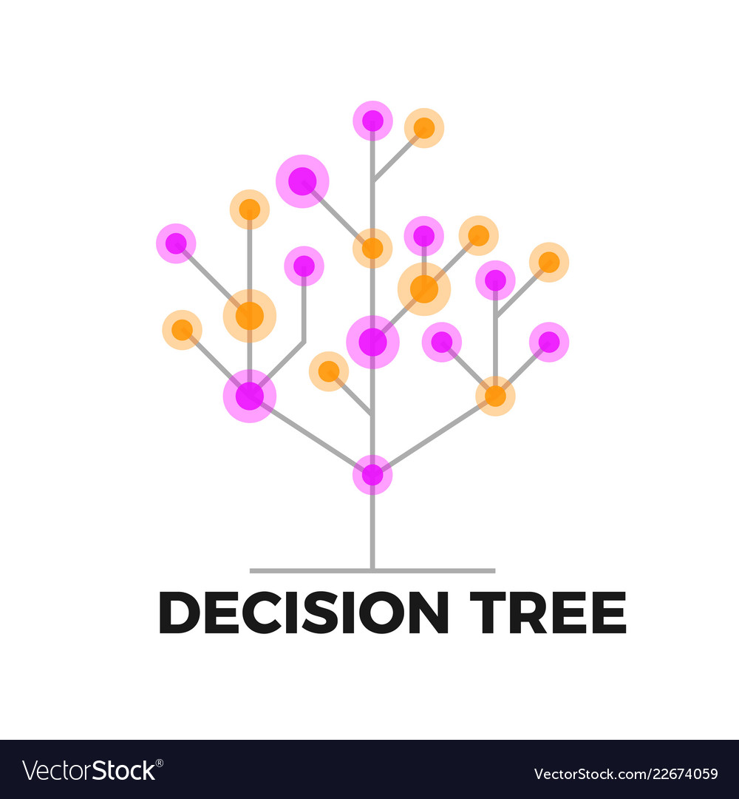
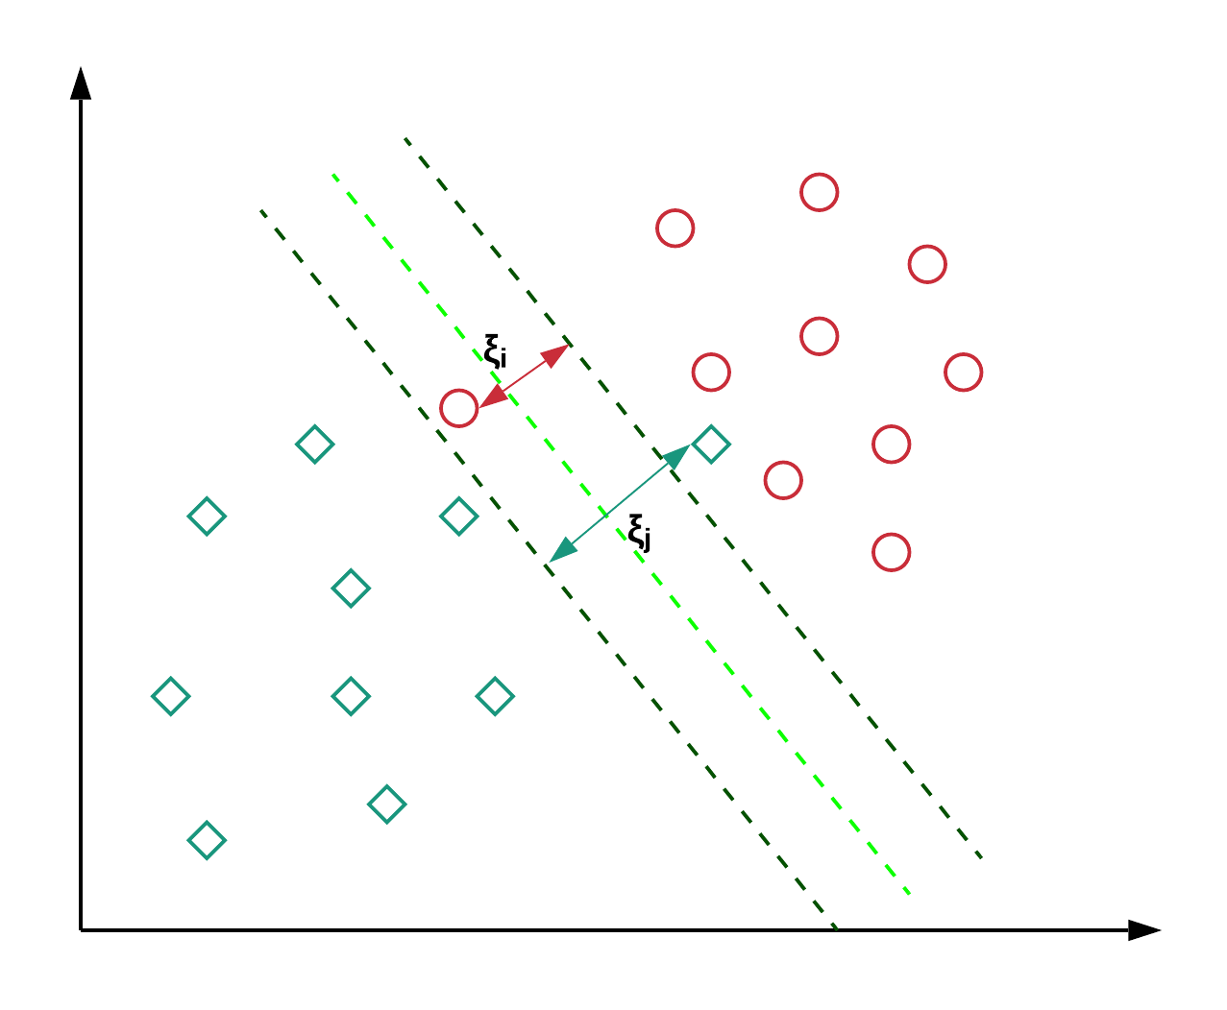
Modelling
Three Classifiers where used:
SVM (Supper Vector Machines)
Decision Trees
K Nearest Neighbors

Slide 7
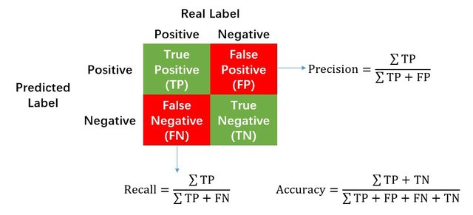
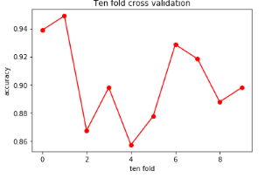
Performance Evaluation
Confusion Matrix
10-Fold Cross Validation
Notes:
DT with TF-IDF
the harmonic mean of precision and recall.

Slide 8
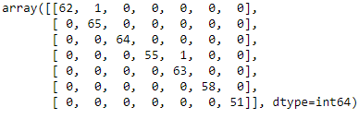
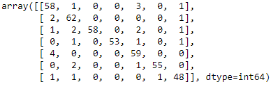
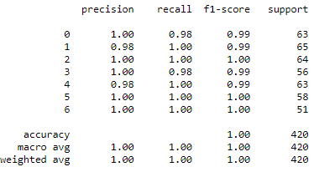
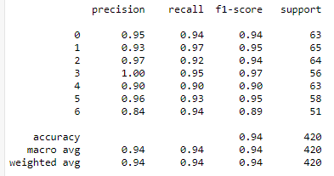
Examples of Confusion Matrices
Notes:
Left: KNN with BOW
Right: DT with TF-IDF

Slide 9
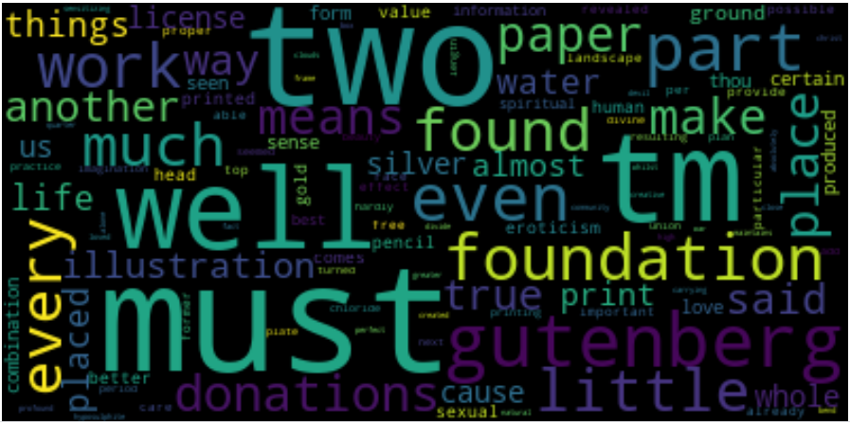
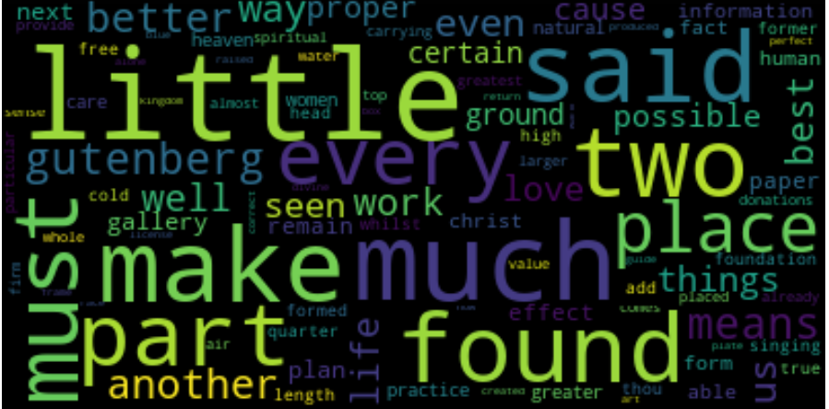

Error Analysis
It is helpful to know misclassified instances to improve algorithms in the future and understand their predictions.
Location of misclassified instances and both the correct and predicted label
Figures that demonstrate what words where misclassified more than others
Notes:
Up: all misclassifications in KNN with BOW model
Down: Only for Author a

Slide 10
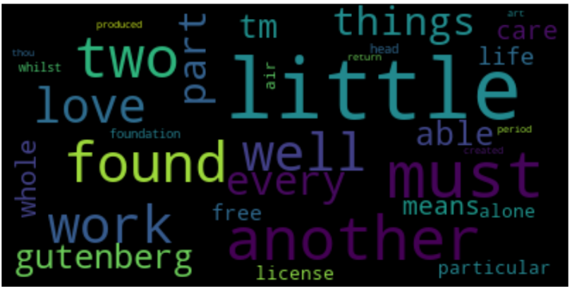
An Improvement after Error Analysis
Changing the order of lowercasing and eliminating stop words

Slide 11

Conclusion
Based on the accuracies and results of confusion matrices for each model, the best model is when KNN classifier is used with TF-IDF type of feature engineering with an accuracy of 0.9959183673469388

