Slide 1

GW1
The Buoys

Slide 2
Team structure
Stephen – Project Manager + Software Assist
Oly – Management Assist + Integration
Ify – Integration
Jack – Design + Integration
Dan – Machine Vision
Leo – Machine Vision

Slide 3
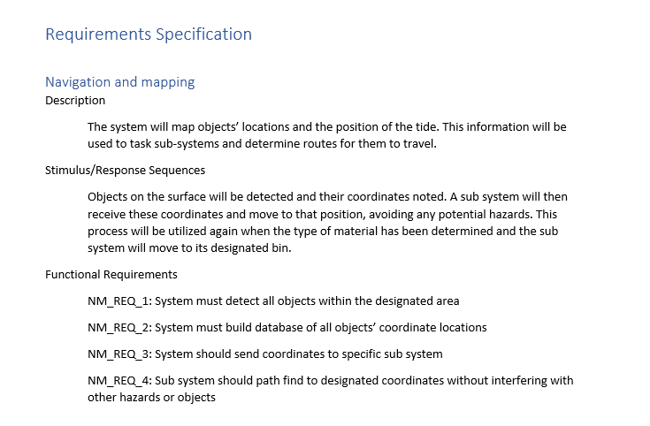
requirements

Slide 4
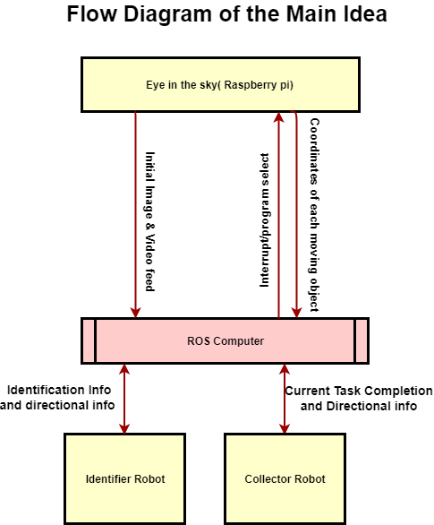
Functional flow

Slide 5
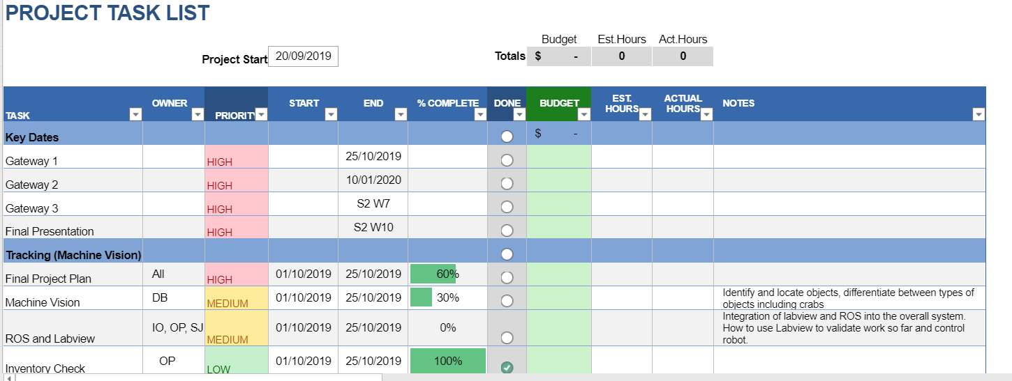
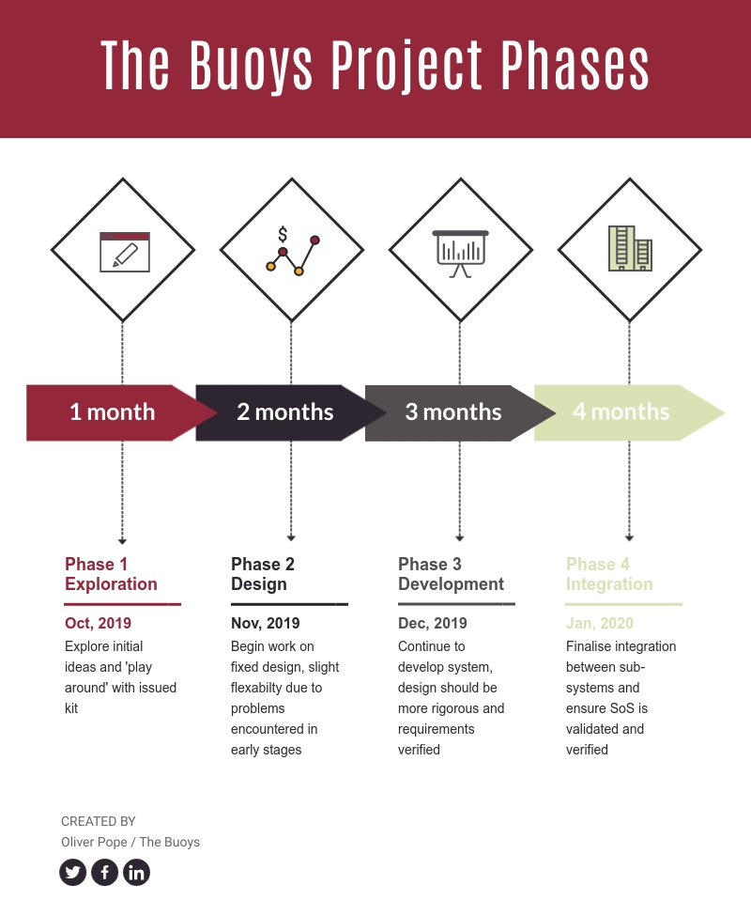
Project Management

Slide 6
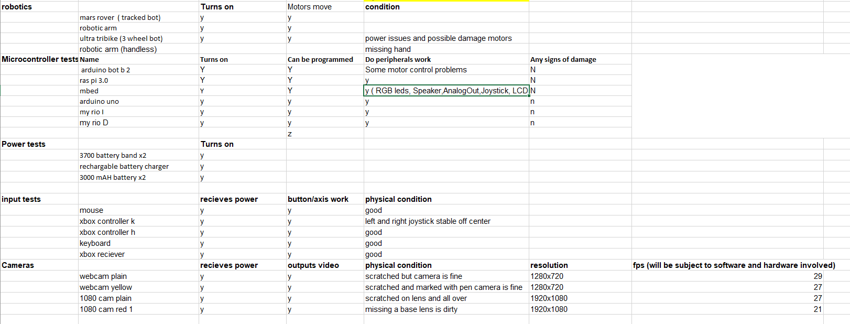
Critical Evaluation

Slide 7
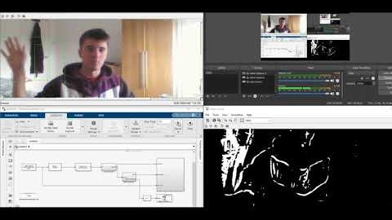
Technical Research – Machine vision

Slide 8
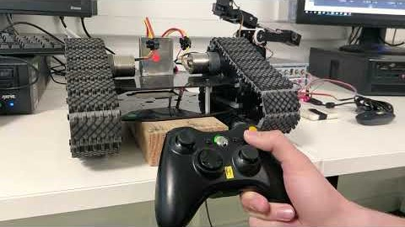
Technical Research – Wireless control

Slide 9
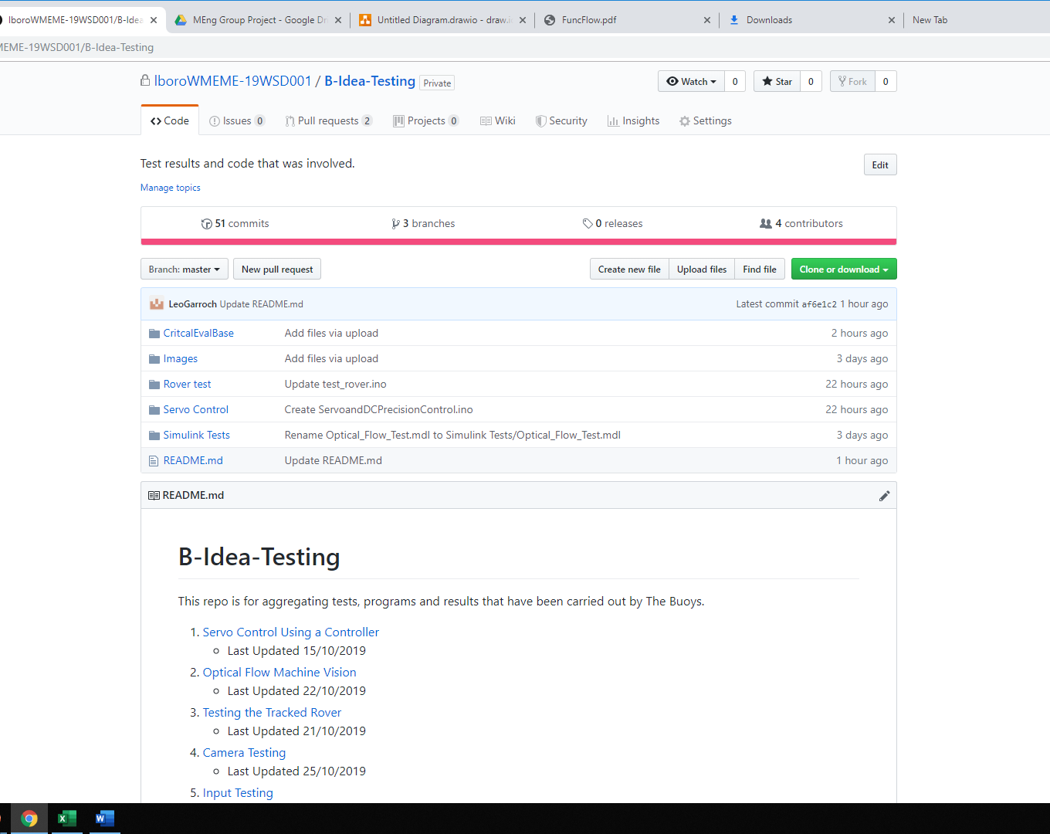
Version Control

Slide 10

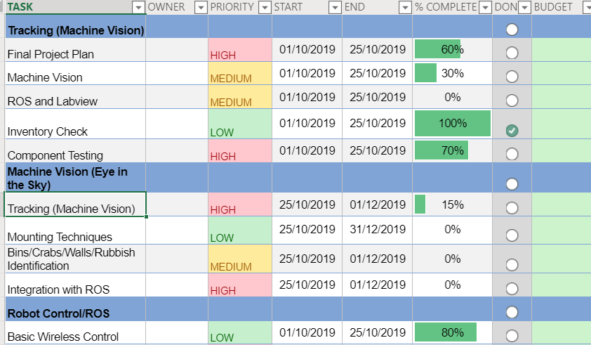
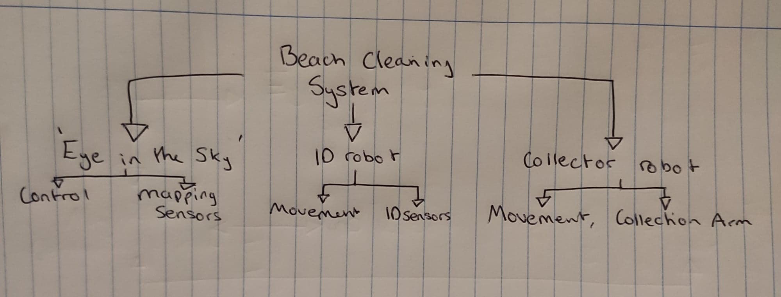
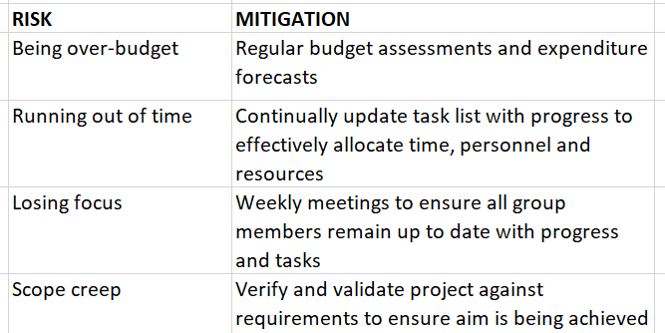
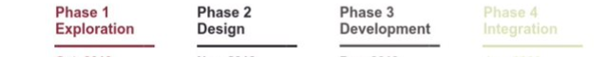
19WSD001 Team Project
23/10/19
AIMS & OBJECTIVES
Aim: Utilise integrated autonomous technologies to enhance and develop waste management in coastal areas.
Objectives: Integration of several individual systems to produce a more complex system of systems, capable of delivering user specified tasks.
Automation of whole system to minimise human interactions
Effective and comprehensive movement of different materials to specified areas
Activities
Budget statement
Current budget at £200, no immediate spending forecast.
Stakeholders
P: Environment Secretary, Local Councils
E: Private Investors, Gov’t grants, PST (Budget Approval)
S: Users, Media, Charities, Environmentalists, Public
T: PST, Researchers, Hard/Software developers
L: Environment Agency, Gov’t
E: Gov’t, Environmental organisations
Mission phase completion
4 main phases; completed exploration phase now onto design. Have tested components and researched varying ideas and now moving onto a more rigorous design although remaining pragmatic to counter potential issues during continued development of project.
Key issues and risks
Strategy/ Plan
Exploration: Explore initial ideas and ‘play around’ with issued kit.
Design: Begin work on fixed design, slight flexibility due to likelihood of problems encountered in early stages
Development: Continue to develop system, design should be more rigorous, and requirements verified
Integration: Finalise integration between sub-systems and ensure SoS is validated and verified. System will be fully autonomous
The Buoys
https://lunet-my.sharepoint.com/:f:/r/personal/elop4_lunet_lboro_ac_uk/Documents/MEng%20Group%20Project?csf=1&e=qwLKEk
Programme
GW1
GW2
GW3
Notes:
A version of this is compulsory at each gateway meeting and optional for PST meetings.
In terms of sizing, this should be legible printed on A3, but will probably be viewed on screen. Minimum font size =12
Diagram in the middle should be a top level systems diagram.
The plan will change as the project progresses – that is ok and expected.

