Slide 1




General public
Volunteers
Experts

Slide 2


Slide 3
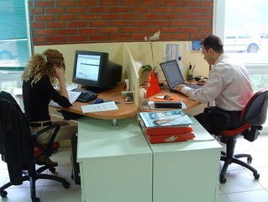


Worker
Data Collection
Data Analysis

Slide 5

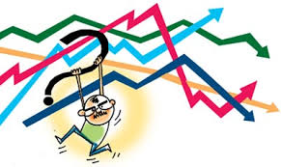
Data Cleaning
Data Interpretation

Slide 7
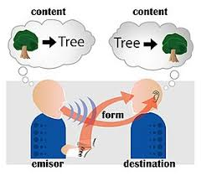
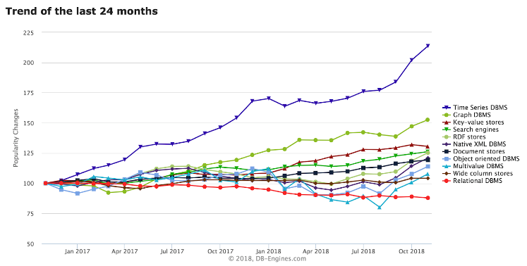
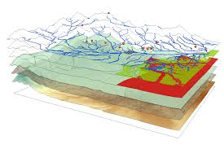
Data Communication
Time series data
Geo-spatial data

Slide 9

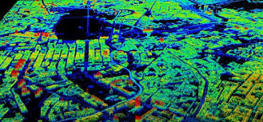
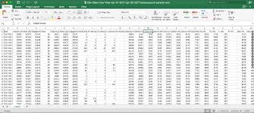
Satellite or aerial data
csv
API

Slide 11
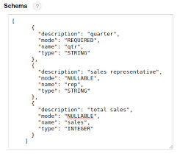
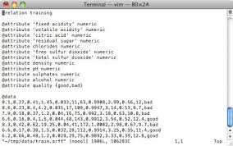

JSON
.arff
PDF

Slide 13
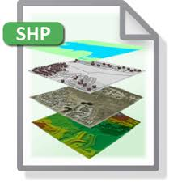


Shape file
What tools?
What skills?

Slide 15



Who KNOWS the data?
Individual or participatory sensemaking?
How to move from data to action?

Slide 17

What role does data actually play in innovation?

