Slide 1
ParFlow数值方法简介
杨晨
中山大学大气科学学院

Slide 2
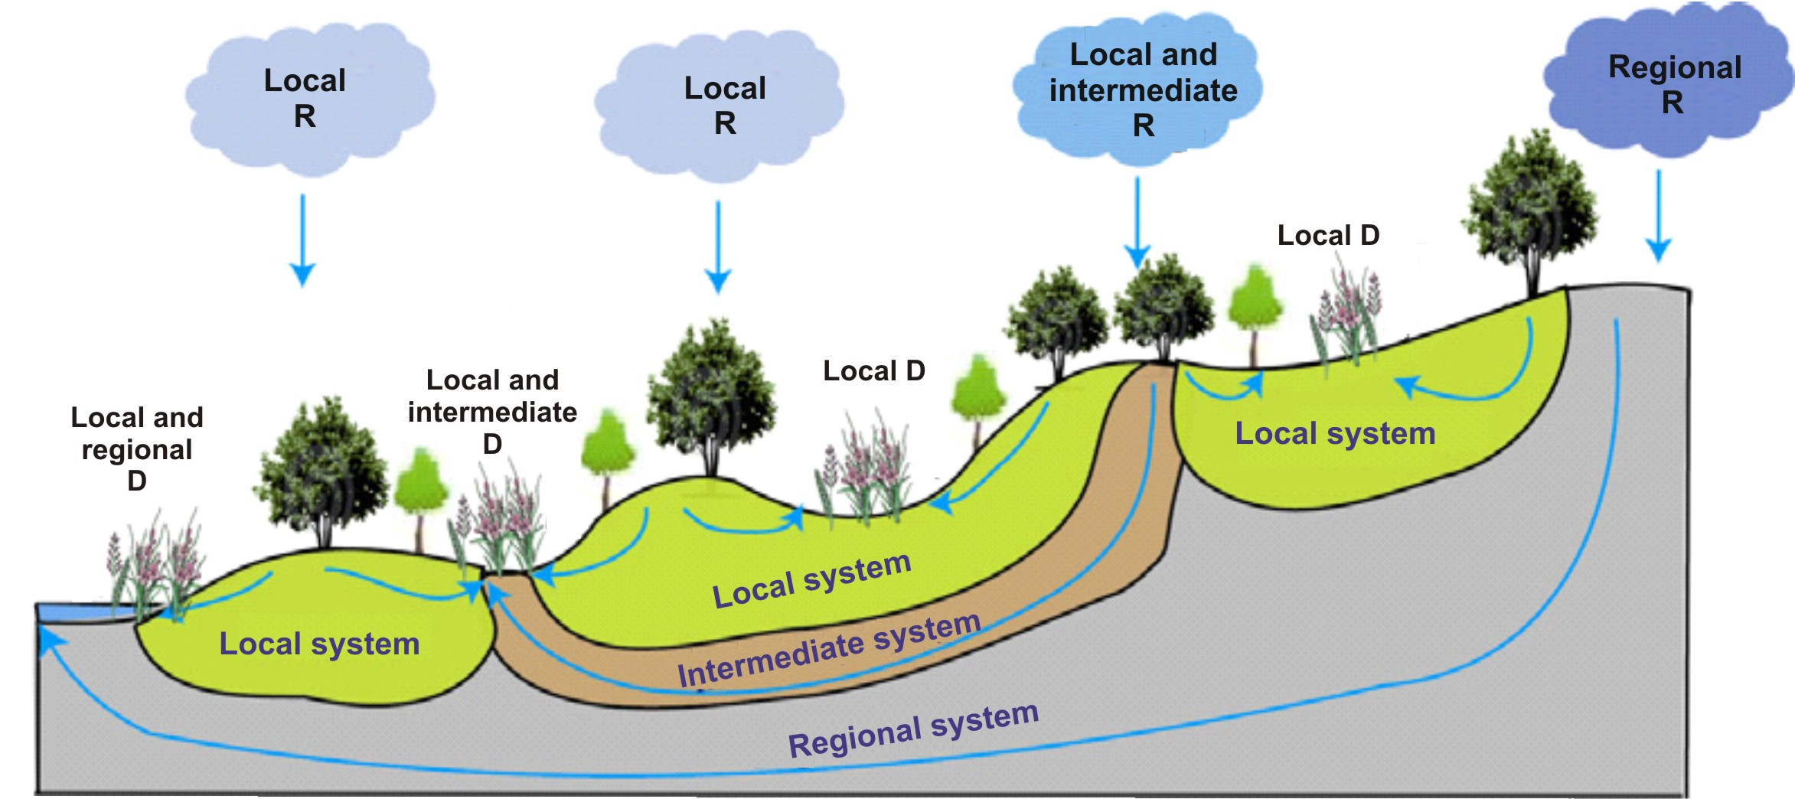
Toth, JGR, 1963

Slide 3


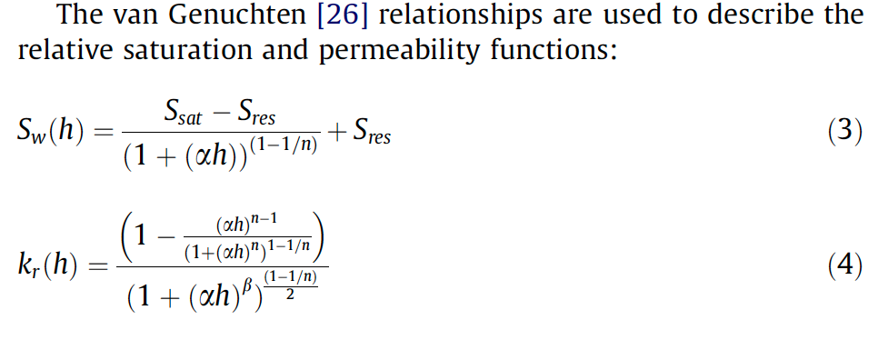
Richards’ equation
Osei-Kuffuor et al., AWR, 2014;
Maxwell, AWR, 2013

Slide 4

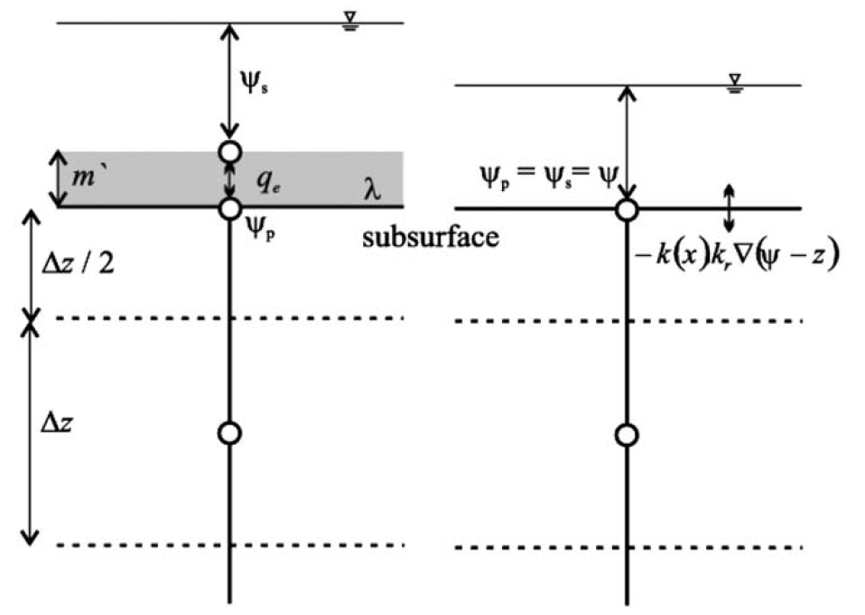


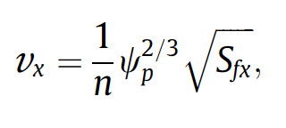

Shallow water equation
Continuity equation
Momentum equation
Kinematic wave approximation
Manning’s equation
Previous studies
ParFlow
Kollet and Maxwell, AWR, 2006
Osei-Kuffuor et al., AWR, 2014

Slide 5
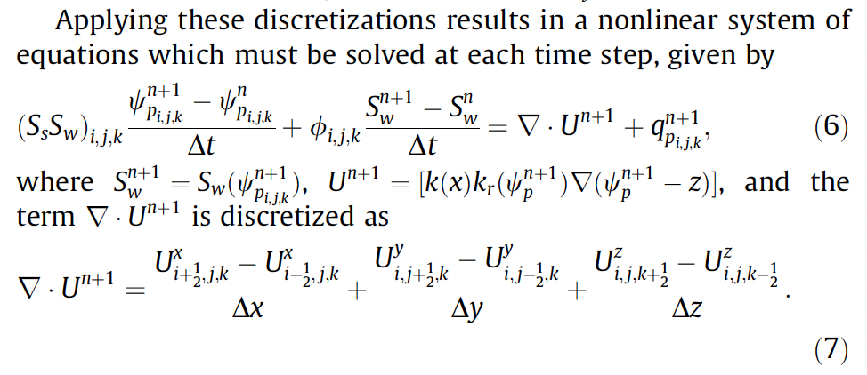

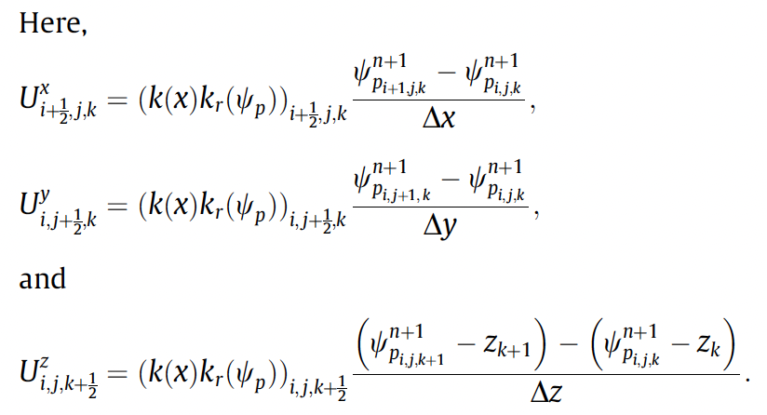
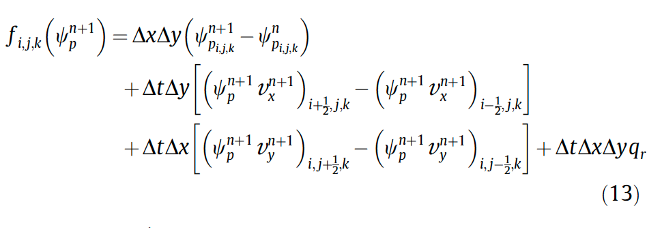
the nonlinear function to be evaluated

Slide 6
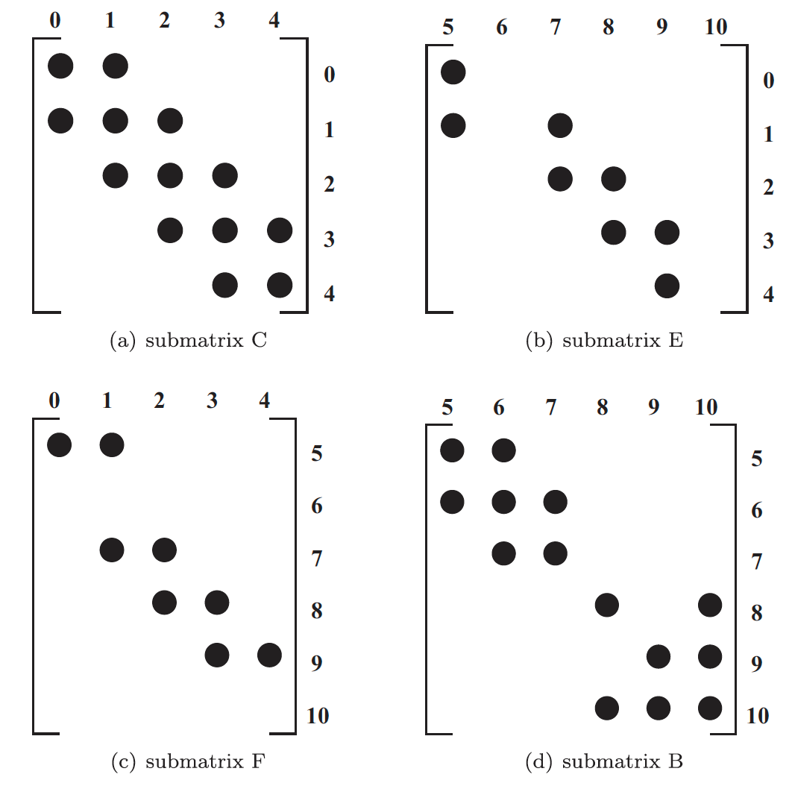
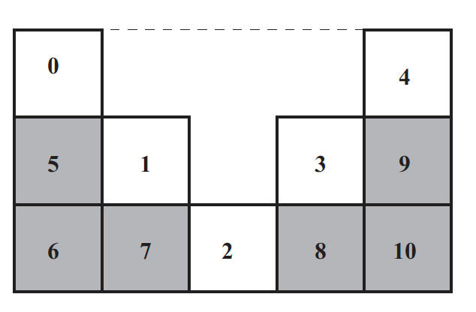
Integrated
hydrologic model
Surface-Surface
Surface-Subsurface
Subsurface-Surface
Subsurface-Subsurface
二维剖面

Slide 7
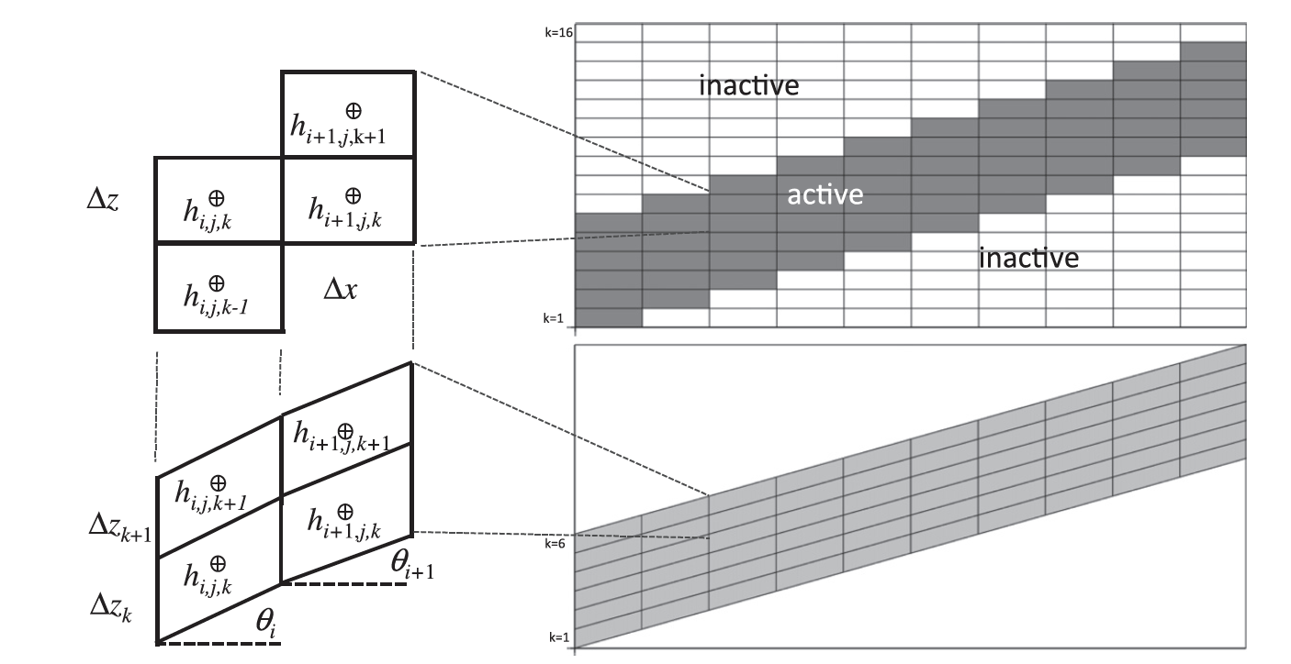
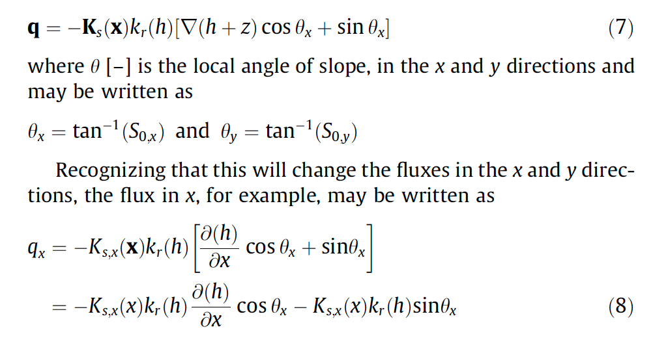
Terrain Following Grid (TFG)
正交网格
TFG
Maxwell, AWR, 2013

Slide 8
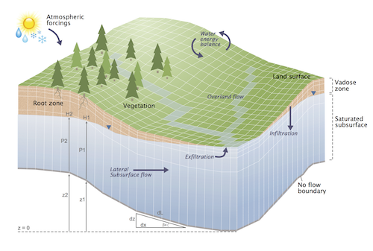

Slide 9
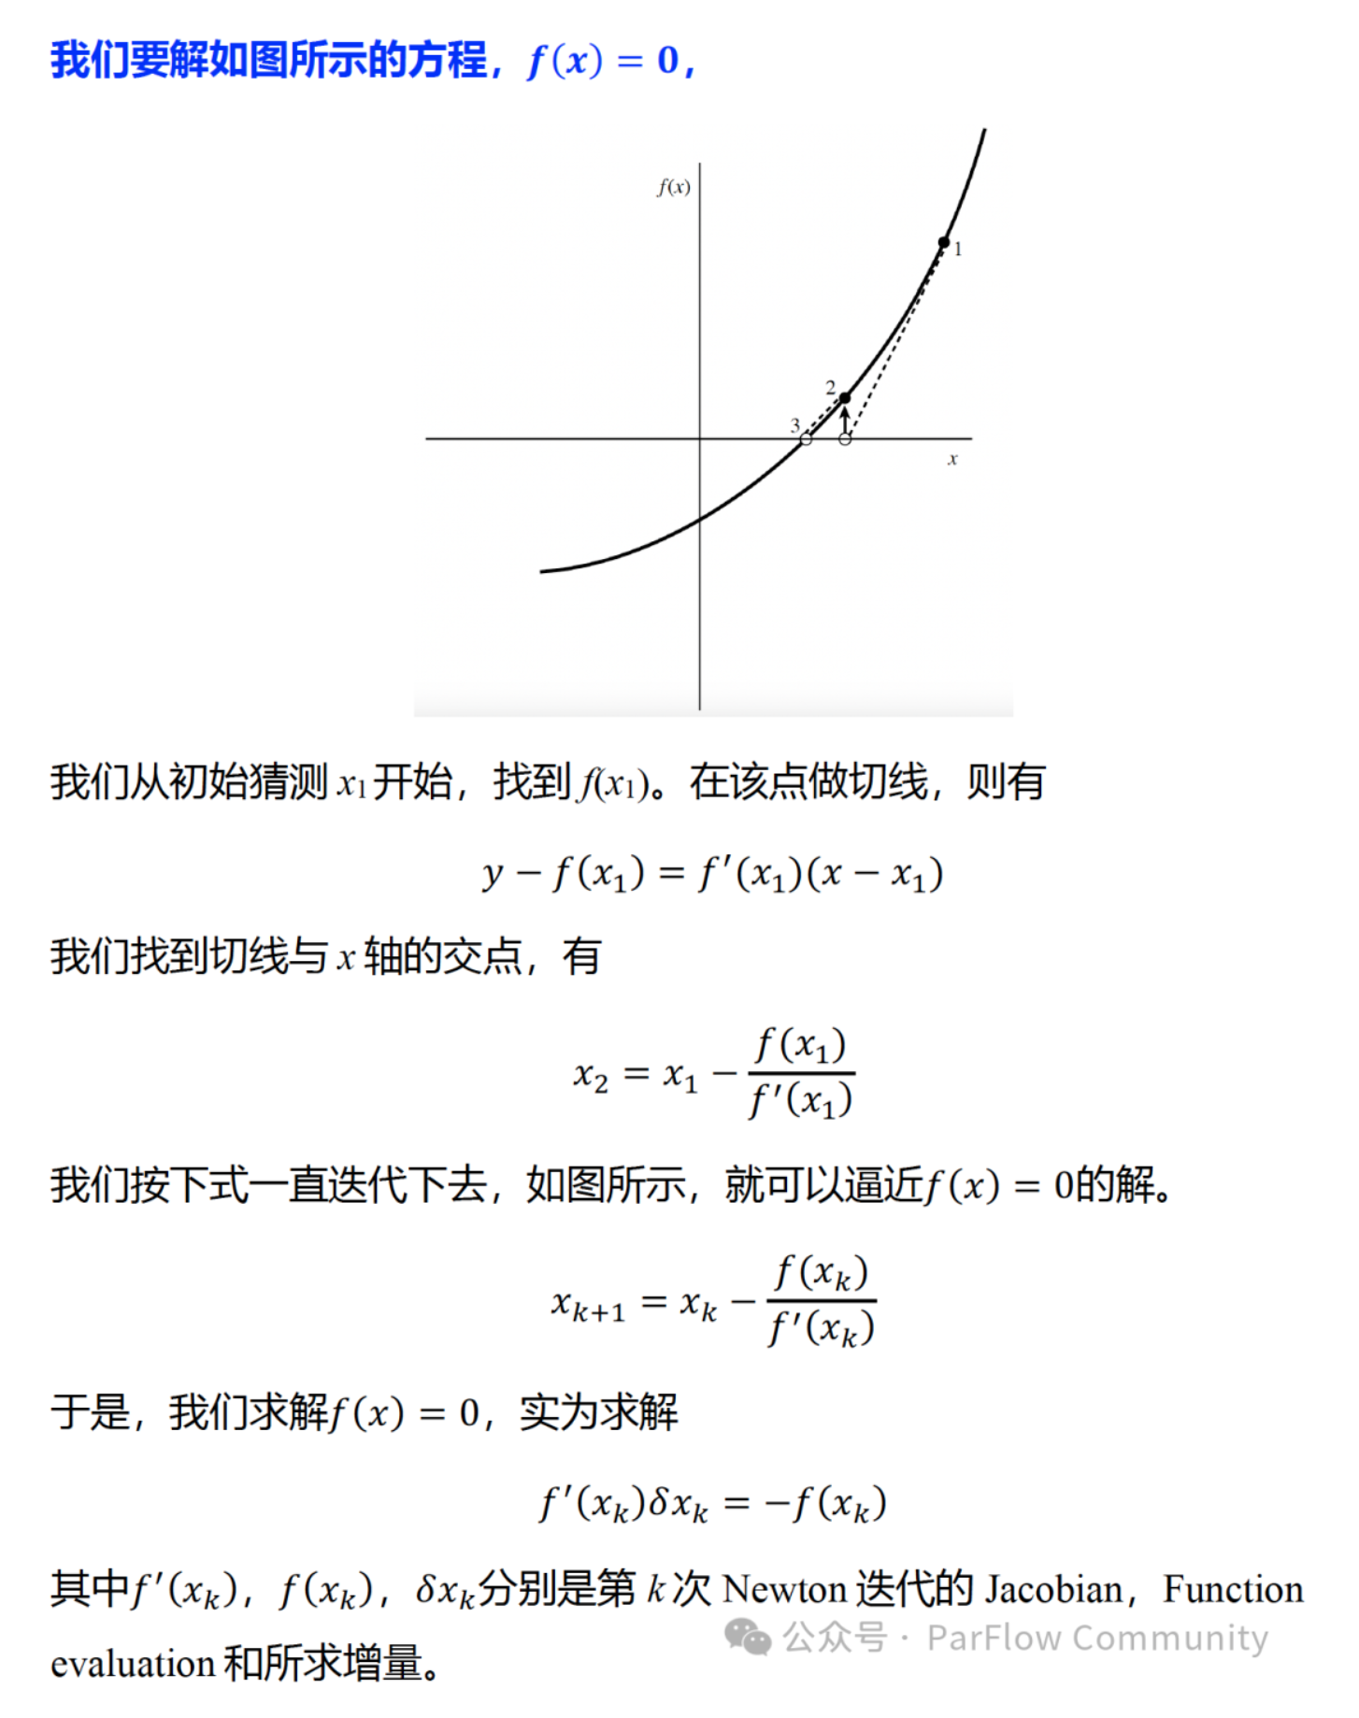
Newton’s Method

Slide 10
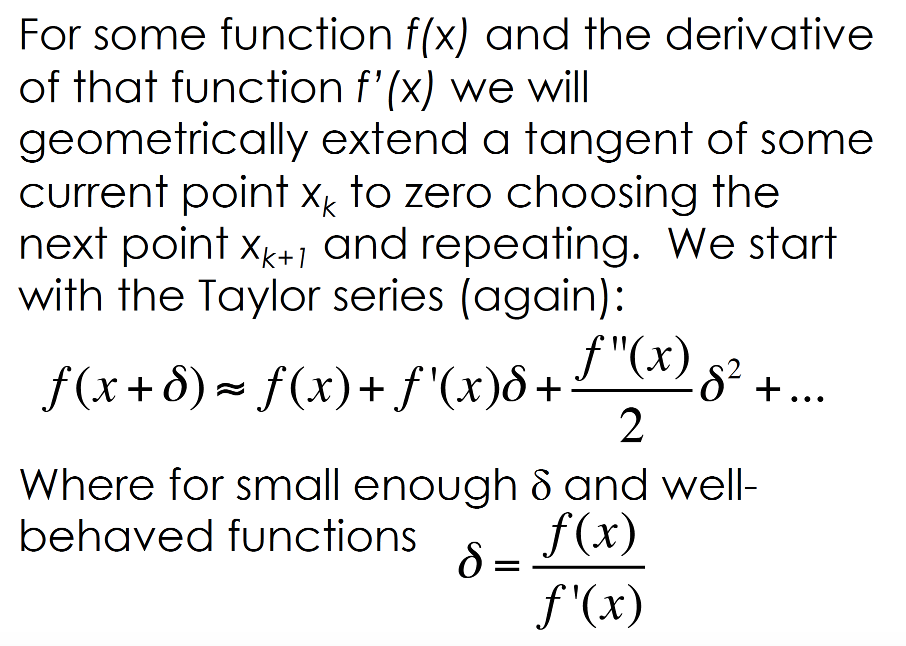

Slide 11
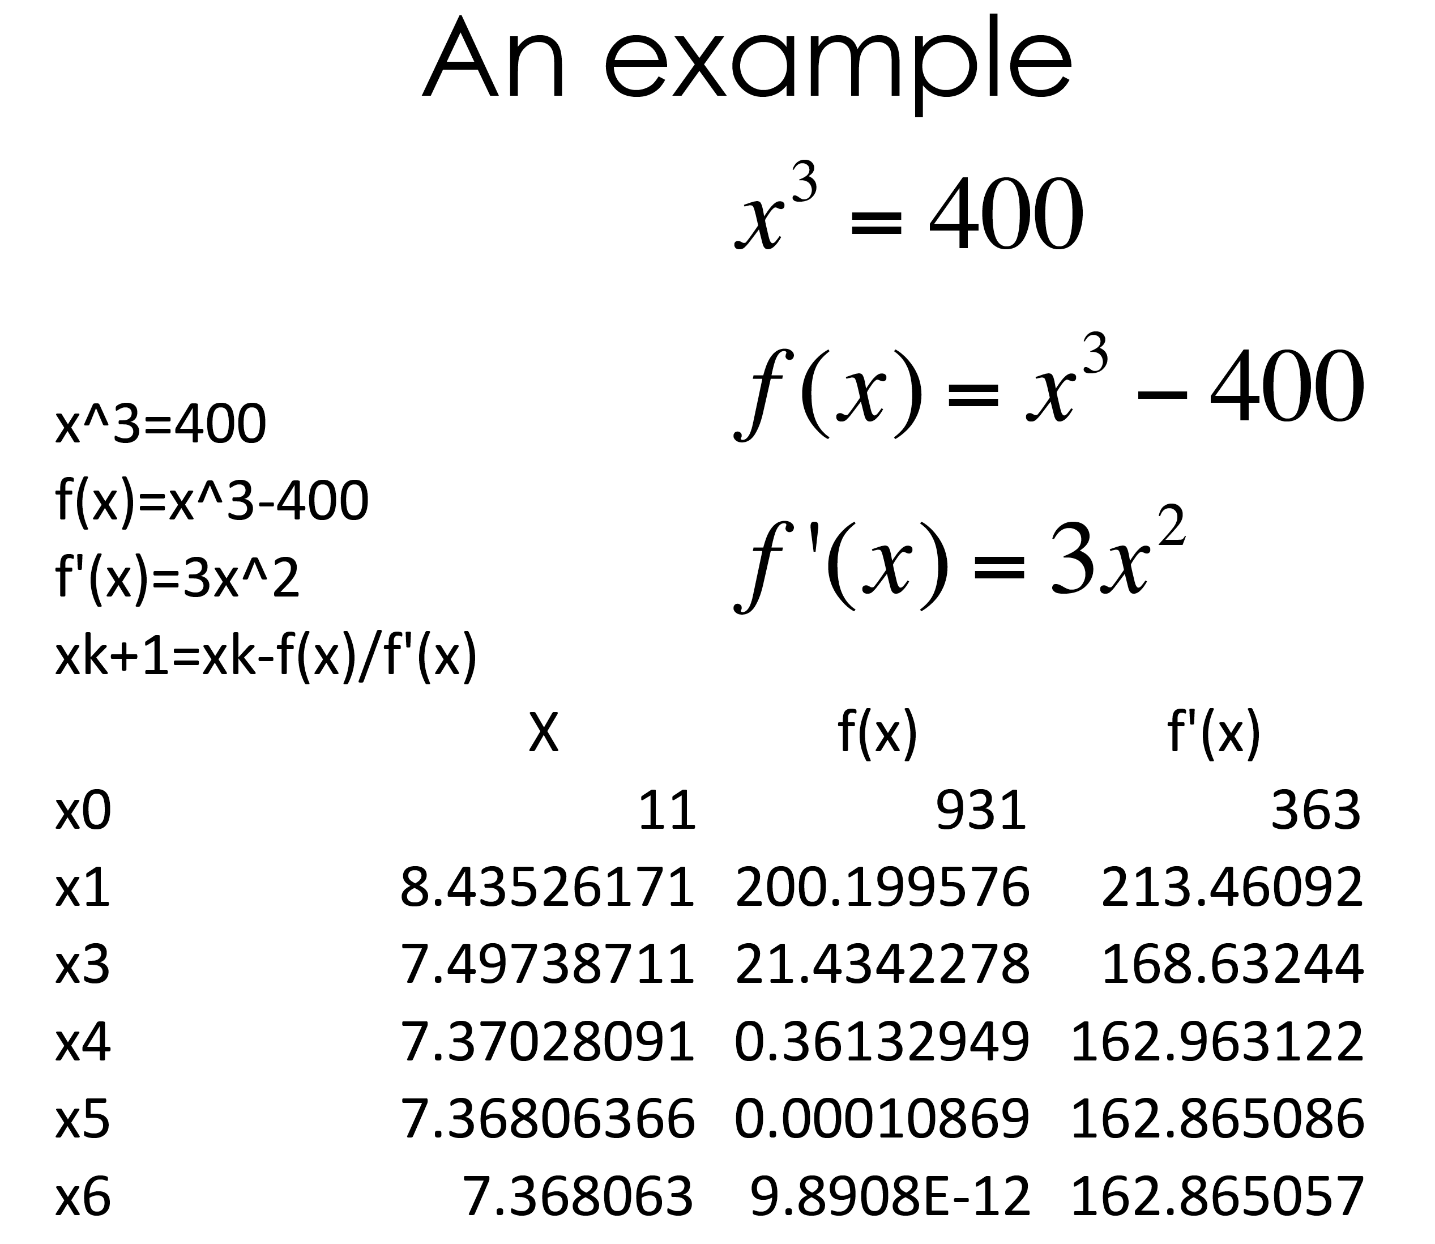
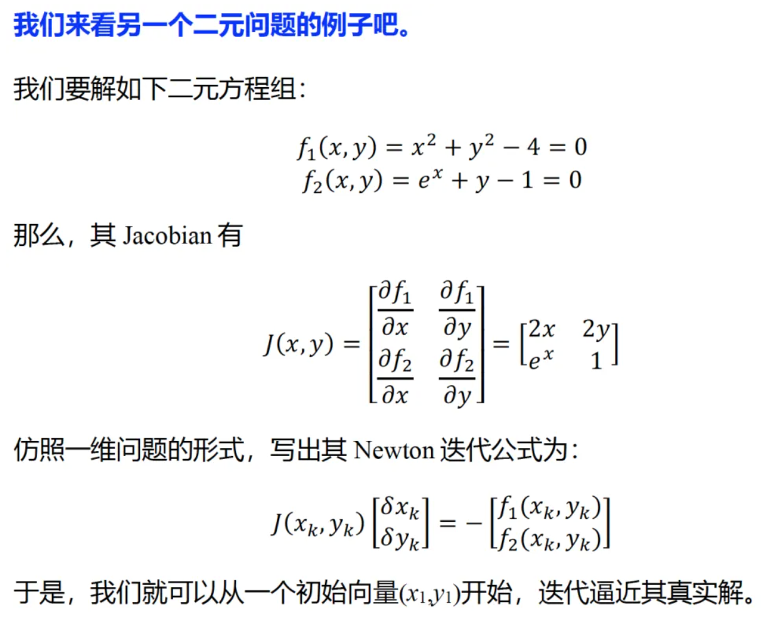

Slide 12
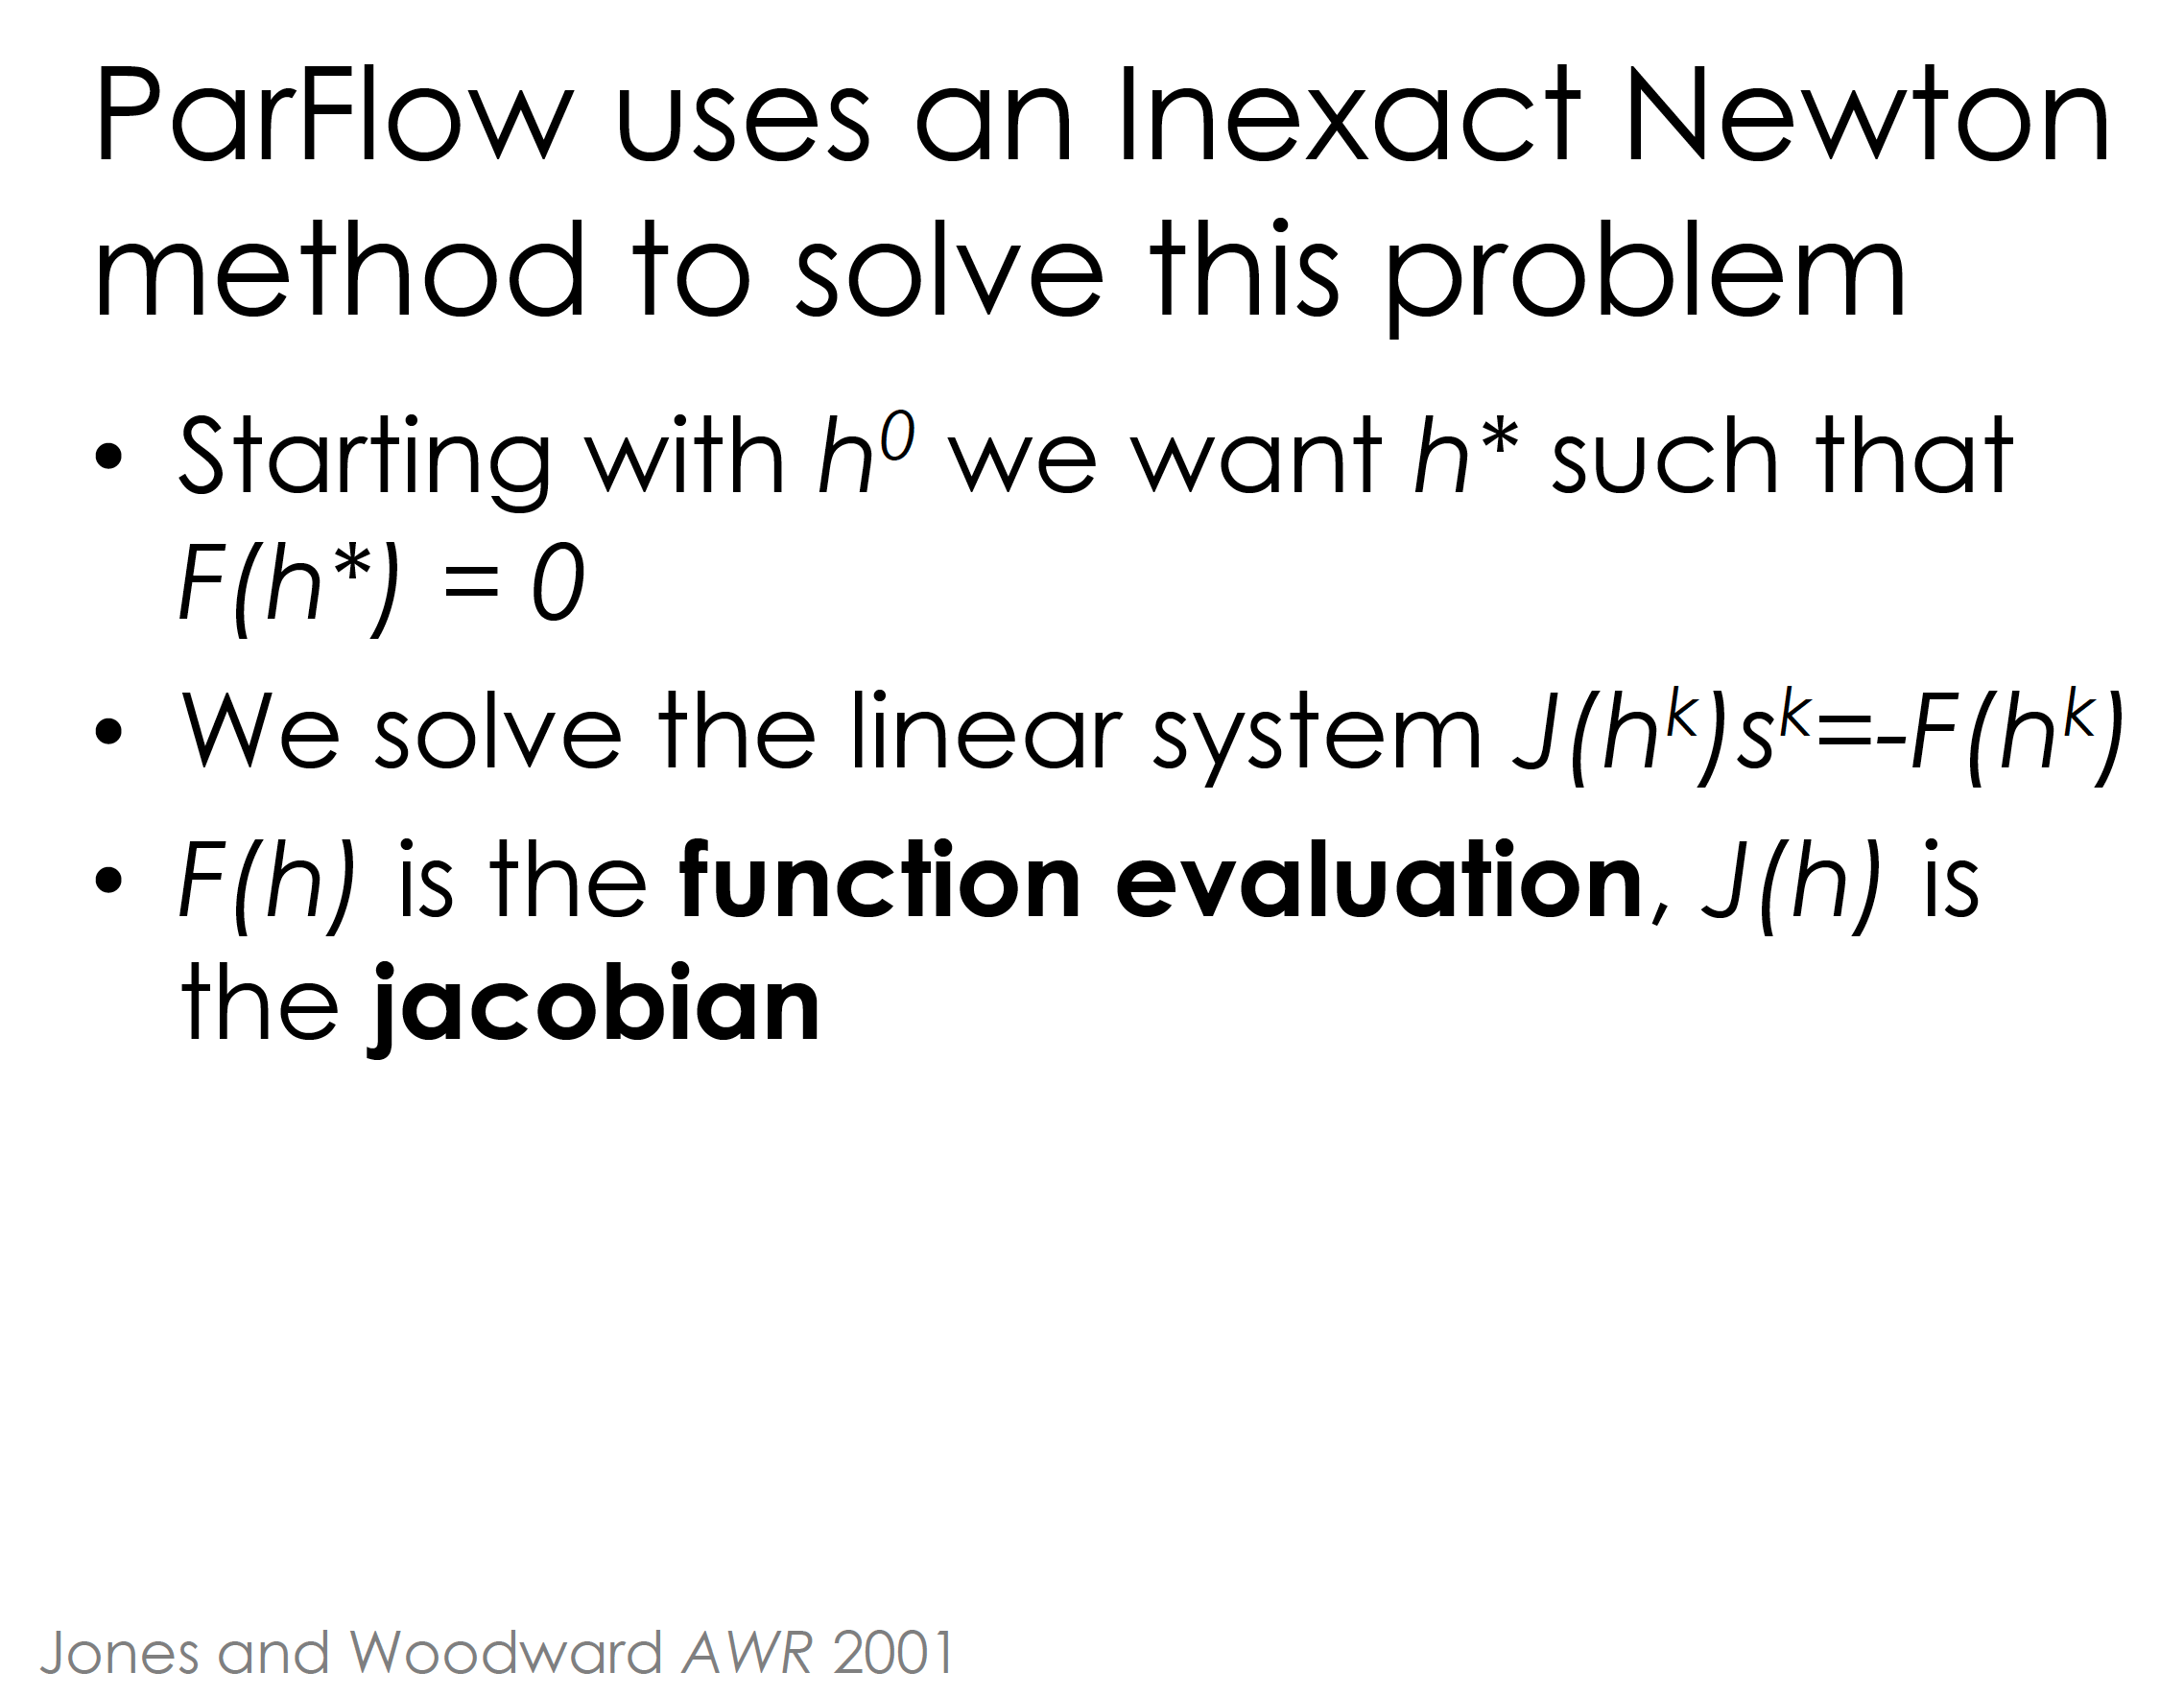

Slide 13
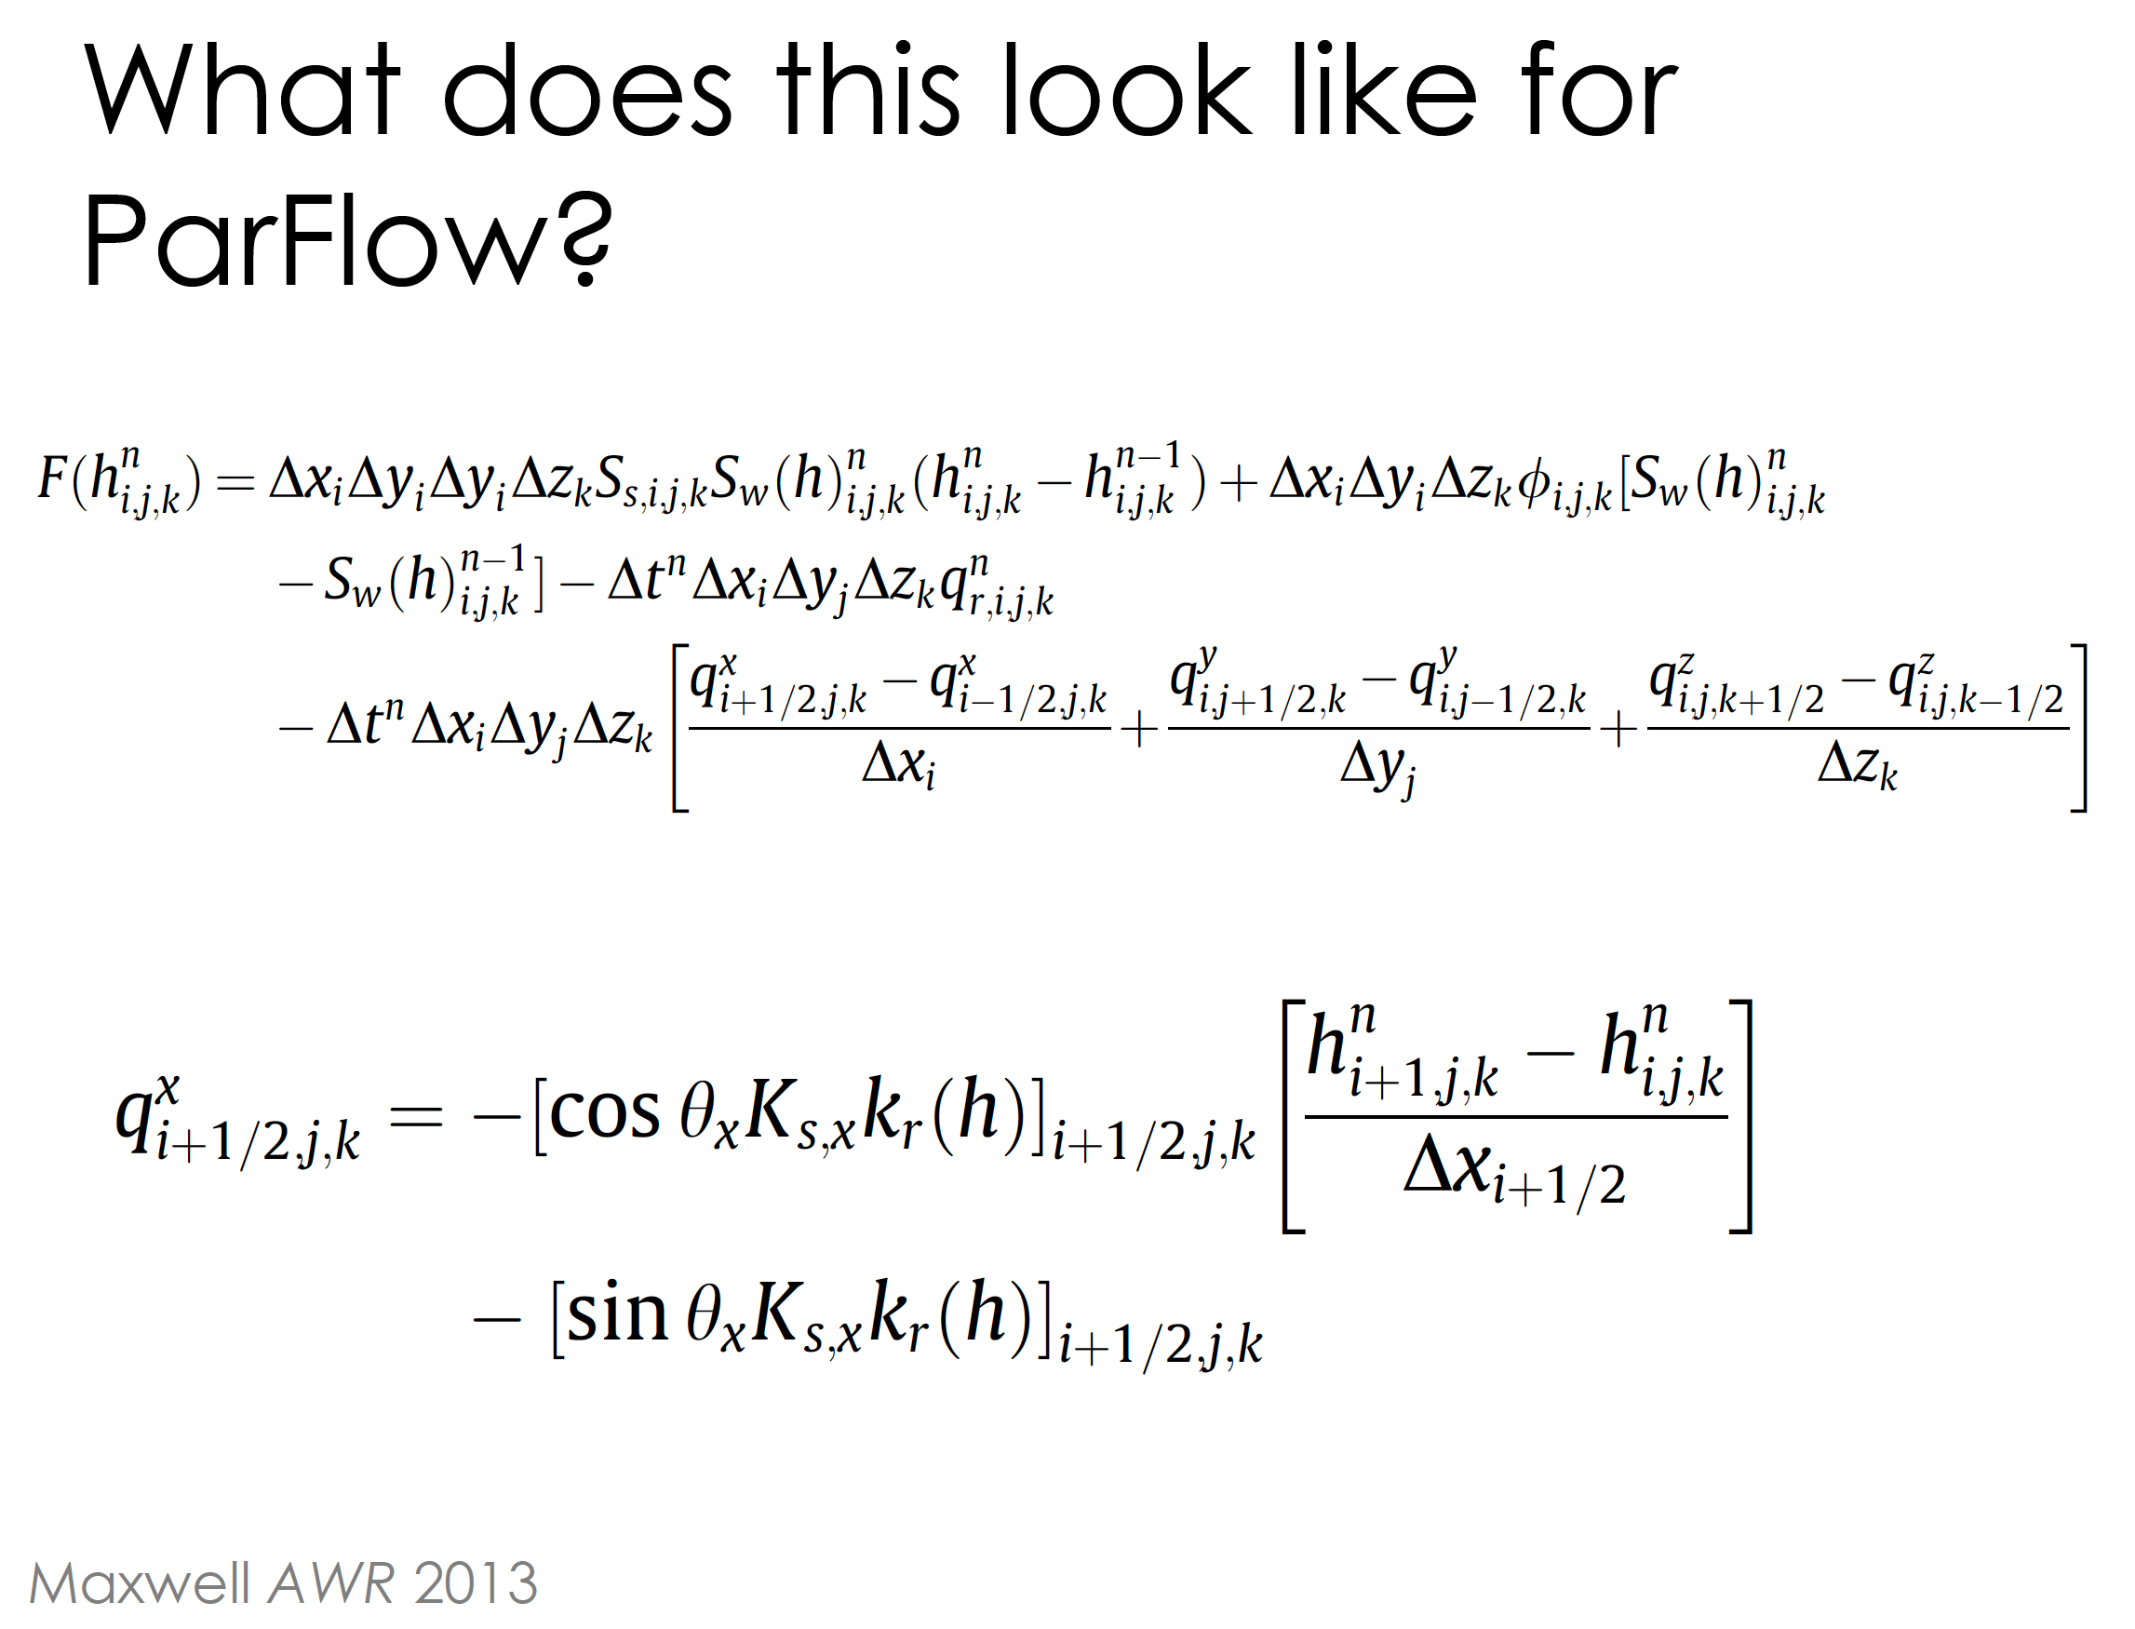
Function
evaluation

Slide 14
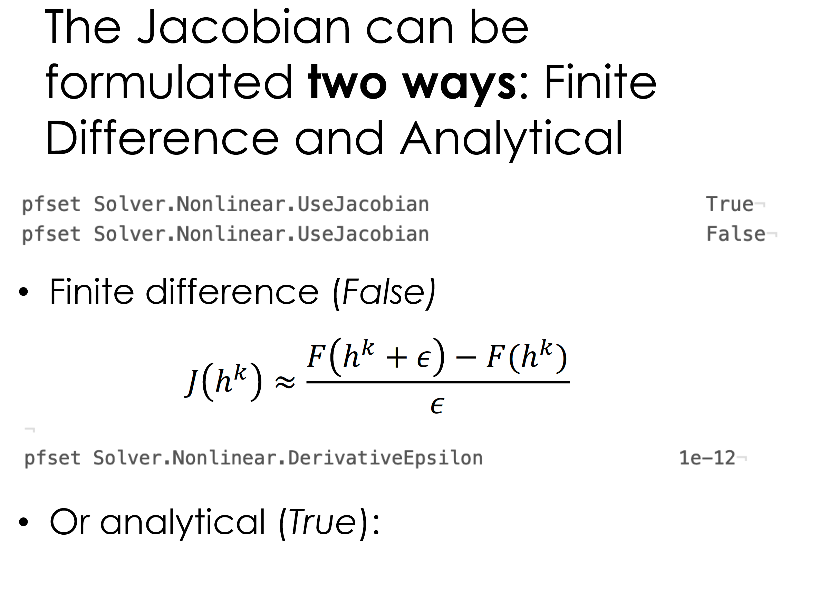
Jacobian

Slide 15
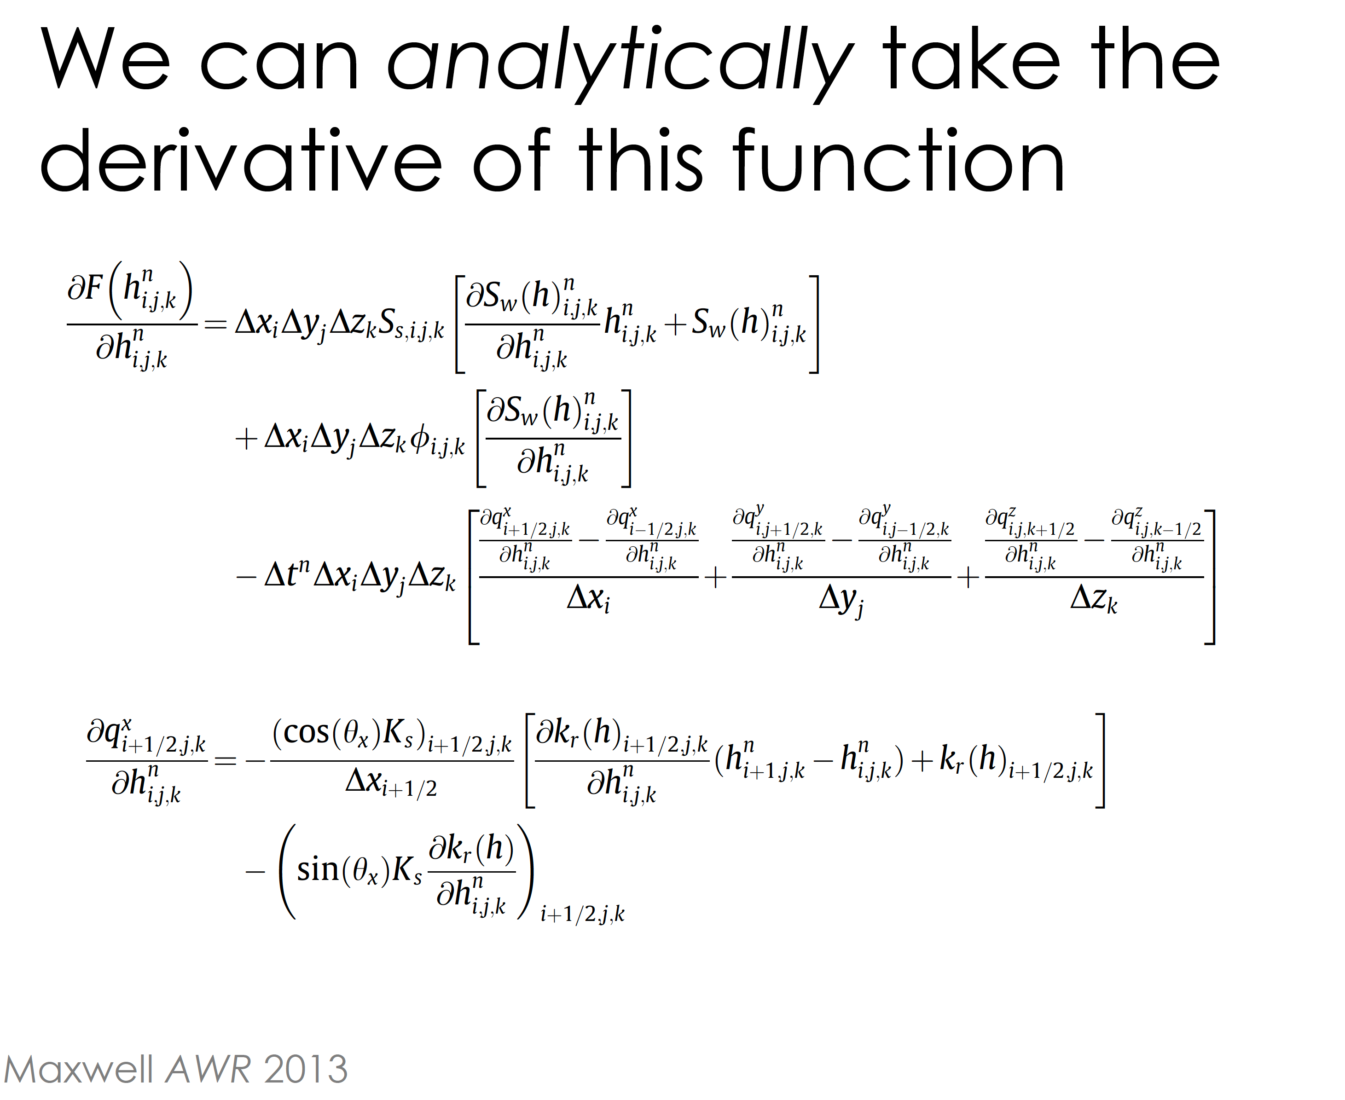

Slide 16
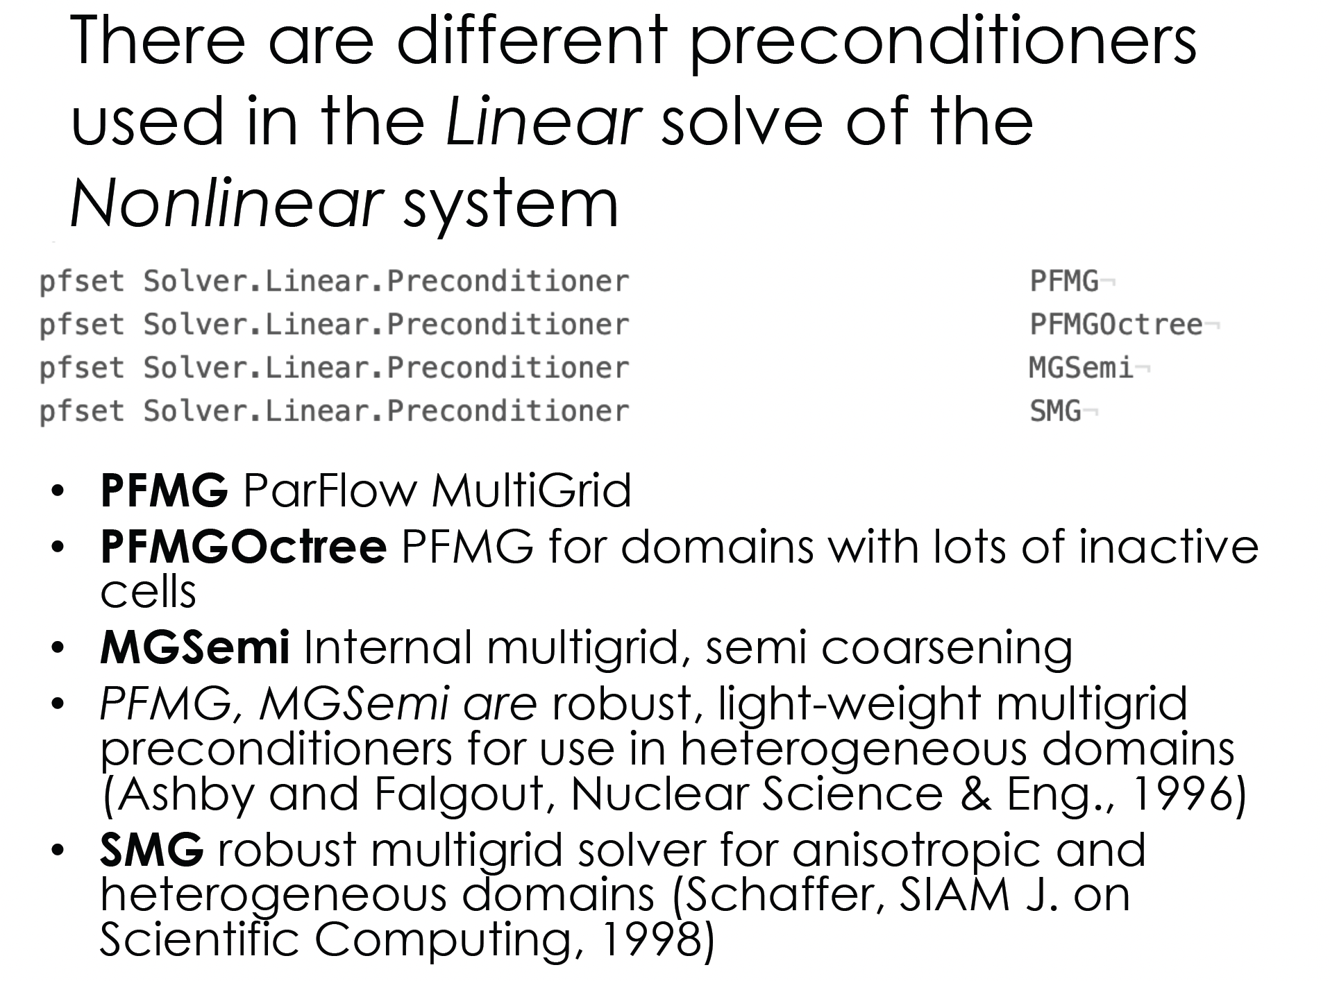
Krylov method
CG
GMRES

Slide 17
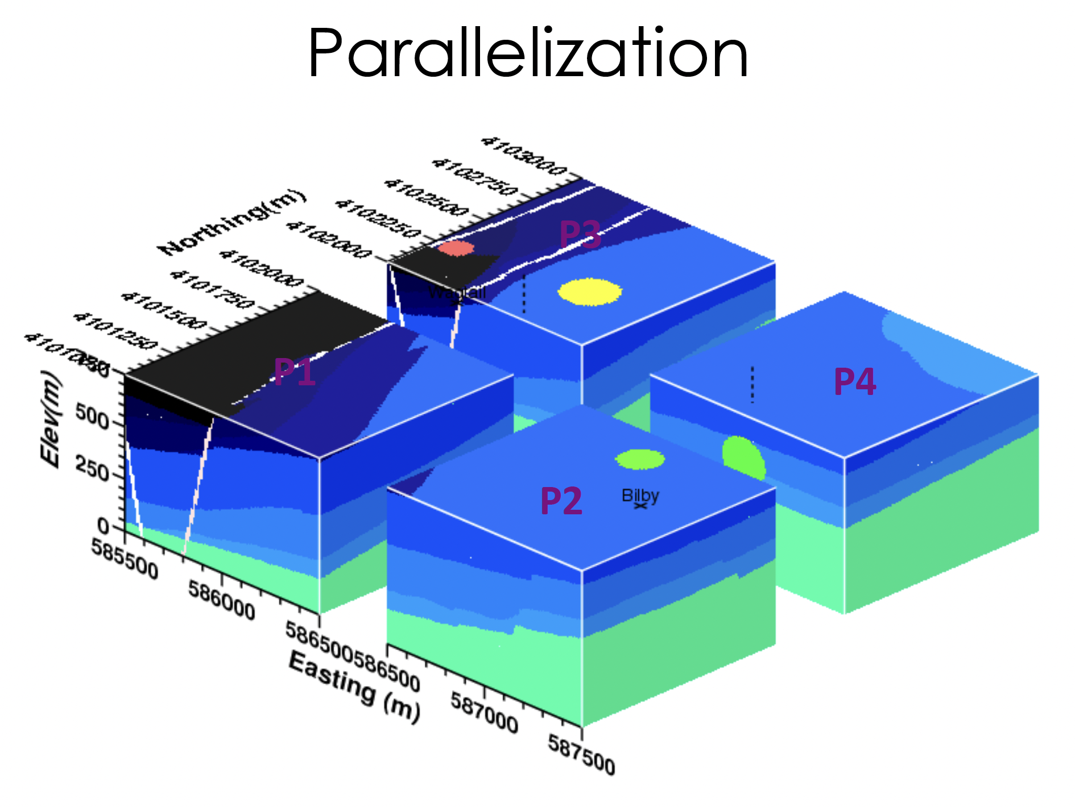

Slide 18
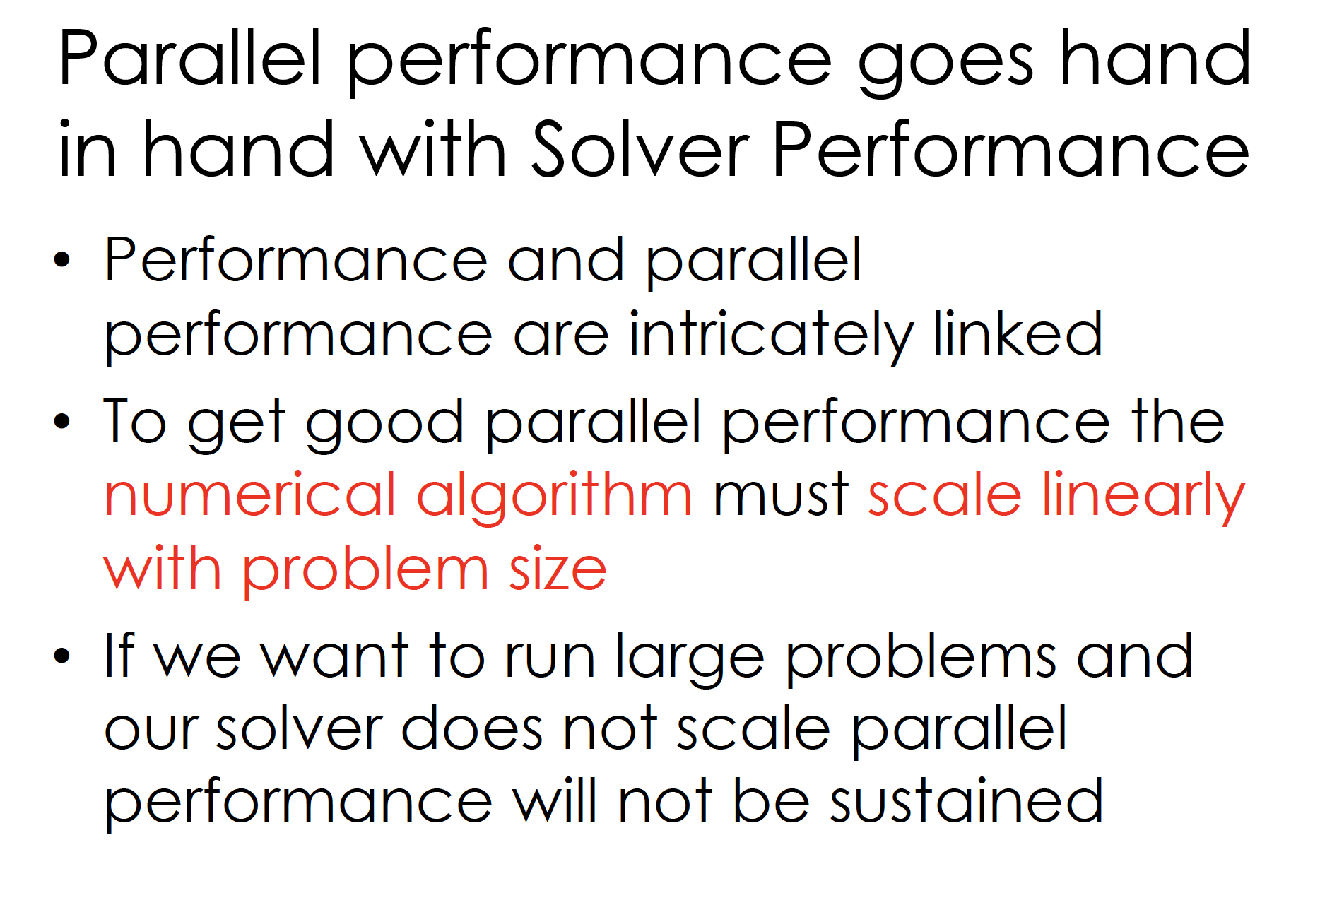

Slide 19
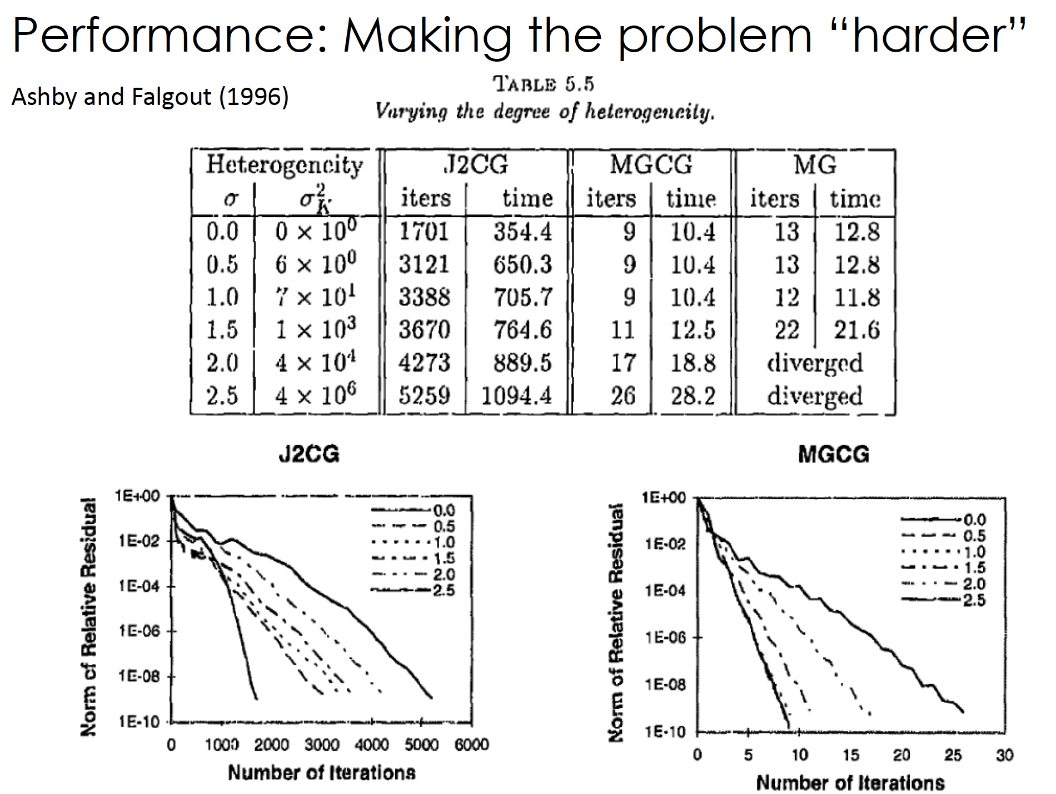

Slide 20
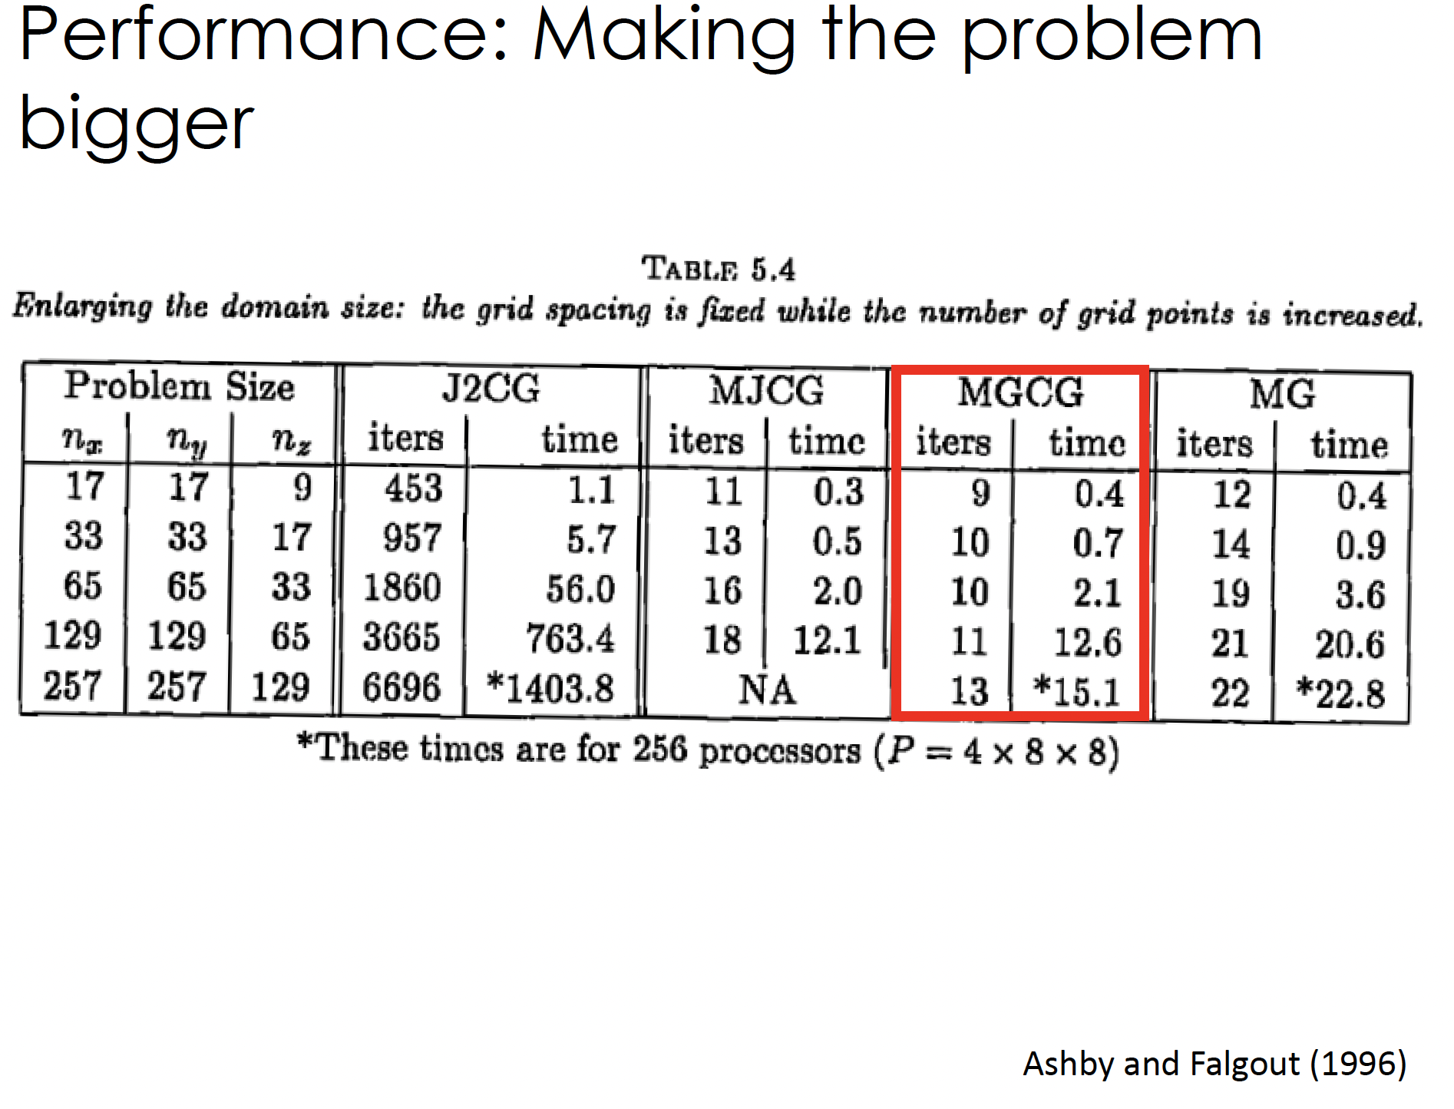

Slide 21
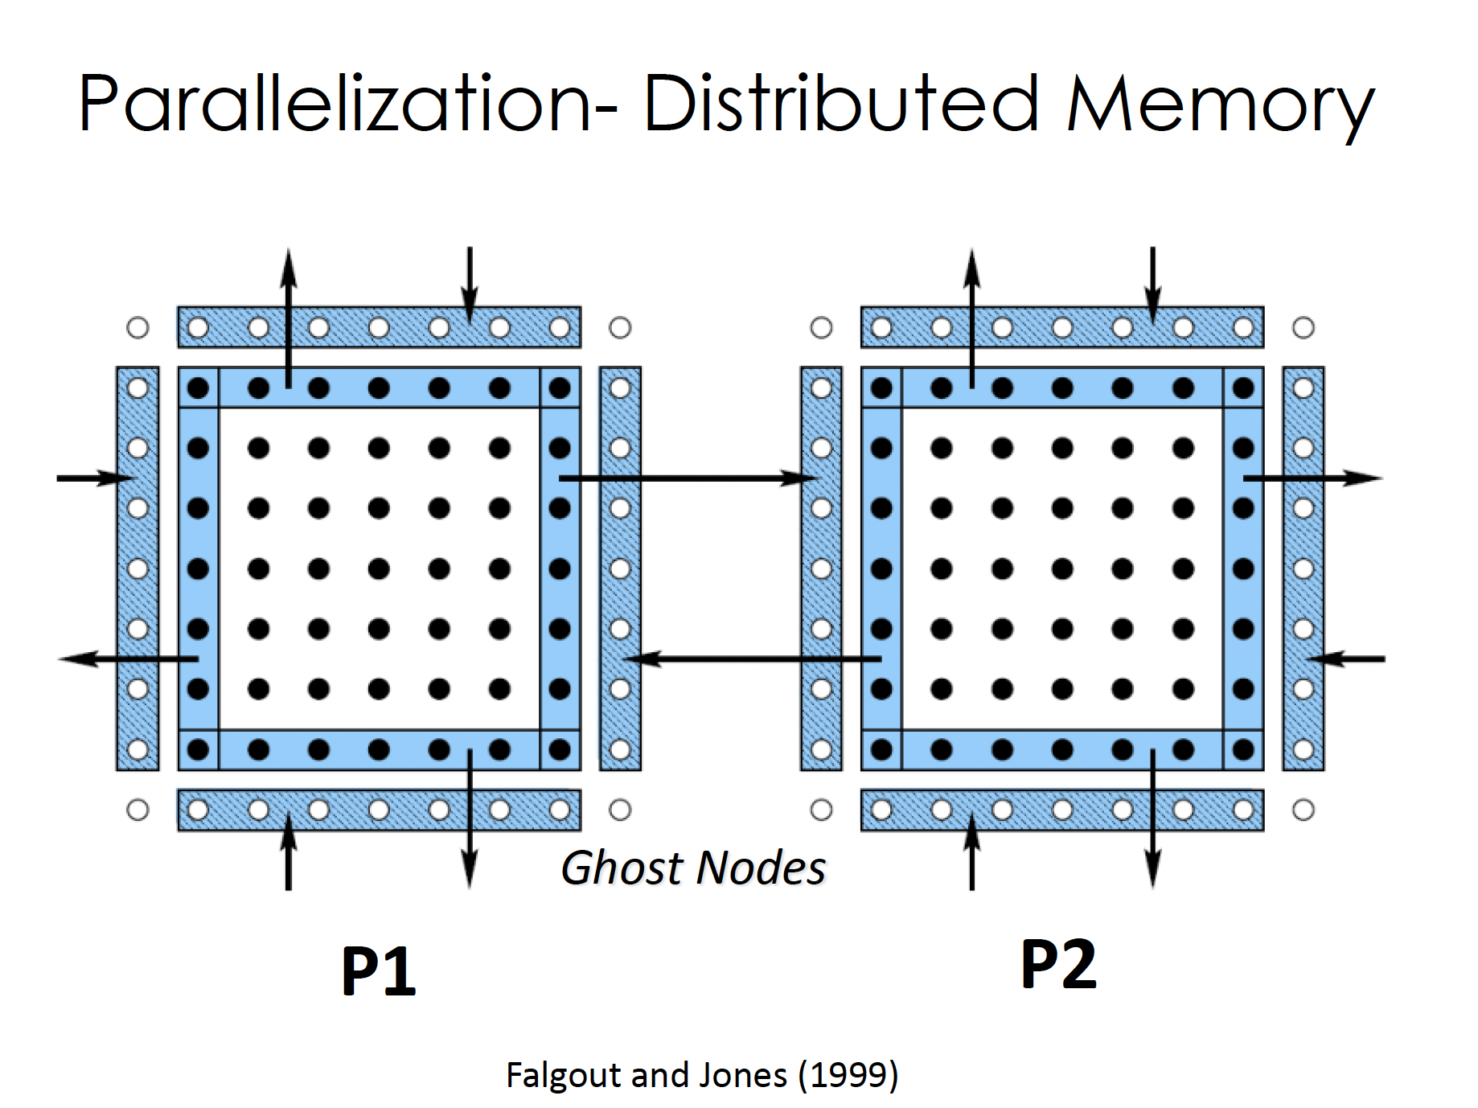

Slide 22
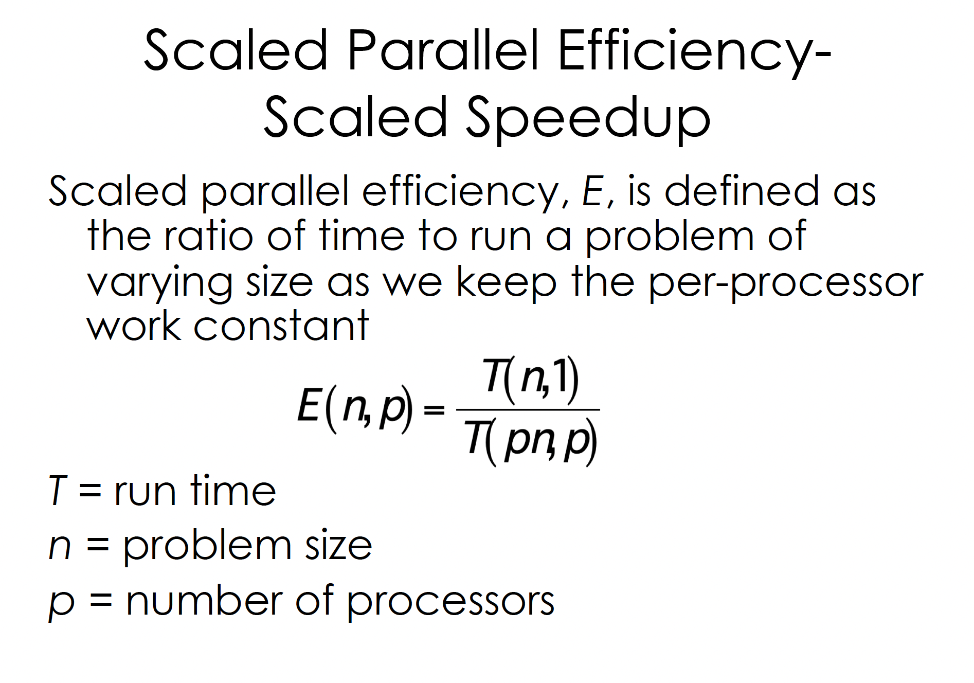

Slide 23
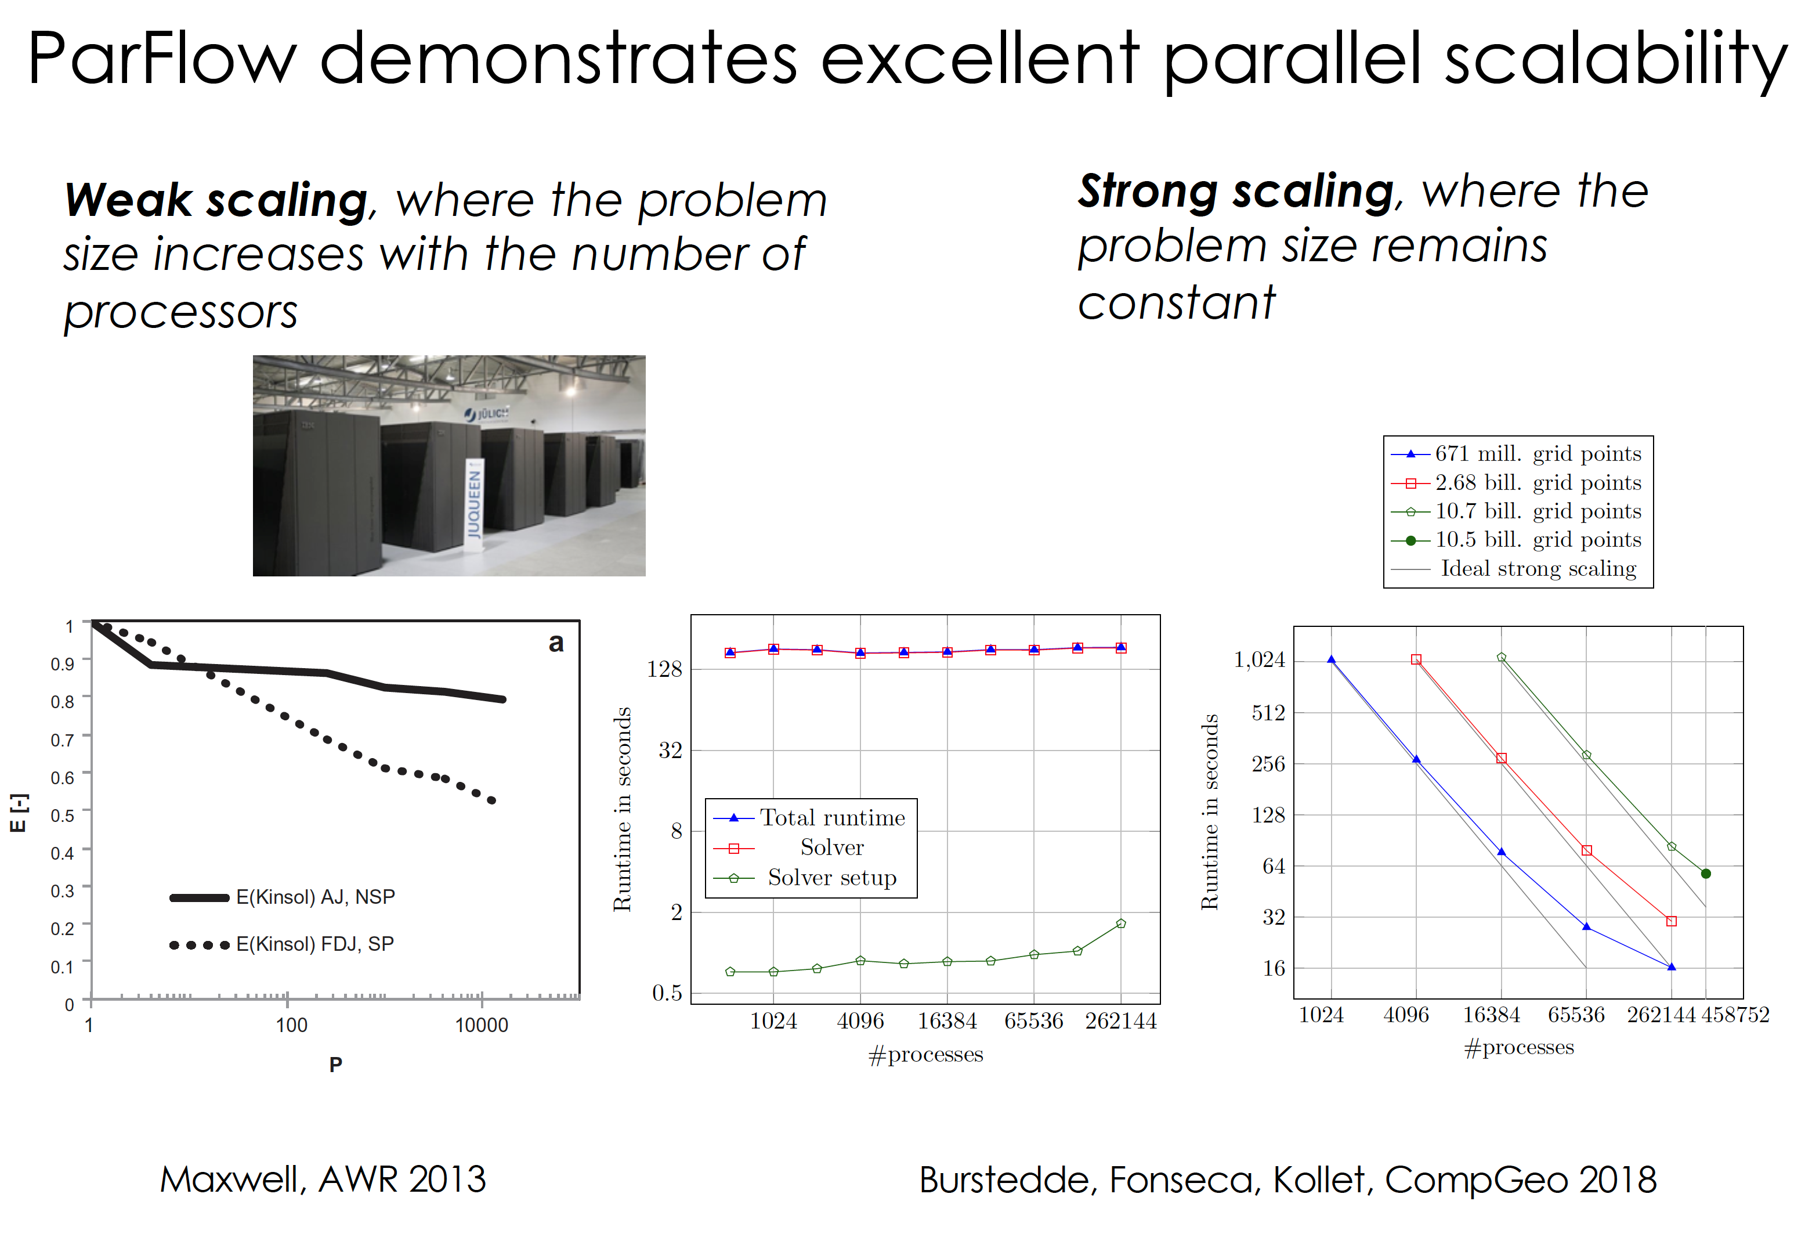

Slide 24
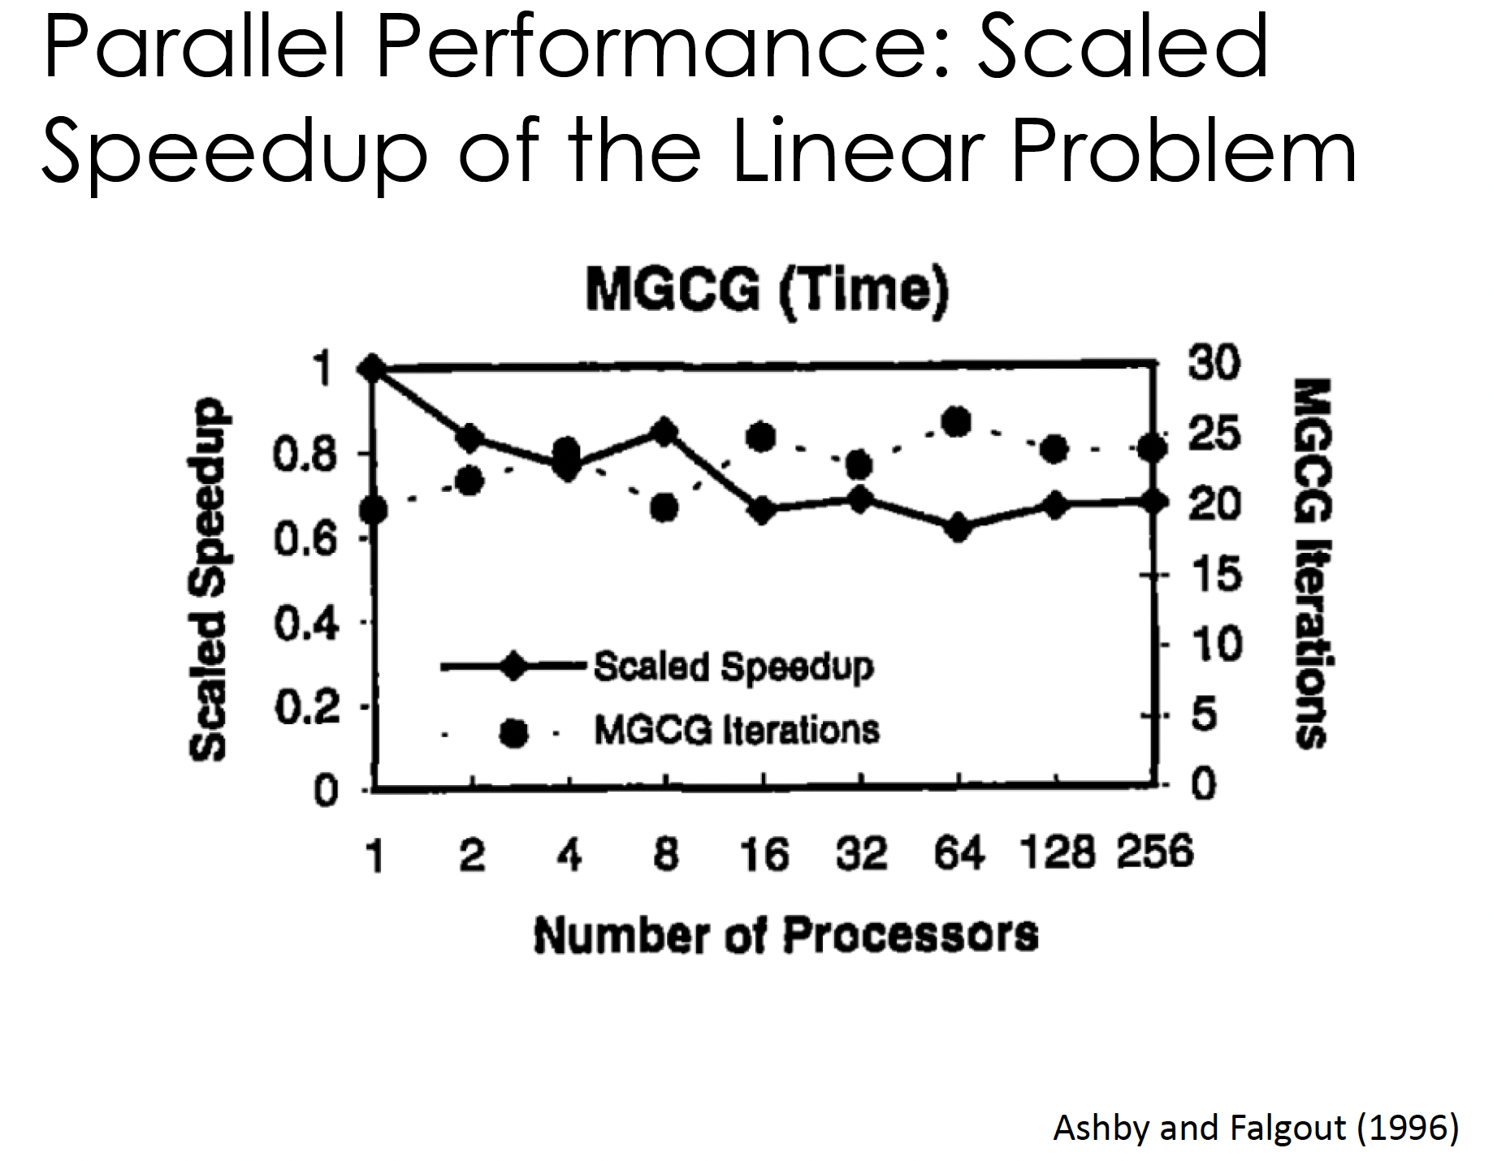

Slide 25
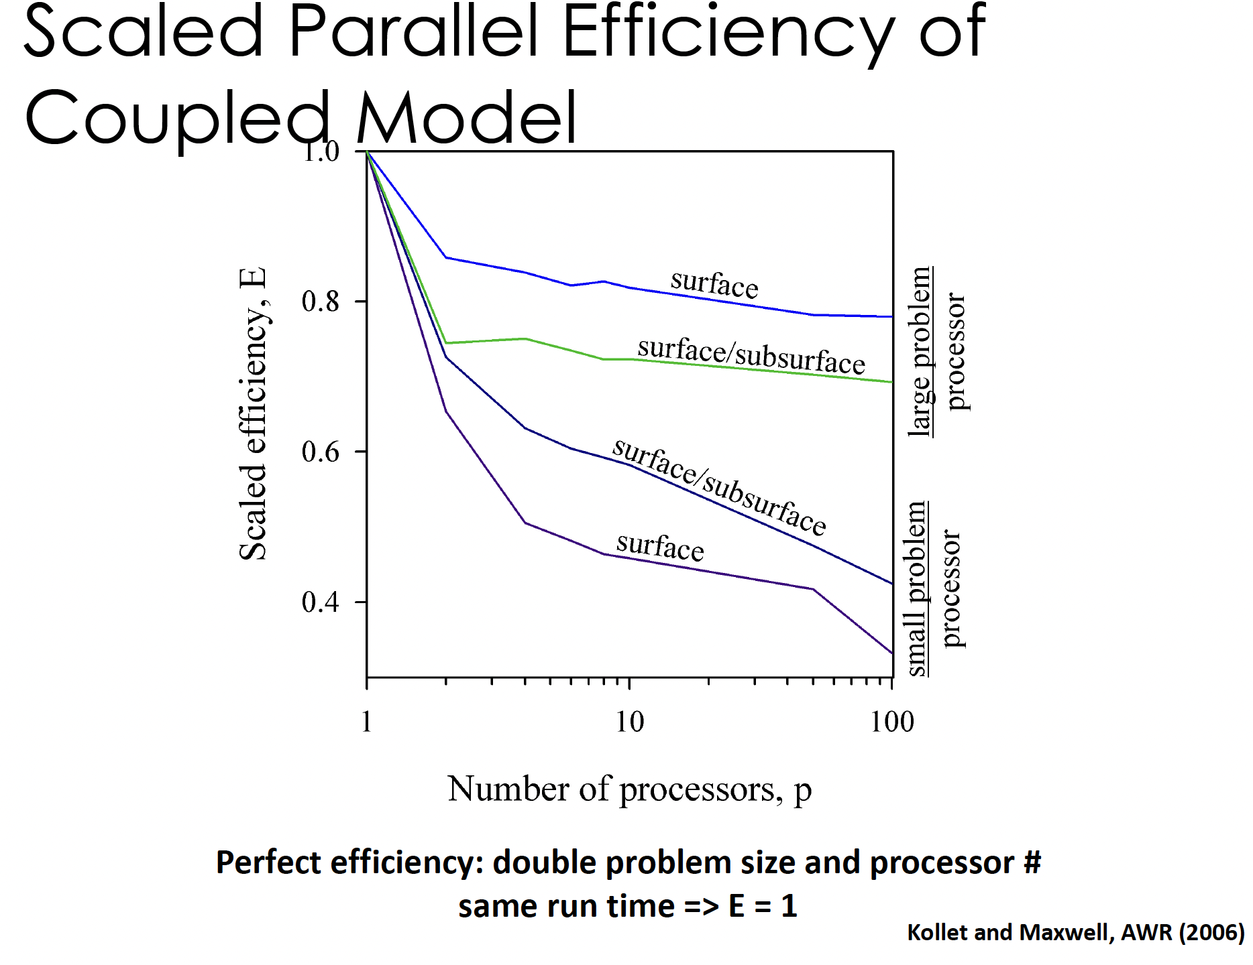

Slide 26
Thank you!

Slide 27
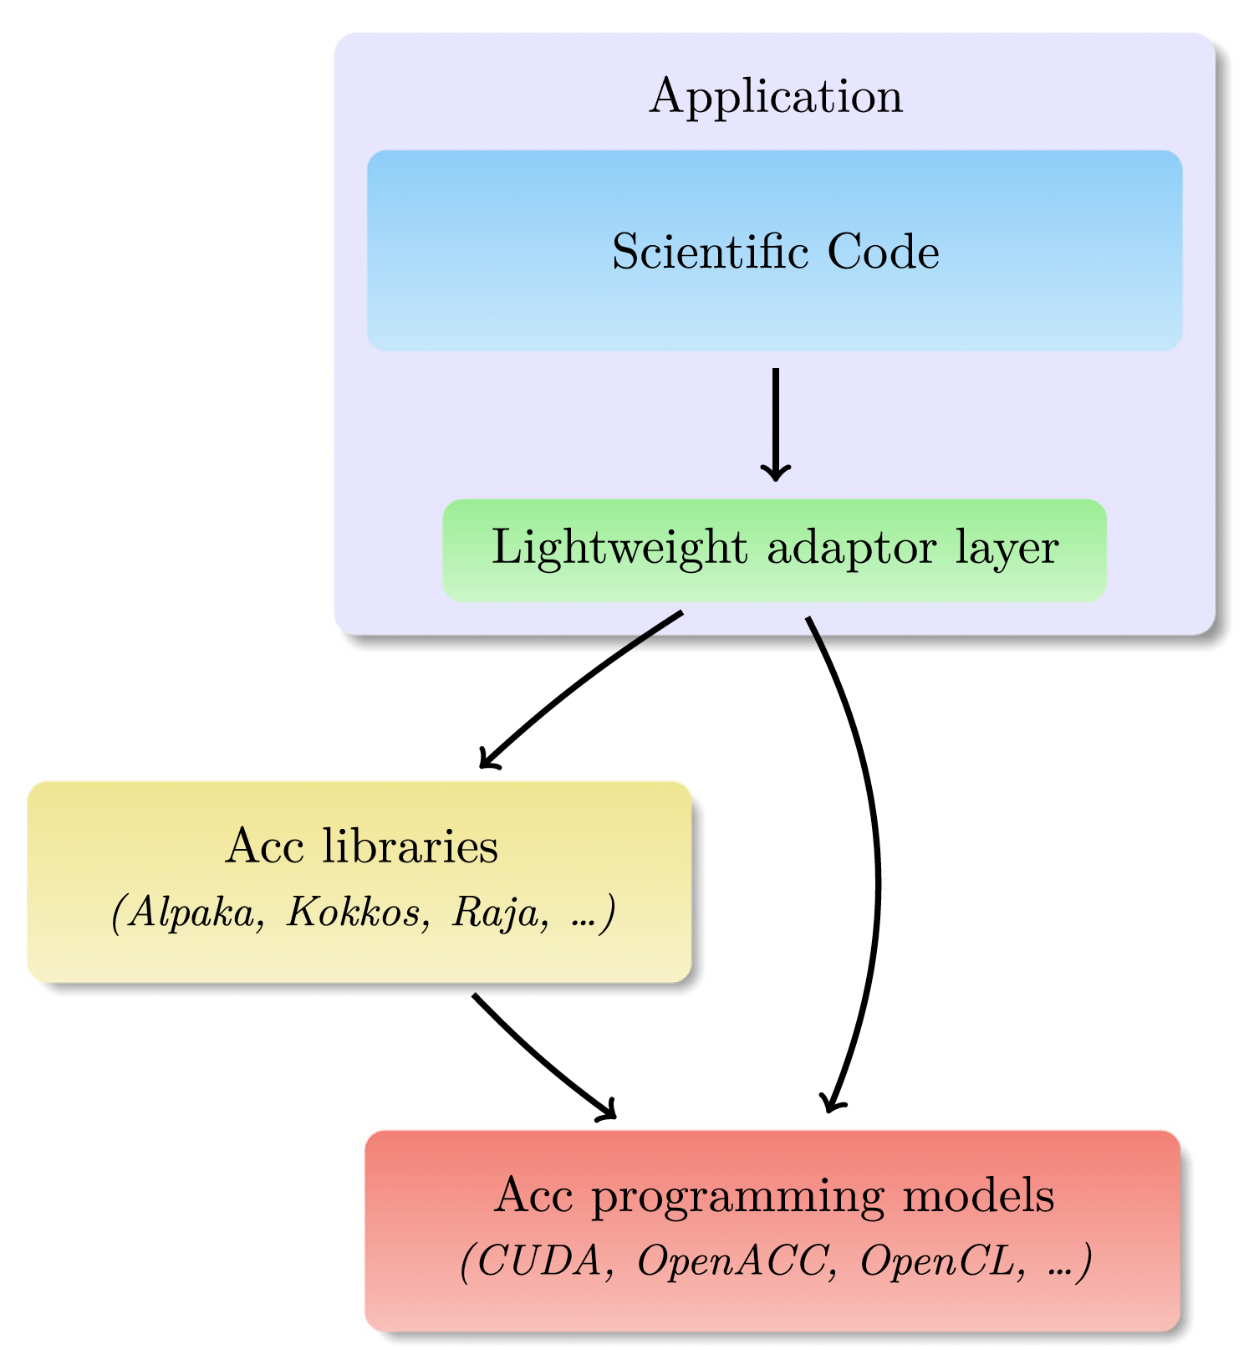
ParFlow GPU并行
Hokkanen et al., 2021

Slide 28
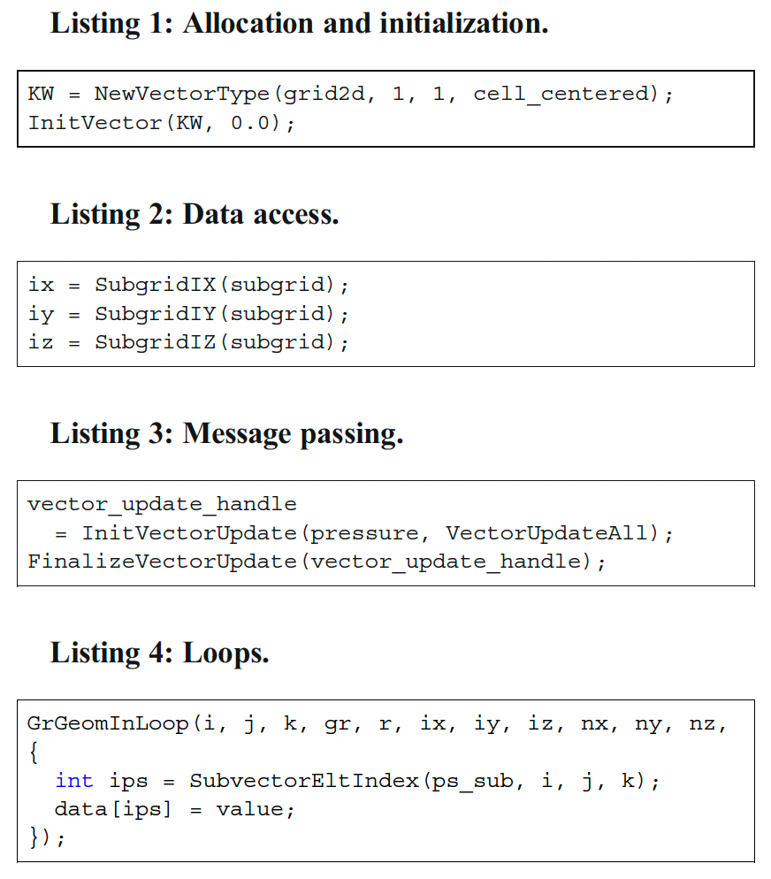
ParFlow embedded domain-specific language
(ParFlow eDSL)

Slide 29


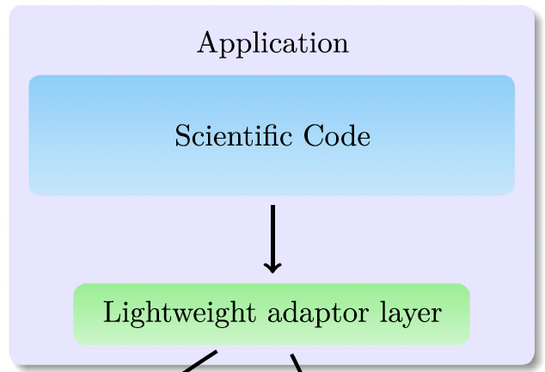
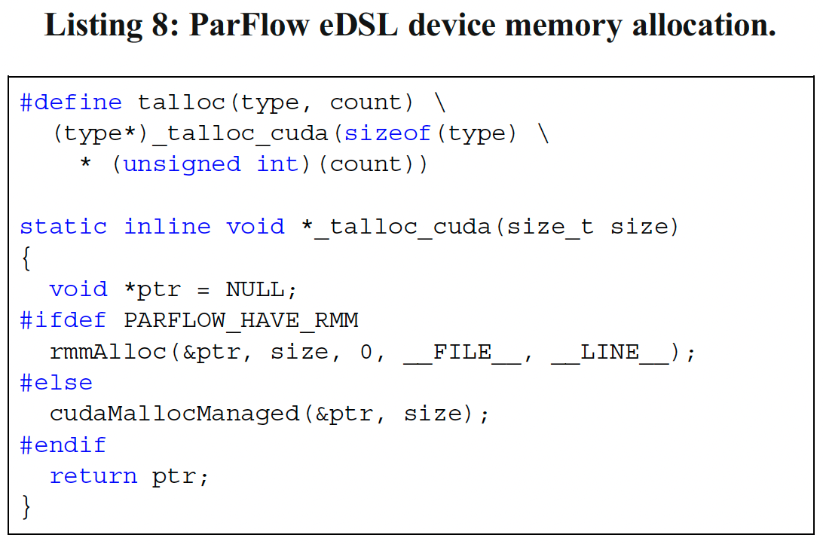
Rapids Memory Manager (RMM)

Slide 30
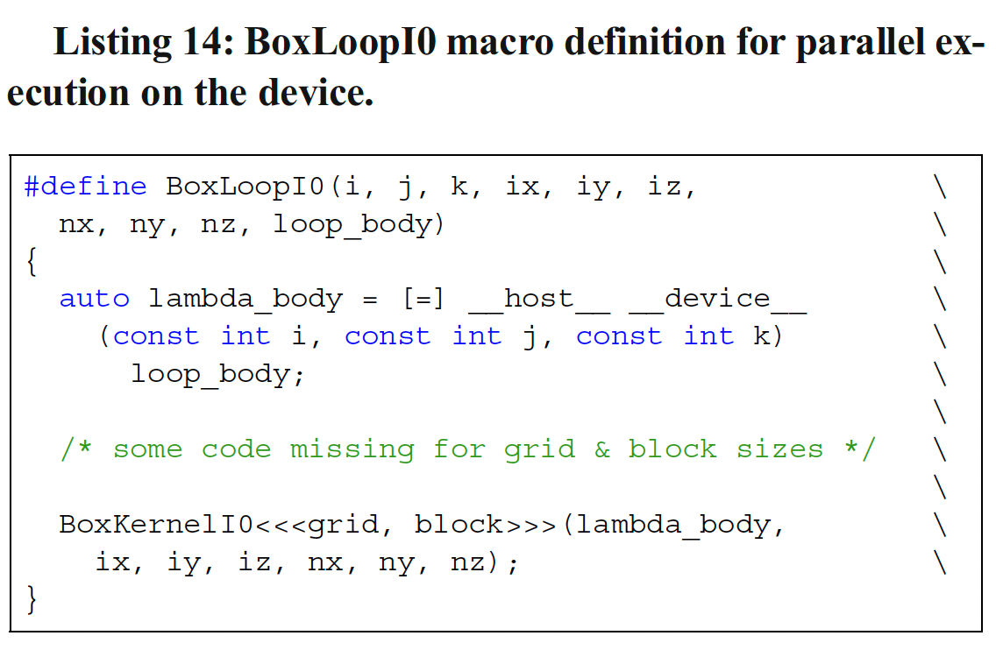
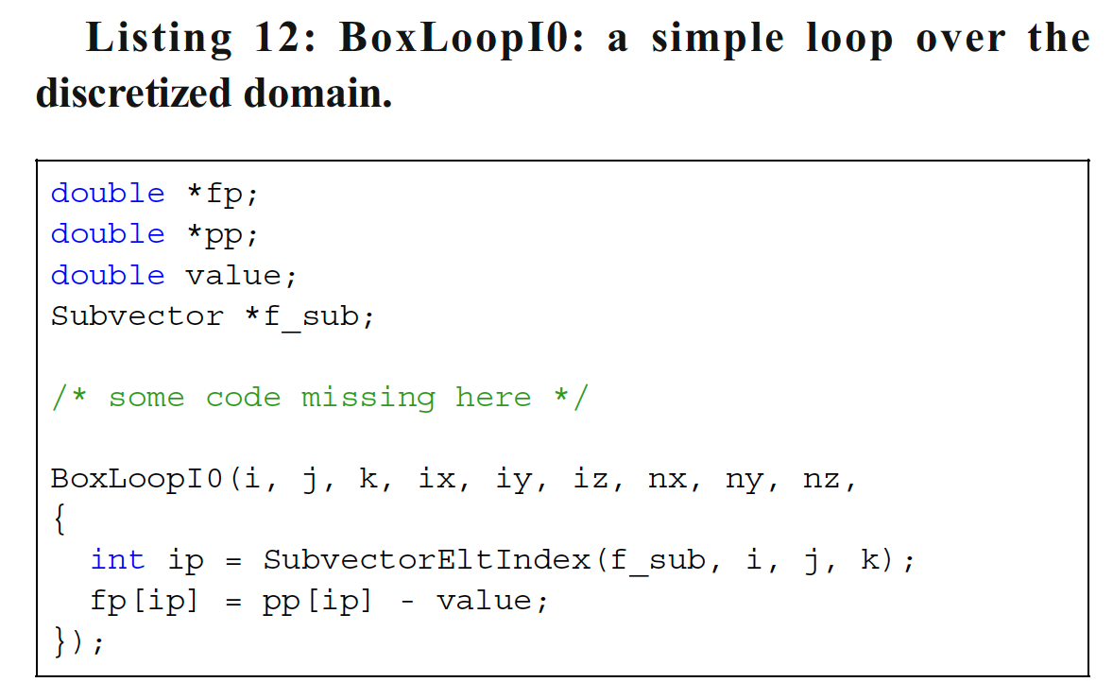
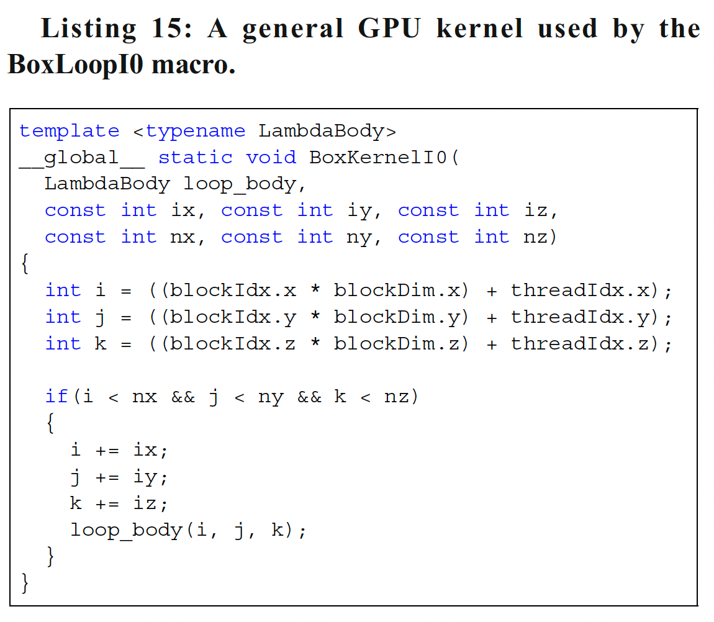
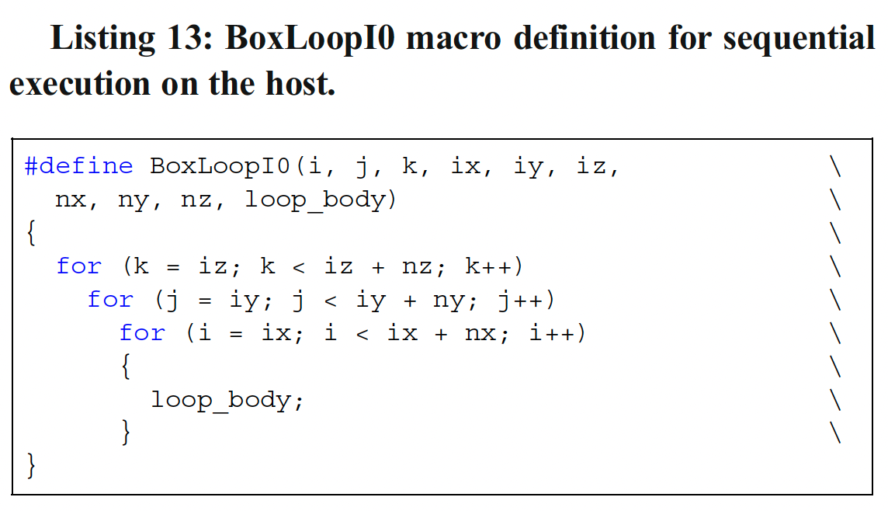
extended host-device lambda
GPU
CUDA Kernel
CPU

Slide 31


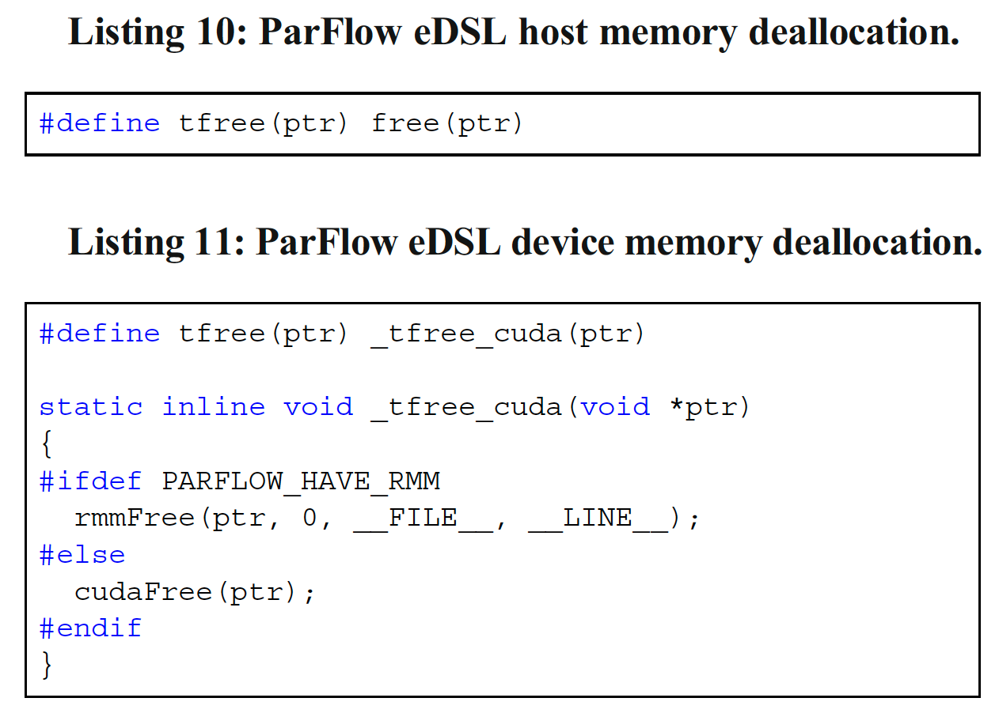


Slide 32
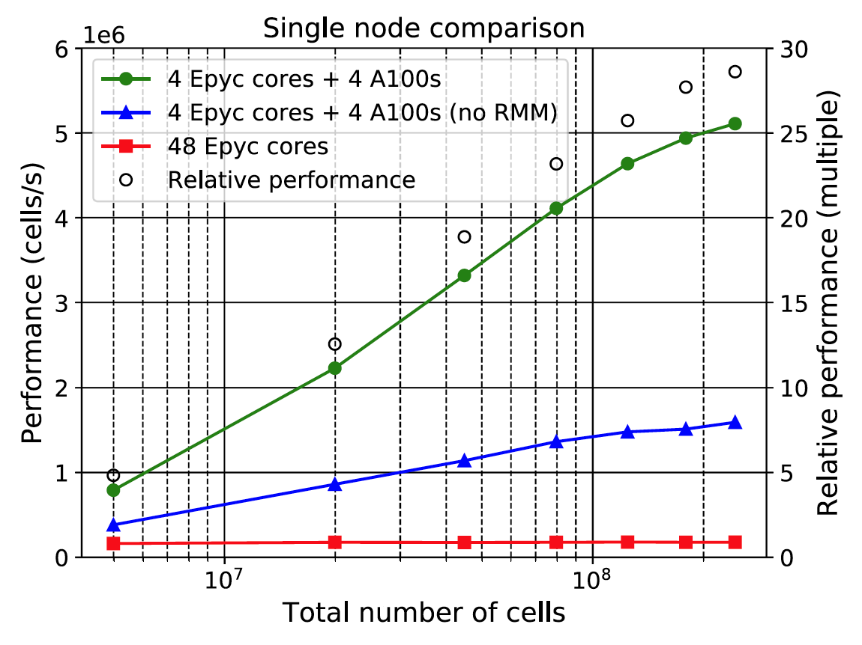

1个node
任务量增加

Slide 33
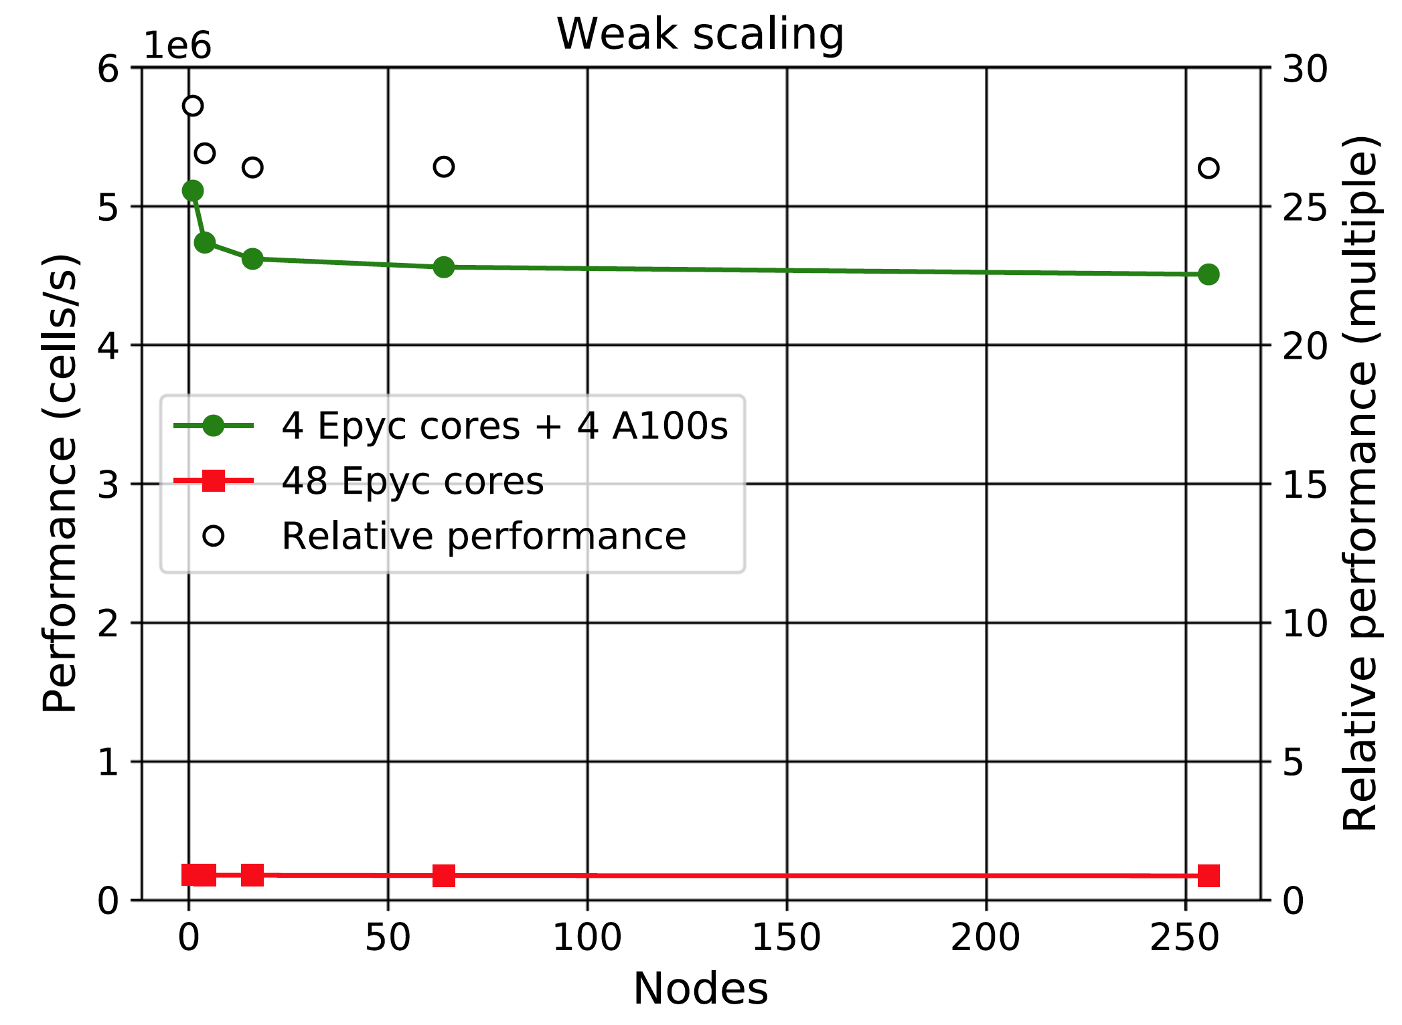
任务量不变
增加nodes

