Slide 1
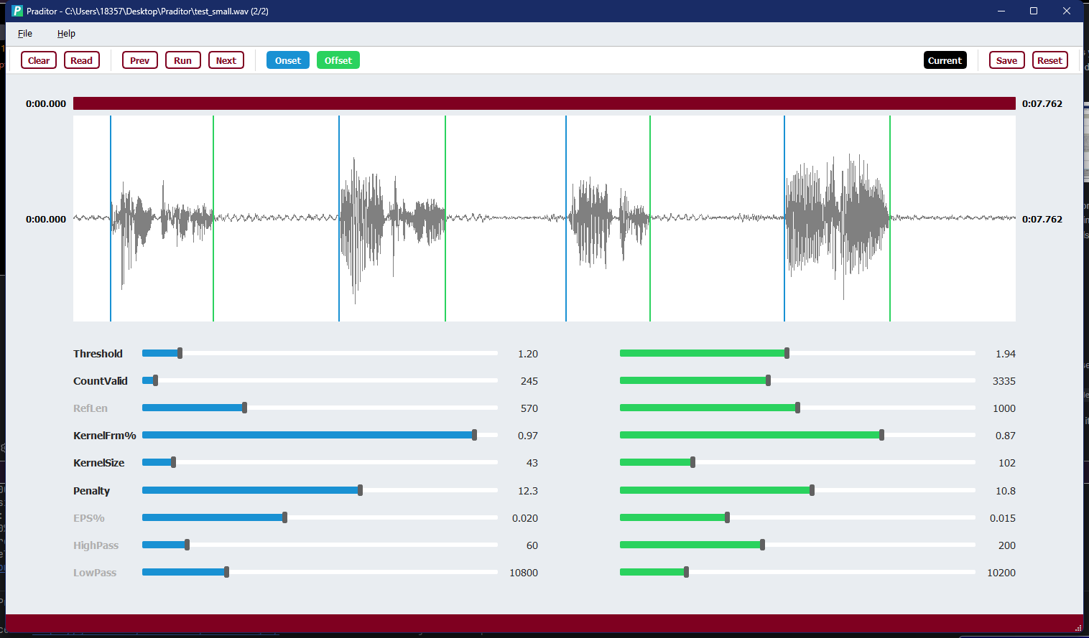
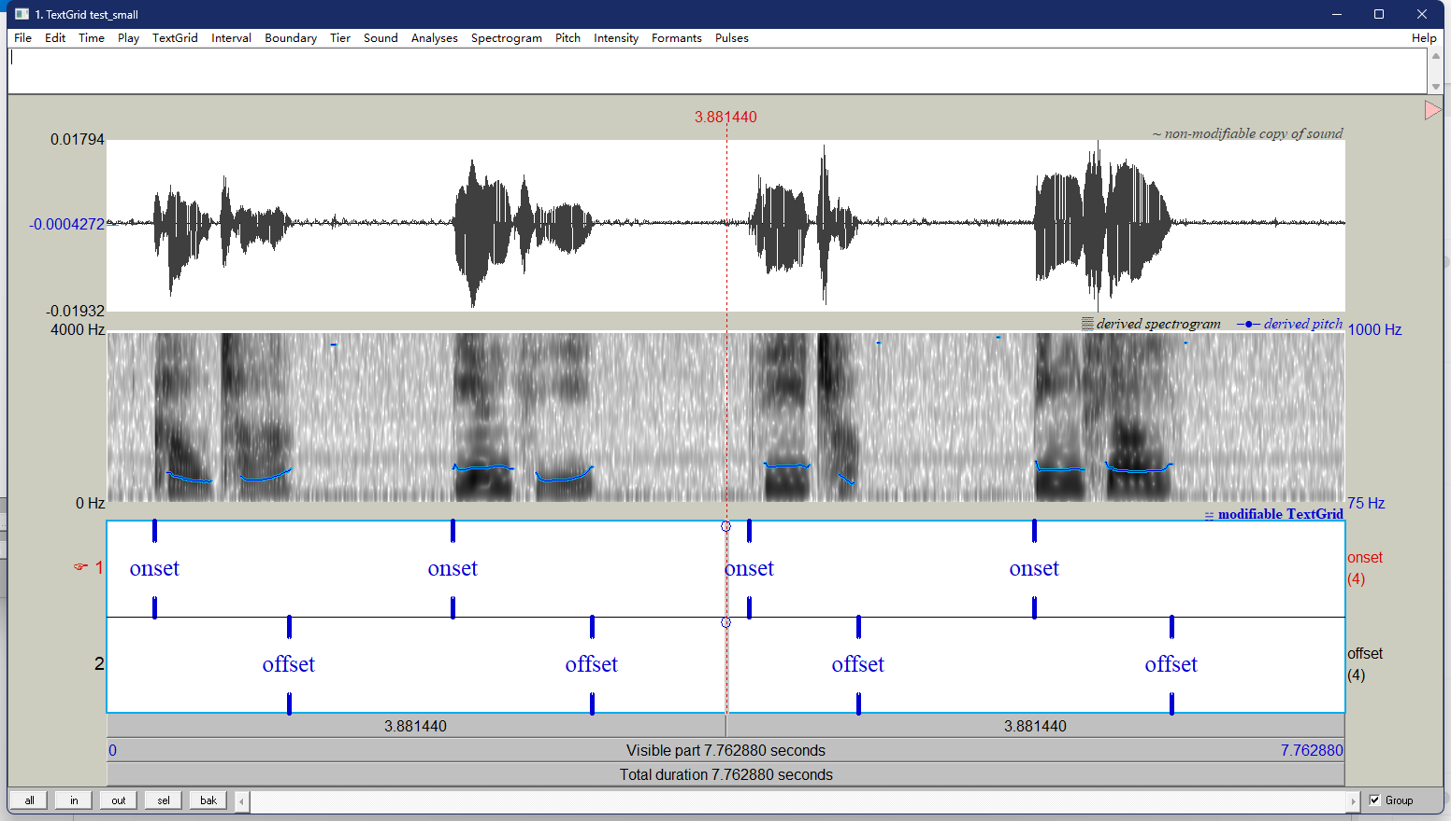

Slide 2
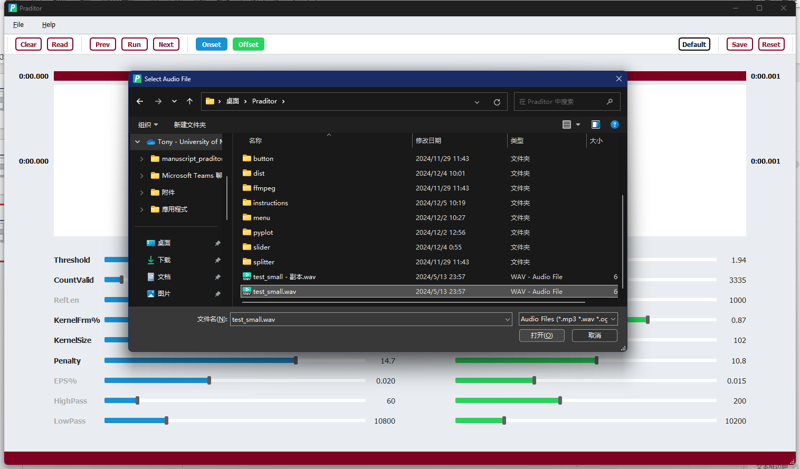


Slide 3
3.0
Cliff
1.2
actual noise (abs)
1.0
mean amplitude
As Close As Possible

Slide 4
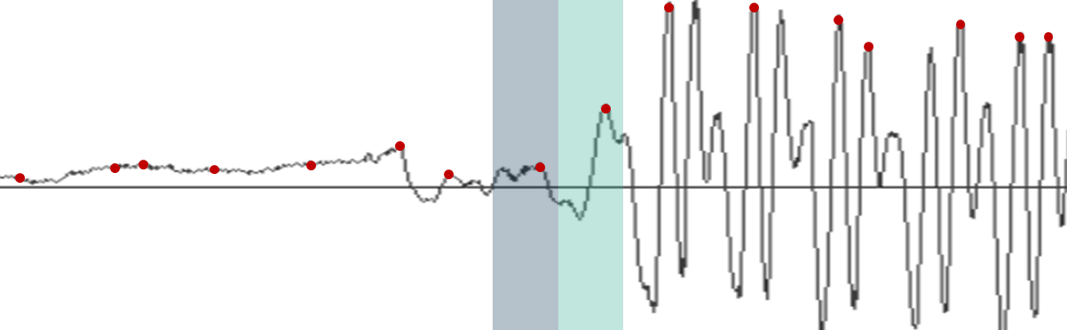
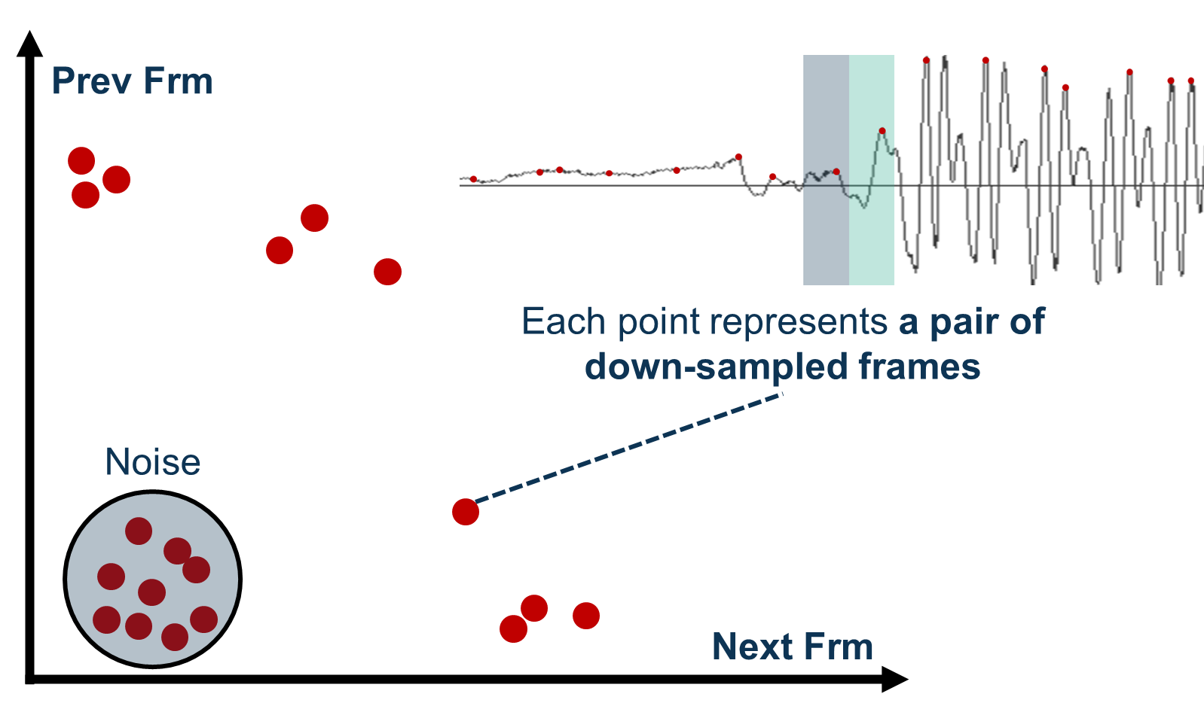
Prev Frm
Each point represents a pair of down-sampled frames
Noise
Next Frm

Slide 5
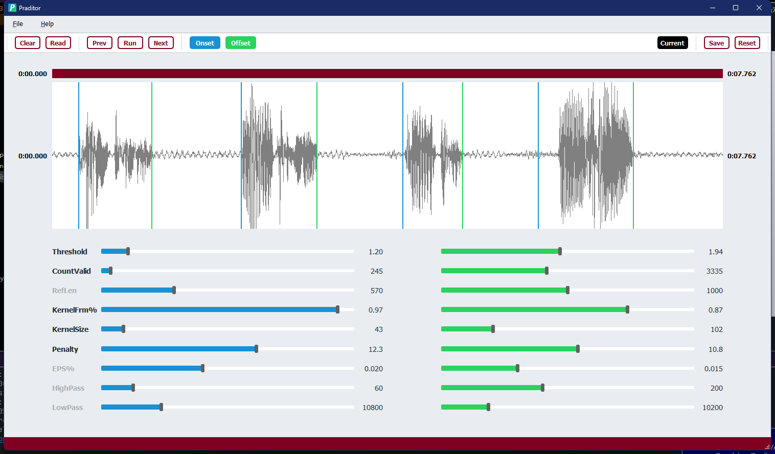

Slide 6

Praditor |
Speech Onset Detection

Slide 7
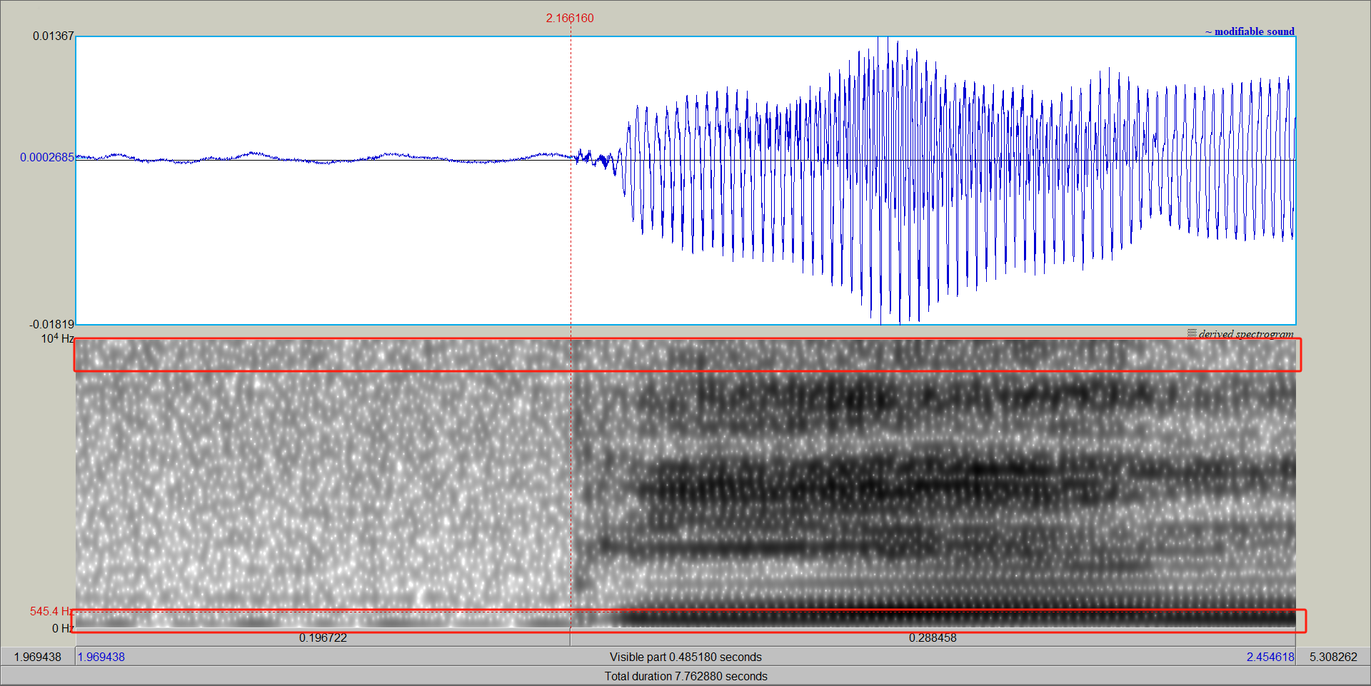

Slide 8
ValidCount = 3 Penalty = 1
ValidCount = 3 Penalty = 2
ValidCount = 7 Penalty = 2

Slide 9
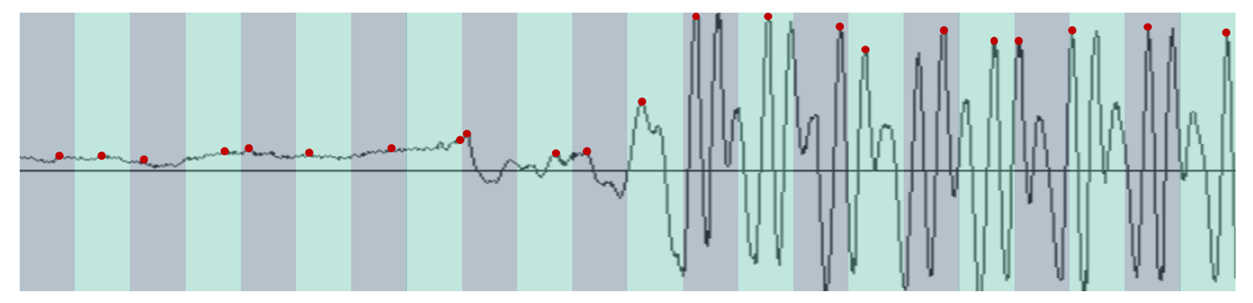

Slide 10
