Slide 1
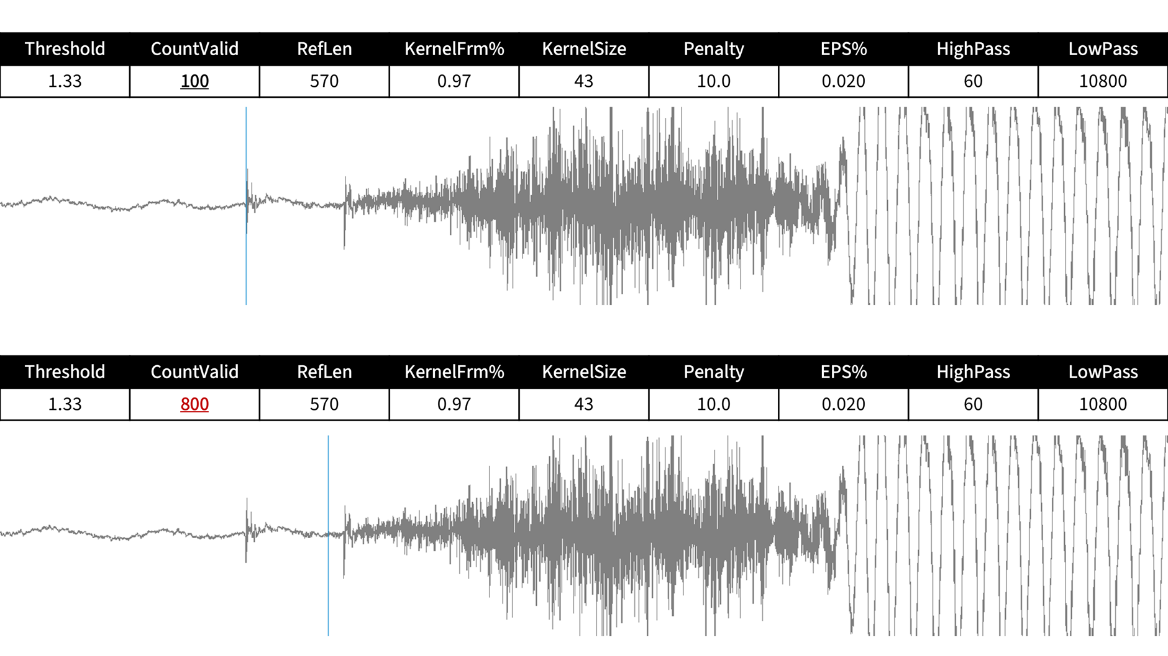
NetActive
NetActive

Slide 2
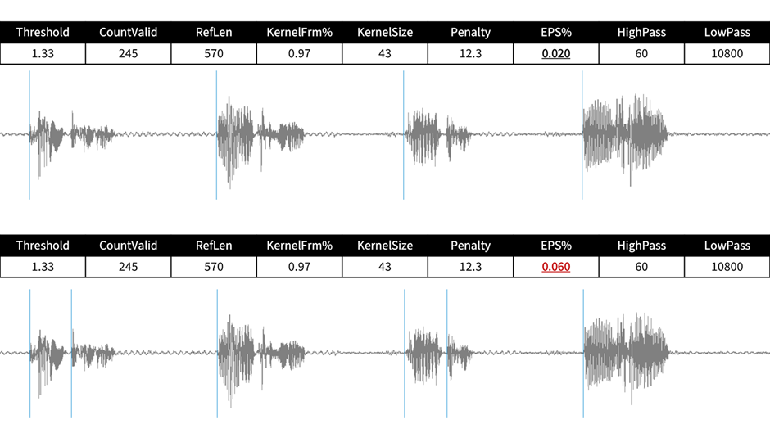
NetActive
NetActive

Slide 3
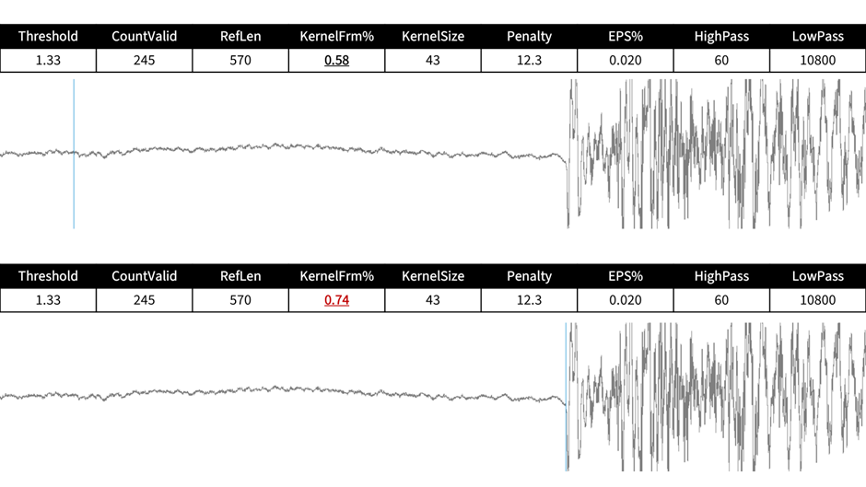
NetActive
NetActive

Slide 4
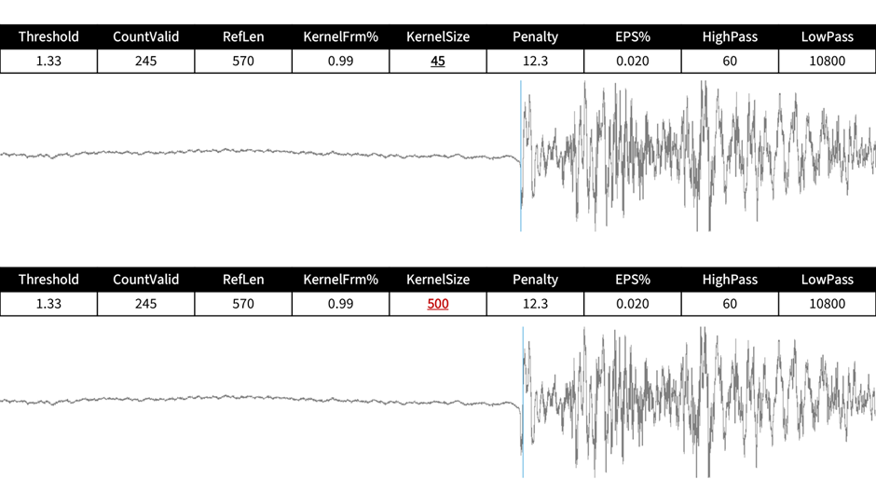
NetActive
NetActive

Slide 5
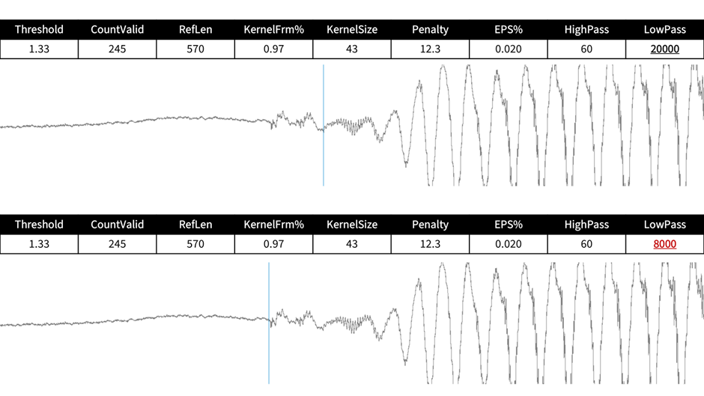
NetActive
NetActive

Slide 6
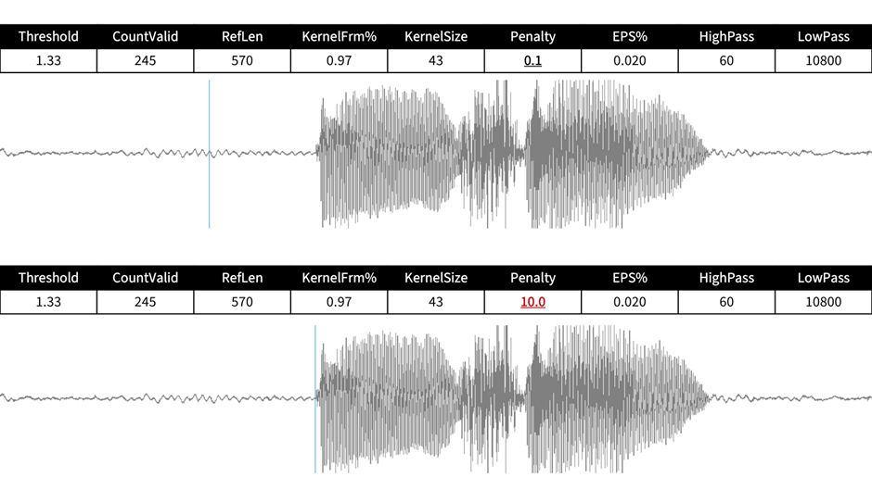
NetActive
NetActive

Slide 7
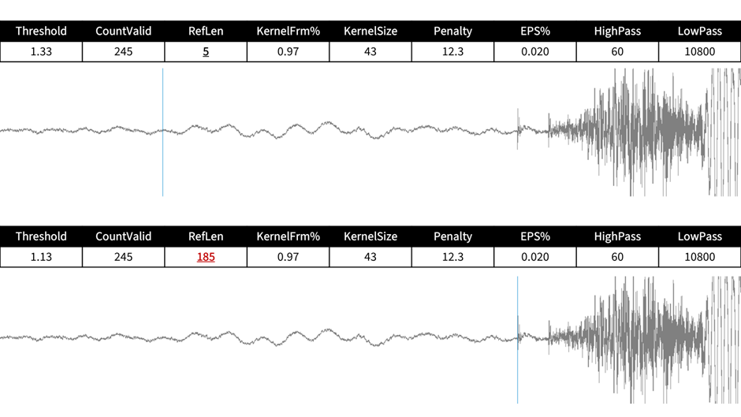
NetActive
NetActive

Slide 8
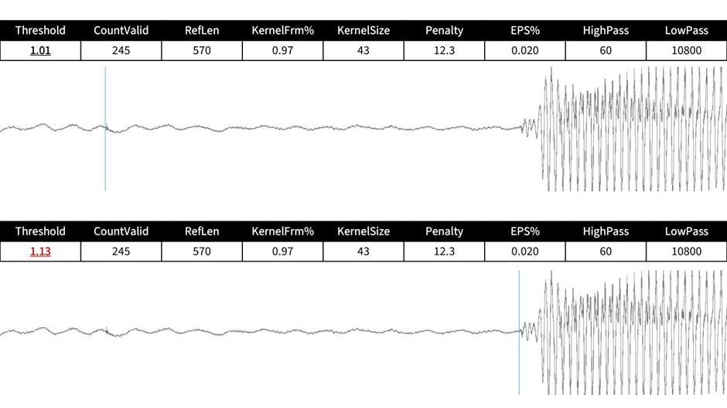
NetActive
NetActive

