Slide 1
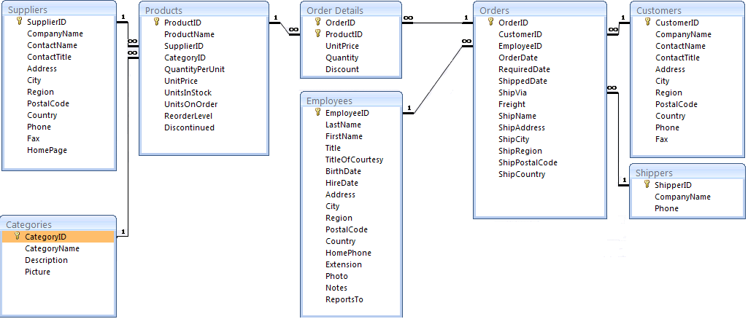
Class Example: NorthWind - Table Design (schema, table design)
Notes:
The table design of Northwind database.

