Slide 1
FastMdAnalysis Benchmarks – Trp-cage 500
Runtime, memory, and usability comparisons versus MDTraj and MDAnalysis
Note: third-party metrics include helper scripts for exporting data and plots.
Dataset: Trp-cage 500

Slide 2
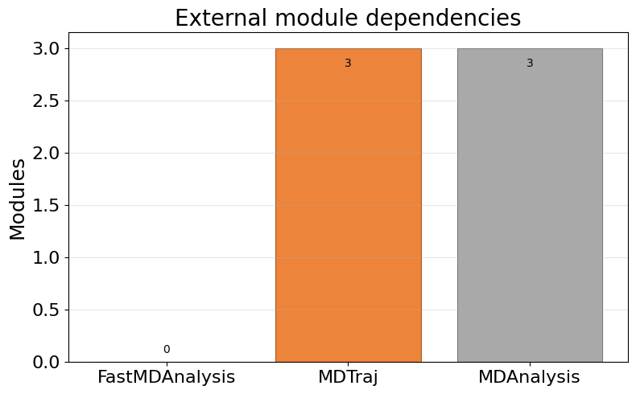
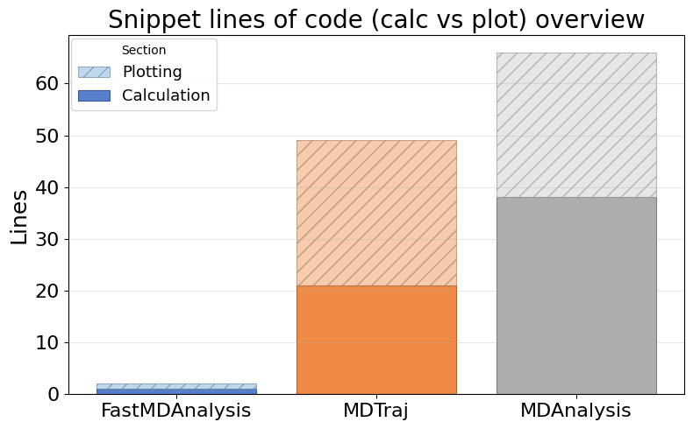
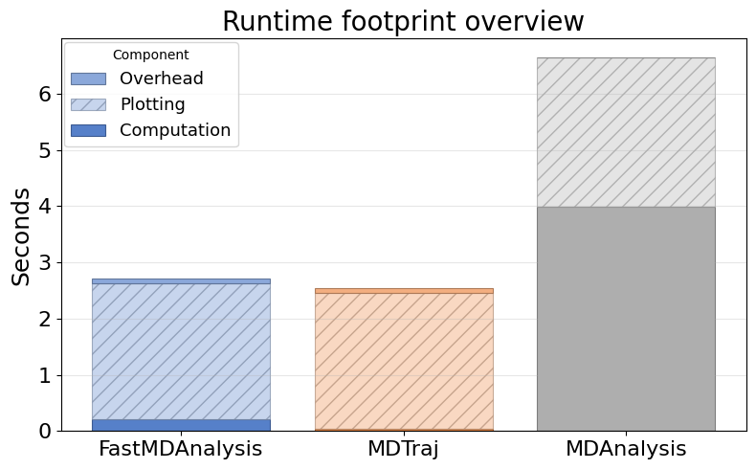
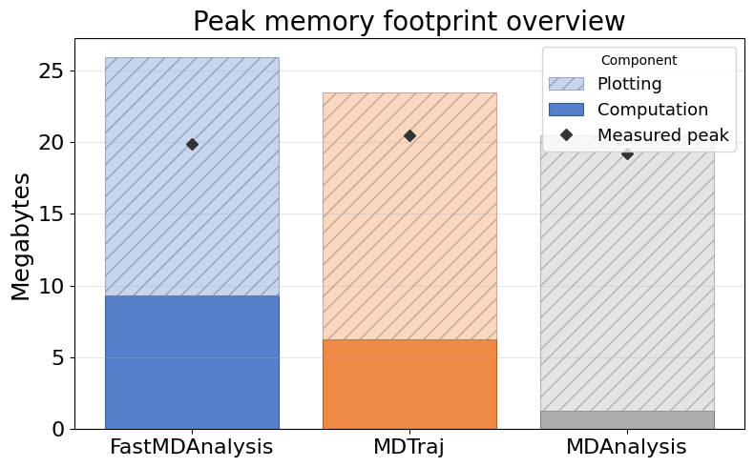
Overview: Dependencies, LOC, Runtime, Memory

Slide 3
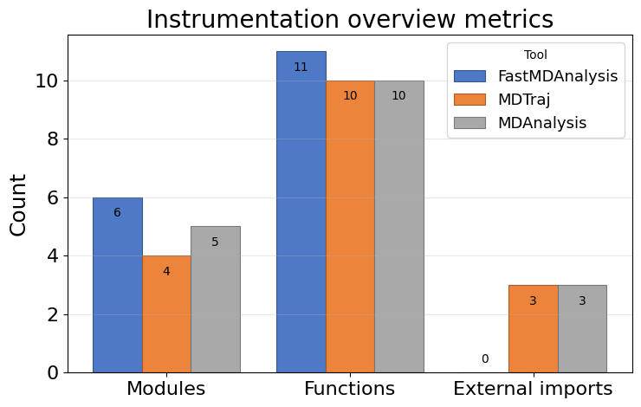
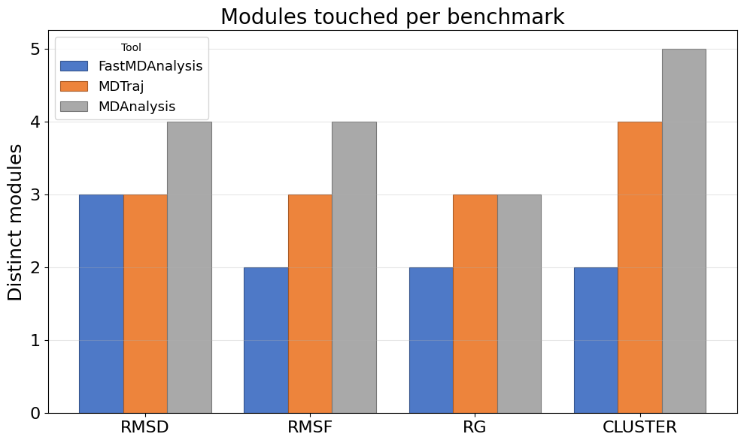
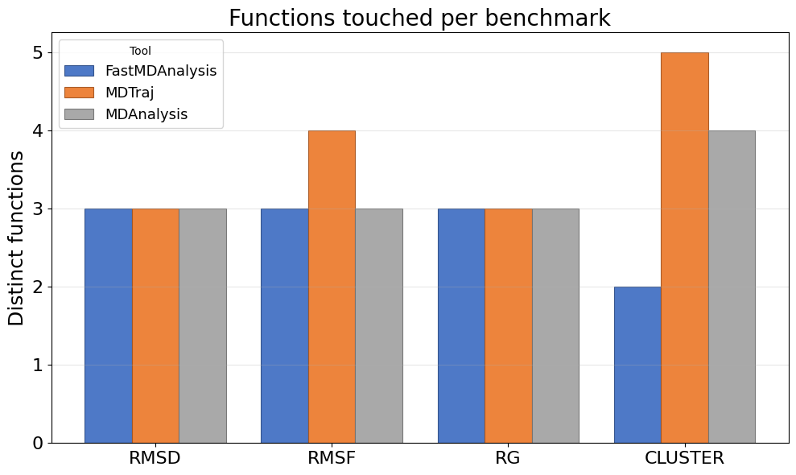
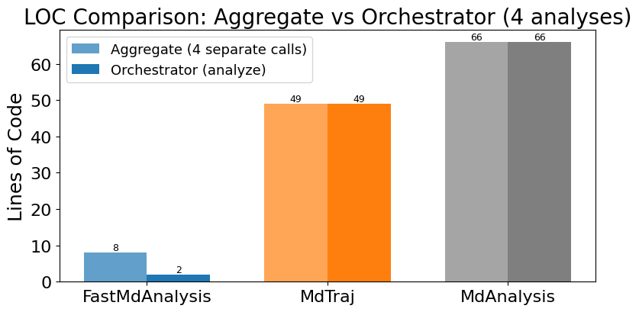
Instrumentation overview: touchpoints, modules, functions, LOC

Slide 4
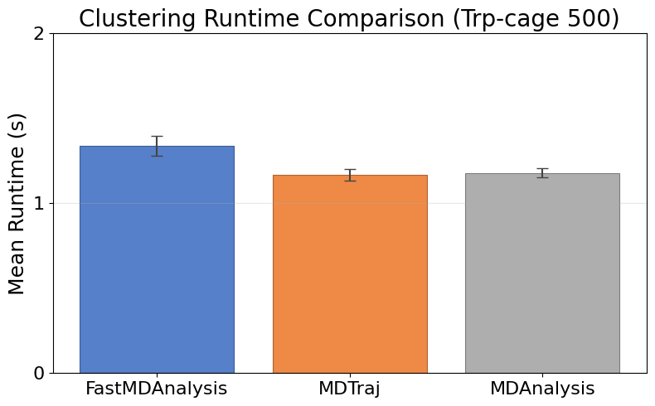
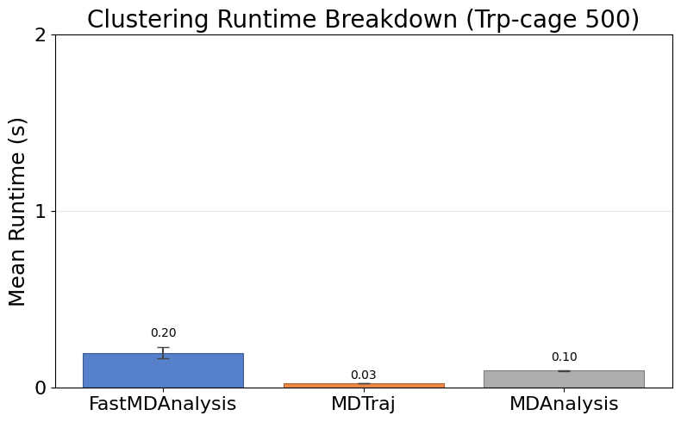
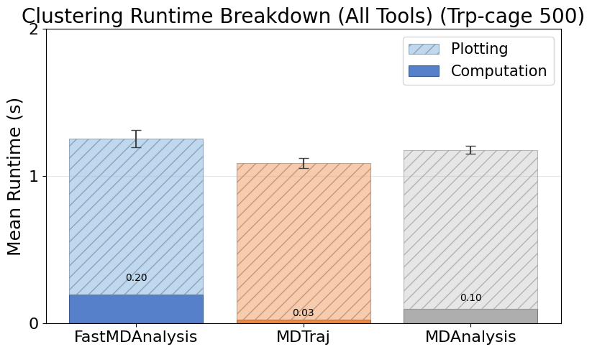
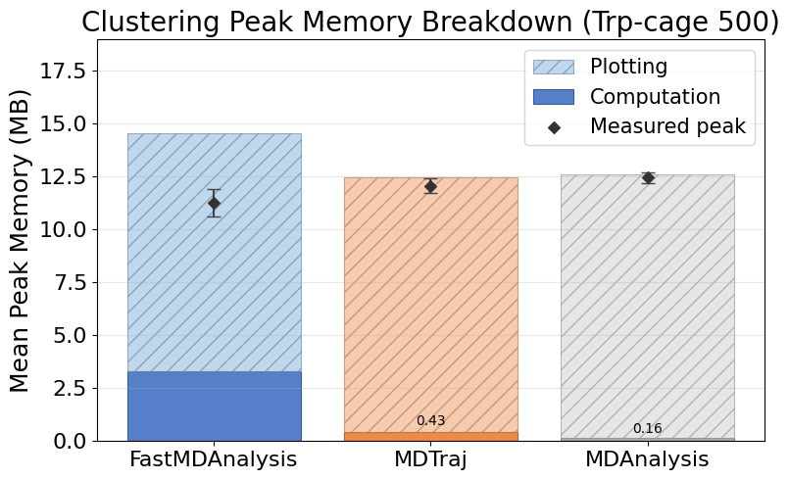
Cluster Trpcage 500
Note: MDTraj and MDAnalysis metrics include helper scripts we wrote to save data files and plots; their APIs do not emit those artifacts automatically.

Slide 5
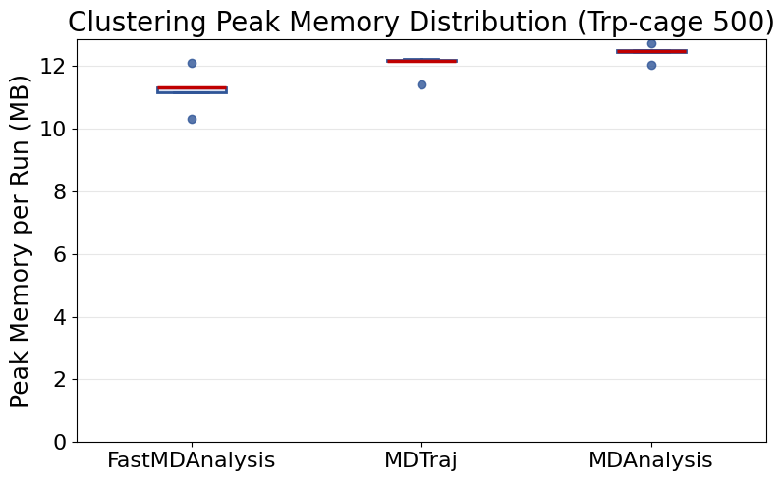
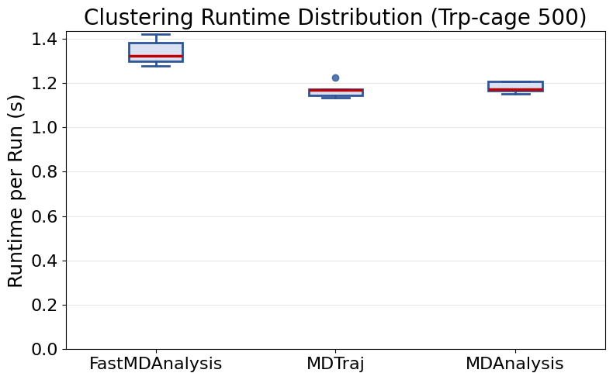
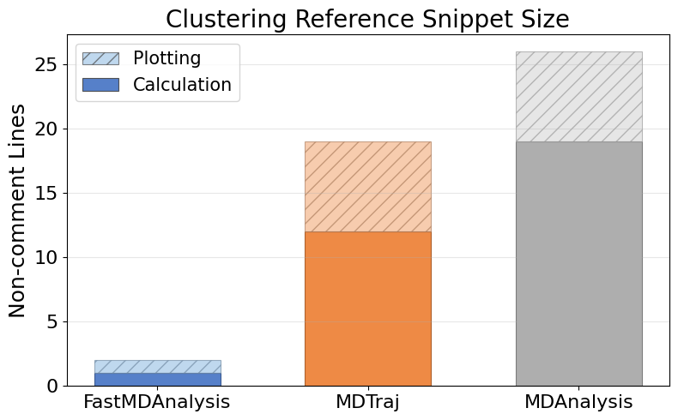
Cluster Trpcage 500 (continued)

Slide 6
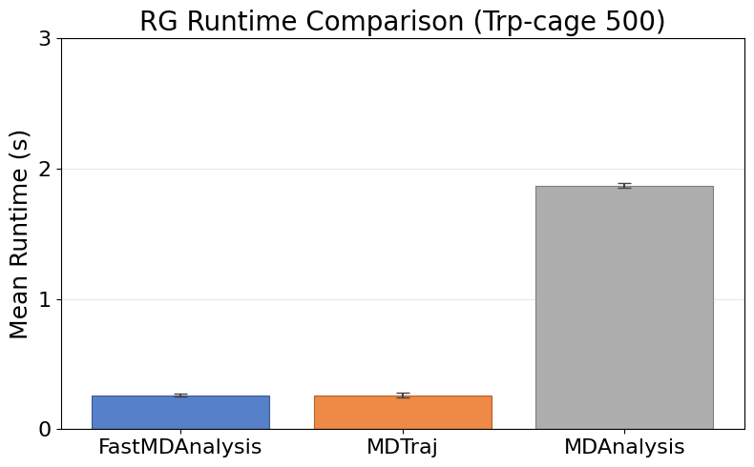
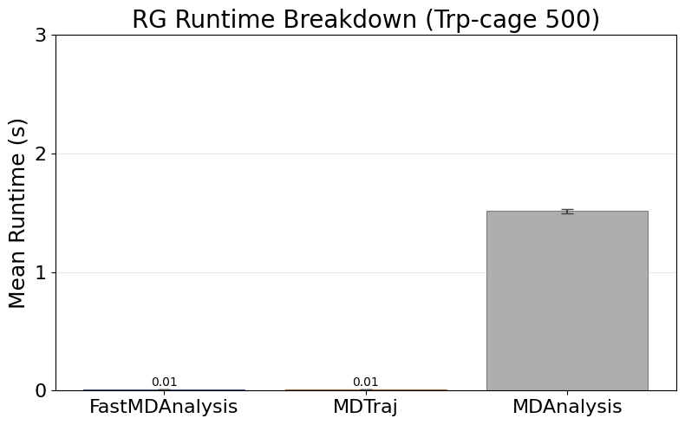
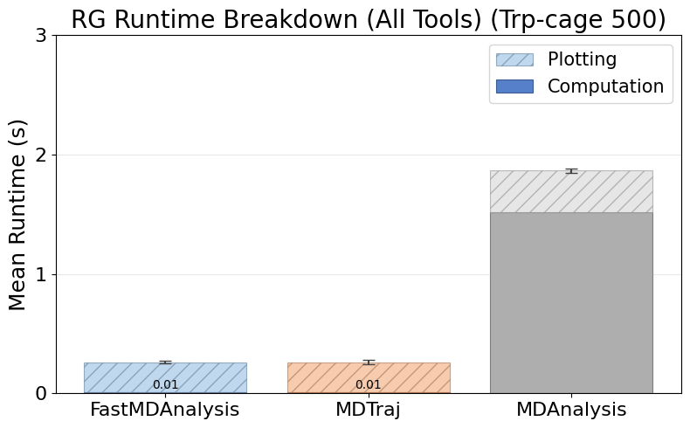
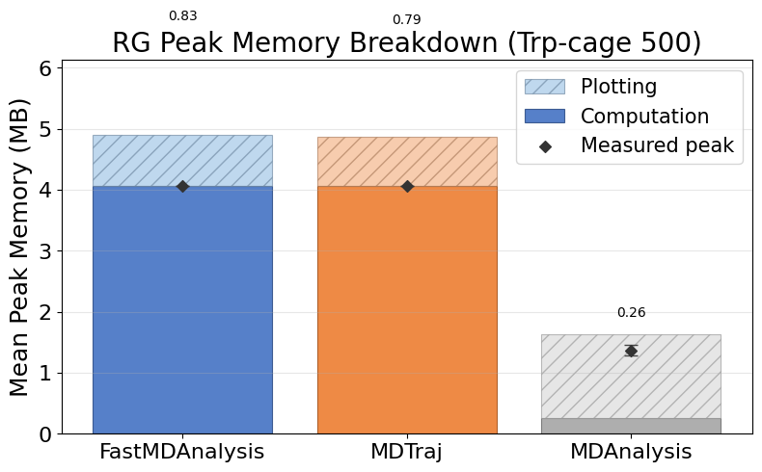
Rg Trpcage 500
Note: MDTraj and MDAnalysis metrics include helper scripts we wrote to save data files and plots; their APIs do not emit those artifacts automatically.

Slide 7
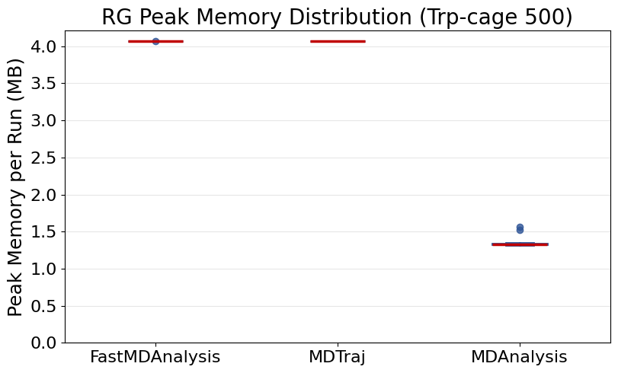
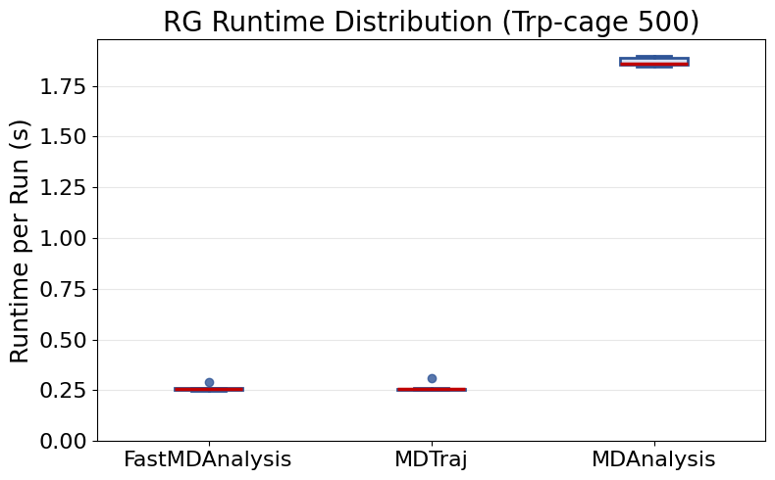
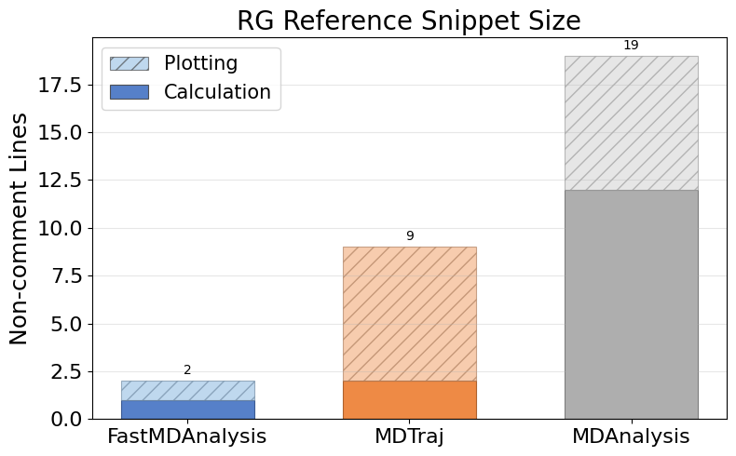
Rg Trpcage 500 (continued)

Slide 8
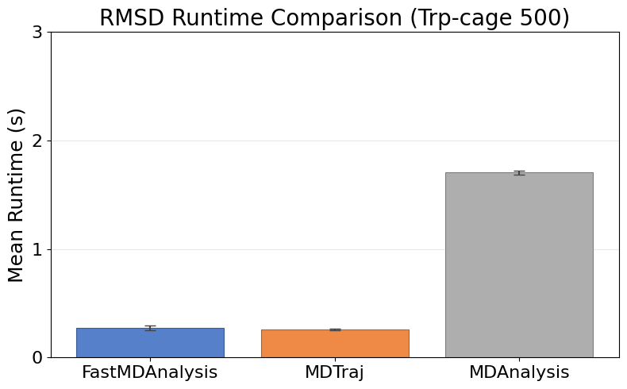
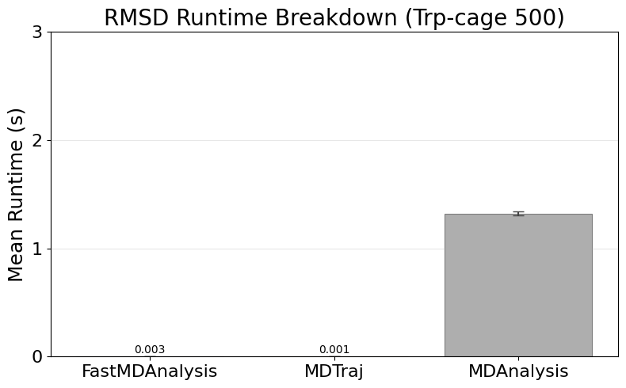
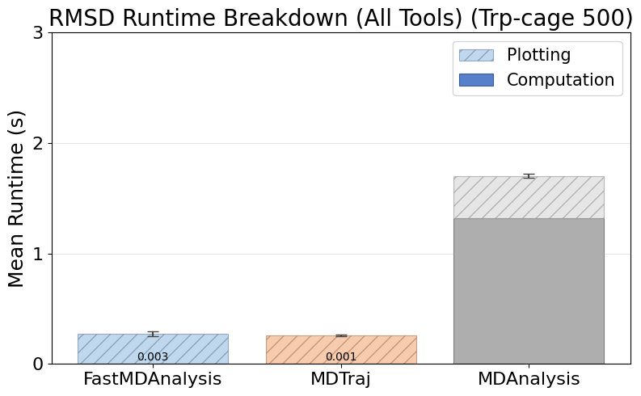
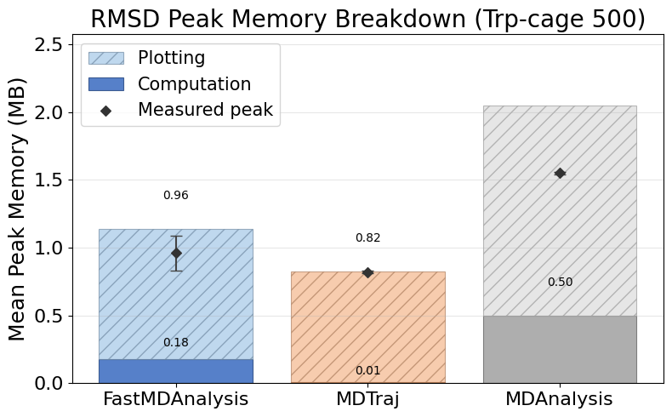
Rmsd Trpcage 500
Note: MDTraj and MDAnalysis metrics include helper scripts we wrote to save data files and plots; their APIs do not emit those artifacts automatically.

Slide 9
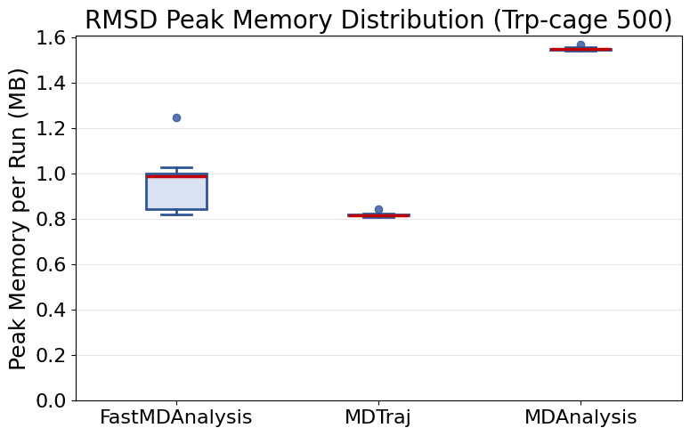
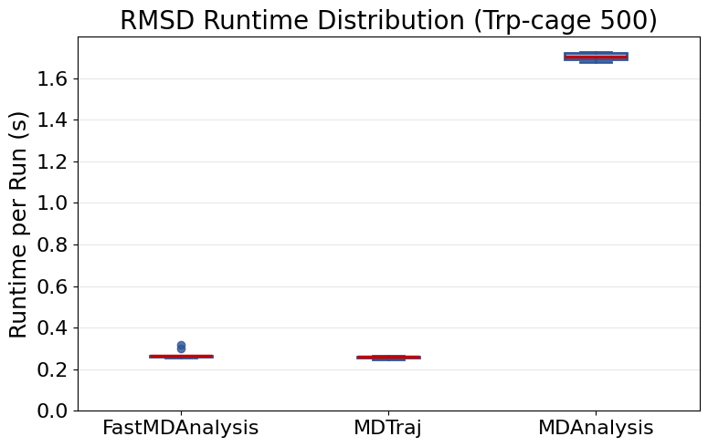
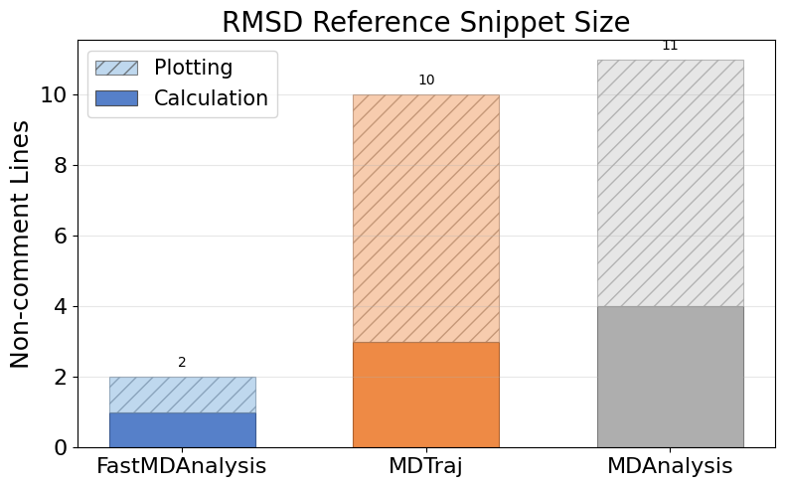
Rmsd Trpcage 500 (continued)

Slide 10
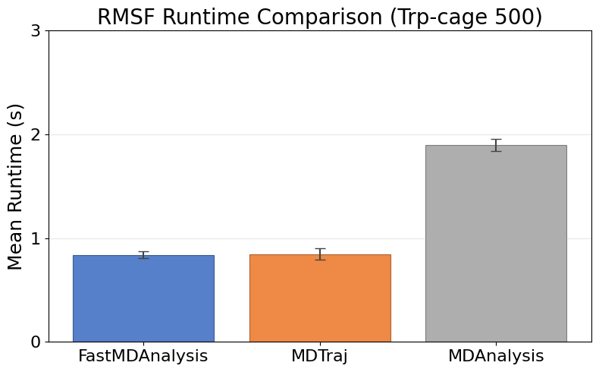
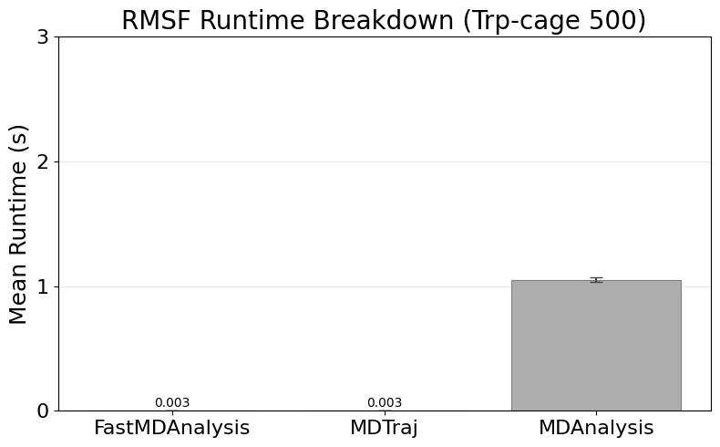
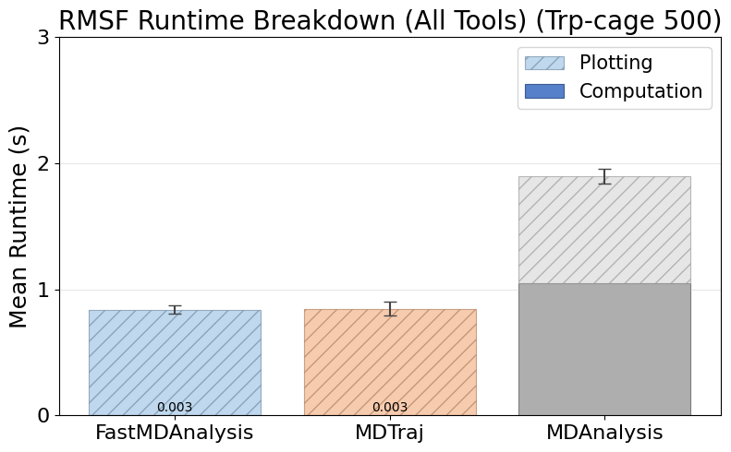
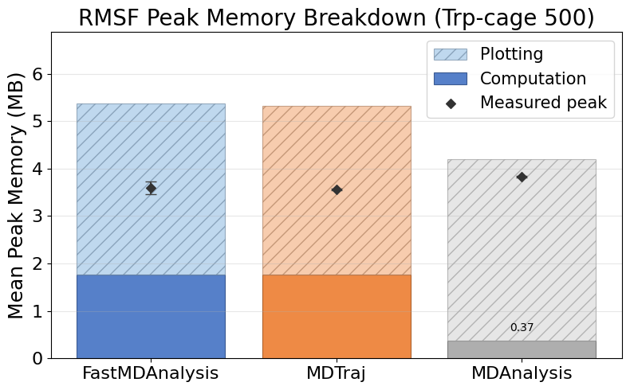
Rmsf Trpcage 500
Note: MDTraj and MDAnalysis metrics include helper scripts we wrote to save data files and plots; their APIs do not emit those artifacts automatically.

Slide 11
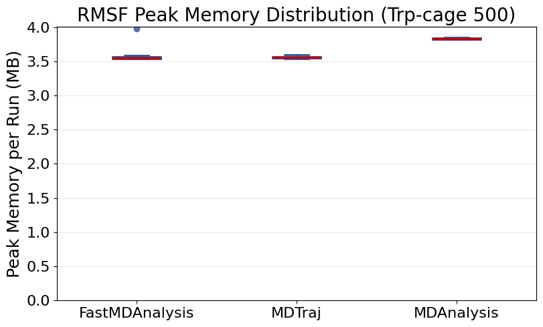
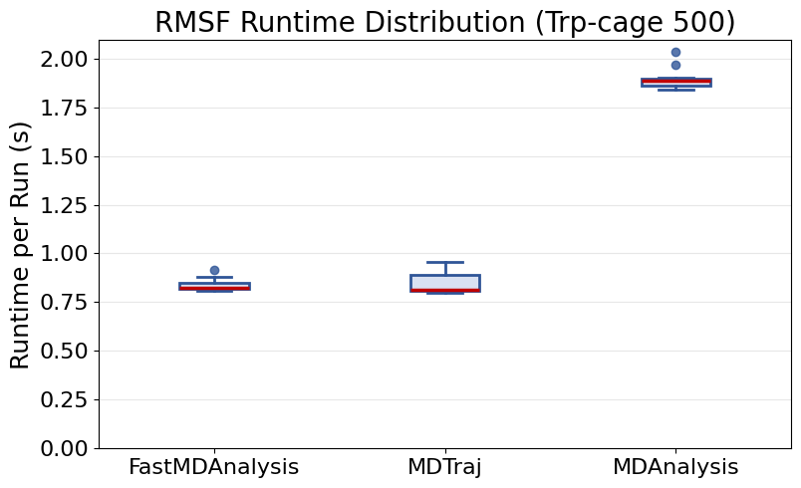
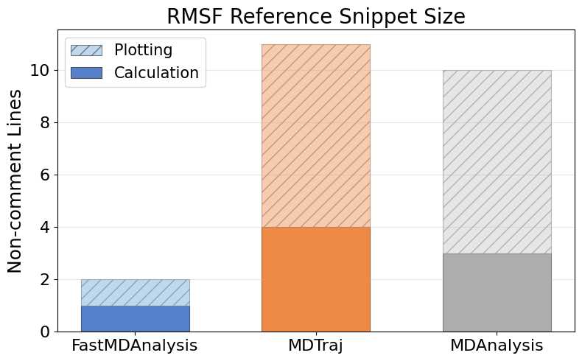
Rmsf Trpcage 500 (continued)

Slide 12
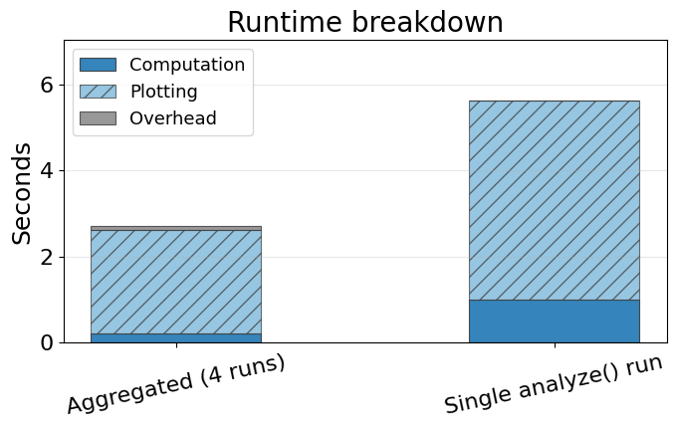
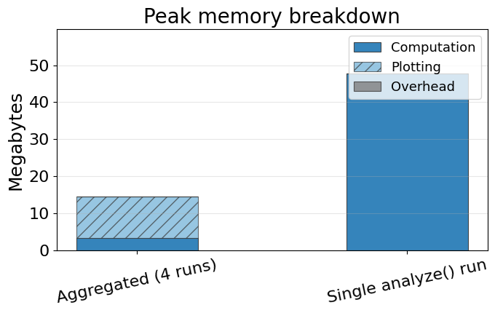
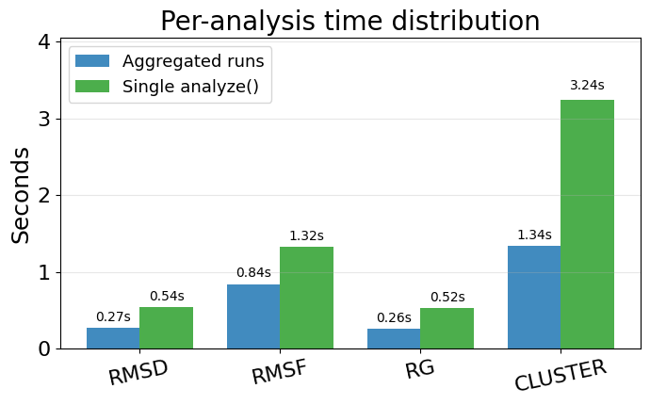
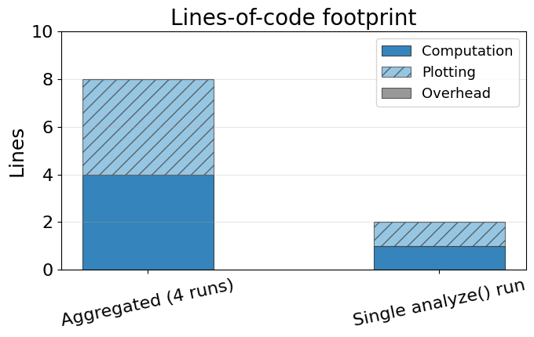
Single-run vs aggregated FastMDAnalysis
Aggregated bars sum the computation, plotting, and overhead from individual analyze runs. Single-run bars reflect the orchestrated analyze(...) benchmark metrics for those same slices. Bottom-left chart breaks down runtime per analysis for the single run (slides counted as plotting).

Slide 13
Instrumentation Overview
  FastMDAnalysis: 6 modules, 11 functions, 0 external imports, 35 runs, 35 successful, 0 exceptions.
  Mdtraj: 4 modules, 10 functions, 3 external imports, 35 runs, 35 successful, 0 exceptions.
  Mdanalysis: 5 modules, 10 functions, 3 external imports, 35 runs, 35 successful, 0 exceptions.
  Snippet footprint overview: FastMDAnalysis 1 calc / 1 plot (2 total) lines, Mdtraj 21 calc / 28 plot (49 total) lines, Mdanalysis 38 calc / 28 plot (66 total) lines.
  Runtime overview: FastMDAnalysis 0.21s calc / 2.41s plot / 0.09s overhead (2.71s total), Mdtraj 0.04s calc / 2.42s plot / 0.08s overhead (2.54s total), Mdanalysis 3.99s calc / 2.66s plot / 0.01s overhead (6.65s total).
  Note: All tools show aggregate of 4 separate analysis calls (rmsd, rmsf, rg, cluster) using pre-loaded trajectories for apples-to-apples comparison. FastMDAnalysis orchestrator approach (single analyze() call) is preserved for LOC comparison only.
  Peak memory overview: FastMDAnalysis 9.30 MB calc / 16.63 MB plot (19.87 MB peak), Mdtraj 6.28 MB calc / 17.20 MB plot (20.48 MB peak), Mdanalysis 1.30 MB calc / 19.19 MB plot (19.19 MB peak).
  Charts on the following slides illustrate these touchpoint gaps.

