Slide 1
FastMdAnalysis Benchmarks – Ubiquitin 99 (5000 frames)
Runtime, memory, and usability comparisons versus MDTraj and MDAnalysis
Note: third-party metrics include helper scripts for exporting data and plots.
Dataset: Ubiquitin 99 (5000 frames)

Slide 2
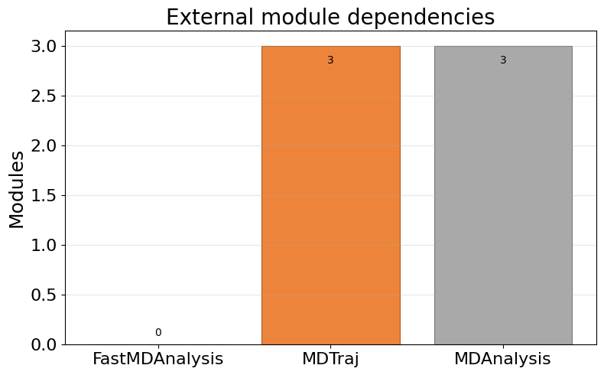
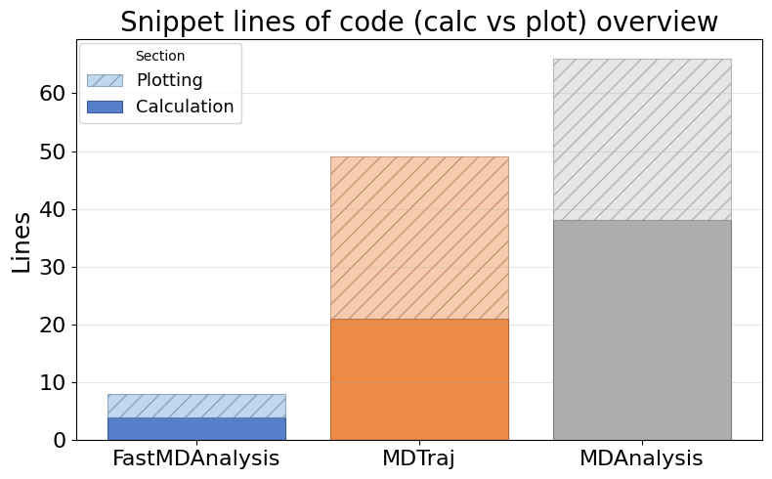
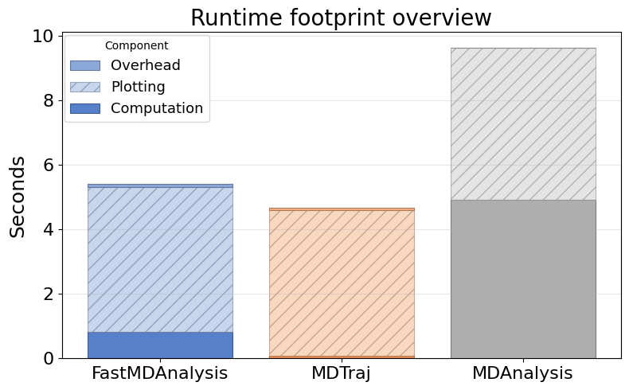
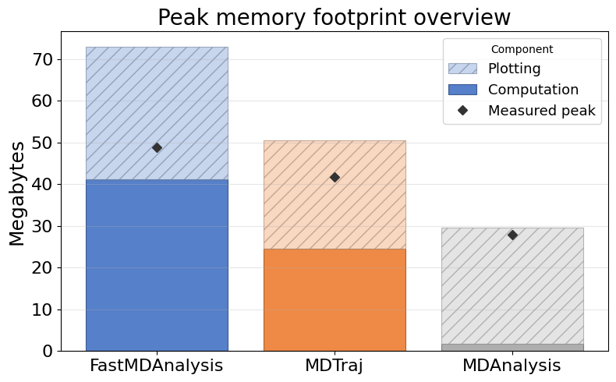
Overview: Dependencies, LOC, Runtime, Memory

Slide 3
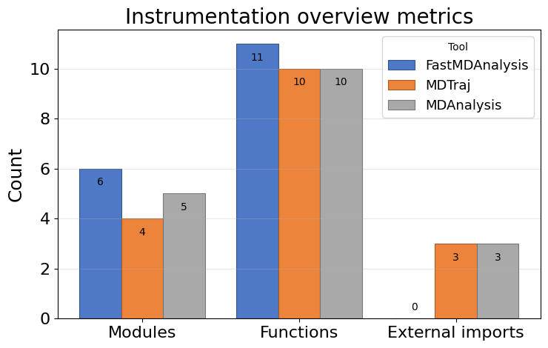
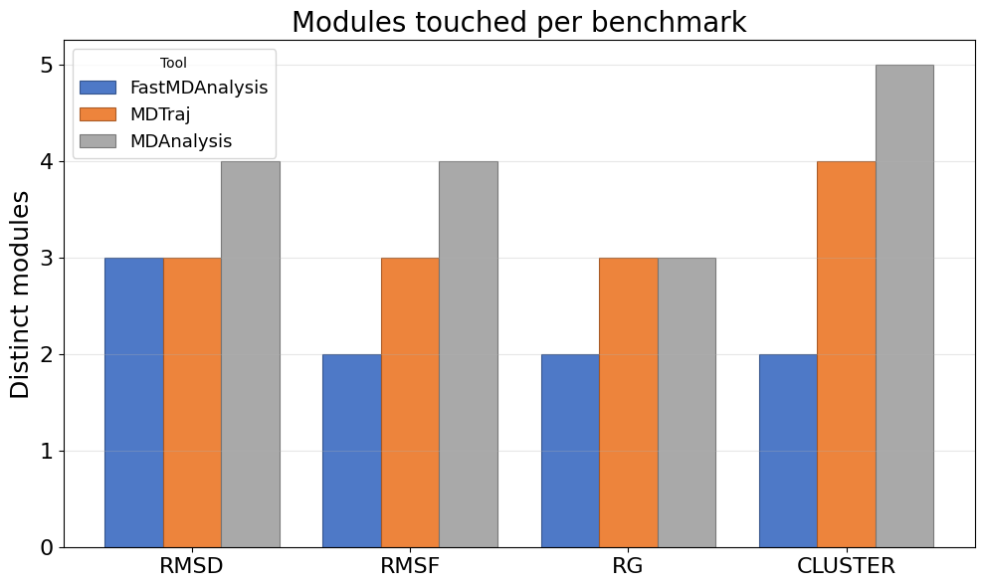
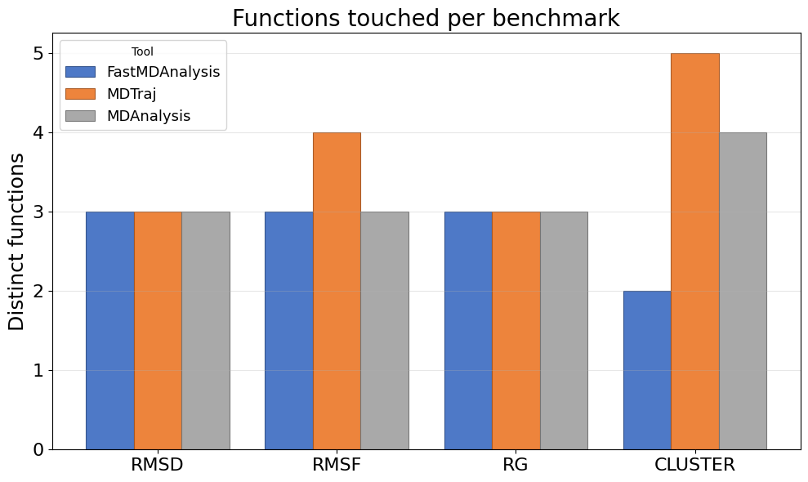
Instrumentation overview: touchpoints, modules, functions, LOC

Slide 4
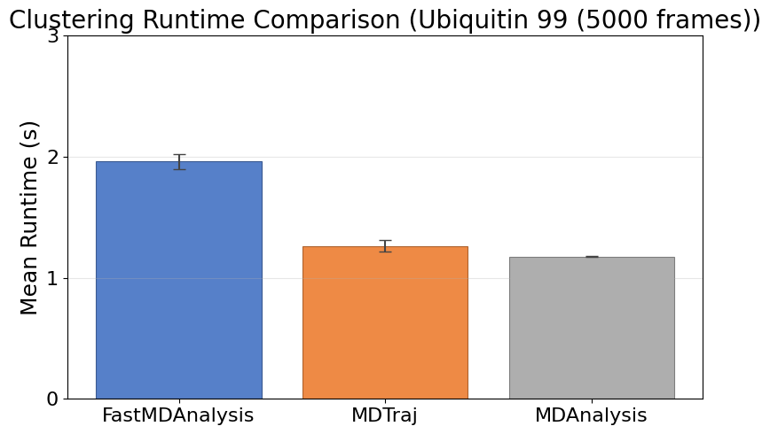
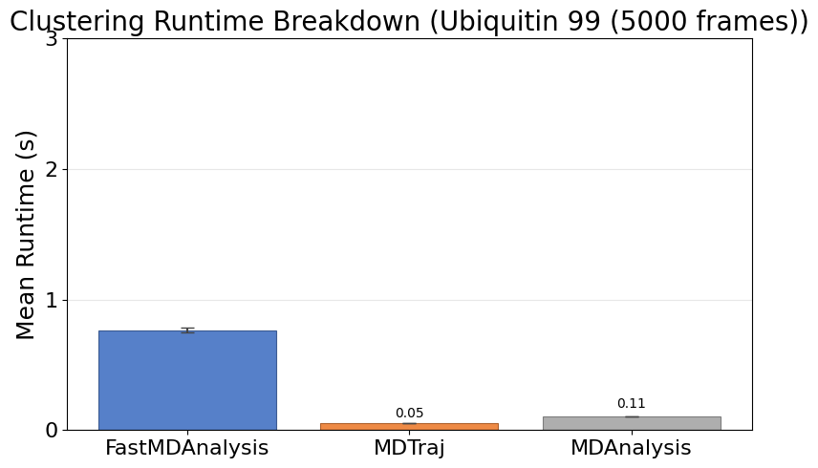
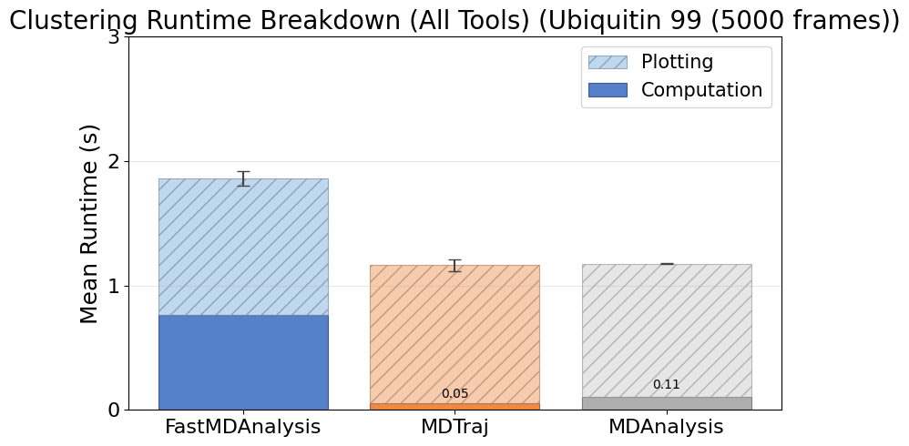
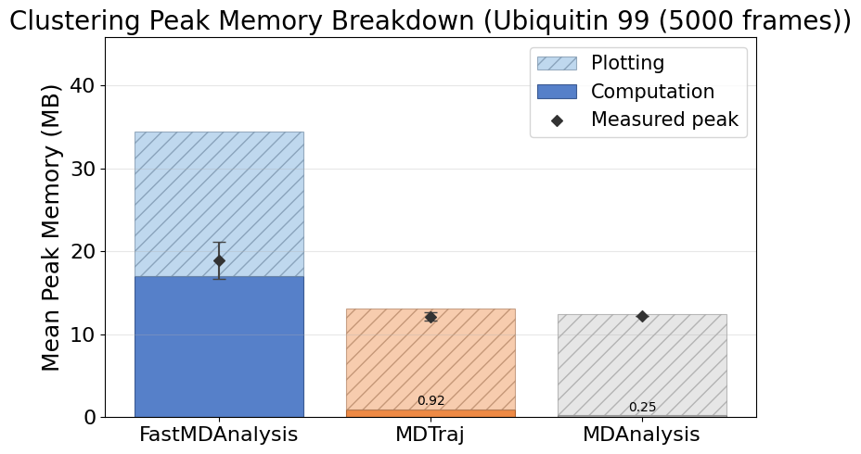
Cluster Ubiquitin99 5000
Note: MDTraj and MDAnalysis metrics include helper scripts we wrote to save data files and plots; their APIs do not emit those artifacts automatically.

Slide 5
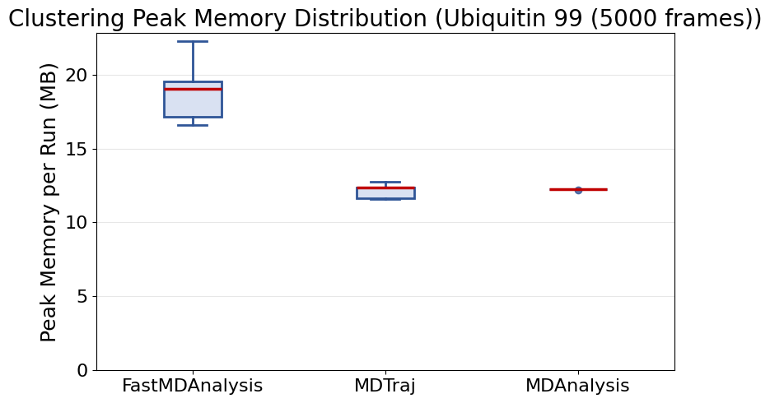
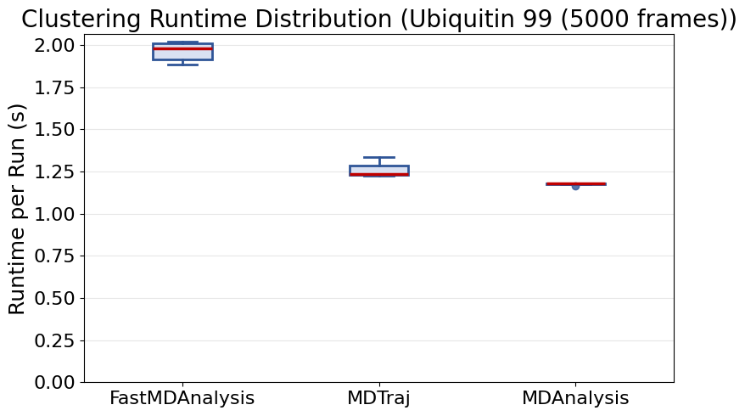
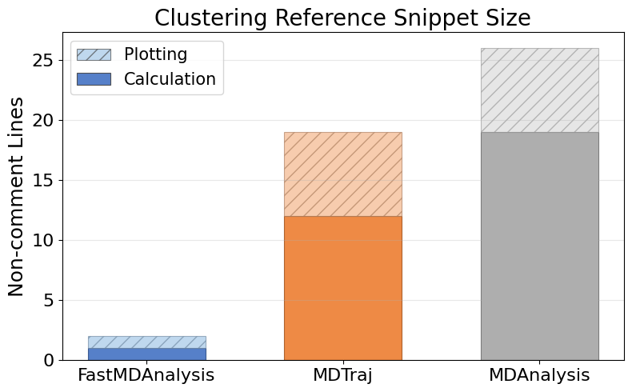
Cluster Ubiquitin99 5000 (continued)

Slide 6
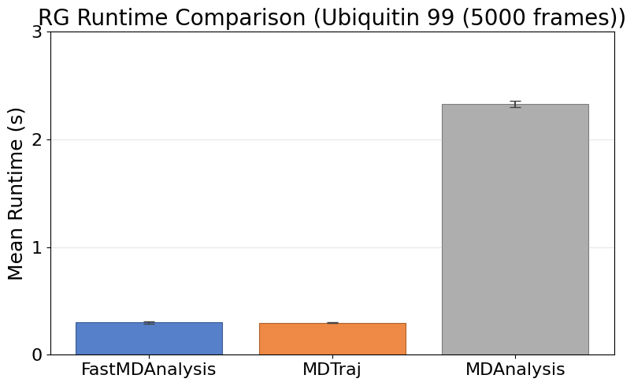
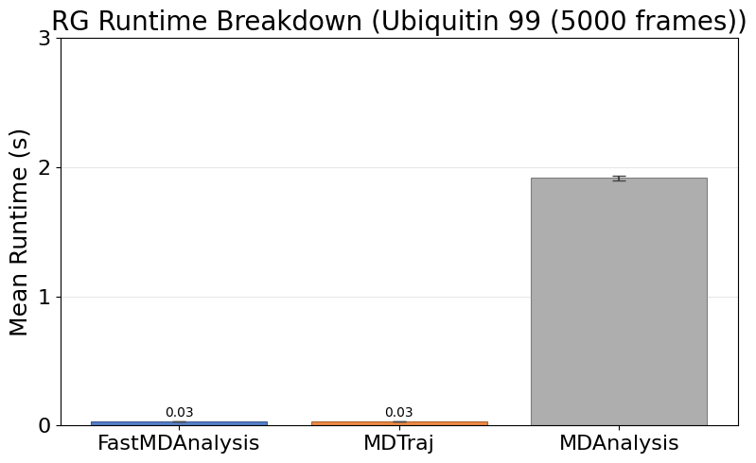
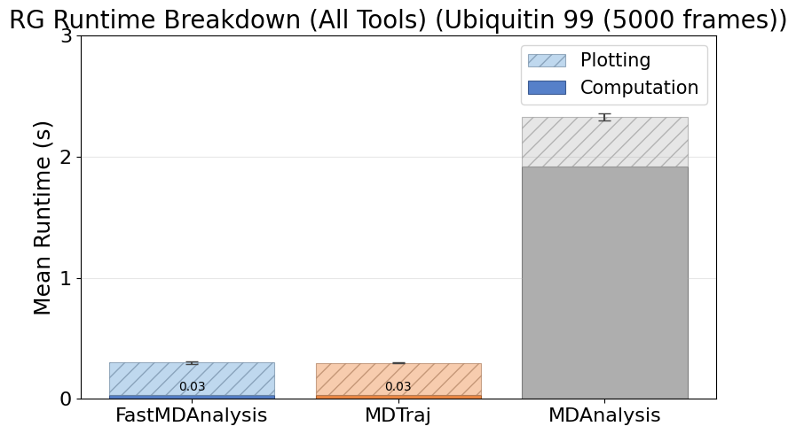
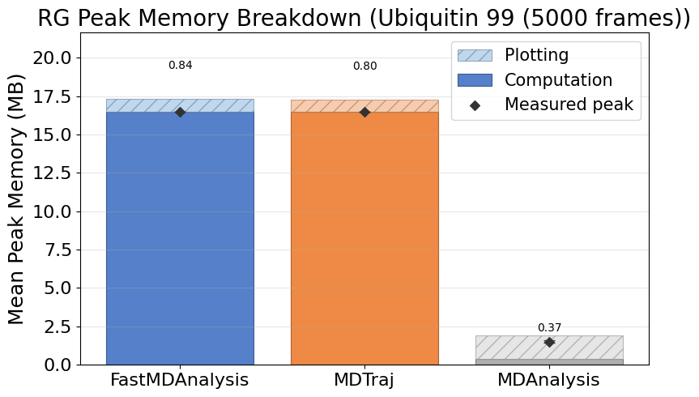
Rg Ubiquitin99 5000
Note: MDTraj and MDAnalysis metrics include helper scripts we wrote to save data files and plots; their APIs do not emit those artifacts automatically.

Slide 7
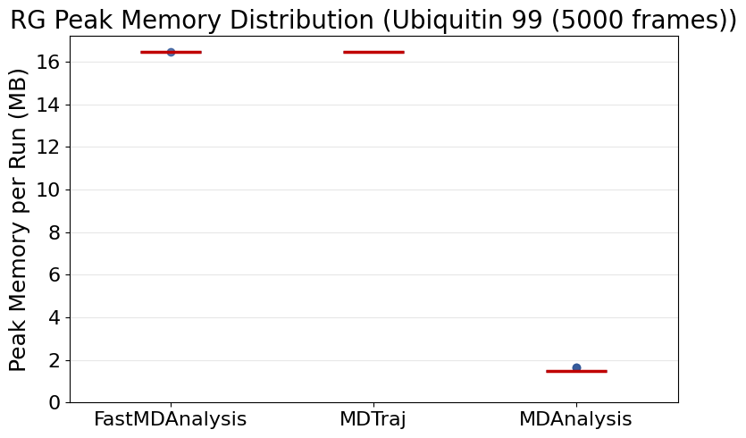
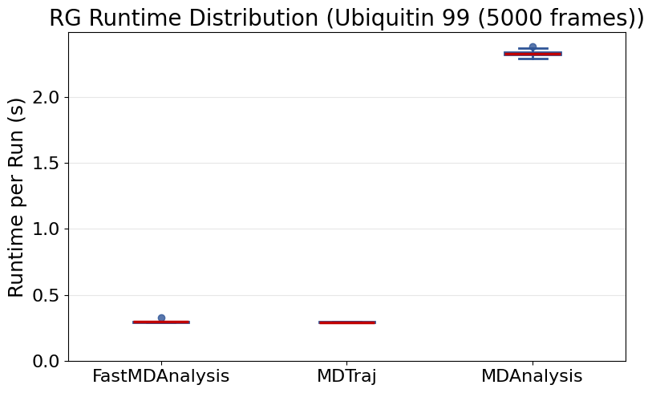
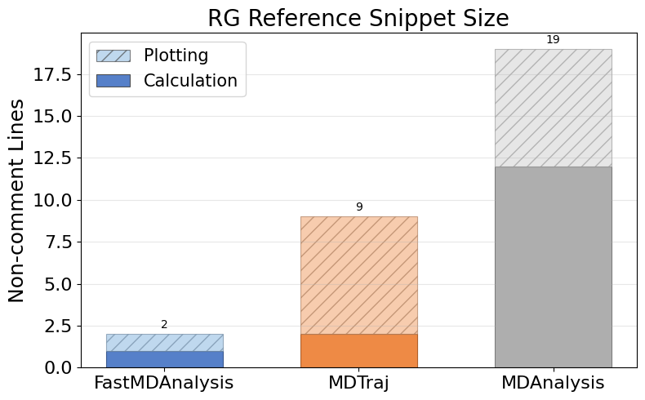
Rg Ubiquitin99 5000 (continued)

Slide 8
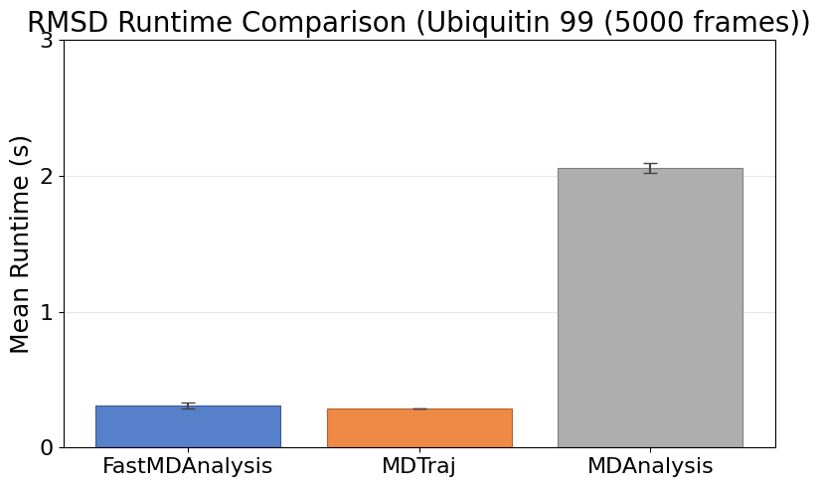
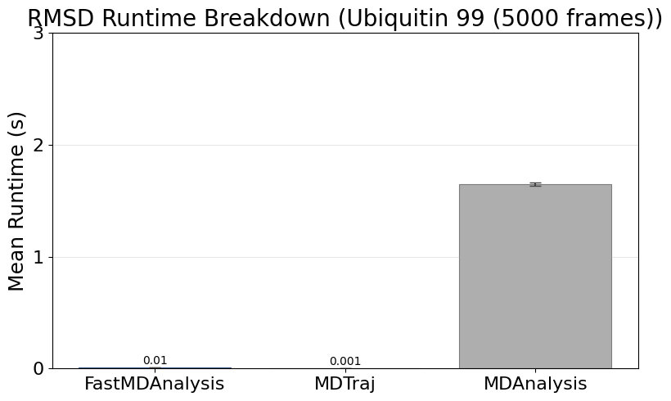
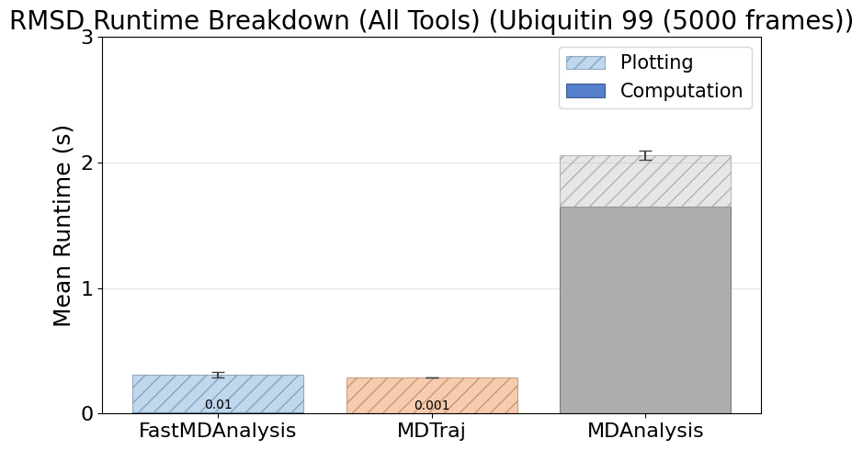
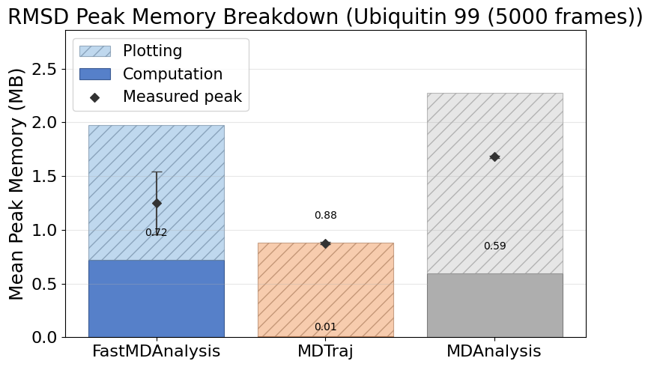
Rmsd Ubiquitin99 5000
Note: MDTraj and MDAnalysis metrics include helper scripts we wrote to save data files and plots; their APIs do not emit those artifacts automatically.

Slide 9
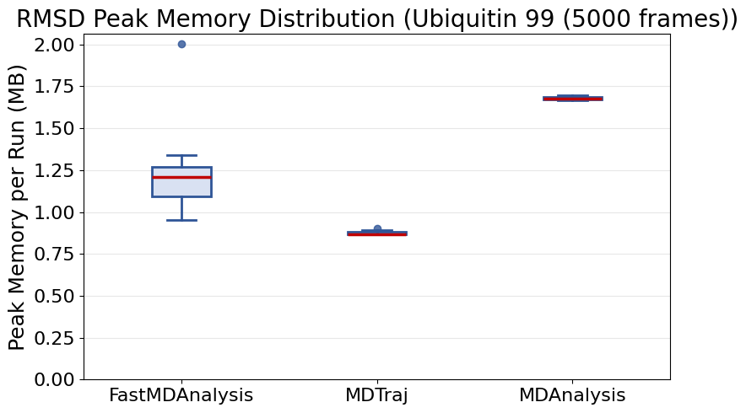
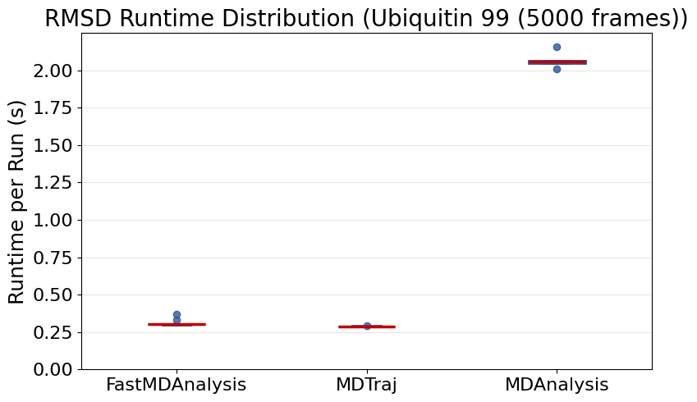
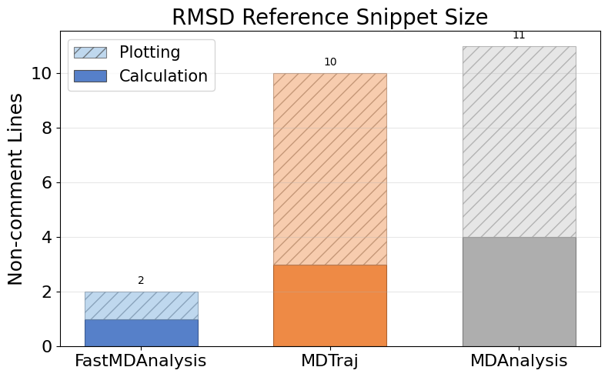
Rmsd Ubiquitin99 5000 (continued)

Slide 10
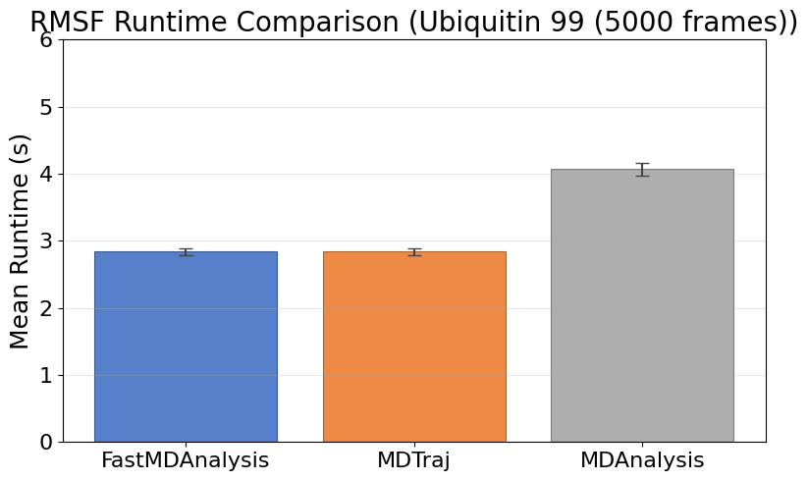
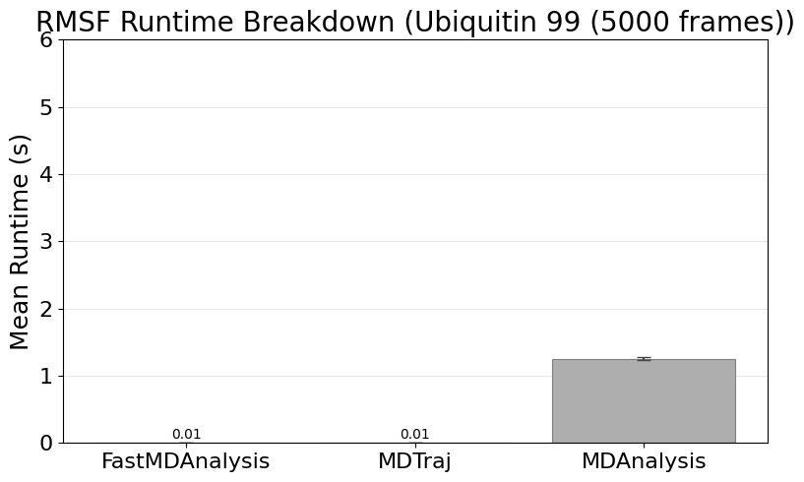
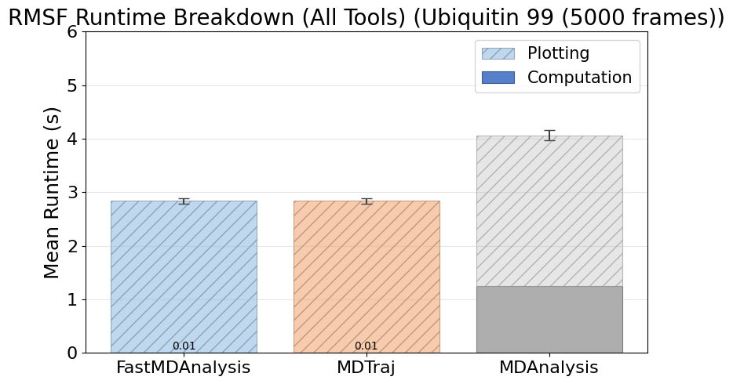
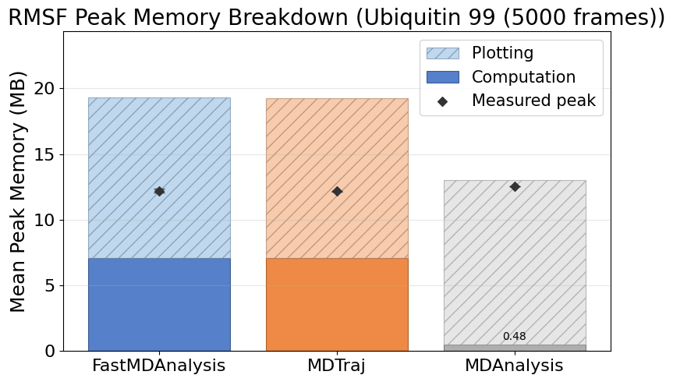
Rmsf Ubiquitin99 5000
Note: MDTraj and MDAnalysis metrics include helper scripts we wrote to save data files and plots; their APIs do not emit those artifacts automatically.

Slide 11
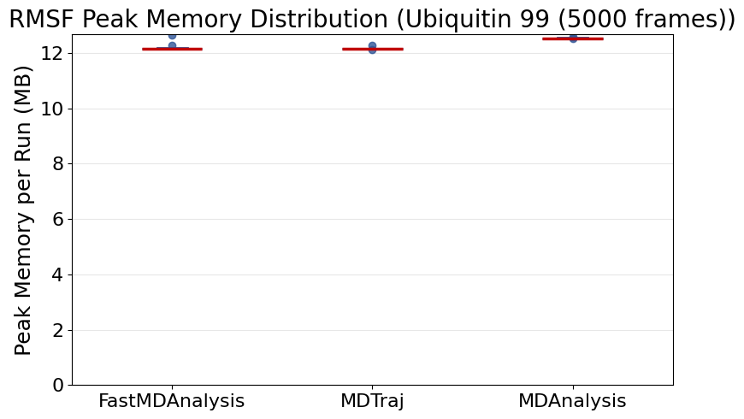
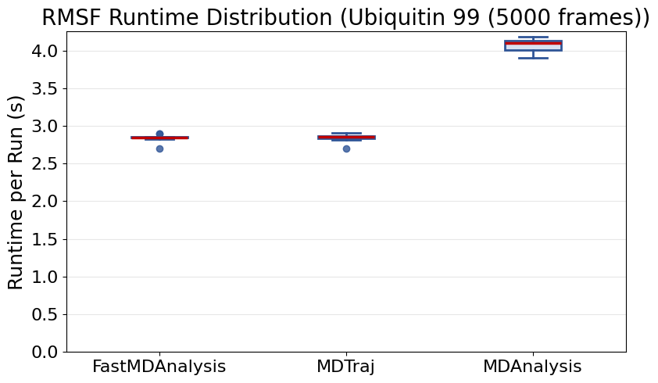
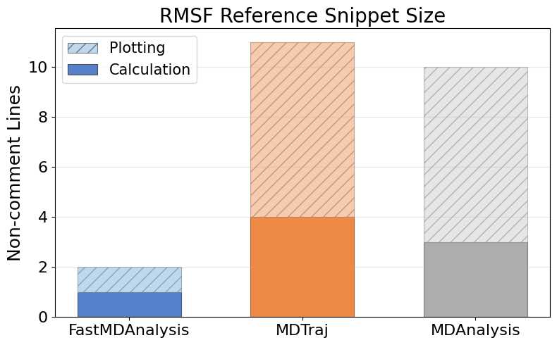
Rmsf Ubiquitin99 5000 (continued)

Slide 12
Instrumentation Overview
  FastMDAnalysis: 6 modules, 11 functions, 0 external imports, 35 runs, 35 successful, 0 exceptions.
  Mdtraj: 4 modules, 10 functions, 3 external imports, 35 runs, 35 successful, 0 exceptions.
  Mdanalysis: 5 modules, 10 functions, 3 external imports, 35 runs, 35 successful, 0 exceptions.
  Snippet footprint overview: FastMDAnalysis 4 calc / 4 plot (8 total) lines, Mdtraj 21 calc / 28 plot (49 total) lines, Mdanalysis 38 calc / 28 plot (66 total) lines.
  Runtime overview: FastMDAnalysis 0.81s calc / 4.50s plot / 0.10s overhead (5.41s total), Mdtraj 0.09s calc / 4.49s plot / 0.10s overhead (4.68s total), Mdanalysis 4.92s calc / 4.71s plot / 0.01s overhead (9.64s total).
  Note: FastMDAnalysis shows single-line analyze() orchestrator with integrated file I/O. Calc/plot split estimated using 17.5%/82.5% ratio from individual benchmarks. Other tools show aggregate with file I/O separated. Memory includes all analyses running together.
  Peak memory overview: FastMDAnalysis 41.25 MB calc / 31.74 MB plot (48.85 MB peak), Mdtraj 24.48 MB calc / 25.99 MB plot (41.66 MB peak), Mdanalysis 1.70 MB calc / 27.98 MB plot (27.98 MB peak).
  Charts on the following slides illustrate these touchpoint gaps.

