Slide 1
FastMdAnalysis Benchmarks – Ubiquitin 99 (500 frames)
Runtime, memory, and usability comparisons versus MDTraj and MDAnalysis
Note: third-party metrics include helper scripts for exporting data and plots.
Dataset: Ubiquitin 99 (500 frames)

Slide 2
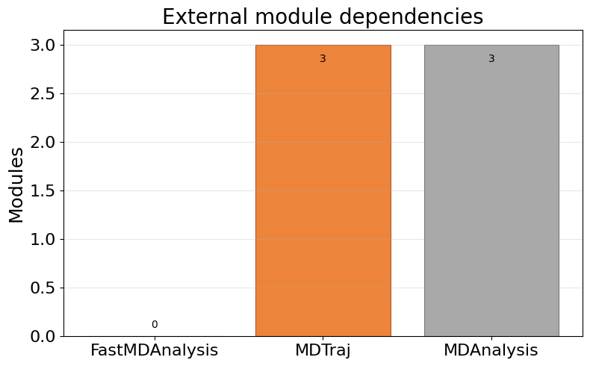
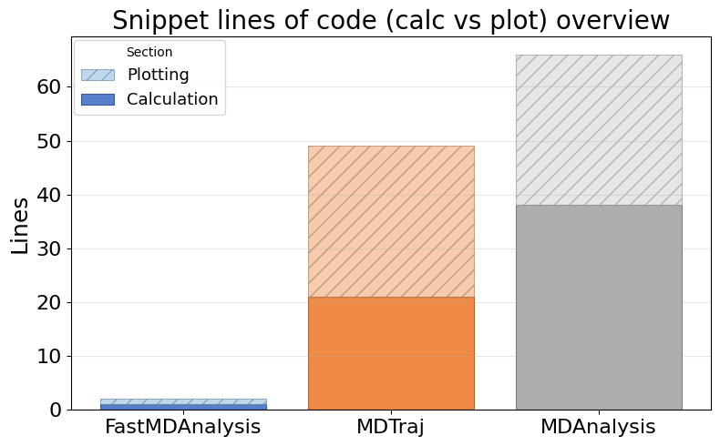
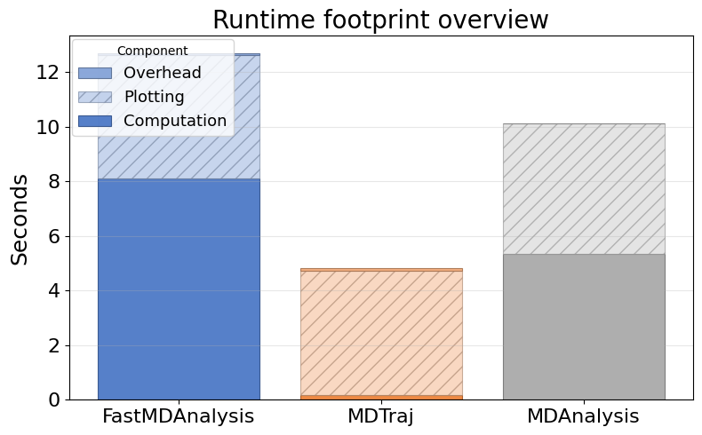
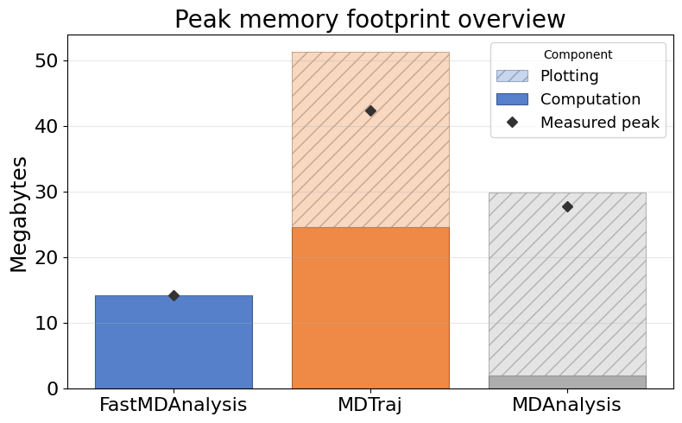
Overview: Dependencies, LOC, Runtime, Memory

Slide 3
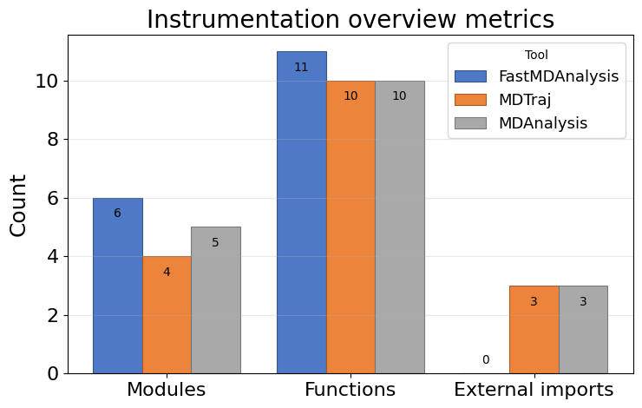
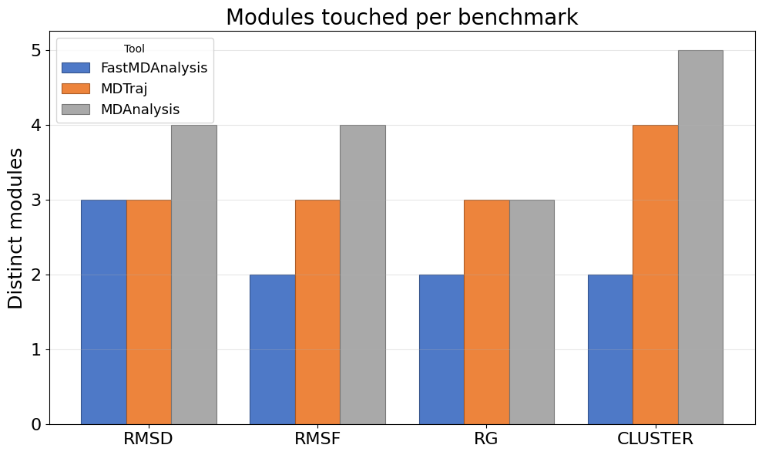
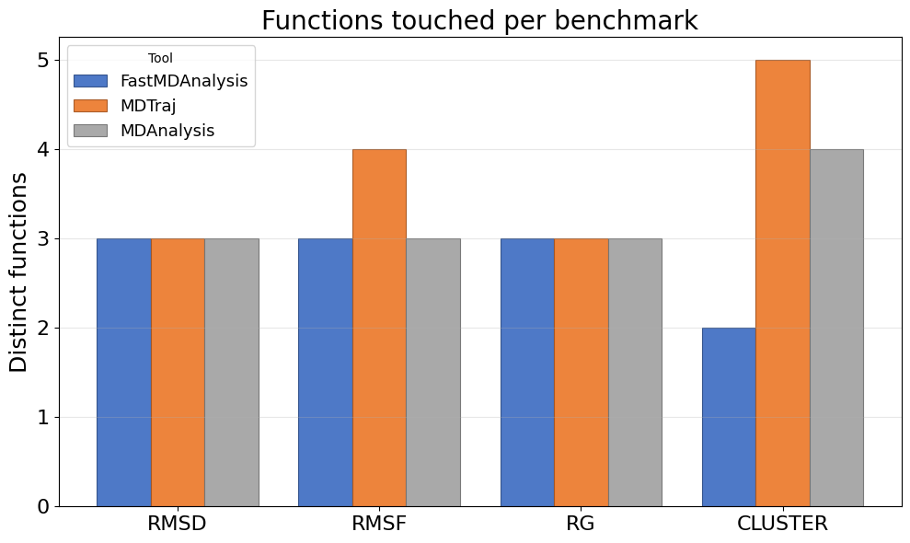
Instrumentation overview: touchpoints, modules, functions, LOC

Slide 4
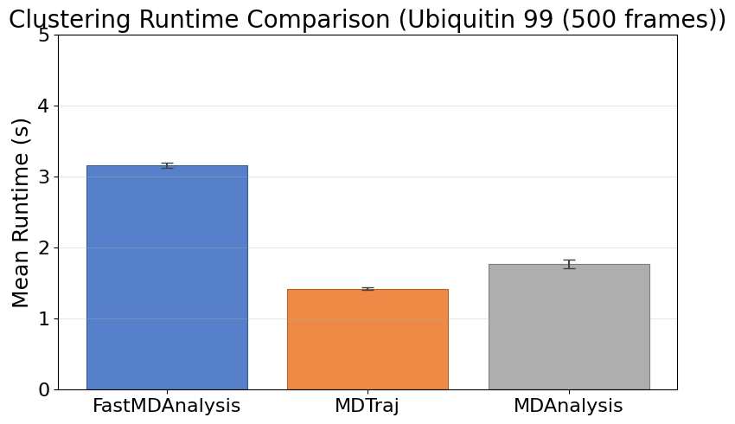
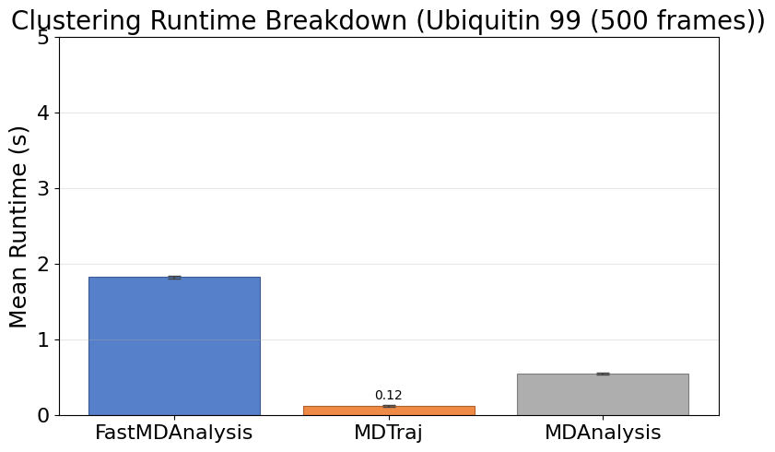
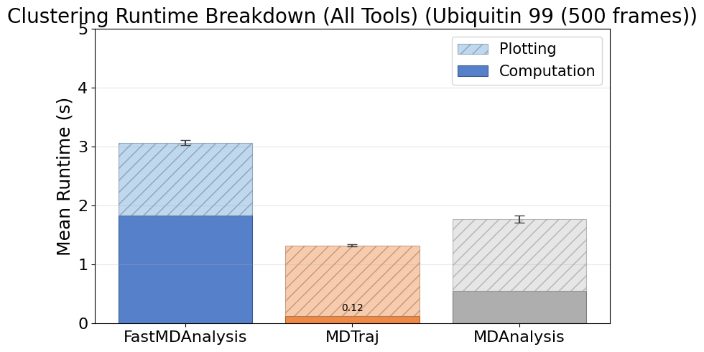
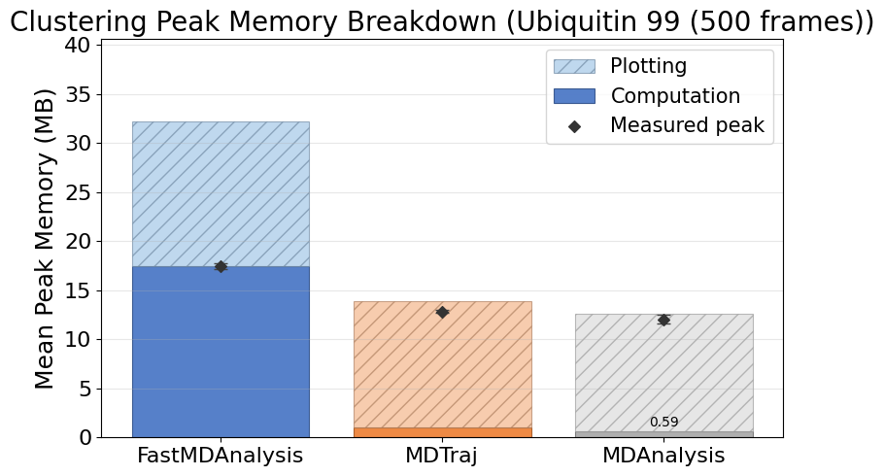
Cluster Ubiquitin99 500
Note: MDTraj and MDAnalysis metrics include helper scripts we wrote to save data files and plots; their APIs do not emit those artifacts automatically.

Slide 5
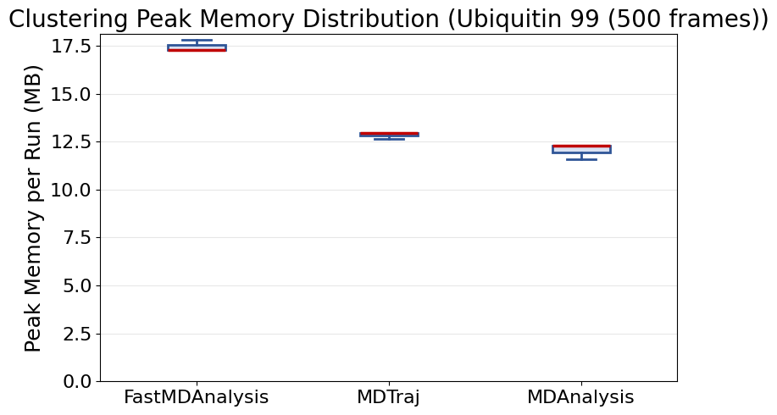
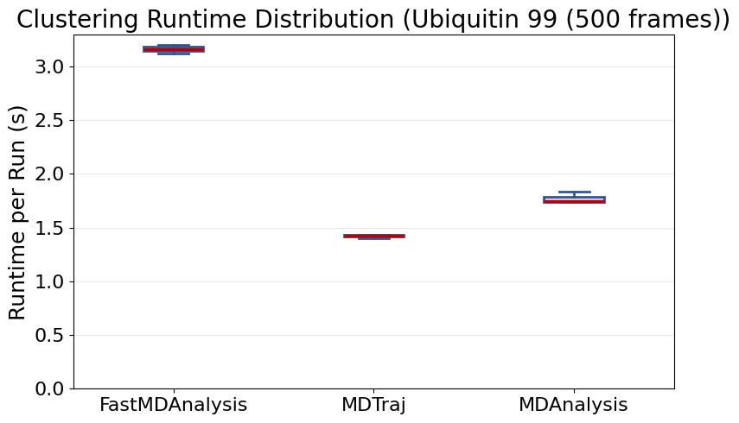
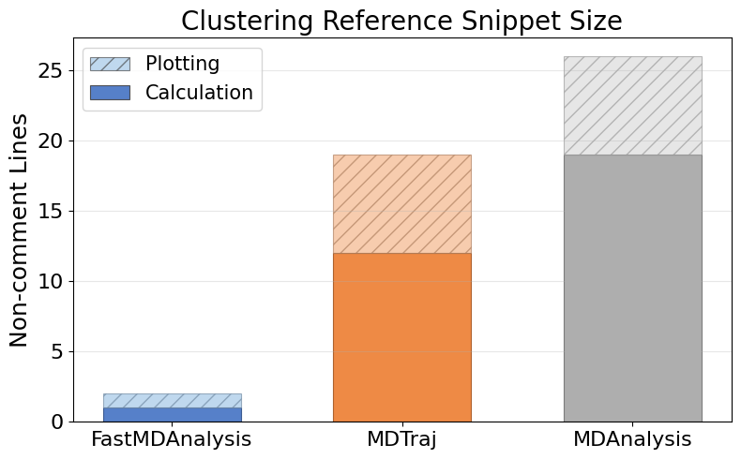
Cluster Ubiquitin99 500 (continued)

Slide 6
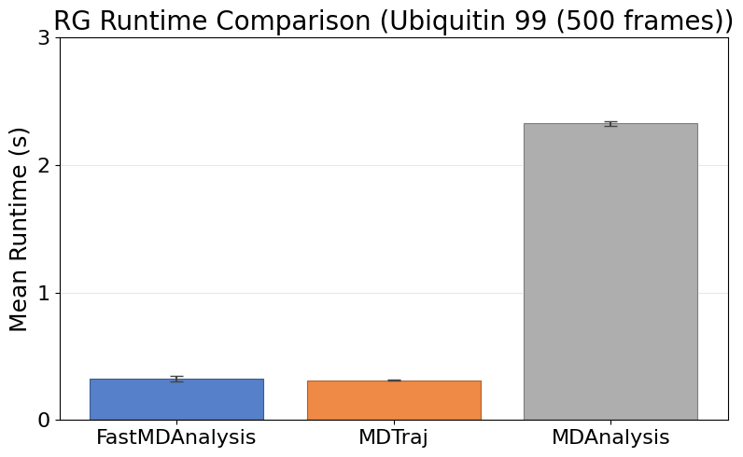
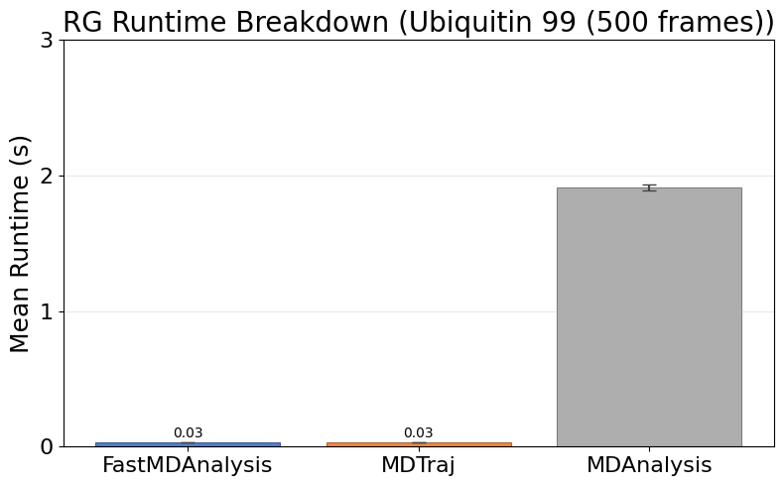
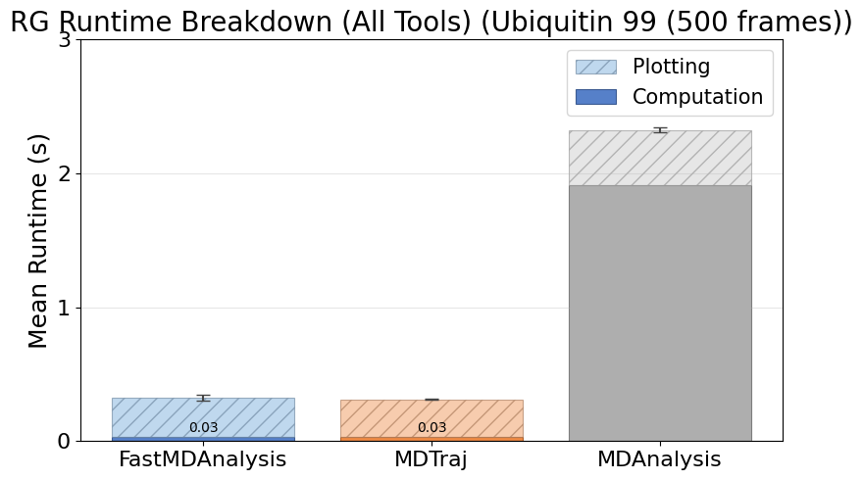
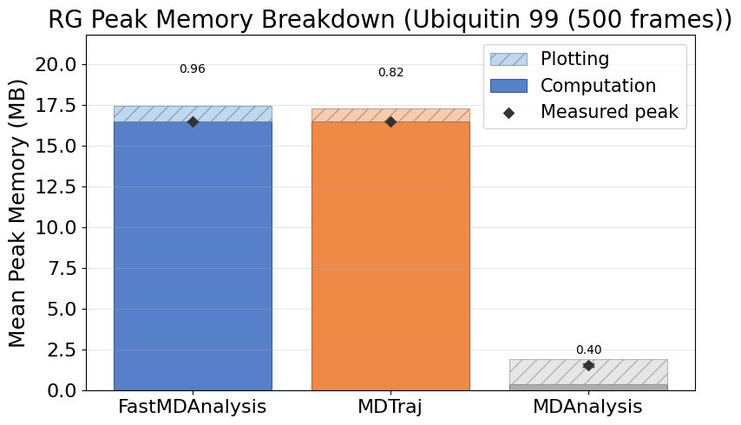
Rg Ubiquitin99 500
Note: MDTraj and MDAnalysis metrics include helper scripts we wrote to save data files and plots; their APIs do not emit those artifacts automatically.

Slide 7
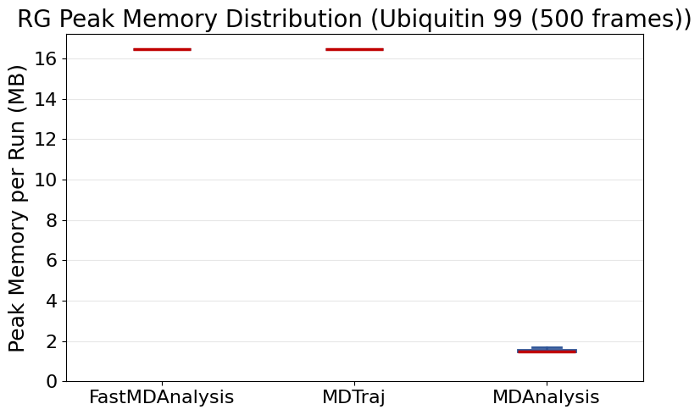
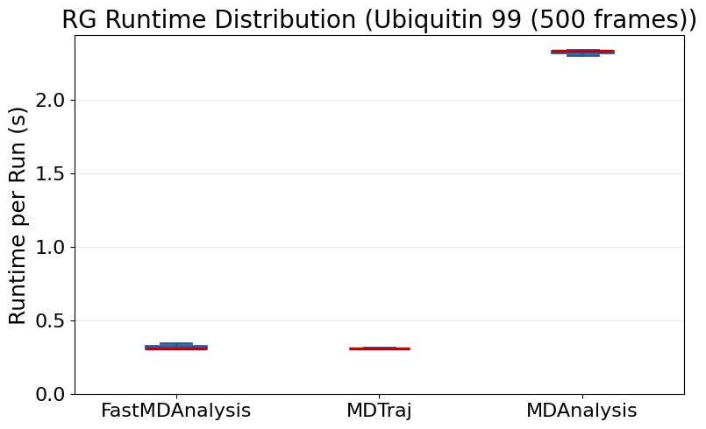
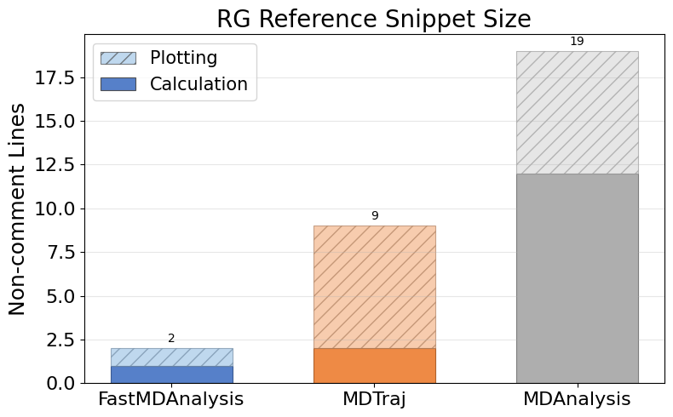
Rg Ubiquitin99 500 (continued)

Slide 8
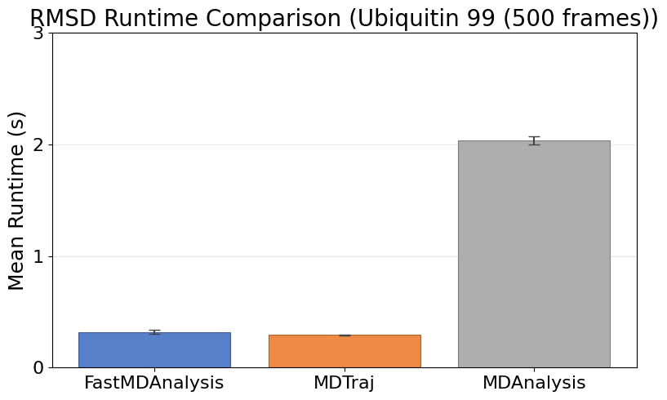
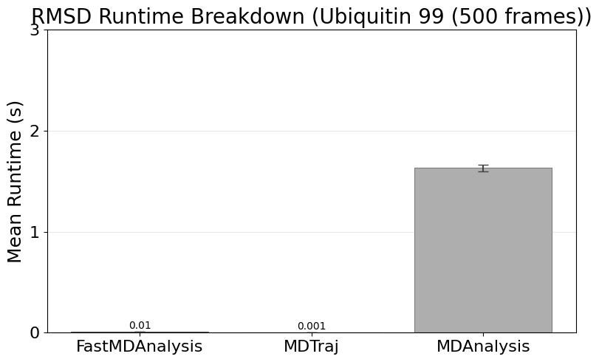
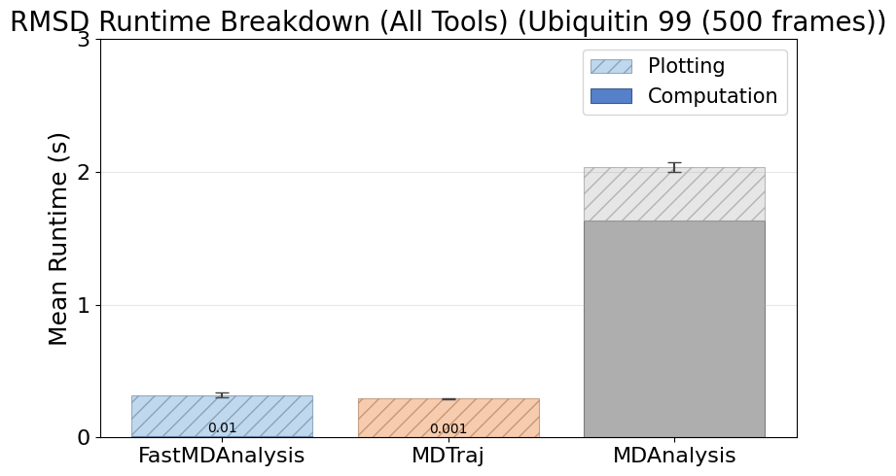
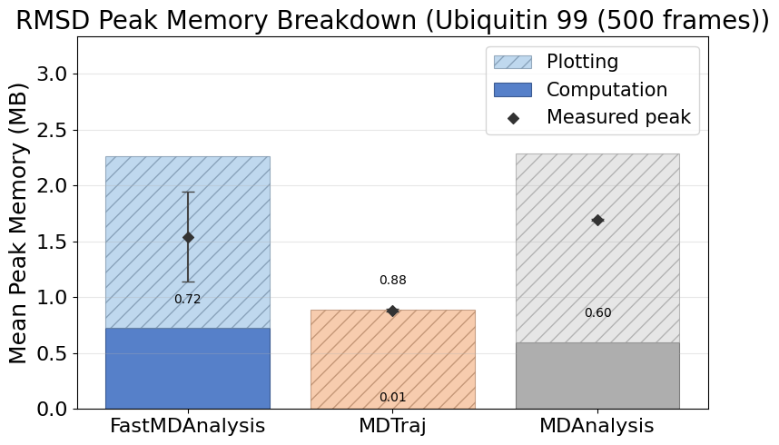
Rmsd Ubiquitin99 500
Note: MDTraj and MDAnalysis metrics include helper scripts we wrote to save data files and plots; their APIs do not emit those artifacts automatically.

Slide 9
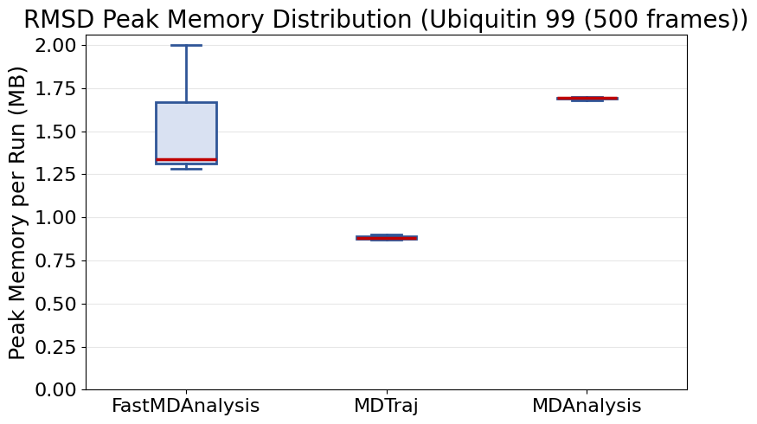
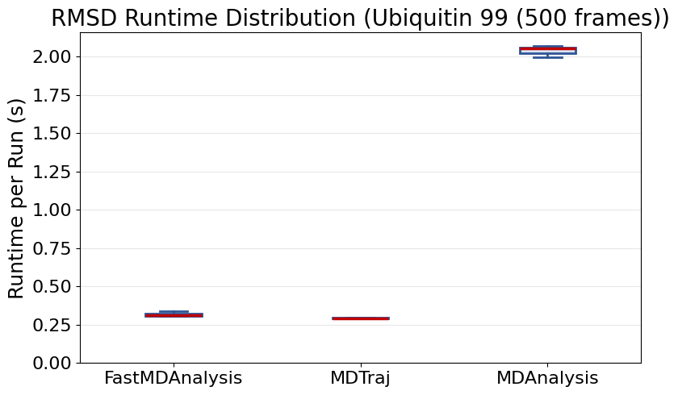
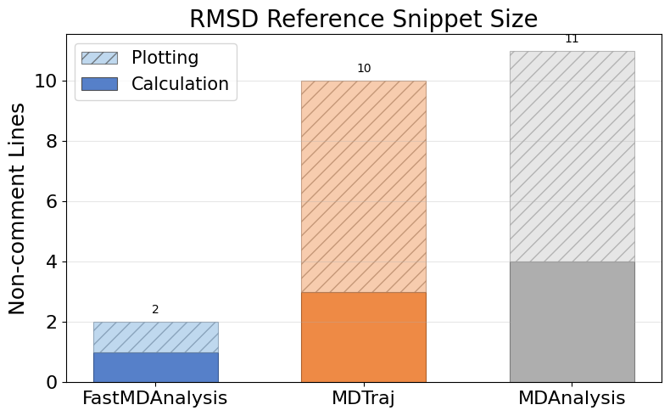
Rmsd Ubiquitin99 500 (continued)

Slide 10
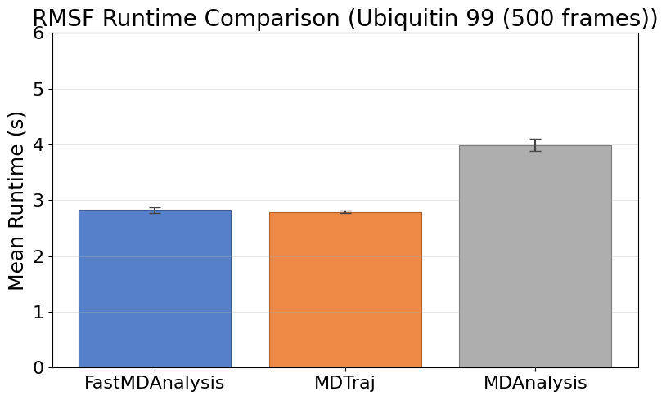
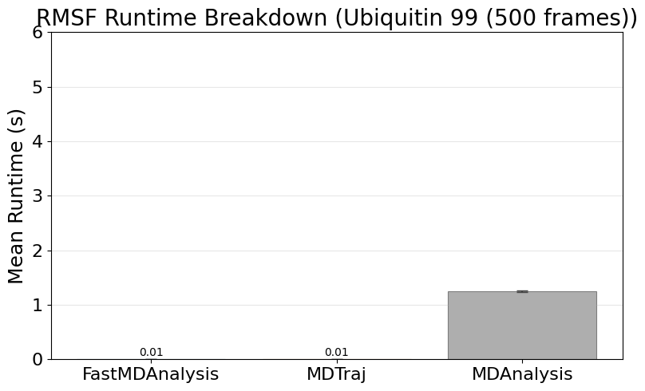
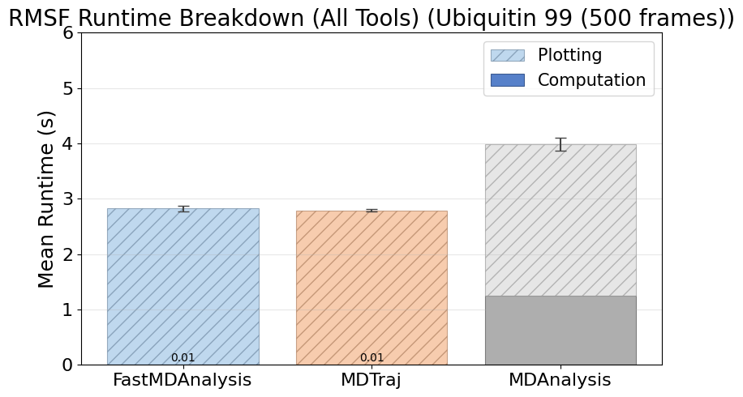
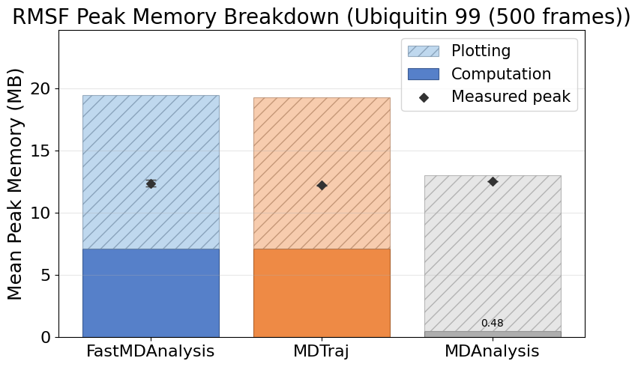
Rmsf Ubiquitin99 500
Note: MDTraj and MDAnalysis metrics include helper scripts we wrote to save data files and plots; their APIs do not emit those artifacts automatically.

Slide 11
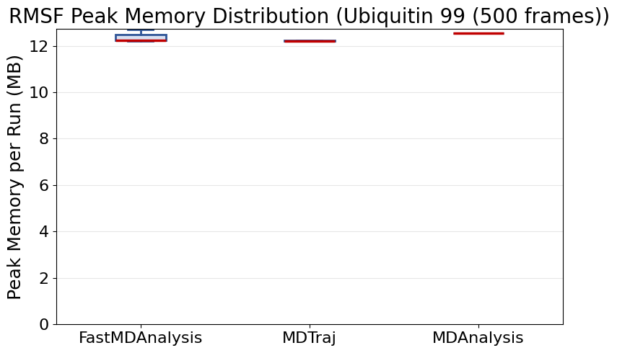
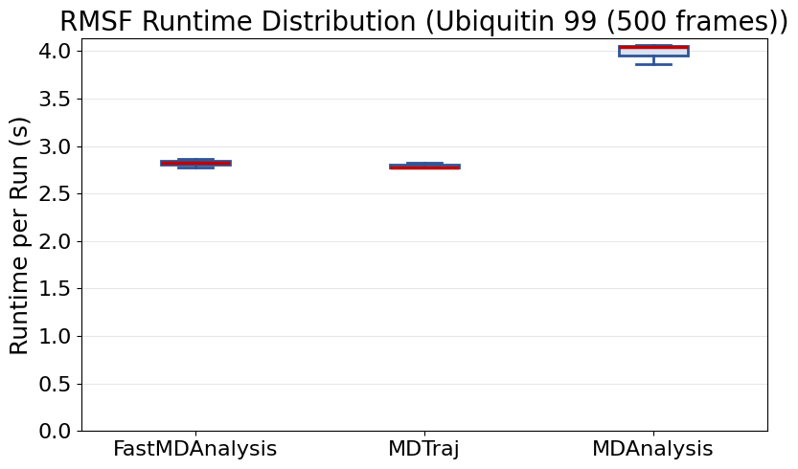
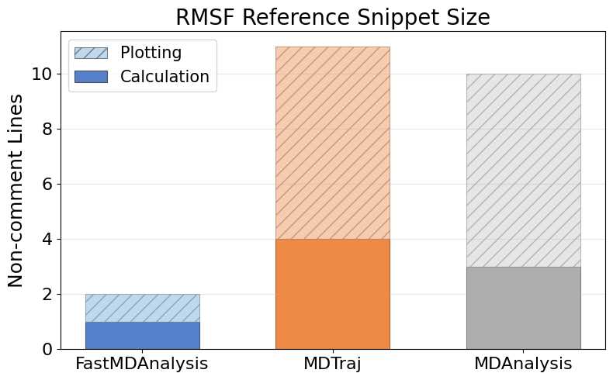
Rmsf Ubiquitin99 500 (continued)

Slide 12
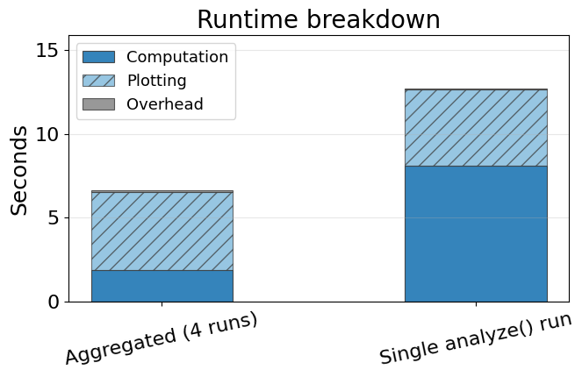
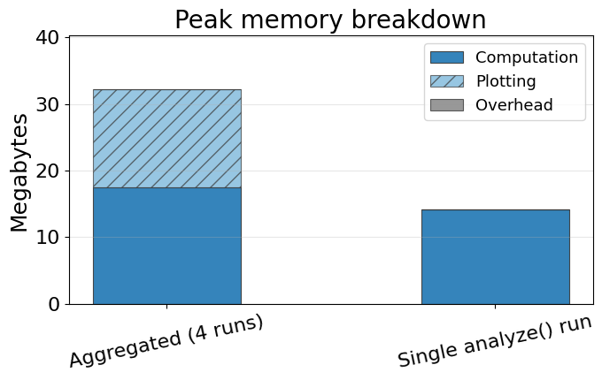
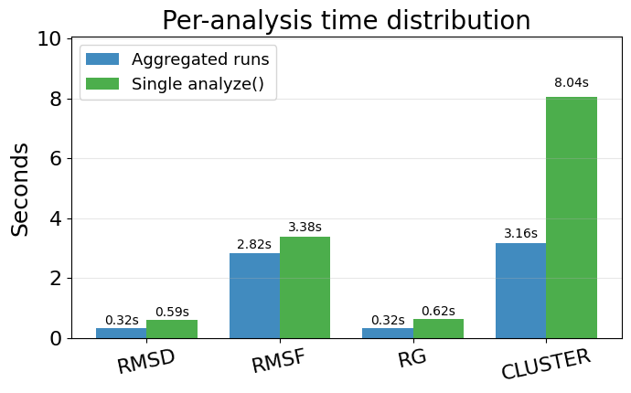
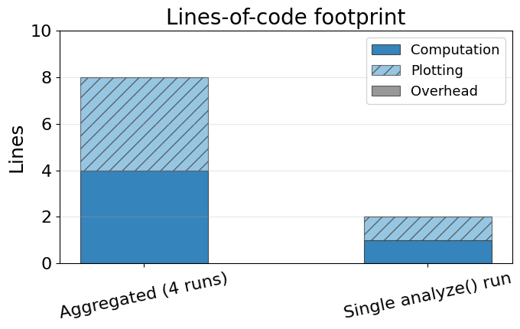
Single-run vs aggregated FastMDAnalysis
Aggregated bars sum the computation, plotting, and overhead from individual analyze runs. Single-run bars reflect the orchestrated analyze(...) benchmark metrics for those same slices. Bottom-left chart breaks down runtime per analysis for the single run (slides counted as plotting).

Slide 13
Instrumentation Overview
  FastMDAnalysis: 6 modules, 11 functions, 0 external imports, 12 runs, 12 successful, 0 exceptions.
  Mdtraj: 4 modules, 10 functions, 3 external imports, 12 runs, 12 successful, 0 exceptions.
  Mdanalysis: 5 modules, 10 functions, 3 external imports, 12 runs, 12 successful, 0 exceptions.
  Snippet footprint overview: FastMDAnalysis 1 calc / 1 plot (2 total) lines, Mdtraj 21 calc / 28 plot (49 total) lines, Mdanalysis 38 calc / 28 plot (66 total) lines.
  Runtime overview: FastMDAnalysis 8.11s calc / 4.53s plot / 0.06s overhead (12.70s total), Mdtraj 0.16s calc / 4.56s plot / 0.10s overhead (4.82s total), Mdanalysis 5.35s calc / 4.77s plot / 0.01s overhead (10.13s total).
  Note: FastMDAnalysis shows single-line analyze() orchestrator with integrated file I/O. Calc/plot split estimated using 17.5%/82.5% ratio from individual benchmarks. Other tools show aggregate with file I/O separated. Memory includes all analyses running together.
  Peak memory overview: FastMDAnalysis 14.23 MB calc / 0.00 MB plot (14.23 MB peak), Mdtraj 24.62 MB calc / 26.77 MB plot (42.41 MB peak), Mdanalysis 2.07 MB calc / 27.83 MB plot (27.83 MB peak).
  Charts on the following slides illustrate these touchpoint gaps.

