Slide 1
FastMdAnalysis Benchmarks – Ubiquitin 99
Runtime, memory, and usability comparisons versus MDTraj and MDAnalysis
Note: third-party metrics include helper scripts for exporting data and plots.
Dataset: Ubiquitin 99

Slide 2
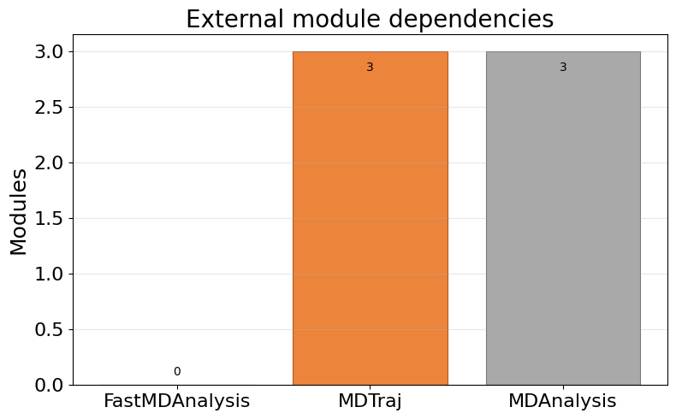
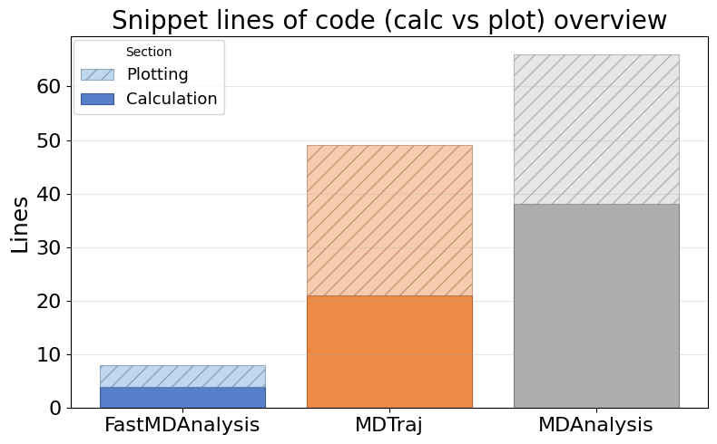
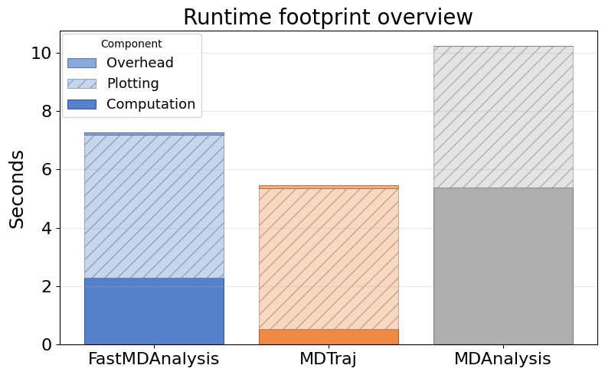
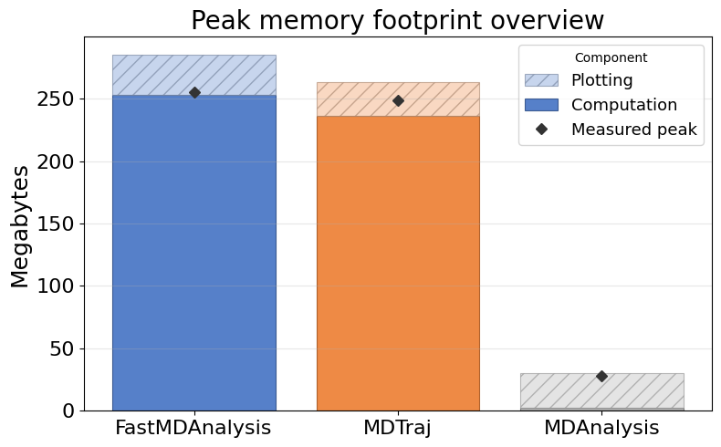
Overview: Dependencies, LOC, Runtime, Memory

Slide 3
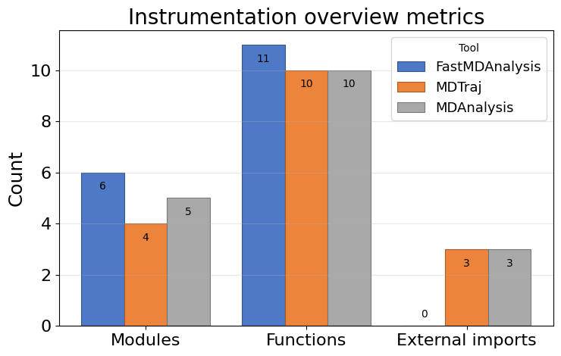
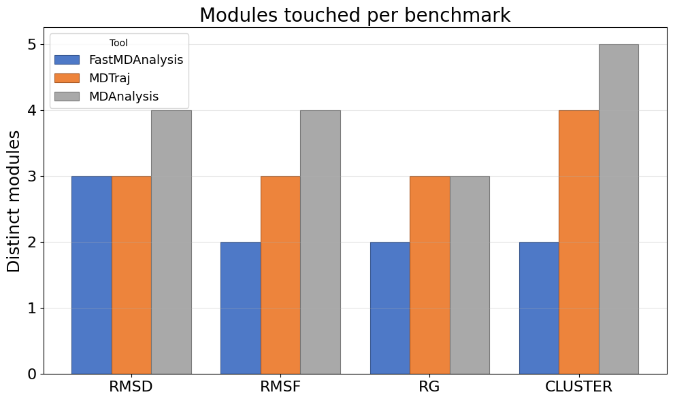
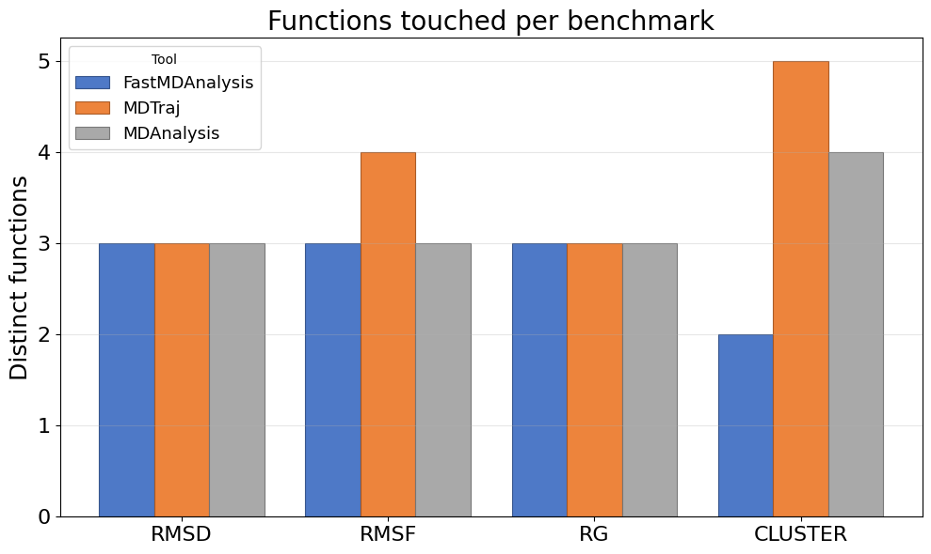
Instrumentation overview: touchpoints, modules, functions, LOC

Slide 4
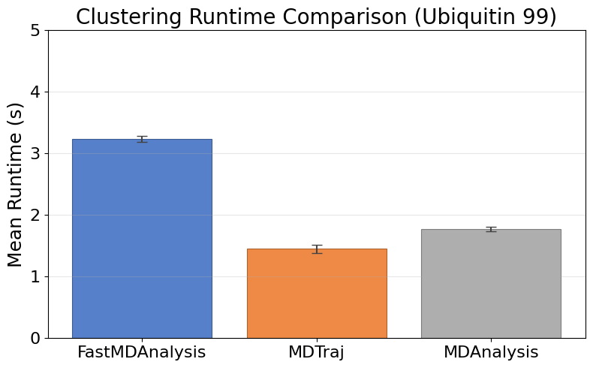
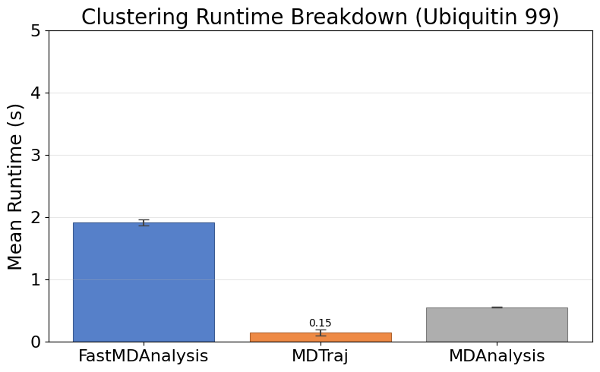
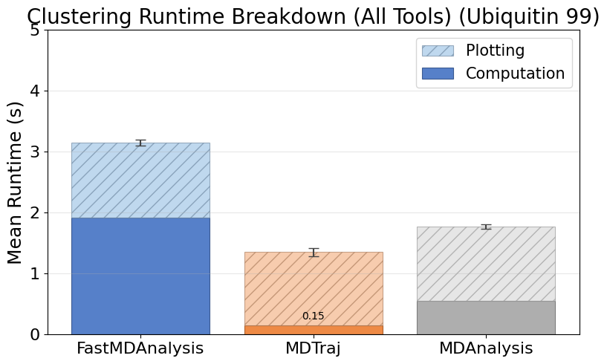
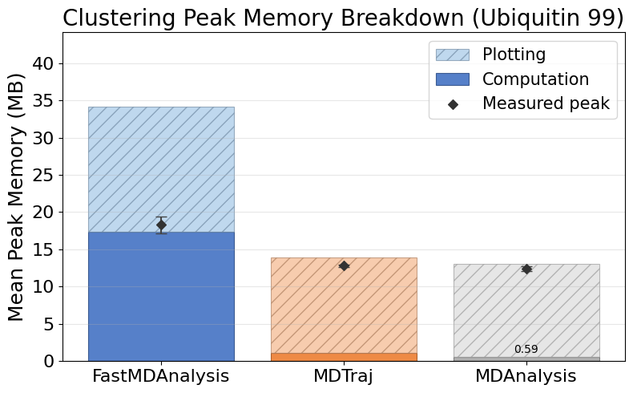
Cluster Ubiquitin99
Note: MDTraj and MDAnalysis metrics include helper scripts we wrote to save data files and plots; their APIs do not emit those artifacts automatically.

Slide 5
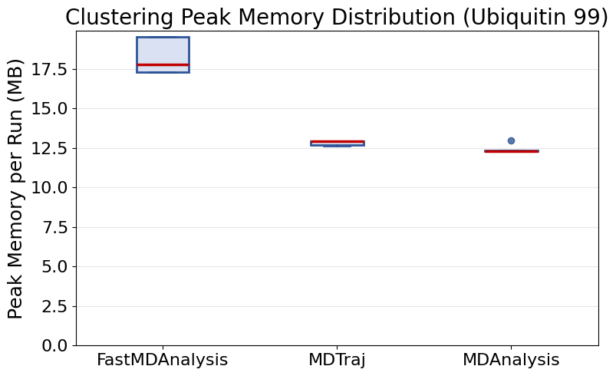
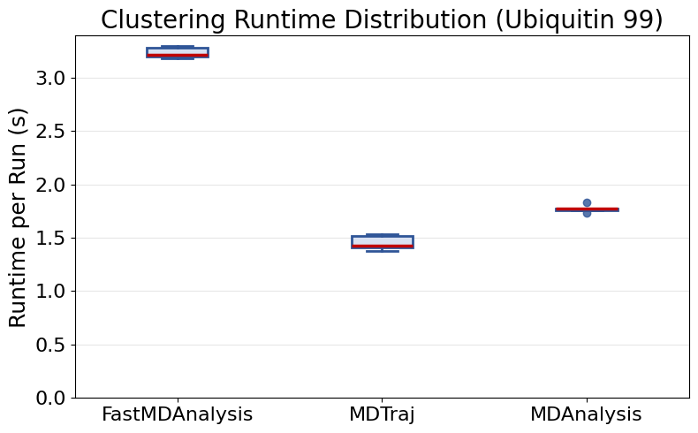
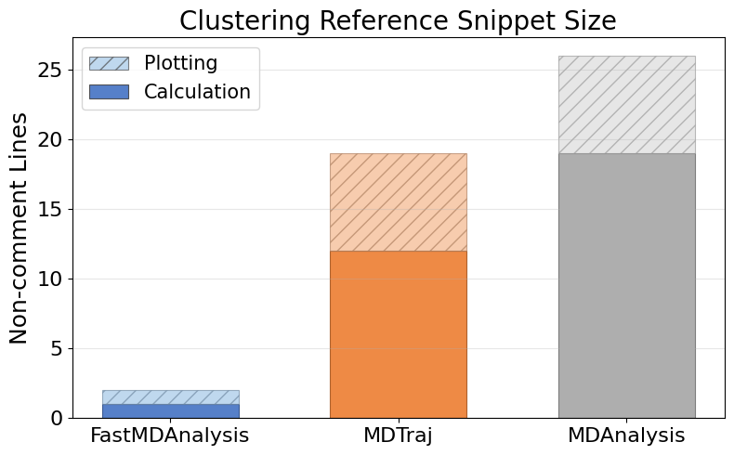
Cluster Ubiquitin99 (continued)

Slide 6
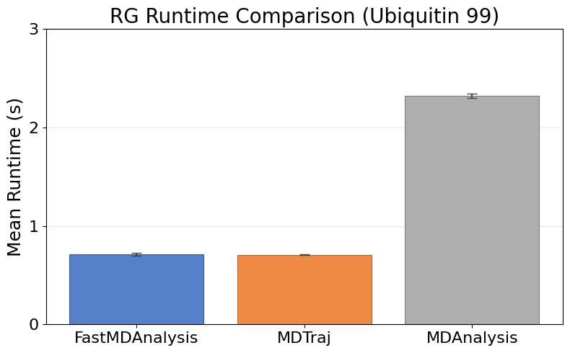
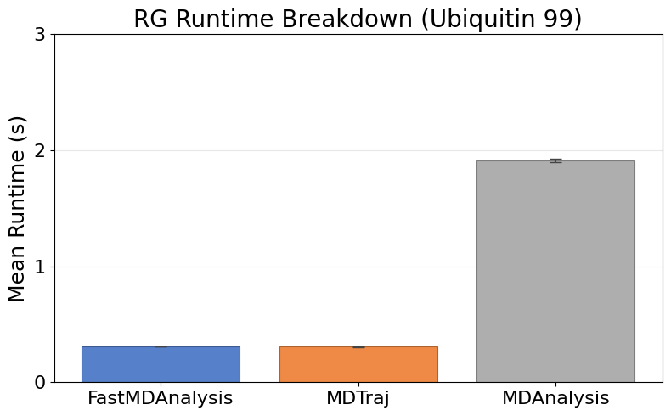
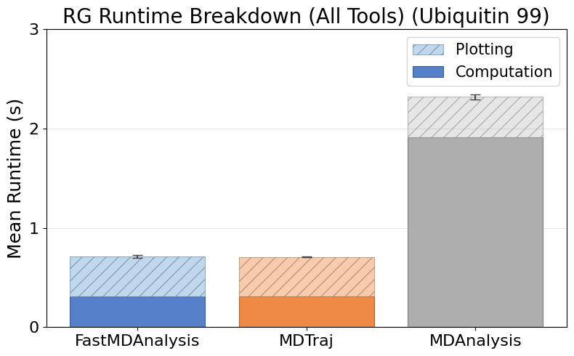
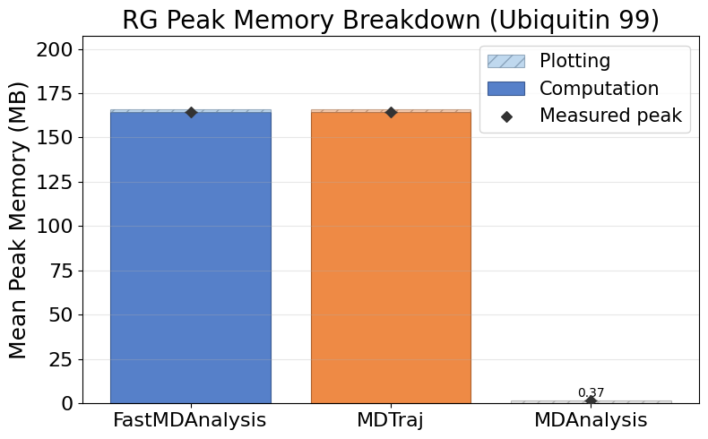
Rg Ubiquitin99
Note: MDTraj and MDAnalysis metrics include helper scripts we wrote to save data files and plots; their APIs do not emit those artifacts automatically.

Slide 7
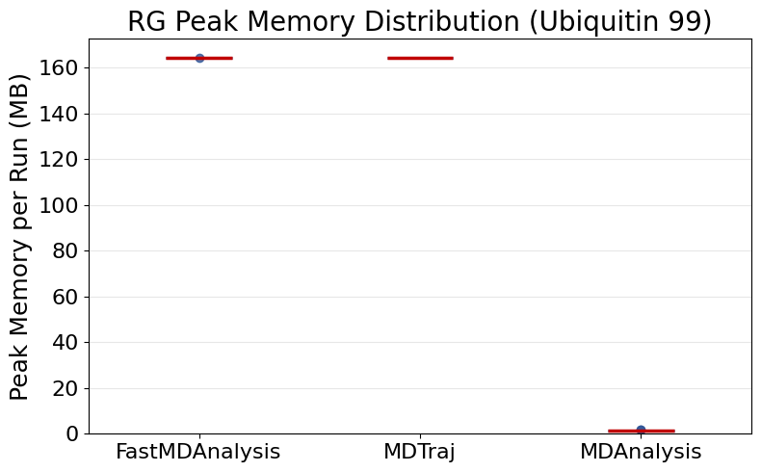
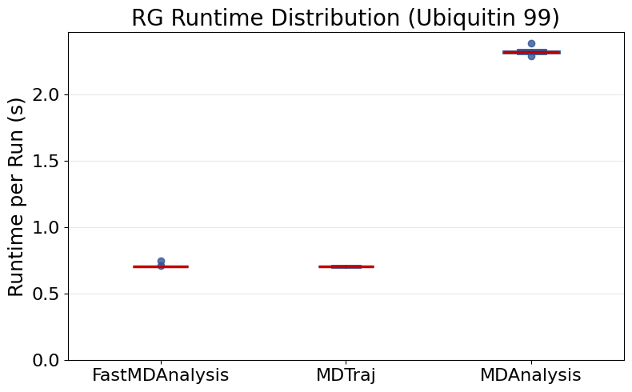
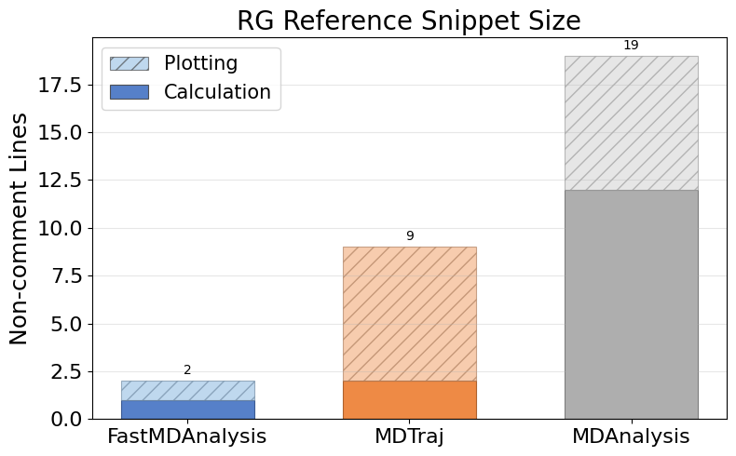
Rg Ubiquitin99 (continued)

Slide 8
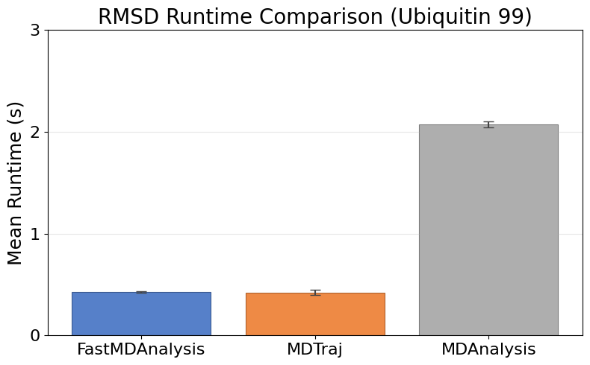
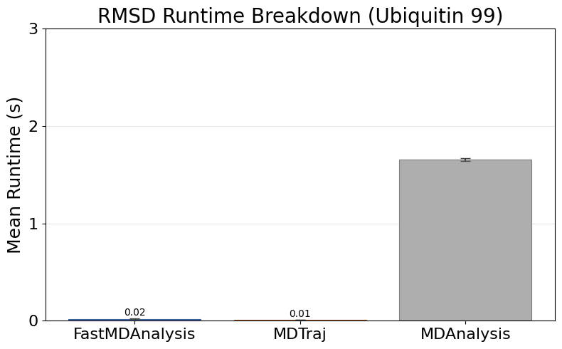
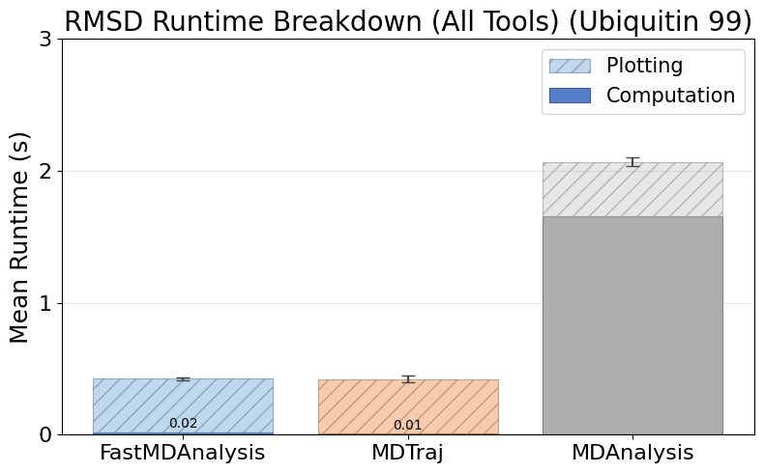
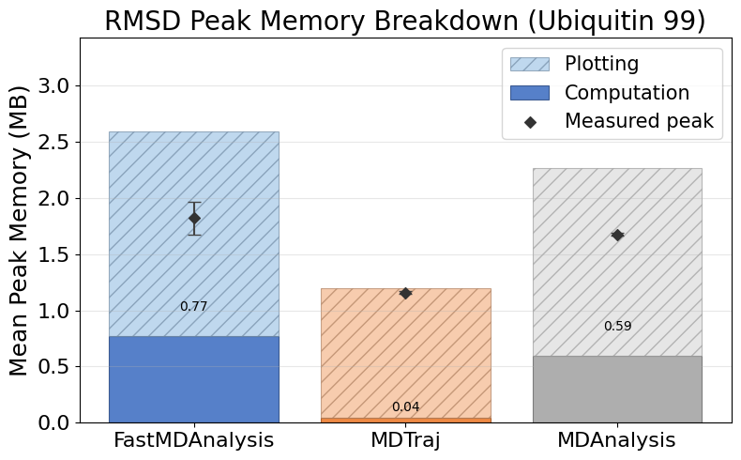
Rmsd Ubiquitin99
Note: MDTraj and MDAnalysis metrics include helper scripts we wrote to save data files and plots; their APIs do not emit those artifacts automatically.

Slide 9
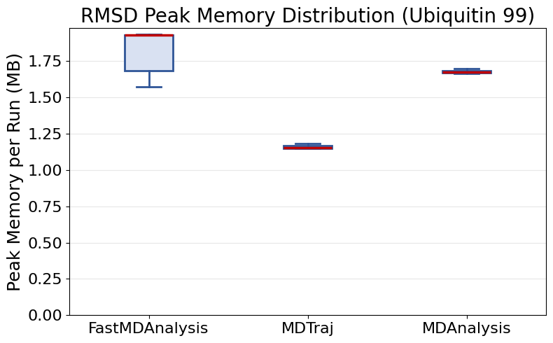
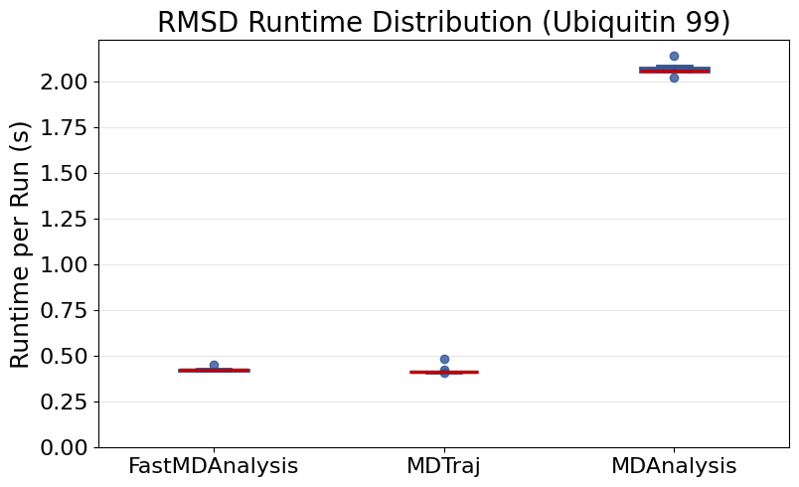
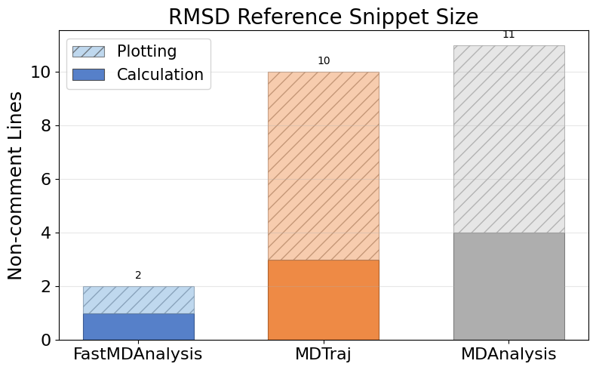
Rmsd Ubiquitin99 (continued)

Slide 10
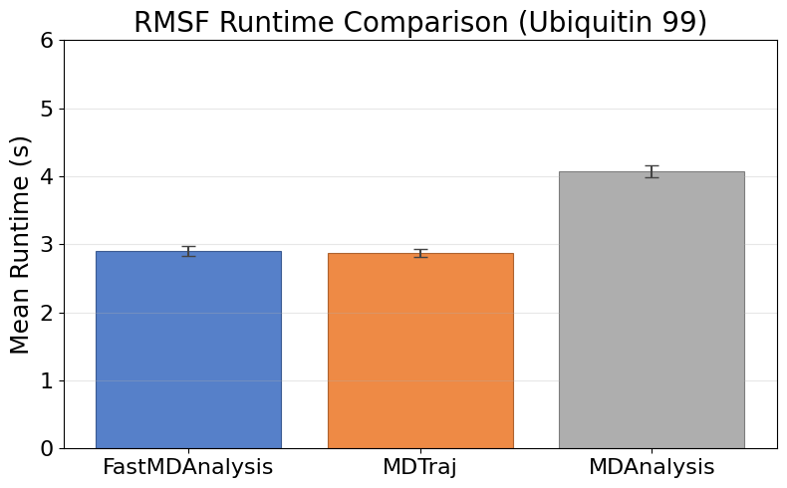
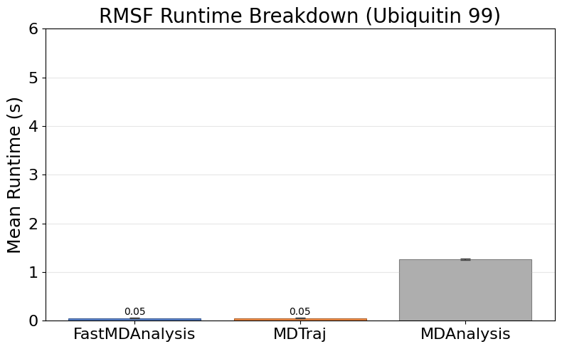
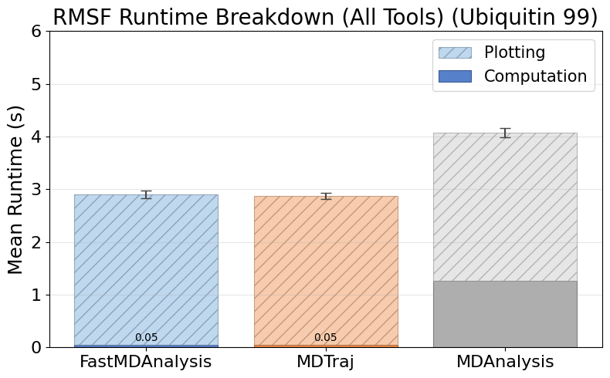
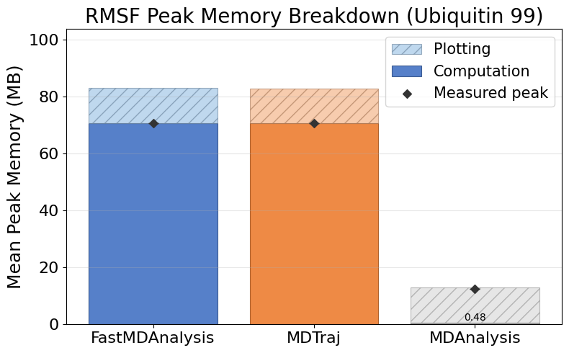
Rmsf Ubiquitin99
Note: MDTraj and MDAnalysis metrics include helper scripts we wrote to save data files and plots; their APIs do not emit those artifacts automatically.

Slide 11
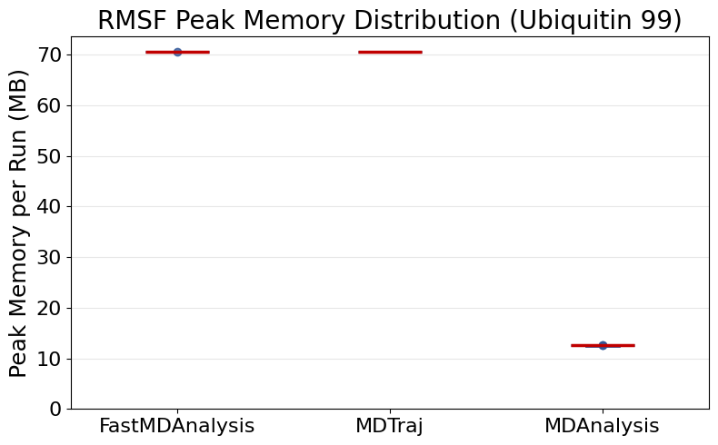
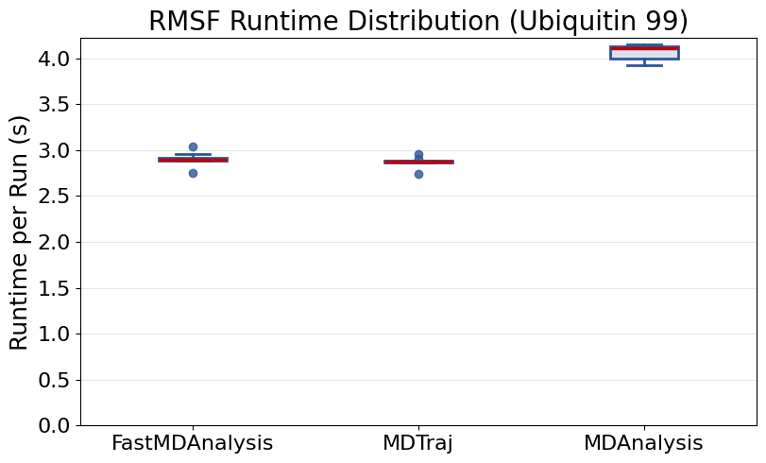
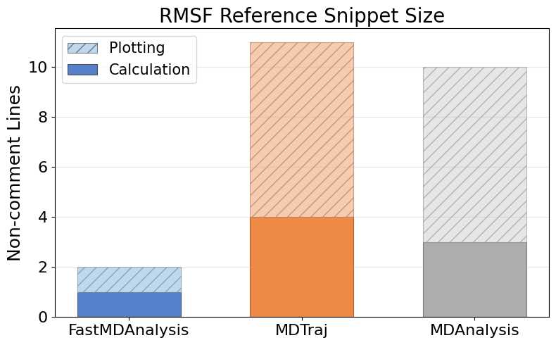
Rmsf Ubiquitin99 (continued)

Slide 12
Instrumentation Overview
  FastMDAnalysis: 6 modules, 11 functions, 0 external imports, 35 runs, 35 successful, 0 exceptions.
  Mdtraj: 4 modules, 10 functions, 3 external imports, 35 runs, 35 successful, 0 exceptions.
  Mdanalysis: 5 modules, 10 functions, 3 external imports, 35 runs, 35 successful, 0 exceptions.
  Snippet footprint overview: FastMDAnalysis 4 calc / 4 plot (8 total) lines, Mdtraj 21 calc / 28 plot (49 total) lines, Mdanalysis 38 calc / 28 plot (66 total) lines.
  Runtime overview: FastMDAnalysis 2.30s calc / 4.88s plot / 0.09s overhead (7.27s total), Mdtraj 0.52s calc / 4.83s plot / 0.10s overhead (5.45s total), Mdanalysis 5.39s calc / 4.84s plot / 0.01s overhead (10.24s total).
  Peak memory overview: FastMDAnalysis 253.26 MB calc / 32.15 MB plot (255.21 MB peak), Mdtraj 236.20 MB calc / 27.42 MB plot (249.08 MB peak), Mdanalysis 2.03 MB calc / 28.19 MB plot (28.19 MB peak).
  Charts on the following slides illustrate these touchpoint gaps.

