Slide 1
FastMDAnalysis — Analysis Slides
7 figure(s) — generated 2025-11-06 05:28:34

Slide 2
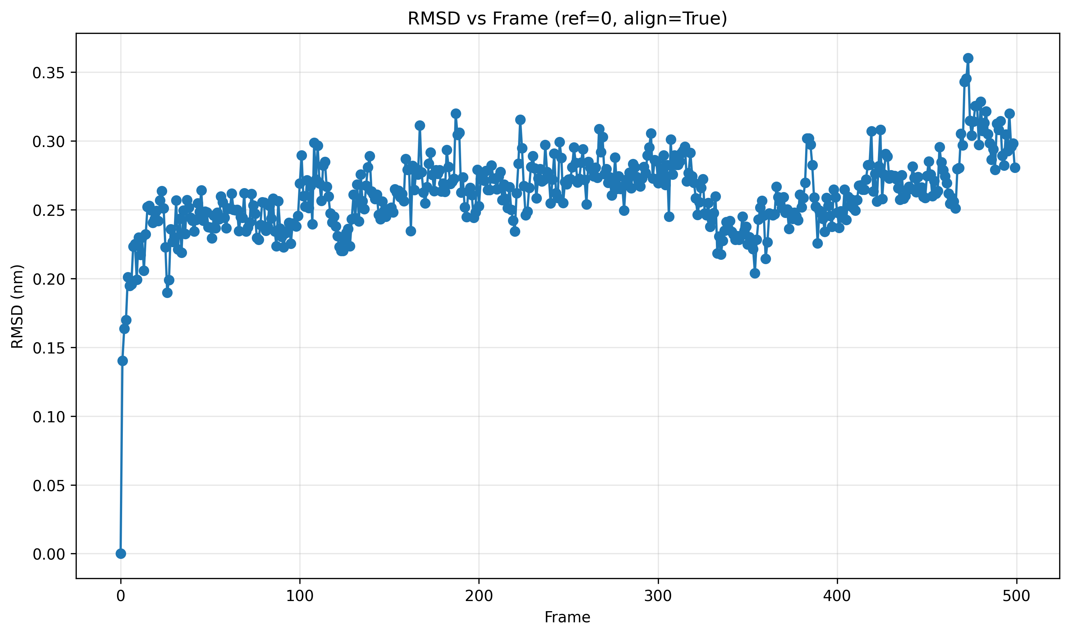
RMSD
benchmarks/results/orchestrator_ubiquitin99_500/fastmdanalysis/rep_01/rmsd/rmsd.png — 220 KB — saved 2025-11-06 05:28:21

Slide 3
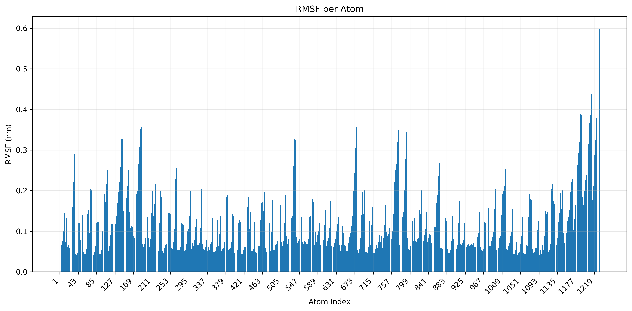
RMSF
benchmarks/results/orchestrator_ubiquitin99_500/fastmdanalysis/rep_01/rmsf/rmsf.png — 145 KB — saved 2025-11-06 05:28:25

Slide 4
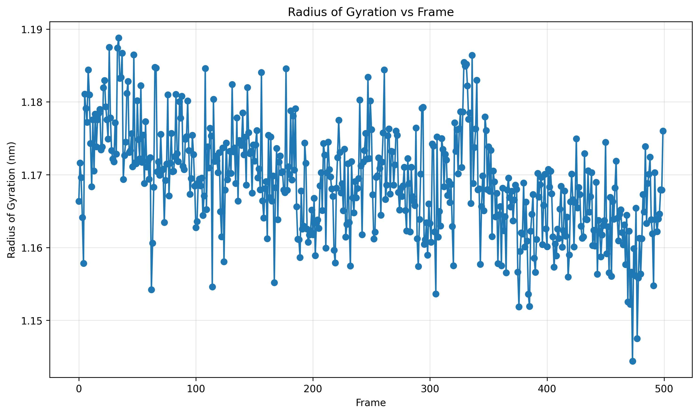
RG
benchmarks/results/orchestrator_ubiquitin99_500/fastmdanalysis/rep_01/rg/rg.png — 453 KB — saved 2025-11-06 05:28:25

Slide 5
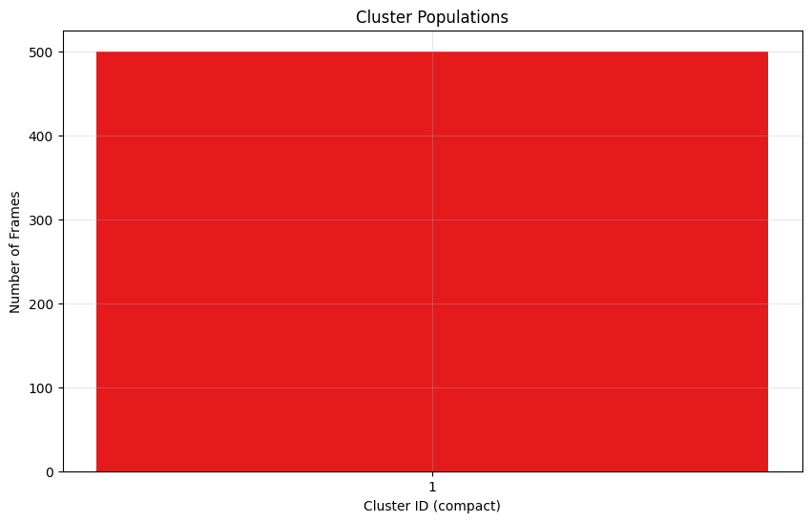
Dbscan (pop)
benchmarks/results/orchestrator_ubiquitin99_500/fastmdanalysis/rep_01/cluster/dbscan_pop.png — 17 KB — saved 2025-11-06 05:28:33

Slide 6
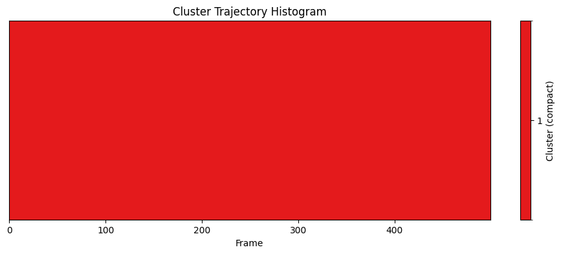
Dbscan (traj hist)
benchmarks/results/orchestrator_ubiquitin99_500/fastmdanalysis/rep_01/cluster/dbscan_traj_hist.png — 13 KB — saved 2025-11-06 05:28:34

Slide 7
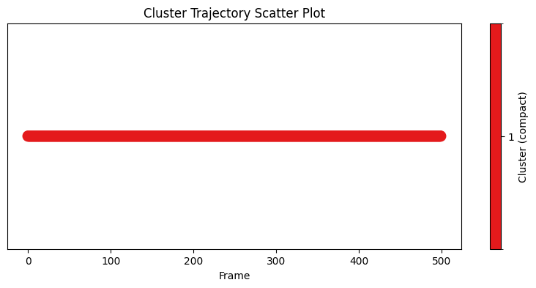
Dbscan (traj scatter)
benchmarks/results/orchestrator_ubiquitin99_500/fastmdanalysis/rep_01/cluster/dbscan_traj_scatter.png — 14 KB — saved 2025-11-06 05:28:34

Slide 8
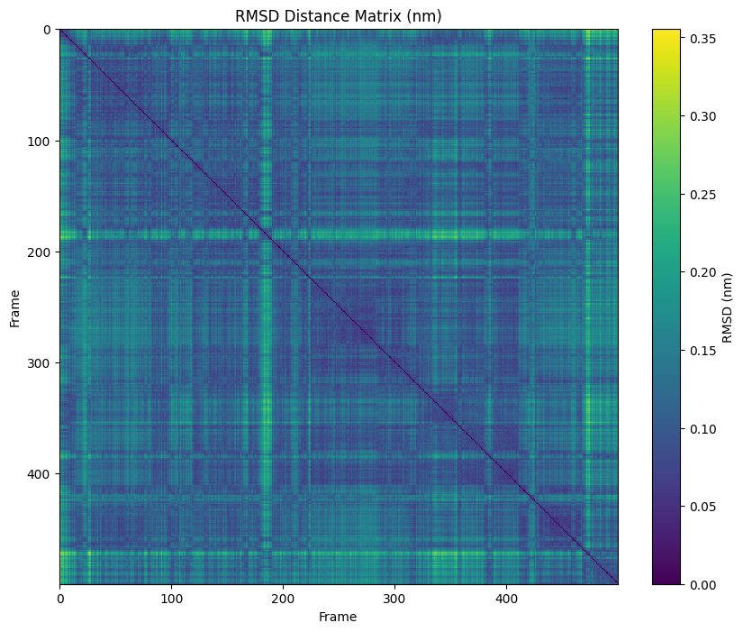
Dbscan (distance matrix)
benchmarks/results/orchestrator_ubiquitin99_500/fastmdanalysis/rep_01/cluster/dbscan_distance_matrix.png — 497 KB — saved 2025-11-06 05:28:34

