Slide 1
FastMdAnalysis Benchmarks – Trp-cage 5000
Runtime, memory, and usability comparisons versus MDTraj and MDAnalysis
Note: third-party metrics include helper scripts for exporting data and plots.
Dataset: Trp-cage 5000

Slide 2
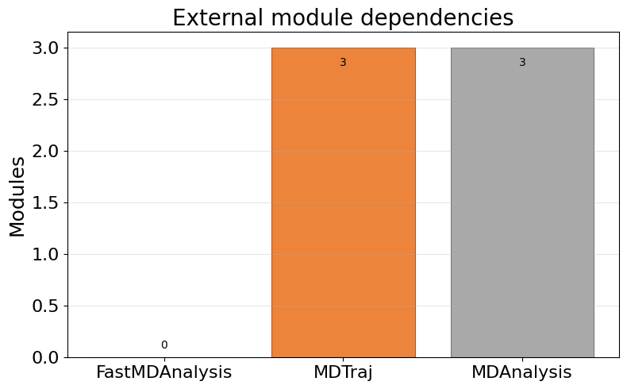
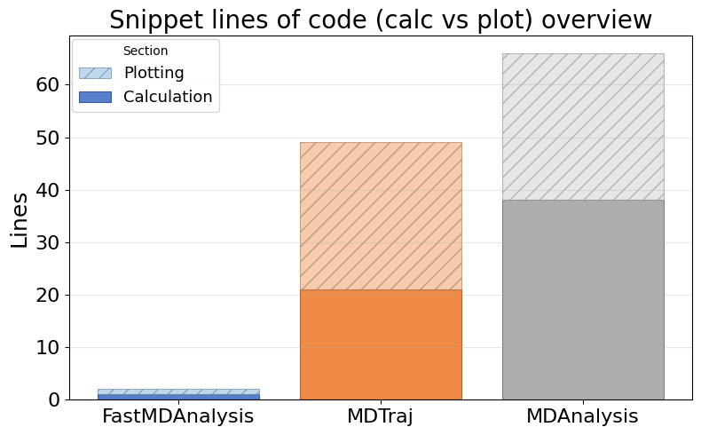
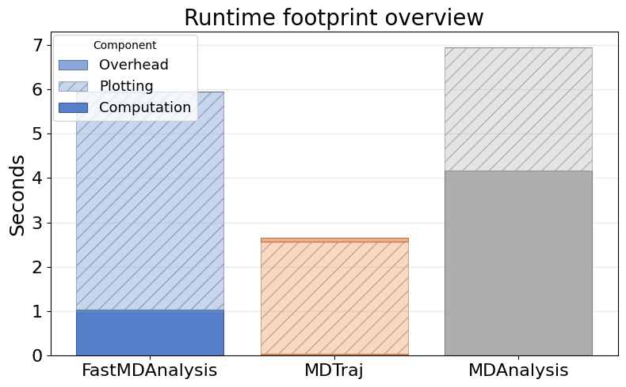
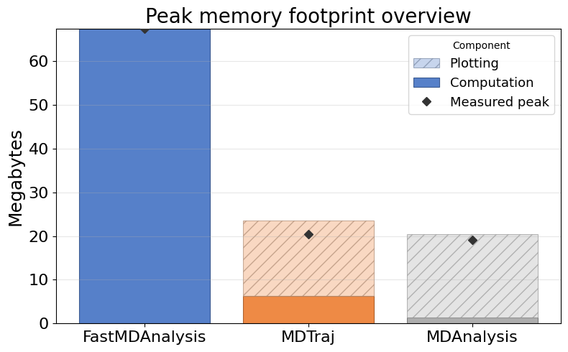
Overview: Dependencies, LOC, Runtime, Memory

Slide 3
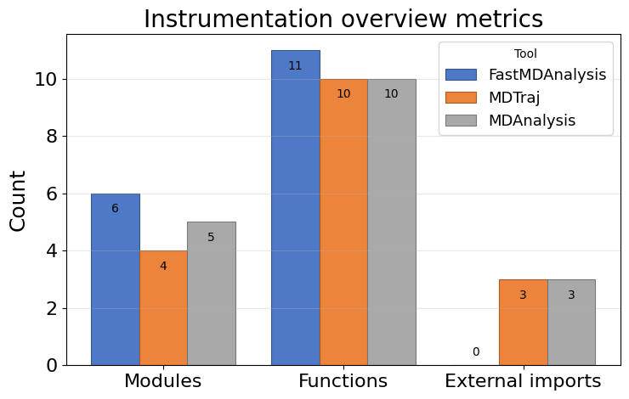
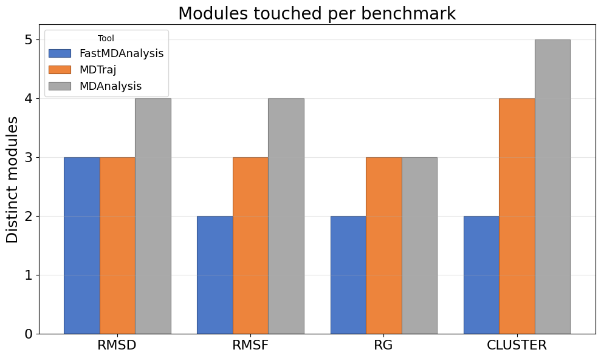
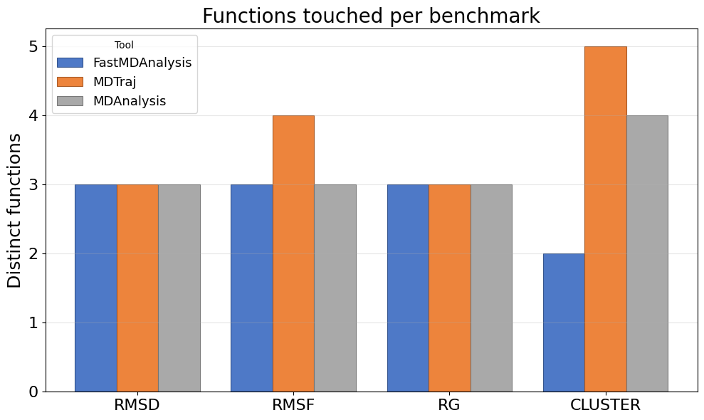
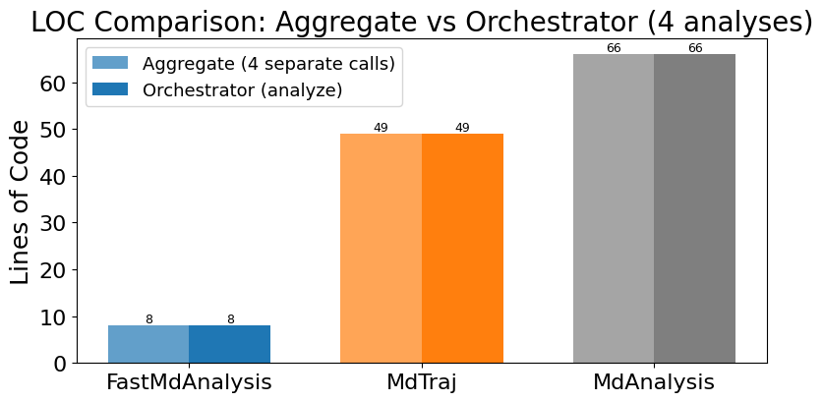
Instrumentation overview: touchpoints, modules, functions, LOC

Slide 4
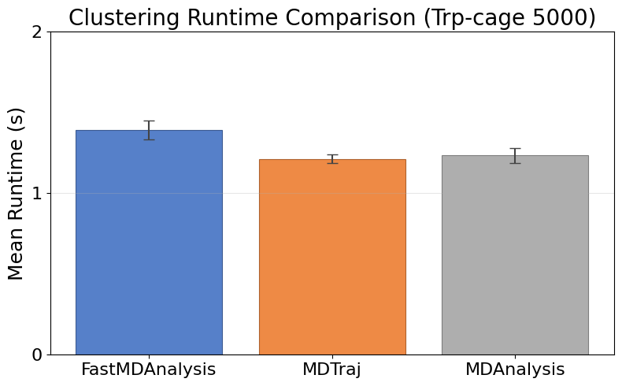
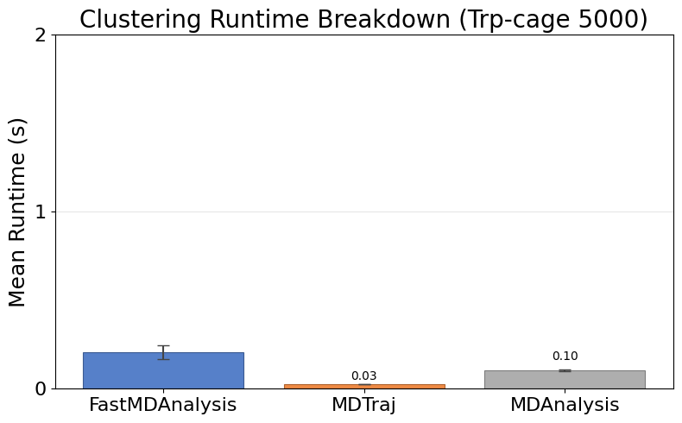
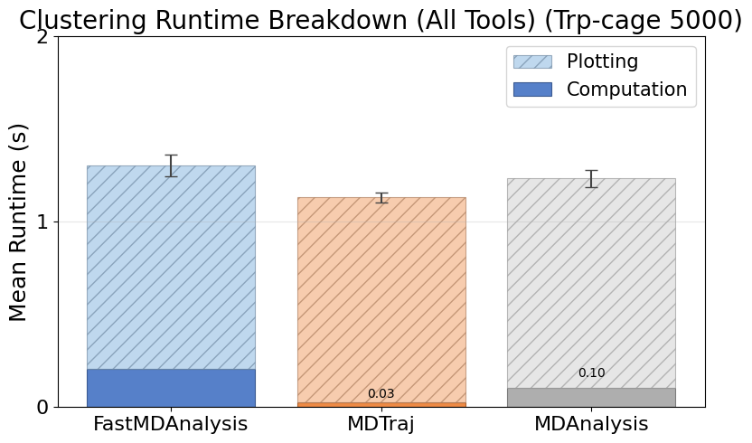
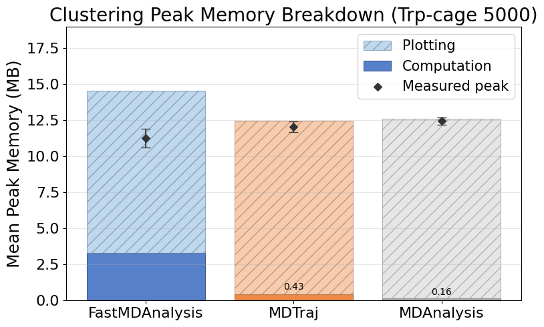
Cluster Trpcage 5000
Note: MDTraj and MDAnalysis metrics include helper scripts we wrote to save data files and plots; their APIs do not emit those artifacts automatically.

Slide 5
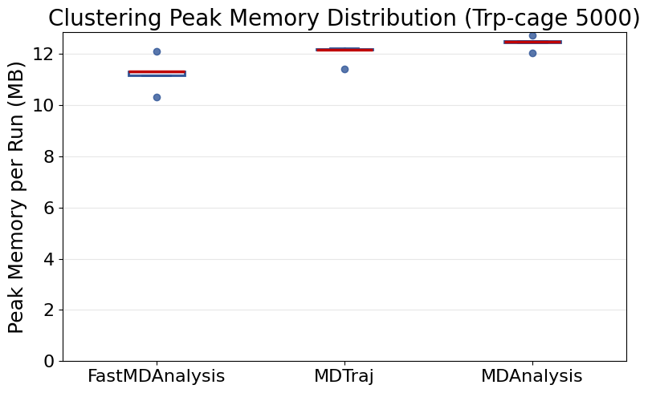
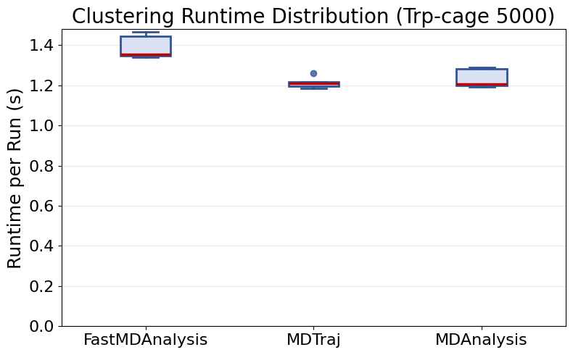
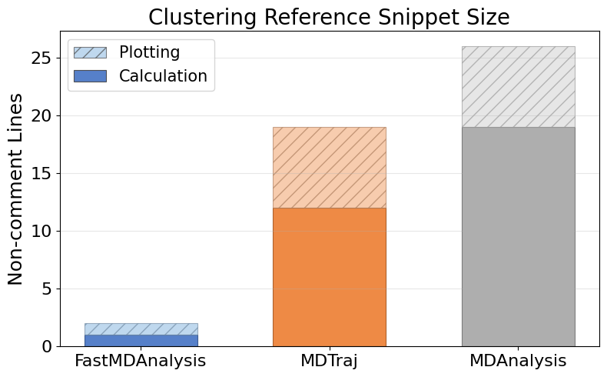
Cluster Trpcage 5000 (continued)

Slide 6
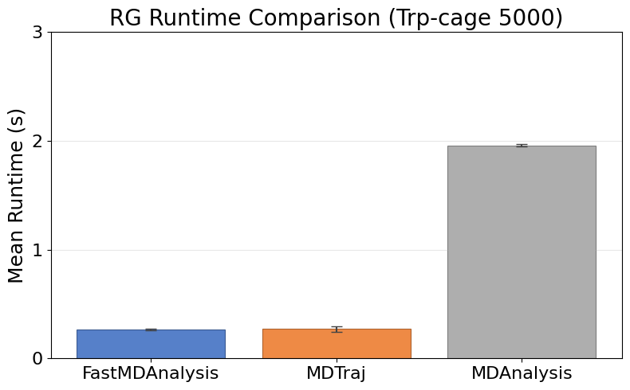
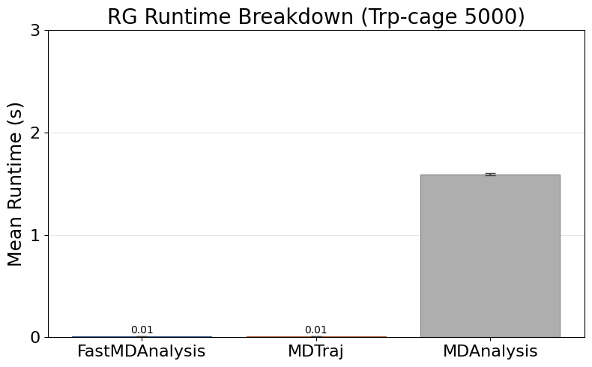
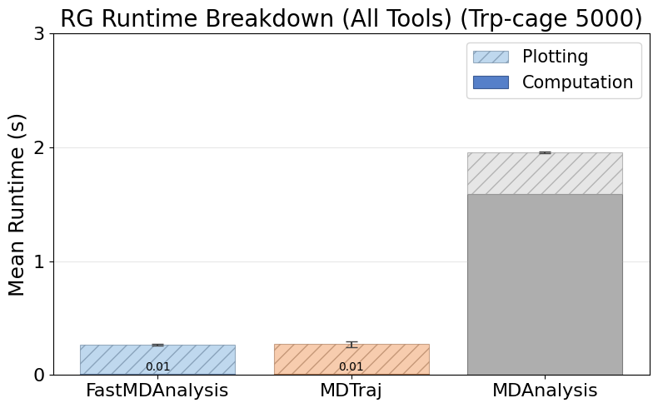
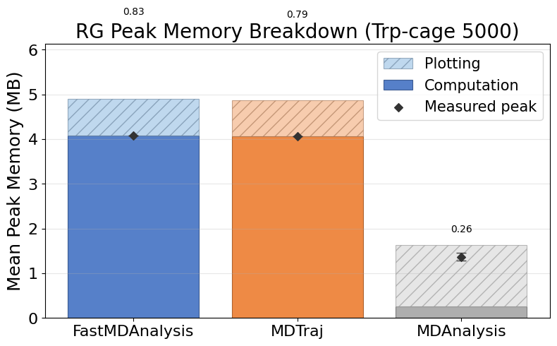
Rg Trpcage 5000
Note: MDTraj and MDAnalysis metrics include helper scripts we wrote to save data files and plots; their APIs do not emit those artifacts automatically.

Slide 7
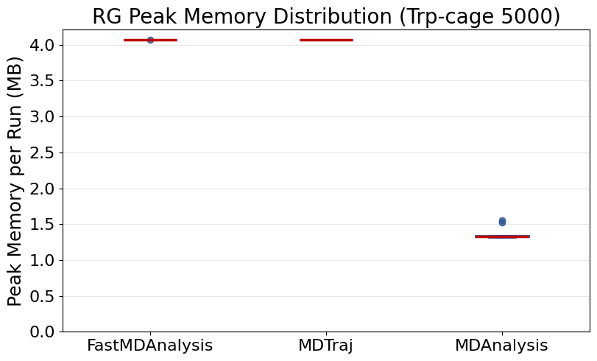
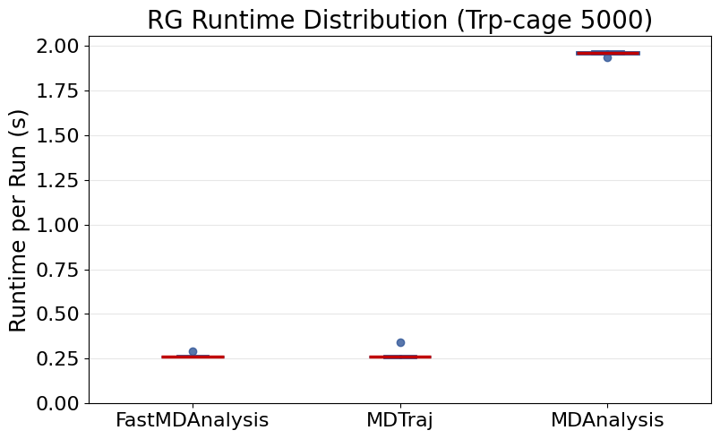
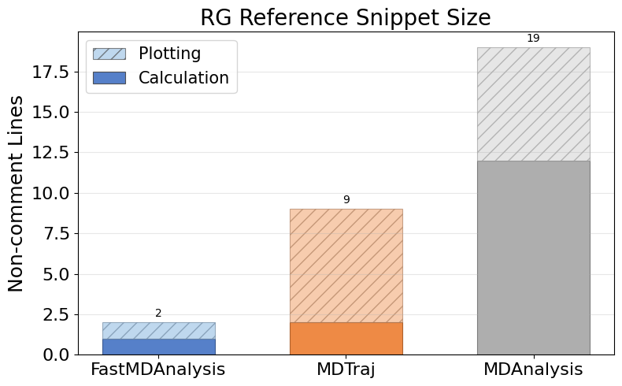
Rg Trpcage 5000 (continued)

Slide 8
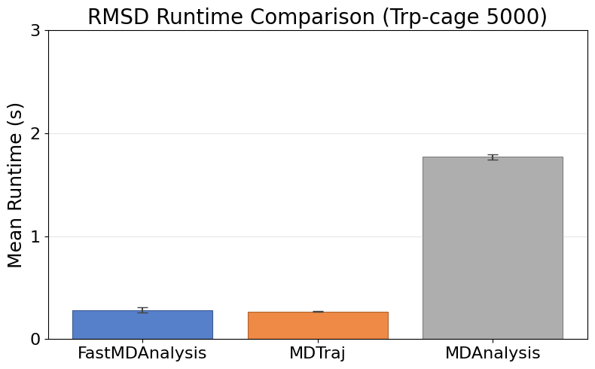
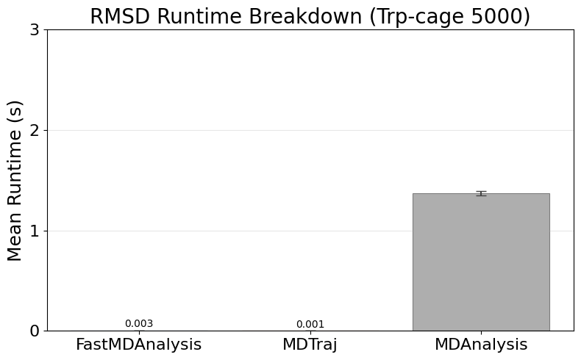
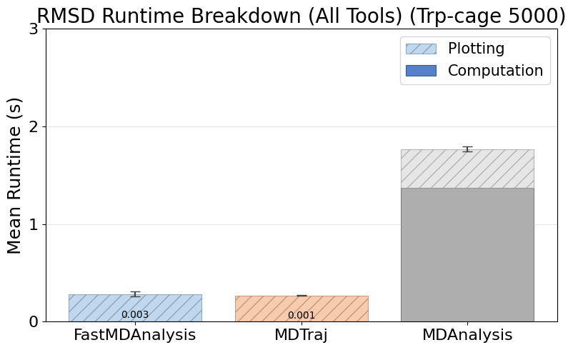
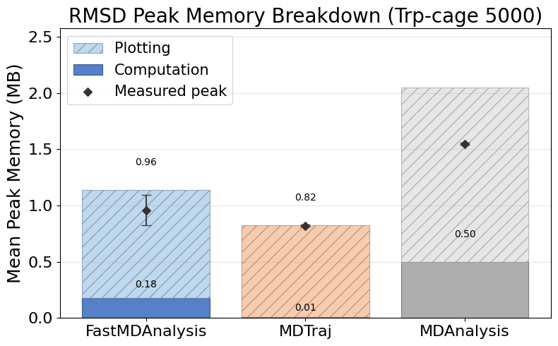
Rmsd Trpcage 5000
Note: MDTraj and MDAnalysis metrics include helper scripts we wrote to save data files and plots; their APIs do not emit those artifacts automatically.

Slide 9
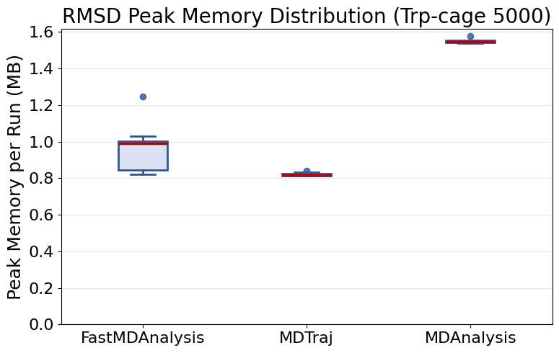
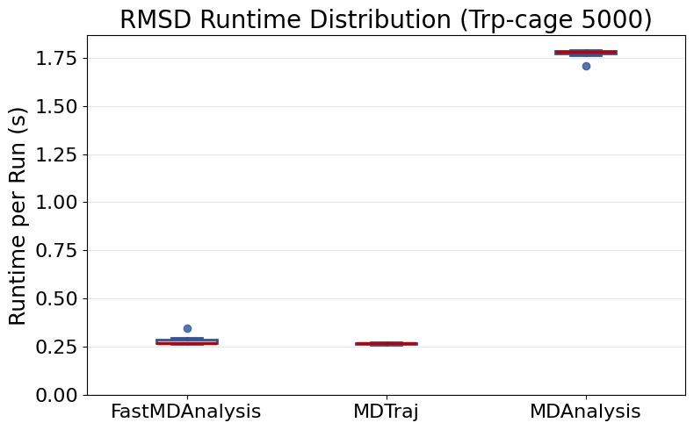
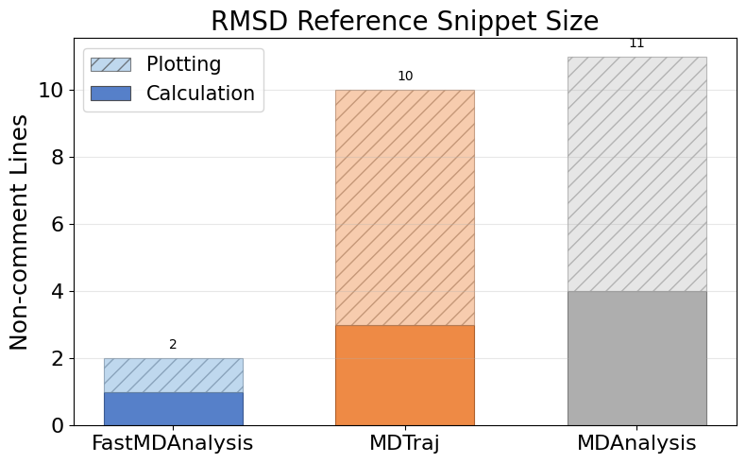
Rmsd Trpcage 5000 (continued)

Slide 10
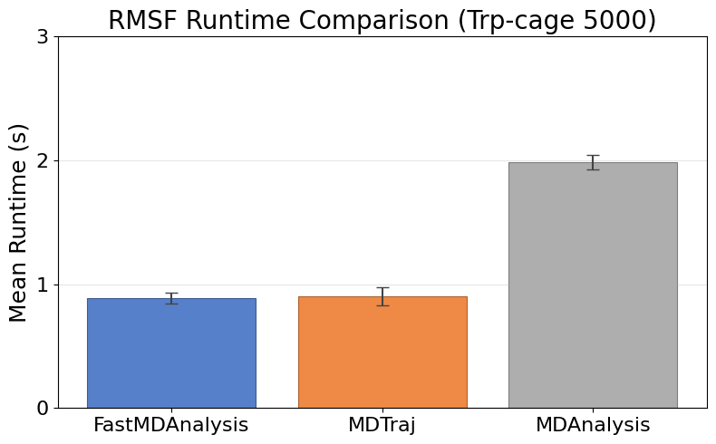
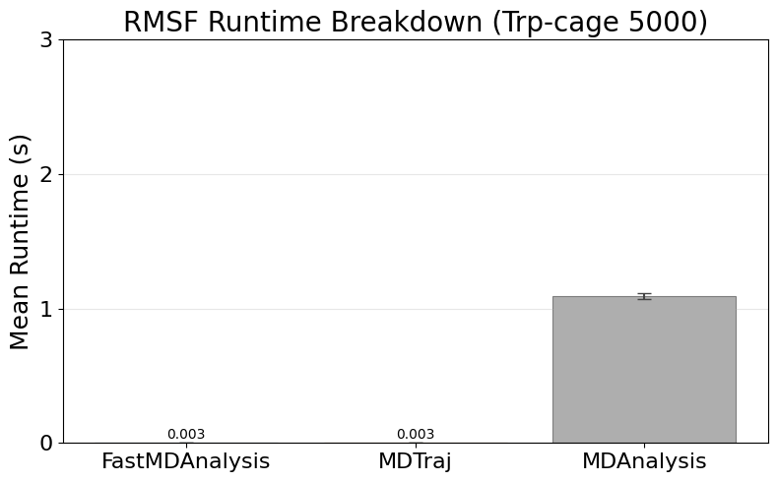
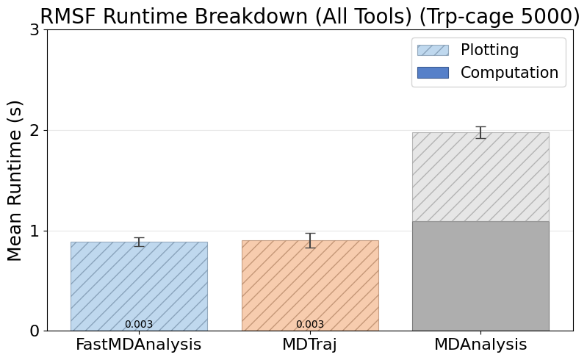
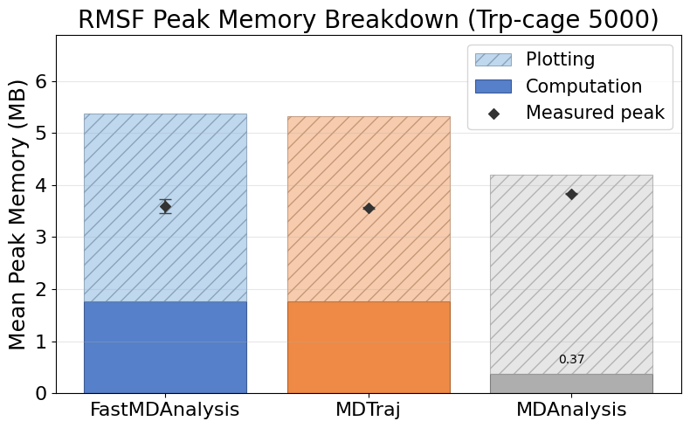
Rmsf Trpcage 5000
Note: MDTraj and MDAnalysis metrics include helper scripts we wrote to save data files and plots; their APIs do not emit those artifacts automatically.

Slide 11
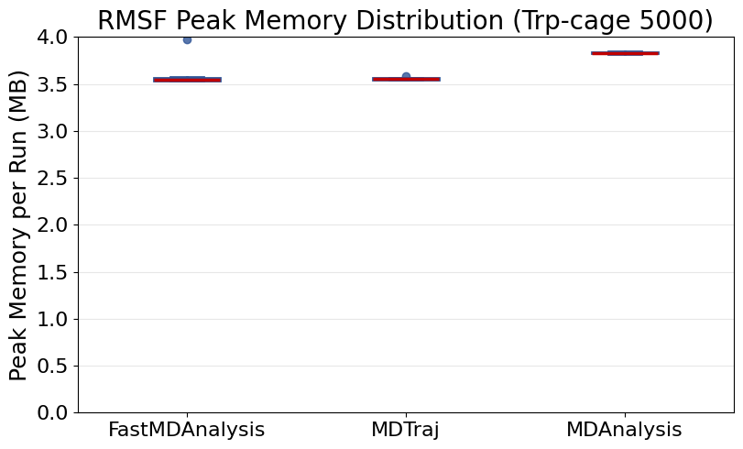
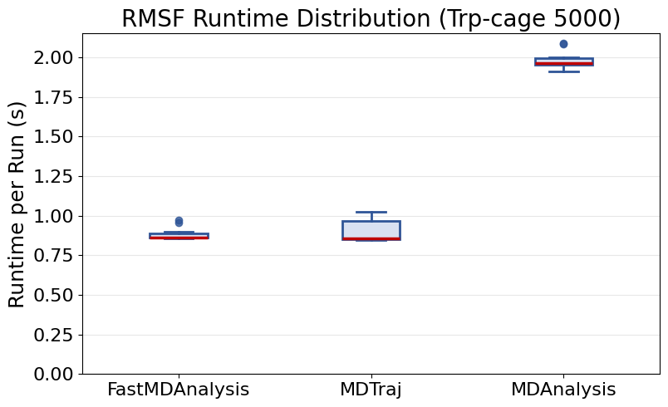
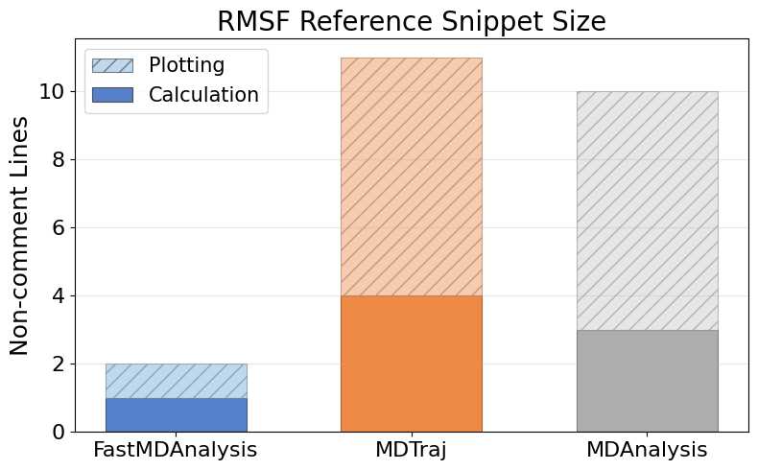
Rmsf Trpcage 5000 (continued)

Slide 12
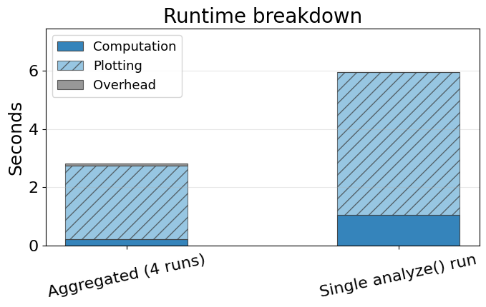
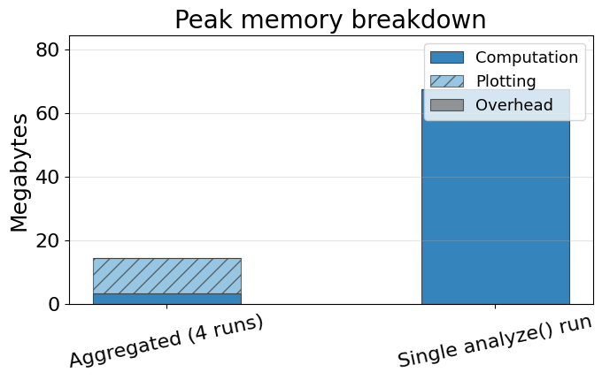
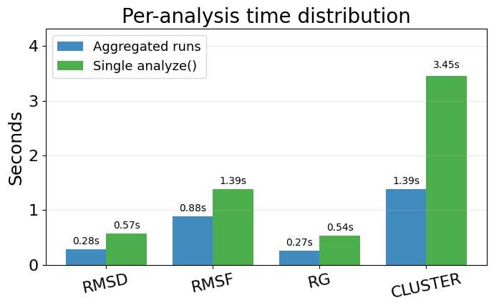
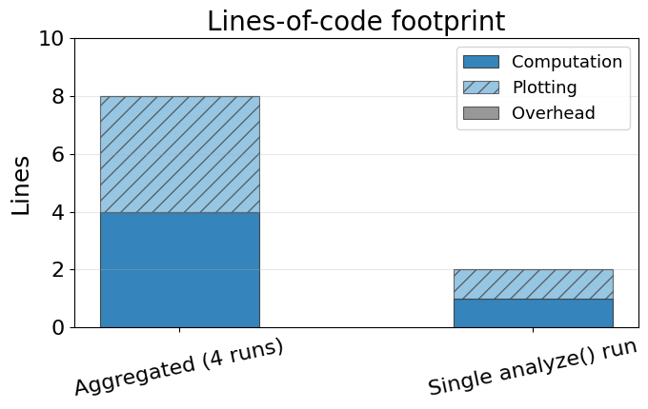
Single-run vs aggregated FastMDAnalysis
Aggregated bars sum the computation, plotting, and overhead from individual analyze runs. Single-run bars reflect the orchestrated analyze(...) benchmark metrics for those same slices. Bottom-left chart breaks down runtime per analysis for the single run (slides counted as plotting).

Slide 13
Instrumentation Overview
  FastMDAnalysis: 6 modules, 11 functions, 0 external imports, 35 runs, 35 successful, 0 exceptions.
  Mdtraj: 4 modules, 10 functions, 3 external imports, 35 runs, 35 successful, 0 exceptions.
  Mdanalysis: 5 modules, 10 functions, 3 external imports, 35 runs, 35 successful, 0 exceptions.
  Snippet footprint overview: FastMDAnalysis 1 calc / 1 plot (2 total) lines, Mdtraj 21 calc / 28 plot (49 total) lines, Mdanalysis 38 calc / 28 plot (66 total) lines.
  Runtime overview: FastMDAnalysis 1.04s calc / 4.91s plot (5.95s total), Mdtraj 0.04s calc / 2.53s plot / 0.08s overhead (2.65s total), Mdanalysis 4.16s calc / 2.78s plot / 0.01s overhead (6.95s total).
  Note: FastMDAnalysis timing uses single-line analyze() orchestrator approach. Calc/plot split is estimated using empirically measured ratio from individual benchmarks (17.5% computation, 82.5% plotting/saving), reflecting that matplotlib plotting and data file I/O are relatively expensive operations.
  Peak memory overview: FastMDAnalysis 67.40 MB calc / 0.00 MB plot (67.40 MB peak), Mdtraj 6.28 MB calc / 17.20 MB plot (20.48 MB peak), Mdanalysis 1.30 MB calc / 19.19 MB plot (19.19 MB peak).
  Charts on the following slides illustrate these touchpoint gaps.

