Slide 1
FastMdAnalysis Benchmarks – Trp-cage
Runtime, memory, and usability comparisons versus MDTraj and MDAnalysis
Note: third-party metrics include helper scripts for exporting data and plots.
Dataset: Trp-cage

Slide 2
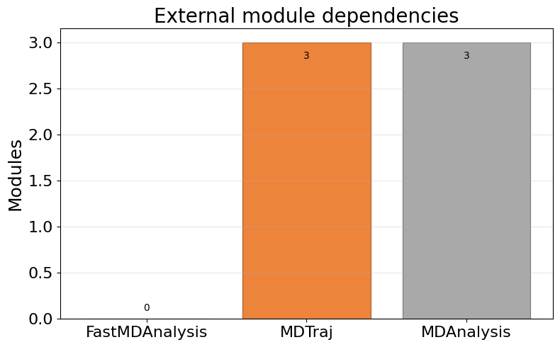
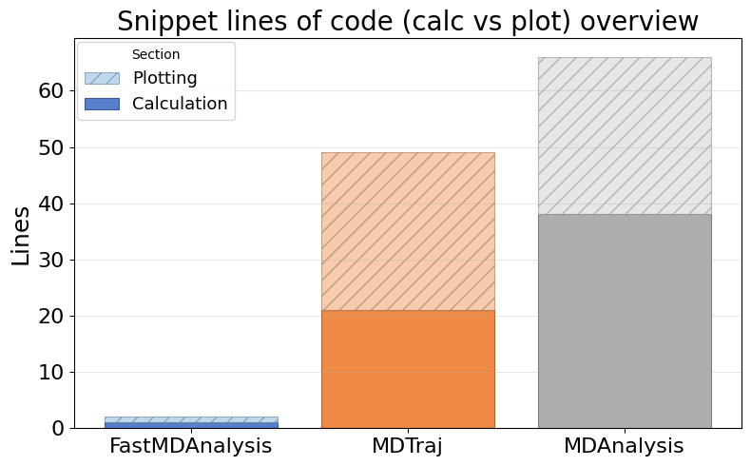
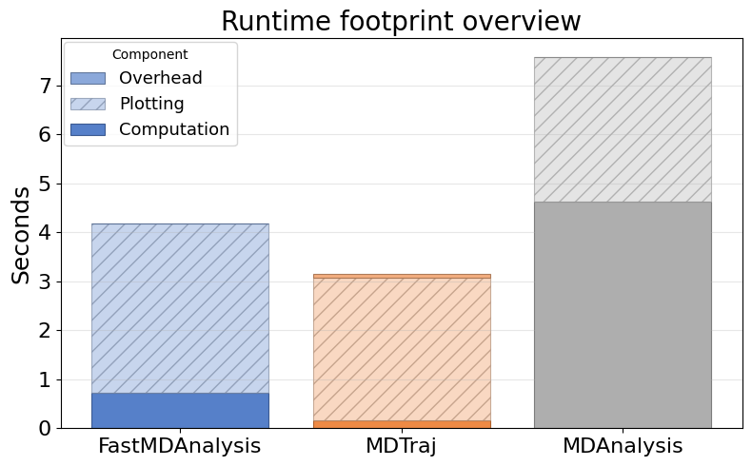
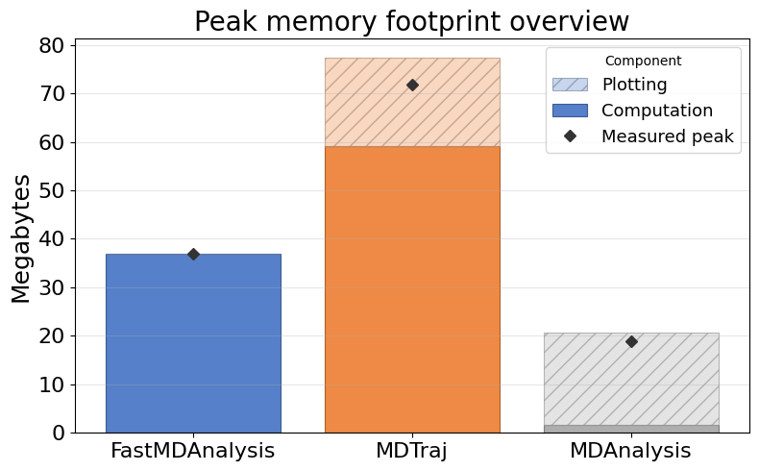
Overview: Dependencies, LOC, Runtime, Memory

Slide 3
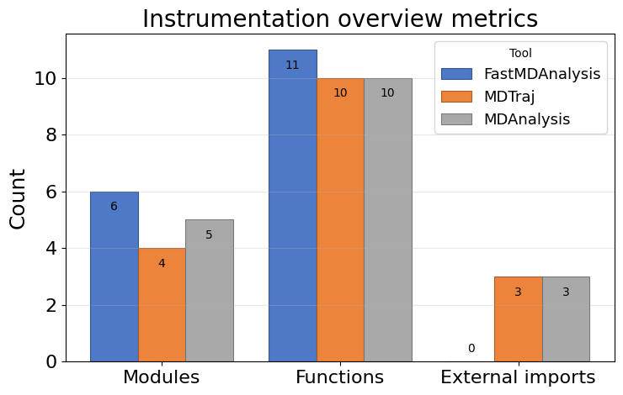
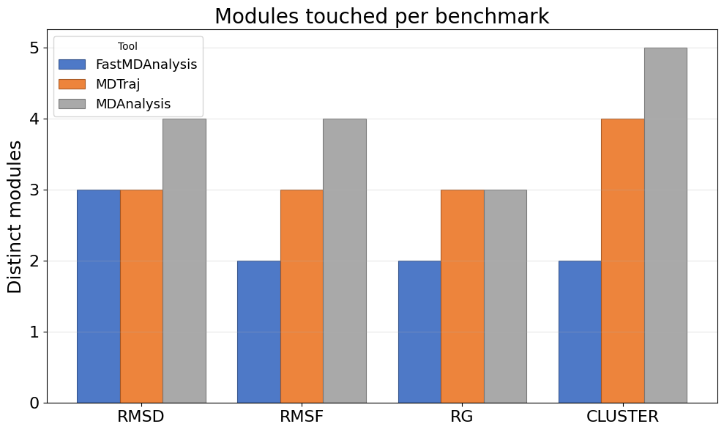
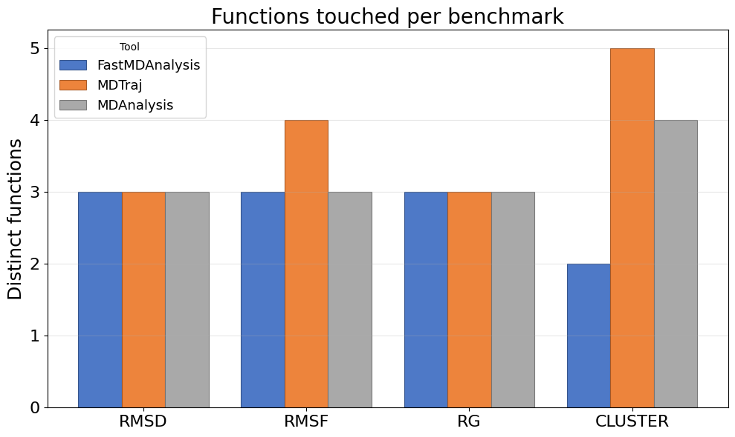
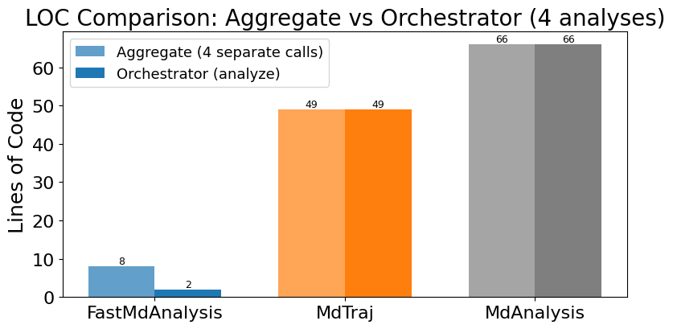
Instrumentation overview: touchpoints, modules, functions, LOC

Slide 4
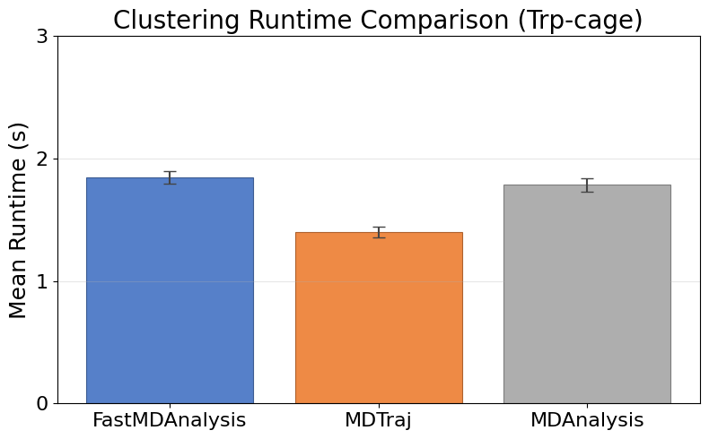
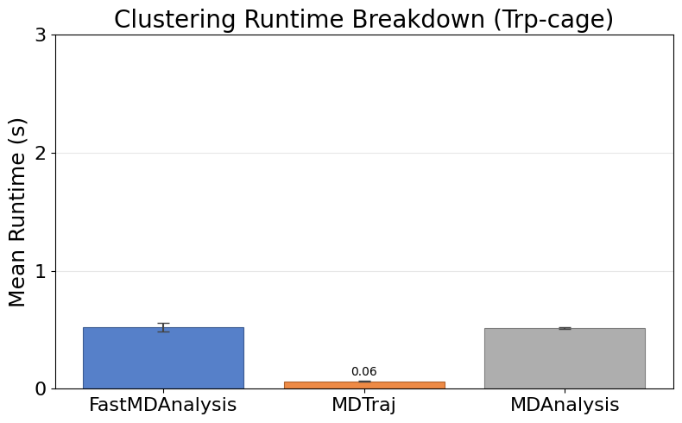
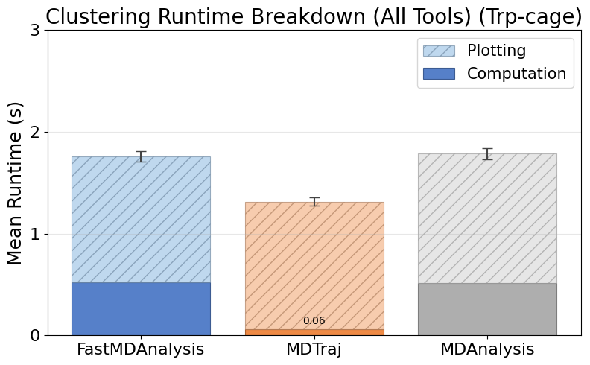
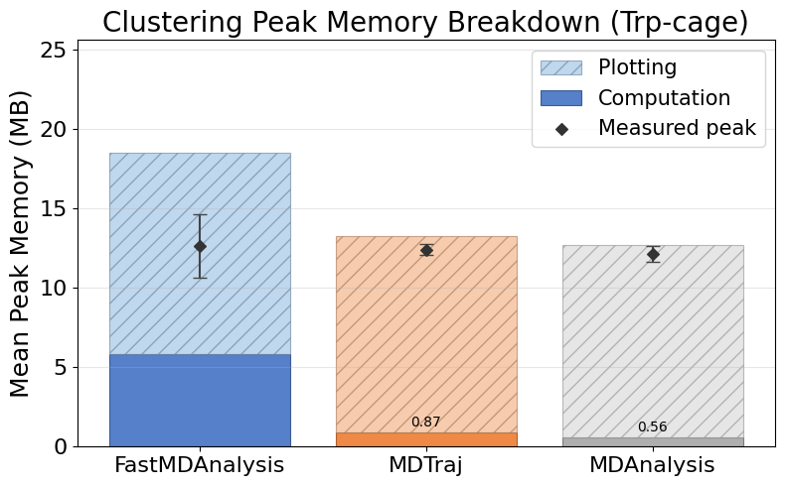
Cluster Trpcage
Note: MDTraj and MDAnalysis metrics include helper scripts we wrote to save data files and plots; their APIs do not emit those artifacts automatically.

Slide 5
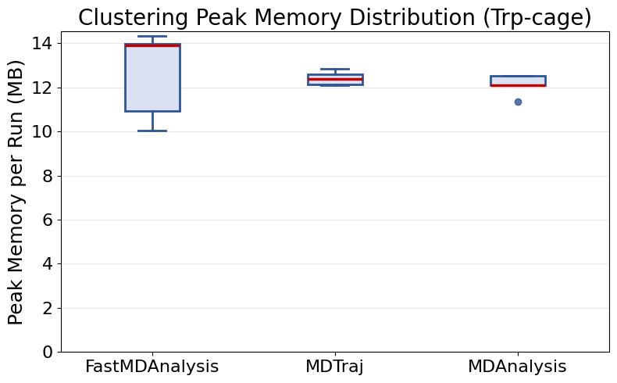
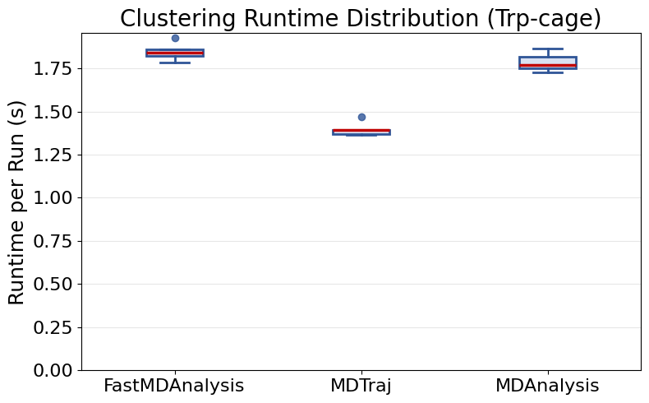
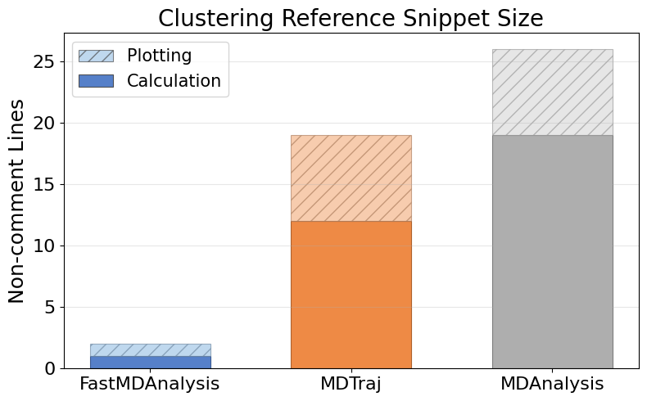
Cluster Trpcage (continued)

Slide 6
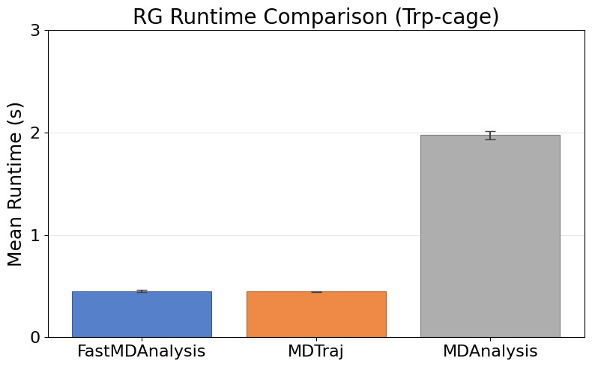
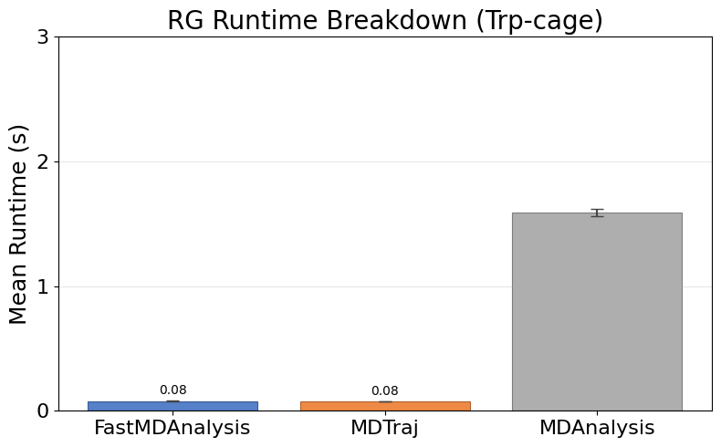
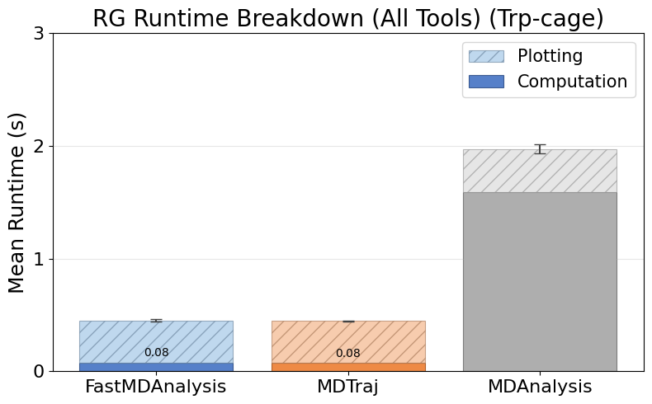
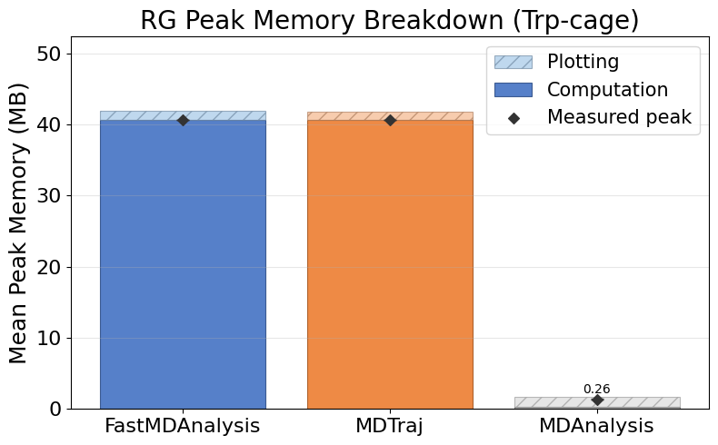
Rg Trpcage
Note: MDTraj and MDAnalysis metrics include helper scripts we wrote to save data files and plots; their APIs do not emit those artifacts automatically.

Slide 7
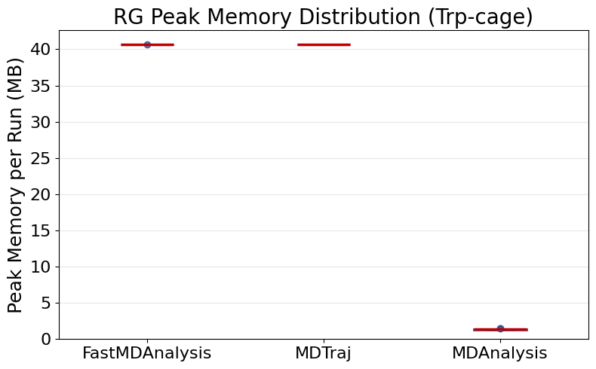
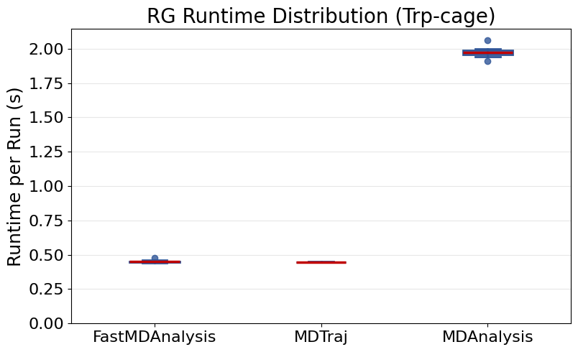
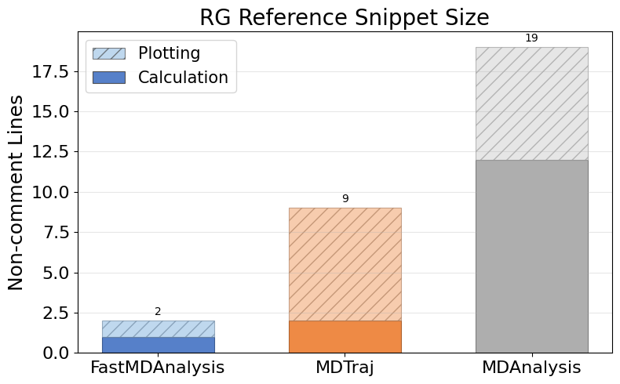
Rg Trpcage (continued)

Slide 8
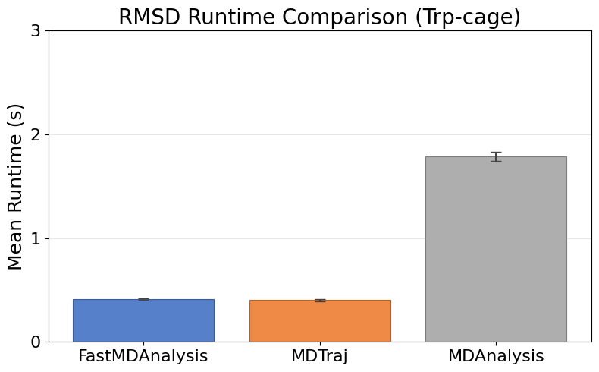
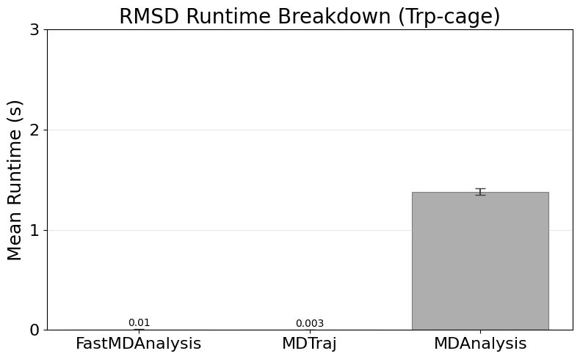
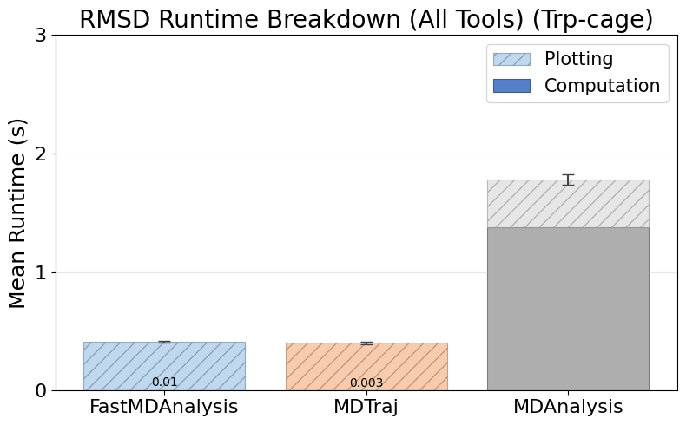
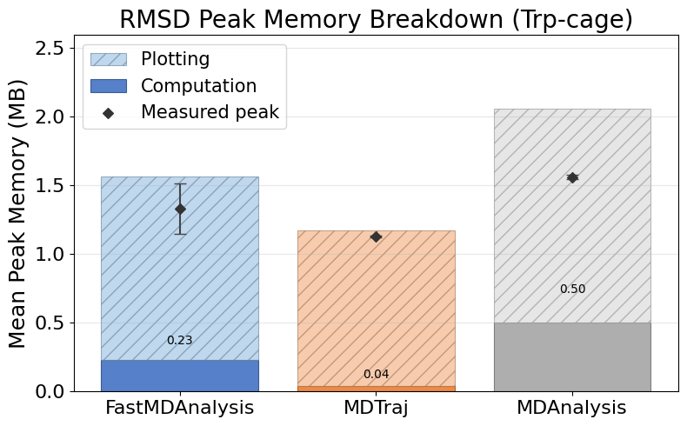
Rmsd Trpcage
Note: MDTraj and MDAnalysis metrics include helper scripts we wrote to save data files and plots; their APIs do not emit those artifacts automatically.

Slide 9
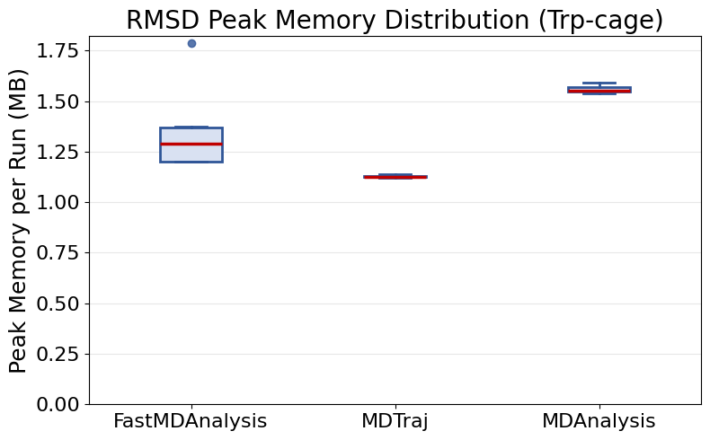
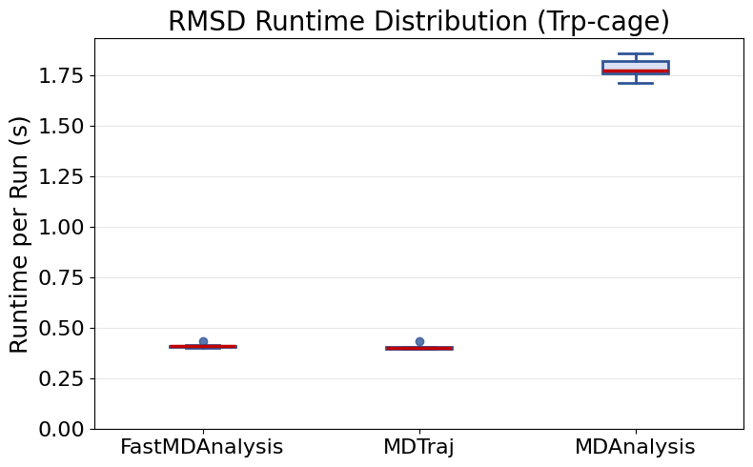
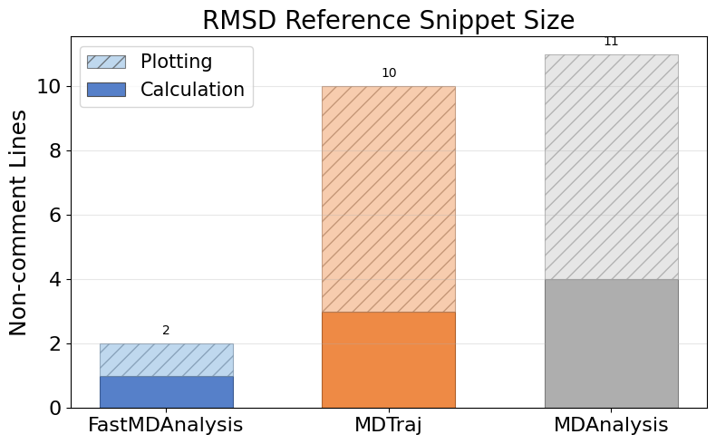
Rmsd Trpcage (continued)

Slide 10
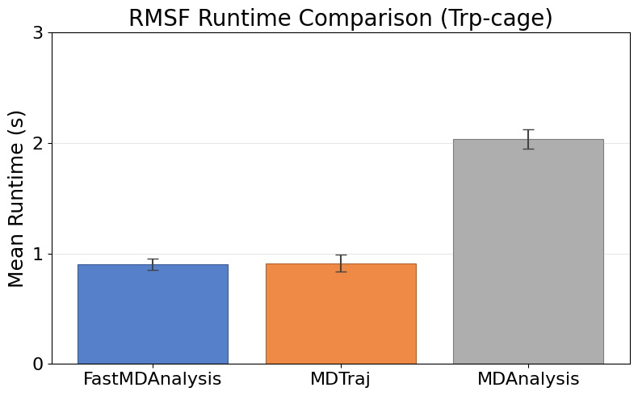
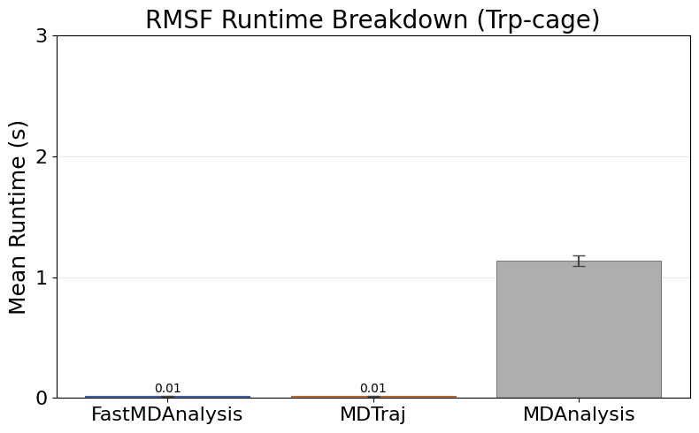
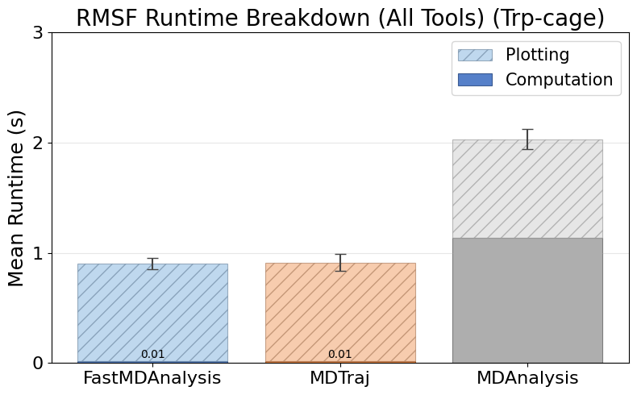
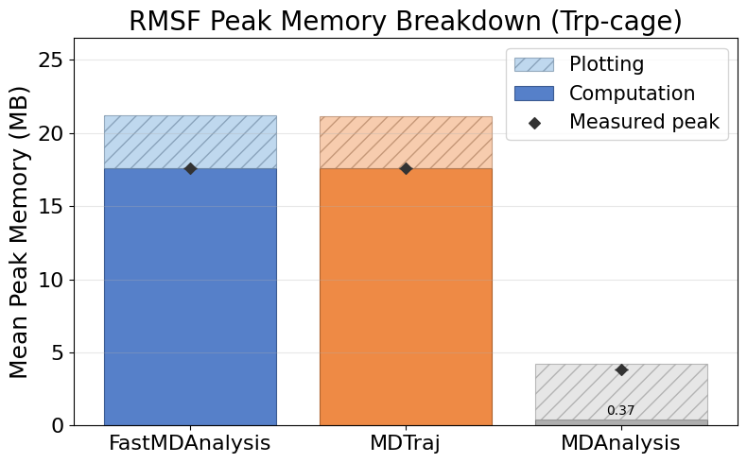
Rmsf Trpcage
Note: MDTraj and MDAnalysis metrics include helper scripts we wrote to save data files and plots; their APIs do not emit those artifacts automatically.

Slide 11
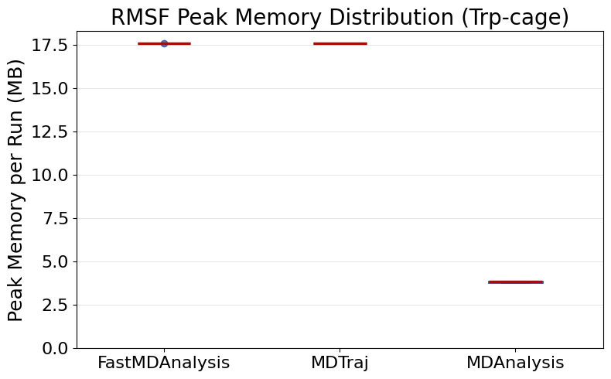
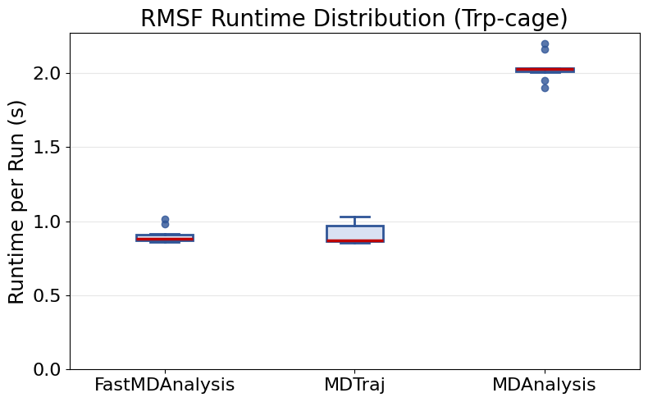
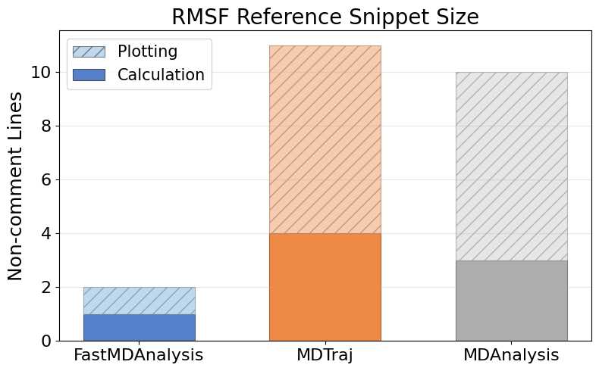
Rmsf Trpcage (continued)

Slide 12
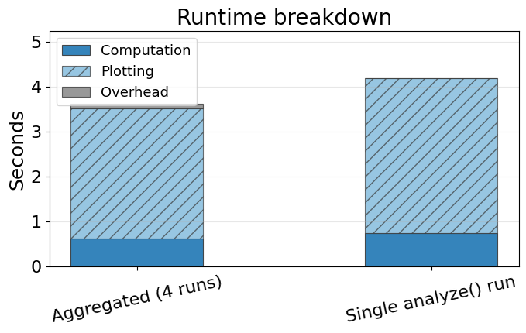
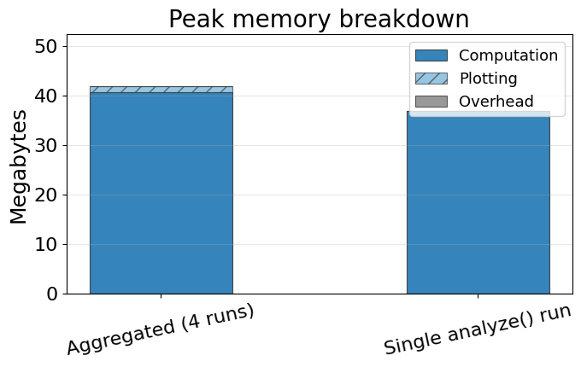
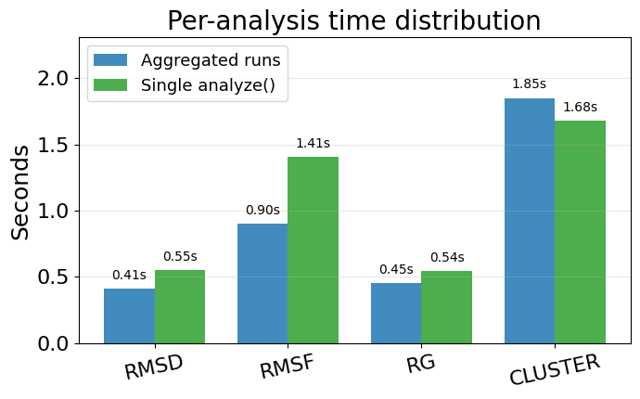
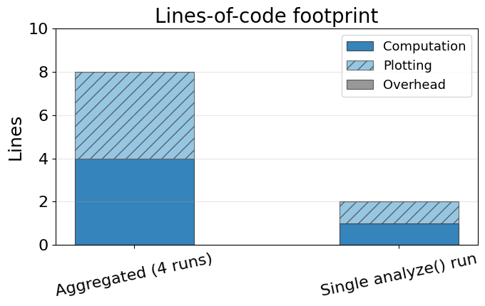
Single-run vs aggregated FastMDAnalysis
Aggregated bars sum the computation, plotting, and overhead from individual analyze runs. Single-run bars reflect the orchestrated analyze(...) benchmark metrics for those same slices. Bottom-left chart breaks down runtime per analysis for the single run (slides counted as plotting).

Slide 13
Instrumentation Overview
  FastMDAnalysis: 6 modules, 11 functions, 0 external imports, 35 runs, 35 successful, 0 exceptions.
  Mdtraj: 4 modules, 10 functions, 3 external imports, 35 runs, 35 successful, 0 exceptions.
  Mdanalysis: 5 modules, 10 functions, 3 external imports, 35 runs, 35 successful, 0 exceptions.
  Snippet footprint overview: FastMDAnalysis 1 calc / 1 plot (2 total) lines, Mdtraj 21 calc / 28 plot (49 total) lines, Mdanalysis 38 calc / 28 plot (66 total) lines.
  Runtime overview: FastMDAnalysis 0.73s calc / 3.46s plot (4.19s total), Mdtraj 0.16s calc / 2.92s plot / 0.08s overhead (3.16s total), Mdanalysis 4.62s calc / 2.95s plot / 0.01s overhead (7.58s total).
  Peak memory overview: FastMDAnalysis 36.83 MB calc / 0.00 MB plot (36.83 MB peak), Mdtraj 59.15 MB calc / 18.24 MB plot (71.78 MB peak), Mdanalysis 1.70 MB calc / 18.89 MB plot (18.89 MB peak).
  Charts on the following slides illustrate these touchpoint gaps.

