Slide 1

Intro To GitHub

Slide 2
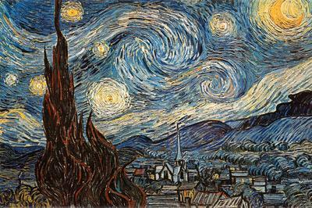
Coding as an Art
Write beautiful code.
Share it with community to get bragging rights.
Github is for programmers as Art galleries is for Artists
I don’t know why I put this image here but seemed right.

Slide 3
Open Source Community
Free vs Open source.
Enterprise move toward open source
Google has been leading the herd in releasing open source projects [android, TensorFlow, golang]
Microsoft under satya’s lead is also adopting open source practices [VS code]
IBM development of Hyperledger
Open source software's that we adore [VLC, Linux, most blockchains, Angular, android studio]
[Question: what does winrar comes under? ]

Slide 4
Why opensource?
Opensource codes are democratic (of the community, by the community, for the community)
Features are decided and discussed by community
Bugs are discovered by community
Bugs are fixed by the community
Its basically you created a product for which user will define features and they will also work on creating those feature and they will love the product because its awesome.

Slide 5
But session was about Github..
Github played an essential part in making opensource so popular
Lets see how open source projects are written in github and how we can benefit from adopting what they have adopted
Let go over this practices one by one
[Caution 1: Boring stuff starts from next slide]

Slide 6

README Please…
First thing I want to go over is Readme file
Essence of a Readme file is to tell people what your code is about. Without it no-one will know what you have created.
Sections of Ideal README.md file
Name and Description
Badges (they look cool I will show you)
Visuals (I never do this)
Installation
If you won’t tell they won’t know
Usage
Only god and programmer knows how a program works
Support
HELP ME! HELP ME!

Slide 7
Continue README Sensei
Sections of Ideal README.md file
Roadmap
You might know it now but lets leave for future
Contributing
This section is a must for all open Source projects
It entails details regarding how people can contribute to the project
Authors and acknowledgment
I MADE IT ( B-D )
They also helped
License
Pay me please
[Note: Oh I stole it all from this site(https://www.makeareadme.com/)

Slide 8
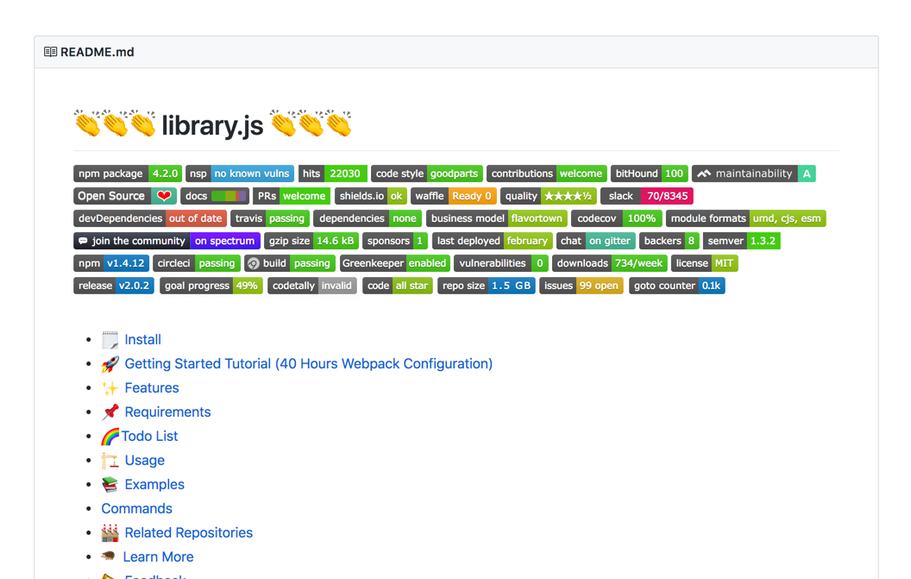
Badges (Medal of Honor)
Badges are the pretty colourful stuff you see beneath the name of repository
Lets go over some easy ones
Npm version
Node version
Code style
License
Useful hard ones
Build
Coverage

Slide 9
Let us C some README.md
First the site (https://www.makeareadme.com/)
TensorFlow (https://github.com/tensorflow/tensorflow)
Geth (https://github.com/ethereum/go-ethereum)

Slide 10
What else? (for JS developers)
Git pull in morning and git push in evening (Oops night)
Don’t Upload node_modules folder write and commit .gitIgnore
You can copy your required .gitIgnore file from https://github.com/github/gitignore
package.json should have all dependencies of project if any additional steps are required please mention in installation section of README.md file
OS version and details regarding dependencies should also be included in README.md
Known vulnerabilities after npm install can be fixed by running npm fix

Slide 11
When will this end?? [Branches]
Every Industry follow different branching standards
3 branches is all it takes
Dev : Branch where all development for current sprint is done
Develop : Once a sprint is done code is merged to develop branch
Master : Once the sprint code is fully tested against all test scenarios it is merged to master
Every version has a branch
Ethererum do this
Every bug or feature has a branch
Once the bug is fixed or feature is developed that branched is merged to master

Slide 12
Boilerplate
Lazy developers like me don’t like doing any of the above stuff so I just steal :p
Boilerplates are the basic structure with code and README.md for common usecase programs.
JS webserver (https://github.com/danielfsousa/express-rest-es2017-boilerplate)
Python webserver (https://github.com/realpython/flask-boilerplate)
Most common projects have boilerplate created for them which can be used for quick development

Slide 13
Finally the END [Commits]
Just read this (https://github.com/trein/dev-best-practices/wiki/Git-Commit-Best-Practices)
We should commit often
Commit working copies
Write meaning full commit messages

Slide 14
Thank You (Have a great Week Day)
Install Git (https://www.atlassian.com/git/tutorials/install-git)
Git cheatsheet (https://www.atlassian.com/git/tutorials/atlassian-git-cheatsheet)
My git Repo (https://github.com/Parag08)

