Slide 1

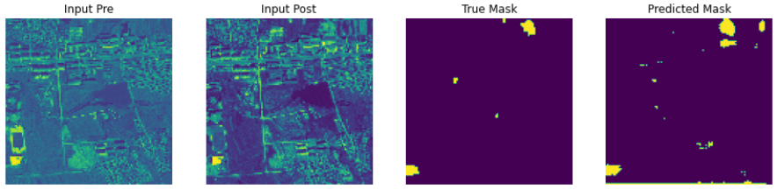
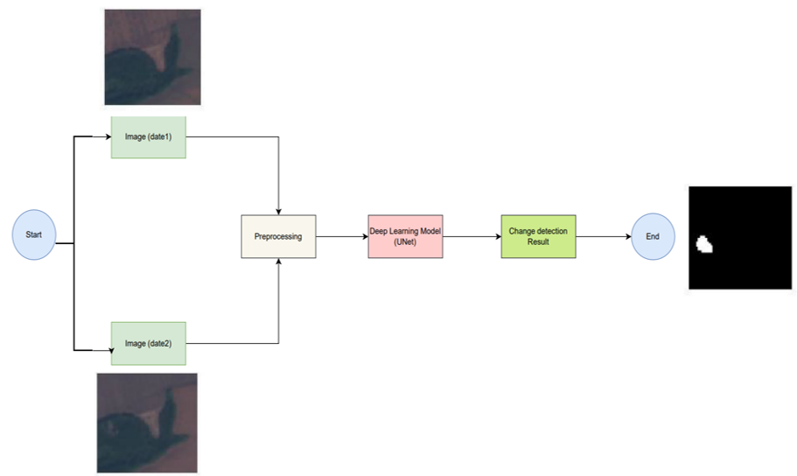
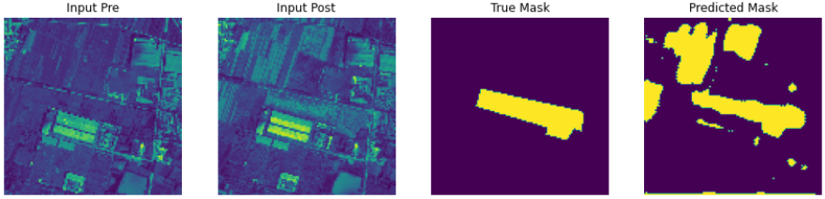
Deforestation Change Detection using U-Net architecture
Team Members: Pranav Jadhav, Parag Hegde, Kiran D M, Bhuvi Sangam
Guide: Mrs Indira Bidari
Team No: S14
School of Computer Science and Engineering, KLE Technological University, Hubballi-580021, Karnataka, India
TM
Problem Domain:
Deep Learning
Results
The dataset is split into testing and training portions. Training and Testing dataset has 3 classes namely A, B and Label where A and B contain image of time 1 and time 2, and Label contains the Mask/ Acutal output. Each class is loaded into a list for both training and testing datasets . These Lists are subjected to grayscaling function and all the images are converted into grayscaled. The preprocessed data is fed as input to the U-Net model. U-Net model learns from training dataset and predicts the deforestation change for testing dataset. The obtained results are compared with the ground truth masks present in folder ‘Labels’ of testing dataset and the dice score is calculated.
Methodology
Problem Definition:
Deforestation Change Detection Using U Net Architecture.
The model was able to achieve an accuracy of 89% measured using dice score test. The Predicted and actual output are shown in the below figure.
Conclusion
In this work, we detect the change in landcover that has occurred between a pair of RGB images. Along with images from two timeframes, the dataset also has ground truth images, which are used while training the model. The images are initially preprocessed and then, they are given as input to the U-Net model for training. The U-Net model performs segmentation and detects the change between the pair of input images.The trained model is tested on the testing dataset and the dice accuracy obtained is 89%
Objectives
To Detect the change in the forest cover due to deforestation over two time series in same place
To apply deep learning techniques in deforestation change detection.
To analyze the performance of the U-Net architecture in deforestation change detection.
To generate the predicted change detection output image.

