Slide 1
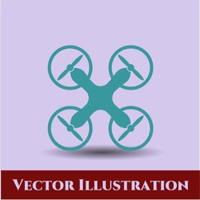
Robofest 3.O
Autonomous Swarm Robot

Slide 2
Points To Be Cover
Abstract
Basic Component
Features
Applications
Software

Slide 3
Abstract
This project aims to design and develop a group of aerial vehicles capable of coordinated motion without external controls. The primary objective is to enable the robots to move together in a synchronized manner, maintaining a predefined distance and direction, including forward, backward, left, and right movements over a range of 100 meters.
The system comprises 3 aerial robots, each equipped with flight controllers, communication modules (ESP8266), and control mechanisms. These robots are designed to operate as a unified swarm, with a central control unit acting as the master node responsible for distributing commands and facilitating coordination among the individual robots. The central control unit has Odroid Xu4 as the processor to give commands and take the feedback from the swarm. The project includes rigorous testing and evaluation of the system. Simulations and real-world experiments were conducted to validate the performance of the swarm algorithm, communication protocols, and overall coordination capabilities of the aerial swarm robots.

Slide 4
Basic Component
Odroid Xu4: The Odroid XU4 is a powerful single-board computer with an octa-core processor, 2 GB of RAM, and a Mali-T628 MP6 GPU. It offers various connectivity options, including Gigabit Ethernet, USB 3.0, and Wi-Fi. With its compact form factor, it is suitable for applications such as multimedia, gaming, servers, and IoT projects.
Flight Controller: A flight controller is the central component of a drone that manages its flight by processing sensor data, executing control algorithms, and adjusting motor outputs for stability and control. It incorporates sensors, a microcontroller, control algorithms, and communication interfaces. It offers multiple flight modes and can be customized or upgraded through firmware updates.

Slide 5
Electronic Speed Controller: An Electronic Speed Controller (ESC) is a device that controls the speed and direction of an electric motor. It receives signals from a flight controller and converts them into the appropriate power output for the motor. ESCs use PWM signals to regulate motor speed and often include features such as voltage regulation, current protection, and programmability. They are essential components in drones, allowing precise motor control for optimal performance.
GPS: GPS drones are equipped with a GPS module that allows them to know their location relative to a network of orbiting satellites. Connecting to signals from these satellites allows the drone to perform functions such as position hold, autonomous flight, return to home, and waypoint navigation.

Slide 6
Features
Autonomous Coordination: The robots are capable of coordinating their movements autonomously, without relying on external controls or human intervention. They work together as a cohesive group, executing synchronized motions.
Capabilities: Each aerial robot is equipped with Esp8266 that enable them to exchange information with the control unit and other robots in the swarm. This communication facilitates coordination, information sharing, and consensus building.
Swarm Algorithm: The system incorporates a sophisticated swarm algorithm that determines the desired direction of motion for the entire swarm. This algorithm takes into account inputs from the control unit and feedback from individual robots to achieve consensus and maintain synchronized motion.

Slide 7
Central Control Unit: The system operates with a single control unit that acts as the master node. It communicates with the individual robots, distributes commands, and collects feedback to ensure coordination and synchronization among the aerial vehicles.
Positional Awareness: Each robot possesses localization capabilities to determine its position relative to other robots in the swarm. This positional awareness is crucial for maintaining the desired formation and synchronized motion.
Scalability: The system is designed to accommodate a group of 3 aerial vehicles, but it can potentially be scaled up to include a larger number of robots. The algorithms and coordination mechanisms should be adaptable to accommodate additional robots while maintaining performance and coordination.

Slide 8
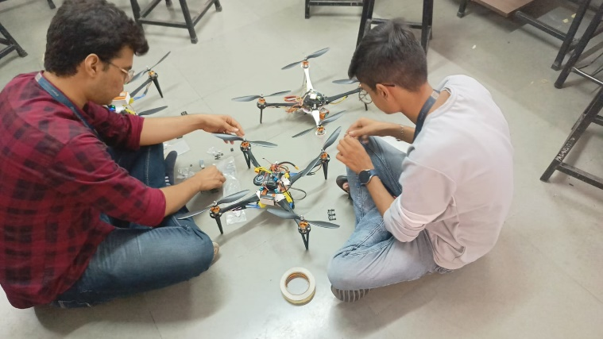
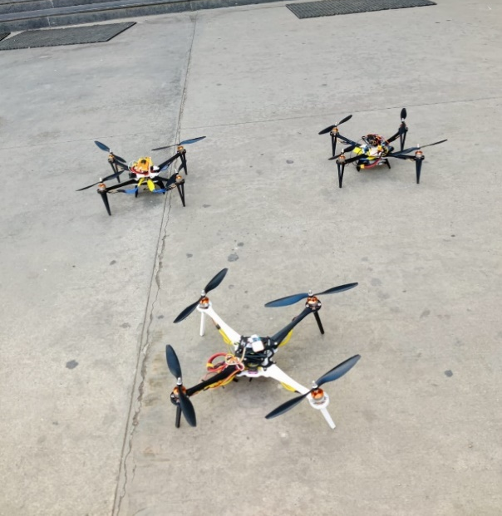
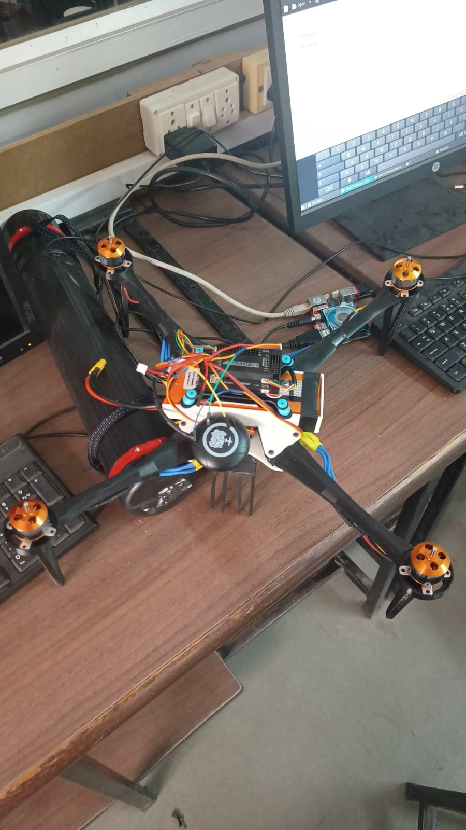
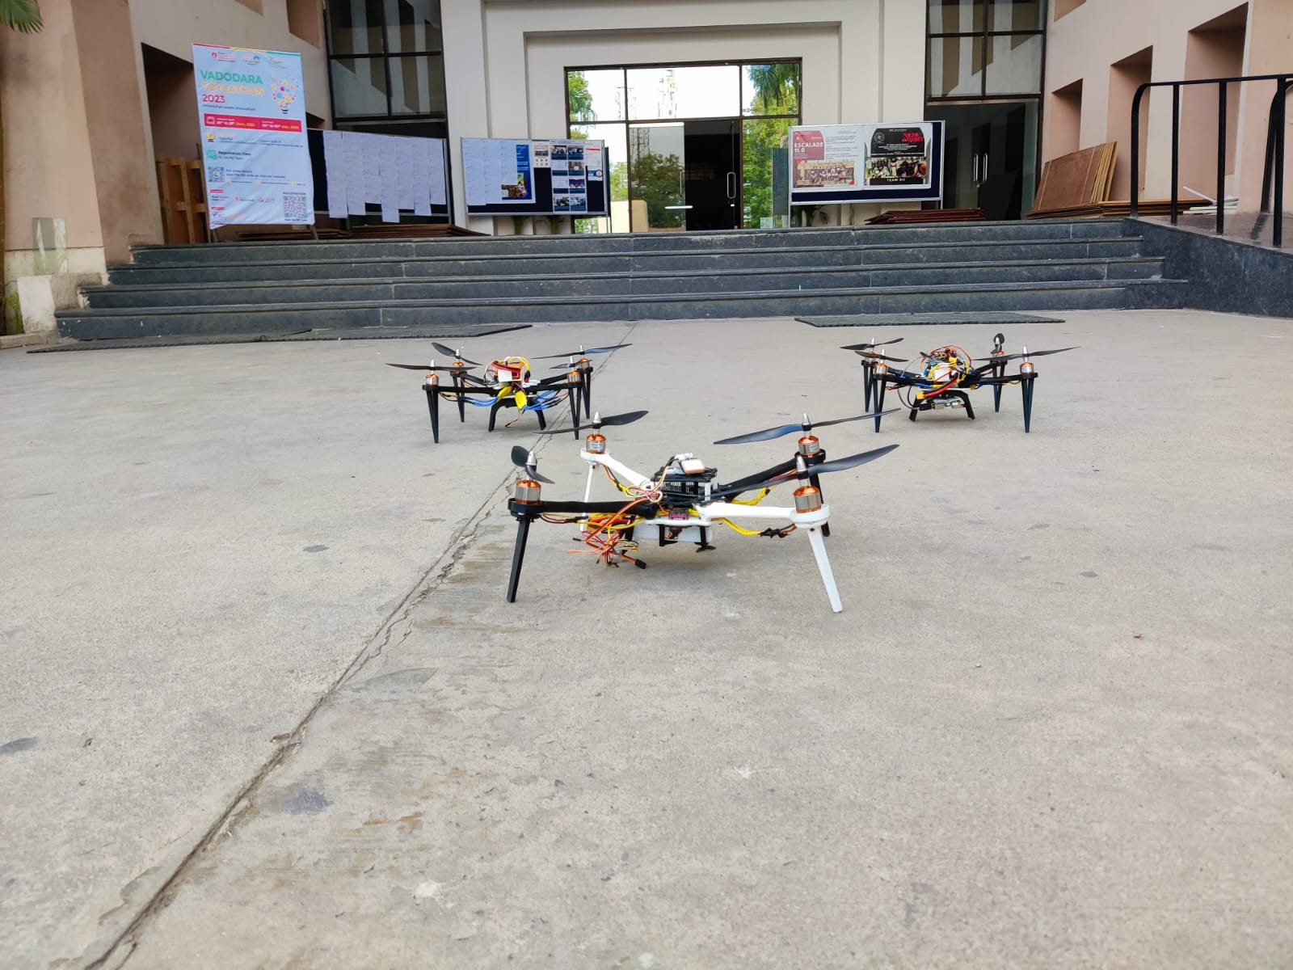

Slide 9
Deliverables achieved in terms of final objectives for the prototype
We have achieved the objective of making a swarm that can function and co-ordinate with each other simultaneously.
Our central unit can give commands to the other drones and also get feedback from them using telemetry communications.
There are no external controls used.
Data synchronization on Private Server.

Slide 10
Applications
AERIAL PHOTOGRAPHY: Drones are now being used to capture footage that would otherwise require expensive helicopters and cranes. Fast paced action and sci-fi scenes are filmed by aerial drones, thus making cinematography easier. These autonomous flying devices are also used in real estate and sports photography. Furthermore, journalists are considering the use of drones for collecting footage and information in live broadcasts
SHIPPING AND DELIVERY: Major companies like Amazon, UPS, and DHL are in favor of drone delivery. Drones could save a lot of manpower and shift unnecessary road traffic to the sky. Besides, they can be used over smaller distances to deliver small packages, food, letters, medicines, beverages
GEOGRAPHIC MAPPING: Available to amateurs and professionals, drones can acquire very high-resolution data and download imagery in difficult to reach locations like coastlines, mountaintops, and islands. They are also used to create 3D maps and contribute to crowd sourced mapping applications.

Slide 11
DISASTER MANAGEMENT: Drones provide quick means, after a natural or man-made disaster, to gather information and navigate debris and rubble to look for injured victims. Its high definition cameras, sensors, and radars give rescue teams access to a higher field of view, saving the need to spend resources on manned helicopters. Where larger aerial vehicles would prove perilous or inefficient, drones, thanks to their small size, are able to provide a close-up view of areas.
PRECISION AGRICULTURE: Farmers and agriculturists are always looking for cheap and effective methods to regularly monitor their crops. The infrared sensors in drones can be tuned to detect crop health, enabling farmers to react and improve crop conditions locally, with inputs of fertilizer or insecticides. It also improves management and effectuates better yield of the crops.
SEARCH AND RESCUE: Presence of thermal sensors gives drones night vision and makes them a powerful tool for surveillance. Drones are able to discover the location of lost persons and unfortunate victims, especially in harsh conditions or challenging terrains. Besides locating victims, a drone can drop supplies to unreachable locations in war torn or disaster stricken countries. For example, a drone can be utilized to lower a walkie-talkie, GPS locator, medicines, food supplies, clothes, and water to stranded victims before rescue crews can move them to some place else.

Slide 12
Thank you

