Slide 1
Capstone Project:
Marketing & Retail Analytics
Submitted on :
10th Jan 2023
Submitted By : Jayant Singhal
Parag Behera
Shubhranshu Shekhar Dash

Slide 2
Agenda
Problem Statement
Product Analysis (BY revenue)
Product Category Analysis (by Order Quantity)
Product ID pareto analysis (for Toys)
Product Category depth Analysis
Product depth analysis for top 10 product category
Market Basket Analysis (for top 10 Product Category)
Recommendations

Slide 3
Marketing & Retail Analytics – Problem Statement
OList, an e-commerce company has faced some losses and wants to manage their inventory very well to reduce any unnecessary costs that they might be bearing.
As part of this problem statement analytics, we have to help OList to identify the product categories which they can get rid of without significantly impacting business by providing insights on :
Analysing the inventory cost and providing suggestions to manage cost efficiently by the company
Identifying top products that contributes to the revenue
Doing a market basket analysis to analyze the purchase behavior of individual customers to estimate with relative certainty, what items are more likely to be purchased individually or in combination with some other products.

Slide 4
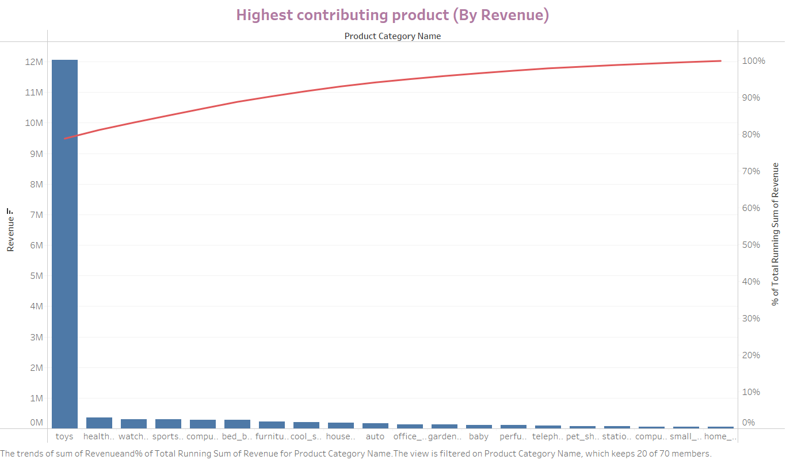
Product analysis (by revenue)
Key Insights: Based on the review of Pareto Analysis, more than 80% of the revenue is contributed by Toys and Health Beauty product categories. Further, approximately 90% of the revenue is being contributed by top 7 product categories.
Toys
Health Beauty
Watches_gifts
Sports_Leisure
Computer Accessories
Bed Bath Table
Furniture Décor
Recommendation:
Based on overall product categories (not considering the product ID and association/market basket analysis – which will be analyzed separately) O-List should focus on managing the inventory for these 2 to 7 product categories based on market demand and working capital.

Slide 5
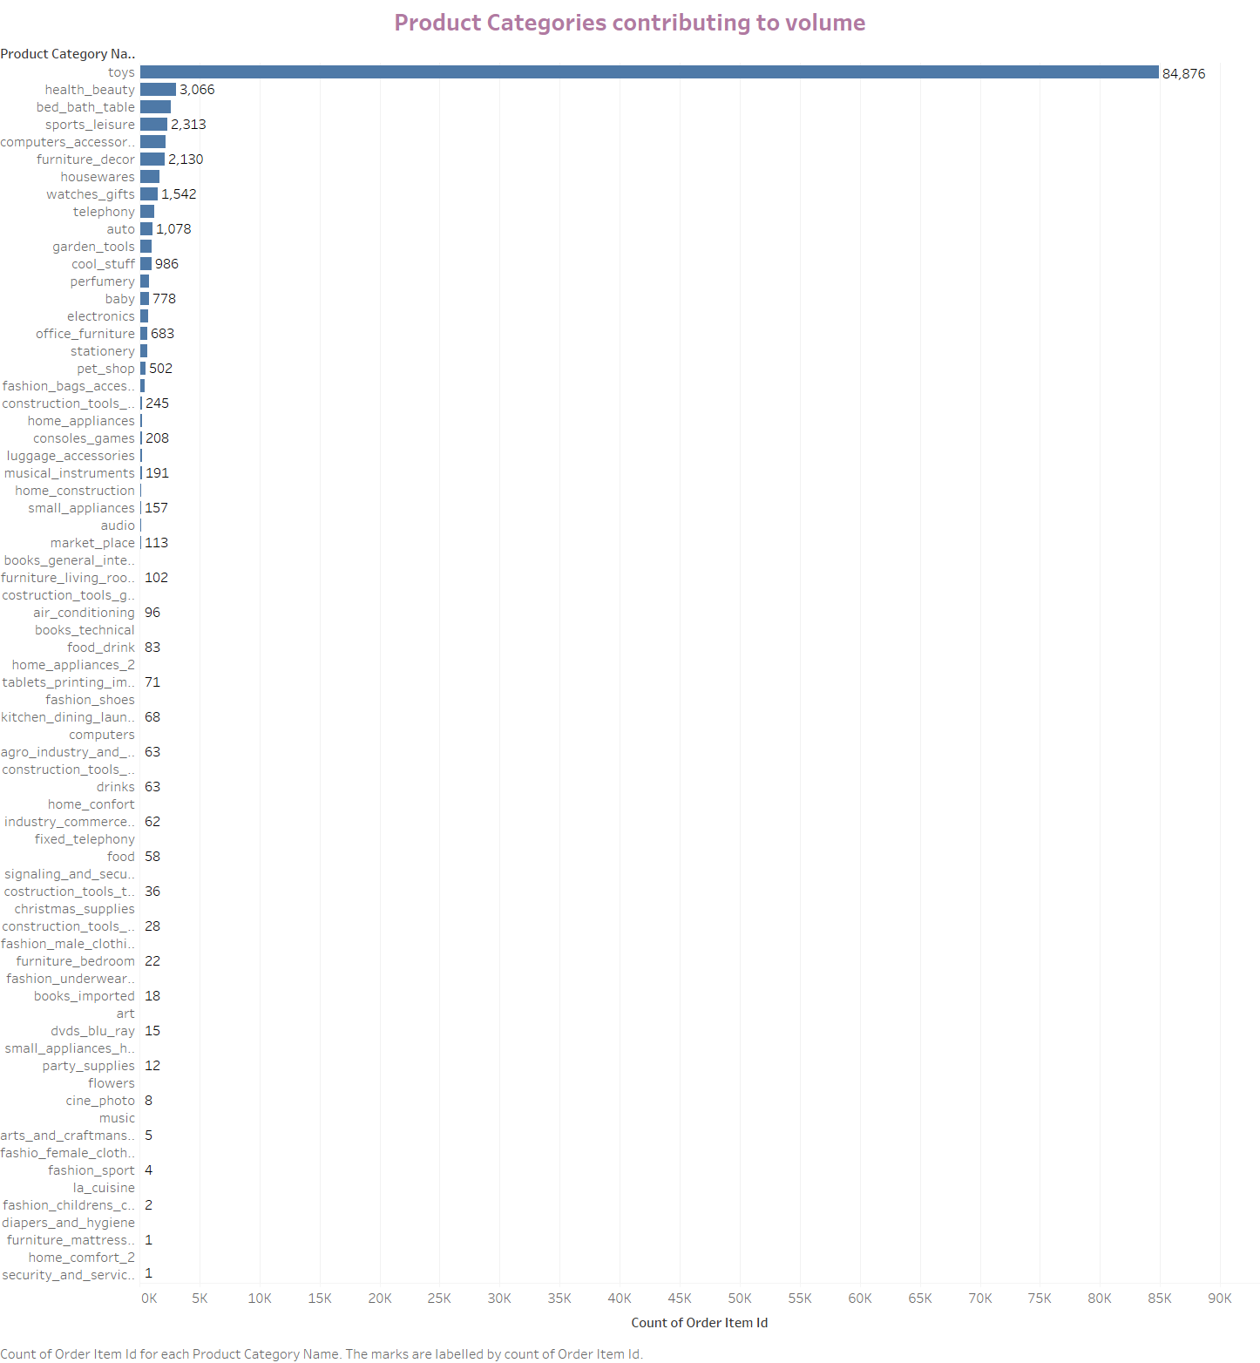
Product Category Analysis (by Order Quantity)
Key Insights: Based on the review of items ordered for each product category, majority of the order volume is contributed by top 10 product categories. Here are the top 10 categories:
Toys
Health Beauty
Bed Bath Table
Sports_Leisure
Computer Accessories
Furniture Décor
Housewares
Watches_gifts
Telephony
Auto
Recommendation:
Based on above, O-List can focus on optimizing the inventory management of top selling products ordered.
Toys category can further be analyzed to identify the key products within the category that are highly contributing to the revenue.

Slide 6
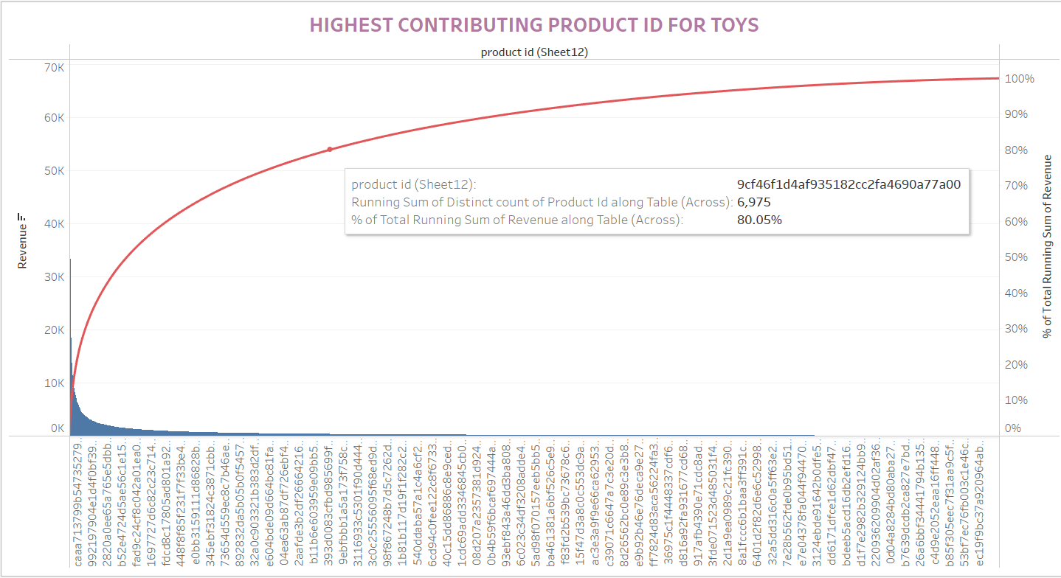
Product ID pareto analysis (for Toys)
Key Insights: As the number of unique products within the Toys category are 24K, based on the pareto analysis, there are around 7K products that are contributing to the 80% of the revenue generated by toys product category.
Recommendation:
This is the key for O-List as they do not need to focus on 24K, rather can only focus on lesser quantity as that will help in optimizing the revenue with maintenance of lesser inventory.
They can also evaluate Just-in-Time (JIT) inventory management technique.

Slide 7
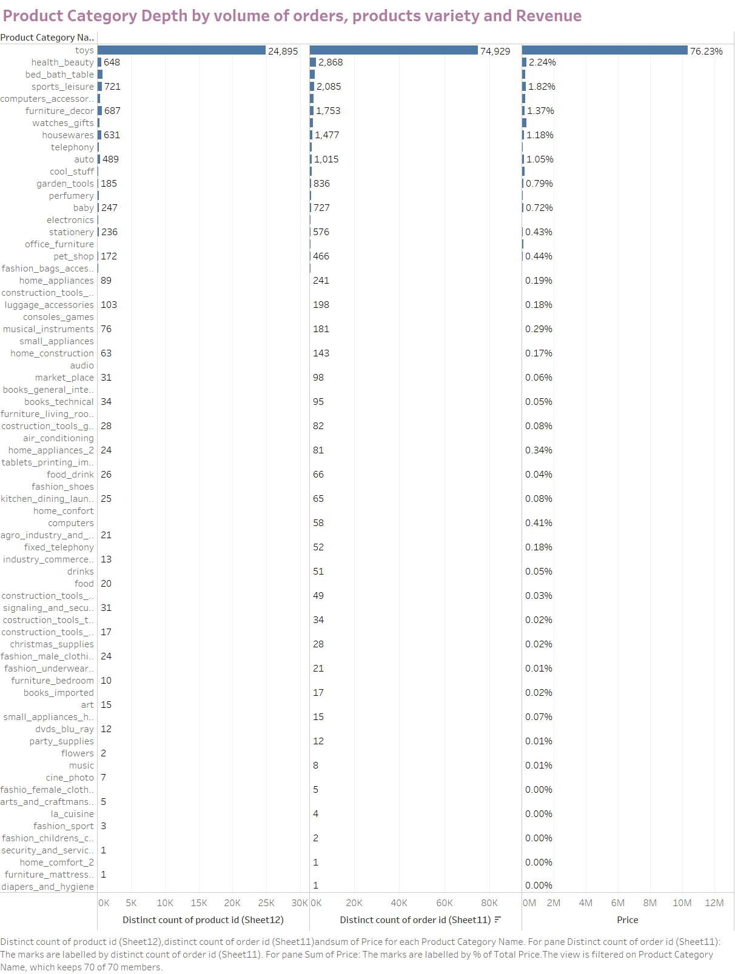
Product Category depth Analysis
Key Insights: By analyzing the product depth, ordered items within each product category and revenue contribution, we are highlighting product categories (in addition to toys) with lower depth in terms of products but higher order volume. These are:
Health Beauty
Bed Bath Table
Sports Leisure
Computer Accessories
Furniture Decor
Recommendation:
To manage the cost efficiently, O-List can utilize this visual to determine the product categories (to be maintained in inventory) that can generate higher order volume / Revenue.

Slide 8
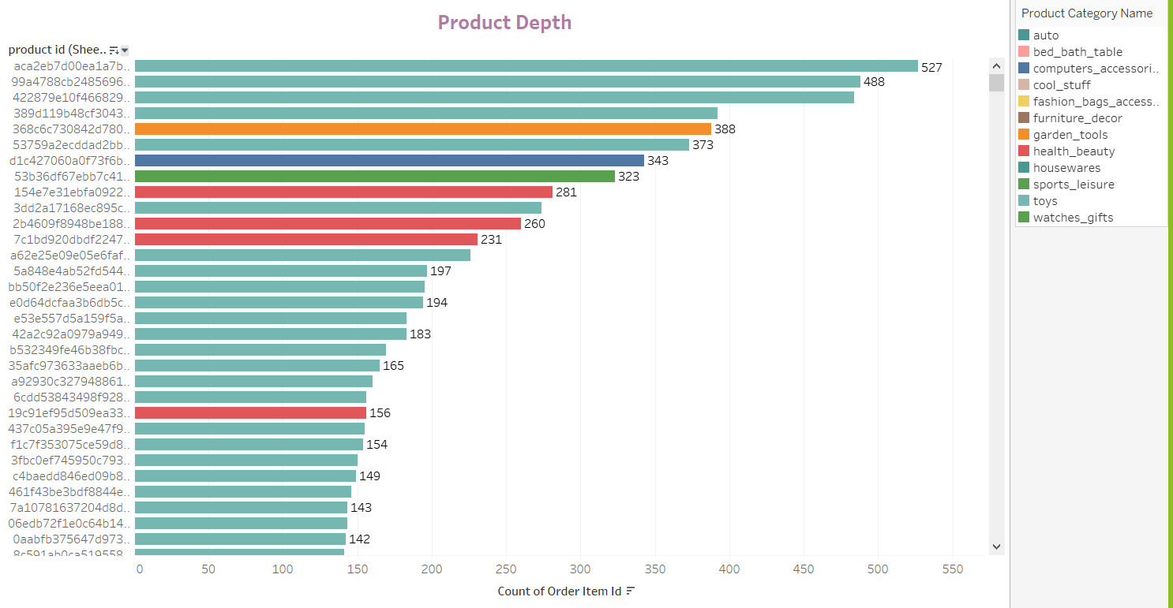
Product depth analysis for top 10 product category
Key Insights:
This highlights the products with higher order volume and their respective product categories.
Recommendation:
O-List should maintain inventory based on the review of the number of items ordered for each product ID. They should avoid ordering large quantities for those products which have lower order item volume.

Slide 9
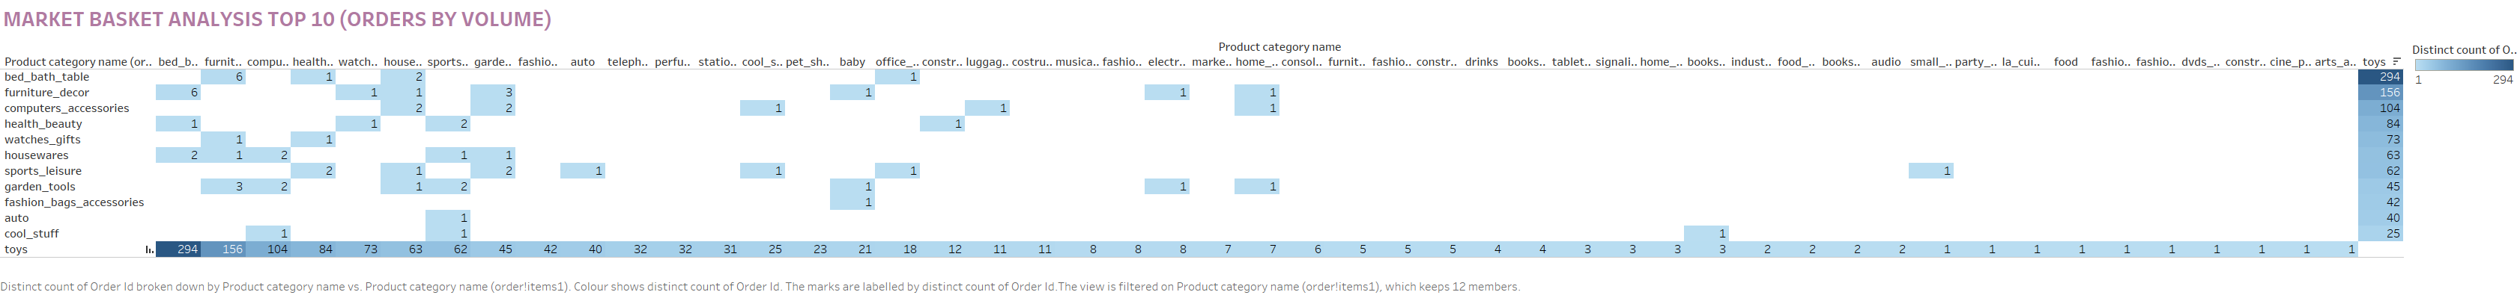
Market Basket Analysis (for top 10 Product Category)
Key Insights: Each order is considered a basket to identify those products that are ordered in combination. Based on review of above, there are additional product categories that customers order along with toys.
Bed Bath Table
Furniture Décor
Computer Accessories
Health Beauty
Watches gifts
Recommendation:
O-List should manage the cost of inventory and also for ensuring at the same time that revenue is maximized, following actions are recommended:
Keep inventory of product categories that are bought frequently along with toys (as mentioned above).
Marketing strategy for increasing sales of product categories with strong association as shown above.

Slide 10
Recommendations
Revenue Maimization vis-à-vis Inventory cost management
O-List should manage the cost of inventory and also for ensuring at the same time that revenue is maximized, following actions are recommended:
Keep inventory of product categories that are bought frequently along with toys (as mentioned in market basket analysis slide 9).
Marketing strategy for increasing sales of product categories with strong association should be prioritized.
Product Depth
1. O-List do not need to focus on 24K products in toys, rather can only focus on lesser quantity as that will help in optimizing the revenue with maintenance of lesser inventory.
2. They can also evaluate Just-in-Time (JIT) inventory management technique.
Continuously review the visuals and dashboard to enhance customer surveys and make necessary adjustments in marketing strategy.

Slide 11
THANK YOU

