Slide 1

Figure 1. Project Template. Adapted from visme.com, 2020, retrieved from https://dashboard.visme.co/v2/projects/own

Slide 2


Slide 3
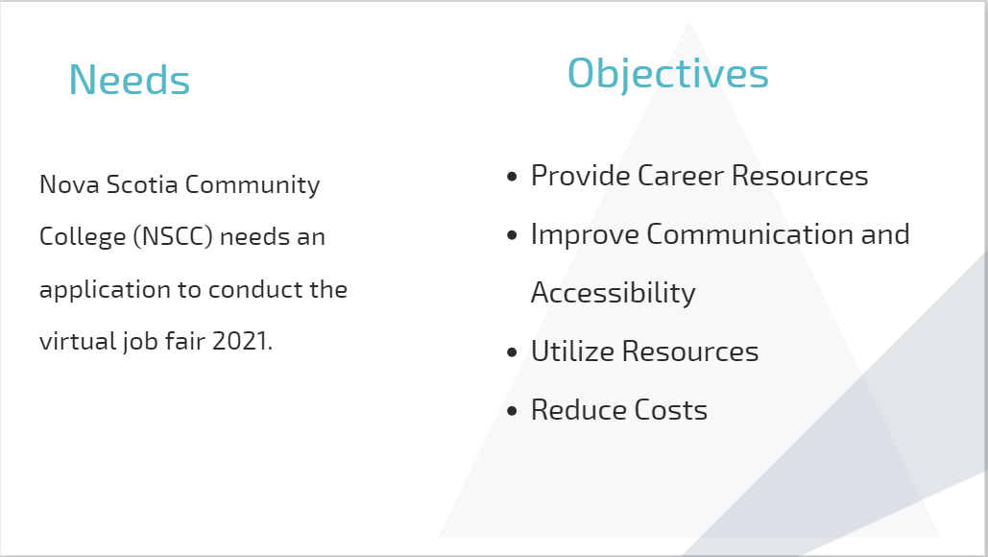

Slide 4
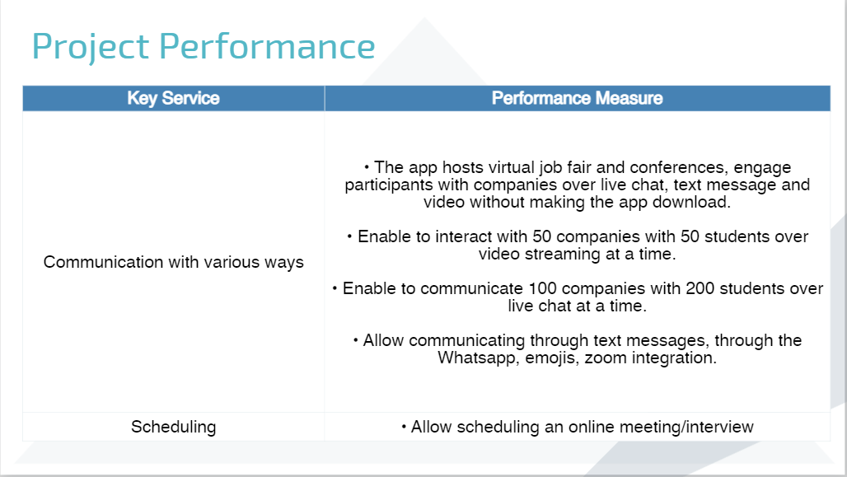

Slide 5
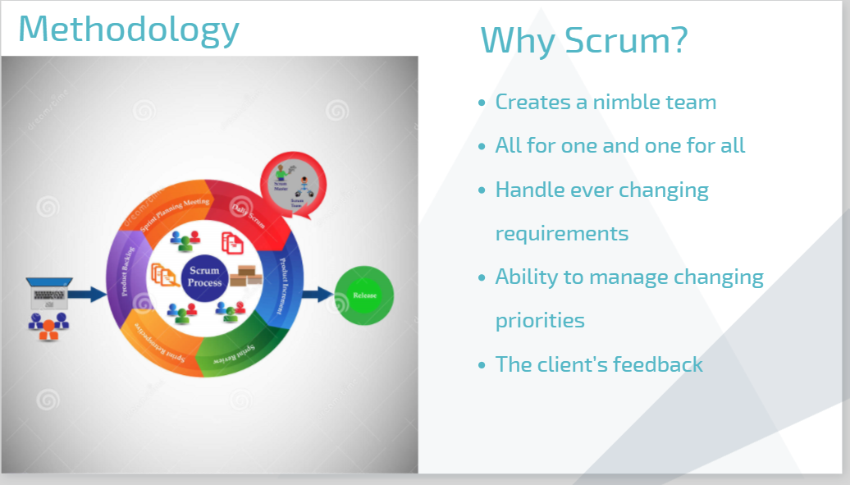
Figure 3. Project Methodology. Concept of Scrum Development Life cycle & Agile Methodology by dreamstime, 2017, retrieved from https://www.dreamstime.com/stock-illustration-concept-scrum-development-life-cycle-agile-methodology-each-change-go-different-phases-release-image69396768

Slide 6
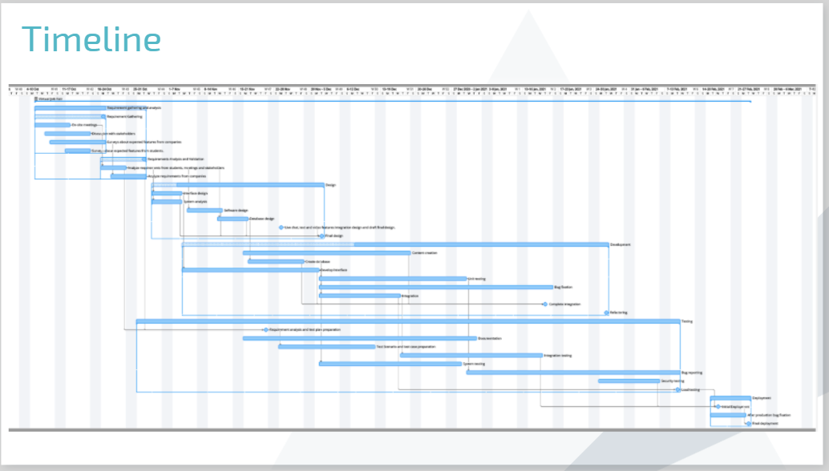

Slide 7
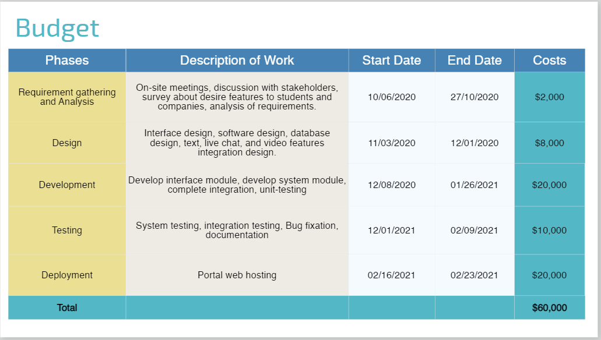

Slide 8
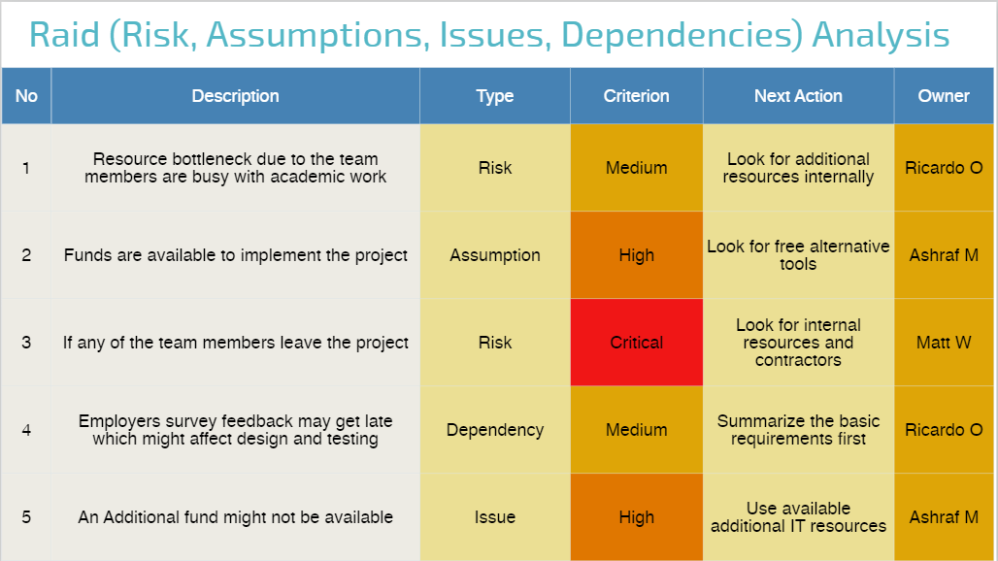

Slide 9
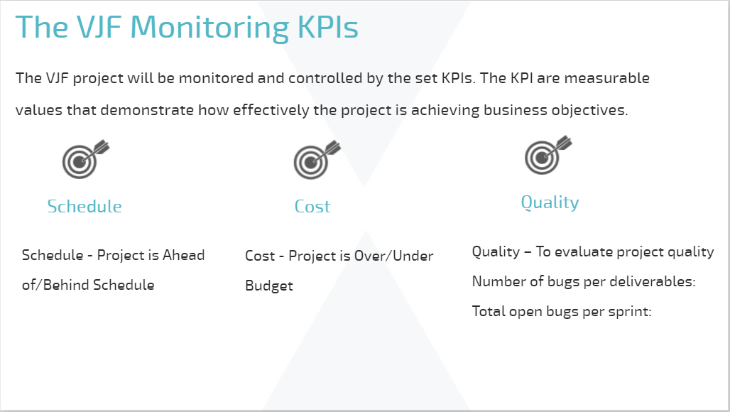

Slide 10
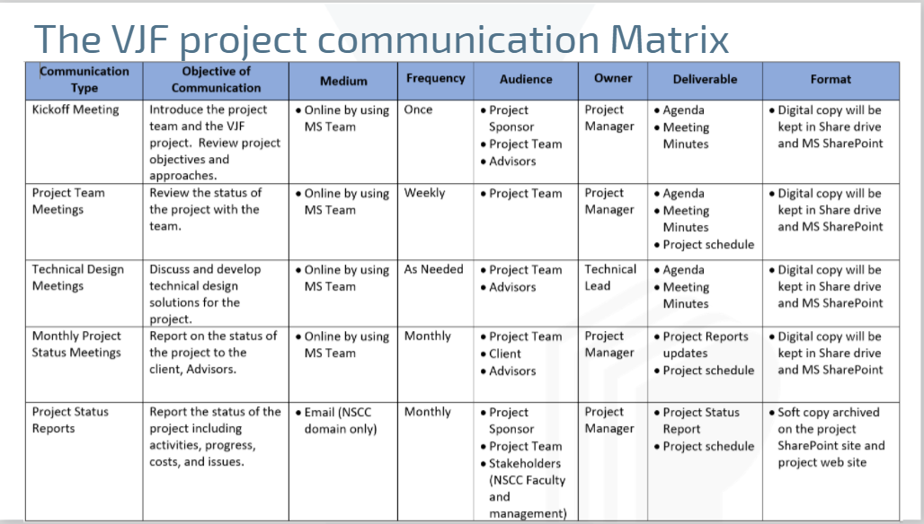

Slide 11
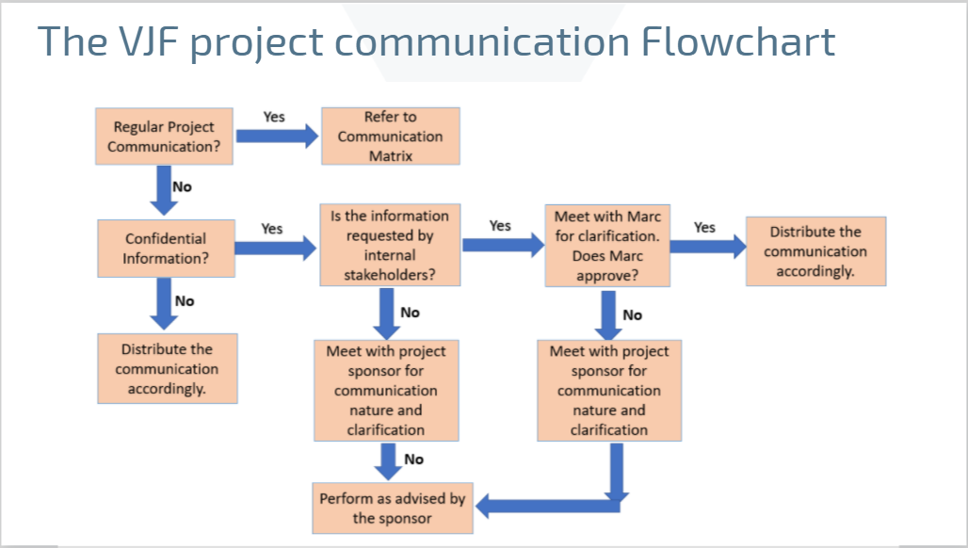

Slide 12
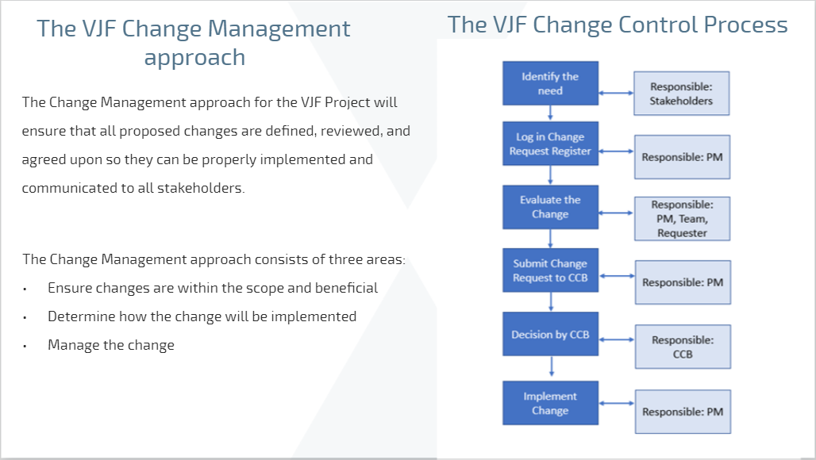

Slide 13
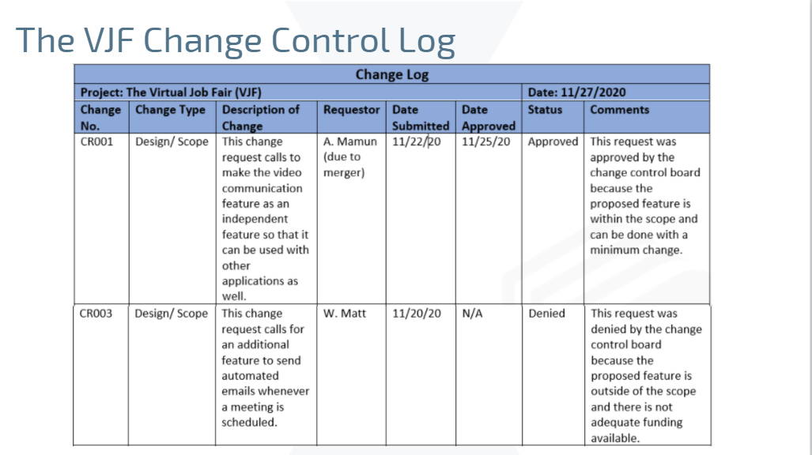

Slide 14
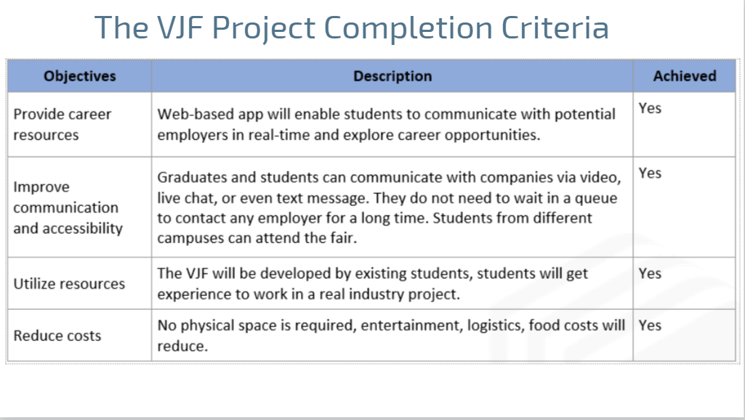

Slide 15
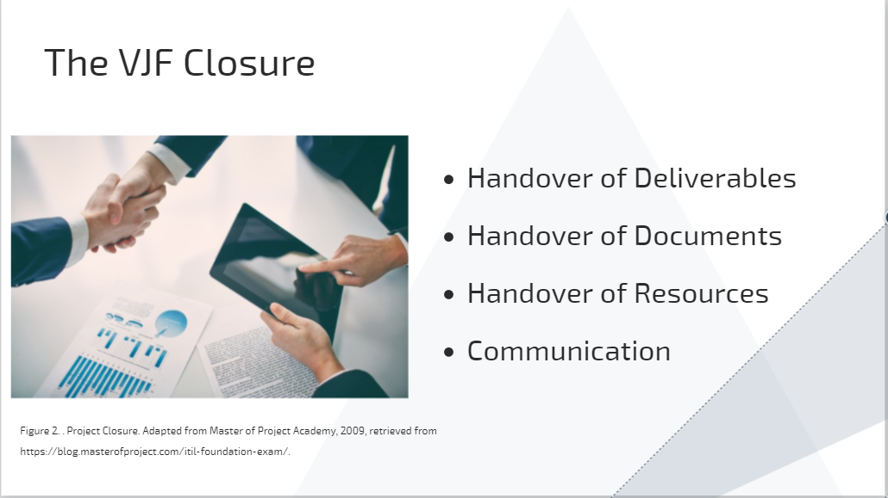


Slide 16
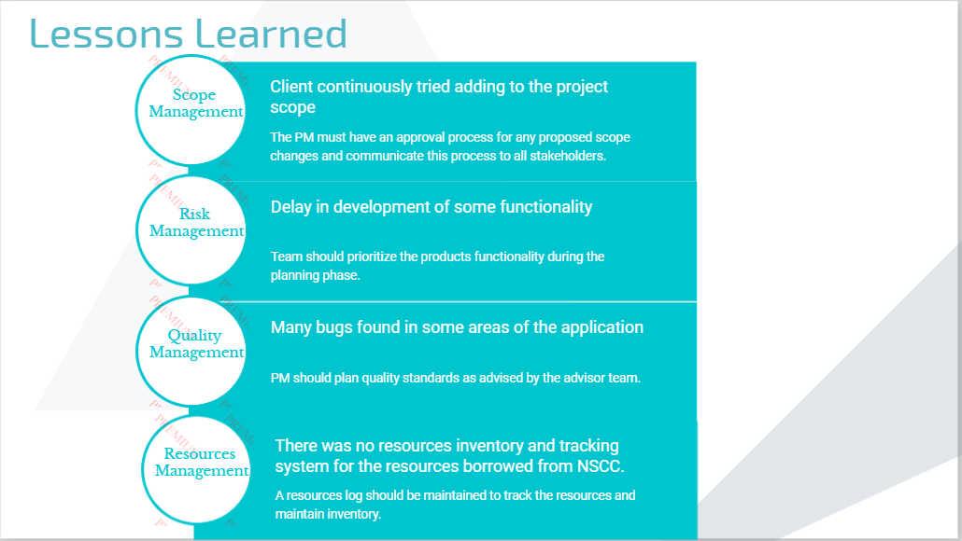

Slide 17
