Slide 1
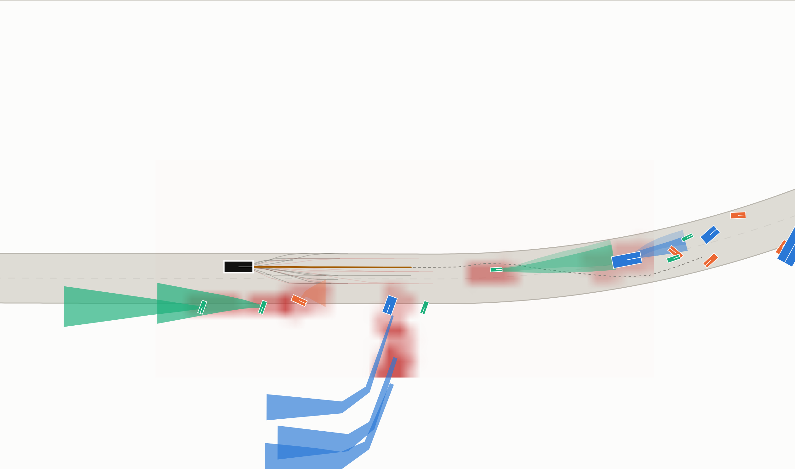

SMART INDIA HACKATHON 2026
SARATHI
Problem Statement ID – SIH26037
Problem Statement Title – Adaptive Path Planning and Collision Avoidance for Autonomous Vehicles on Unstructured Indian Roads
Theme – Robotics and Drones
PS Category – Software
Team ID – «TEAM ID»
Team Name (Registered on portal) – «TEAM NAME»
The planner's own view: drivable corridor, risk field, and the trajectory it chose — computed live, twenty times a second.

Slide 2
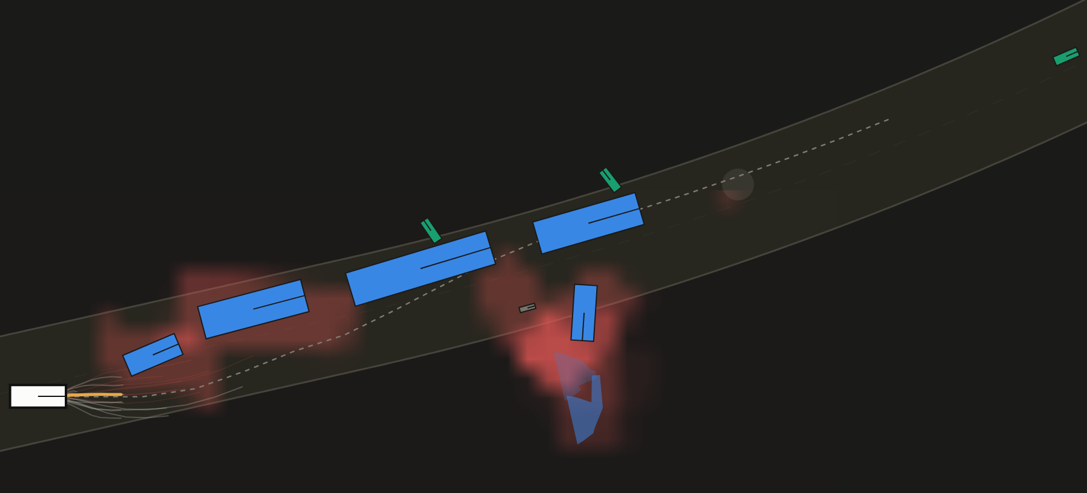
SARATHI — PLANNING WITHOUT LANES
«TEAM NAME»
Proposed Solution
An Indian road has no lanes to follow — only free space that is negotiated, and that changes every second.
• Lane centreline → drivable corridor, re-solved 20 times a second by a dynamic program through the free space ahead
• Occupancy grid → Indian Driving Risk Field: continuous, class-conditioned, harm-weighted, indexed by time
• Behaviour picked by an 8-state machine; the path itself by a jerk-minimal Frenet lattice scored in space and time
How it addresses the problem
• Lane markings are never read, so faded, absent or wrong markings need no special case and no mode switch
• A pothole is a cost bowl, not a wall; the verge is drivable; a cow is a high-variance hazard rather than a box
Innovation
• Multi-modal intent per road user — cut in, filter, dart, ride the wrong way — each with covariance that grows with time
• An RSS safety supervisor recalibrated to Indian gap acceptance; it is monotone by construction, so it can only ever slow us down
Night, degraded sensing, a rider coming the wrong way: risk field in red, its predicted path in blue, our chosen line in amber.
A conventional stack uses | SARATHI uses instead
Lane centreline | Drivable corridor, re-solved each tick
Occupancy grid | Class- and harm-weighted risk field
One predicted path | Multi-modal intent per road user
Lane-change logic | 8 behaviours, wrong-way evade included

Slide 3
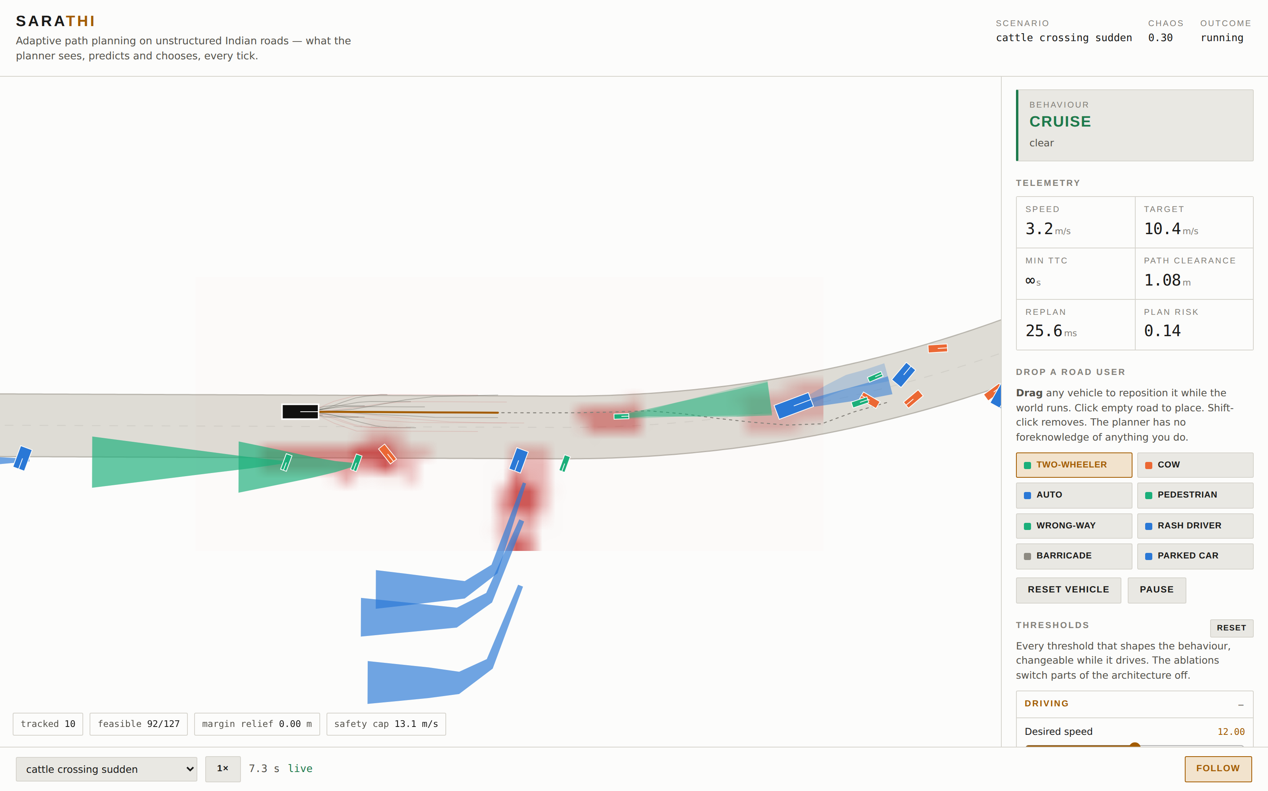
TECHNICAL APPROACH
«TEAM NAME»
SENSE
FUSE
PREDICT
RISK FIELD
CORRIDOR
BEHAVIOUR
LATTICE
RSS + CBF
Technologies
• MATLAB, Simulink, Stateflow — the behaviour machine maps 1:1 onto Stateflow states
• Automated Driving Toolbox, Navigation Toolbox and RoadRunner where licensed; the stack runs without them
• Python 3.11, NumPy, SciPy — reference implementation and live demo
• India Driving Dataset (IIIT Hyderabad) for the class taxonomy
Methodology
• Sense — camera, LiDAR and radar with occlusion, dropout and class confusion. The planner never sees ground truth.
• Fuse — constant-velocity Kalman tracks; class fused in log-odds
• Predict — a manoeuvre distribution per agent, conditioned on class
• Risk field — anisotropic kernels sized by footprint and uncertainty
• Plan — corridor DP, then behaviour, then a jerk-minimal lattice
• Assure — RSS-India inverted in closed form, plus a barrier speed cap
One scenario file drives both the Python and the MATLAB runtime
Mission Control — every value on screen is computed live, not replayed.
20 Hz
closed loop, no GPU
46 ms
median 95th %ile replan
12
road-user classes

Slide 4
FEASIBILITY AND VIABILITY
«TEAM NAME»
Feasibility — it already runs
• One command from a clean clone: uv run sarathi serve
• 10 scenarios — the five the problem statement names, plus five harder ones we added
• 88 automated tests, including behavioural regressions
• 20 Hz closed loop on an ordinary laptop; no GPU, no cloud
Viability
• Built on the sponsor's own toolchain, and reproducible: every number on this slide comes out of a committed script
What is still wrong
5 of 30 runs end in contact; in 3 of those we were stationary and were struck. The rest are ours to fix.
Challenges, and what we do about them
— Caution in dense traffic — measured every run, and every threshold is exposed live so behaviour can be tuned and defended
— Real-world perception — grounded in IDD rather than assumed
— RoadRunner licensing — a two-tier MATLAB design, so the deliverable is never blocked on a licence
Mean route progress. 3 seeds × 10 scenarios per controller, identical seeds and identical sensor noise.
25/30
runs collision-free
43%
route progress; baseline 36%
46 ms
median replan; 8/10 under 50 ms

Slide 5
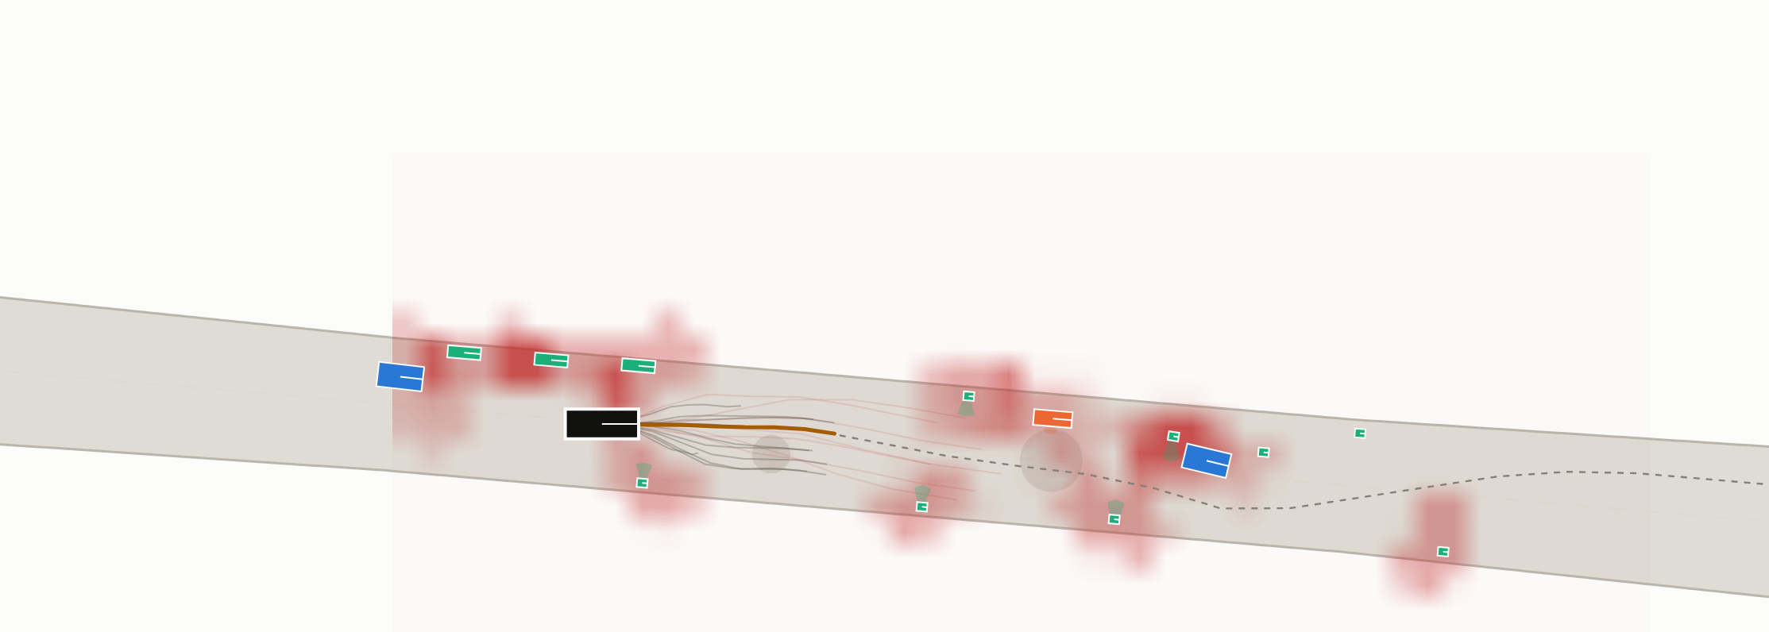
IMPACT AND BENEFITS
«TEAM NAME»
1,77,175
road deaths in India in 2024 — about 485 every day (MoRTH)
Benefits of the solution
• Social — the risk field is explicitly harm-weighted, so a pedestrian costs the planner more than sheet metal does
• Economic — validation in simulation instead of on public roads; the whole stack runs on a laptop
• Environmental — smoother speed profiles and fewer emergency stops than the lane-based baseline on the same scenarios
• Educational — every threshold is exposed and adjustable, so the system can be interrogated rather than trusted
Potential impact
• Most of that toll falls on two-wheeler riders and pedestrians — exactly the road users this planner treats as first-class
• Autonomy built on Western assumptions does not transfer. A planner that needs lane markings cannot even be validated here.
Who benefits
• Researchers — an Indian-conditions scenario library, and a traffic model that reproduces filtering, wrong-way riding and cattle
• Industry — a planner that degrades gracefully instead of disengaging when the road stops being tidy
• Regulators and cities — safety margins that are measurable, reproducible and arguable, not a vendor's assertion
What we can claim today, and no more
On identical seeds the vehicle covers 43% of the route where a lane-following planner covers 36%, and it does so without lane markings at all.
The scenario library and the measurements are as much of the contribution as the planner: anyone can re-run them.
A judge drops a cow in front of the vehicle, mid-run. The planner has no foreknowledge of anything placed by hand.

Slide 6
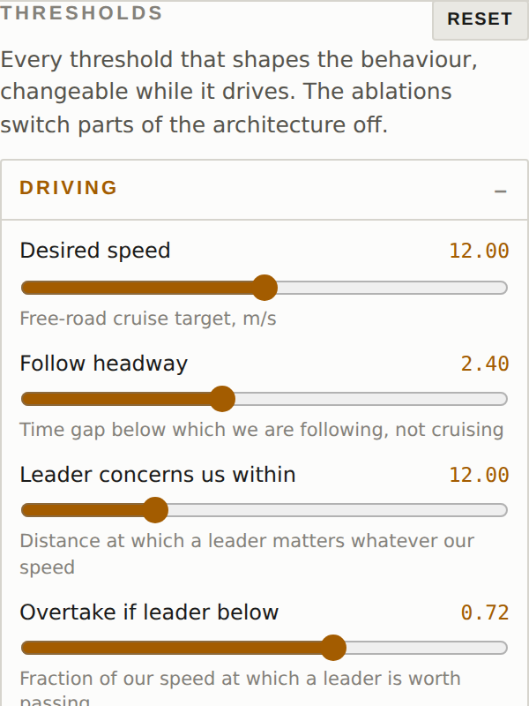
RESEARCH AND REFERENCES
«TEAM NAME»
Grounding — data and the problem itself
• India Driving Dataset, IIIT Hyderabad — idd.insaan.iiit.ac.in
• MoRTH, Road Accidents in India 2024 — 1,77,175 fatalities
Research the design rests on
• Werling et al., Optimal trajectory generation in a Frenet frame — the basis of our lattice (ICRA 2010)
• Shalev-Shwartz, Shammah, Shashua, Responsibility-Sensitive Safety — the formal model our supervisor recalibrates for Indian gaps
• Ames et al., Control barrier functions for safety-critical control
• Non-lane-based car following in heterogeneous, disordered traffic — the model our surrounding agents drive by
MathWorks references
• Highway trajectory planning using a Frenet reference path
• Motion planning in urban environments with a dynamic occupancy grid
• RoadRunner scene and scenario authoring documentation
What the research says we should do next
• Fit the prediction priors to IDD trajectories instead of building them by hand, and put the closed loop in Simulink end to end
Try it yourself — nothing here is scripted
github.com/Paragraph1148/automated-driving
uv run sarathi serve
What a judge can change, live
• Thirty-one thresholds, grouped: driving, caution, planner, safety
• Every one adjustable while the vehicle drives — no restart
• Ablations switch the risk field, the prediction or RSS off, so the contribution of each is visible rather than asserted
The thresholds panel, exactly as it appears in the running demo.

