Slide 1
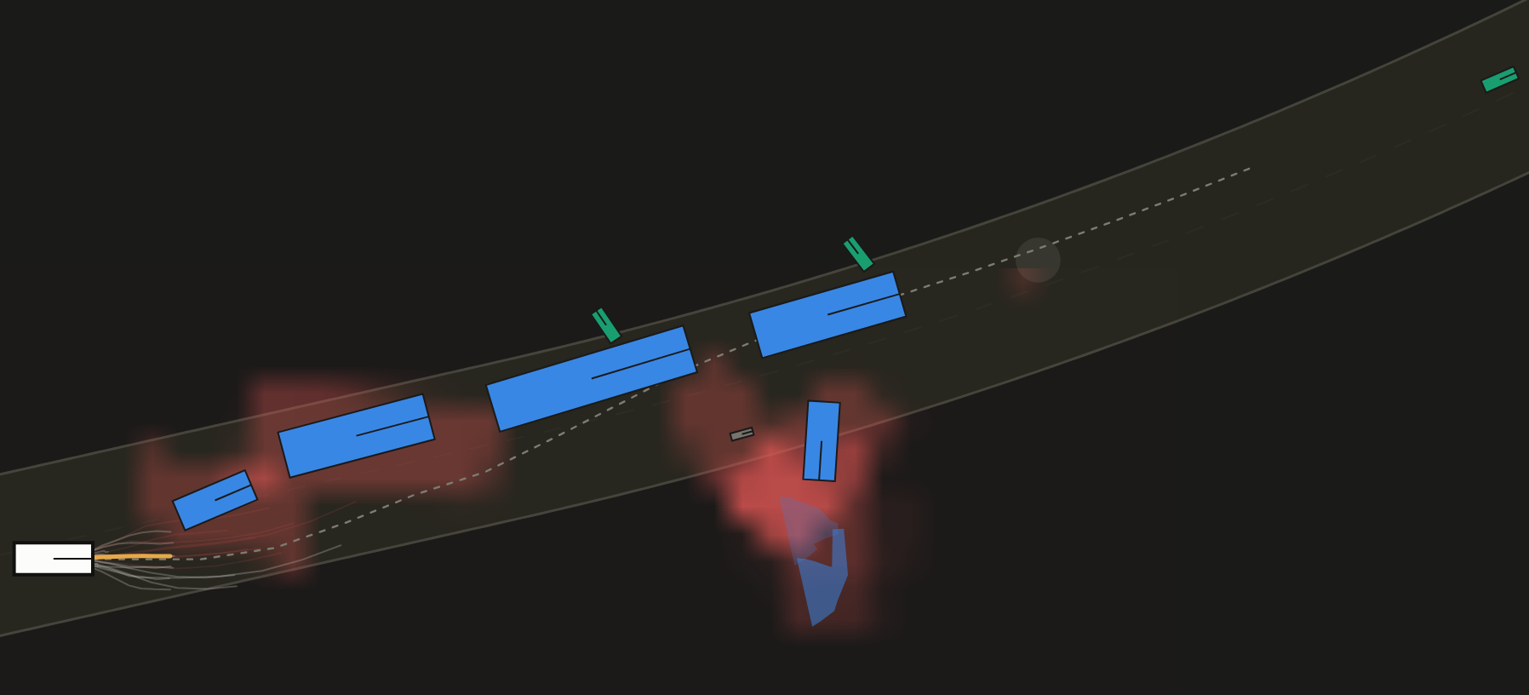
SARATHI
Internal briefing — the version with nothing hidden
Everything the six of us need to explain, demonstrate and defend our SIH26037 entry — including the parts that do not work yet.
SIH26037 · MathWorks · Adaptive path planning on unstructured Indian roads
Notes:
Open with: this deck is for us, not the judges. The submission deck is the other file. Read this one end to end once, then drill slides 21-23.

Slide 2
How to use this deck
Twenty minutes end to end. Then everyone drills their own section.
Presenting (O4, anyone)
Slides 1–3 are the pitch, in order.
Slide 1 is the only one you must know verbatim.
Never present a number that is not on slide 17.
Driving the demo (B1, B2)
Slides 15–16: the console, then the runbook.
Rehearse the failure path, not just the happy one.
One person drives, one person narrates. Never both.
Everyone, without exception
Slides 18–19: the weaknesses and the Q&A drill.
If a judge asks and you do not know — say so, then say who does.
A confident wrong answer loses more marks than a gap.
The one idea this whole project rests on
Every production self-driving stack plans inside a lane. An Indian road does not have lanes — it has free space that is negotiated, and that changes every second. So we removed the lane from the planner entirely: the reference line is computed from where the road is actually free, and the obstacle map is a continuous risk field that knows what each road user is and what it might do next.
If you can say that paragraph in your own words, you can hold a conversation with any judge.
Notes:
Do not let anyone skip slide 21. The weakest thing we can do is be surprised in public by a limitation we already know about.

Slide 3
1
The 60-second pitch
Say it in this order. It works.
1
The problem Indian roads have no usable lane markings, and traffic is mixed and non-lane-based. Every production planner assumes both. That is why autonomy stalls here.
Phrases that lose the room
“basically it's like a normal self-driving car, but…”
“we used AI to detect obstacles”
“it works most of the time”
Any sentence with three clauses in it.
2
The idea Replace the two primitives that break. The lane centreline becomes a drivable corridor solved from free space. The occupancy grid becomes a risk field that is class-aware, harm-weighted and predicted forward in time.
3
The proof Ten scenarios, 3 seeds each, against a conventional lane-following planner on identical seeds and identical sensor noise. We publish the losses as well as the wins.
Open with the road, not the algorithm
Start with the road every judge has actually driven on. The moment they picture a market street with a cow in it, the rest of the pitch has somewhere to land.
Then, and only then, say the words 'drivable corridor' and 'risk field'.
4
The demo It is live. Drag a cow into our path with the mouse and the planner has never seen it before. Every threshold is exposed on screen and can be changed while it drives.
Notes:
Sixty seconds. Time yourself. If you run long, cut point 3 to one sentence, never point 2.

Slide 4
2
What the problem statement actually asks for
MathWorks wrote this. Every phrase in it is a scoring line.
Adaptive path planning — a path that changes as the scene changes, not a fixed route
Collision avoidance — with dynamic, unpredictable obstacles
Unstructured roads — missing or unreliable lane markings, mixed traffic, encroachment
Replanning latency — they will ask how fast the loop is, and want a number
Path smoothness — jerk and curvature, not just 'it avoided the thing'
MathWorks toolchain — MATLAB, Simulink, Stateflow, RoadRunner
What they will actually test on the day
Can you break it in front of them? (so we let them try)
Do your numbers survive a follow-up question?
Is anything on screen scripted or pre-rendered?
Do you understand your own algorithm, or did you paste it?
The trap to avoid
A judge from MathWorks knows the Frenet planning example in the Automated Driving Toolbox by heart. If our answer sounds like that example, we are one of forty teams. Our answer has to start at the corridor and the risk field — the parts that example does not have.

Slide 5
Part 1
How the thing works
Eight stages, twenty times a second. Learn the order — most judge questions are really 'which stage handles that?'
SENSE
FUSE
PREDICT
RISK FIELD
CORRIDOR
BEHAVIOUR
LATTICE
RSS + CBF

Slide 6
3
Why the lane is the wrong primitive
This is the slide that makes us different from the other teams.
A conventional stack | What breaks on an Indian road | SARATHI instead
Lane centreline as reference | No markings, or markings nobody obeys | Corridor: a dynamic program over free space, re-solved every tick
Occupancy grid of obstacles | A pothole and a child become the same wall | Risk field: continuous, class-conditioned, harm-weighted
One predicted path per object | A rider filters or cuts in without warning | Multi-modal intent, with covariance that grows with time
Lane-change state machine | Nothing to change lanes between | Eight behaviours, including wrong-way evade
Fixed safety envelope | Nobody keeps a Western following distance | RSS recalibrated to Indian gap acceptance, applied as a speed cap
If you remember one sentence from this slide
We did not add Indian conditions to a Western planner. We removed the assumption the Western planner is built on.

Slide 7
4
The system map
Every tick, in this order, at 20 Hz.
SENSE
FUSE
PREDICT
RISK FIELD
CORRIDOR
BEHAVIOUR
LATTICE
RSS + CBF
1. Sense
Camera, LiDAR, radar. Range noise, dropout, class confusion, occlusion by angular intervals. We never plan on ground truth.
2. Fuse
Constant-velocity Kalman tracks. Class fused as log-odds so two sightings can disagree without flipping.
3. Predict
Per agent, a distribution over manoeuvres — continue, cut in, filter, stop, dart, wrong-way — conditioned on its class.
4. Risk field
Each hypothesis becomes an anisotropic kernel: a flat core the size of the body, a skirt sized by uncertainty, weighted by how badly hitting it would hurt.
5. Corridor
A dynamic program over (distance, offset) finds the cheapest ribbon of free space ahead. This replaces the lane.
6. Behaviour
Eight states decide the intent — follow, nudge, overtake, yield, creep, evade, stop. Maps 1:1 onto Stateflow.
7. Lattice
Jerk-minimal quintic/quartic polynomials in the Frenet frame, sampled and scored against the risk field in space and time.
8. RSS + CBF
The supervisor. Inverts the RSS condition in closed form to a safe speed, then a control-barrier filter caps it. Monotone: it can only slow us down.
Notes:
Drill: someone names a hazard, you name the stage that handles it.

Slide 8
5
Sense — and why we refuse ground truth
The single most common way a hackathon demo lies to itself.
SENSE
FUSE
PREDICT
RISK FIELD
CORRIDOR
BEHAVIOUR
LATTICE
RSS + CBF
Three sensors, three failure modes. Camera: good bearing, poor depth, class confusion. LiDAR: good geometry, no class. Radar: good speed, sparse.
Noise is anisotropic. Depth error and lateral error are not the same size — modelling them as one circle is the mistake that makes a demo look better than it is.
Occlusion is geometric. Each obstacle claims an angular interval; anything behind it is simply not seen. A bus hides three two-wheelers, exactly as it does in life.
Dropout and false classes are on. A cow is sometimes seen as a pedestrian for a few frames. The planner has to survive that.
What to say if a judge pushes
“The planner has no access to the simulator's state. It sees tracks, with the errors a real detector makes. That is why the risk field has an uncertainty skirt at all — if we planned on ground truth, the skirt would be decoration.”
In the code sarathi/perception/sensors.py Ask B2

Slide 9
6
Fuse — tracks, not detections
Where most of our early bugs lived.
SENSE
FUSE
PREDICT
RISK FIELD
CORRIDOR
BEHAVIOUR
LATTICE
RSS + CBF
Constant-velocity Kalman filter per track; association by gated nearest neighbour on predicted position.
Class is fused in log-odds, not by averaging probabilities. Two confident, disagreeing sightings must not average to 'no idea'.
Merging is size-aware. An early bug let a bus's gate swallow two two-wheelers riding beside it. Merge now needs class agreement and a length check.
Heading is only trusted above 1 m/s. Below that, heading from motion is noise — the bug that made our risk kernels spin. Slide 21 tells that story; it is a good one.
Numbers to have ready
median position error ≈ 1.2 m at typical range
≈ 92% class accuracy after fusion
no duplicate tracks in the regression suite
In the code sarathi/perception/fusion.py Ask B2

Slide 10
7
Predict — one object, several futures
A single predicted path is a lie in mixed traffic.
SENSE
FUSE
PREDICT
RISK FIELD
CORRIDOR
BEHAVIOUR
LATTICE
RSS + CBF
Six manoeuvres: continue, cut in, filter between vehicles, stop, dart across, ride the wrong way.
Priors are class-conditioned. A two-wheeler filters; a bus does not. A pedestrian darts; a barricade never moves.
Covariance grows with time and is clamped to what the object can physically reach — a stationary car cannot be 1.8 m sideways in a second.
Above a probability threshold a hypothesis becomes a hard constraint instead of a cost. That threshold is on screen and adjustable.
The honest caveat
Our priors are hand-built from observed Indian driving, not learned from a trajectory dataset. Say that before a judge asks. Then say what we would do with data: fit the priors per class from IDD tracks.
If a judge points at a prediction cone spilling off the carriageway: the mean path is propagated along the corridor, but the cone also draws the lateral uncertainty, and uncertainty is not confined to the road. That is deliberate — a pedestrian who steps off the verge is exactly the case we must not model away.
In the code sarathi/prediction/intent.py Ask B2

Slide 11
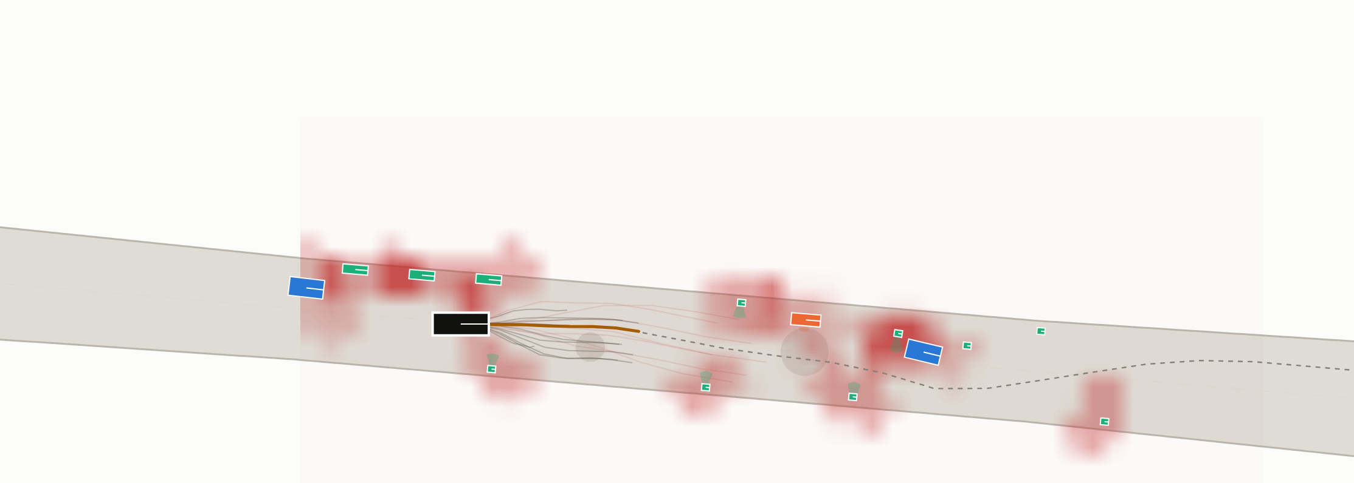
8
The risk field — the centre of the whole idea
If you only understand one stage deeply, make it this one.
SENSE
FUSE
PREDICT
RISK FIELD
CORRIDOR
BEHAVIOUR
LATTICE
RSS + CBF
Continuous, not a grid. Every point in (s, d, t) has a risk value, so the planner can trade a little risk for a lot of progress instead of hitting a wall.
Class-conditioned. The kernel around a cow is not the kernel around a barricade — different size, different anisotropy, different growth in time.
Harm-weighted. A pedestrian costs more than sheet metal. This is a deliberate ethical choice and we should say so out loud.
Flat-top kernels. The core is the config-space footprint — inside it, risk is saturated. The skirt is uncertainty. That shape is why clearance behaves sanely.
Time-indexed. The field at t+2 s is built from predictions, so the lattice is scored against where things will be, not where they were.
Red is the risk field at the current instant. The grey fan is every trajectory scored this tick; amber is the one chosen.
Building the whole field costs 18 ms a tick — it was 116 ms before we vectorised it.
In the code sarathi/planning/risk.py Ask B1

Slide 12
9
The corridor — what replaced the lane
A dynamic program, not a rule.
SENSE
FUSE
PREDICT
RISK FIELD
CORRIDOR
BEHAVIOUR
LATTICE
RSS + CBF
State is (distance along, lateral offset). Cost combines risk, deviation, and how much the offset has to change.
The verge is drivable, at a price. A shoulder of 0.9 m is part of the search space, because on a village road it is part of the road.
A pothole is a cost bowl, not an obstacle. You can cross it slowly; the planner decides whether that is worth it.
Output is a reference line plus a clearance profile and which side is free — the behaviour layer needs all three.
This is what makes markings irrelevant. There is no branch anywhere in the code for 'markings missing'.
Judge question you will get
“Isn't your corridor just a lane you computed?” — Yes, and that is the point: it is derived from free space every tick instead of read from paint. When a bus stops in it, the corridor bends around the bus; a lane cannot.
In the code sarathi/planning/corridor_path.py · world/corridor.py Ask B1

Slide 13
10
Behaviour — eight states, and why each exists
Maps 1:1 onto Stateflow, which is exactly what the sponsor wants to see.
SENSE
FUSE
PREDICT
RISK FIELD
CORRIDOR
BEHAVIOUR
LATTICE
RSS + CBF
CRUISE
free road — hold the desired speed
FOLLOW
matched to a leader's speed and gap
NUDGE
squeezing past an obstruction, speed reduced
OVERTAKE
leader is slow and there is width to pass
YIELD
giving way at a junction or to a vulnerable road user
CREEP
dense traffic — walking pace, maximum alertness
WRONG_WAY_EVADE
a rider is coming head-on on our side
EMERGENCY_STOP
time-to-collision below threshold — stop now
Every transition has a dwell time so the vehicle cannot chatter between states. Dwell is one of the thresholds exposed on screen. · In the code: sarathi/planning/behaviour.py (ask B1).

Slide 14
11
The lattice — jerk-minimal, and scored in time
The part that looks like the textbook. Do not stop at the textbook.
SENSE
FUSE
PREDICT
RISK FIELD
CORRIDOR
BEHAVIOUR
LATTICE
RSS + CBF
Quintic laterally, quartic longitudinally, in the Frenet frame of the corridor reference — the classical jerk-minimal form (Werling).
We sample terminal states, not controls: lateral offsets across the corridor, terminal speeds, and durations.
Scoring is against the time-indexed risk field, plus jerk, curvature, offset and speed shortfall. Weights are on screen.
Batched in NumPy. Evaluating candidates one at a time cost 71 ms; batching brought the same work to 7.5 ms.
Infeasible is not the same as unsafe. Candidates that break curvature or acceleration limits are dropped before scoring; the count is on screen as 'feasible n/m'.
The sampling bug that cost us most
At a standstill, 81 of 131 candidates were rejected for exceeding the acceleration limit and 49 more for curvature — one usable trajectory left. Both were self-inflicted: we sampled terminal speeds the car cannot reach in the time given, and we advanced the lateral profile with the clock, so a stopped car was asked to move sideways before it had moved at all.
Fixed by sampling inside the reachable set (peak accel of the quartic is 1.5·Δv/T) and advancing the lateral with distance travelled instead — Werling's own low-speed form. Usable fan: 1 → 35-50.
In the code sarathi/planning/lattice.py Ask B1

Slide 15
12
RSS + control barrier — the supervisor
The answer to 'how do you know it is safe?'
SENSE
FUSE
PREDICT
RISK FIELD
CORRIDOR
BEHAVIOUR
LATTICE
RSS + CBF
RSS gives a formal condition for a safe longitudinal gap given both speeds, reaction time and braking limits.
We invert it in closed form to get a safe speed directly, instead of proposing a speed and testing it.
Parameters are recalibrated for India. Western reaction time and gap acceptance would make the vehicle undriveable here — and pretending otherwise would be dishonest.
A control-barrier filter caps the result, so the commanded speed can only ever be reduced by the supervisor.
Monotone by construction. That single property is why the supervisor cannot cause a collision, and it is the sentence to say.
The hard question, and the answer
“RSS assumes everyone else follows RSS. Nobody here does.” — Correct. We use RSS as a lower bound on our own behaviour, not as a prediction of theirs. Their behaviour is handled in the prediction stage, which assumes they will do the worst plausible thing.
In the code sarathi/safety/rss.py Ask B1

Slide 16
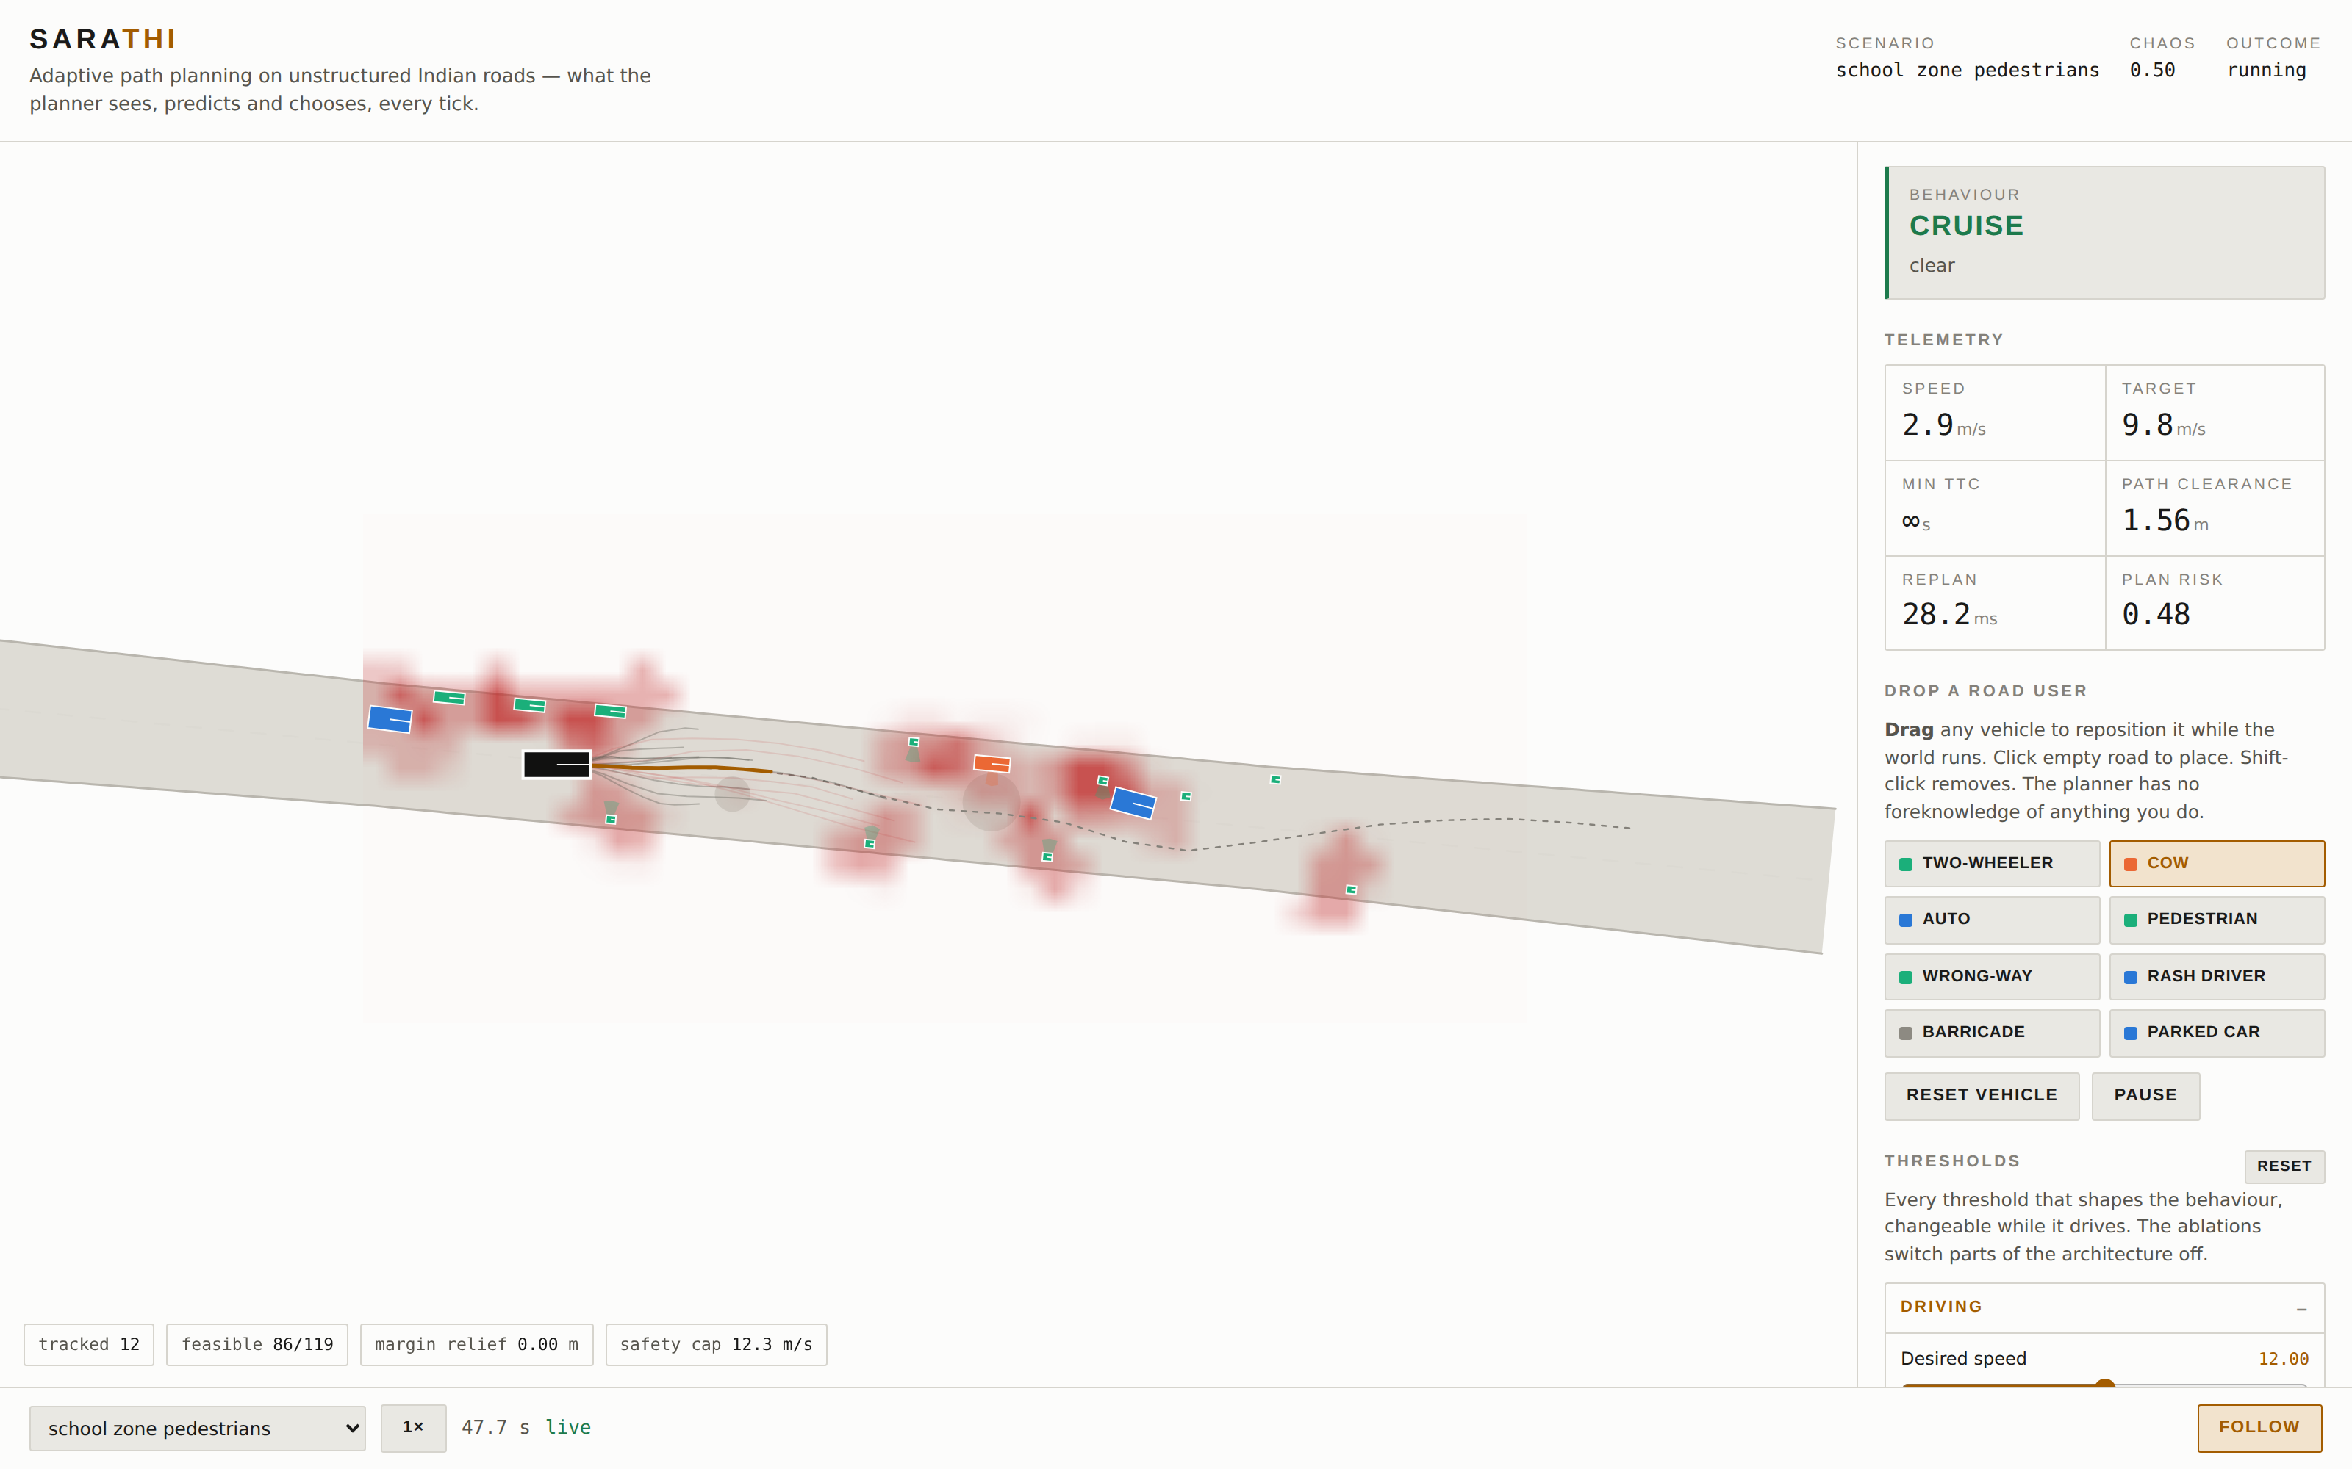
13
The traffic around us is the other half of the work
A planner is only as honest as the traffic it is tested against.
Non-lane-based car following (NLB-IDM). Agents form dynamic pseudo-lanes: the interaction strength between two vehicles depends on how much their bodies overlap laterally, not on which lane they are in.
Class-specific lateral clearance. A two-wheeler will pass a bus with 0.4 m. A car will not.
Gap seeking. Riders actively hunt for gaps rather than queueing — which is why our market and bus-stop scenarios are hard.
Twelve road-user classes, car, bus, truck, auto-rickshaw, two-wheeler, bicycle, pedestrian, pushcart, cattle, stray dog, barricade, parked vehicle.
Wrong-way riders are a policy, not a script. They hug the verge, crawl, and seek gaps against the flow — and they do not politely turn around when we approach.
Why this matters for marks
If our traffic were polite, our planner would look brilliant and mean nothing. The scenarios are adversarial on purpose, and we should invite the judge to make them worse.
Cattle: high variance, low speed, no compliance.

Slide 17
Part 2
Running it in front of a judge
The demo is the argument. Everything else is supporting evidence.

Slide 18
14
The scenario library — what each one proves
Scenario | Origin | What it is there to prove | Progress · clean
Village road, unmarked | required | No markings at all; narrow, two-way | 48% · 2/3
Cattle crossing | required | Sudden high-variance hazard at speed | 50% · 3/3
Dense market | required | Encroachment, pedestrians, walking pace | 22% · 3/3
Highway merge | required | Large speed differential | 40% · 3/3
Unsignalled junction | required | Negotiation with no right of way | 48% · 1/3
Narrow bridge, oncoming | ours | Committed oncoming bus, no room for both | 61% · 3/3
Bus stop overtake | ours | Overtaking into oncoming traffic | 35% · 3/3
Night, wrong-way rider | ours | Degraded sensing plus a head-on rider | 40% · 1/3
Construction diversion | ours | Barricade slalom, corridor bent hard | 27% · 3/3
School zone | ours | Restraint: many VRUs, low speed, no heroics | 62% · 3/3
Five of these are ours, not theirs
The problem statement names five situations. We added five harder ones and report them the same way. Volunteering a scenario you do not always win is worth more than a clean sweep of easy ones.
One scenario file, two runtimes
The same YAML drives the Python stack and the MATLAB/Simulink port. When a judge asks whether the MATLAB side is real, that is the answer: it runs the same scenario definitions, not a re-implementation.
Mean route progress and collision-free runs out of 3, from the same campaign as slide 17.

Slide 19
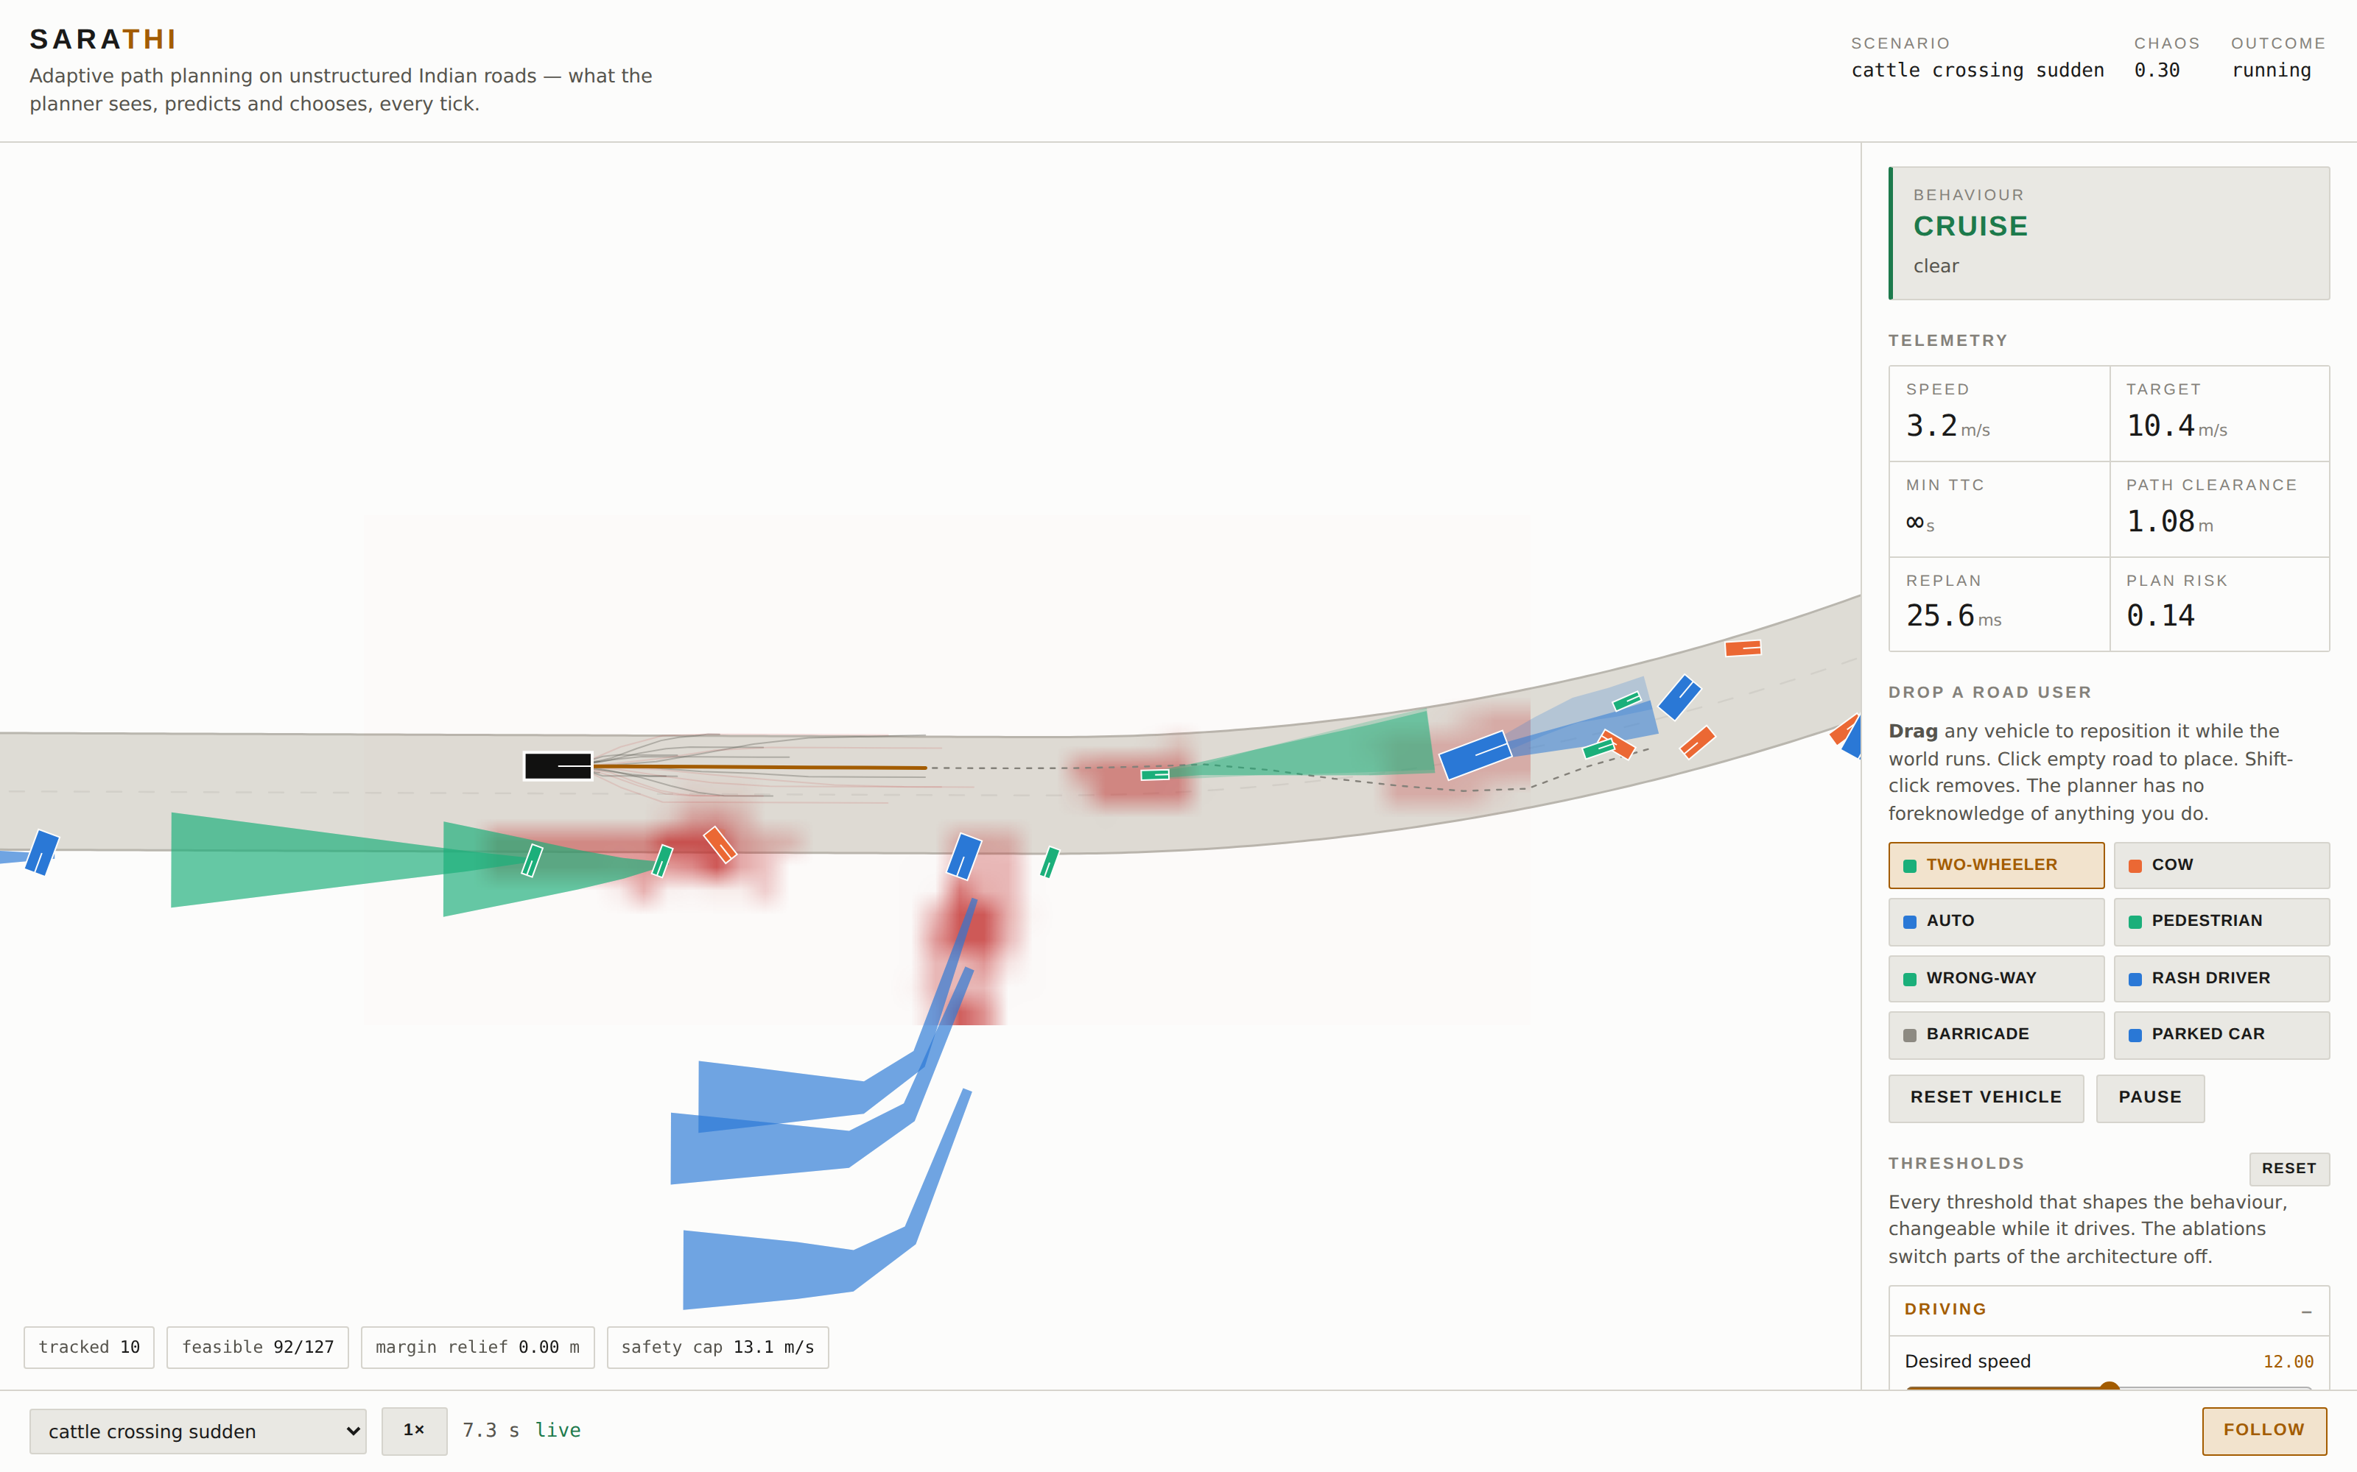
15
Mission Control, part by part
Know every panel. A judge will point at one and ask.
Behaviour card which of the eight states we are in, and the reason for it
Telemetry speed, target, min TTC, path clearance, replan time, plan risk
Drop a road user click to place, drag to move, shift-click to remove — live
Thresholds every tunable in the system, changeable while it drives
Ablations switch off the risk field, the prediction or RSS and watch it degrade
Chips, bottom left tracked objects, feasible candidates, margin relief, safety cap
Point at these, in this order
The behaviour card, so they know the machine has states. Then path clearance, so they know it is measuring, not guessing. Then hand over the mouse before they ask whether any of it is real.
The whole interface is one HTML file served by the same process that runs the simulation — nothing to install, nothing to build.

Slide 20
16
The demo runbook
Rehearse this until it is boring.
0
Before they arrive uv run sarathi serve. Check the browser is on the narrow bridge scenario, follow-cam on, 1× speed. Have a second terminal ready.
If it goes wrong
Vehicle stuck → Reset vehicle button, keep talking.
Browser dead → reload; the session survives.
Server dead → second terminal, same command.
Everything dead → the recorded replay page, and say so.
1
Frame it (15 s) “This is running live. Nothing is pre-recorded, and the planner has no knowledge of anything we do next.”
2
Let it drive (20 s) Point at the behaviour card as it changes. Say the state name out loud when it switches — it makes the machine legible.
3
Hand them the mouse “Put something in our way.” This is the moment that wins the room. Do not narrate over it.
Who does what
B2 drives the machine.
O4 narrates and watches the clock.
B1 answers algorithm questions only.
O3 has the numbers open on a second screen.
4
Break a threshold (30 s) Raise the clearance margin until the vehicle refuses to pass, then lower it. Shows the trade-off is real and ours.
5
Ablate (30 s) Turn the risk field off. It degrades to a lane follower and starts failing. Turn it back on.
6
Land it (15 s) Back to the numbers slide. “That behaviour is what these numbers measure, across ten scenarios and three seeds.”

Slide 21
17
The numbers we quote, and where they come from
Every figure below is produced by scripts/benchmark.py — 3 seeds × 10 scenarios per controller, identical seeds for both.
25/30
27/30
our runs collision-free
baseline, same seeds
43%
36%
mean route progress
baseline, same seeds
46 ms
20 Hz
median scenario replan; 8 of 10 under 50 ms, worst 72 ms in the dense market
closed loop, no GPU
Rule for all of us
If a number is not on this slide, do not say it. If a judge asks for one we do not have, say we will measure it.
Mean route progress per scenario. Higher is better.

Slide 22
18
What is still wrong — say it before they find it
Volunteered limitations read as rigour. Discovered ones read as spin.
It is too cautious in dense traffic. Mean route progress across all runs is 43%. On the hardest scenarios the vehicle spends much of the run stopped. We know why: from a standstill the sampled terminal speeds do not match what the acceleration limit can deliver over the sampled horizons, so the candidate fan is too narrow exactly when it needs to be wide.
Not every run is collision-free: 25 of 30. Of the 5 contacts, 3 happened with the vehicle stationary and another road user driving into it; the rest we drove into and they are ours to fix. We report the split rather than the flattering half.
Prediction priors are hand-built, not fitted to data. Defensible, but it is the first thing a research judge will push on.
The MATLAB port is a two-tier design. Full toolchain where licensed, base products otherwise. Be straight about which tier we are demonstrating.
The bug worth telling them about
The vehicle would not pull away from a stopped bus. Rather than tune the thresholds, we counted why each candidate trajectory was thrown away: at a standstill, 81 of 131 failed the acceleration limit and 49 failed curvature. One survived.
Both were our own doing — we were sampling terminal speeds the car cannot reach, and moving the lateral profile on the clock rather than on distance travelled.
Say this one out loud. It shows we debug by measuring, which is the thing most hackathon teams cannot demonstrate.
If a judge says “so it doesn't really work yet”
“It drives every scenario and it is collision-free in most runs. Where it is weak, it is weak by being slow rather than by being unsafe — which is the failure mode we chose. We can show you the exact cause on the screen right now, and the fix is a sampling change, not a rewrite.”
Never say
“It always works.”
“That's just a simulation artefact.”
“We'll fix that later.” — say when, and how.

Slide 23
19
Q&A drill — the twelve questions we will actually get
One sentence each. Learn the shape of the answer, not the words.
Isn't this the Frenet planner from the ADT example? That example is one of our eight stages; the corridor and the risk field are what it does not have.
Why not end-to-end learning? No Indian dataset large enough to be safe, and no way to explain a failure to a regulator.
Isn't your risk field just a blurred occupancy grid? It is class-conditioned, harm-weighted and indexed by time — a grid has none of those three.
What if perception is wrong? It is wrong, deliberately, in every run: noise, dropout, occlusion and class confusion are all on.
RSS assumes others follow RSS. We use it as a bound on our own behaviour; theirs is handled by worst-plausible-case prediction.
Why does it stop so often? It was, badly; we found the sampling cause by counting rejected candidates — slide 12.
Would this run on a real vehicle? 20 Hz on a laptop CPU with no GPU; the gap to a vehicle is sensors and integration, not compute.
What is Indian about it, specifically? Twelve road-user classes, non-lane-based following, wrong-way riders, cattle, and gap acceptance recalibrated.
Where is the MATLAB? The behaviour machine is Stateflow-shaped by design and the same scenario files drive both runtimes.
How do we know your numbers? One committed script produces them; both controllers see identical seeds and identical sensor noise.
What broke, and how did you find it? The rotating-kernel bug — found by measuring predicted heading against actual, not by staring at it.
What would you do with three more months? Fit prediction priors to IDD, fix the standstill sampling, and put the whole loop in Simulink.
Notes:
Drill in pairs. One reads the question, the other answers in one sentence with no filler. Anyone who needs two sentences has not learned it.

Slide 24
20
Who owns what — and what they hand in
There are no fillers. Roughly half the marked deliverable is not planning code.
Who | Role | Owns | Codes?
B1 | Planning lead | planning/, safety/, the lattice and the supervisor | Yes
B2 | Perception + platform | perception/, prediction/, Mission Control, MATLAB port | Yes
O1 | Licence + RoadRunner | MathWorks liaison, then the two RoadRunner scenes | No
O2 | Scenario director | Every scenario spec — geometry, agents, realism | YAML
O3 | Data + evidence | IDD taxonomy, the benchmark campaign, every table and plot | Scripts
O4 | Narrative | Report, decks, video, and the pitch itself | No
Critical path
O2's scenarios unblock B1, O1 and O3 — they come first.
O1 starts the licence request today, and a 30-day trial in parallel.
Nobody waits on anybody else to start.
Rehearsal, non-negotiable
Two full run-throughs with the timer, out loud.
One where someone deliberately breaks the demo.
One Q&A round where nobody is allowed to say “um, so basically”.
The hand-ins, not the job titles
O1 — two RoadRunner scenes, exported and committed, plus a licence-status note.
O2 — ten scenario specs, and the stress variants of each.
O3 — the benchmark campaign, and every table and plot in the report.
O4 — the report, both decks, the video, and the three-minute pitch.

Slide 25
21
Glossary — so nobody freezes mid-sentence
Frenet frame Coordinates along a reference line: s is distance along, d is offset sideways.
Jerk-minimal The polynomial that gets from one state to another with the least rate-of-change of acceleration. Comfort, mathematically.
Lattice The fan of candidate trajectories we generate and score each tick.
Corridor The ribbon of drivable free space our dynamic program finds. Our replacement for the lane.
Risk field Continuous cost over space and time; class-conditioned and harm-weighted.
Anisotropic kernel A risk blob that is not a circle — longer along the direction of travel than across it.
RSS Responsibility-Sensitive Safety: a formal minimum-gap condition. We invert it to a safe speed.
CBF Control barrier function: a filter that guarantees we stay inside a safe set.
NLB-IDM Non-lane-based intelligent driver model — car following without lanes.
Ablation Switching a component off to show what it was contributing.
TTC Time to collision, on current relative motion.
Chaos Our scenario dial: how aggressive and disorderly the surrounding traffic is.
Log-odds Adding evidence in log space, so two confident observations can disagree without averaging to nothing.
Configuration space The obstacle grown by our own footprint, so the vehicle can be planned for as a point.

Slide 26
The one thing to remember
We are not showing a car that avoids obstacles.
We are showing a planner that does not need a lane.
Everything else — the risk field, the eight behaviours, RSS, the scenarios — exists to make that one claim survive contact with a judge.
github.com/Paragraph1148/automated-driving · uv run sarathi serve

