Slide 1


SMART INDIA HACKATHON 2025
AJAYSETU
Problem Statement ID - 25153
Problem Statement Title - Mapping of Implementing and Executing Agencies across PM-AJAY Components
Theme - Smart Automation
Team ID - 69295
Team Name(Registered on Portal) - ByteForge

Slide 2
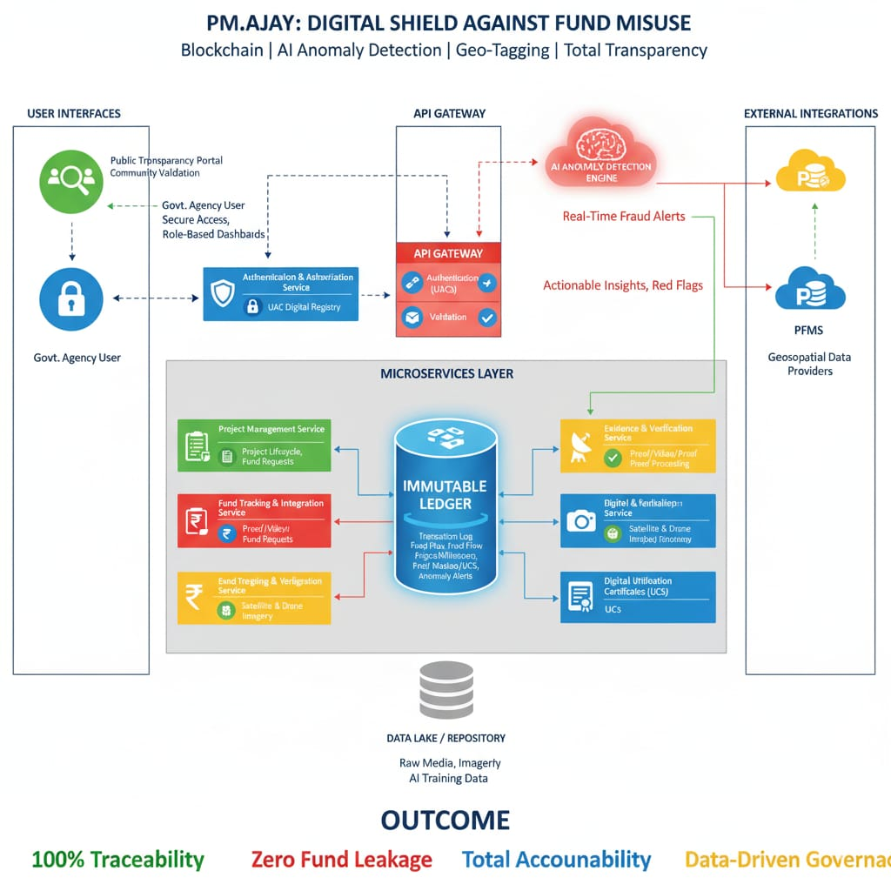
AJAYSETU
ByteForge
Proposed Solution
Real-Time PFMS Integration: Implement end-to-end fund traceability and auto-track utilization by integrating the system with PFMS.
Unified Agency Repository (UAR): Create a centralized repository with Unique Agency Codes, geo-tagged offices, and roles for clear accountability.
Geo-Tagged Progress Verification: Mandate geo-tagged photos/videos and AI checks to digitally confirm physical project completion before payment.
Blockchain-Secured Transaction Ledger: Store all fund releases, approvals, and utilization records on an immutable blockchain ledger for tamper-proof auditing.
Anomaly Detection Engine: Employ AI/ML models to automatically detect suspicious transaction patterns, duplicate claims, and potential fund fraud.
Public Audit Portal: Establish a public transparency portal for social verification, grievance submission, and open visibility of project status and funds.

Slide 3
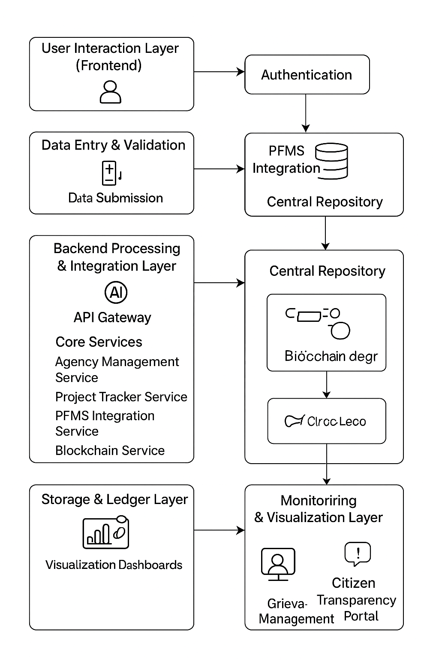
















TECHNICAL APPROACH
ByteForge
Technology Stack
Frontend: Bootstrap, Tailwind CSS, SASS, LESS, React, Angular, Vue.js, Svelte, jQuery, Next.js, Nuxt.js
Backend: Python, JavaScript (Node.js), Java, PHP, Go (Golang), C#, Django, Express.js, Spring Boot, Laravel, FastAPI, NestJS, SQL, REST APIs, GraphQL
AI&ML: LangChain, OpenAI APIs, PyTorch Lightning, Hugging Face Transformers, TimeGPT (Nixtla), OpenCV, TensorFlow, Keras, Scikit-learn, MLflow, Streamlit
Deployment & Infrastructure: Docker, Kubernetes, AWS Lambda, GCP Cloud Functions, Supabase, Vercel
Security & Authentication: Clerk.dev, OAuth 2.0, JWT, Zero Trust, HashiCorp Vault, SAML, OpenID Connect, Web Application Firewalls, OWASP ZAP, Burp Suite
Python JavaScript (Nod , Gatsb AWS, Azure, Google Cloud Platform, Terraform, Pulumi, y, Alpine.js, Material-U , MySQL, MongoDB, Redis, Cassandra, DynamoDB, ElasticSearch, RabbitMQ, Kafka I, Chakra UI, Ant Design, Three.js, D3.js, Webpack, Vite, Parcel, Tailwind UI, Headless UI e.js) Java PHP Ruby , Firebase, Firestore, Docker, Kubernetes, , ASP.NET Core, Ruby on Rails Rasa X, Ansible, W Gradio eights & Biases, Prometheus, Grafana Go (Golang) , Grafana, Loki, Tempo, Terraform, Pulumi, Ansible, Chef, Puppet, Prometheus, Grafana, Cloudflare, Fastly C# C++ Kotlin Rust Scala Perl Elixir Swift SQL PostgreSQL MySQL MongoDB Redis Django Flask Express.js Ruby on Rails Laravel ASP.NET Core Spring Boot NestJS Koa.js Gin Phoenix CakePHP FastAPI Apache Nginx Microsoft IIS Docker Kubernetes AWS Azure Google Cloud Platform Firebase GraphQL RES
Blockchain Ledger
IIntegration Layer

Slide 4





FEASIBILITY AND VIABILITY
ByteForge
Feasibility :
Technical: Compatible with PFMS and GIS system.
Modularization: Easy to scale and integrate modules.
Market: Strong demand for transparency solutions.
Economic: Affordable deployment with phased rollout.
Use Cases:
Technical: Real-time fund tracking and validation.
Modularization: Independent monitoring for each component.
Market: Transparency portal for citizens and media.
Economic: Optimized fund utilization reducing project delays.
Supporting Facts for feasibility & Viability:
Huge hospital dues: In July 2025, the Indian Medical Association (IMA) reported that the Kerala government owed hospitals over ₹400 crore in pending payments under the scheme.
The revelation: The CAG's 2023 report tabled in Parliament exposed that hospitals in Kerala illegally received ₹2.60 crore by making fraudulent claims for treatment provided to patients who were already deceased.
Viability:
Technical: Fully implementable with existing government tech.
Modularization: Clearly seperable components with APIs.
Market: High adoption potential in e-governance.
Economic: Cost-effective with strong ROI potential.
Challenges:
Technical: Integration with legacy government database.
Modularization: Ensuring Seamless data Flow across modules.
Market: Resistance to digital transition by agencies.
Economic: Initial setup and maintainance cost concerns.

Slide 5
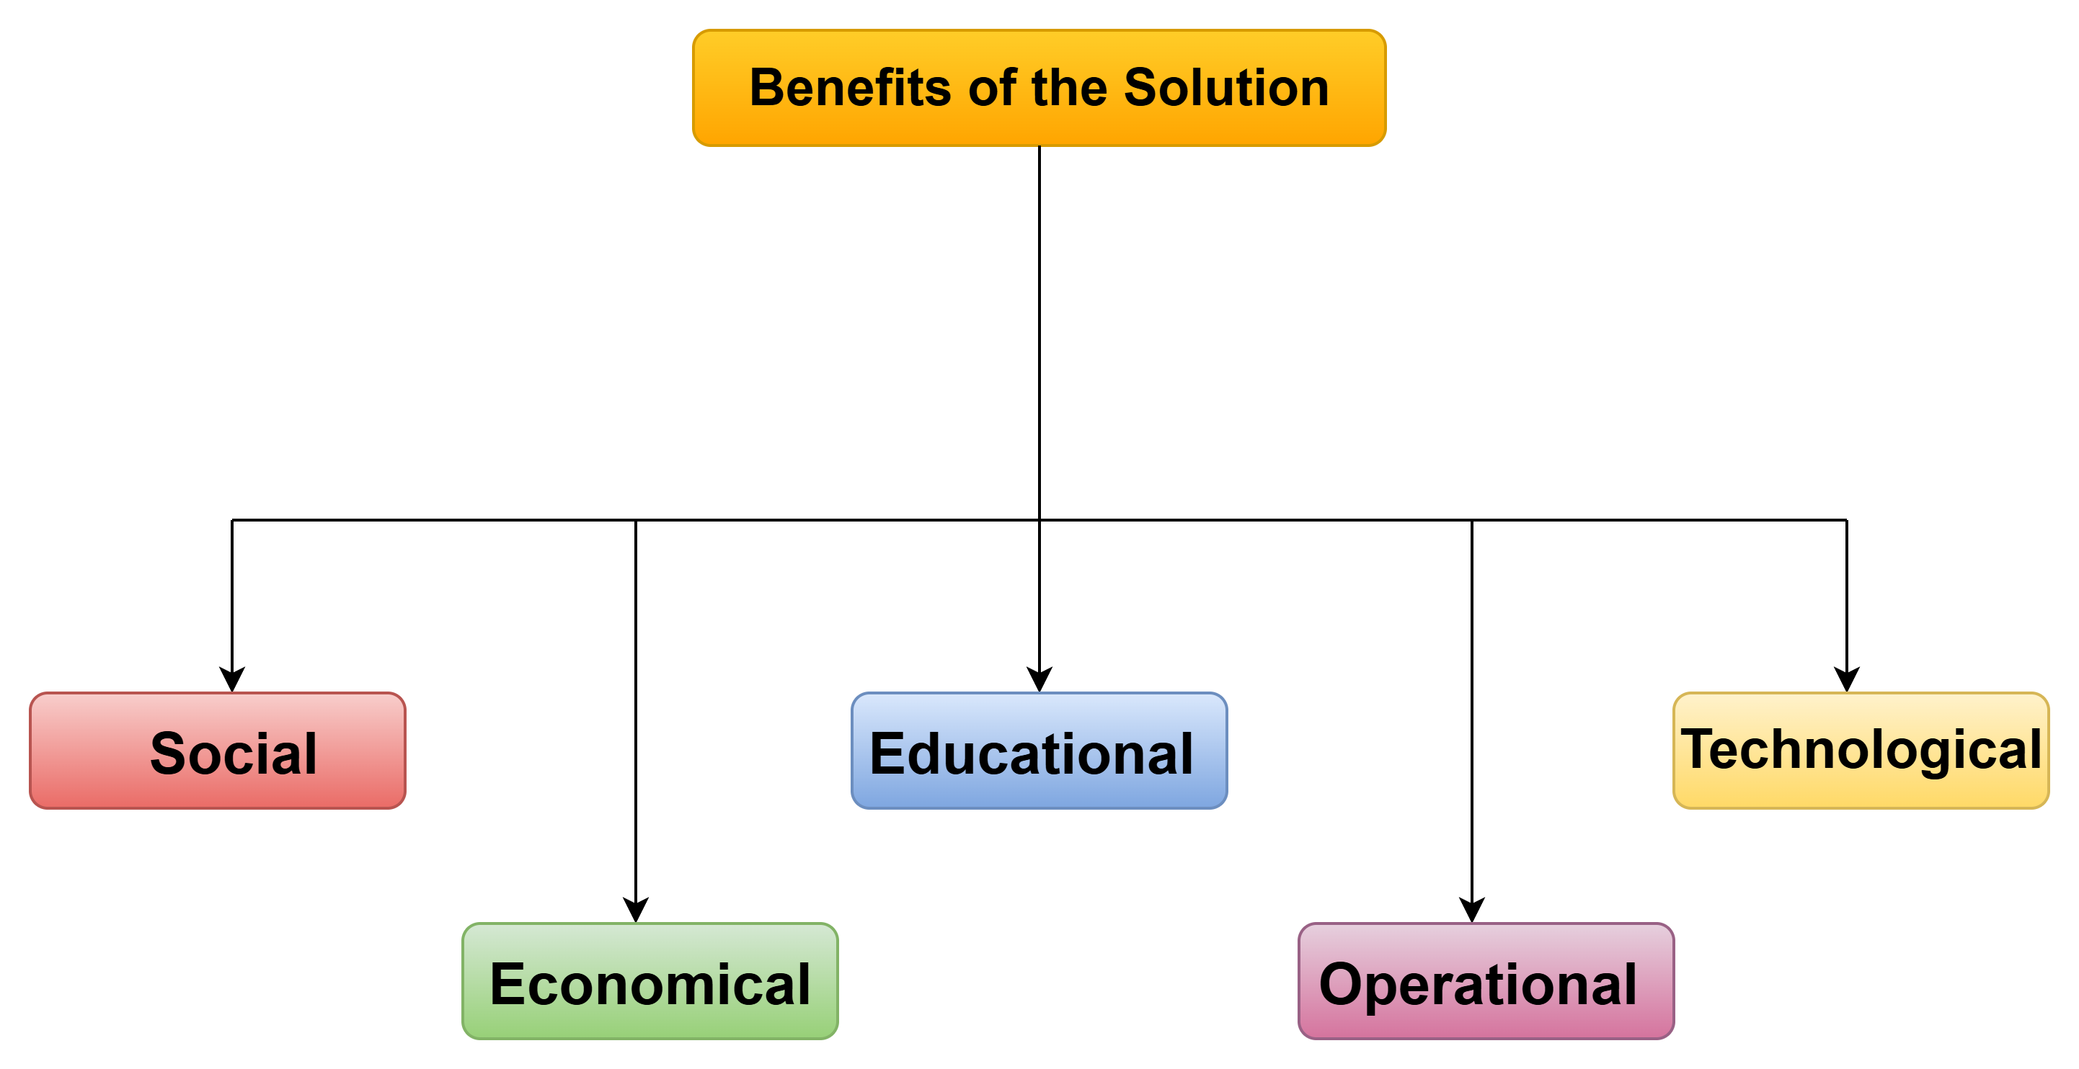
IMPACT AND BENEFITS
Fund Utilisation Optimisation: Smart Contracts ensure zero fund idling and efficient budget use.
ByteForge
Benefits of the Solution
Social:
Improved Community safety and awareness.
Enhanced citizen engagement with authorities.
Reduced social conflicts and misundestandings.
Educational:
Better access to learning resources.
Increased digital literacy among citizens.
Promotes skill development and training.
Economical:
Boosts local business opportunities efficiently.
Reduces operational costs for agencies.
Encourages employment and entrepreneurship.
Operational:
Optimizes workflow and resource allocation.
Reduces redundancy in processes.
Improves project monitoring and tracking.
Potential impact on civillians:
Transparency in Fund Utilization: Open Books on Funds.
Community Empowerment: Locals gain Oversight.
Reduced Confusion: Clear Roles end Confusion.
Trust in Governance: Builds Trust, fights Graft

Slide 6


RESEARCH AND REFERENCES
ByteForge
Comparision with existing system:
References:
Official Release:
PM-AJAY
Official Release By Govt. Of India
Feature | PM-AJAY | AJAYSETU
Digital Data Management
Geographic Mapping
Unified Multi-Agency Mapping
AI-Driven Insights
Public Portal
Supporting Facts:
SCAMS
Prototype:

