Slide 1
STOCK MARKET PRICE PREDICTION
Submitted in the partial fulfillment for the award of the degree of
BACHELOR OF ENGINEERING
IN
Cloud Computing
Submitted by:
Ayushman Singh 20BCS4154
Parag Sharma 20BCS4158
Kunal Singh 20BCS4157
Under the
Supervision of:
MR. Hariharan Udhayakumar
Department of AIT-CSE
DISCOVER . LEARN . EMPOWER

Slide 2
Outline
Introduction to Project
Problem Formulation
Objectives of the work
System Requirement Analysis
Results and Outputs
Conclusion
References

Slide 3
Introduction to Project
The оbjeсtive оf Stock market prediction is to predict the future stock value of companies in order to obtain high proﬁts.
In this approach, we are using the technical analysis by using LSTM (Long Short-Term Memory) method. LSTM, is a Recurrent Neural Network, one of the popular deep learning models, used in stock market prediction.
we will fetch the historical data of stock automatically using python libraries and fit the LSTM model on this data to predict the future prices of the stock.

Slide 4
Problem Formulation
The challenge of this project is to accurately predict the future closing value of a given stock across a given period of time in the future. For this project we will use a Long Short Term Memory networks – usually just called “LSTM” to predict the closing price of US STOCK MARKET.
In this project we are going to collect a sufficient amount of historical stock data. Using the data to train a dataset. Once trained, it can be used to predict stock behavior. The particular algorithms and indicator on which the prices would be predicted will be moving averages.

Slide 5
Objectives of the Work
The proposed work is aimed to carry out work leading to the development of an approach for Stock Price Prediction
The proposed aim will be achieved by Create a Machine learning model

Slide 6
System Requirement
Analysis
PYTHON 3.7.5
JUPYTER NOTEBOOK
TIINGO API

Slide 7
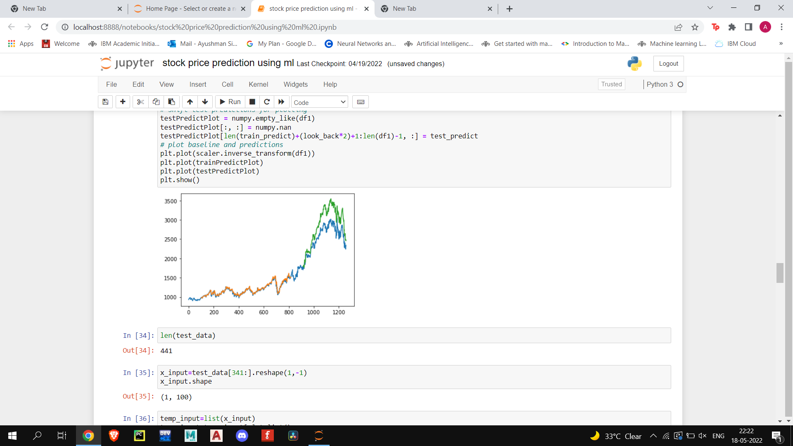
Results and Outputs

Slide 8
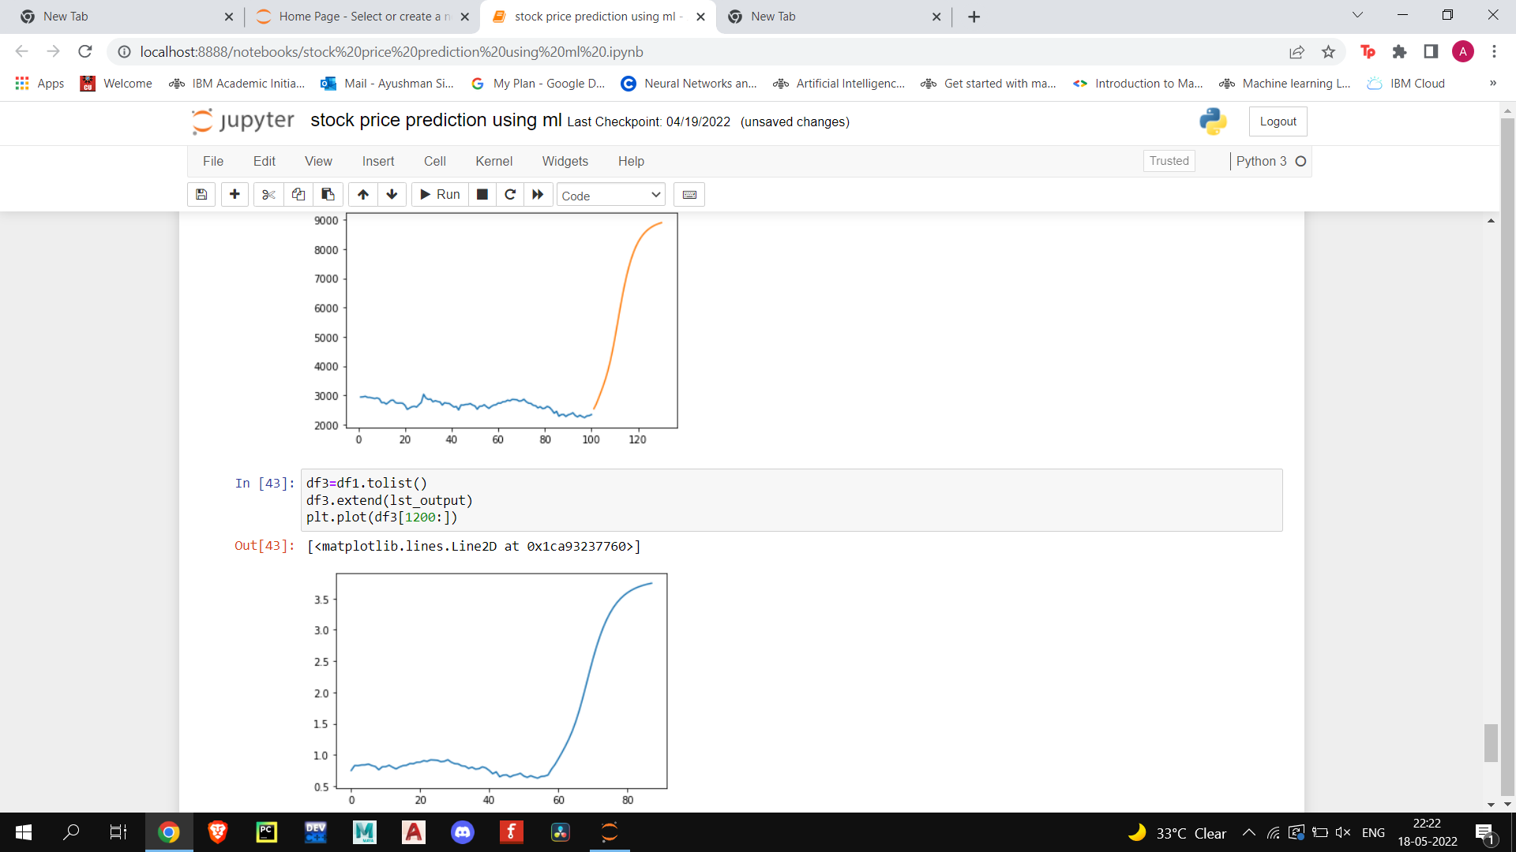

Slide 9
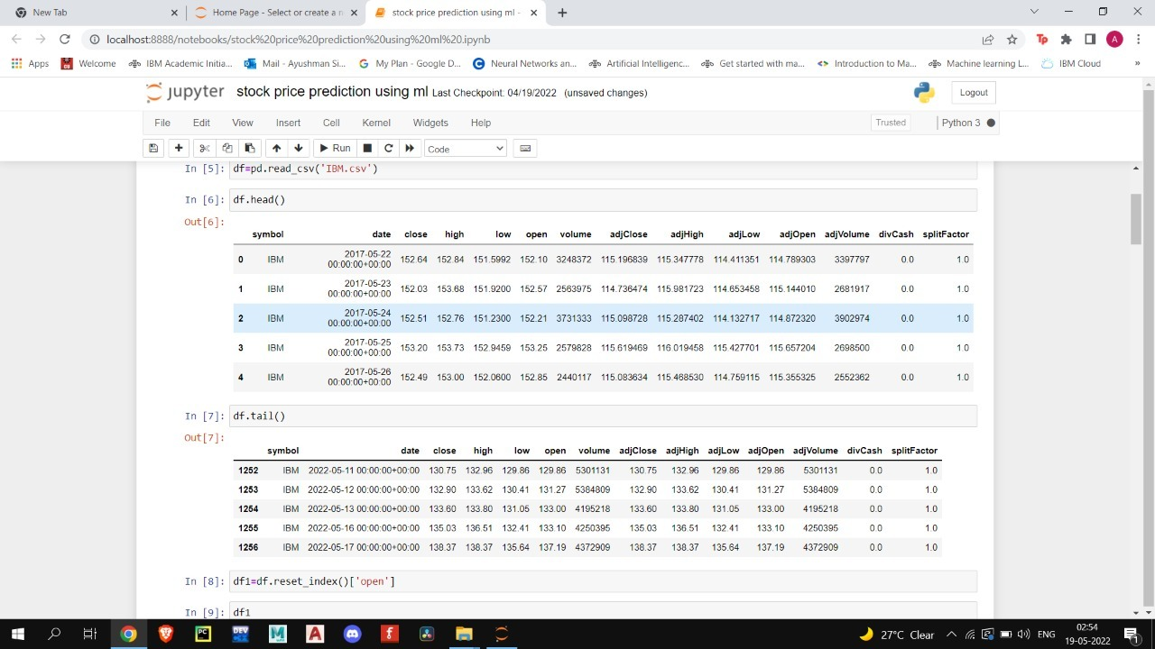

Slide 10
Conclusion
Determining the Stock market forecasts is always been challenging work for business analysts.
Thus, Project applies the data mining technology of neural network to stock price forecast and receives a preferable result, which will provide the research of the stock market development a new thought & We attempted to make use of huge textual data to predict the stock market indices.

Slide 11
References
https://www.tiingo.com/
https://www.geeksforgeeks.org/
https://www.simplilearn.com/tutorials/machine-learning-tutorial/stock-price-prediction-using-machine-learning

