Slide 1
Classifying Playing Cards
EE4H Presentation and Demonstration – Yousef Amar and Chris Lewis

Slide 2
Introduction
Implement Computer Vision approaches to automatically classify playing cards.
Combination of high-level methods and low-level processing.
Written in C++ using OpenCV.
Extracting all details from whole image.
“The four of diamonds.”

Slide 3
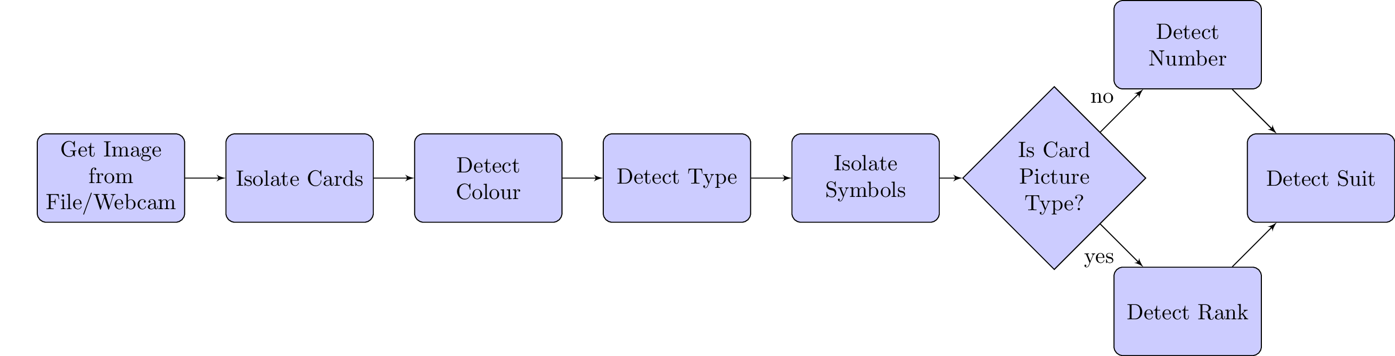
Implementation
Overview of classification process:
Close rank
Erode symbols
Count remaining symbols
Red or Black?
Remove background
Filter red channel
Evaluate corners
Corner blobs
Top is rank
Below is suit
Find all cards:
CLAHE
Contours
Duplicates
Picture card?
Picture square within card square?
Picture type, else value type
Use isolated suit/rank symbols as SEs for strict morphological Hit-or-Miss

Slide 4
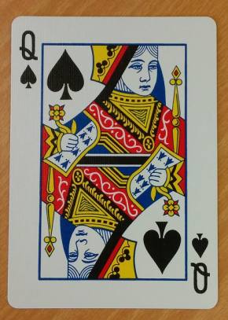
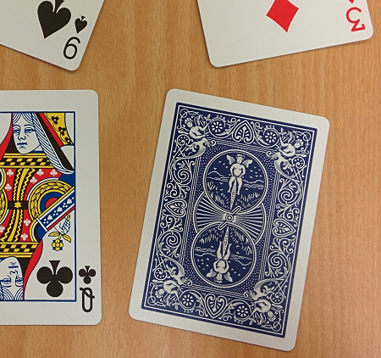
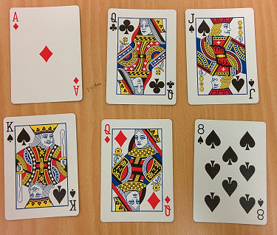
Testing Methods
Progression in difficulty:
Provided whole-image cards
Single card in good conditions
Multiple cards in one image
Multiple cards at odd angles
Invalid cards included (reverse sides)

Slide 5
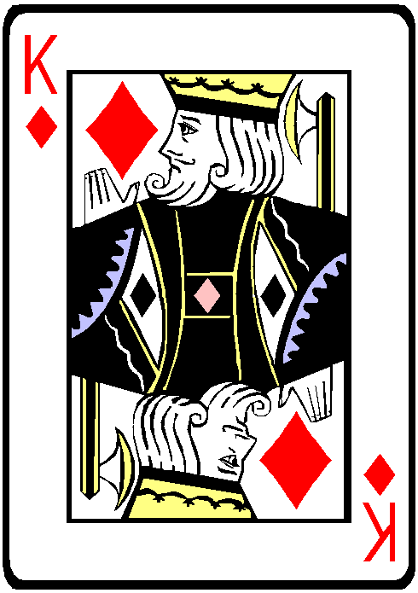
Live Demonstration
Two scenarios:
Pre-captured original images of cards on a desk
Live captured images from a webcam

Slide 6
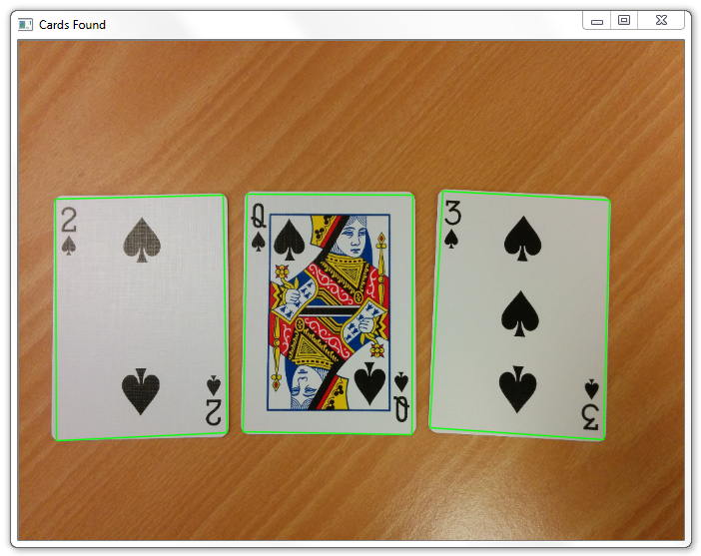
Results

Slide 7
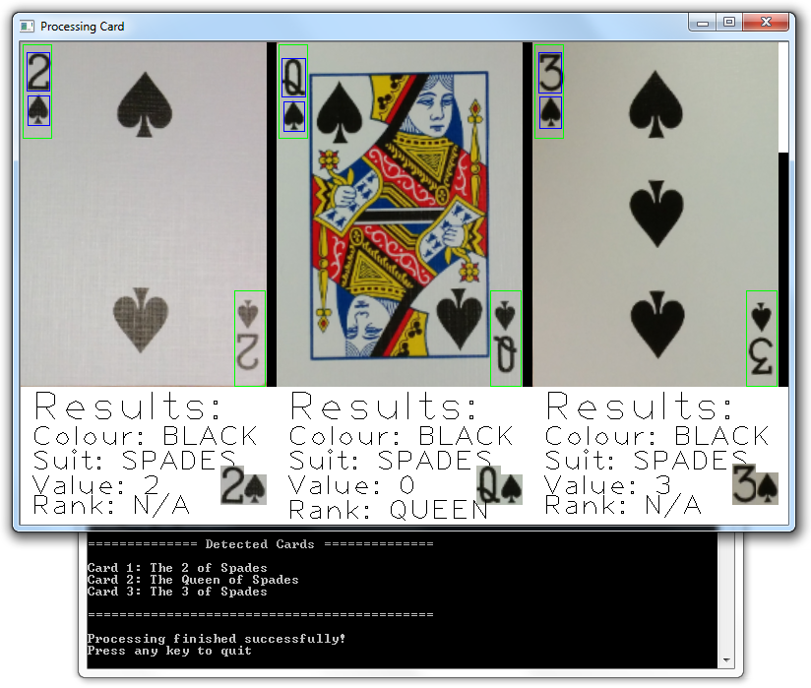
Results

Slide 8
Results Discussion
In good lighting, almost perfect classification.
Performance for suit and picture card also good.
Occasional misclassifications can result from:
Busy backgrounds
Images containing ‘card-like’ objects, i.e: skylights, posters etc.
Cards too small as a proportion of the image, requires different CLAHE window size.
Non-deck cards such as ad cards.
Improvements:
Refined to work in alternative settings, card styles.
Supplementing classification through multiples frames (video)
Inconsistent conditions prevent absolute accuracy measure.

Slide 9
Conclusions
C++ implementation of card isolation and classification with excellent accuracy.
Obstacles overcome:
Perspective/orientation
Lighting
Multiple cards per image
Picture cards as well as pure value cards.
Consistent results in consistent conditions.
Any questions?

