Slide 1
SARANGI JEWELS × DIGITAL COMMERCE
From One Beautiful Store
to a Complete Digital Business
A proposal to bring Sarangi Jewels' ornaments, ladies' store and dance-costume rentals
online — under one system you fully own and control.
Prepared for the Owner, Sarangi Jewels | September 2026
01

Slide 2
THE OPPORTUNITY
Three businesses, one roof — and one missing piece
1
2
3
Jewellery & Ornaments
Ladies' Store
Costume Rentals
Walk-in only. Sales stop when the shutter comes down, and reach ends at the street.
New arrivals depend on footfall. No way for regulars to browse or reorder from home.
Bookings, availability and returns are tracked manually — easy to double-book or lose track.
The fix isn't three separate apps — it's one platform that already understands jewellery, apparel and rentals together.
01

Slide 3
THE SOLUTION
One system, five connected experiences
Customer Website
Customer Mobile App
Admin Dashboard
Browse, buy and book rentals from any device — a real storefront open 24/7.
The same catalog and cart in your customers' pocket, with order tracking.
You control products, prices, stock, orders and rentals from one screen.
Staff Mobile App
Central Engine
Your team picks, packs, ships and scans orders on the shop floor.
One backend keeps stock, pricing and bookings in sync everywhere, instantly.
03

Slide 4
WHAT CUSTOMERS GET
A shopping experience built for jewellery & apparel
✦
Rich Product Catalog
✦
Cart & Secure Checkout
Categories, filters, variants and detailed product pages for ornaments and apparel.
Guest or account checkout with live stock checks before an order confirms.
✦
Online Payments + COD
✦
Wishlist & Reviews
Card/UPI payments via Razorpay, with Cash-on-Delivery for local customers.
Customers save favourites and leave ratings — built-in word of mouth.
✦
Order Tracking & Returns
✦
WhatsApp Commerce
Live order status, history, and a structured returns/exchange flow.
Order updates and support conversations on the channel customers already use.
04

Slide 5
BUILT FOR YOUR BUSINESS
A dedicated engine for dance-costume rentals
1
2
3
4
5
Customer
Browses & Books
Availability
Auto-Checked
Pickup / Delivery
Scheduled
Return &
Condition Check
Deposit
Settled
→
→
→
→
Inventory is shared across ornaments, apparel and rental stock — so a costume that's rented out is instantly marked unavailable everywhere, and returns automatically release it back for sale or the next booking.
Multi-location inventory • Serial / batch tracking for high-value pieces • Automated low-stock alerts
05

Slide 6
RUNNING THE BUSINESS
Everything the owner needs, in one dashboard
Orders & Fulfillment
Products & Pricing
Promotions & Coupons
Track every order from placed to shipped; staff app handles pick, pack, ship.
Add products, update prices and images without touching any code.
Run festive discounts, automatic offers and member pricing when you want to.
Reports & Analytics
Staff Roles & Access
Customer Records (CRM)
See what's selling, best customers, and revenue trends at a glance.
Separate logins for admin, fulfillment and support — no shared passwords.
A running history of every customer's purchases and rentals.
06

Slide 7
WHY IT'S DEPENDABLE
Built on the same technology as major online stores
Bank-Grade Payments
Encrypted Accounts
Razorpay integration with signature-verified transactions — the same rails used by leading Indian retailers.
Passwords are hashed, never stored in plain text; secure staff and customer logins.
Built To Scale
You Own It
Modern cloud-ready architecture that grows from one shop to multiple outlets.
Runs on your own server or hosting — no dependence on a third-party SaaS subscription.
07

Slide 8
THE BUSINESS CASE
What this changes for Sarangi Jewels
24/7
3-in-1
0
1
Store stays open
beyond shop hours
Jewellery, apparel and
rentals, one system
Double-bookings once
rental stock is live
Dashboard to run
the entire business
New Feature
Make session can be booked in Sarangi Portal and managed from the admin office
Beyond convenience, this is a growth channel: new customers who never walk past your shop can now find, browse and buy from Sarangi Jewels — and every sale is recorded, not remembered.
08

Slide 9
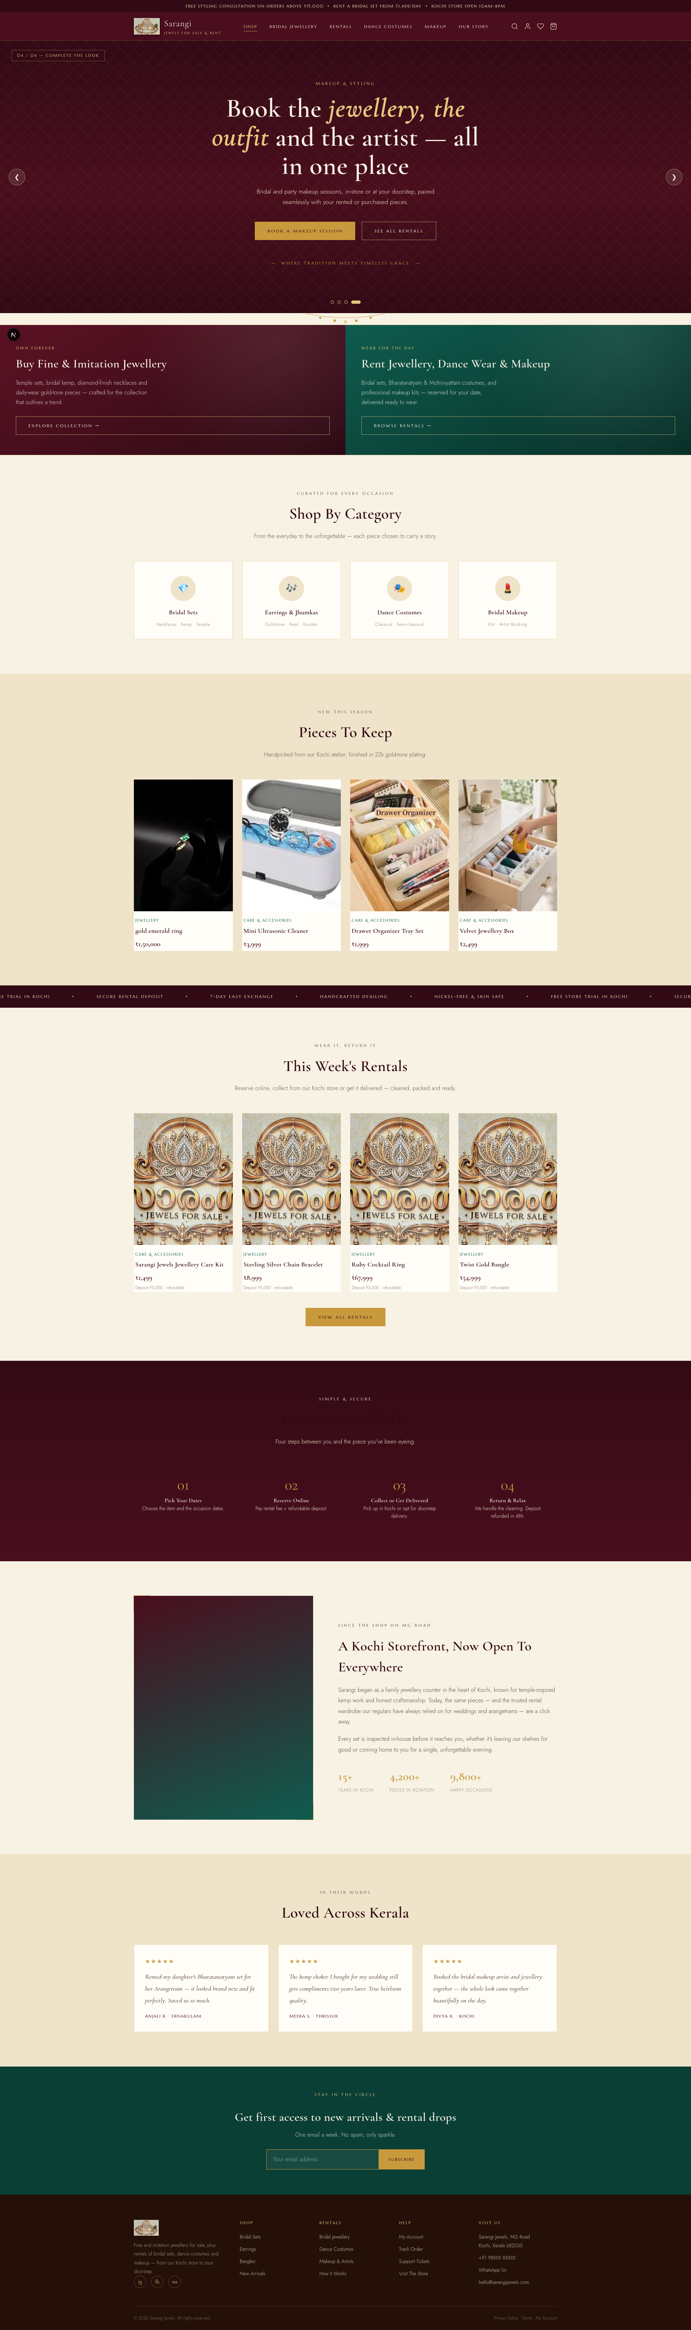
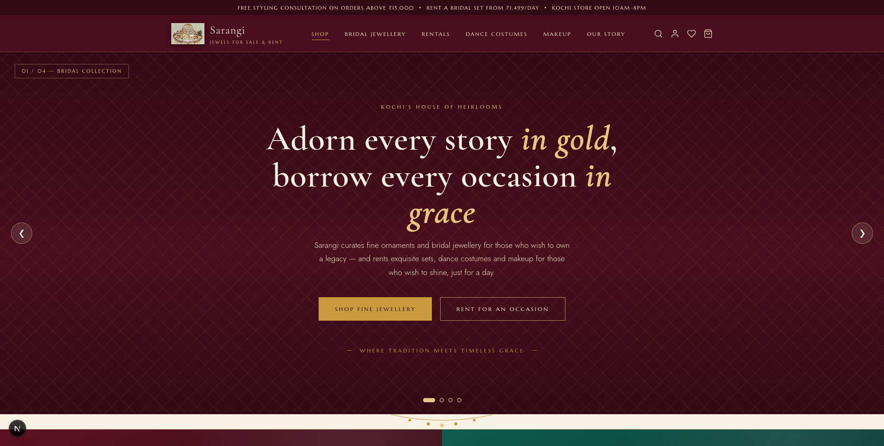
Store
Store Front
The one-page design for the store front which is premium styled to match our domain
08

Slide 10
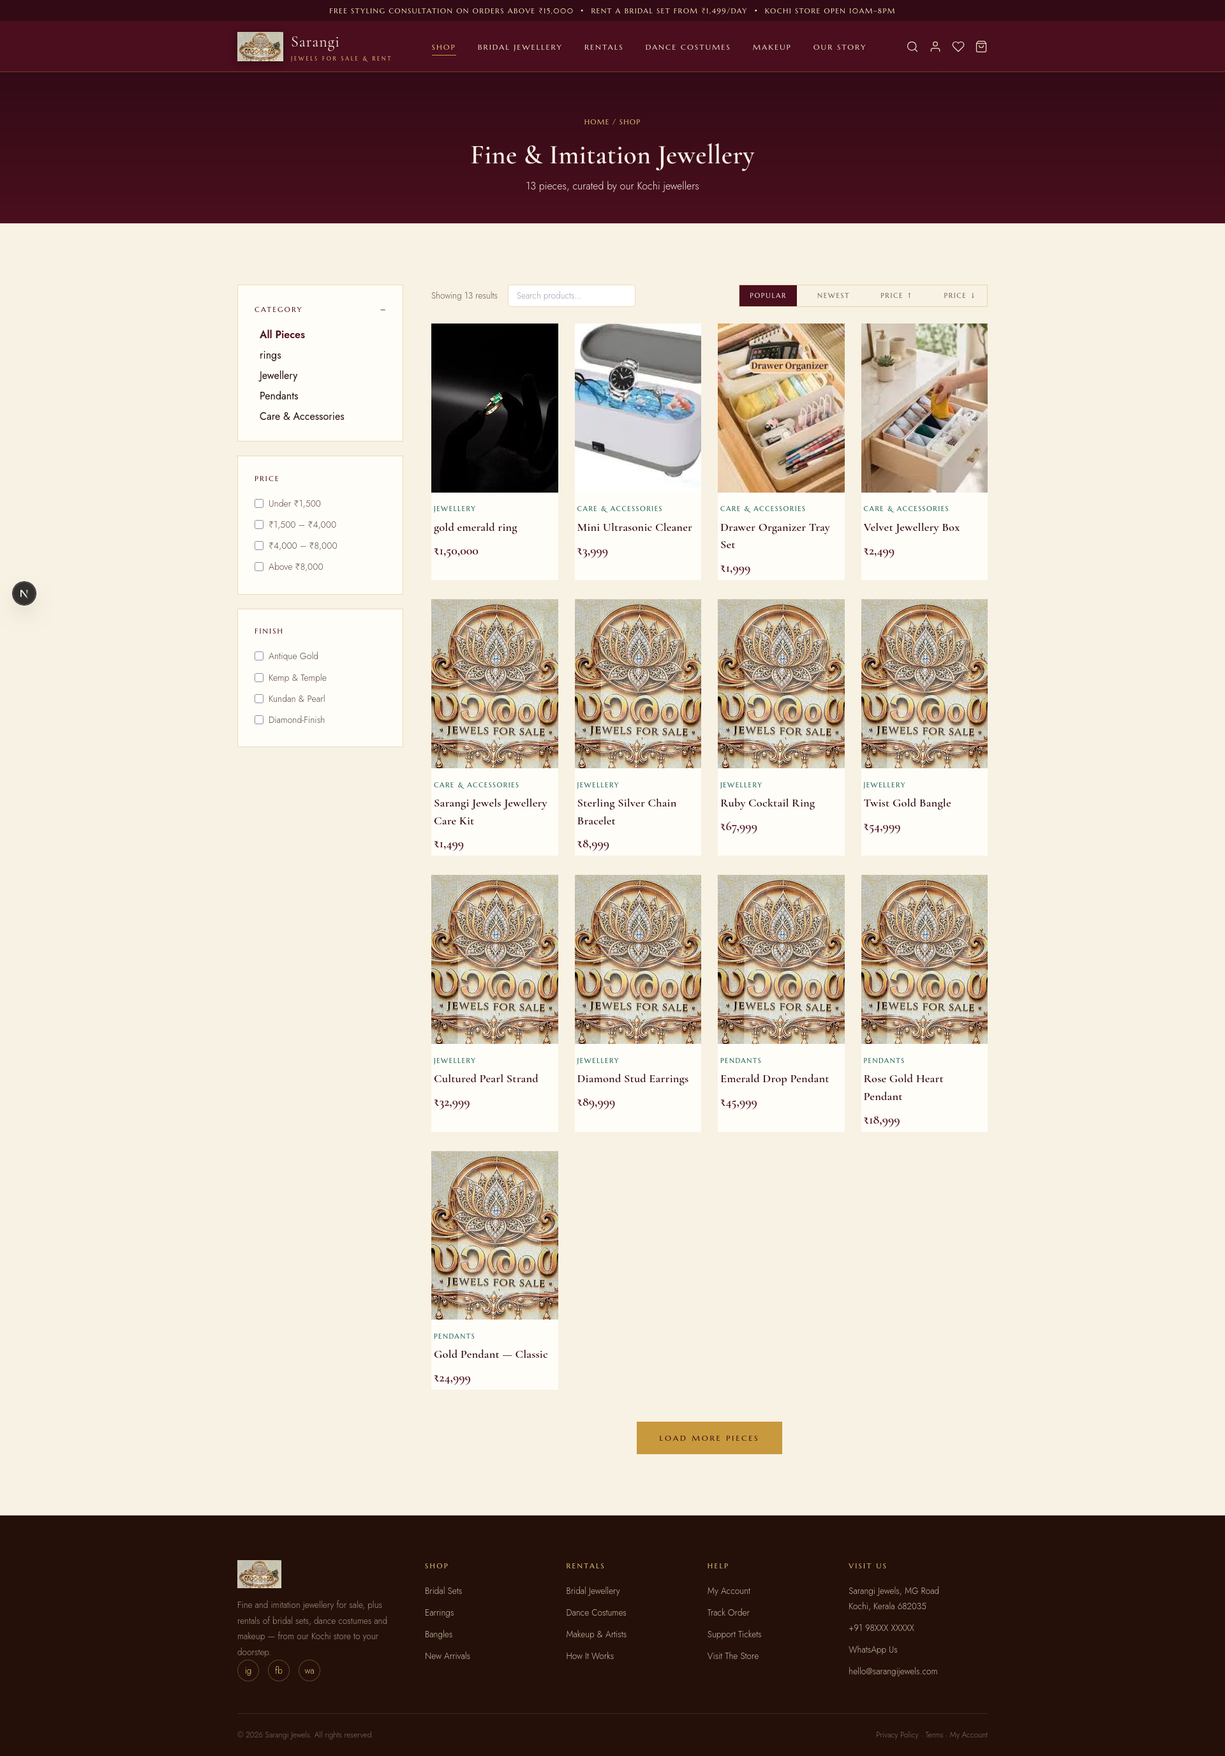
Store
Products List
View the list of products available in the store
08

Slide 11
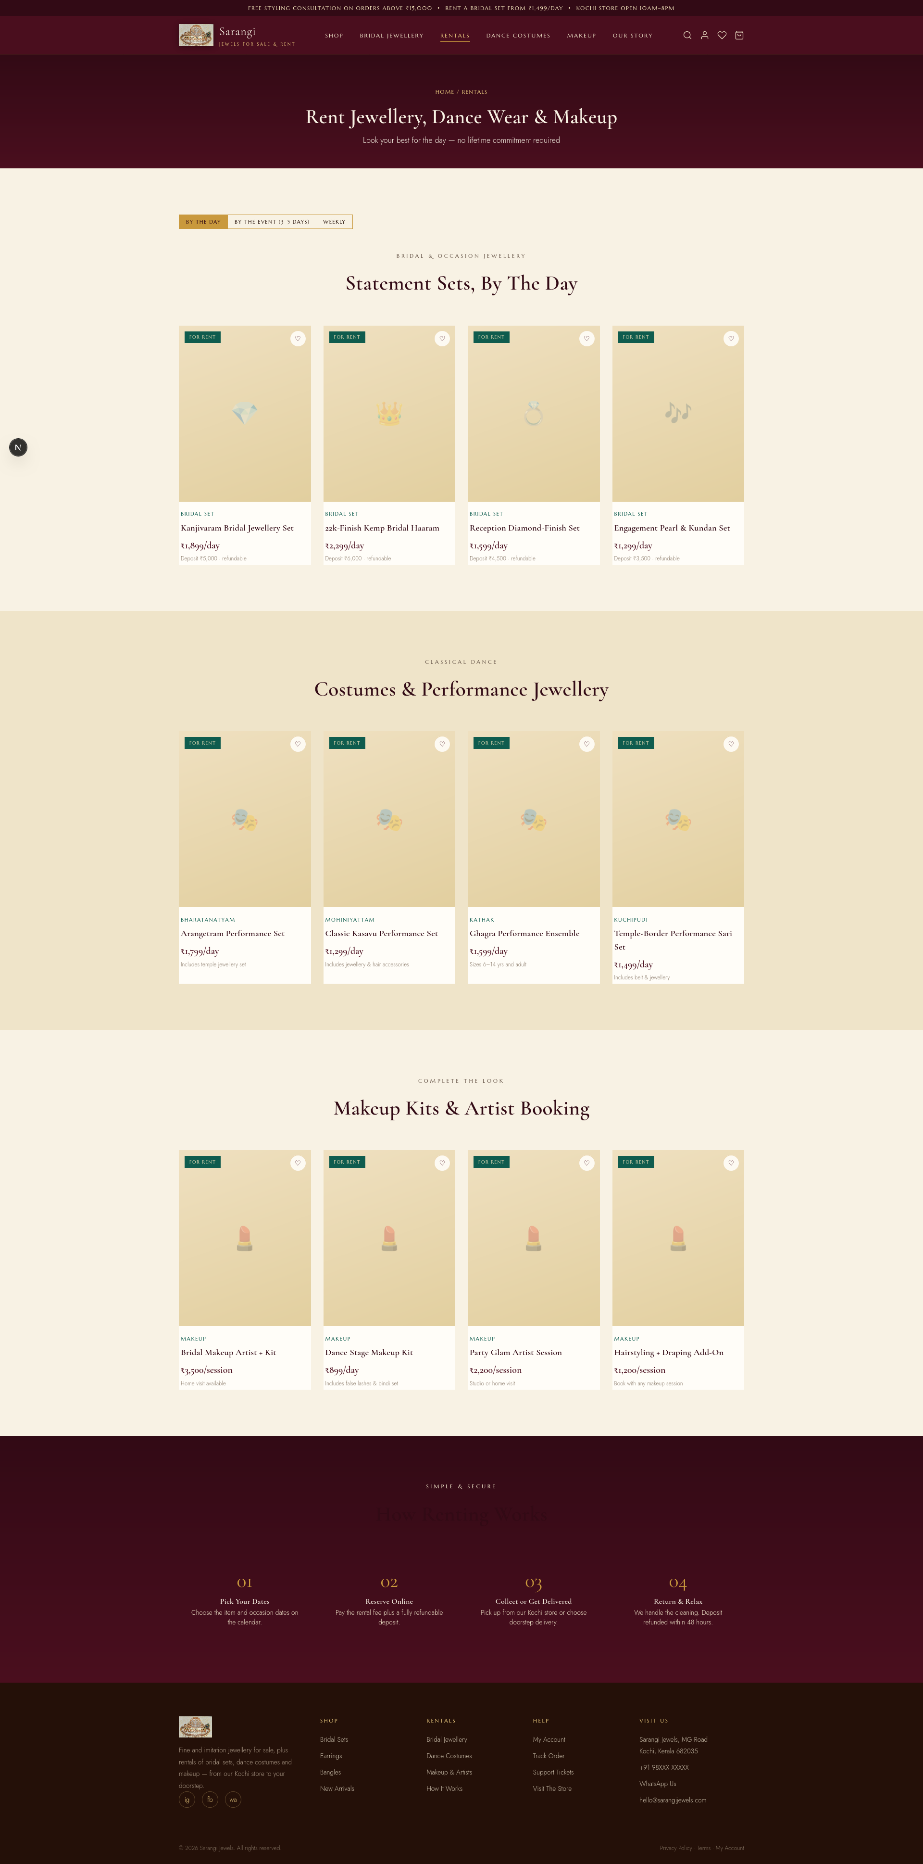
Store
Rental Items List
View the list of rentals available in the store
Customers get to choose the items for rental and add to the rental order
08

Slide 12
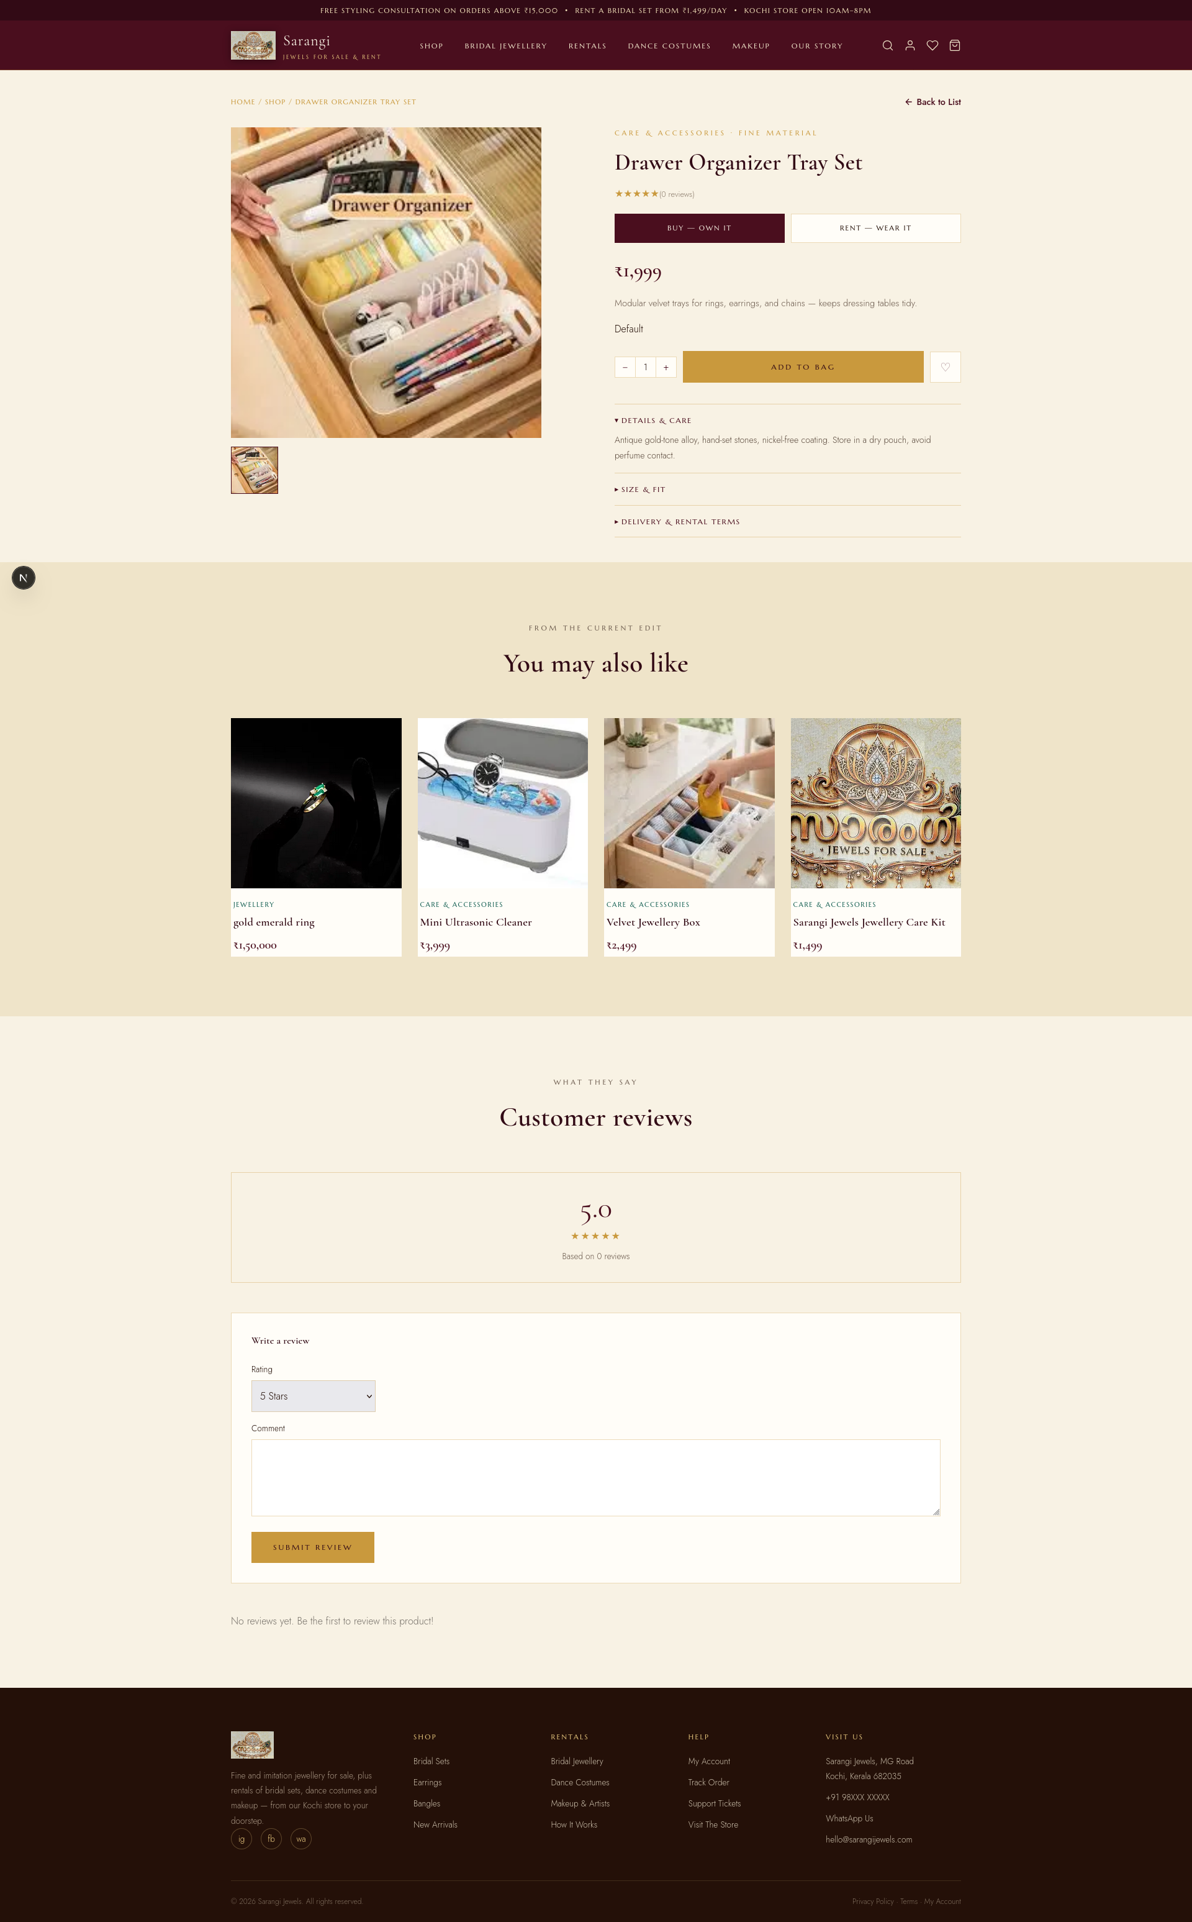
Store
Product Details View
View the Product Details for the selected product
Customer can choose to buy or rent the product
The items are added to cart for checkout
08

Slide 13
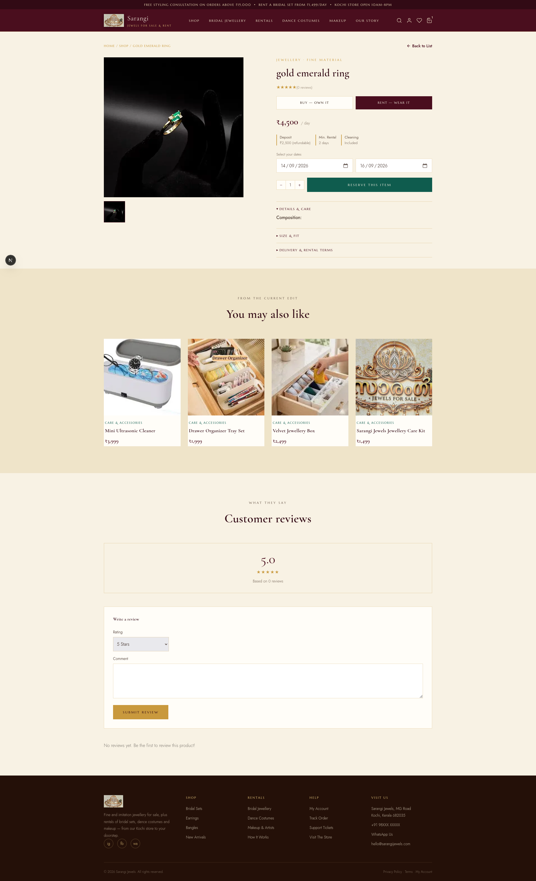
Store
Product Details View
View the Product Details for the selected product
Customer can choose to buy or rent the product
The items are added to cart for checkout
08

Slide 14
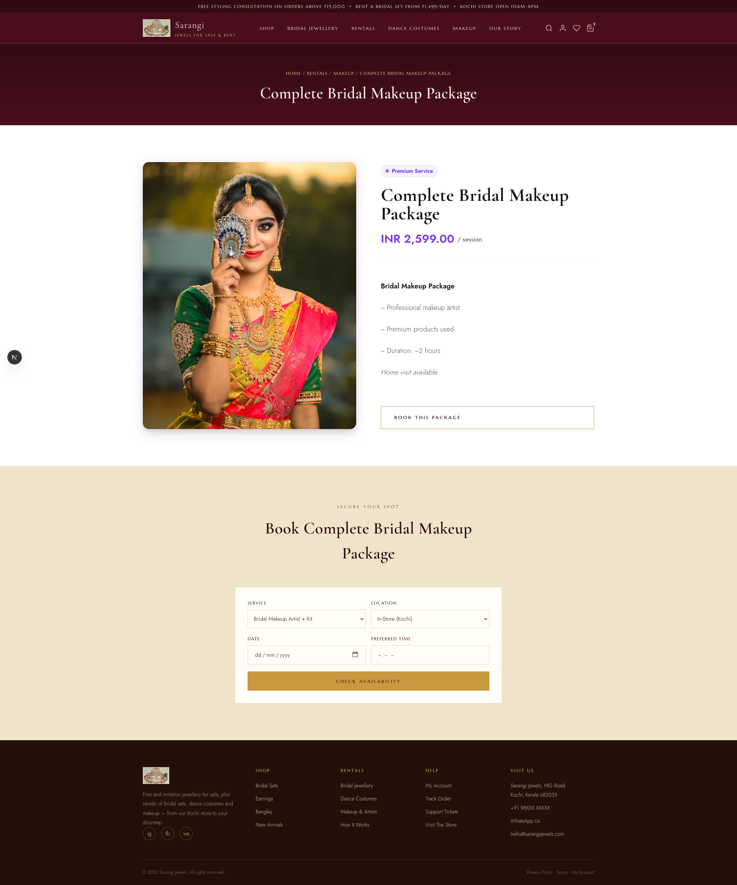
Store
Makeup Booking View
Book makeup sesssion
08

Slide 15
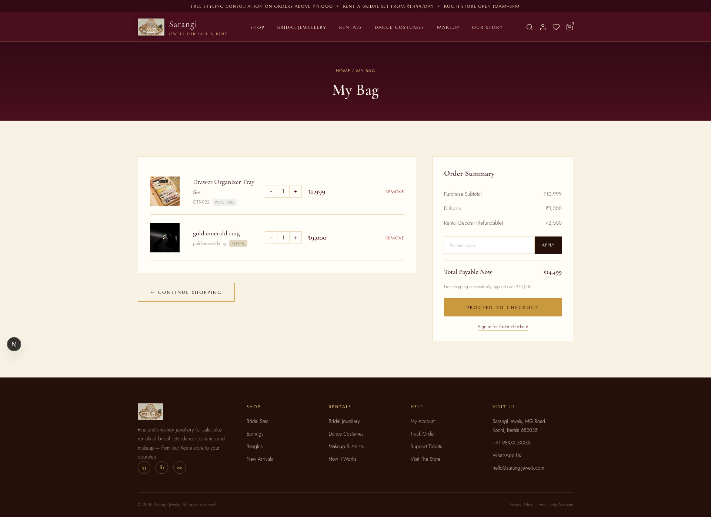
Store
Cart View
Manage the cart items for checkout
08

Slide 16
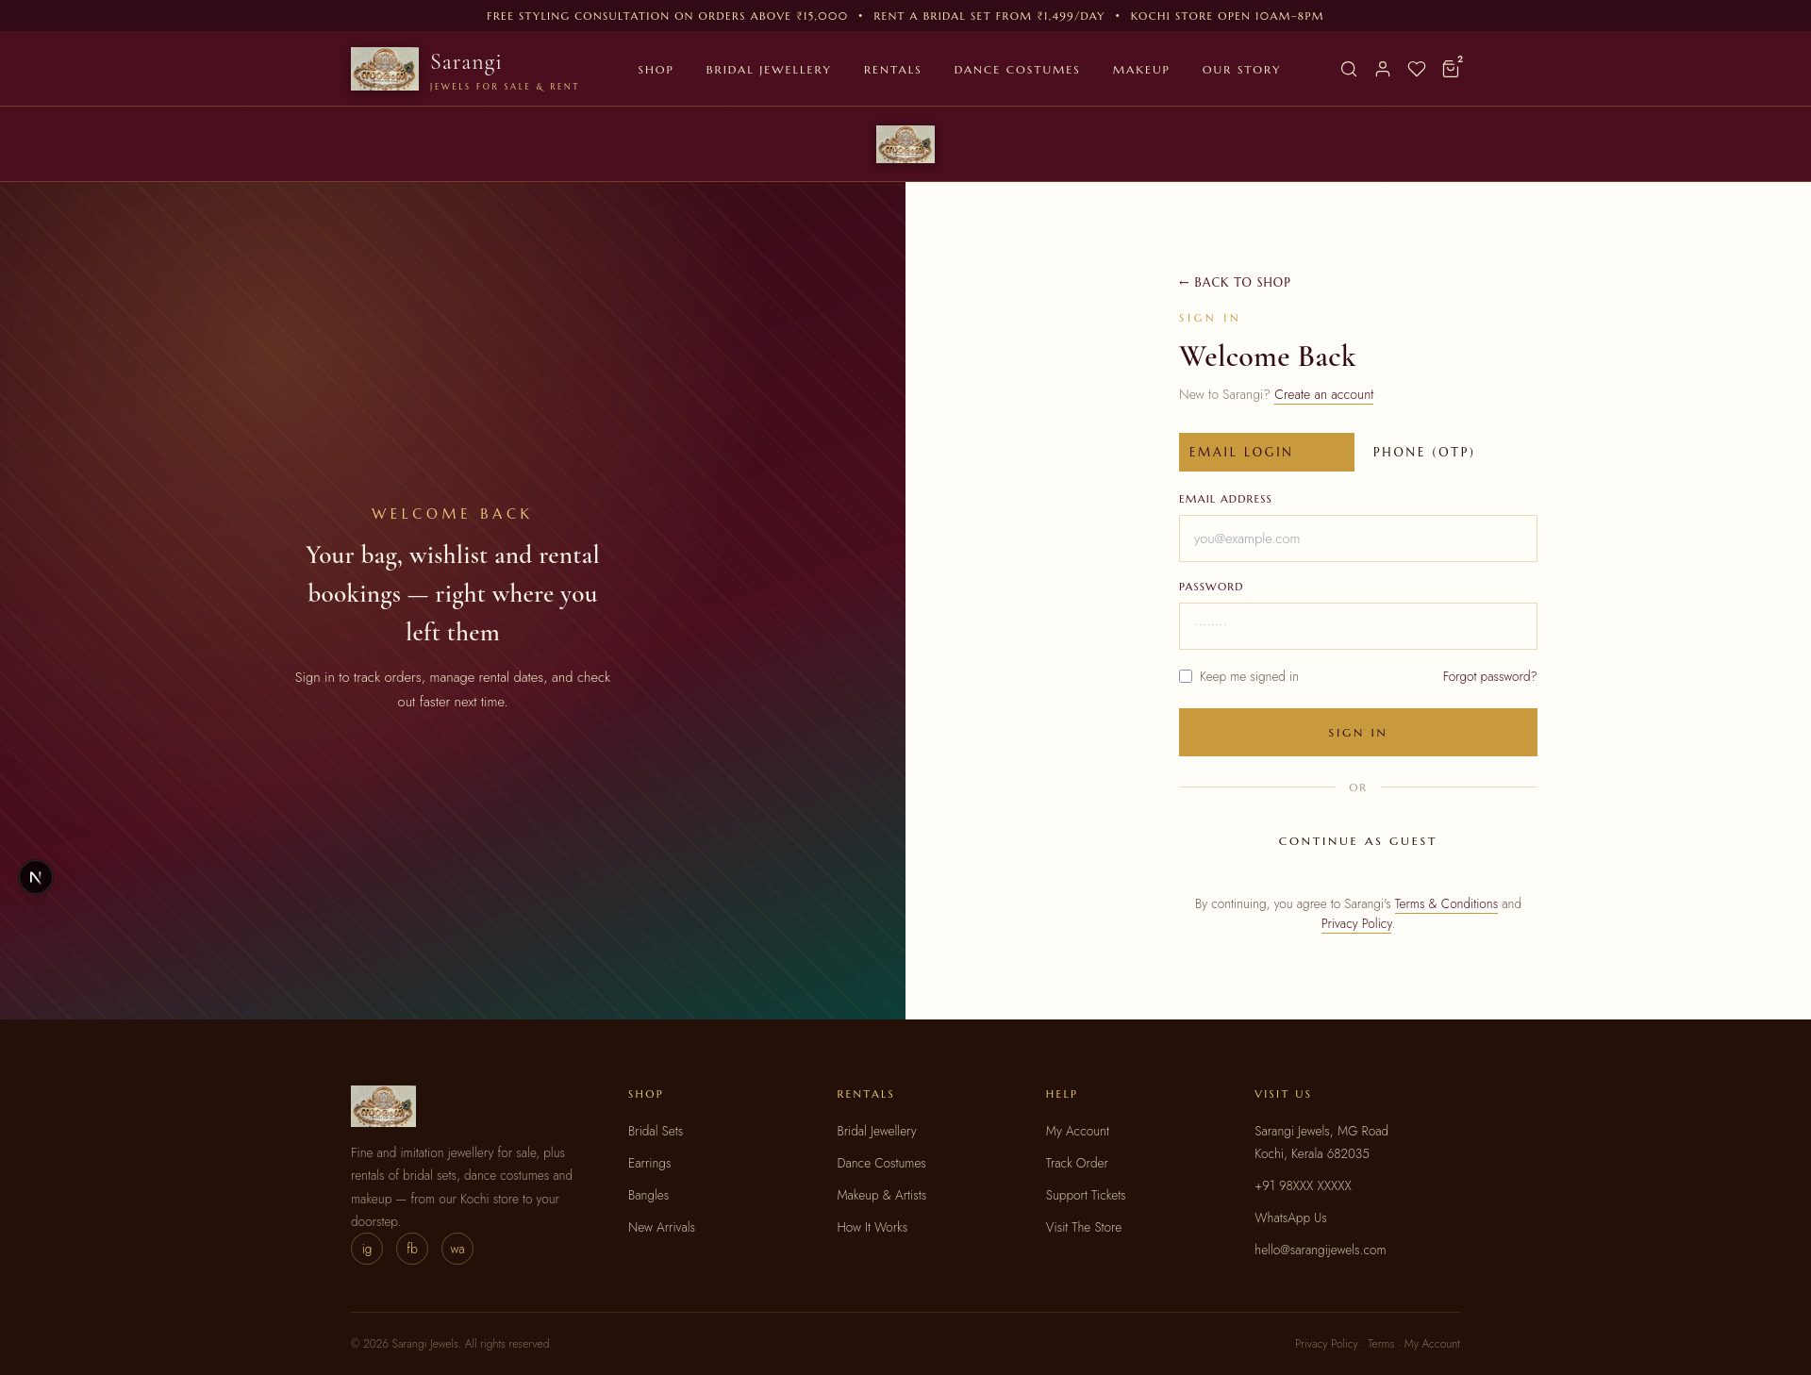
Store
Customer Login
Login / Register
08

Slide 17
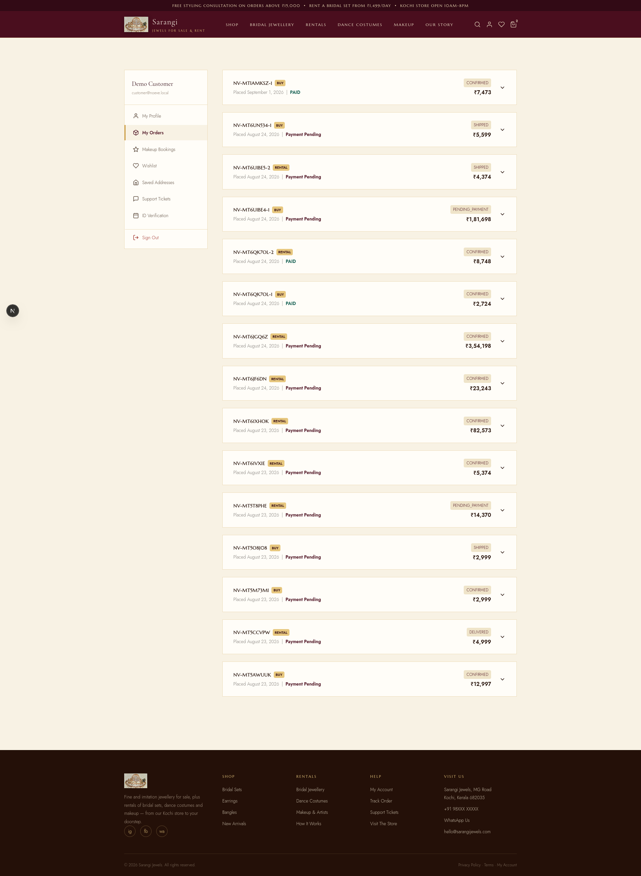
Store
Customer Profile
Customer can manage the orders and profile
08

Slide 18
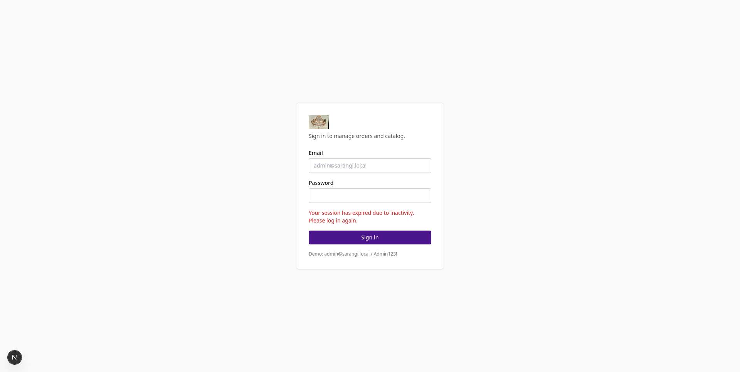
Store Administration
Screens for Admin Portal
Login for Admin Portal
08

Slide 19
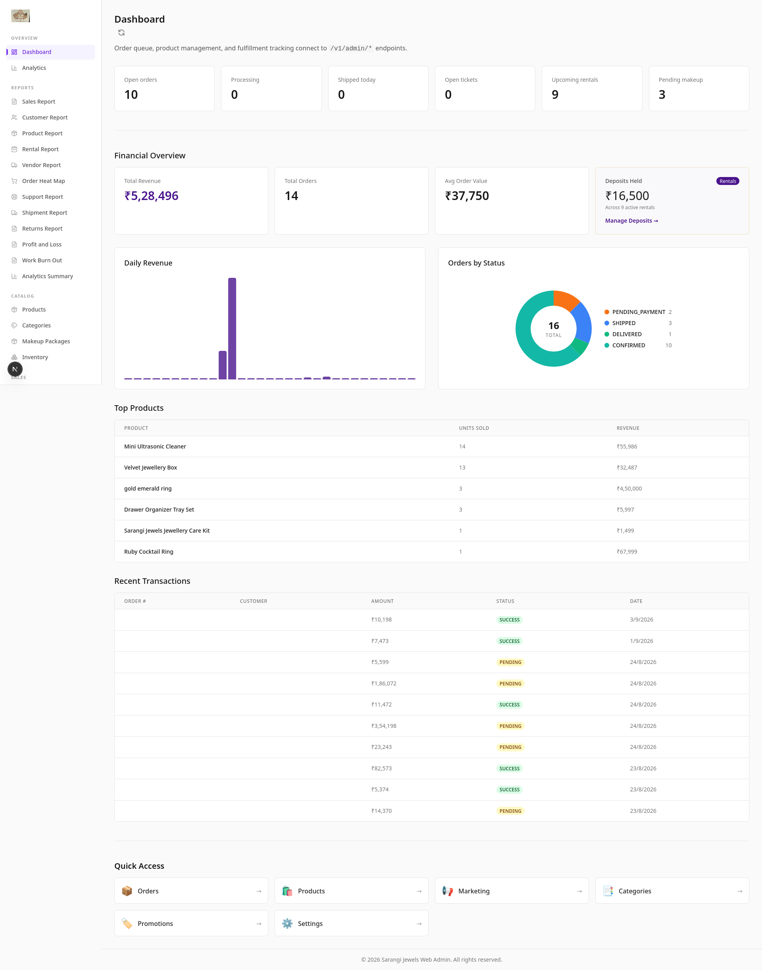
Store Administration
Screens for Admin Portal
Dashboard for Admin Portal
The dashboard provides overview of how the operations and sales are functioning
08

Slide 20
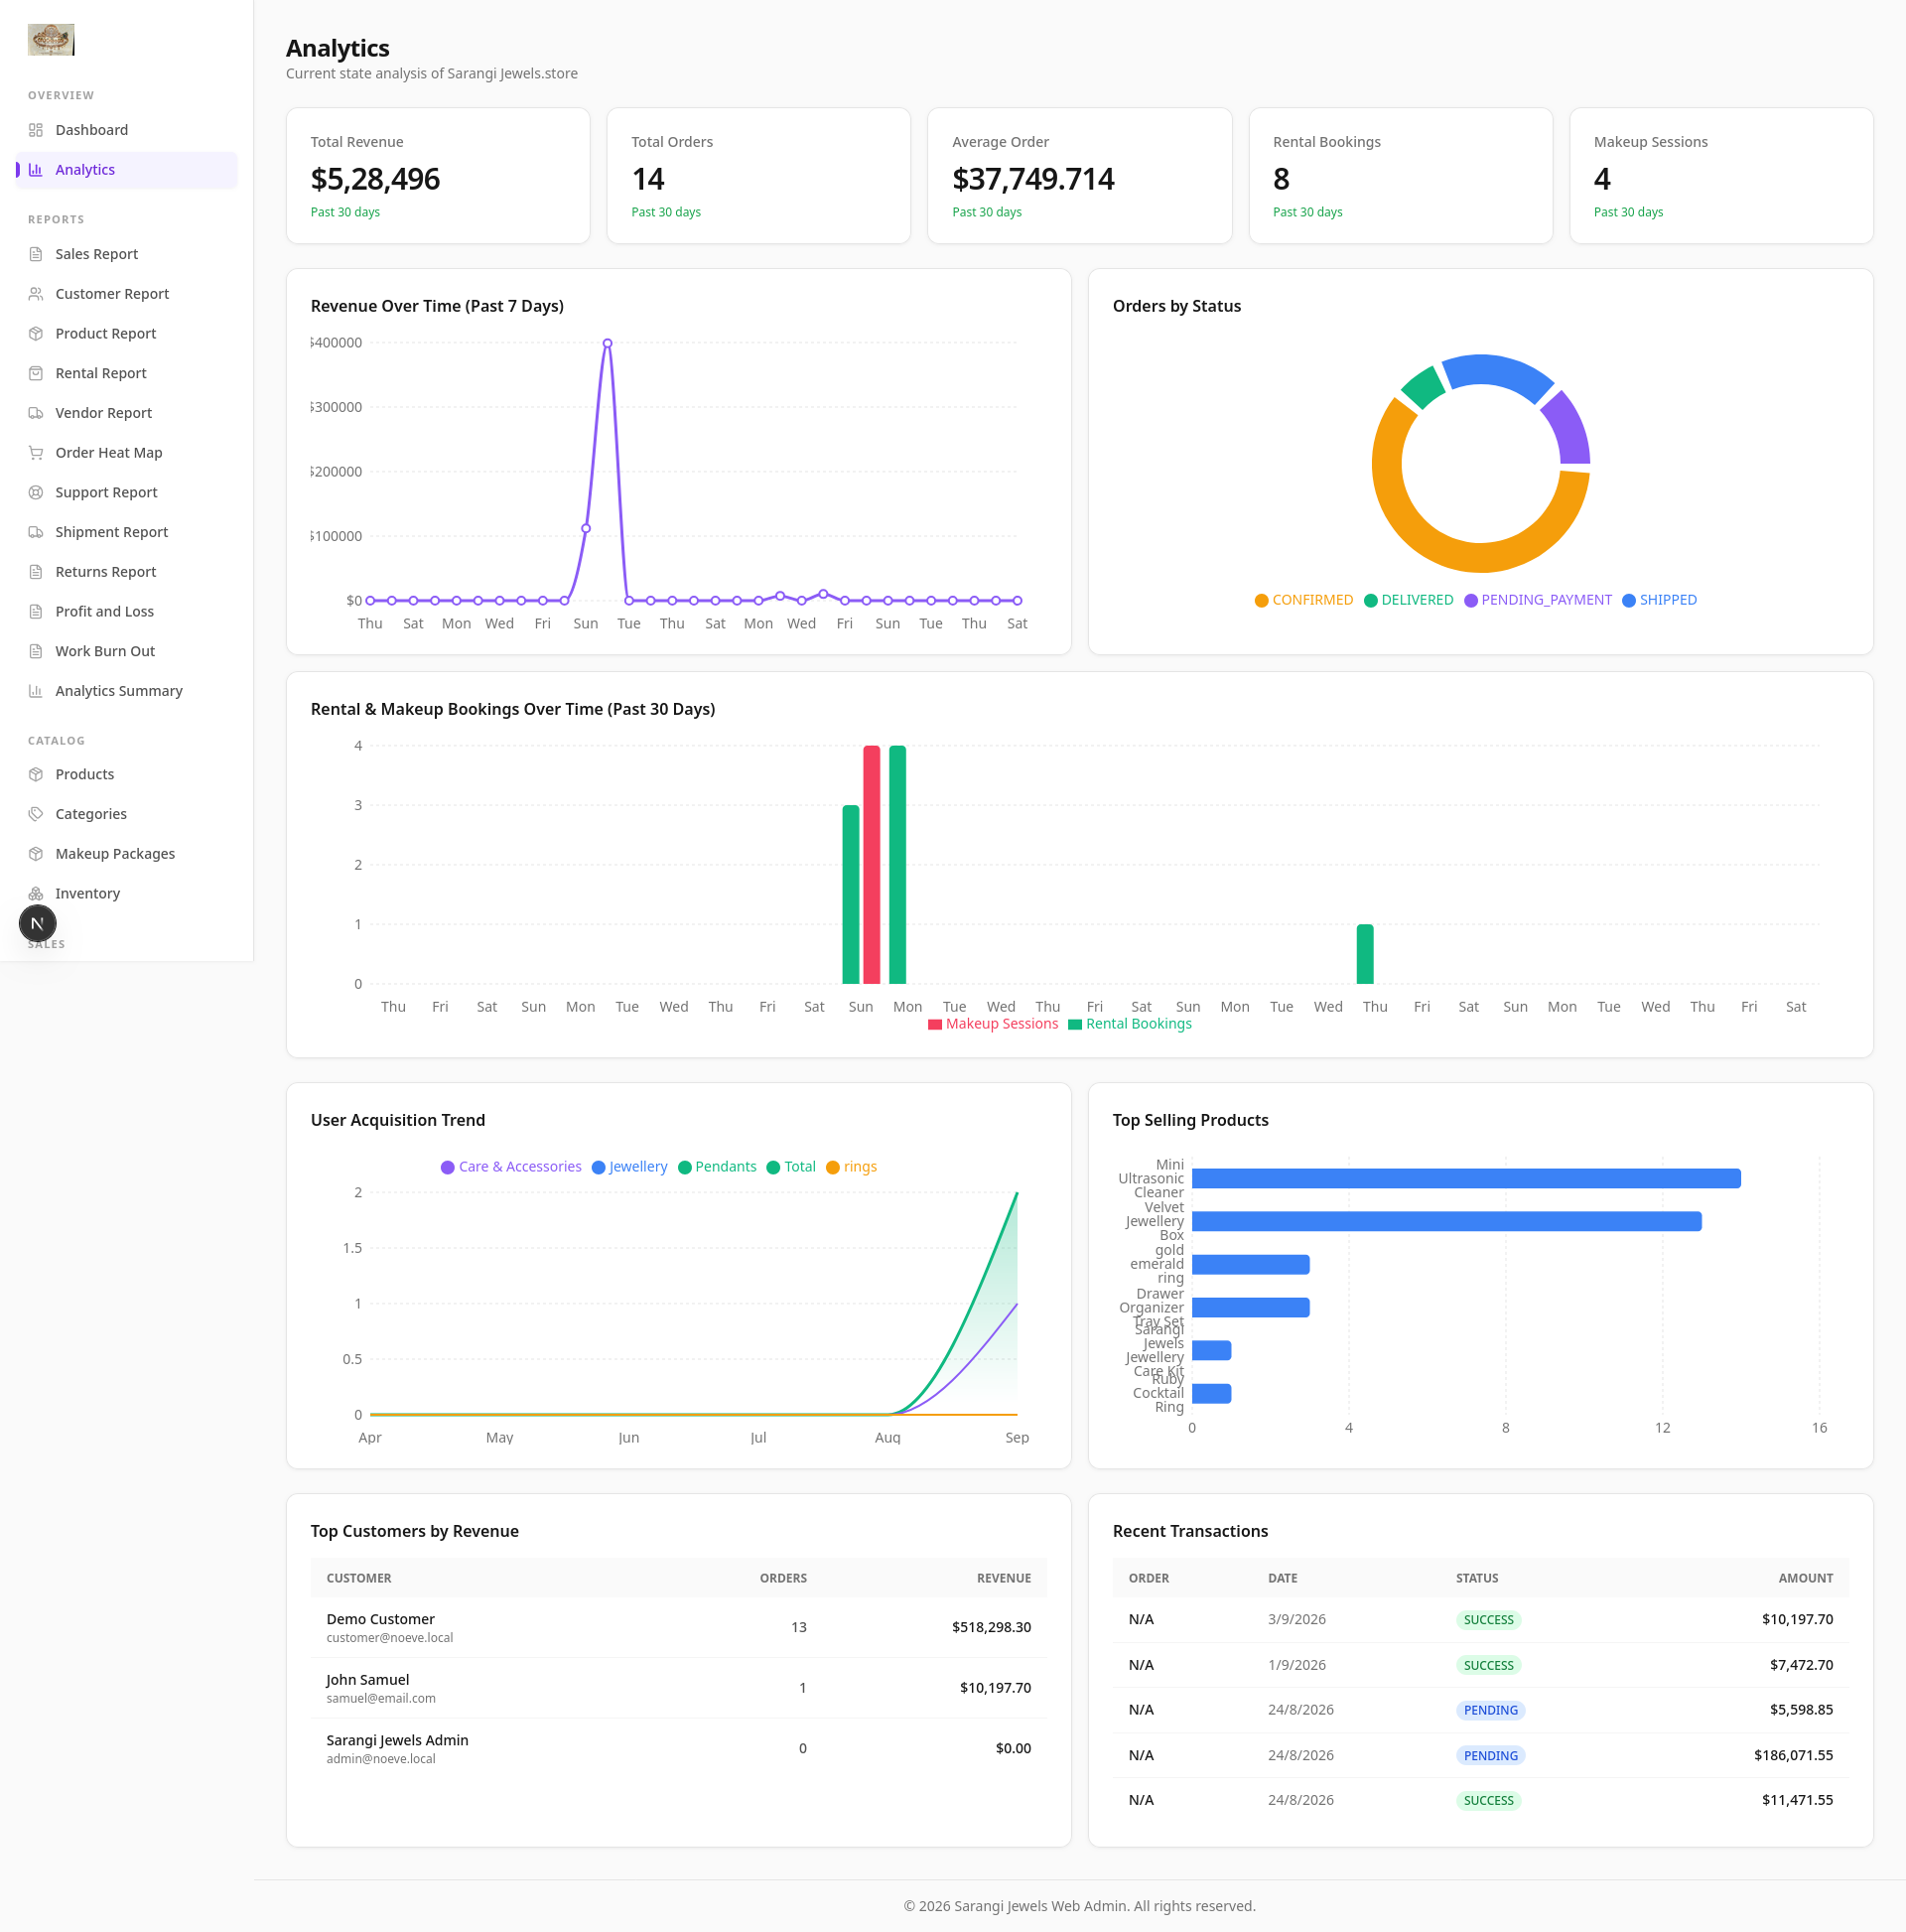
Store Administration
Screens for Admin Portal
Analytics for Admin Portal
The analytics provides complete statistical overview of how the system is functioning.
Major analytics
- Revenue over Time
- Top Selling Products
- Rental and Makeup Bookings
- Use Acquisition Trend
08

Slide 21
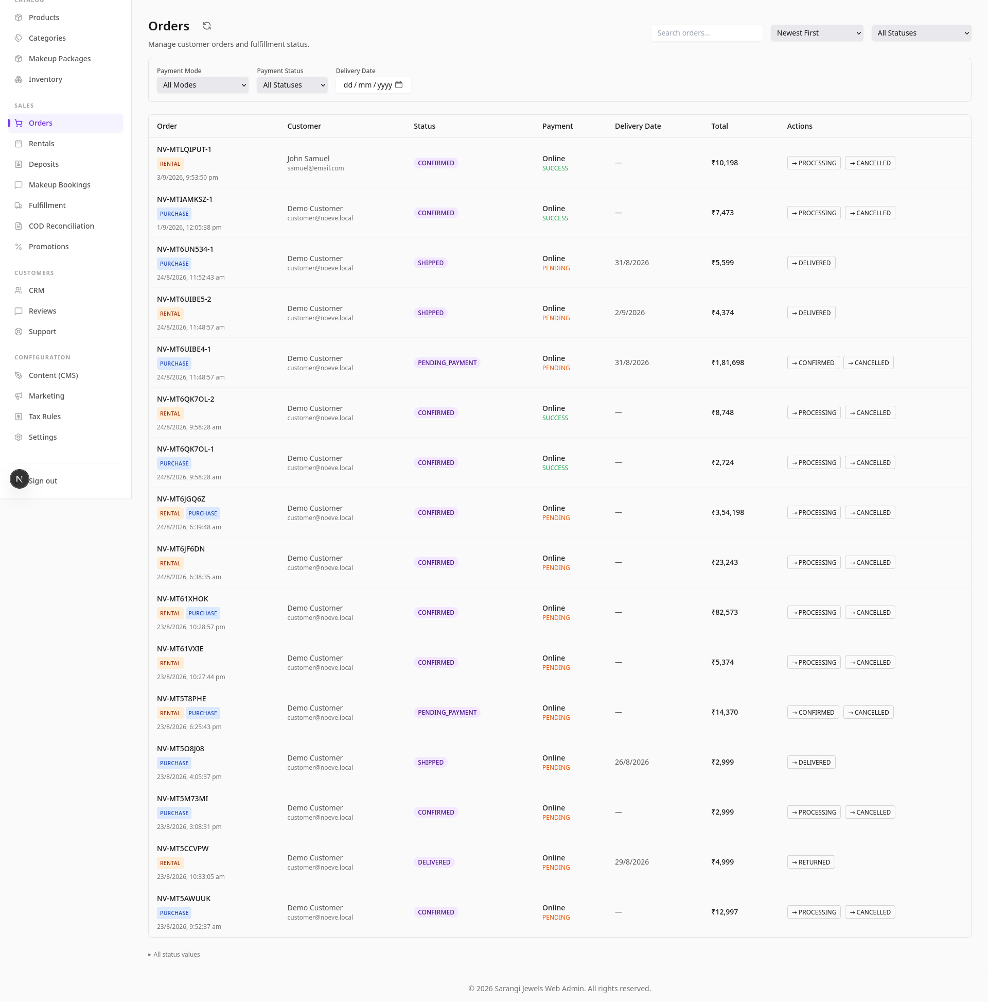
Store Administration
Screens for Admin Portal
Orders View in Admin Portal
Manage the purchase and rental orders from one screen.
- View all the orders from the customers and the order details
- Process the orders through a streamlined workflow
- The customer gets notified when the order processing is done.
08

Slide 22
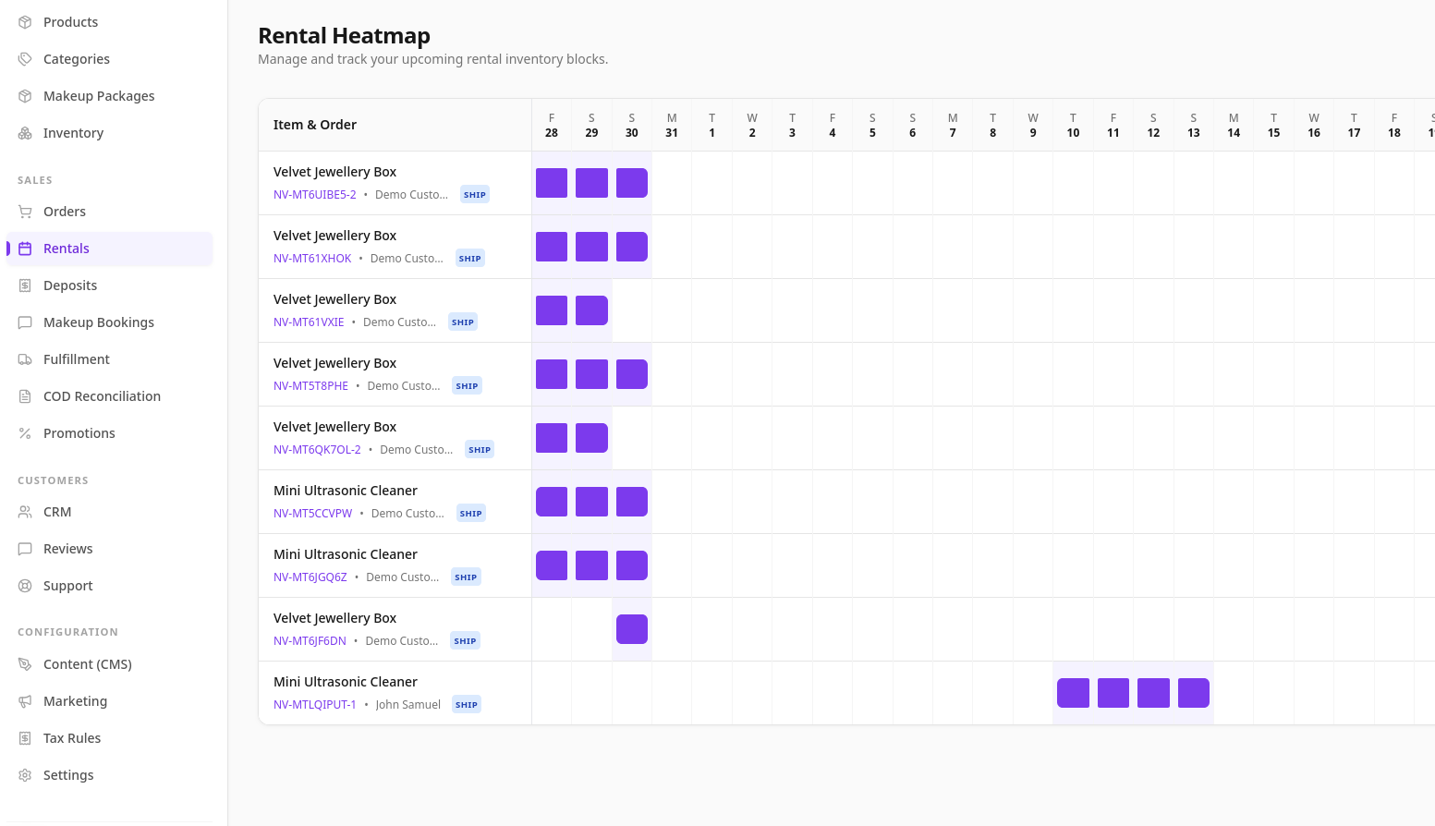
Store Administration
Screens for Admin Portal
Rental Heatmap View in Admin Portal
Plan and manage the rental orders using the rental heatmap
- Display when the rentals bookings and date of bookings
- Manage the rental bookings
08

Slide 23
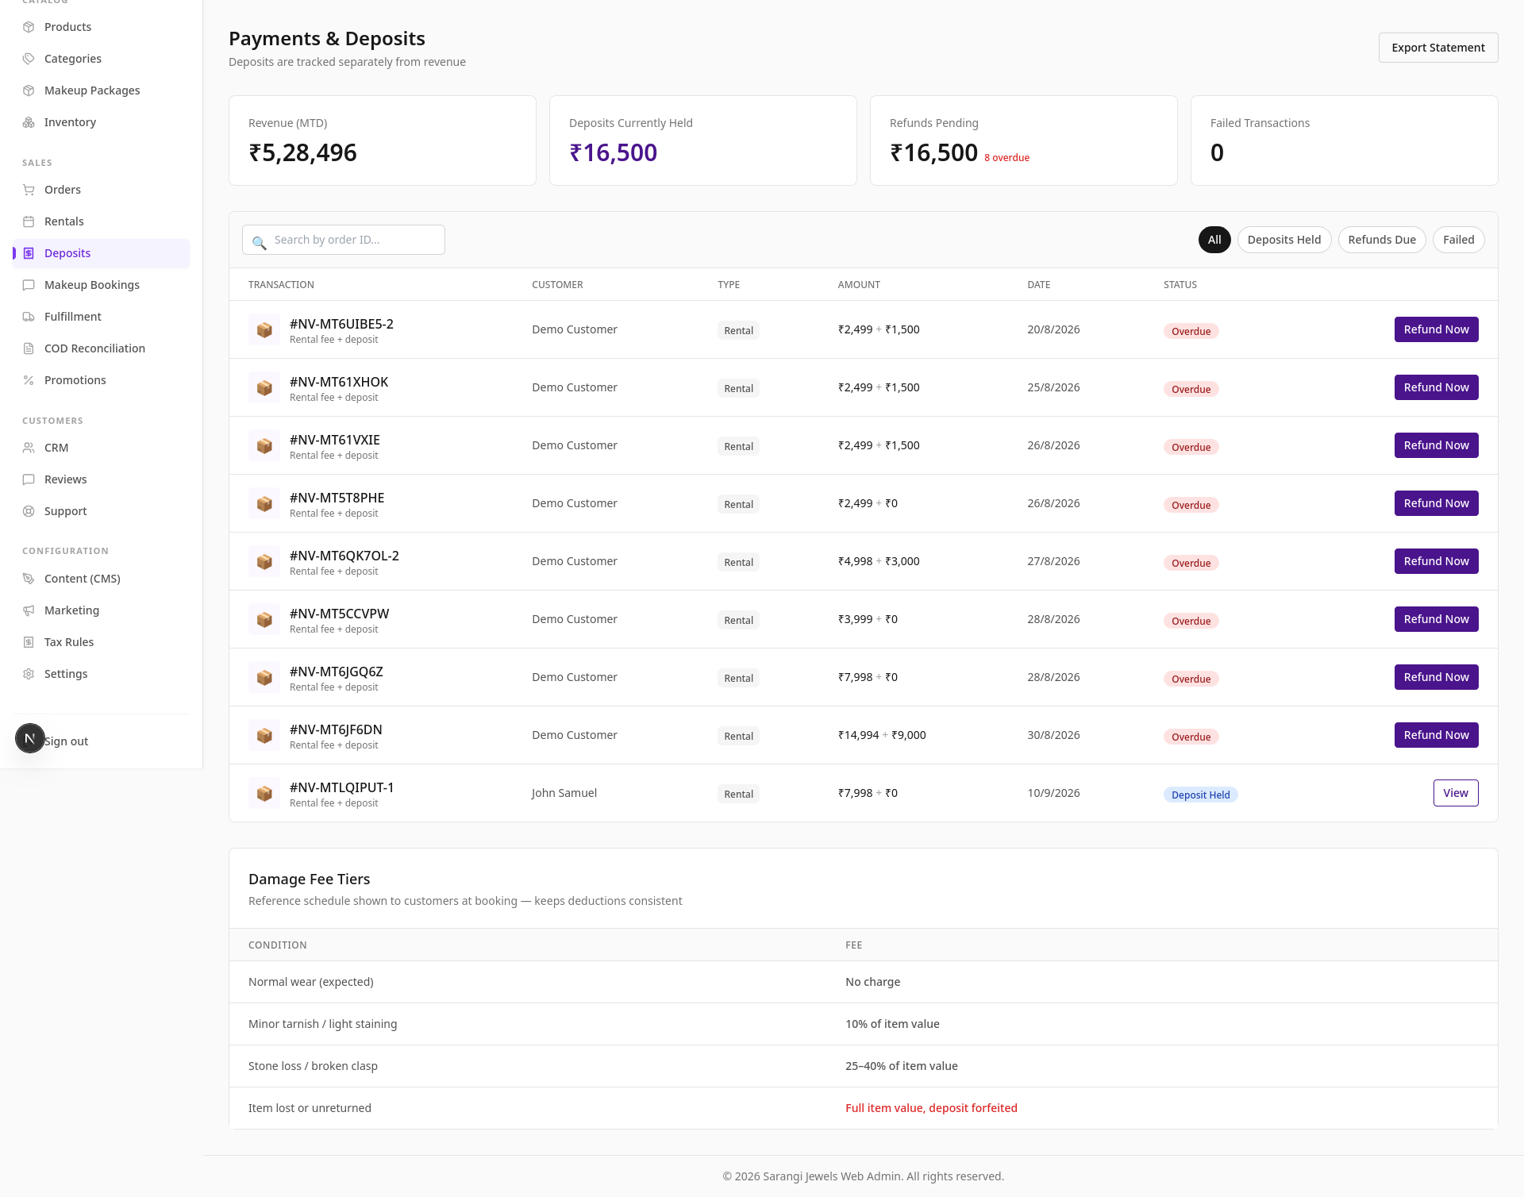
Store Administration
Screens for Admin Portal
Deposits View in Admin Portal
Manage the rental deposits
- When rental bookings are made, the deposits for the rentals are managed here.
- Refund the rental deposit when the rentals are returned.
08

Slide 24
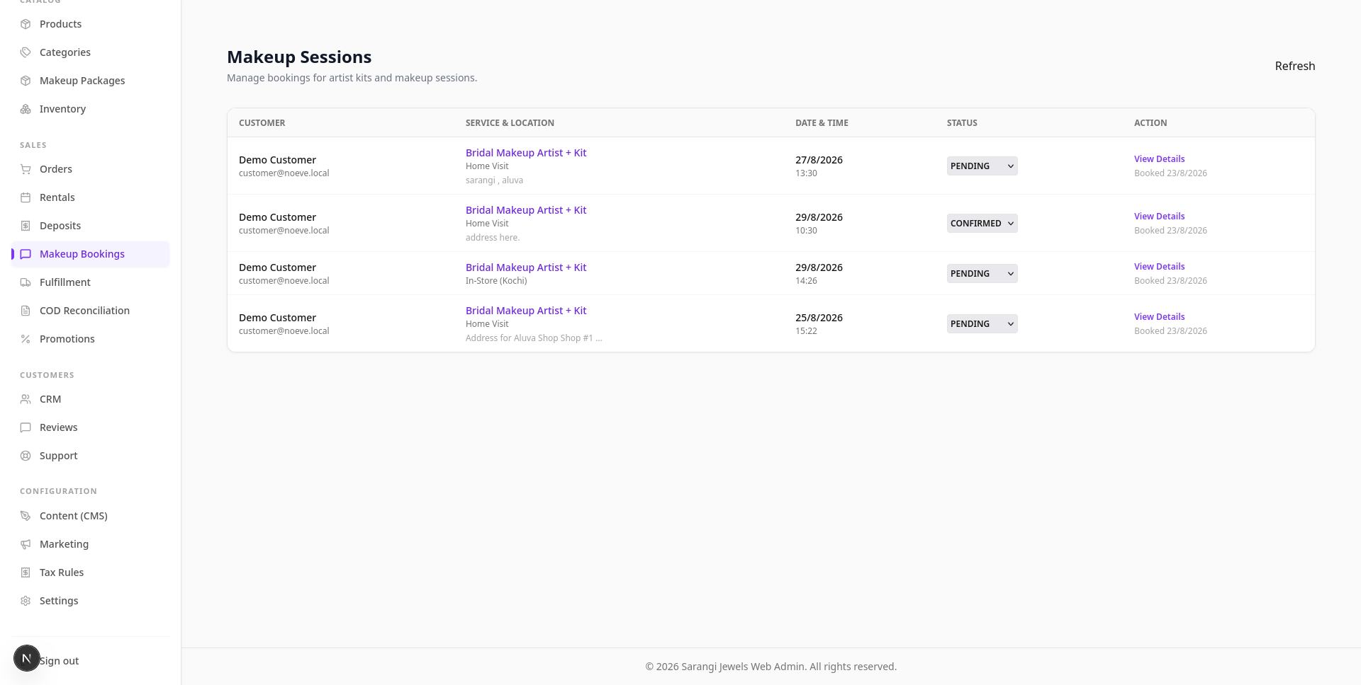
Store Administration
Screens for Admin Portal
Makeup Sessions View in Admin Portal
Manage the sessions for makeup bookings
- The bookings for makeup sessions can be managed from here.
08

Slide 25
THE INVESTMENT
A complete platform, priced simply
SOFTWARE PACKAGE
FLEXIBLE TERMS
₹2,00,000
Monthly instalment plans available — no need to pay the full amount upfront. See the attached quotation for 3 / 6 / 9 / 12-month options.
One-time licence — full platform, ready to launch
✓ Website + mobile app for customers
✓ Admin dashboard + staff mobile app
SOURCE CODE (OPTIONAL)
✓ Rental booking & inventory engine
Full ownership of the source code is priced separately, on top of the software package — for those who want complete, unrestricted control of the codebase. Details in the quotation.
✓ Payments (online + COD) configured
✓ Setup, onboarding & training included
✓ Support during initial launch period
09

Slide 26
LET'S TAKE SARANGI JEWELS ONLINE
A simple next step
1
Review the attached quotation and sale agreement
2
Choose full payment or a monthly instalment plan
3
We configure, load your catalog, and go live
4
Your team gets hands-on training before launch
Thank you for considering this partnership.
10

