Slide 1
Step 1: Preparation TODO https://github.com/Paralian/umr-data-integration-project-the-TODO-team.git

Slide 2
Integration of RPG Entities
Motivation: Every RPG-Game have different stats systems/distributions which presents a challenge to integrate and compare characters, enemies, NPCs, etc.
Mashups between different universes are a thing. From Superman vs. Batman, to Godzilla vs. King Kong, to Whiterun Guard vs an Ancient Golden Dragon
Idea: Integrate these stats systems by means of:
Normalization to compare metrics
Classification of repeatable values for grouping purposes
If possible, generalization of common types of groups
Meta-integration!

Slide 3
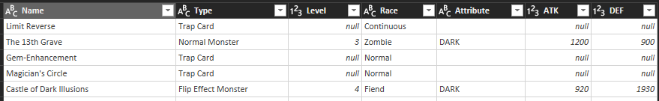
Dataset 1: Yu-Gi-Oh! Trading Cards Dataset
6449 unique entries
7 Attributes
Sparse Data for some attributes
Entries are almost completely clean (no mixed data types)
Source: Kaggle
Credit: T.A. THOR
Link: https://www.kaggle.com/datasets/tathor/yugioh-trading-cards-dataset?resource=download

Slide 4
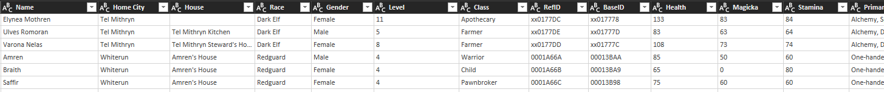
Dataset 2: Skyrim Named Characters
1009 entries
40 different attributes describing named NPCs
Source: Kaggle
Credit: M. AJI PRASETYO
link: https://www.kaggle.com/datasets/muhajipra/people-of-skyrim
Filename: Skyrim_Named_Characters.csv

Slide 5
Dataset 3: Dungeons and Dragons 5th Edt. monsters
324 entries
7 Attributes
Mixed data types inside single entries: JSON values mixed into strings in a .CSV is a common thing
Source: Kaggle
Credit: PATRICK GOMES
Link: https://www.kaggle.com/datasets/patrickgomes/dungeons-and-dragons-5e-monsters

Slide 6
Dataset 4: Dungeons and Dragons diverse data
5 files with 898 entries total
Mixed data types inside single entries: JSON values mixed into strings inside a .CSV greets again
Source: Kaggle
Credit: SHADOWTIME2000
Link: https://www.kaggle.com/datasets/shadowtime2000/dungeons-dragons
Filenames: DnD_classes.csv, DnD_equipment.csv, DnD_monsters.csv, DnD_races.csv, DnD_spells.csv

Slide 7
Showcase
What if…
If you were a Dragonborn from Skyrim, would you be able to fight actual dragons in Dungeons&Dragons?
How about fighting dragons with Yu-Gi-Oh cards instead of rolling a d20?
Sociology in the metaverse: which RPG universe is the most diverse?
How much exactly is 3000 ATK?
We need a baseline for answering that

Slide 8
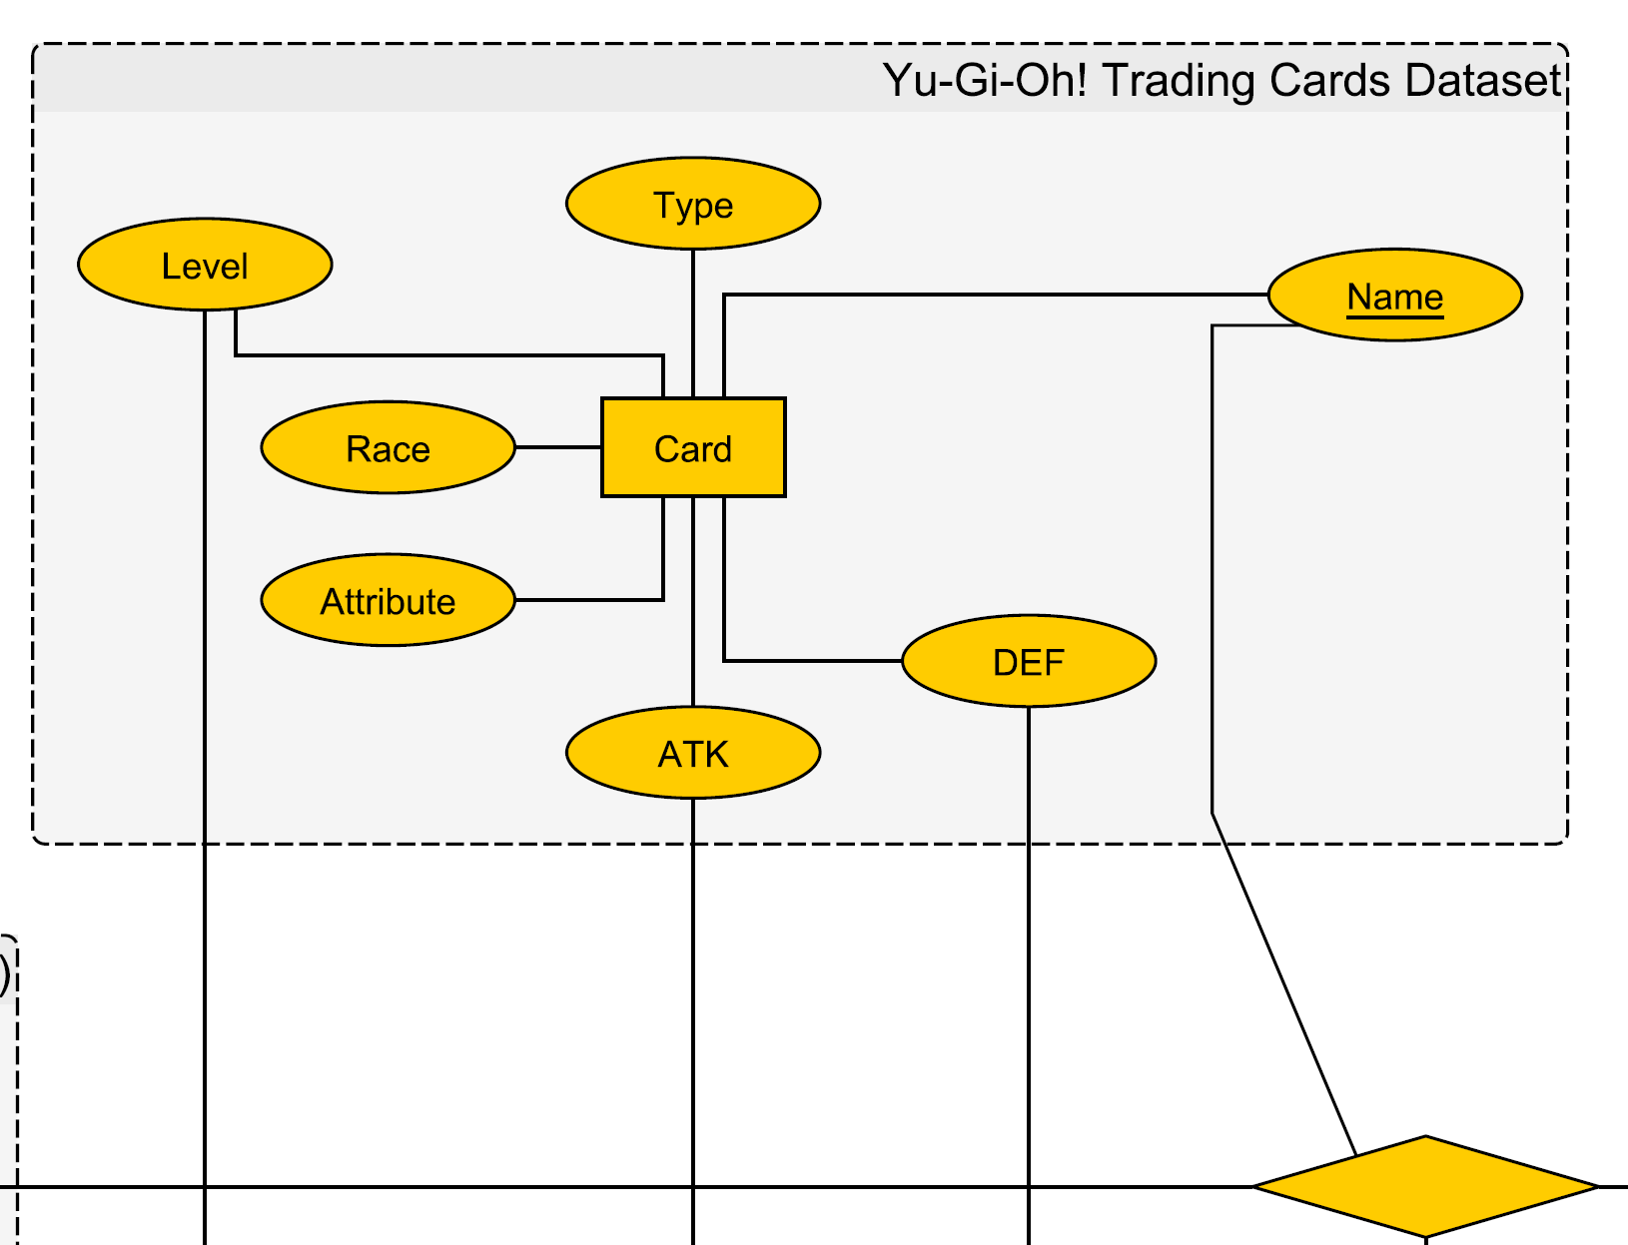
Draft of an Entity-Relation model (part)

Slide 9
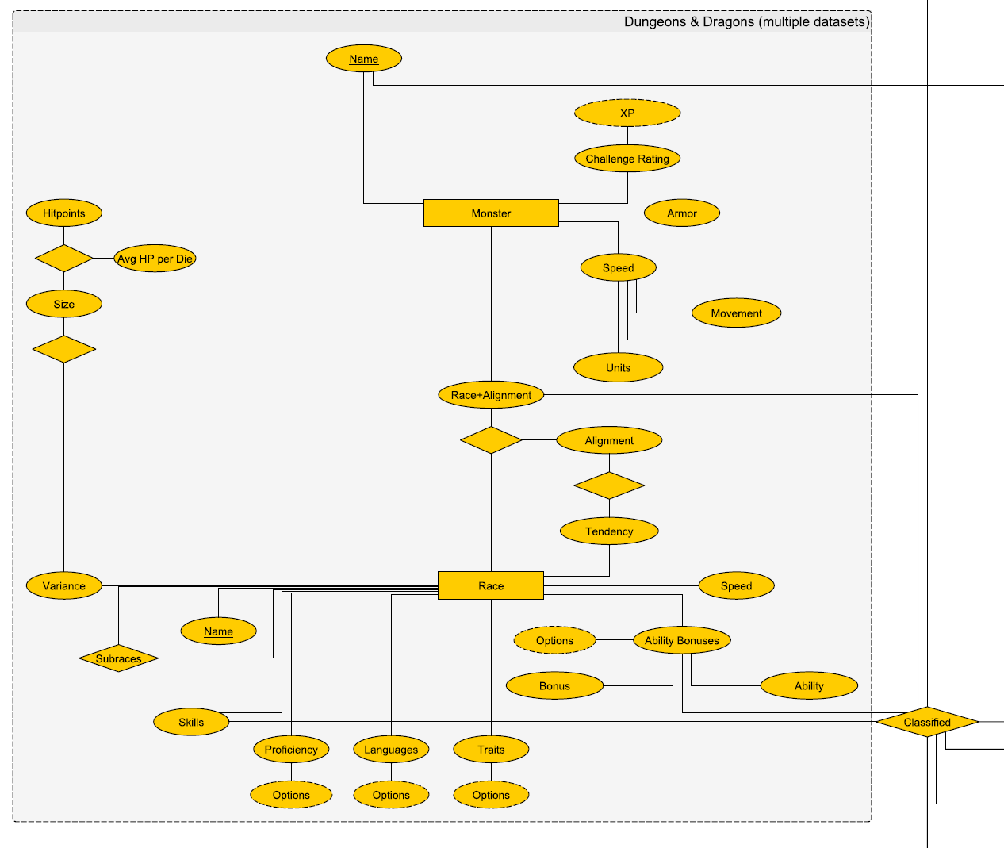
Draft of an Entity-Relation model (part)

Slide 10
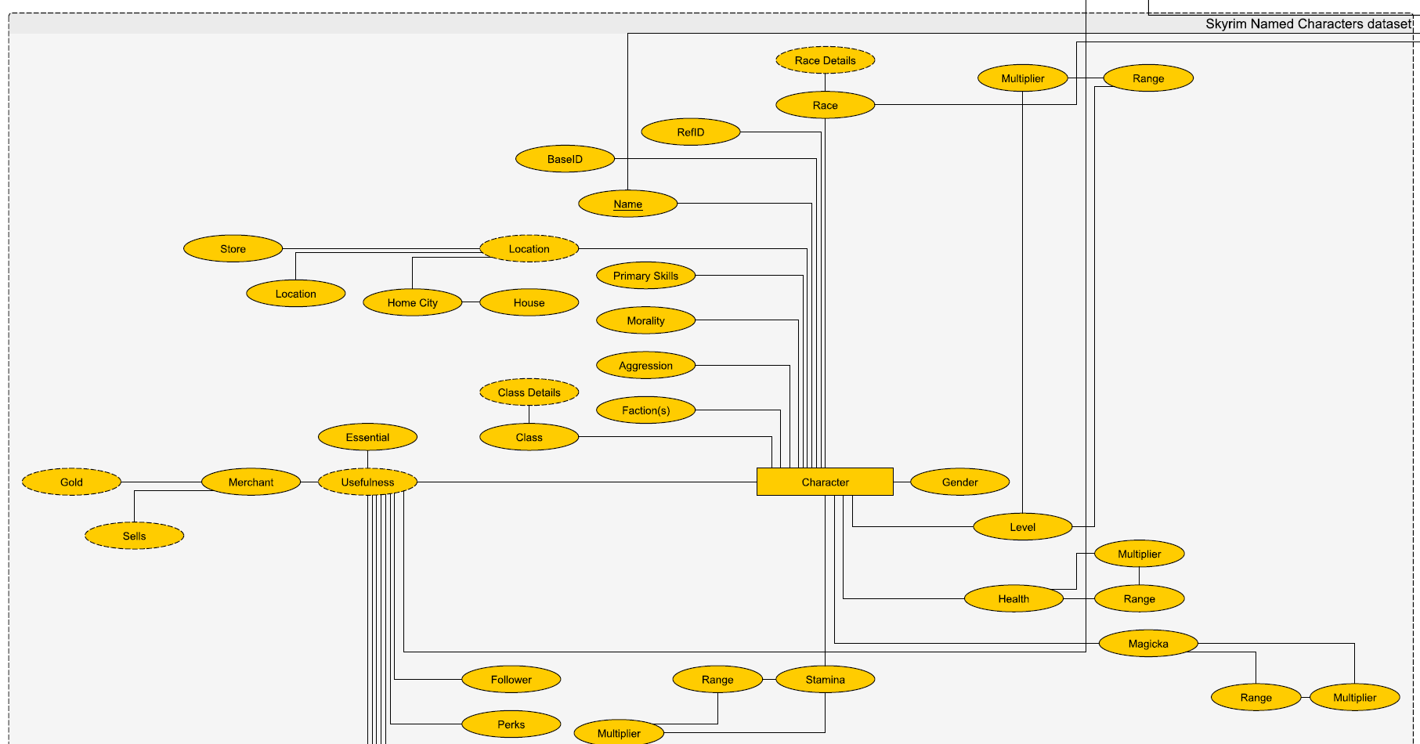
Draft of an Entity-Relation model (part)

Slide 11
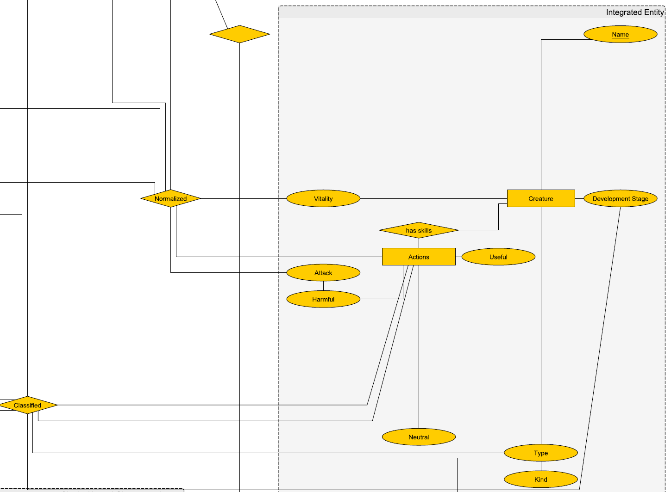
Draft of an Entity-Relation model (part)

Slide 12
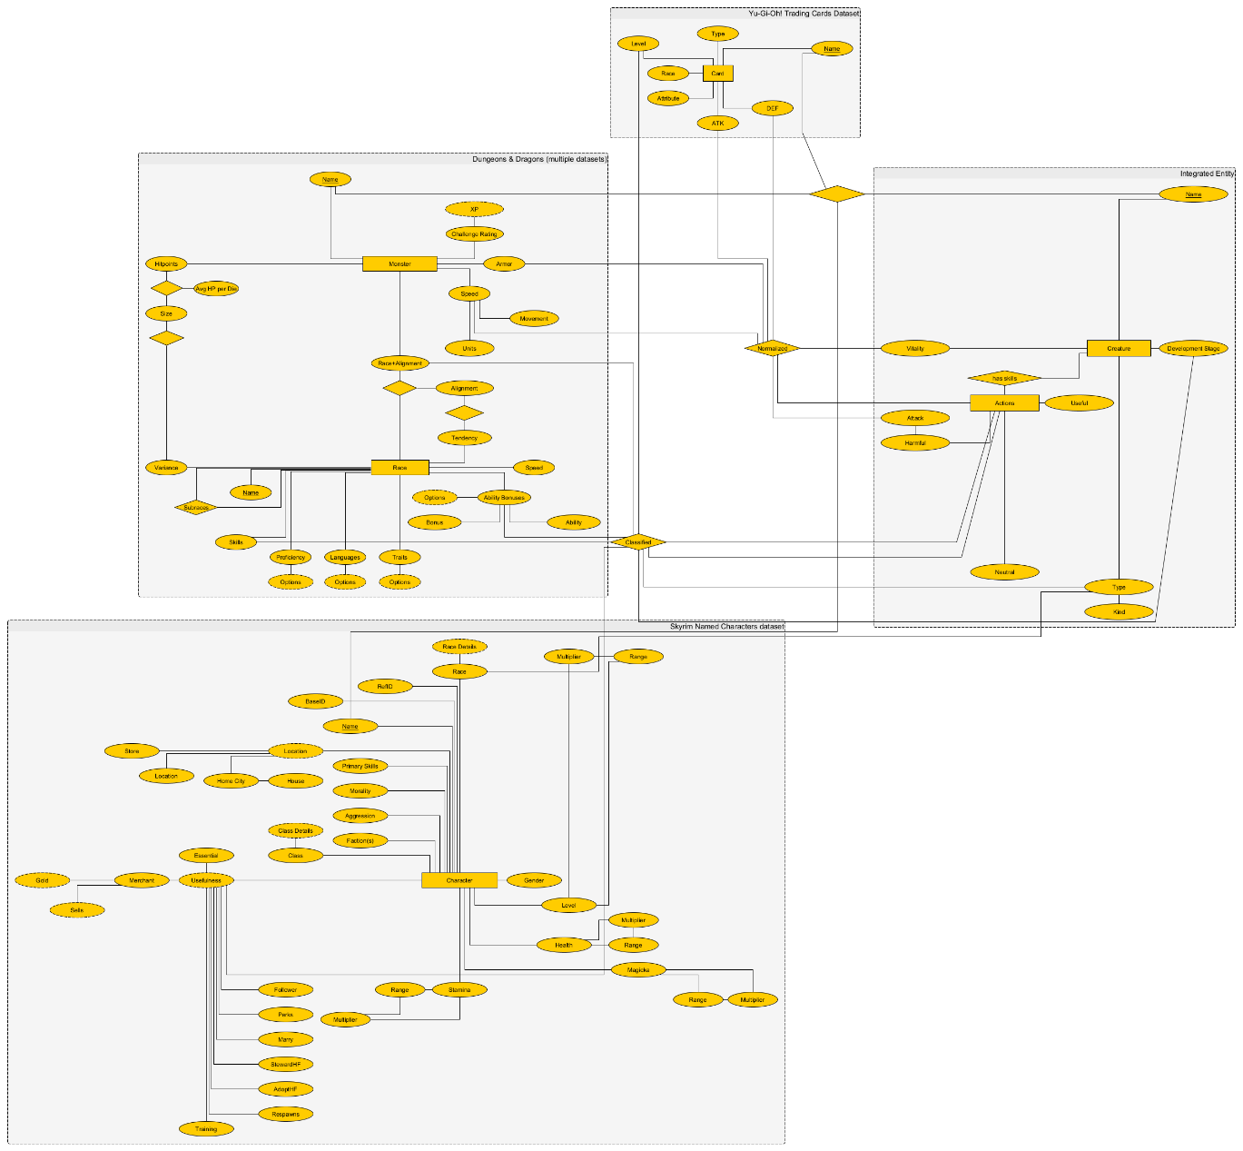
Draft of an ER-Model (actual size)
Yu-Gi-Oh ->
Integrated Entity
D&D ->
People of Skyrim ->

