Slide 1
Step 2: Integration TODO https://github.com/Paralian/umr-data-integration-project-the-TODO-team.git

Slide 2
Integration of RPG Entities Scope
Attributes in the integrated entity are supposed to be:
Essential:
ID: name, type, kind
Metrics: development, vitality,
Comparable/Classifiable
Aligned with the general idea of an entity in an RPG
They all have common way of functioning
Features are mostly similar, their functionality is very different
Dice from D&D, Card rules from YuGiOh, HP from Skyrim need conversion into universal system

Slide 3
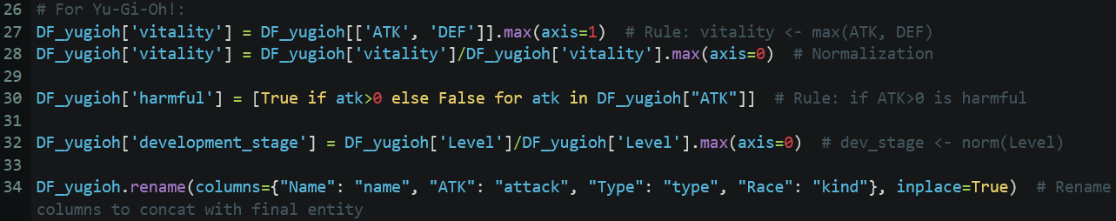
Pipeline
Source (YuGiOh) → target:
Name → name
Type → type
Race → kind
Level → development stage
max(ATK, DEF) → vitality
ATK → attack
Monster → harmful
(boolean to boolean transfer, treat null as false)

Slide 4
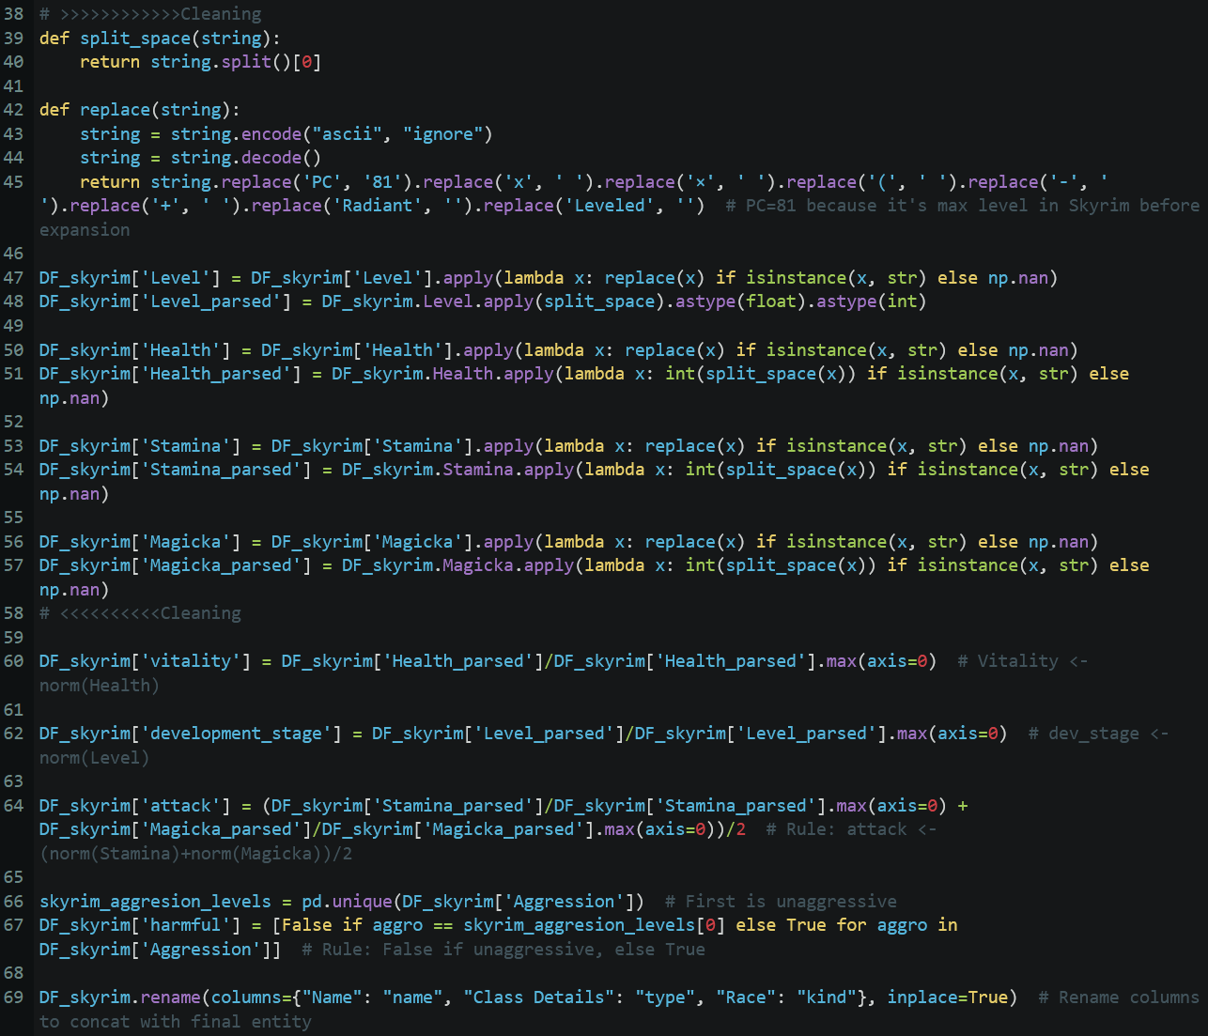
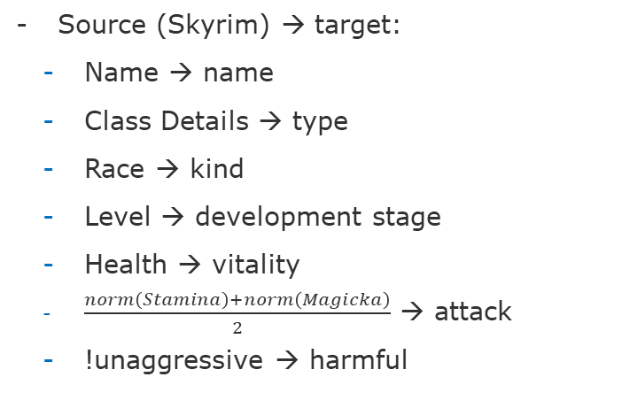
Pipeline
Source (Skyrim) → target:
Name → name
Class Details → type
Race → kind
Level → development stage
Health → vitality
$\frac{norm\left(Stamina\right)+norm\left(Magicka\right)}{2}$ → attack
!unaggressive → harmful

Slide 5
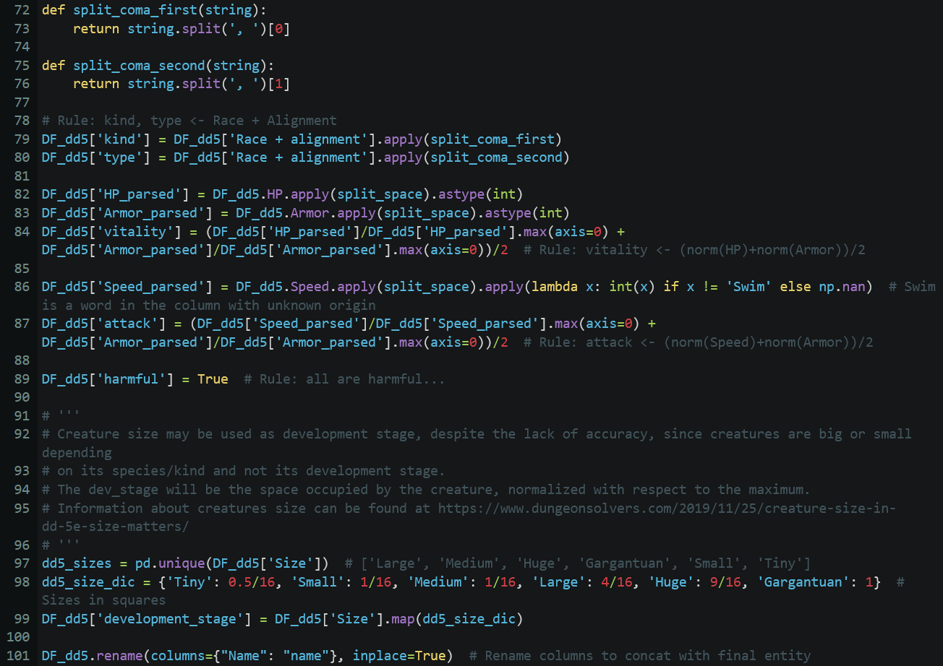
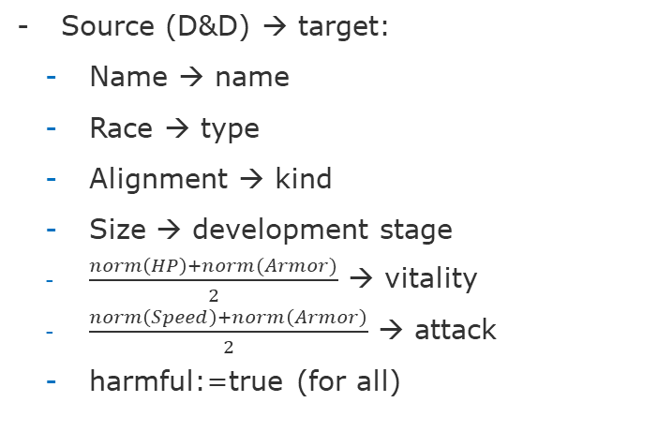
Pipeline
Source (D&D) → target:
Name → name
Race → type
Alignment → kind
Size → development stage
$\frac{norm\left(HP\right)+norm(Armor)}{2}$ → vitality
$\frac{norm\left(Speed\right)+norm\left(Armor\right)}{2}$ → attack
harmful:=true (for all)

Slide 6
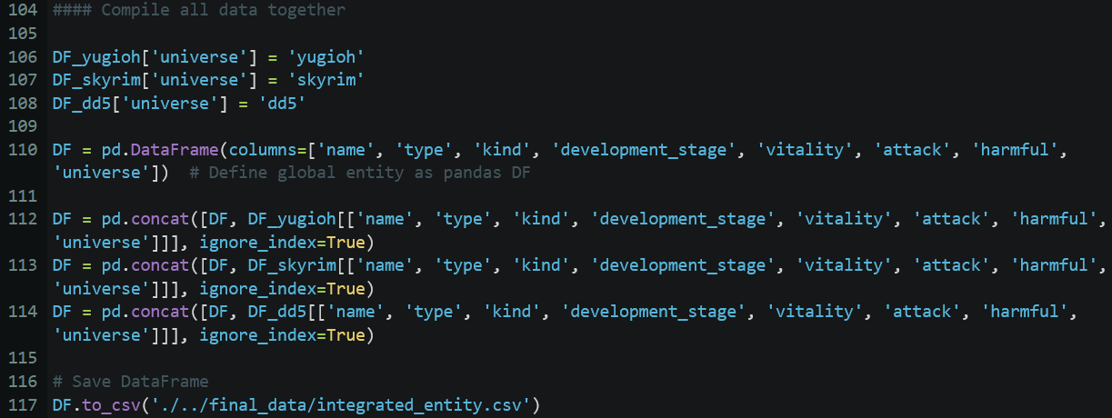
Pipeline
- Putting all dataframes together
- Saving the results

Slide 7
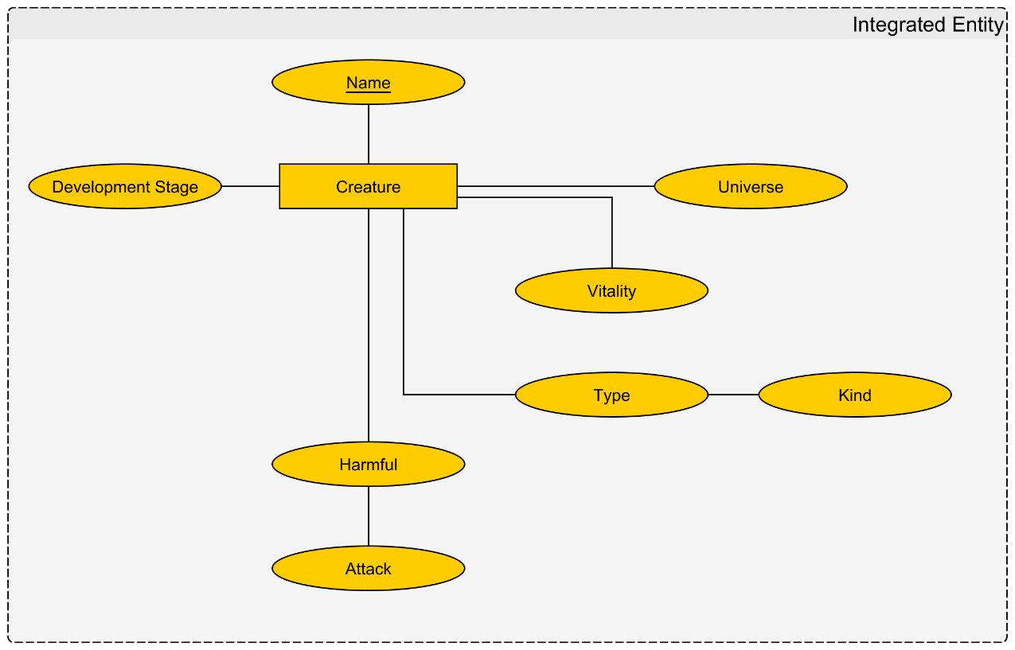
Resulting Entity-Relation model

Slide 8

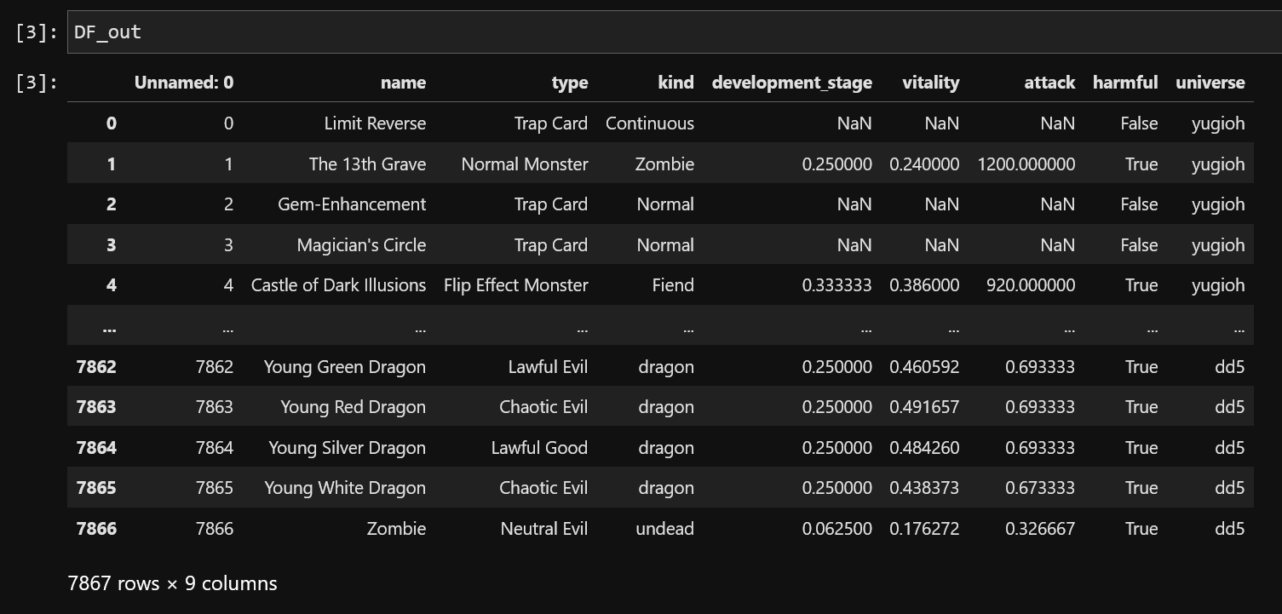
Resulting dataframe
Resulting integrated Entity + metadata

