Slide 1
Step 3: Cleaning TODO https://github.com/Paralian/umr-data-integration-project-the-TODO-team.git

Slide 2
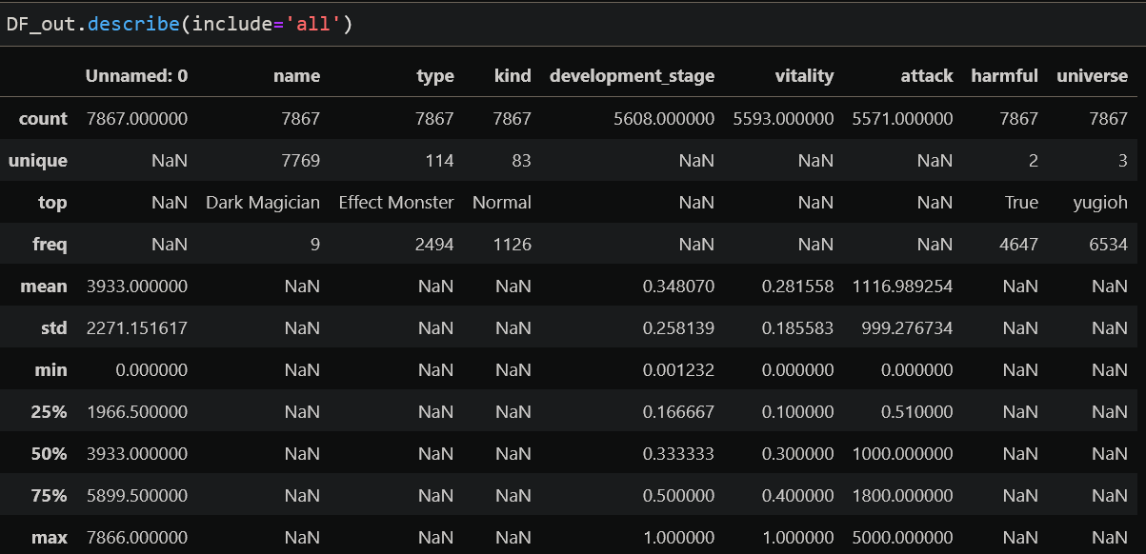
Integration of RPG Entities Before cleaning
3 universes
7867 Total entities
7769 Unique names
→ 98 duplicate entities possible
→ Top duplicated entity: “Dark Magician”, 9 times!
Name, Type and Kind are strings: cleaning is only relevant for elimination of duplicates
development_stage, vitality and attack are decimal values
→ first two already normalized
→ attack goes up to 5000
Harmful and universe are metadata, need to preserve as-is

Slide 3
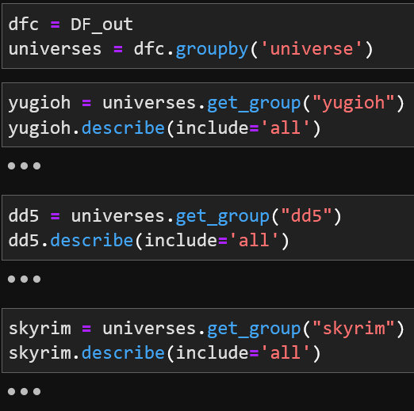
Pipeline
Finding inconsistencies in groups: each universe has its own system of values

Slide 4
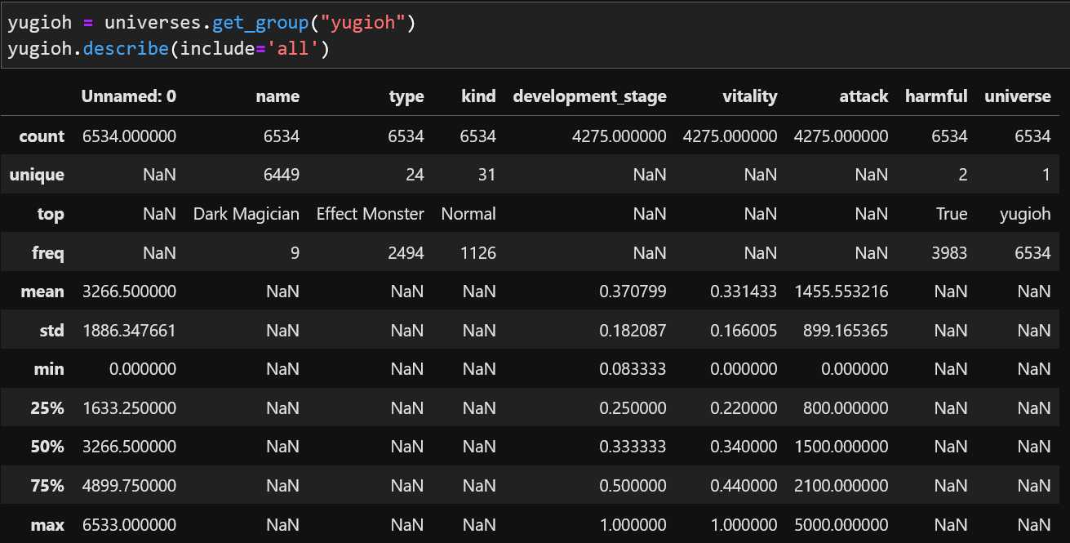
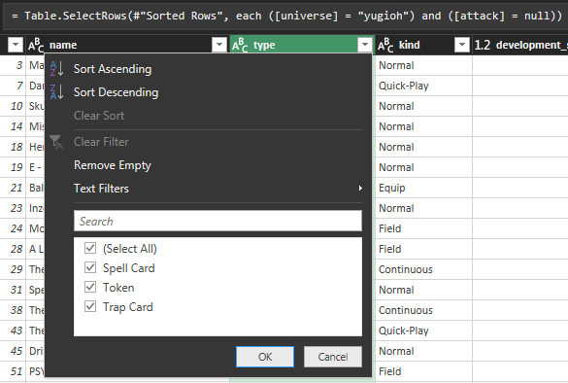

Pipeline
Most duplicates are in the yugioh universe:
6449 unique names out of 6534 entries → 85 duplicates (from total 98 duplicates)
Attack values are missing for 2259 entities (~35% of data) → replace null with 0 as possible remediation
All such entries are spell cards, trap cards and tokens → essential for the universe and non-deletable

Slide 5
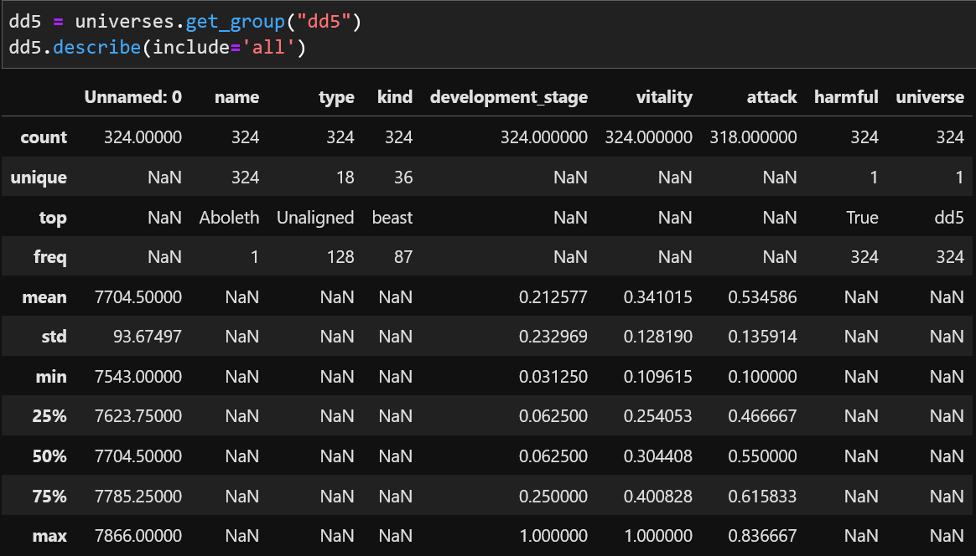
Pipeline
D&D has all unique names
→ no duplicates already
Attack values missing for 6 out of 324 entities, need further investigation
Attack values range from 0 to 0.836, need normalization

Slide 6
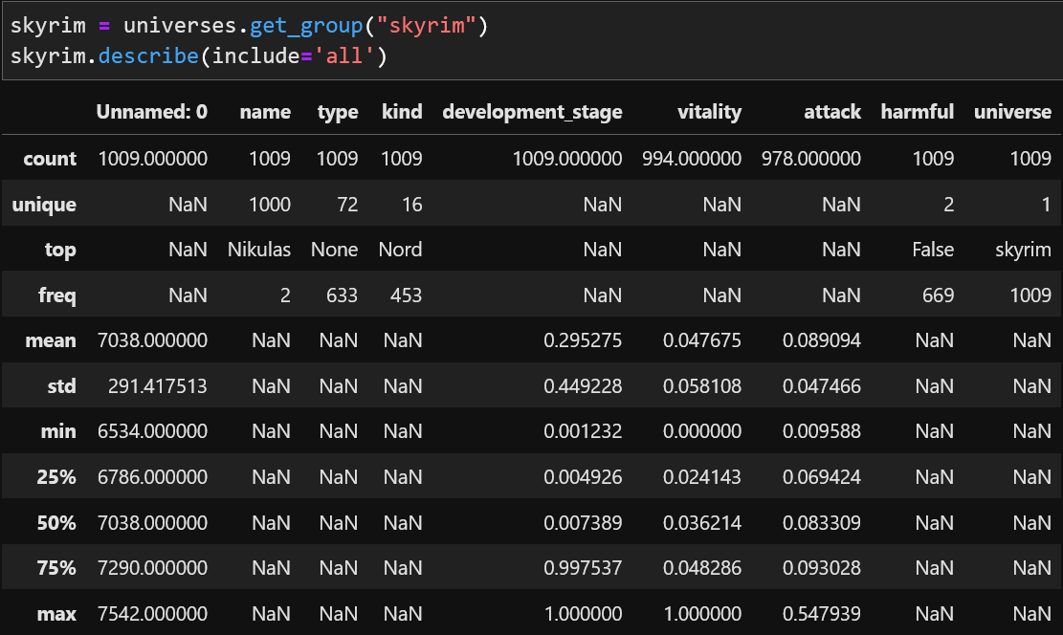
Pipeline
Skyrim dataset has 1009 entries, 1000 are unique
Top duplicate count per name is 2, need to investigate
Attack values need normalization

Slide 7

Pipeline
Let’s set all entries in “kind” column to lowercase
Then reduce the duplicates
How many are truly identical entities?
Which are those?

Slide 8
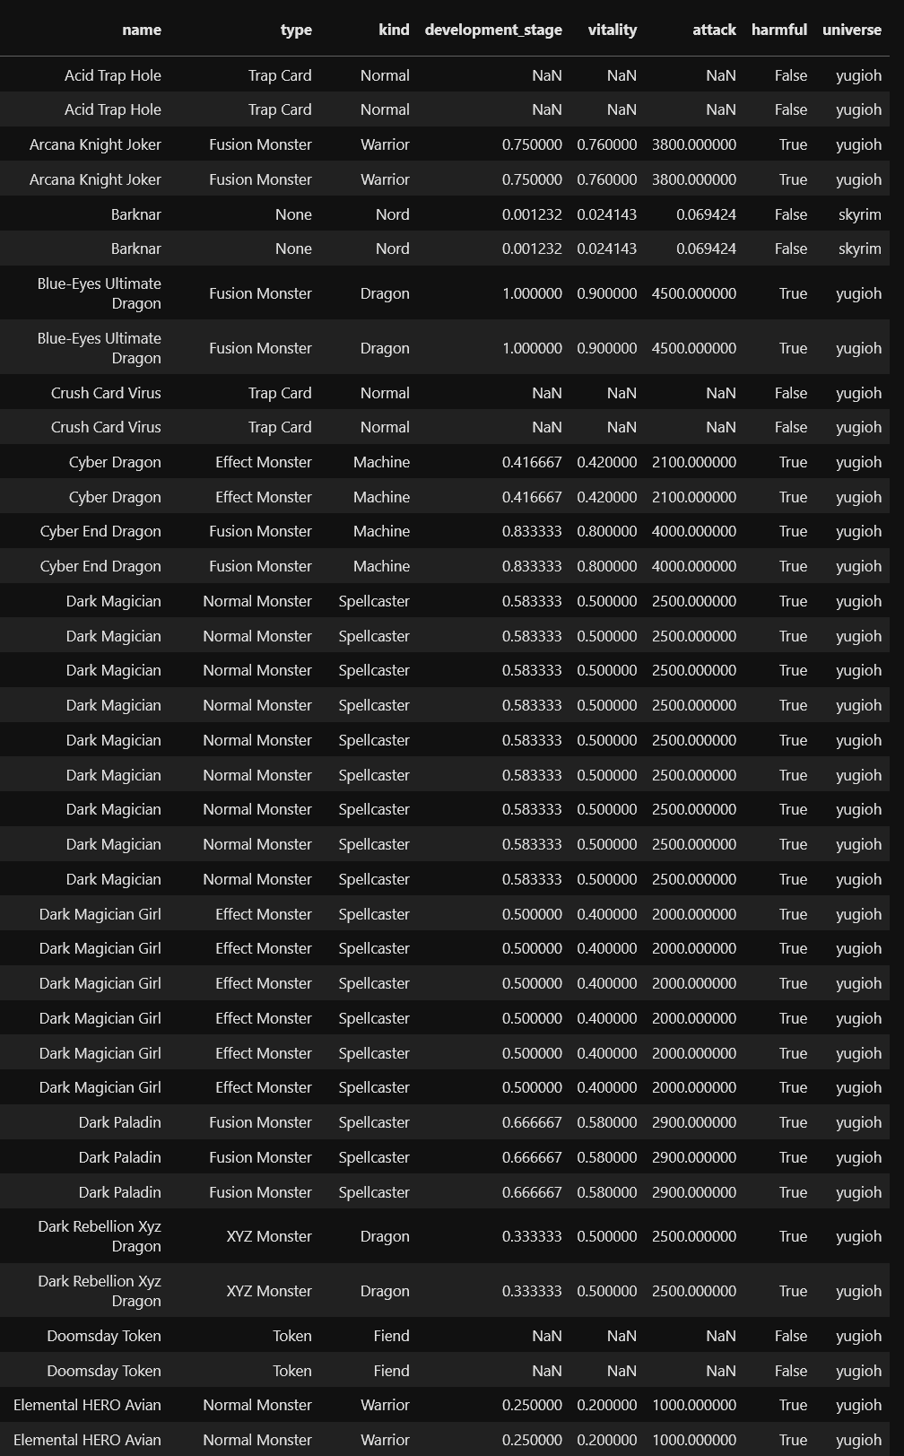
Pipeline
…Which are those?
…and many more

Slide 9
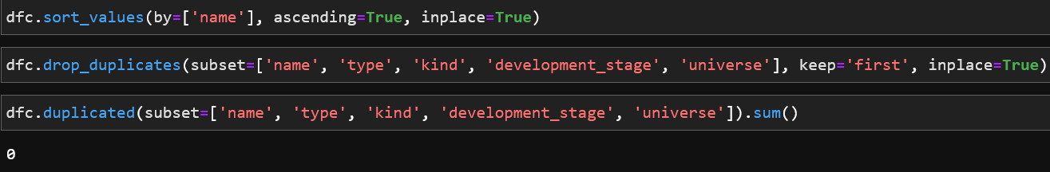
Pipeline
Dealing with duplicates

Slide 10
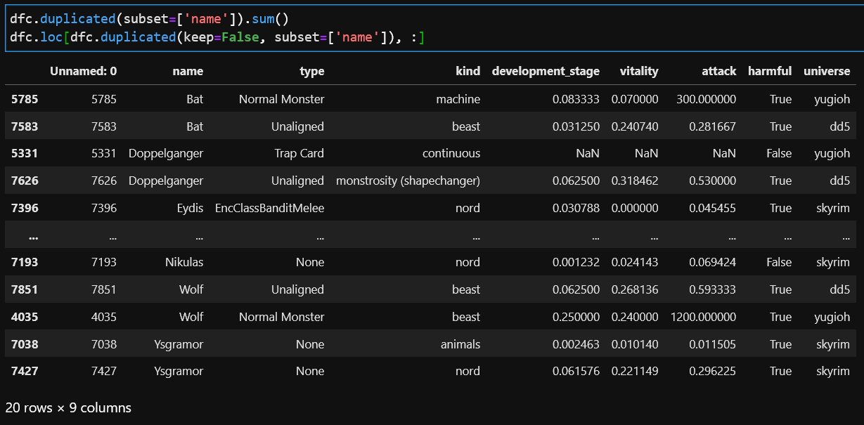
Duplicate Removal results
Check for remaining similar entities
Result: entities with similar names but from different universes
Only 20 entities!

Slide 11
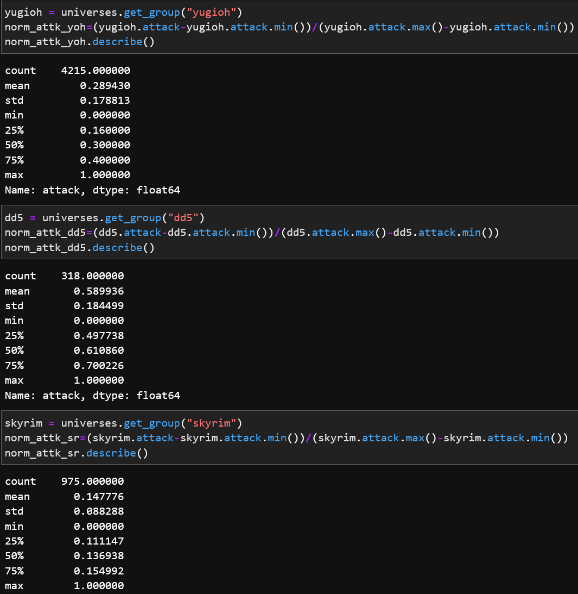

Normalization Results
Result: entities from different universes have now attack values ranging from 0 to 100%
Easily comparable with each other
NaN values replaced with 0

