Slide 1

Greedy: activity selection
Step 1: sort by finish time
Pick me

Slide 2

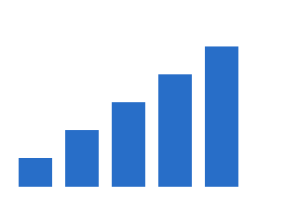
Bars build up

