Slide 1
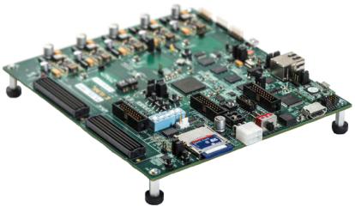

Final Presentation
Hardware DLL
Real Time Partial Reconfiguration Management of FPGA by OS
Submitters: Alon Reznik Anton Vainer
Supervisors: Ina Rivkin Oz Shmueli
Bi-Semestrial Student Project
Winter 2014/2015

Slide 2
Motivation
SW execution can be slow. Most parallel algorithms can be executed faster by dedicated HW accelerators on an FPGA.
Executing suitable algorithms by HW accelerators will free the CPU for other tasks.
An OS may contain many SW processes, but An FPGA cannot contain as many HW accelerators.

Slide 3
Objective
Design and implement an innovative embedded system architecture to manage hardware accelerators in real time.
Application Developers:
HLS compatible framework for synthesizing HW accelerators.
Extended flexibility for interfacing with the HW accelerators.
System Users:
The architectural modification is transparent.
Only the improved performance is noticeable.
3

Slide 4
Partial Reconfiguration
Available functions
Programmable logic
Func A
LM A[9:15]
Func E in RP 0
Func C in RP 1
RP 2
RP 3
Func B
LM B[0:2,8:15]
Func C
LM C[0:15]
RP 4
RP 5
RP 6
Func D in RP 7
Func D
LM D[0:2,7:15]
Func E
LM E[0:1]
Func B in RP 8
RP 9
RP 10
RP 11
Func F
LM F[0:15]
RP 12
RP 13
RP 14
RP 15
LM = Loadable Module
RP = Reconfigurable Partition
4

Slide 5
Basic Flowchart
Empty partitions available?
Application requests an acceleratable function to process input data
No
Call the software function
Yes
Compatible module available?
No
Best Case Scenario:
Yes
Software function returns output data to the application
Load the module into its compatible partition
Do other tasks
No
Worst Case Scenario:
Input data is processed by the original (unaccelerated) function.
Send input data to the loaded module
Output data ready?
Yes
Application reads output data from the loaded module
5

Slide 6

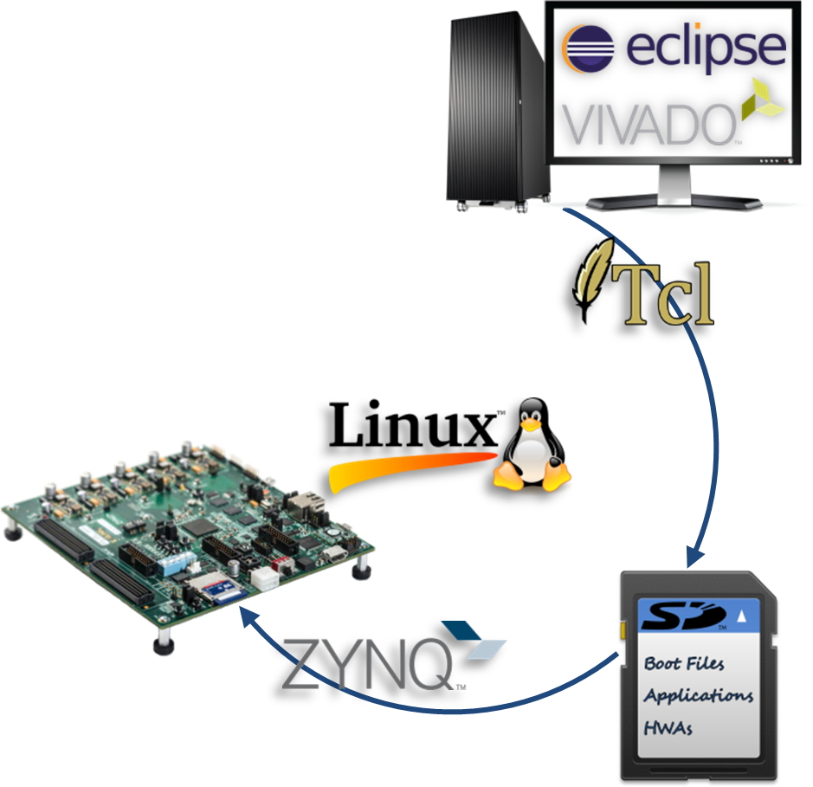

Overview
Hardware
Design for a partially reconfigurable FPGA embedded on a Xilinx Zynq-7000 board.
Software
Implementation of the management application for Linux OS.
Interface
Linux OS (on the PS) connects to the HW accelerators (on the PL) via an AXI interconnect.

Slide 7
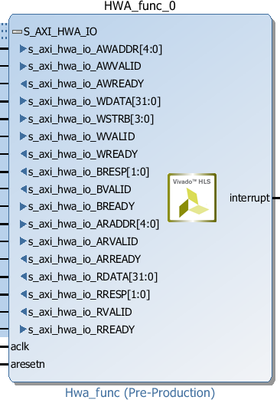
Reconfigurable Partition
Slave AXI Bus
Handshaking Signals:
start
valid
done
idle
Input Data
Output Data
Unused/Optional Interrupt Signal
Clock Signal
Reset Signal

Slide 8
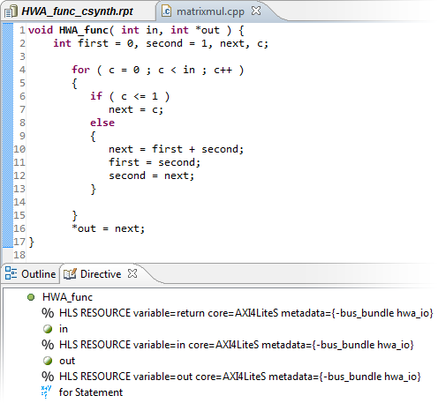

Loadable Module
C Synthesis
Utilization Estimates/Constraints Verification
RTL Exportation
The top-level function is included in the bus bundle to generate the following handshaking signals:
start
valid
done
idle
The handshaking signals and I/O are bundled into a bus.
An IP-XACT adapter is generated for the AXI4-LiteS bus bundle.
Address maps are created for the IP-XACT adapter components.
These addresses will be used by the PR management application.
HDL File
in
control
out
control = handshaking signals
in = input data
out = output data

Slide 9
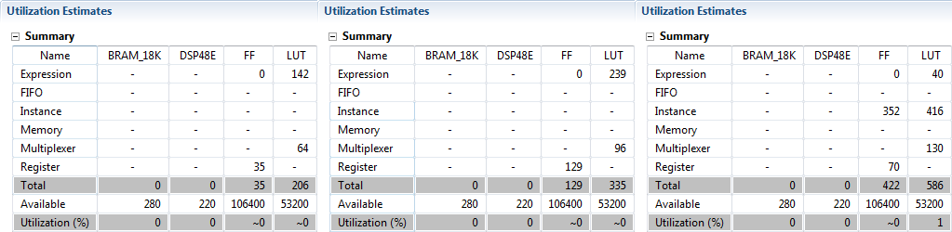
Module Resources Estimates
Prime Number | Fibonacci Number | Greatest Common Divisor
These estimates do not include routing.

Slide 10
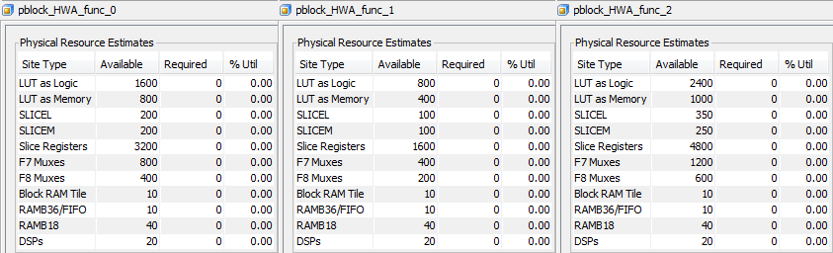
Partition Resources Constraints
Reconfigurable Partition 0 | Reconfigurable Partition 1 | Reconfigurable Partition 2
Due to the FPGA fabric and Pblock geometric constraints, different resources are available to different RPs.
Some IP core utilization estimates might meet the utilization constraints of an RP subset. As a result, the synthesized RMs will be compatible to this RP subset only.
It is up to the user to verify RM/RP utilization compatibility, and choose only the compatible RMs.
It is up to the PR management application to optimize resource utilization, and choose the best possible RP for a given RM set

Slide 11




Loading Module into Partition
Slave AXI Bus
Handshaking Signals:
start
valid
done
idle
Input Data
Output Data
Reconfigurable Module
Unused/Optional Interrupt Signal
Can be easily implemented in Vivado HLS
Clock Signal
Reset Signal
Internal Fragmentation

Slide 12
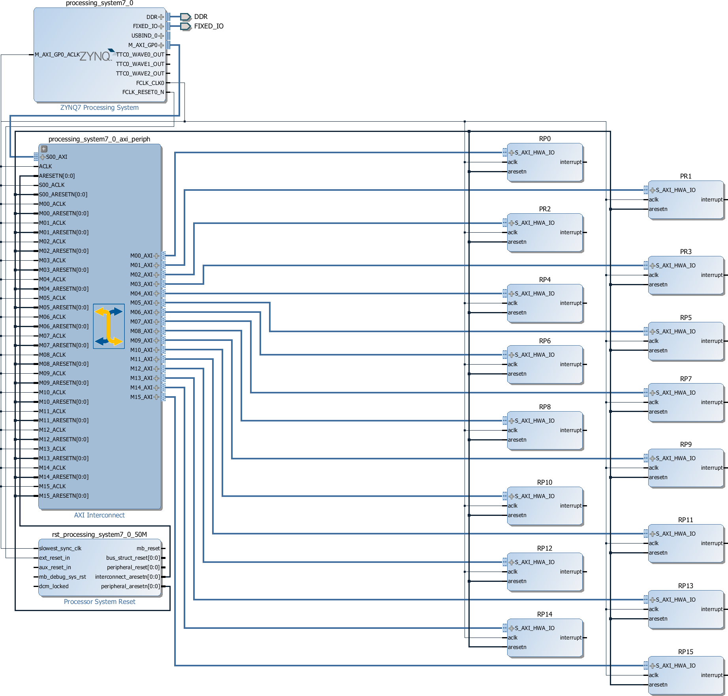


FPGA Configuration
Static Logic
Reconfigurable Logic
RP 0
RP 1
RP 2
RP 3
RP 15

Slide 13
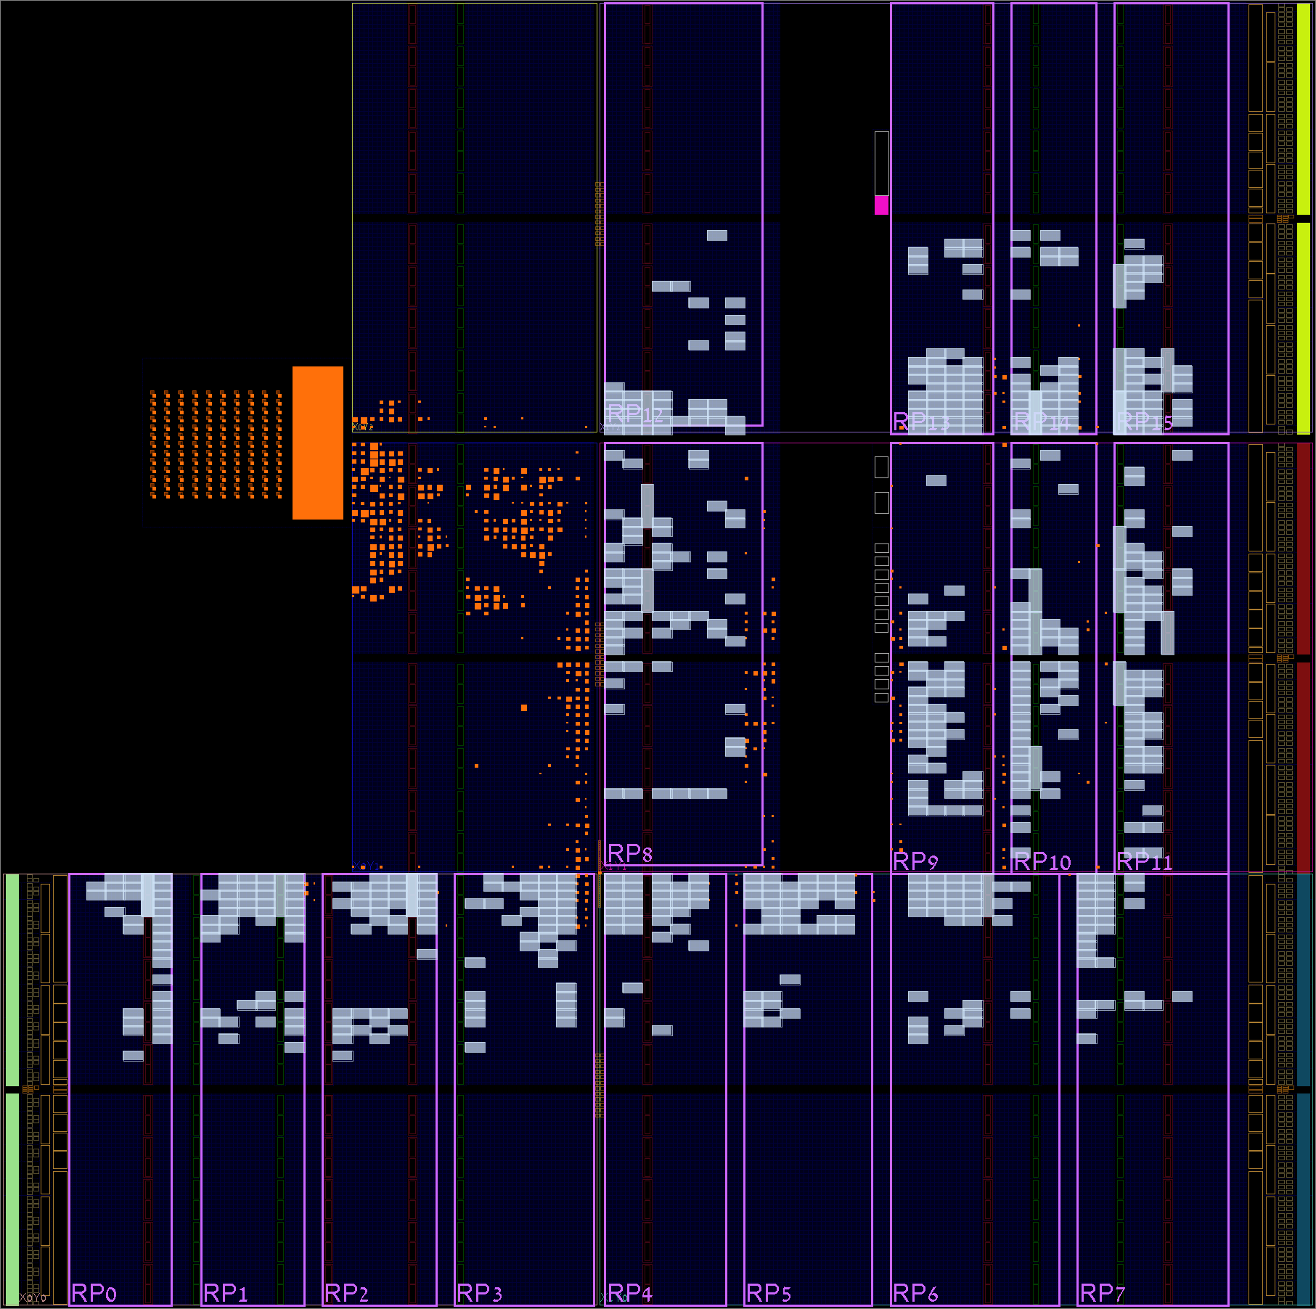
Partitioned Floorplan
Static Logic
Considerations for determining the number of RPs:
As shown in the latest Xilinx workshop, an RP's physical location on the FPGA fabric is an integral part of an RM design. Thus, a unique partial bitstream has to be created for every RP on the FPGA fabric. The size of a typical partial bin file (binary bitstream) is about 100KB. For example, a system with 10 different HW accelerators would mean that 10X16X100=16MB of Memory is used.
Considerations for determining the sizes of the RPs:
Unfortunately, we have a very limited FPGA design experience. Our custom IP cores are quite small in size. Therefore, the synthesized RMs fit easily in the large RPs on the FPGA fabric. These sizes were chosen empirically for testing purposes, and they will be later adapted for larger and more complex IP cores (floating point matrix multiplication, FIR filter, Sobel/Sepia filter, etc.).
There is an obvious tradeoff between the number and the sizes of the RPs:
Increasing the number of the RPs will increase the number of HW accelerators that can operate simultaneously, but it will also create more routing and thus reduce the available FPGA resources, in addition to the increase in memory usage.
Increasing the sizes of the RPs will allow for larger and more complex HW accelerators to be utilized, but it will also increase the internal fragmentation for smaller HW accelerators and reduce the overall performance.
RP 0
RP 1
RP 2
RP 3
RP 15

Slide 14
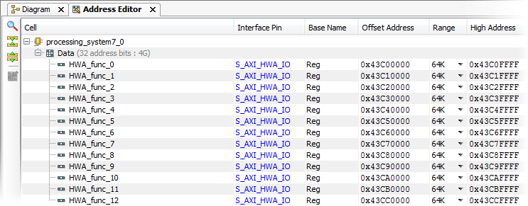
Hardware Data Structures
Since we restrict the C/C++ function interface, only the following data is used in the data structure:
* (int) HW index (is linearly translated to HW address)
* (int) Accelerator index (what is the index of the loaded data, -1 for empty)
* (int) Number of inputs
* (int) Number of outputs

Slide 15
Automation scripts
Fix_16.tcl:
Due to optimizations made by the synthesis, the number of address bits varies between accelerators, this causes issues with standard HW API.
This script fixes this issue by expanding the address bits to 16.
Make_dcp.tcl (runs fix_16.tcl):
This script loads the accelerator made by HLS into the design and compiles it to bitstream files that can be loaded onto the FPGA using Xillinx tools.
Make_bin.bat:
This script converts the bitstream files to bin files that can be loaded to the FPGA using the driver on the embedded Linux.

Slide 16
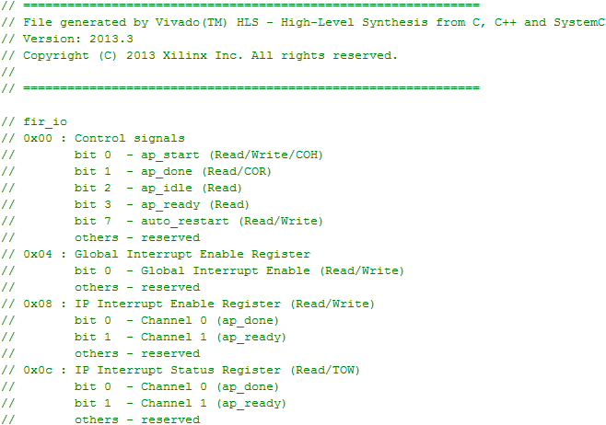
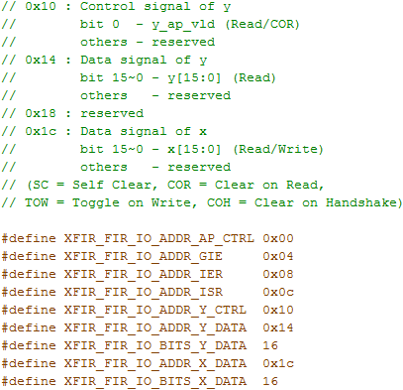

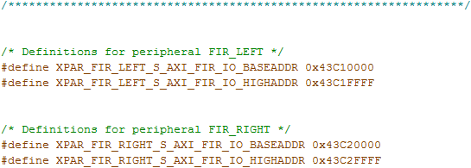

Example of Module Registers
Y is output (has control register).
X is input
Offset from Vivado HLS
Base from Vivado IDE

Slide 17
Application Program Interface
void xillix_initialize (void);
int xillix_load (const char* hwa_repo_path, const int input_param_num, const int output_param_num);
void xillix_activate (const int rp_idx, const long* input_params);
bool xillix_check_result (const int rp_idx);
void xillix_get_result (const int rp_idx, long* output_params);
void xillix_unload (const int rp_idx);
void xillix_terminate (void);
* The API is built to run in user space, holding consistency between processes using files.

Slide 18
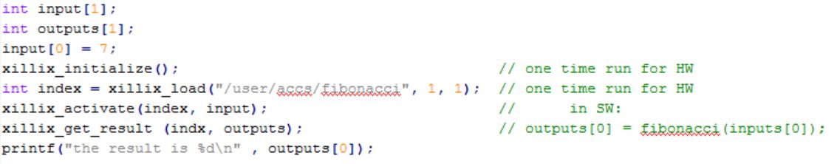
Typical Function Calling Sequence
The API functions use memory-mapping to interface with the programmable logic directly from user space.

Slide 19






Hardware Accelerator Generation
Open the generic HWA template in Vivado HLS
Bundle the top-level function and I/O for AXI4-LiteS and run C synthesis
Verify that your utilization estimates meet the utilization constraints
Export RTL and verify that your HDL files were created in the IP folder
Wait for your partial bin files (binary bitstreams) to be created
Add the partial bin files to the SD card
Execute the automation scripts
Replace the HWA_func top-level function with your C/C++ function

Slide 20

Source Code Modification
That’s it !
Compile your source code and add the elf files to the SD card
Change direct calls to the targeted function into their equivalent (or other) API function calling sequence
Include the API’s header file in the source code

Slide 21
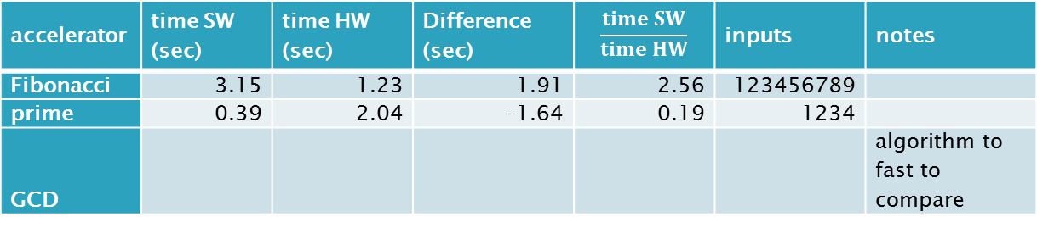
Performance Analysis
3 algorithms tested using the default HLS settings on the XC702 board.
The results:
accelerator | time SW (sec) | time HW (sec) | Difference (sec) | $$\frac{time SW}{time HW}$$ | inputs | notes
Fibonacci | 3.15 | 1.23 | 1.91 | 2.56 | 123456789
prime | 0.39 | 2.04 | -1.64 | 0.19 | 1234
GCD |  |  |  |  |  | algorithm to fast to compare
Fibonacci algorithm was solved by HLS in a way that benefits HW, from the results we can see that the HW is 60% faster.
Prime algorithm is match faster on SW that on HW (HW is 4 times slower). This might be because HLS default solution is not optimized well for HW or the algorithm itself is faster on SW.
GCD algorithm got results in single micro seconds on both SW and HW regardless of input size so it's not comparable.

Slide 22
Future Development Options
This project lays the foundation for an actual HW DLL.
Building a Linux kernel module to manage operation. This will enable interrupts and remove poling or busy wait, increasing performance.
Building a GUI to see and manage the status of the reconfigurable system.
Analyse commercial programs, build and optimize the functions in HLS and demonstrate the multitasking of the system in real HW DLL conditions.
Define and build an interface and accelerator that can use more than one reconfigurable block.

Slide 23
Documentation
For more detailed information, please read: final_report_ver1.0.docx
Thank You.

