Slide 1
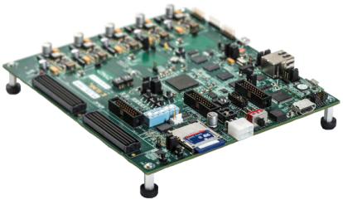
Mid-Semester Presentation
Hardware DLL
Real Time Partial Reconfiguration Management of FPGA by OS
Submitters: Alon Reznik Anton Vainer
Supervisors: Ina Rivkin Oz Shmueli
Bi-Semestrial Student Project
Winter 2014/2015

Slide 2
Project: Motivation
SW execution can be slow. Most parallel algorithms can be executed faster by dedicated HW accelerators on an FPGA.
An OS may contain many SW processes, but An FPGA cannot contain as many HW accelerators.
Executing suitable algorithms by HW accelerators will free the CPU for other tasks.

Slide 3
Project: Goal
Design and implement an innovative embedded system architecture to manage hardware accelerators in real time.
Application Developers:
Easy synthesis of HW accelerators from native SW languages (C/C++).
Extended flexibility for interfacing with the HW accelerator manager (API).
System Users:
The architectural modification is transparent.
Only the improved performance is noticeable.

Slide 4
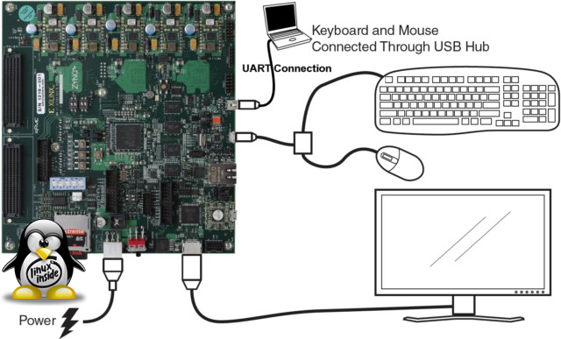
System: Overview

Slide 5
System: Specifications
HW: Design for a partially reconfigurable FPGA embedded on a Xilinx Zynq-7000 board.
SW: Implementation of the management application for Linux OS.
Interface: Linux OS (on the PS) connects to the HW accelerators (on the PL) via an AXI interconnect.

Slide 6
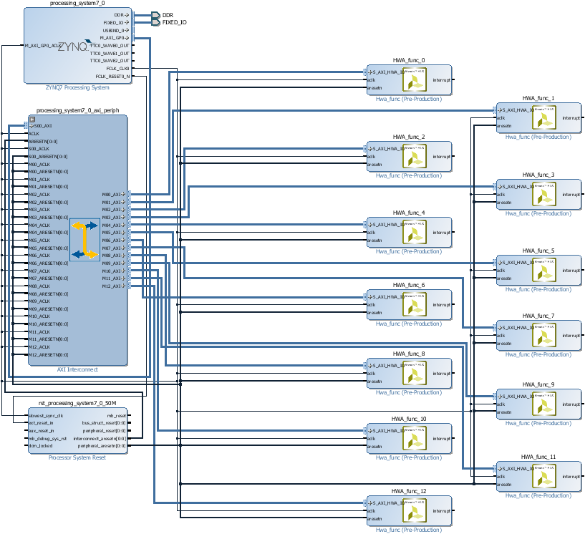
System: Block Design (PS & PL)
Static
Reconfigurable
RP 0
RP 1
RP 2
RP 3
RP 12

Slide 7
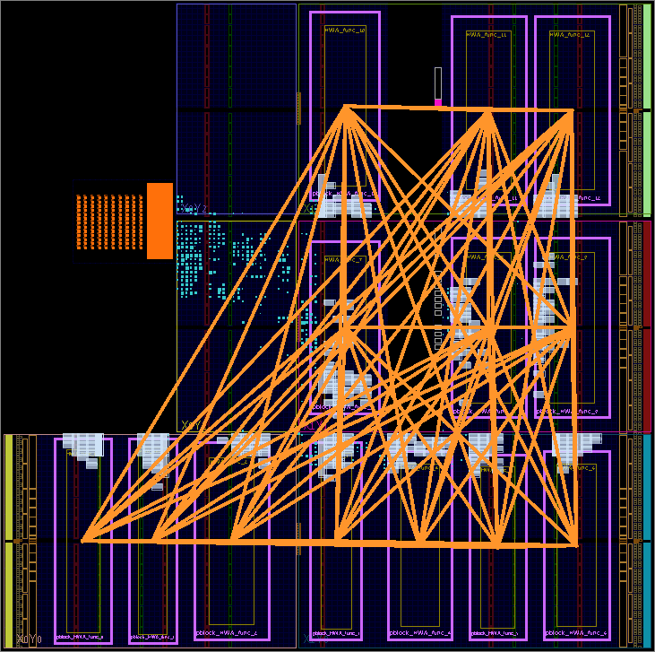
System: Static FPGA Design
HWA_func_0
HWA_func_1
HWA_func_2
HWA_func_3
HWA_func_12

Slide 8






System: Utilization Flow
Open the generic HW DLL Vivado HLS project (HWA_func)
Replace HWA_func C function with your C/C++ function
Bundle your function I/O for AXI4-Lite interconnect
Run C synthesis and verify that your IP core meets HW DLL utilization constraints
Your accelerated function HDL files were created in the IP folder
Wait for your partial bin files (binary bitstreams) to be created
Copy all partial bin files to the HW DLL SD card
Use HW DLL API in your application to interact with your HW accelerator
Run HW DLL Tcl file (Tcl_monster)

Slide 9
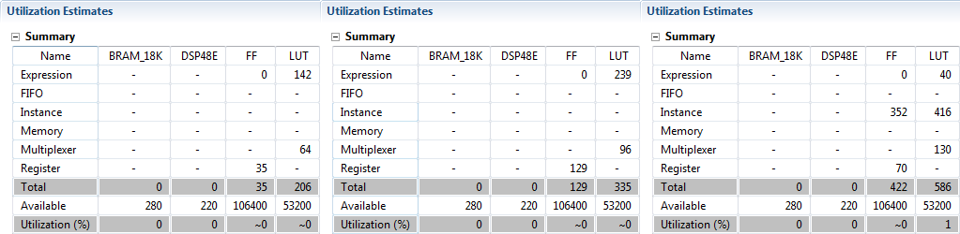
Utilization Constraints Examples
Prime Number | Fibonacci Number | Greatest Common Divisor
These estimates do not include routing.

Slide 10
Proof of Concept Demo
We’ve implemented a static design with 13 reconfigurable partitions.
We’ve used the HW DLL system utilization flow to implement 3 reconfigurable modules:
Prime Number
Fibonacci Number
Greatest Common Divisor
These is a total of 39 partial bin files for every possible PR configuration.

Slide 11








Project: Checklist (Done Tasks)
Use Vivado HLS to synthesize custom IP cores (HW accelerators) from C language.
Use Vivado IDE to design an embedded system with static AXI port addresses, and integrate the custom IP cores into the embedded system design.
Use Vivado IDE to assign Pblocks to the IP cores, and implement the static design.
Use Vivado SDK to program the ZC702 board, and test the embedded system via UART.
Use Vivado HLS to synthesize a generic IP core.
Use Vivado IDE to assign RPs to the IP cores, and implement the PR design.
Use Vivado SDK to create a Zynq boot image with PetaLinux and the PR design.
Write a Tcl script to automate the RM (partial bin files) creation flow.
Write a test application for the custom IP cores in Linux.
Use PuTTY to verify the real time PR of the custom IP cores in Linux.

Slide 12
Project: Gantt Chart
Write a Tcl script to automate the utilization flow as much as possible.
Design an API for the PR management application.
Design and implement a data structure to link RPs, RMs and processes.
Design and implement a mutex/semaphore for resource mutual exclusion and data structure consistency.
Implement the PR management application according to the API.
TODO: Put it on the chart

