Slide 1
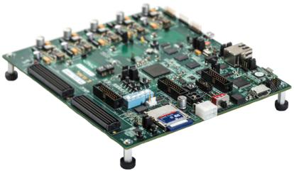

Final Presentation
Hardware DLL
Real Time Partial Reconfiguration Management of FPGA by OS
Submitters: Alon Reznik Anton Vainer
Supervisors: Ina Rivkin Oz Shmueli
Bi-Semestrial Student Project
Winter 2014/2015

Slide 2
Abstract
Design and implement an innovative embedded system architecture to manage hardware accelerators in real time.
Application Developers:
HLS compatible framework for synthesizing HW accelerators.
Extended flexibility for interfacing with the HW accelerators.
System Users:
The architectural modification is transparent.
Only the improved performance is noticeable.
2

Slide 3
System Description
Empty partitions available?
Application requests an acceleratable function to process input data
No
Call the software function
Yes
Compatible module available?
No
Best Case Scenario:
Yes
Software function returns output data to the application
Load the module into its compatible partition
Do other tasks
No
Worst Case Scenario:
Input data is processed by the original (unaccelerated) function.
Send input data to the loaded module
Output data ready?
Yes
Application reads output data from the loaded module
3

Slide 4
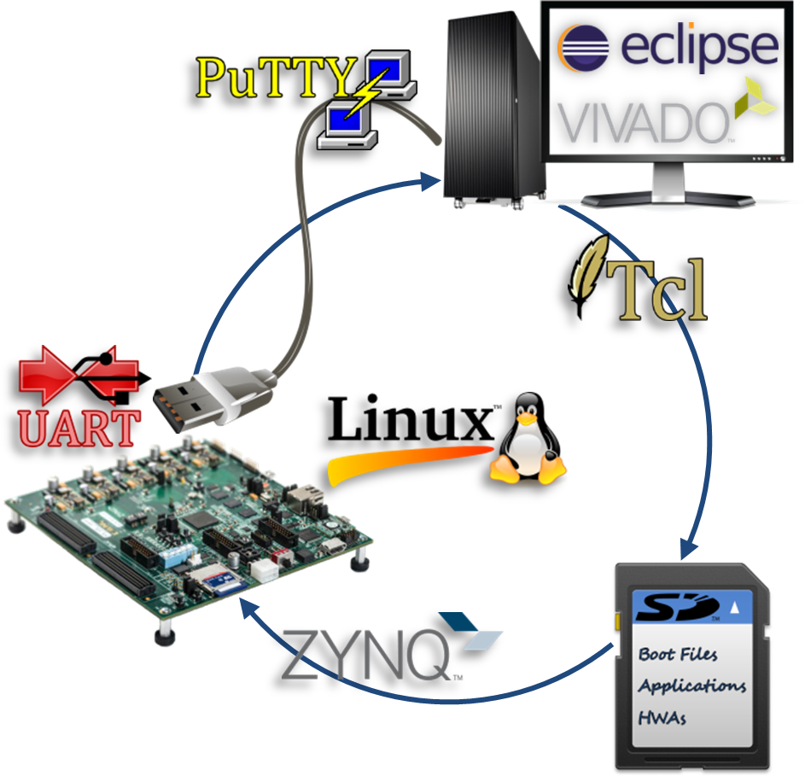
Specification
Hardware
Design for a partially reconfigurable FPGA embedded on a Xilinx Zynq-7000 board.
Software
Implementation of the management application for Linux OS.
Interface
Linux OS (on the PS) connects to the HW accelerators (on the PL) via an AXI interconnect.

Slide 5








System Block Diagram
Open the generic HWA template in Vivado HLS
Bundle the top-level function and I/O for AXI4-LiteS and run C synthesis
Verify that your utilization estimates meet the utilization constraints
Export RTL and verify that your HDL files were created in the IP folder
Wait for your partial bin files (binary bitstreams) to be created
Add the partial bin files to the SD card
Include the API’s header file in the source code before compiling it
Execute the automation scripts
Replace the HWA_func top-level function with your C/C++ function

Slide 6
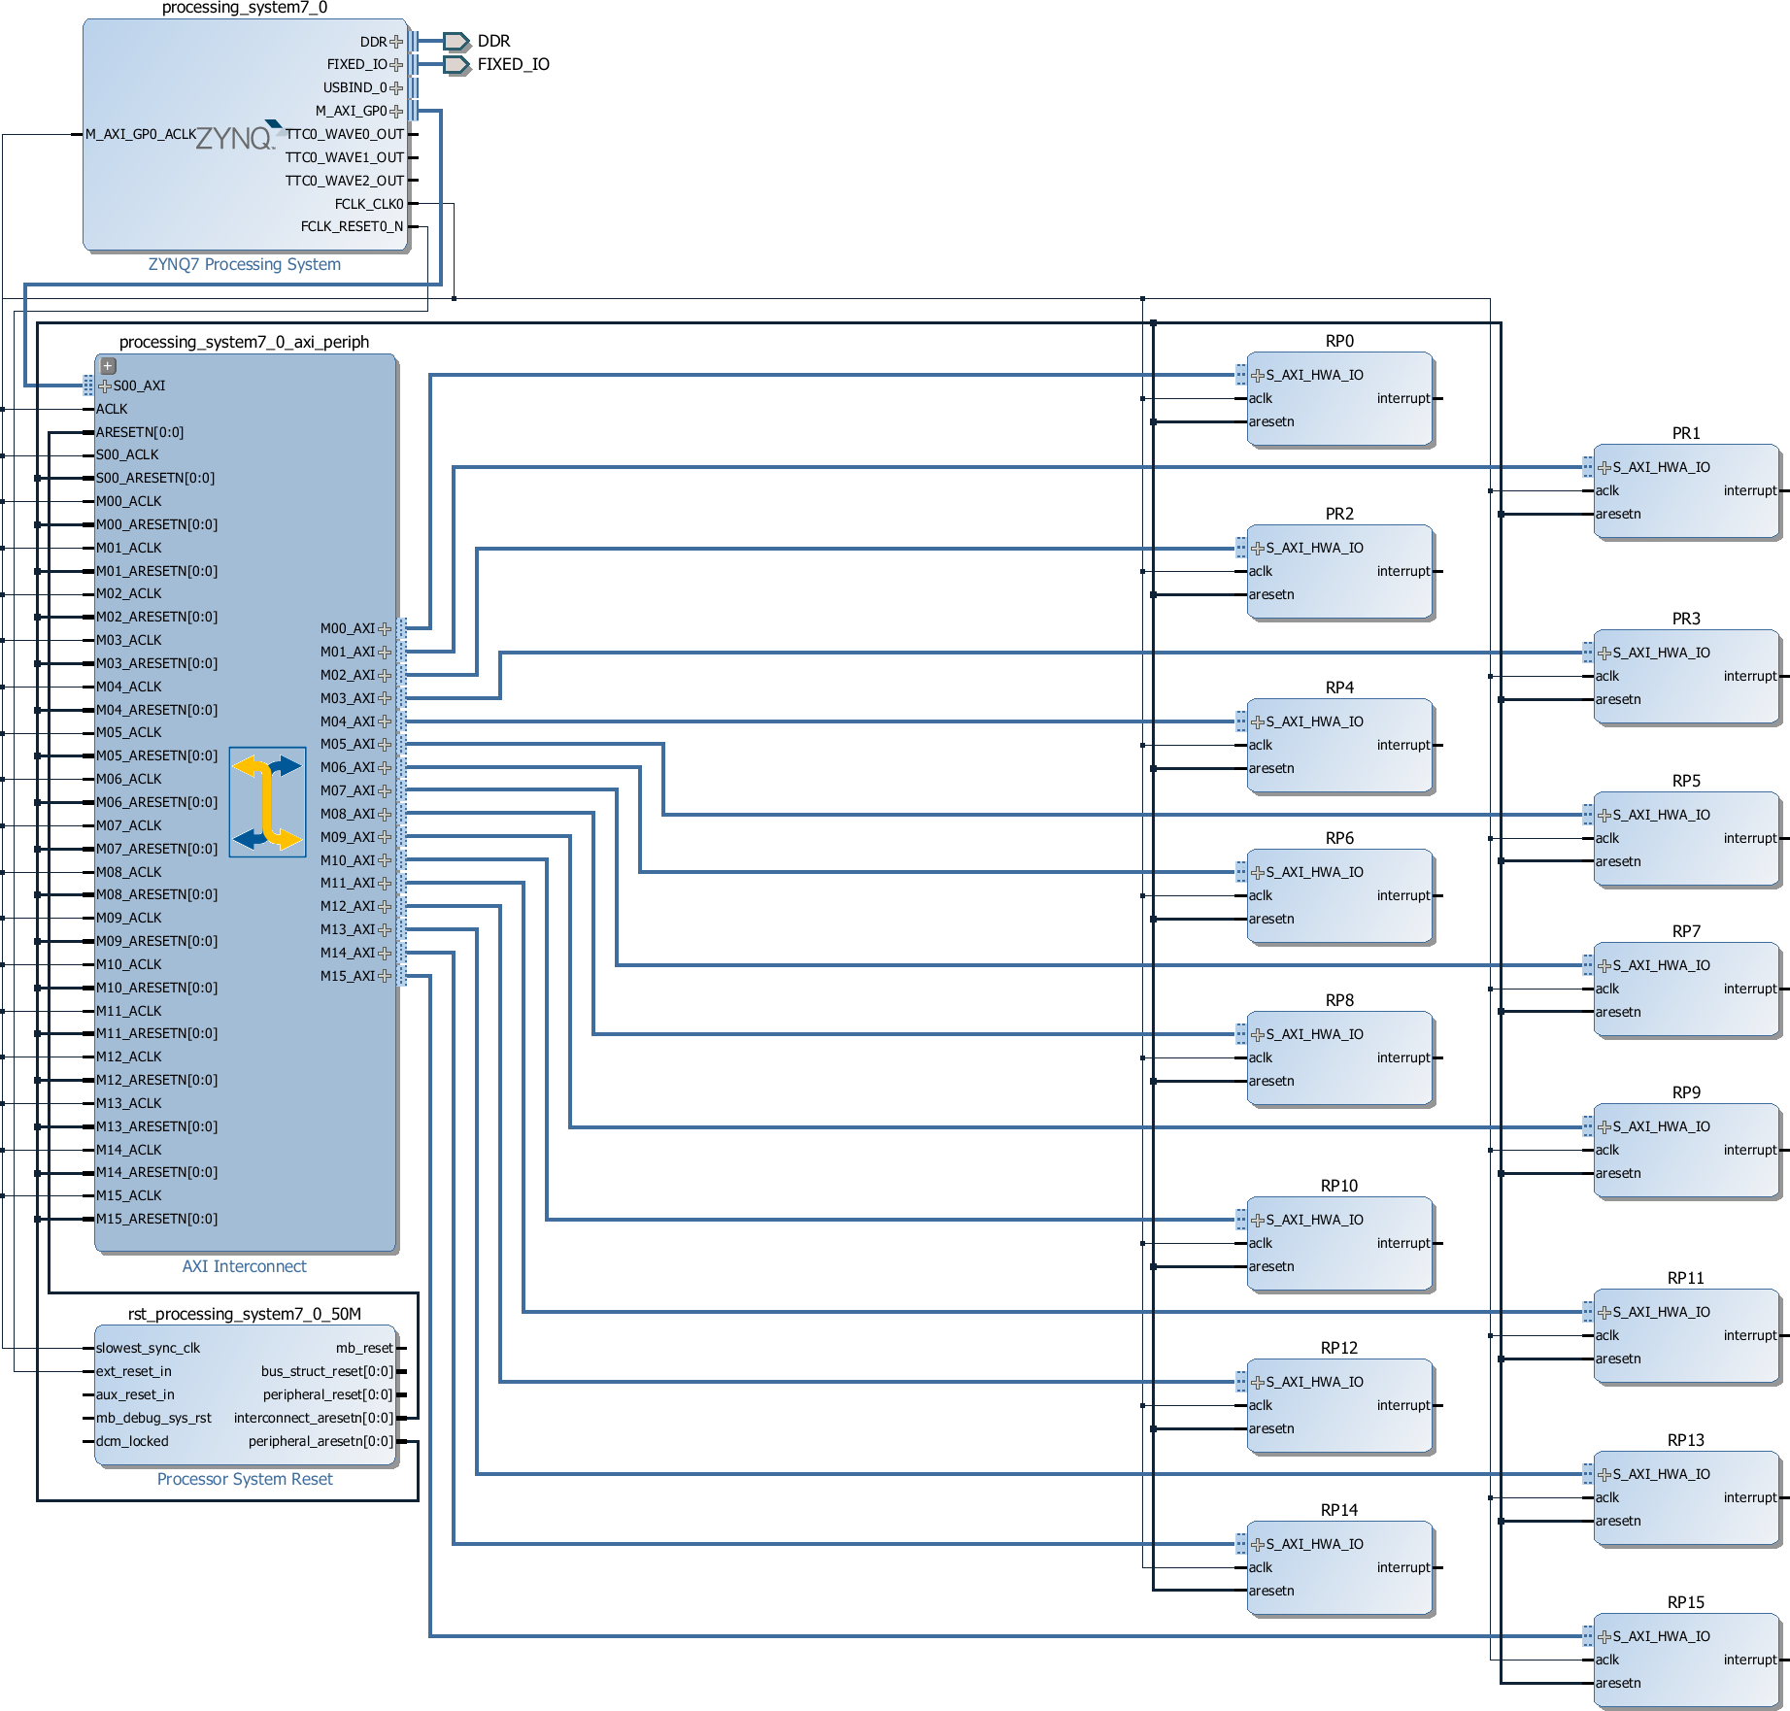


FPGA Block Diagram
Static Logic
Reconfigurable Logic
RP 0
RP 1
RP 2
RP 3
RP 15

