Slide 1
IIT Gandhinagar
Course: CS 301
Instructor:
Nipun Batra
Project: Parallel ZIP
Two encoding schemes:
Huffman Coding
Run-length Coding
Team Members:
Ajinkya (18110013) | Jitender (18110075) | Palak (18110110) | Sagar (18110149)

Slide 2
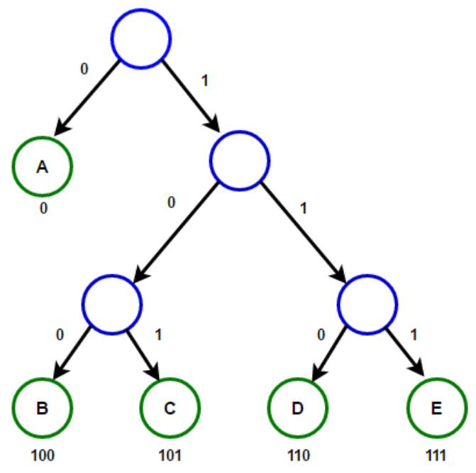
Huffman Coding Implementation
Huffman Tree
Variable length encoding (greedy)
Prefix rule- no ambiguity in decoding
Time complexity -O(nlogn)

Slide 3
Compression through Huffman encoding:
Int X
=21
=00010101
=abbb
Text File
abbbac...
Compressed file
XY...
Encodings:
a : 00
b : 01
...
Decimal(00010101)=21
Char X=21

Slide 4
Run Length Encoding(RLE)
Text file
hello
hello
for run length <=2, no encoding
1h1e2l1o
Text file
wwwwbbbbb
wwwwbbbbb
for run length >2, do encoding
4w5b
Better!!
Better!!

Slide 5


Run Length Encoding(RLE)
Based on run-length of each character write “count” only when needed!
Text file
hellowwwbbb
hello3w3b
Final implementation on alphanumeric input
In worst case!!
sizeof(zipped file) = sizeof(original file)
Extra character(ASCII 17) is used to separate count and character.
Extra character is used only when count>2, ensuring in no case we get a zip.txt > file.txt

Slide 6
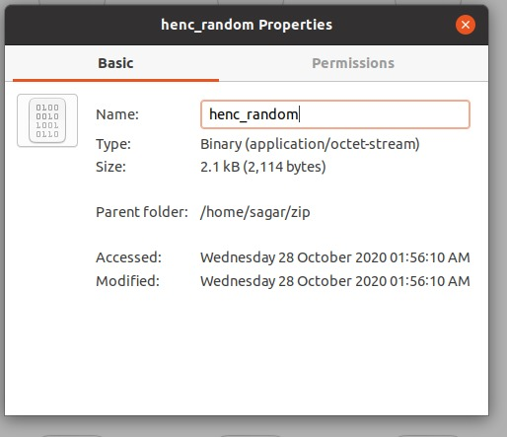
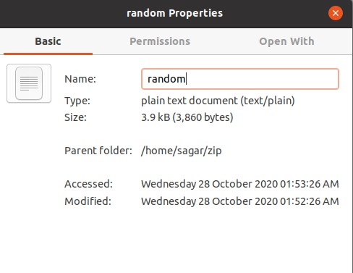
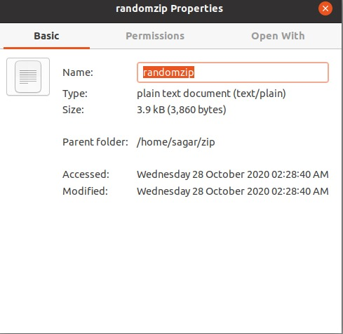
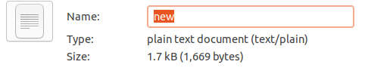
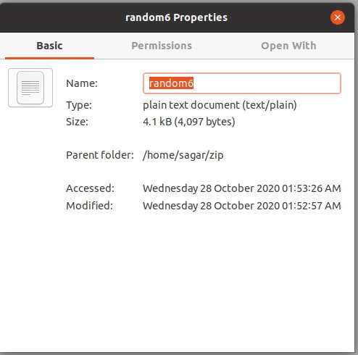
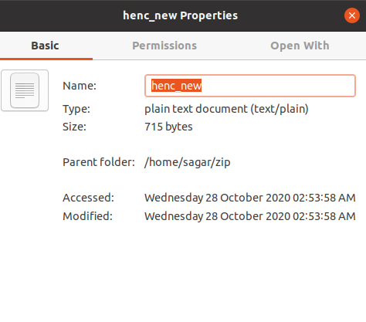
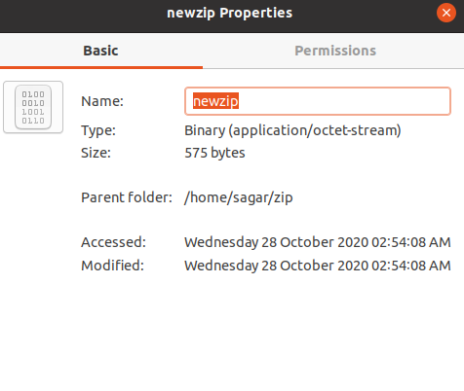
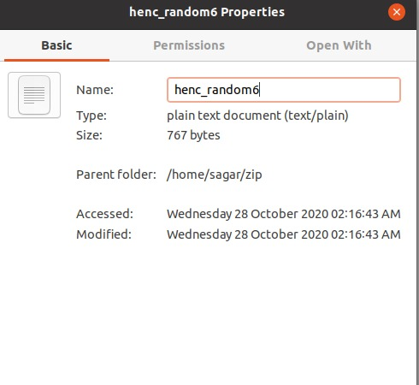
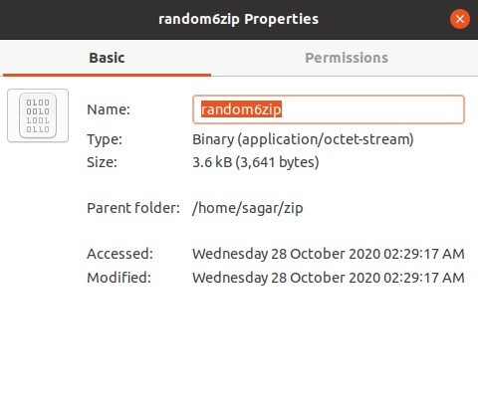
Analysis:
Reduction-by % = (actual size-zipped size/actual size)*100
1.)
45%
Huffman
0%
Original size
Run-Length
2.)
3.)
57%
65%
81%
11%

Slide 7
Thank
You!

